Slide 1
Chapter One
Basic Relations and the First Law of Thermodynamics

Slide 2
1.1 BASIC CONCEPTS
Any thermodynamic analysis begins with the precise specification of the matter or space under investigation.
Thermodynamic System
A Thermodynamic system can be defined as Entity that is being subjected to analysis or 3D region or space bounded by an arbitrary surface.
Identification of the boundary of a system is very important particularly in the determination of magnitude of thermodynamic irreversibilities as there can be internal and external irreversibilities.

Slide 3
To identify the system means also to identify the system’s environment or surroundings.
The physical space which lies outside the arbitrary selected boundary of the system is called the surrounding or environment.
A boundary neither contains matter nor occupies a volume in space ( mathematically zero thickness).
The value of a property that is measured at a point on the surface called “boundary” must be shared by both the system and the environment because they are in contact at this point.

Slide 4
Analysis of thermodynamic processes includes the study of mass and energy transfer across the boundaries as closed systems and open (flow) systems.
Closed system: no flow system, control mass
Open systems: flow systems, control volume (boundary-control surface)
The condition or the being of a thermodynamic system is described by an ensemble of quantities called thermodynamic properties. We refer the conditions described by properties as state.
Not all the quantities (numerical values) calculated in connection with a certain system are thermodynamic properties.

Slide 5
Thermodynamic properties are those quantities that do not depend on the history of the system as the system evolves between two different states.
Primitive properties-which appeal to human senses(T,P,V,m)
Derived properties- derived from primitive properties (u,s,h,x).
Examples of properties: pressure, temperature, density. Work, heat, mass transfer, entropy transfer, entropy generation are not properties.
Two types of properties:
Intensive ( whose values don not depend on the size of the system) – pressure, temperature and other specific properties;
Extensive (whose values depend on the size of the system)-total values of mass, volume, enthalpy, etc.

Slide 6
. Phase: quantity of matter that is homogeneous throughout in both chemical composition and physical structure (it all be solid, liquid or gas).
Process: interactions of a system with its environment which results in a change of state of the system. To know the process means to know the interactions experienced by the system with the environment (eg. Heat transfer, work transfer, entropy transfer etc.)
Path of the process is the history, or the succession of states, followed by the system from beginning to end.
Thermodynamic cycle: special process in which the final state coincides with the initial state.

Slide 7
1.2 THE FIRST LAW OF THERMODYNAMICS
Two principles of classical thermodynamics:
(1) Equivalence of work transfer and heat transfer referring to cycle – 1st law-conservation of energy.
(2) Inherent irreversibility of all processes that occur in nature- summarized by the 2nd law.
It is an engineering tradition to discuss first law first and the second law second. This ordering is based on two views (both questionable):
Frist law is older than second law and
Concept of internal energy defined by the first law is easier to grasp than the concept of entropy production of the second law
First and second law emerged together out of the writings of Rankine, Clausius, and Lord Kelvin in the 1850’s.

Slide 8
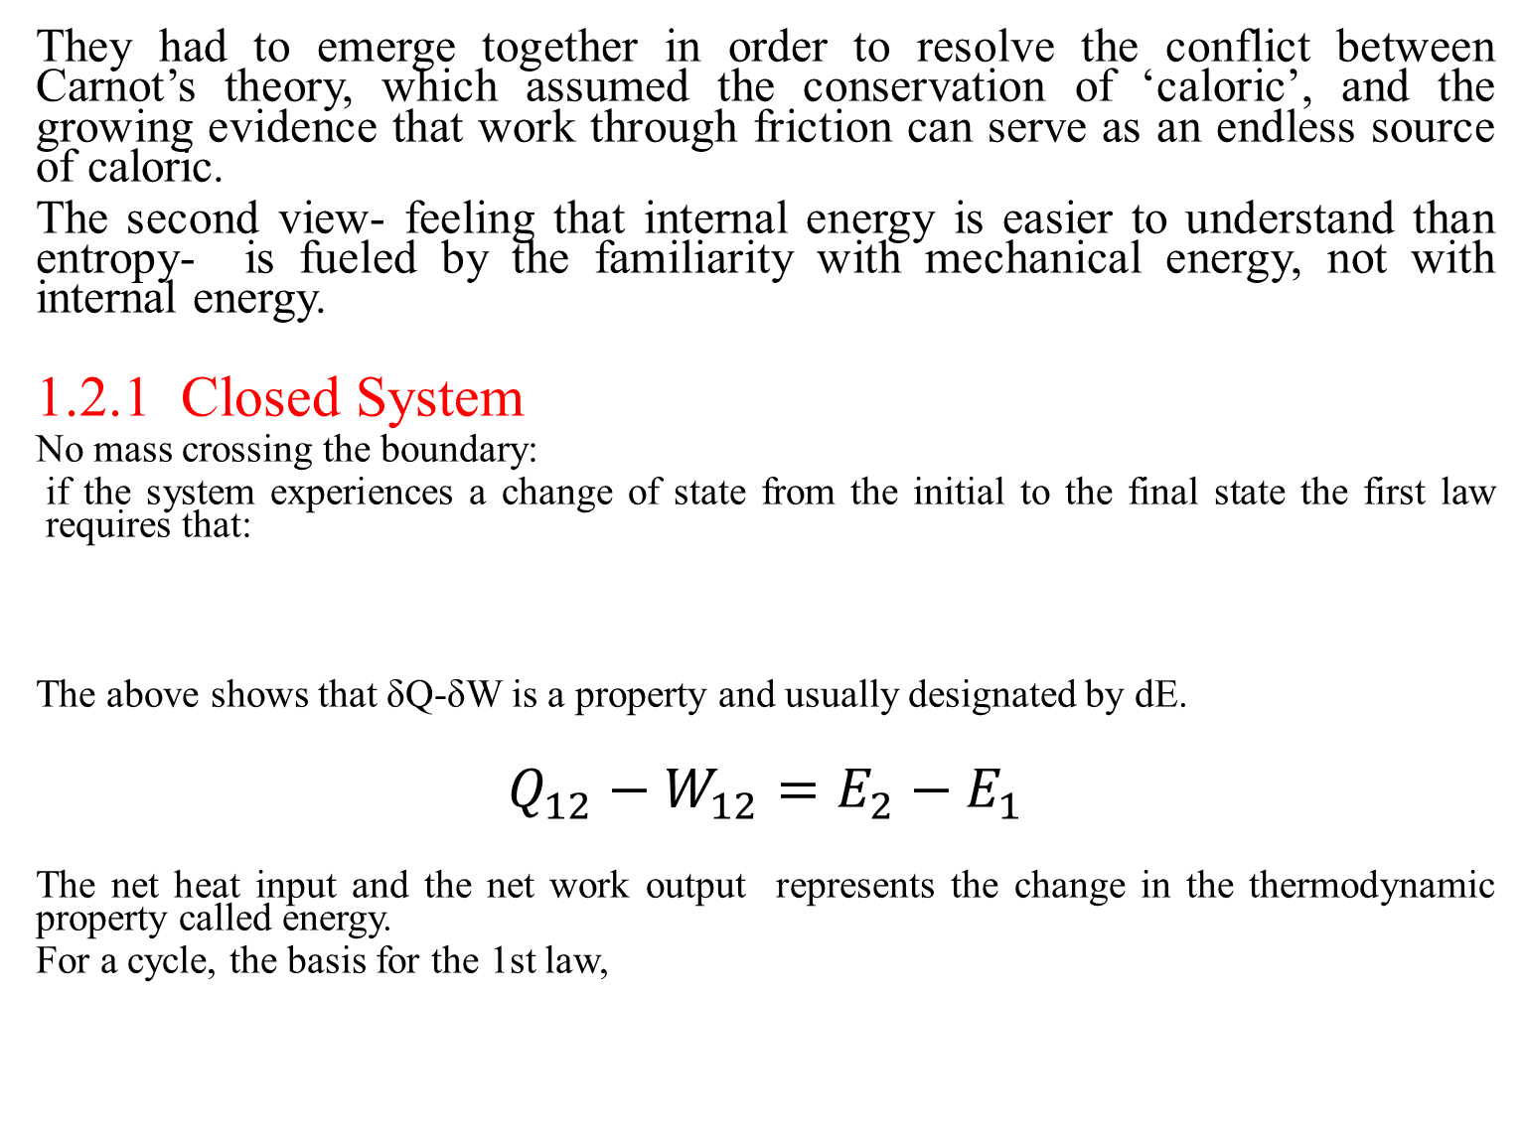
They had to emerge together in order to resolve the conflict between Carnot’s theory, which assumed the conservation of ‘caloric’, and the growing evidence that work through friction can serve as an endless source of caloric.
The second view- feeling that internal energy is easier to understand than entropy- is fueled by the familiarity with mechanical energy, not with internal energy.
1.2.1 Closed System
No mass crossing the boundary:
if the system experiences a change of state from the initial to the final state the first law requires that:
The above shows that δQ-δW is a property and usually designated by dE.
$$Q_{12}−W_{12}=E_{2}−E_{1}$$
The net heat input and the net work output represents the change in the thermodynamic property called energy.
For a cycle, the basis for the 1st law,

Slide 9
Fig.1.1 Graphic statements of the 1st law for closed systems
Q = E₂ – E₁ + W (initial state 1 to final state 2)
Q =W (closed system undergoing a cycle ΔE=0)
Q = ΔU + W (stationary control mass)

Slide 10
ΔE is path independent Fig.1.2 The path dependence of Q and W

Slide 12
Work Transfer
Work interactions in thermodynamics are associated with the displacement of the system’s boundary
force exerted by the environment on the system. For the sign convention (work output) to be satisfied
For the system to experience work interactions, there must be force on the boundary and boundary movement. Ex. Boundary displacement without an opposing force (free expansion of a gas) is a zero work process.

Slide 13
To determine PdV work from a graph requires the history of the path followed during the process.
This in turn requires equilibrium condition of the system for its state to be determined. Usually a near equilibrium condition called quasie-equilibrium is assumed for ideal processes.
The work in such process is termed as reversible work, W_{rev}. Quasie-static derived from mechanics may not allow temperature equilibrium.

Slide 14
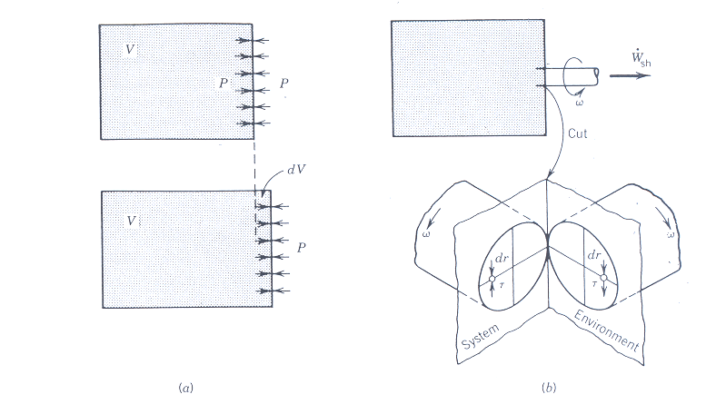
PdV work:
Fig 1.3 PdV work transfer and shaft work transfer
For shaft work, the movement of the shear stress in the shaft will give rise to the product of the torque and angular speed.

Slide 15
For fluids, as the shear force on the wall does not move, work transfer is zero.
The reversible work can be expressed in its generalized form as
δW _{rev} = -∑ Y_{i}dX_{i}
Y_{i} = generalized force
X_{i} = generalized displacement

Slide 16
Heat Transfer
Fundamental distinction between heat transfer and work transfer is due to the 2nd law of thermodynamics.
Heat transfer is accompanied by entropy transfer where as work transfer proceeds in the absence of entropy transfer.
Heat transfer is the energy interaction driven by the temperature difference between system and its environment.

Slide 17
Temperature difference needs the definition of temperature which in turn is based on the concept of thermal equilibrium.
Zeroth Law of Thermodynamics (1931): If blocks B and C are separately in thermal equilibrium with a third block A, then B and C are in thermal equilibrium.
Zeroth law helped in defining temperature
First law …………………… internal energy
Second law ………………… entropy
Temperature is recognized as a property whose numerical value determines whether the system is in thermal equilibrium with another system

Slide 18
Thermal equilibrium in different types of thermometers can mean no more changes in the level of the mercury or the resistance of a wire used to sense temperature.
Traditionally two easy-to-reproduce states are used for calibration of thermometers.
Newton (1701): interval between the freezing point of water and the human body temperature had a scale of 12
Fahrenheit (1714): assigned mixture of ice and common salt as 0 and human body temperature as 96. On this scale freezing and boiling of water correspond to numbers 32 and 212 respectively.

Slide 19
Réaumur (1731): assigned freezing point of water as 0 and boiling point as 80.
Celsius (1742): assigned freezing point of water 100 and boiling as 0. Present day Celsius is reversed (1747)
The above are all called empirical temperatures.
The temperature scales in use today are based on the concept of thermodynamic temperature defined in terms of the 2nd law of thermodynamics. The scales are based on the triple point of water
(0.01ºC= 273.16K)

Slide 20
T(ºC) = T(K) – 273.15
T(R) = (9/5) T(K)
T(ºF) = T(R) – 459.67
T(ºF) = (9/5) T(ºC) +32
T(ºC) = (5/9)(T(ºF)-32)
1 R or 1ºF = (5/9)(1 K or 1ºC)

Slide 21
Energy Change
represents other macroscopic forms of energy storage as shown in the table tables&misc.docx .
These are independent of one another. Each energy storage can be increased or decreased only through characteristic energy interaction related to the expressions in the δW column (uncoupled cases). Whereas if U can be changed through work transfer, heat transfer or both , case becomes coupled.

Slide 22
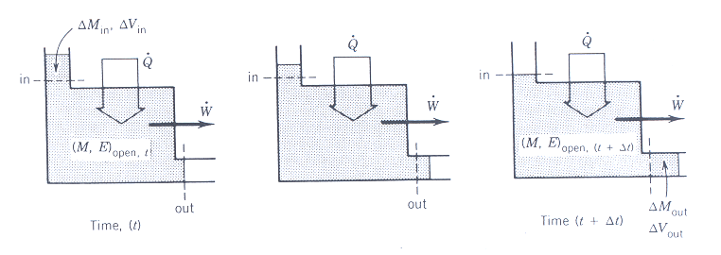
1.2.2 Open System
Conservation of mass
As a rate

Slide 23
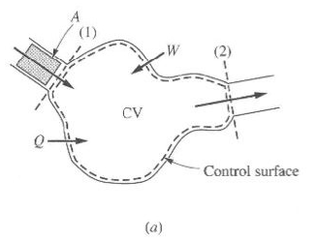
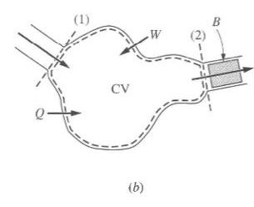


Fig1.4 The development of conservation principles for a control volume analysis. (a) control
Mass at time t; (b) control mass at t+∆t

Slide 24
Conservation of Energy
Applying the First law on the closed system
Q – W = E₂ – E₁
W includes three forms for open systems:
- The flow or displacement work associated with mass crossing a control surface.
- Shaft work which can be measured by devices external to the control volume,
- other forms of work in special situations , such as moving boundary work.

Slide 25
Using

Slide 27
For multiple inlet and outlet ports the generalized statement of the First Law of Thermodynamics becomes

Slide 28
For no flow the equation degenerates into that of cm situation
e represents energy associated with flow of mass across the system boundary due to internal energy, kinetic energy, and potential energy.
on a unit mass basis given by:
The definition of enthalpy shows up as
h = u + Pv
In terms of enthalpy the first law becomes

Slide 29
The more familiar equation is given as
Special Cases
Steady state:
m and E are independent of time

Slide 30
Unsteady state – Transient flow
Conservation of mass
(net accumulation or depletion of mass may occur within the control volume)
Integration for a time interval of t will give (when mass flow rate varies with time)
For a single inlet and a single outlet port

Slide 31
First law of thermodynamics
Applicable equation
Integrating for a time interval of t

Slide 32
The left-hand expression has two forms
Integrating the right hand expressions, remembering that

Slide 33
Integration usually uses uniform state-uniform flow process assumptions.
Uniform state: requires that the state within the control volume at any instant be uniform but may change with time.
Uniform flow: requires that the state of the mass crossing a control surface be invariant with time, but the mass flow rate across that particular control surface may vary with time.

Slide 34
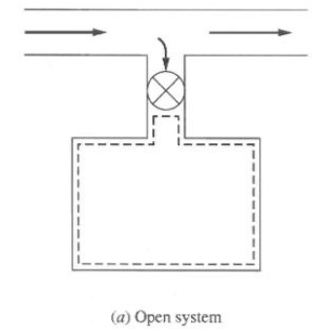
Charging rigid vessel: initially it may be evacuated or may contain some finite amount of matter.
Consider an evacuated rigid tank connected through a closed valve to a high pressure line (mass enters only at one section and no efflux of matter occurs)
Contribution from ke and pe are negligible
W = 0, ΔE = ΔU Resulting equation
Negligible heat transfer due to insulation or short duration of process (tank filled rapidly ,Q is small)

Slide 35
For uniform flow situation source has a constant enthalpy, h_{L}. Integration from initial mass m_{i} to final mass m_{f} in the control volume will give
h_{L}(m_{L} – 0) = m_{f}u_{f} – m_{i}u_{i}
For evacuated tank (initially), m_{i} = 0
h_{L}m_{L} = m_{f}u_{f}
From mass balance
m_{in} = m_{L} = m_{f}
This will give h_{L} = u_{f}. For an ideal gas C_{p}T_{L}=C_{v}T_{f}
or T_{f}=(C_{p}/C_{v})T_{L} = kT_{L}

Slide 36
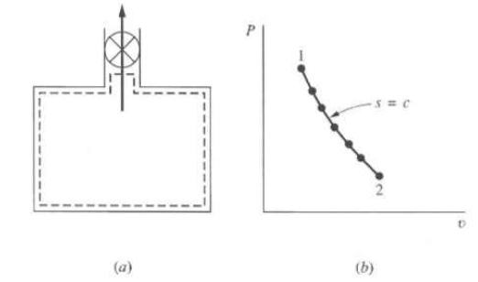
Discharging a rigid vessel:
Consider again a fluid from a pressurized vessel
Adiabatic, no cv work and negligible contributions from ke and pe, and the resulting equation will be
dU = hdm or hdm = d(mu) = (mdu + udm)
This will give
(h-u)dm = mdu or
The above equation assumes quasie-equilibrium process

Slide 37
using h – u = Pv and V=mv and for a fixed volume of tank dV=0=mdv+vdm gives
Substitution gives
Remembering the first Tds equation Tds = du + Pdv the process within the tank is isentropic.
For an ideal gas, the isentropic process in the vessel will give the following results.

Slide 38
EXAMPLE
A tank with a volume of 1.5 m³ is filled with air at a pressure of 7 bars and a temperature of 250ºC. Determine a) the final temperature, b) the percent of mass left in the tank, and c) the quantity of mass, in kg, that left the tank if the gas is permitted to leave the tank under adiabatic conditions until the pressure drops to1.0 bar.

Slide 39
Transient analysis-boundary work
For a supply of fluid from a source h=h_{L} the applicable equation for negligible contributions from ke and pe is
For adiabatic process (Fig.1.5)
Substituting the Pv work will give

Slide 40
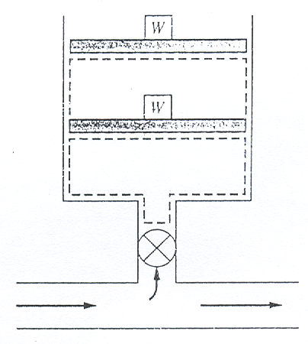
Fig.1.5 A control volume with a moving boundary

Slide 41
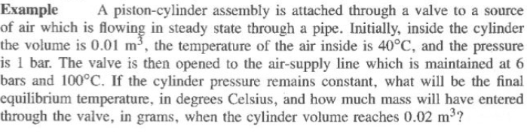
Unknowns are m_{L} or m_{f} and u_{f} since m_{L}=m_{f}-m_{i}
V_{f} = m_{f}v_{f} This will bring u_{f} and v_{f} as unknowns. Another equation of the form P=f(u_{f},v_{f})
will be a second equation.

Slide 42

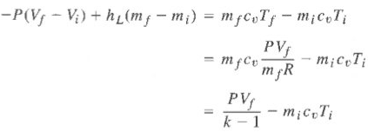


Slide 43
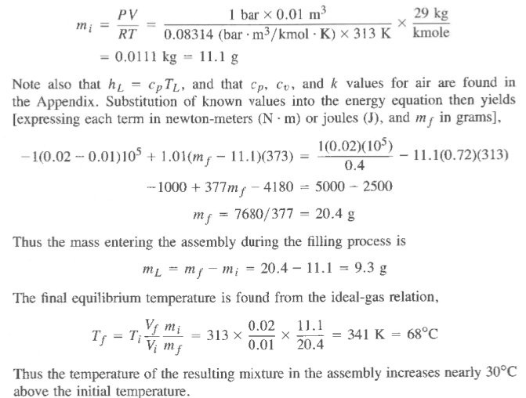

Slide 44
1.3 COUPLED AND UNCOUPLED SYSTEMS
Most processes in thermodynamics are the results of thermal (heat transfer) interaction and mechanical work transfer interactions experienced by the system. Both interactions affect the properties of the system. Such systems are called coupled systems.
There are also many physical situations in which the coupling between thermal and mechanical aspects is vanishingly small. These represent uncoupled systems. The thermodynamic behavior of such systems is simply the collective behavior of the individual system elements.

Slide 45
1.3.1 Uncoupled Systems
Pure system elements that describe uncoupled thermodynamic behavior are
Pure conservative system elements
Pure thermal system elements
Pure dissipative system elements
1. Pure Conservative System Elements
This system can experience only mechanical work transfer with the environment which is the result of the movement of force through a distance. This work can be stored in different forms as shown

Slide 46
in Table 1.1 which is completely recoverable. It is this recoverability that makes it to be described as conservative. For such a system, the first law gives
-W₁₋₂ = E₂ – E₁
A typical example for storage in a spring is shown in Fig.1.6.
For such cases, the cyclic integral reduces to zero due to its recoverability.

Slide 47
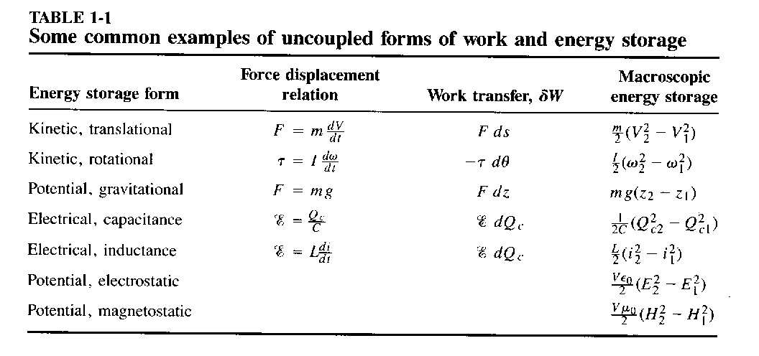

Slide 48
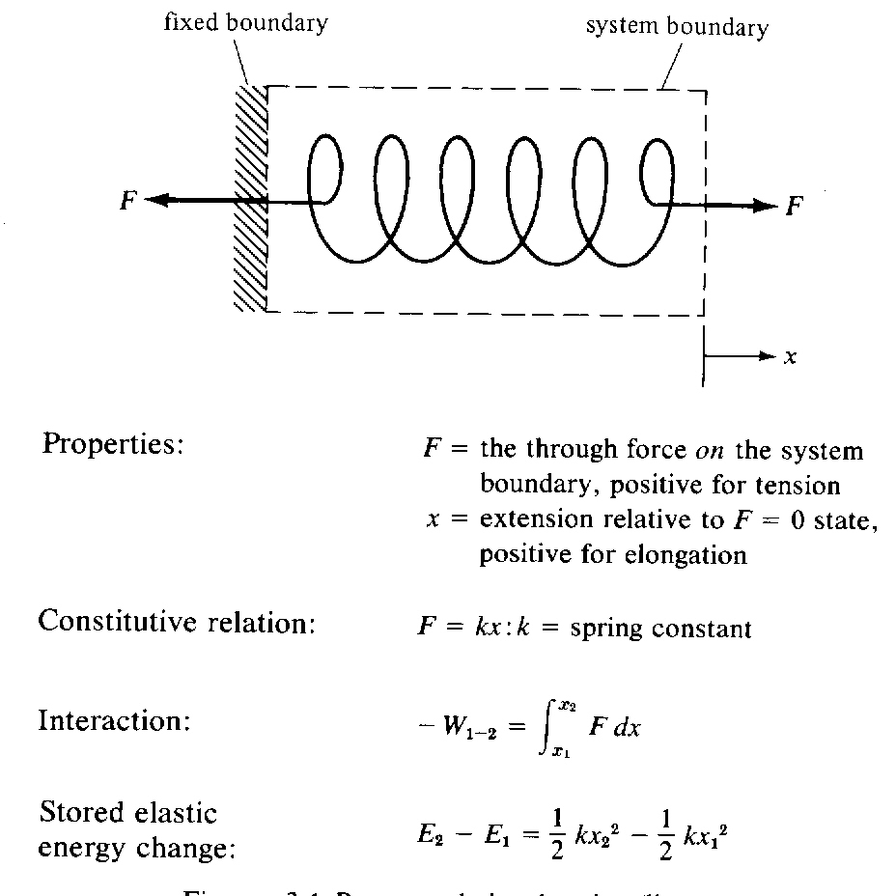
Fig.1.6 Pure translational spring

Slide 49
2. Pure Thermal System Elements
Here the only energy transfer interaction is heat transfer. It does not experience work transfer. This is a good model for the thermal behavior of liquids and solids that do not change volume during the heat transfer process. A typical model is shown in Fig.1.7 where the storage type is internal energy.
First law gives
Q₁₋₂ = U₂ – U₁

Slide 50
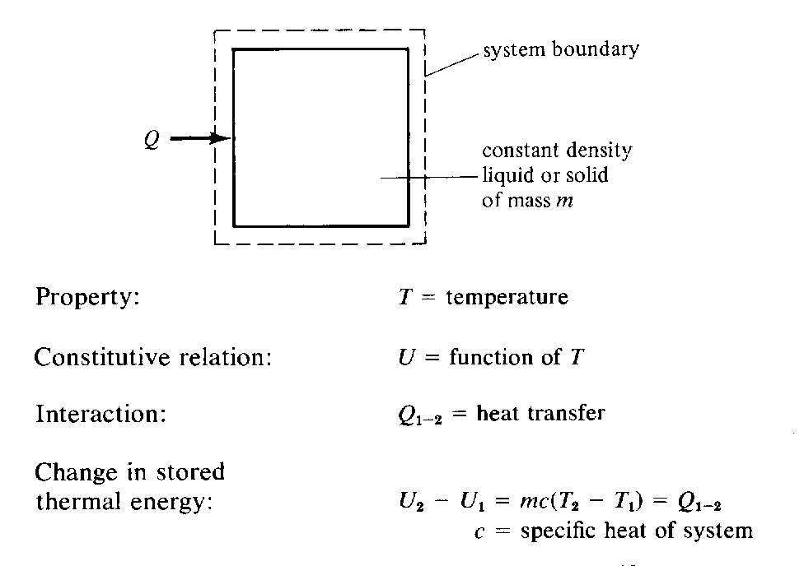
Fig.1.7 Pure thermal system with constant specific heat

Slide 51
3. Pure Dissipative System Elements
Here dissipative effects such as simple friction or damping is considered. In such cases an input of work generates heat. Accordingly the first law gives
-W₁₋₂ = -Q₁₋₂
The pure translational damper is shown in Fig.1.8

Slide 52
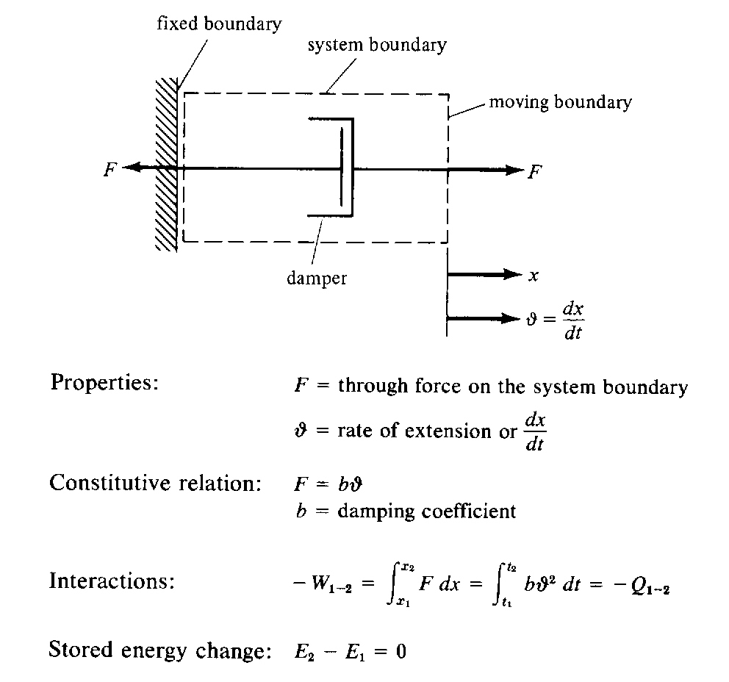
Fig.1.8 Pure translational damper (linear)

Slide 53
1.3.2 Coupled System
When energy interactions are coupled, a single mode of energy storage is affected by both interactions unlike the uncoupled system. As an example if we consider both work and heat transfer interactions with a system, a thermodynamic property of the system (for example u) will be affected by both interactions. In such cases
For non dissipative effects, the first law gives

Slide 54
1.4 USEFUL RELATIONS
1.4.1 Second Law Relations
Entropy change for a control mass when there is heat interaction is given by
(equality for internally reversible process)
The inequality equation can easily be converted into equality by using the entropy generated S_{gen} term as

Slide 55
1.4.2 Simple Compressible Substances
Reversible work of the boundary type, PdV, is the only one considered. Any two independent properties are required to completely define the state of the system. In addition to P, T, and v, other properties that we will be concerned with are enthalpy, h = u + Pv, entropy, s, Helmholtz function, a = u – Ts, Gibbs function, g = h – Ts and two specific heats

Slide 56
Two important equations derived from the first law are the Tds equations given by
Tds = du + Pdv and Tds = dh – vdP
1.4.3. Ideal Gases
Basic equations
h and u are functions of T only

Slide 57
Integration of the above equations for constant specific heats will give
The special case of isentropic process will give the following relations

Slide 58
For variable specific heats
where T_{ref} = 0 (arbitrarily assigned)
The entropy change is given by
Value of sº are tabulated as functions of temperature.

Slide 59
For isentropic process
Defining sº = R ln P_{r} (relative pressure a function of T only) for isentropic process, it gives
Values of P_{r} and v_{r} are tabulated.

Slide 60
1.4.4 Incompressible Substances
Approximation v = constant. Consequences are
For constant c, integrations will give
Enthalpy of compressed liquid at pressure P is approximated by
h = h_{f} + v_{f} (P – P_{sat})

Slide 61
1.4.5. Isentropic (First Law or adiabatic) Efficiencies
Comparison made for the same initial state and same final pressure.
Turbine Efficiency-change in ke neglected

Slide 62
Nozzle Efficiency- comparison of kinetic energies
Inlet ke will usually be negligible.
Compressor and Pump Efficiencies-changes in ke are negligible.

Slide 63
Ranges of practical efficiencies
Turbine: 80 – 90 percent
Nozzle: Upward from 90 percent
Compressor: 70 – 85 percent
Pump: 50 – 90 percent

Slide 64
1.5 DIFFERENT PRESENTATIONS OF THE FIRST LAW
Poincareś scheme
Carathéodory scheme
Work transfer through adiabatic boundary
dE = -δW_{adiabatic}
δQ - δW = - δW_{adiabatic}- Independent of path
Keenan and Shapiro scheme
dE = δQ_{zero work}
δW = δQ - δQ_{zero work}
δQ - δW = δQ_{zero work}- Independent of path

