Slide 1
CHAPTER 2
The Second Law of Thermodynamics

Slide 2
Concepts of reversibility (and irreversibility), entropy, entropy transfer and entropy generation are reviewed here.
Once more Carnot devices as applied to heat engines, refrigerators, and heat pumps will also be seen.
2.1 THE SECOND LAW FOR CLOSED SYSTEMS
Theoretical analysis of heat engines (developed in the latter half of the 18th century-η<5%)was a memoir of Sadi Carnot (1824); early step in the development of the 2nd law.

Slide 3
The two statements of the 2nd law more frequently cited are those due to Clausius and to Kelvin and Planck.
Kelvin-Planck statement:(1851, 1897)
It is impossible to construct a heat engine which produces no other effects than the extraction of heat from a single source and the production of an equivalent amount of work.
Clausius statement:(1850)
Heat cannot pass spontaneously (unaided) from a region of lower temperature to a region of higher temperature.
The above laws were deduced from specific applications such as steam engines and refrigerators.

Slide 4
Other formulations which avoid specific applications:
Caraththéodory statement: (1909)
In the neighborhood (however close) of any equilibrium state of a system of any number of thermodynamic coordinates, there exist states that cannot be reached (are inaccessible) by reversible adiabatic processes.
Hatsopoulous and Keenan:(1965)
A system having specified allowed states and an upper bound in volume can reach from any given state a stable state and leave no net effect on the environment.
All the four statements are equivalent

Slide 5
2.1.1 REVERSIBILITY
  Two major goals of 2nd law analysis are :
  determining the “ideal” or “theoretically best” performance of energy devices
  Evaluating quantitatively the factors that diminish performance in actual practice. This leads to the concept of reversible process (idealized process).
Reversible process is defined as : A process commencing from an initial equilibrium state is called reversible if at any time during the process both the system and the environment with which it interacts can be returned to their initial states.
An irreversible process is such that either the system or its surroundings cannot be returned to their initial states.

Slide 6
Irreversibilities arise from two sources:
    Presence of inherent dissipative effects
    Presence of non quasie-equilibrium processes
Two forms of reversibility:
  Internal- reversibility within the system
  external-reversibility due to interactions with the surroundings
If both occur then total reversible process will be the result.
Examples of internally reversible processes. Internal processes undergoing in thermal reservoirs (sources or sinks) and work reservoirs (sources or sinks).

Slide 7
CYCLES IN CONTACT WITH ONE THERMAL RESERVOIR
For such a case Kelvin-Planck statement imposes
CYCLES IN CONTACT WITH TWO THERMAL RESERVOIRS
Fig.2.1 Schematic of a heat engine operating between two different thermal reservoirs.

Slide 8
Directions of Q are arbitrary. In this case both are positive
First law:
Let W be positive ie. W>0
Then there are three options to see:
The first option violates the first law as it requires for the cycle

Slide 9
For the second option we will use Fig.2.2.
Fig.2.2 Schematic for resolution of the validity of option 1 for two-thermal reservoirs.
According to K-P statement, for cyclic engine B

Slide 10
For one admissible value of Q_{B} = -Q_{A2} net heat to the reservoir is zero i.e
The thermal reservoir at temperature T₂ goes through a cycle.
With this the composite system (A) + (B) + (T₂) executes a cycle.
This composite system interacts with one heat reservoir (T₁) only.
For this the 2nd law requires Q_{A1} to be less than zero and by 1st law this requires W to be negative and this contradicts the assumption of option (ii)
The result of the above argument is that
Q_{A1}<0 and Q_{A2}>0 and Q_{A1} + Q_{A2} >0
This satisfies option (iii).

Slide 11
Of course another possibility of option (iii) +Q_{A1} and –Q_{A2} which gives
For positive work Q_{A1} +Q_{A2} >0 and
for negative work Q_{A1} +Q_{A2} <0
Does the larger of T₁ and T₂ match up with heat-supply reservoir or the heat rejection reservoir. For this we need to know Q_{A2}/Q_{A1}.
Consider the arrangement in Fig.2.3. Let
Q_{C1} +Q_{B1}=0 i.e. Q_{B1}= -Q_{C1} . This makes the composite system (B) + (C) + (T₁) to complete a cycle while interacting with reservoir T₂ only.

Slide 12
Fig.2.3 Schematic of an arbitrary heat engine B and a reversed Carnot-type device C operating between the same two thermal reservoirs.

Slide 13
2nd law: Q_{B2} + Q_{C2} ≤ 0 or –Q_{B2} ≥Q_{C2}
Dividing the inequality by Q_{B1} = - Q_{C1} results in
This implies [since (Q₁or Q₂ is –ve)]
The cycle efficiency is given by

Slide 14
This gives η_{cycle,act} ≤ η_{cycle,rev}. This is the first of the three corollaries-the so-called Carnot’s principle:
The thermal efficiency of any irreversible heat engine is always less than that of totally reversible heat engine operating between the same two heat reservoirs.
The thermal efficiencies of all totally reversible heat engines operating between the same two heat reservoirs are equal
An absolute temperature scale may be defined which is independent of the nature of the measuring substance
The question that poses itself at this point is:
What is the limiting (minimum) value (-Q₂/Q₁) or the limiting (maximum) value of η_{cycle,rev} as the actual engine approaches the performance of a totally reversible heat engine?

Slide 15
2.1.2 THERMODYNAMIC TEMPERATURE SCALE
Carnot’s 2nd principle clearly states that the efficiency is dependent on the reservoirs temperatures T₁ and T₂ or (-Q₂/Q₁) is dependent on T₁ and T₂.
The temperatures measured by the thermometers usually used depend on the kind of fluid used.
But the temperature of interest is independent of the substance used in the thermometer.
Mathematically this dependence can be expressed as

Slide 16
Fig 2.4 Three Carnot type heat engines operating between thermal reservoirs
Using the given arrangement given below

Slide 17
We can write
But the left and right expressions are not compatible. If the functional relationship is changed to

Slide 18
This will give
Any function can be used resulting in its corresponding thermodynamic temperature scale. The Kelvin scale is selected to have = T thus giving .
Values on this scale are referenced to the triple point of water, 273.16 on the Kelvin scale.

Slide 19
By coincidence an ideal gas operating in a Carnot cycle (with reference to ideal gas temperature) results in exactly the same form. This establishes the equivalence of the thermodynamic temperature scale and the ideal gas temperature scale.
For the minimum value of (Q₂/Q₁) to maximize the cycle efficiency, now it is determined to be (T₂/T₁) such that
The K-P statement can be generalized as follows:

Slide 20
Cycles in contact with one thermal reservoir
Cycles in contact with two thermal reservoirs
Cycles in contact with any number of thermal reservoirs- by simple mathematical extension it can easily be proved to give

Slide 21
For differential variations of Q during the cycle while interacting with infinite thermal reservoirs at different temperatures T the above can be written as

Slide 22
The first equation is called Clausius inequality which is applicable to all cycles. The second equation has a characteristic of a property and hence called ‘entropy’ (named by Clausius) and designated by S. Thus
As T is the temperature of the boundary, this will make it internally reversible.
Change in entropy for an internally reversible process is given by

Slide 23
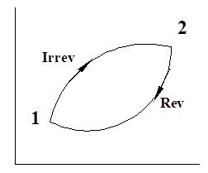
For cycles comprised of processes in contact with any number of thermal reservoirs, let a cycle be formed by an irreversible process 1-2 and be completed by a reversible process 2-1 as shown in the figure below.
For the cycle using Clausius inequality

Slide 24
This gives
Entropy Change Entropy Transfer
(property) (not a property)

Slide 25
2.1.3 CLOSED SYSTEM ENTROPY GENERATION
The previous equation shows that the change in entropy is greater than the entropy transfer. This clearly shows that there is entropy generation while the system is undergoing an irreversible process.
This entropy generation is rather well observed in an adiabatic process where the equation simplifies to ΔS≥0.
This change in entropy of the closed system is due to entropy generation internally. Let the entropy generated be designated by S_{gen}. Then the inequality equation can be written as

Slide 26
The above is also a measure of the inequality.
For a uniform temperature T at the boundary of a control mass while there is heat transfer δQ
If heat transfer occurs at several locations with respective temperatures on the boundary, the equation will be

Slide 27
Generally the above equations represent
Entropy change=entropy transfer + entropy generation

Slide 28
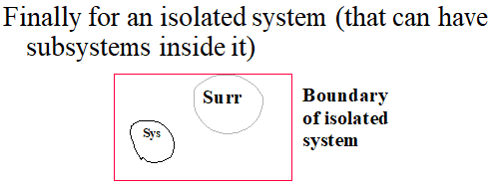

Entropy change=entropy transfer + entropy generation
> 0 > 0
= 0 = 0 (≥ 0)
< 0 < 0

Slide 29
Example 1.
Oxygen initially at 300 K and 100 kPa is contained in a rigid tank. Two alternative processes are to be considered to increase its temperature to 500 K. The gas receives energy (1) adiabatically by means of a paddle wheel driven by an external source and (2) by means of an external heat reservoir at 600 K. In the second case the temperature at the boundary is taken as the gas temperature throughout the process. Find
(a) the entropy production within the system in both cases and
(b) the total entropy production in both cases, in kJ/kmol.K,
(c) Then compare the results

Slide 30
2.1.4 COMPARISON OF REVERSIBLE AND IRREVERSIBLE WORK INTERACTIONS
Closed system reversible work from 1st law
δQ_{rev} = dU + δW_{rev} which will give
TdS = dU + δW_{rev}
For actual work (irreversible process)
δQ = dU + δW
For a process with a specified end states, dU is the same. This will give
TdS – δW_{rev} = δQ - δW

Slide 31
Division by T and rearranging will give
Comparing this with dS=(δQ/T) + δS_{gen}, will give
For negative work δW is more negative.
The work interaction given by δW_{rev} – δW is also called lost work.

Slide 32
2.1.5 ENTROPY GENERATION AND THE HEAT TRANSFER PROCESS
Heat transfer process through a finite temperature difference is an irreversible process. Consider the space between the two reservoirs

Slide 33
The heat transfer space properties remain fixed. For this space the equation can be written as
Or as a composite isolated system S_{gen} = ΔS
S_{gen}=∑S_{gen,A+B+Q}= S_{gen,A}+S_{gen,B} +S_{gen,Q}=0+0+S_{gen,Q}
ΔS = ∑ΔS_{A+B+Q}=ΔS_{A}+ΔS_{B}+ΔS_{Q}=(-Q/T_{A}) +(Q/T_{B})+0

Slide 34
This will finally give the same result as:
Example 2
Heat transfer occurs between two bodies with temperatures of 300 and 1000 K. Determine the entropy production associated with a heat transfer of 100 kJ, in kJ/K.

Slide 35
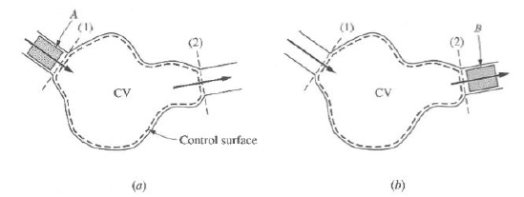
2.2 THE SECOND LAW FOR OPEN SYSTEMS
With reference to the same drawing used for 1st law, replacing E by S will give
S_{cm,t} = S_{cv,t} + ΔS_{in}
S_{cm,t+Δt} = S_{cv,t+Δt} +Δs_{out}
and (ΔS)_{in}= (sΔm)_{in}
(ΔS)_{out} )= (sΔm)_{out}
For the cm

Slide 36
Substitution gives
Division by Δt and rearranging gives
Taking the limit Δt→0 cm coincides with cv
Entropy Rate of Entropy
Generation entropy transfer rate Net entropy flow
Rate in accumulation (via heat rate out of cv
cv inside cv transfer) (via mass flow)

Slide 37
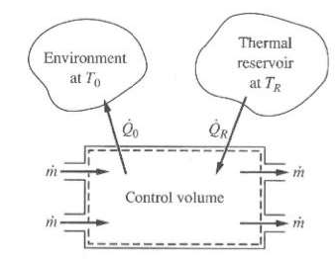
The above requires knowledge of at several locations on the cs- a difficult task.
A system which includes the cv and the surrounding will avoid this problem. This ends up with S_{gen,tot}.
For the small heat transfer region associated with T_{i}, T_{R} and Q_{i}, the entropy production (sum of –Q/T)

Slide 38
With respect to heat transfer space
Summing over the entire control surface area for n regions
For the reservoir T_{R} is constant and ∑Q_{i}=Q_{R}, results in

Slide 39
If we also include the surrounding as another thermal reservoir with contribution of (-Q_{o}/T_{o}), the equation then becomes
(Signs are relative to cv)
Upon rearrangement, it will give

Slide 40
As a rate equation
Substitution in the S_{gen} equation will give (slide 36)

Slide 41
For a single inlet and exit and heat exchange with a single reservoir and steady state process
Division by gives

Slide 42
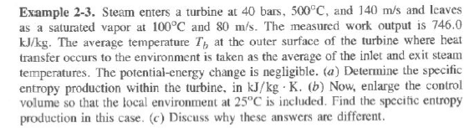
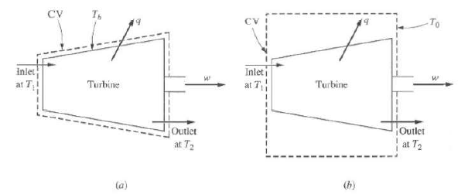

Slide 43
Similar to what was done for the closed system it can easily be shown that the difference between actual and reversible steady flow processes is due to the entropy generation expressed mathematically as
where
This will also be true if i.e. for work inputs since the actual work input is more negative.

Slide 44
2.3 ENTROPY PRODUCTION IN SIMPLE CYCLIC DEVICES
There are internal entropy generations and also external entropy generations due to heat transfer across finite temperature difference between the thermal reservoirs and particular locations of the cycle.
Case (a)
Reversible heat transfer and irreversible engine:

Slide 45
(a) (b)
(a) Heat engine with reversible heat transfer and irreversible engine (b) Heat engine with irreversible heat transfer and irreversible engine

Slide 46
For the engine which runs as a cycle
And again for the engine ΔS_{eng} = 0 and this will give
Signs of Q’s and W’s will be relative to engine.

Slide 47
Case (b)
Irreversible heat transfer and irreversible engine
S_{gen,tot}= S_{gen,QH} +S_{gen,eng} + S_{gen,QL}
If we also consider the three sub-systems considered as isolated system
S_{gen,tot}=ΔS_{TH}+ΔS_{eng}+ΔS_{TL}

Slide 48
2.4 ENTROPY PRODUCTION AND THE 1ST LAW EFFICIENCIES
Here an attempt is made to relate the first law efficiency to entropy generation. Starting with the 1st law equation for a steady flow (neglecting contributions from ke and pe)
δq=dh+δw Also use the 2nd Tds equation to give
Tds=dh-vdp=dh+δw_{rev}, Equating the dh’s will give
δq-δw=Tds-δw_{rev} or ds-δq/T=(δw_{rev}-δw)/T =δs_{gen}
For turbines and pumps respectively

Slide 49
2.5 MECHANISM OF ENTROPY GENERATION
We will consider a simple fluid flow (adiabatic and no cv work) in a pipe to see how fluid friction causes entropy generation.
The general 1st law equation:
δq=dh+d(ke)+δw=dh+VdV+0=0
Using the 2nd Tds equation Tds=dh-vdp will give
Tds+vdP+Vdv=0 or Tδs_{gen}+VdV+vdP=0
Differential pressure loss in a pipe from modified Bernoulli equation is given by

Slide 50
Or
A term by term comparison shows that
Substitution gives

Slide 51
For negligible contribution from changes in velocity
Tδs_{gen} =-vdP or as a rate of entropy generation
which shows that entropy generation rate is proportional to mass flow rate and the pressure drop.
The relationship between S_{gen} and ΔP can be determined for fluid flow through a duct as follows.
Ideal gas:
Adiabatic steady flow with negligible changes in ke and pe, 1st law gives h₁=h₂→T₁=T₂

Slide 52
This will also give
The entropy balance for such a flow was determined as
Substitution gives
P₂ – P₁=ΔP

Slide 53
For (P₁- P₂) << P₁
And for small x the relation ln(1+x) ≈ x
will give
Incompressible fluid:
Δs=c ln(T₂/T₁)=s_{gen} and also as h₁=h₂, this will give
c ΔT + vΔP = 0 or ΔT/T₁ = -vΔP/cT₁=

Slide 54
Substitution will give
For vΔP << cT₁ the approximation ln(1-x)≈-x can be used to give

