Slide 1
A course on
‘’ Renewable Energy Conversion (MIEG 6341)’’
By : Abdulkadir Aman (PhD)
Assistant Professor in Thermal and Energy Systems Engineering,
School of Mechanical and Industrial Engineering
Addis Ababa Institute of Technology (AAiT)
Addis Ababa University (AAU),

Slide 2
Chapter One Introduction to Renewable Energy
Any physical activity in this world, whether carried out by human beings or by nature, is cause due to flow of energy in one form or the other.
The word ‘energy’ itself is derived from the Greek word ‘en-ergon’, which means ‘in-work’ or ‘work content’. The work output depends on the energy input.
Energy is one of the major inputs for the economic development of any country. In the case of the developing countries, the energy sector assumes a critical importance in view of the ever increasing energy needs requiring huge investments to meet them.

Slide 3
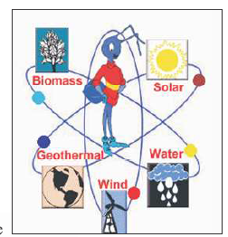
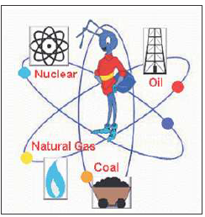
Energy can be classified into several types based on the following criteria:
Renewable and Non-Renewable energy
Conventional and Non-conventional energy
Renewable energy is obtained from sources that are essentially inexhaustible. The most important feature of renewable energy is that it can be harnessed without the release of harmful pollutants.
Non-renewable energy is the conventional fossil fuels such as coal, oil and gas, which are likely to deplete with time.
Renewables
Non-Renewables

Slide 4
Conventional energy resources which are being traditionally used for many decades and were in common use around oil crisis of 1973 are called conventional energy resources, e.g., fossil fuel, nuclear and hydro resources.
Non-conventional energy resources which are considered for large scale use after oil crisis of 1973, are called non-conventional energy sources. E.g. solar,wind,biomass, etc.

Slide 5
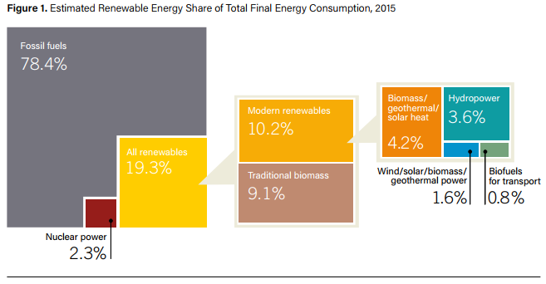
Global overview of Renewable Energy
The growing global movement for 100% renewables – driven by the imperative of addressing climate change, and the pursuit of local economic development and community-owned energy – also gained momentum from the Paris City Hall Declaration, which calls for 100% renewable energy or 80% reductions in greenhouse gas emissions by 2050.
As of 2014, renewable energy provided an estimated 19.2% of global final energy consumption.
Figure 1. Estimated Renewable Energy Share of Global Final Energy Consumption, 2015

Slide 6
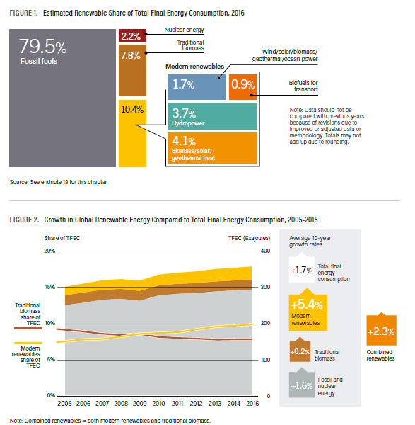

Slide 7
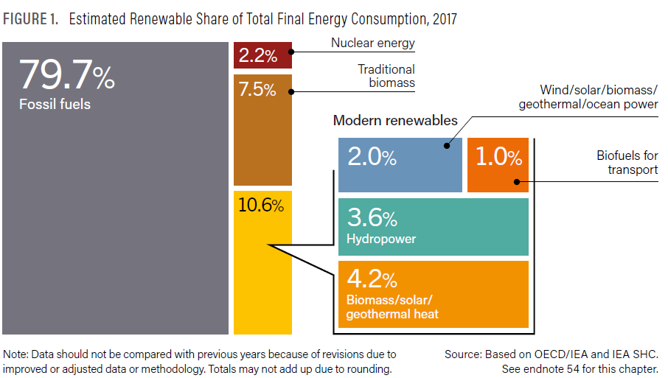

Slide 8
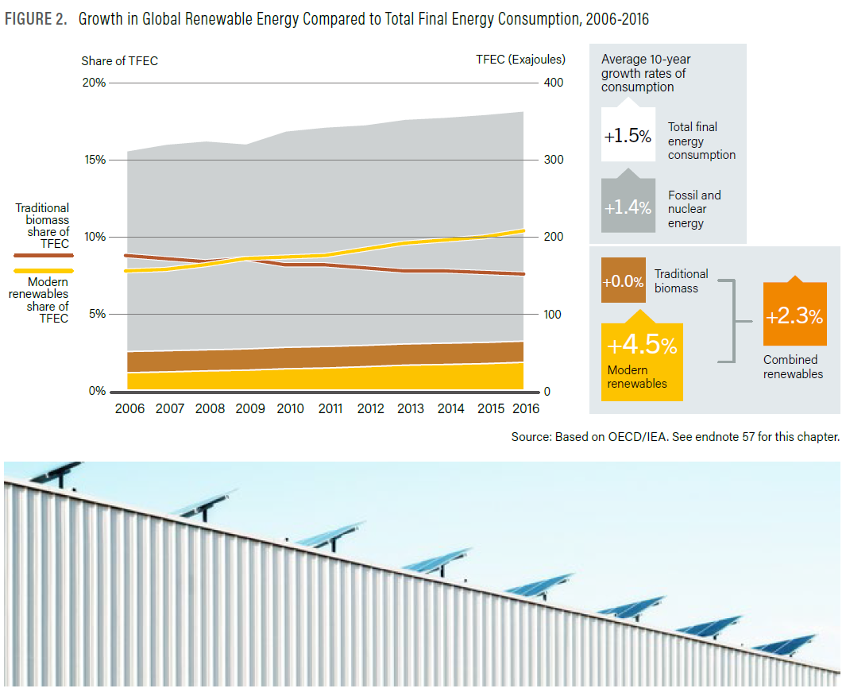

Slide 9
Global Trends in Renewable Energy Investment
2015 produced a new record for global investment in renewable energy. The amount of money committed to renewables excluding large hydro-electric projects rose 5% to $285.9 billion, exceeding the previous record of $278.5 billion achieved in 2011.
This record was achieved despite exchange rate shifts that depressed the dollar value of investments in other currency zones, and despite sharp falls in oil, coal and gas prices that protected the competitive position of fossil fuel generation.

Slide 10
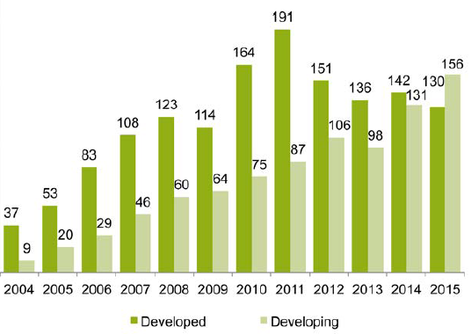
Figure. 3 Global New Investment In Renewable Energy: Developed V Developing Countries, 2004-2015, $Bn

Slide 11
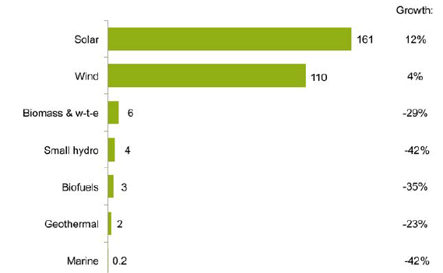
FIGURE 4. GLOBAL NEW INVESTMENT IN RENEWABLE ENERGY BY SECTOR, 2015, AND GROWTH ON 2014, $BN

Slide 12
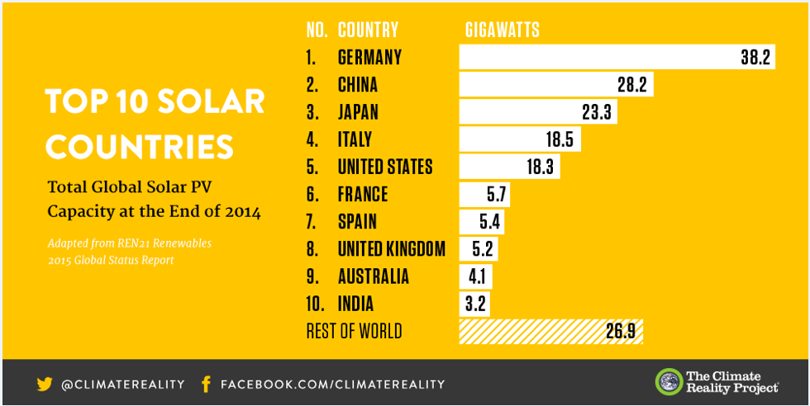

Slide 13
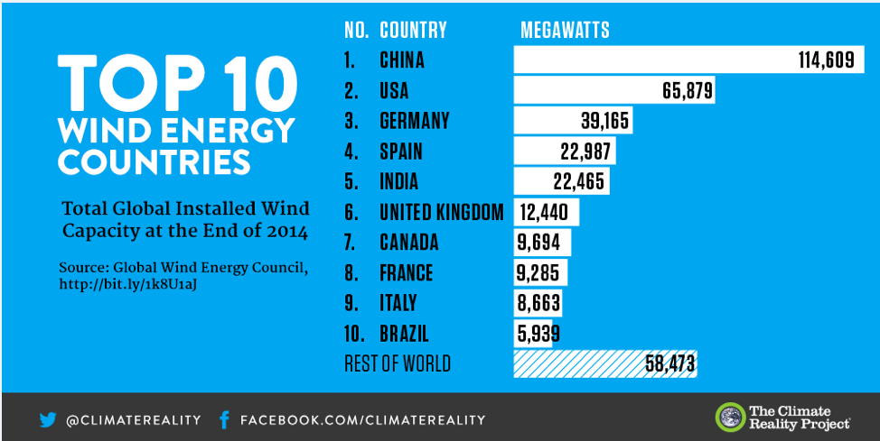

Slide 14
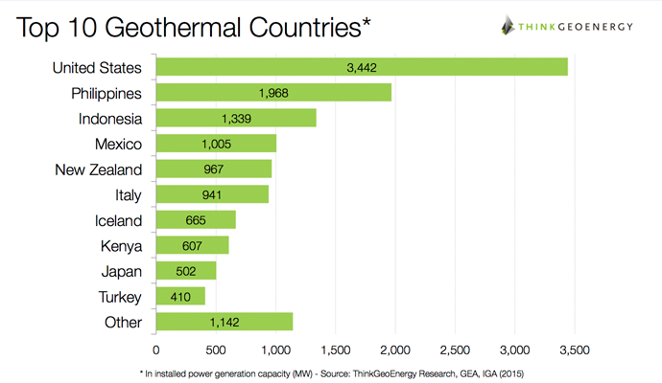

Slide 15
OVERVIEW OF Renewable Energy In Ethiopia
In the last decade, Ethiopia has emerged as an early mover and leader in Africa in terms of climate change, and is recognized for its commitments and substantial national investment in transforming to a climate-resilient green economy.
Ethiopia’s power generation mix consists almost entirely out of renewable energy sources.
In 2018, the bulk of Ethiopia’s 4.5 GW of power generating capacity came from 14 hydropower plants, which account for 85% (3.8 GW) of the country’s total capacity, making it the main energy source.
Several more large hydro plants are currently under development, such as the massive 6.5 GW Great Ethiopian Renaissance Dam (GERD), the 2.16 GW Koysha Hydropower project and the 254 MW Genale Dawa III project.

Slide 16
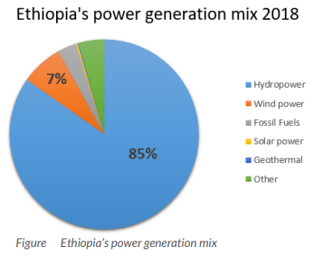
Other than hydropower, the country also has three wind farms, collectively generating 324 MW, and a few diesel plants, generating 143 MW, with the rest being generated by solar power (14 MW), geothermal power (7.5 MW) and other renewables.

Slide 17
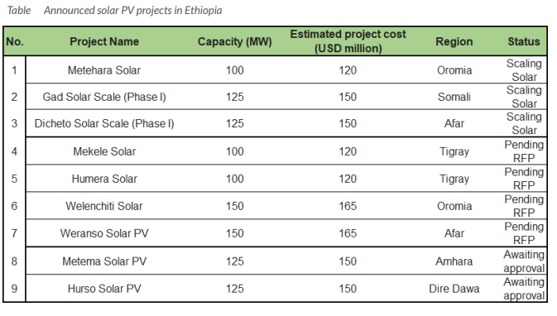

Slide 18
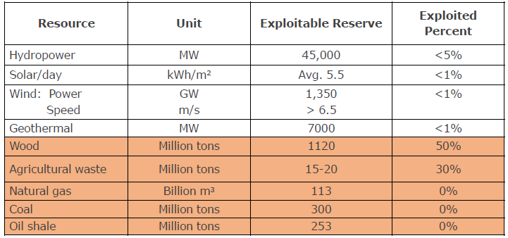
INDIGENOUS ENERGY RESOURCES

Slide 19
RENEWABLE ENERGY POTENTIALS AND THEIR GEOGRAPHICAL DISTRIBUTION
Hydropower
Ethiopia’s plentiful hydropower resources are distributed in nine major river basins and their innumerable tributaries is estimated to generate an economically affordable energy of about 260 TWH.
Wind
Ethiopia has a total wind energy resource reserve of 3030 GW and the potential exploitable quantity is 1,350 GW.
Solar
According to the revised Master Plan, Ethiopia’s average solar energy potential is 5.5 KWh/m2/day and mainly centralized in the north part of the country in Tigray and Afar regions.

Slide 20
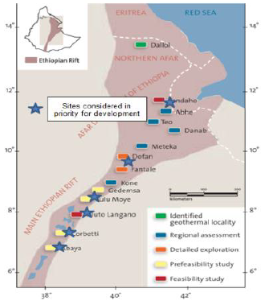
Geothermal
The best perspective areas are distributed along the Ethiopian Rift Valley system which runs for more than 1000 km from the Afar depression, at Red Sea to the Turkana depression southwards.
A total of 16 geothermal resource areas have been identified by various studies. These resources zones are all located within the rift valley system.

Slide 21
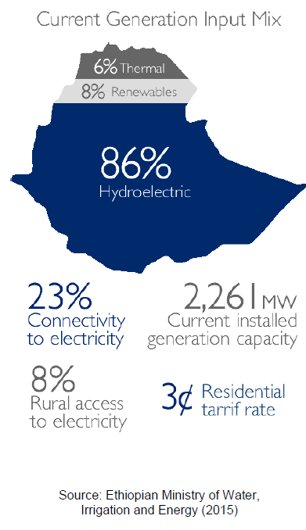

Slide 22
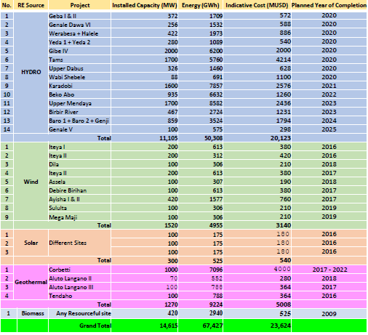
Up-coming Renewable Energy Projects
Inline with the 25 Years Power Sector Master Plan , the following projects are planned for implementation in GTPII
Hydro = 11,015 MW
Wind = 1520 MW
Geothermal = 1270 MW
Solar= 300MW
Biomass= 420MW
Total=14615MW

Slide 23
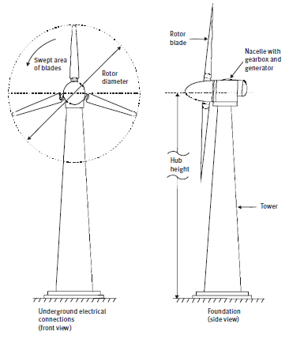
Overview Of Renewable Energy Technologies
Wind energy
A wind turbine produces power by converting the force of the wind (kinetic energy) acting on the rotor blades (rotational energy) into torque (turning force or mechanical energy). This rotational energy is used either within a generator to produce electricity or, perhaps less commonly, it is used directly for driving equipment such as milling machines or water pumps (often via conversion to linear motion for piston pumps).
Figure . Wind energy system schematic

Slide 24
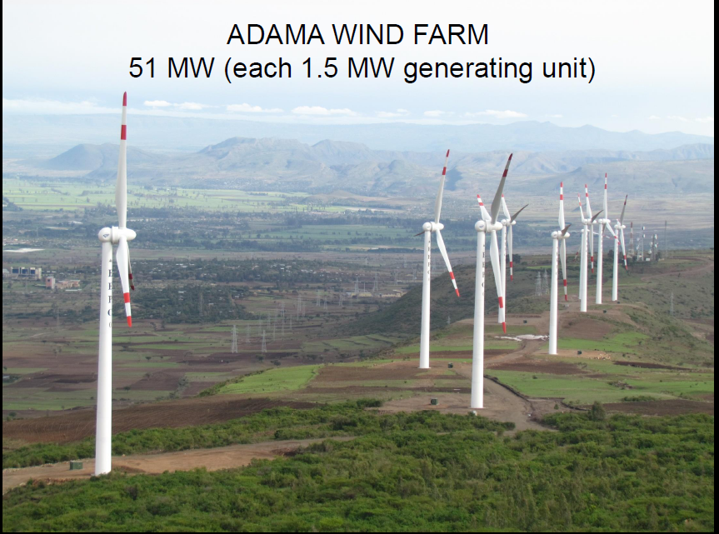

Slide 25
Wind power by its nature is variable (or intermittent), therefore some form of storage or back-up is inevitably involved. This may be through:
connection to an electricity grid system, which may be on a large or small (mini-grid)
incorporating other electricity producing energy systems (from conventional generating stations through diesel generators to other renewable energy systems);
or the use of storage systems such as batteries or, for mechanical systems, storage via water held in a tank.

Slide 26
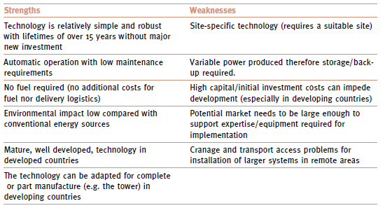
Strengths and weaknesses of wind energy systems

Slide 27
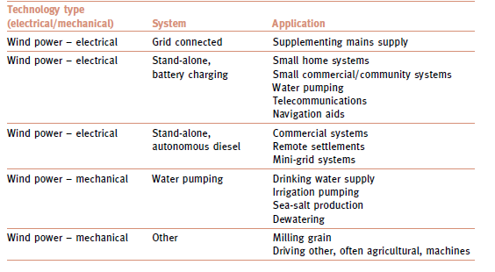
Examples of wind power applications and system type

Slide 28
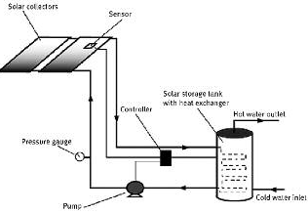
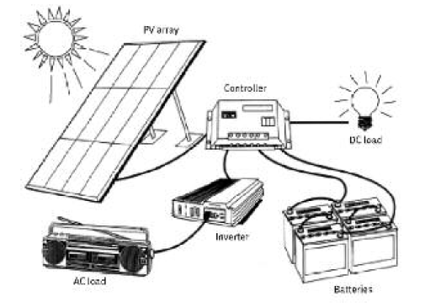
Solar energy
Solar energy technologies can be loosely divided into two categories: solar thermal systems (and solar electric or photovoltaic (PV) systems

Slide 29
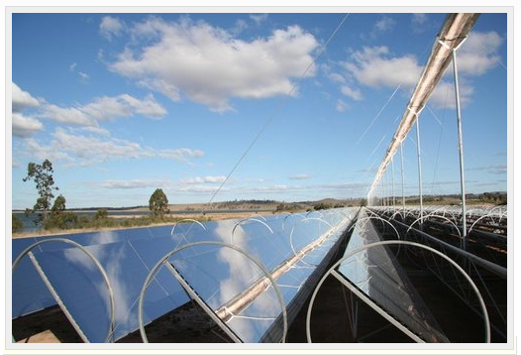
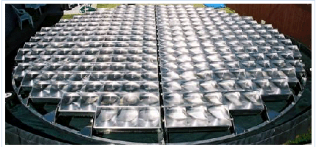
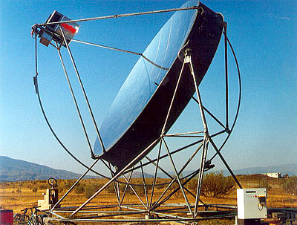
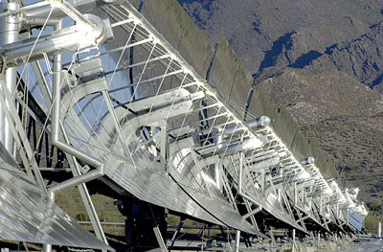
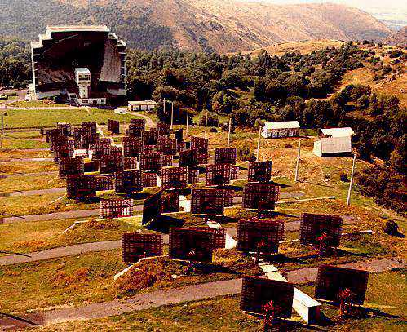
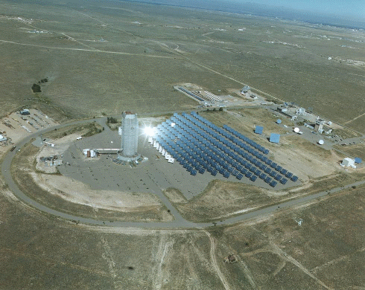
FRESNEL REFLECTOR
LENS CONCENTRATORS
PARABOLIC TROUGH
PARABOLIC DISH
PARABOLIC DISH
& ENGINE
SOLAR FURNACE
SOLAR FURNACE
CENTRAL RECEIVER

Slide 30
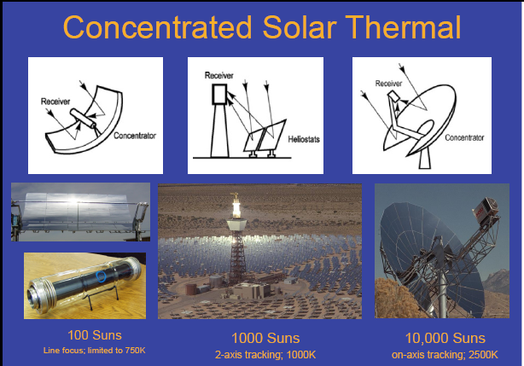

Slide 31
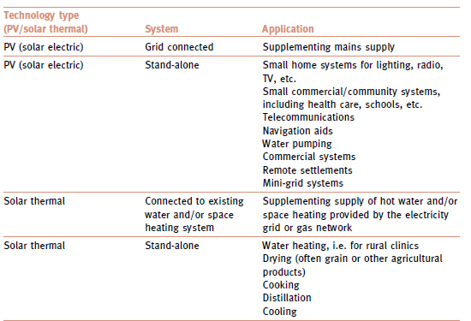
Examples of solar power applications and system type

Slide 32
Bioenergy
Bioenergy is a general term that covers energy derived from a wide variety of material of plant or animal origin. Strictly, this includes fossil fuels but, generally, the term is used to mean renewable energy sources such as wood and wood residues, agricultural crops and residues, animal fats, and animal and human wastes, all of which can yield useful fuels either directly or after some form of conversion.
There are technologies for bioenergy using liquid and gaseous fuel,as well as traditional applications of direct combustion. The conversion process can be physical (for example, drying, size, reduction or densification), thermal (as in carbonization) or chemical (as in biogas production). The end result of the conversion process may be a solid, liquid or gaseous fuel and this flexibility of choice in the physical form of the fuel is one of the advantages of bioenergy over other renewable energy sources.

Slide 33
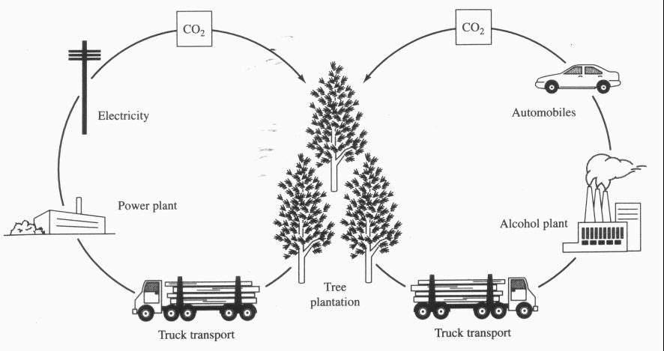
Biomass Energy
Carbon neutral
CO₂ ultimately released in energy generation is recently captured and so ideally does not change total atmospheric levels
Carbon leaks can result in a net increase in CO₂ levels
Sequestration in soil can result in a net decrease in CO₂ levels

Slide 34
Biomass Energy
Advantages
Versatile
Renewable
No net CO₂ emissions (ideally)
Emits less SO₂ and NO_{x} than fossil fuels
Disadvantages
Low energy density/yield
In some cases (eg, corn-derived bioethanol) may yield no net energy
Land conversion
Biodiversity loss
Possible decrease in agricultural food productivity
Usual problems associated with intensive agriculture
Nutrient pollution
Soil depletion
Soil erosion
Other water pollution problems

Slide 35
Types of Biomass
Agricultural biomass
biomass residues from field agricultural crops (stalks, branches, leaves, straw, etc.) and
biomass from the byproducts of the processing of agricultural products (residue from cotton ginning, olive pits, fruit pits, etc.).

Slide 36
Biomass from animal waste
waste from intensive livestock operations, from poultry farms, pig farms, cattle farms and slaughterhouses.
Forest biomass
consists of firewood, forestry residues, material cleared from forests to protect them from forest fires, as well as byproducts from wood industries
Municipal waste
The municipal waste consists of solid wastes as human excreta, garbage, city wastes and commercial wastes.
It also includes liquid form domestic sewage and effluent from community institutional activities.

Slide 37
Energy plantation
Energy plantation means growing selected species of trees and shrubs which are harvestable in a comparatively shorter time and are specific means for fuel.
The fuel wood may be used either directly into wood burning stoves and boilers or processed into methanol, ethanol and producer gas.
Marine biomass
Floating water plants (e.g., water hyacinths) are pest plants in many rivers, lakes and ponds in tropical and semitropical areas of the world.

Slide 38
Conversion of Biomass
Biomass can be converted to a number of secondary energy carriers (electricity, gaseous, liquid and solid fuels, and heat) using a wide range of conversion routes.
The conversion routes to fuels and electricity can be distinguished in thermal, chemical, and biochemical conversion routes

Slide 39
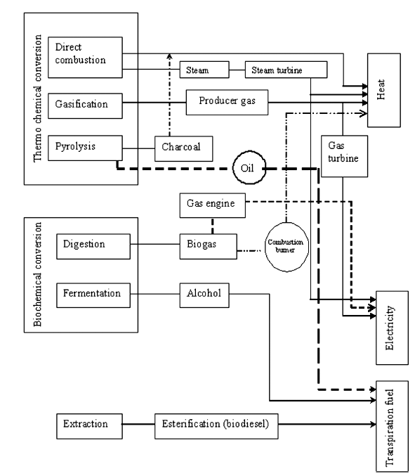
Fig. Biomass conversion routes.

Slide 40
Biofuels
Ethanol is an alcohol distilled from plant material (corn in the U.S., sugar cane in Brazil, wheat in Europe) and used as gasoline substitute or blend stock
U.S. and Brazil account for 90% of global ethanol production and consumption
Ethanol can be blended to around 10% of the gasoline pool without any noticeable impact on vehicle performance, but higher blend proportions require some engine modifications
Biodiesel is produced by the transformation of animal fat or vegetable oil into a conventional diesel substitute
Feedstock represents more than 80% of the total costs of producing biodiesel compared with around 60% for ethanol

Slide 41
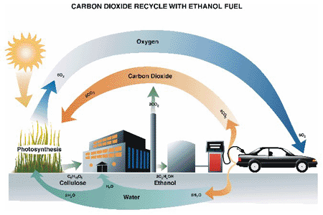
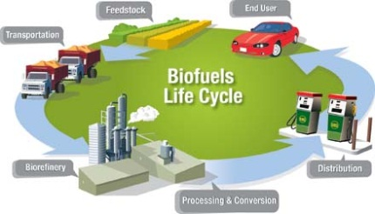
Bio-fuels

Slide 42
Examples of solar power applications and system type

Slide 43
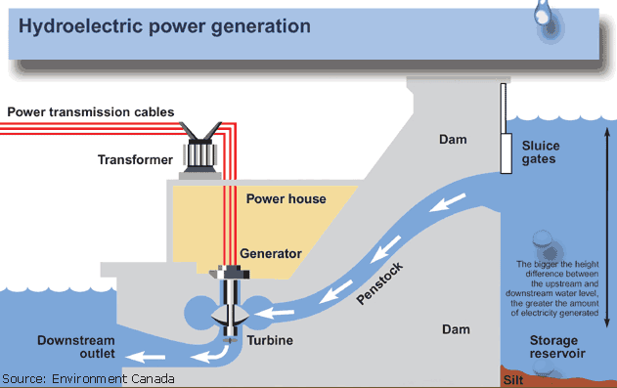
Hydroelectric

Slide 44
Characteristics
Most mature of renewable energies
Largest global contributor amongst all renewable energies
Largely utilizes established technology from other sectors
Can be “switched on-off” at almost immediately
Arguably the Cheapest where available

Slide 45
Pros - Hydroelectric
Cheap electricity
Capable of providing base load power
Capable of large scale production

Slide 46
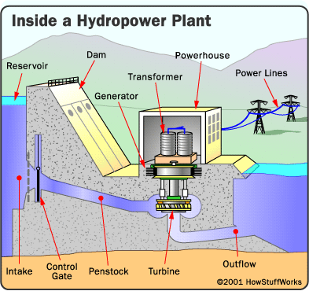
Dam - Most hydropower plants rely on a dam that holds back water, creating a large reservoir. Often, this reservoir is used as a recreational Lake.
Basic components of a conventional hydropower plant

Slide 47
Cons - Hydroelectric
Environmental concerns. Ecology in dam catchment area destroyed
Humanitarian implications. Settlements in catchment areas have to be relocated
Depends on seasonal nature of water (rain) availability in catchment area
High upfront capital investment costs
Limited in number of potential sites/locations

Slide 48
Geothermal Energy
Geothermal energy is one of the only renewable energy sources not dependent on the Sun. Instead, it relies on heat produced under the surface of the Earth.
There are two main applications of geothermal energy,
producing electricity at specialized power plants, and
direct-heating, which puts to direct use the temperature of water piped under the earth’s surface.

Slide 49
