Slide 1
Chapter Three
Solar Heaters and Dryers

Slide 2
Introduction
A solar collector is a special kind of heat exchanger that transforms solar radiant energy into heat.
A solar collector differs in several respects from more conventional heat exchangers. The latter usually accomplish a fluid-to-fluid exchange with high heat transfer rates and with radiation as an unimportant factor. In the solar collector, energy transfer is from a distant source of radiant energy to a fluid.
The flux of incident radiation is, at best, approximately 1100 W/m² (without optical concentration), and it is variable.
Thus, the analysis of solar collectors presents unique problems of low and variable energy fluxes and the relatively large importance of radiation.

Slide 3
3.1 Flat plate collectors
Flat-plate collectors can be designed for applications requiring energy delivery at moderate temperatures, up to perhaps 100ºC above ambient temperature.
They use both beam and diffuse solar radiation, do not require tracking of the sun, require little maintenance ,and are mechanically simpler than concentrating collectors.
The major applications of these units are in
Solar water heating
building heating,
air conditioning and
industrial process heat.
Passively heated buildings can be viewed as special cases of flat-plate collectors with the room or storage wall as the absorber.

Slide 4
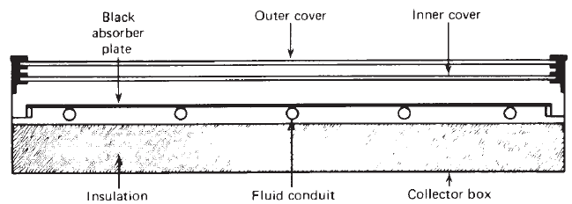
The important parts of a typical liquid heating flat-plate solar collector are shown in fig below.

Slide 5
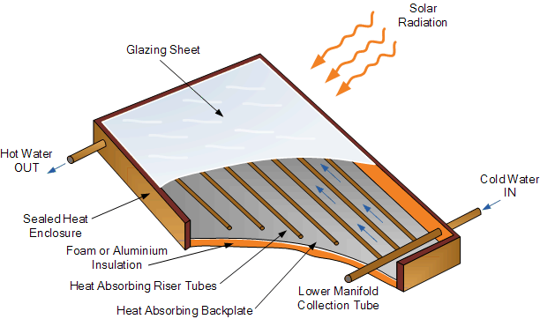

Slide 6
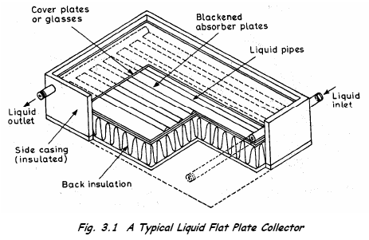
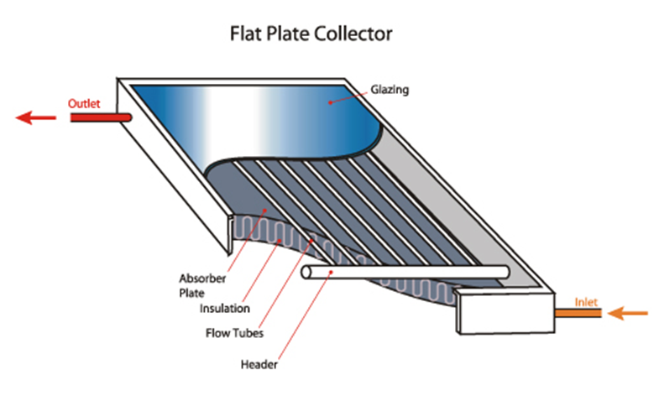

Slide 7
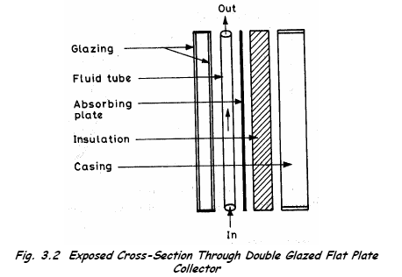

Slide 8

BASIC FLAT-PLATE ENERGY BALANCE EQUATION
In steady state, the performance of a solar collector is described by an energy balance that indicates the distribution of incident solar energy into useful energy gain, thermal losses,and optical losses.
The useful energy output of a collector of area A_{c} is the difference between the absorbed solar radiation and the thermal loss:
3.1
Where : S IS the solar radiation absorbed by a collector per unit area of absorber. it is
equal to the difference between the incident solar radiation and the optical losses
U_{L} Overall heat loss coefficient :it is the thermal energy lost from the collector to the surroundings by conduction, convection, and infrared radiation
T_{pm} the mean absorber plate temperature
T_{a} the ambient temperature

Slide 9
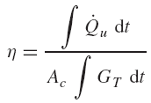

The problem with equation (3.1) is that the mean absorber plate temperature is difficult to calculate or measure since it is a function of the collector design, the incident solar radiation, and the entering fluid conditions.
We can reformulate the equation so that the useful energy gain can be expressed in terms of the inlet fluid temperature and a parameter called the collector heat removal factor, which can be evaluated analytically from basic principles or measured experimentally.
A measure of collector performance is the collection efficiency, defined as the ratio of the useful gain over some specified time period to the incident solar energy over the same time period:
If conditions are constant over a time period,

Slide 10
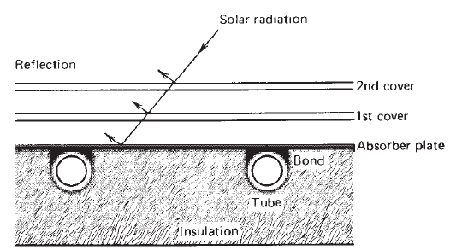
TEMPERATURE DISTRIBUTIONS IN FLAT-PLATE COLLECTORS
It is desirable to have an understanding of the temperature distribution that exists in a solar collector constructed as shown in Figure 3.1.
Figure 3.1 Sheet-and-tube solar collector.

Slide 11
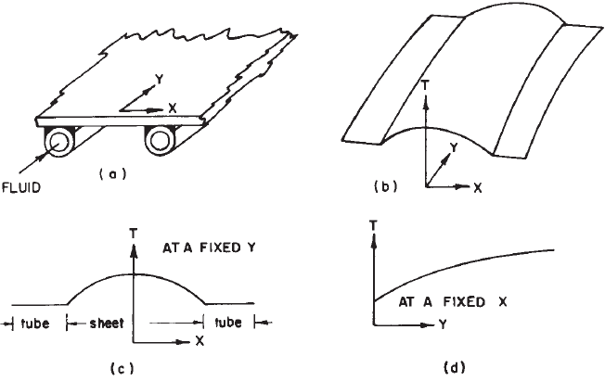
Some of the solar energy absorbed by the plate must be conducted along the plate to the region of the tubes. Thus the temperature midway between the tubes will be higher than the temperature in the vicinity of the tubes. The temperature above the tubes will be nearly uniform because of the presence of the tube and weld metal.
The energy transferred to the fluid will heat the fluid, causing a temperature gradient to exist in the direction of flow.
Figure 3.2 Temperature distribution on an absorber plate

Slide 12
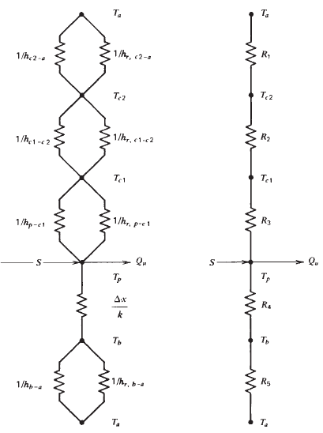
COLLECTOR OVERALL HEAT LOSS COEFFICIENT
It is useful to develop the concept of an overall loss coefficient for a solar collector to simplify the Analysis. Consider the thermal network for a two-cover system shown in Figure 3.3.
At some typical location on the plate where the temperature is T_{p}, solar energy of amount S is absorbed by the plate, where S is equal to the incident solar radiation reduced by optical losses.
This absorbed energy S is distributed to thermal losses through the top and bottom and to useful energy gain.
Figure 3.3 Thermal network for a two-cover flat-plate collector: (a) in terms of conduction, convection, and radiation resistances; (b) in terms of resistances between plates.

Slide 13
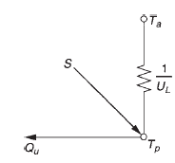
The purpose of this section is to convert the thermal network of Figure 3.3 to the thermal network of Figure 3.4.
Figure 3.4 Equivalent thermal network for flat-plate solar collector.
The steady-state energy transfer between the plate at T_{p} and the first cover at T_{c1} is the same as between any other two adjacent covers and is also equal to the energy lost to the surroundings from the top cover.

Slide 14



The loss through the top per-unit area is then equal to the heat transfer from the absorber plate to the first cover:
3.2
where hc,p−c1 is the convection heat transfer coefficient between two inclined parallel plates.
If the definition of the radiation heat transfer coefficient is used, the heat loss becomes
3.3
where
3.4
The resistance R₃ can then be expressed as
3.5

Slide 15
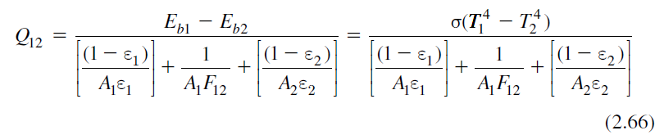
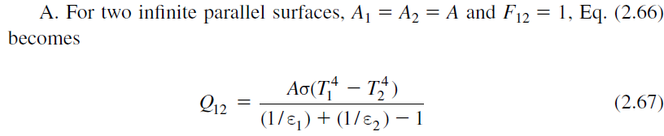
Radiation exchange between surfaces
The net rate of radiation exchange between two surfaces is equal to the overall potential difference divided by the sum of resistances, given by
In solar energy applications, the following geometric orientations between two surfaces are of particular interest.

Slide 16
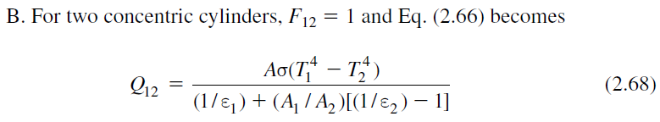
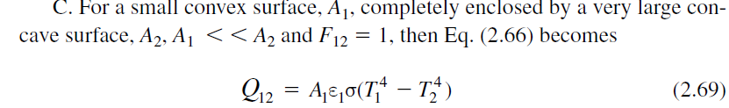


Slide 17



A similar expression can be written for R₂, the resistance between the covers. In general, we can have as many covers as desired, but the practical limit is two and most collectors use one.
The radiation resistance from the top cover accounts for radiation exchange with the sky at T_{s} . For convenience, we reference this resistance to the ambient temperature T_{a}, so that the radiation heat transfer coefficient can be written as:
3.6
The resistance to the surroundings R₁ is then given by
3.7
Where h_{w} is heat transfer coefficient for heat loss from flat plates exposed to outside winds
For this two-cover system, the top loss coefficient from the collector plate to the ambient is
3.8

Slide 18




Convection Heat Transfer Coefficient calculations (Review)
The Nusselt, Rayleigh, and Prandtl numbers are given by
Where h= heat transfer coefficient [W/m² K]
L= plate spacing [m]
k = thermal conductivity [W/m K]
g = gravitational constant [m/s²]
β = volumetric coefficient of expansion (for an ideal gas, β = 1/T ) [1/K]
ΔT = temperature difference between plates [K]
ν = kinematic viscosity [m²/s]
α = thermal diffusivity [m²/s]
In a more recent experimental study using air, Hollands et al. (1976) give the relationship between the Nusselt number and Rayleigh number for tilt angles from 0 to 75◦ as

Slide 19
The procedure for solving for the top loss coefficient using Equations 3.2 through 3.8 is necessarily an iterative process.
First a guess is made of the unknown cover temperatures, from which the convective and radiative heat transfer coefficients between parallel surfaces are calculated.
With these estimates, Equation 3.8 can be solved for the top loss coefficient.
The top heat loss is the top loss coefficient times the overall temperature difference, and since the energy exchange between plates must be equal to the overall heat loss, a new set of cover temperatures can be calculated.

Slide 20

Beginning at the absorber plate, a new temperature is calculated for the first cover. This new first cover temperature is used to find the next cover temperature, and so on.
For any two adjacent covers or plate, the new temperature of plate or cover j can be expressed in terms of the temperature of plate or cover i as
3.9
The process is repeated until the cover temperatures do not change significantly between successive iterations

Slide 21
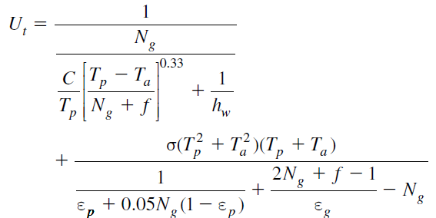
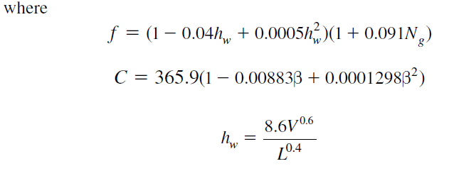
in the proceeding equations, the calculation of the top heat loss coefficient involves the air properties which are functions of temperate. Because the iterations required are tedious and time consuming, especially for the case of multiple cover systems, straightforward evaluation of U_{t} is given by the following empirical equation with sufficient accuracy for design purposes (Klein,1975)

Slide 22
Example
Calculate the top loss coefficient for an absorber with a single glass cover having the following specifications:
Plate-to-cover spacing 25mm
Plate emittance 0.95
Ambient air and sky temperature 10◦C
Wind heat transfer coefficient 10 W/m2 ◦C
Mean plate temperature 100◦C
Collector tilt 45◦
Glass emittance 0.88
.

Slide 23



For this single-glass-cover system,
The radiation coefficient from the plate to the cover hr,p−c is
The radiation coefficient for the cover to the air h_{r,c−a} is given as
The equation for the cover glass temperature is

Slide 24

The procedure is to estimate the cover temperature, from which h_{c,p−c}, h_{r,p−c} and h_{r,c−a} are calculated. With these heat transfer coefficients and h_{w}, the top loss coefficient is calculated. These results are then used to calculate T_{c} from the preceding equation. If T_{c} is close to the initial guess, no further calculations are necessary. Otherwise, the newly calculated T_{c} is used and the process is repeated.
With an assumed value of the cover temperature of 35◦C, the two radiation coefficients become hr,p−c = 7.60 W/m² ◦C, hr,c−a = 5.16 W/m² ◦C
The mean temperature between the plate and the cover is 67.5◦C so the air properties are υ= 1.96 × 10−5 m2/s, k = 0.0293 W/m ◦C, T = 340.5 K, and Pr = 0.7.
The Rayleigh number is

Slide 25



the Nusselt number is
N_{u} = 3.19
The convective heat transfer coefficient is
The first estimate of U_{t} is then
The cover temperature is

Slide 26


With this new estimate of the cover temperature, the various heat transfer coefficients become
and the second estimate of U_{t} is
When the cover glass temperature is calculated with this new top loss coefficient, it is found to be 48.4◦C, which is essentially equal to the estimate of 48.5◦C.
The energy loss through the bottom of the collector is represented by two series resistors, R₄ and R₅, in Figure 3.3, where R₄ represents the resistance to heat flow through the insulation and R₅ represents the convection and radiation resistance to the environment.
The magnitudes of R₄ and R₅ are such that it is usually possible to assume R₅ is zero and all resistance to heat flow is due to the insulation. Thus, the back loss coefficient U_{b} is approximately
The edge losses are then estimated by assuming one-dimensional sideways heat flow around the perimeter of the collector system. If the edge loss coefficient–area product is (U/A)_{edge}, then the edge loss coefficient, based on the collector area A_{c}, is
The overall loss coefficient U_{L} is

Slide 27
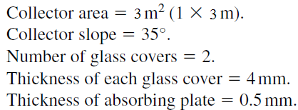
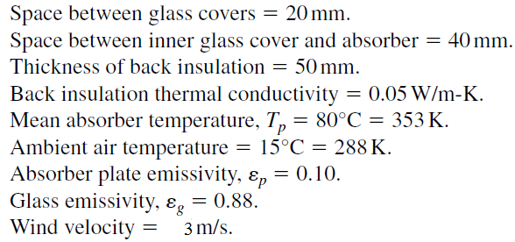
Exercise 1
Estimate the top loss coefficient of a collector that has the following specifications.

Slide 28
Exercise 2
Calculate the Overall loss coefficient for an absorber with a single glass cover having the following specifications:
Plate-to-cover spacing 20mm
Plate emittance 0.95
Ambient air and sky temperature 20◦C
Wind heat transfer coefficient 10 W/m² ◦C
Mean plate temperature 100◦C
Collector tilt 30◦
Glass emittance 0.88
Back-insulation thickness 50mm
Insulation conductivity 0.045 W/m ◦C
Collector bank length 10m
Collector bank width 3m
Collector thickness 75mm
Edge insulation thickness 25mm

Slide 29
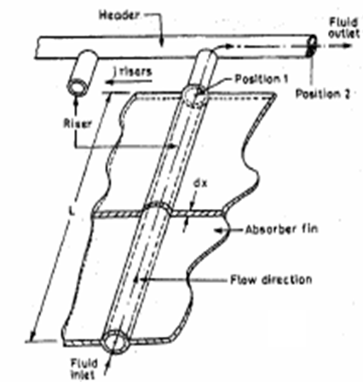
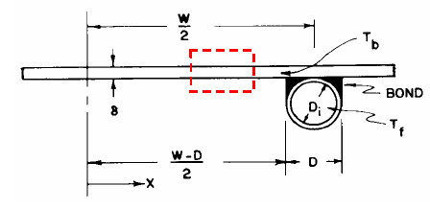
TEMPERATURE DISTRIBUTION BETWEEN TUBES
The temperature distribution between two tubes in a flat plate collector can be derived if we temporarily assume the temperature gradient in the flow direction to be negligible.
Consider the sheet-tube configuration shown in Figure below.
W is the distance between the tubes
D is the tube diameter and
δ is the sheet thickness
Fig. 3.4 Sheet and tube dimensions with configuration.

Slide 30
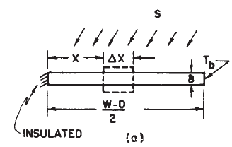
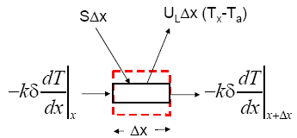
Because the sheet material is a good conductor, the temperature gradient through the sheet is negligible. We will assume the sheet above the bond is at some local base temperature T_{b}.
The region between the centerline separating the tubes and the tube base can then be considered as a classical fin problem.
The fin, shown in Figure 3.5(a), is of length (W − D)/2. An elemental region of width Δx and unit length in the flow direction is shown in Figure 3.5(b).
Figure 3.5. Energy balance on fin element.

Slide 31





Assuming steady-state conditions: An energy balance on this element yields:
Dividing throughout by Δx and taking the limit as Δx approaches zero yields
3.10
Eqn. 3.10 is a second order differential equation. The two boundary conditions necessary to solve this equation are symmetry at the centerline and the known base temperature:
For convenience, we can define two variables, m and Ψ
and

Slide 32




Then, Equation 3.10 becomes
3.11
which has the boundary conditions
The general solution is
Substituting the boundary conditions into the general solution, the result is
3.12

Slide 33


The energy conducted to the region of the tube per unit of length in the flow direction can now be found by evaluating Fourier’s law at the fin base:
3.13
Equation 3.13 accounts for the energy collected on only one side of a tube; for both sides, the energy collection is
3.14
Note that in eqn. 3.14 the useful energy gain is expressed in terms of base temperature T_{b}

Slide 34


Fin Efficiency Factor
Recall that Equation 3.14 is derived considering the region between the centerline separating the tubes and the tube base as a classical fin problem. Hence It is convenient to use the concept of a fin efficiency to rewrite Equation 3.14 as
3.15
where
3.16
The function F is the standard fin efficiency for straight fins with rectangular profile and is plotted in Figure 3.6

Slide 35
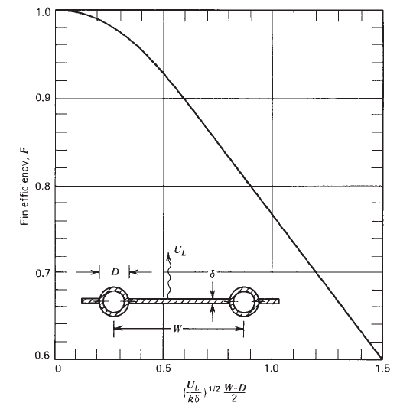
Figure 3.6 Fin efficiency for tube-and-sheet solar collectors.

Slide 36

Collector Efficiency Factor
It is more convenient to express useful energy gain in terms of the fluid (rather than the fin base) temperature
The useful gain of the collector also includes the energy collected above the tube region. The energy gain for this region is
3.17
the useful gain for the tube and fin per unit of length in the flow direction is the sum of Equations 3.15 and 3.17:
3.18
Ultimately, the useful gain from Equation 3.18 must be transferred to the fluid. The resistance to heat flow to the fluid results from the bond and the tube-to-fluid resistance.

Slide 37

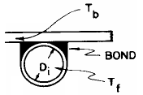

The useful gain can be expressed in terms of the two resistances as
3.19
The bond conductance C_{b} can be estimated from knowledge of the bond thermal conductivity k_{b}, the average bond thickness γ , and the bond width b. On a per-unit-length basis,
N.B: simple wiring or clamping of the tubes to the sheet results in low bond conductance and significant loss of performance. It is necessary to have good metal-to-metal contact so that the bond conductance is greater.

Slide 38

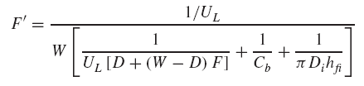
We now wish to eliminate T_{b} from the equations and obtain an expression for the useful gain in terms of known dimensions, physical parameters, and the local fluid temperature. Solving Equation 3.19 for T_{b}, substituting it into Equation 3.18, and solving the result for the useful gain, we obtain
3.20
where the collector efficiency factor F’ is given as
3.21
At a particular location, F’ represents the ratio of the actual useful energy gain to the useful gain that would result if the collector absorbing surface had been at the local fluid temperature.

Slide 39

For most (but not all) geometries, another interpretation for the parameter F’ becomes clear when it is recognized that the denominator of Equation 3.21 is the heat transfer resistance from the fluid to the ambient air. This resistance will be given the symbol 1/U_{o}.
The numerator is the heat transfer resistance from the absorber plate to the ambient air.
Thus F’ is the ratio of these two heat transfer coefficients:
3.22

Slide 40
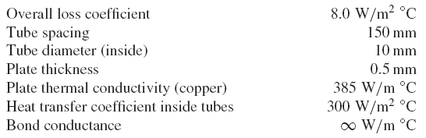
example
Calculate the collector efficiency factor for the following specifications:

Slide 41
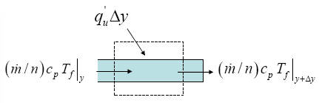
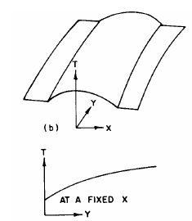
TEMPERATURE DISTRIBUTION IN FLOW DIRECTION
The useful gain per unit flow length as calculated from Equation 3.20 is ultimately transferred to the fluid. The fluid enters the collector at temperature T_{fi} and increases in temperature until at the exit it is T_{fo.}
Referring to the Figure below, we can express an energy balance on the fluid flowing through a single tube of length Δy as
where m˙ is the total collector flow rate and n is the number of parallel tubes.

Slide 42



Dividing through by Δy, finding the limit as Δy approaches zero, and substituting Equation 3.20 for q_{u}, we obtain
3.23
Assume F’ and U_{L} are constant (independent of position) and integrate to obtain the solution for the fluid temperature at any position y (subject to the condition that the inlet fluid temperature is T_{fi}) is
3.24
If the collector has a length L in the flow direction, then the outlet fluid temperature T_{fo} is found by substituting L for y in Equation 3.24. The quantity nWL is the collector area:
3.25

Slide 43


COLLECTOR HEAT REMOVAL FACTOR
The collector heat removal factor F_{R} is used to relate the actual useful energy gain of a collector to the useful gain if the whole collector surface were at the fluid inlet temperature.
3.26
Using the relation between inlet and outlet fluid temperature, it can also be expressed as
3.27

Slide 44

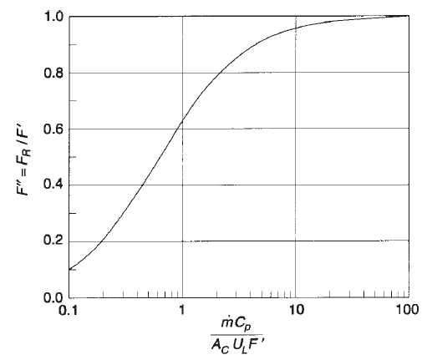
COLLECTOR flow FACTOR
To present Equation 3.27 graphically, it is convenient to define the collector flow factor F’’ as the ratio of F_{R} to F’. Thus
3.28
This collector flow factor is a function of the single variable, the dimensionless collector capacitance rate
^{F’}’ becomes constant after the dimensionless collector capacitance rate Becomes greater than 10
Figure 3.6 Collector flow factor

Slide 45

The collector heat removal factor F_{R} is equivalent to the effectiveness of a conventional heat exchanger, which is defined as the ratio of the actual heat transfer to the maximum possible heat transfer.
The maximum possible useful energy gain (heat transfer) in a solar collector occurs when the whole collector is at the inlet fluid temperature; heat losses to the surroundings are then at a minimum.
The collector heat removal factor times this maximum possible useful energy gain is equal to the actual useful energy gain Q_{u} :
3.28
Eqn. 3.28 is an extremely useful equation and applies to essentially all flat-plate collectors. With it, the useful energy gain is calculated as a function of the inlet fluid temperature. This is a convenient representation when analyzing solar energy systems, since the inlet fluid temperature is usually known.

Slide 46


ABSORBED SOLAR RADIATION (S)
The prediction of collector performance requires information on the solar energy absorbed by the collector absorber plate.
The solar energy incident on a tilted collector can be found by the fundamentals concepts of solar radiation This incident radiation has three different spatial distributions: beam radiation, diffuse radiation, and ground-reflected radiation, and each must be treated separately.
At times it is convenient to define an average transmittance-absorptance product as the ratio of the absorbed solar radiation S to the incident solar radiation I_{T} . Thus,
3.29
When the beam fraction is high, (τα)av is close to (τα)b. When the diffuse fraction is high, using the value of (τα)d for (τα)av may be a reasonable assumption.
useful energy gain by the collector is highest when beam radiation is high, and as an approximation when I_{T} data are available, the following can be assumed:

Slide 47
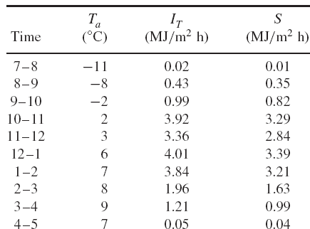
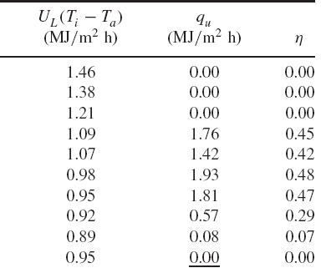
eXAMPLE
Calculate the daily useful gain and efficiency of an array of 10 solar collector modules installed in parallel near Boulder, Colorado, at a slope of 60◦ and a surface azimuth of 0◦. The hourly radiation on the plane of the collector I_{T} , the hourly radiation absorbed by the absorber plate S, and the hourly ambient temperature Ta are given in the table below. For the collector assume the overall loss coefficient U_{L} to be 8.0 W/m² ◦C and the plate efficiency factor F’ to be 0.841 .The water flow rate through each 1 x 2-m collector panel is 0.03 kg/s and the inlet water temperature remains constant at 40 ◦C. Assume a controller turns off the water flow whenever the outlet temperature is less than the inlet temperature.

Slide 48



CRITICAL RADIATION LEVEL
we can now determine the critical radiation level G_{Tc} for flat-plate collectors by rewriting the basic flat plate equation (eq. 3.28) in the following form.
3.30a
The critical radiation level is that value of G_{T} that makes the term in the brackets identically zero, that is, where the absorbed radiation and loss terms are equal:
3.30b
The collector output can now be written in terms of the critical radiation level:
3.30c
The equations for Qu indicate that for the collector to produce useful output, that is, for Qu > 0, the absorbed radiation must exceed the thermal losses and GT must be greater than G_{Tc}.
In Equations 3.30c, only positive values of the terms in parentheses are considered. This implies that there is a controller on the collector that shuts off the flow of fluid when the value in parentheses is not positive.

Slide 49


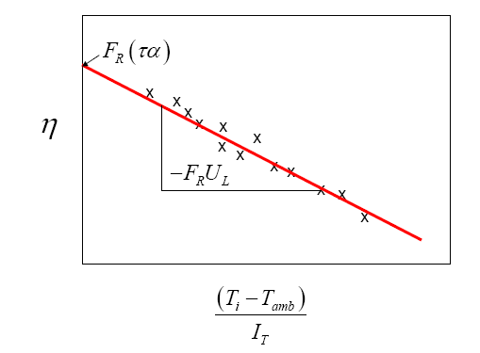
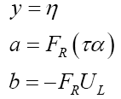
Collector Efficiency
The instantaneous efficiency of the collector can be expressed as:
3.31
Where
Note that, if F_{R}U_{L} is constant, eqn 3.31 is the equation of a straight line Y=a + b X, with

Slide 50
Experimental testing of Flat Plate Collectors
The performance of solar thermal systems for heating and cooling depends largely on the performance of solar collectors. Therefore, experimental measurement of thermal performance of solar collectors by standard methods is important and necessary.
The experimentally determined performance data is needed for design purposes and for determining the commercial value of the collectors.
The thermal performance of a solar collector is determined by establishing an efficiency curve from the measured instantaneous efficiencies for a combination of values of incident radiation, ambient temperature and inlet fluid temperature.

Slide 51


An instantaneous efficiency of collector under steady state conditions can be established by measuring the mass flow rate of the heat transfer fluid, its temperature rise across the collector (T_{f,out} – T_{f,in}) and the incident solar radiation intensity (I_{c}) as :
(1)
The efficiency, _{c ,} of a collector under steady state can also be written according to the Hottel-Whillier-Bliss equation as:
(2)

Slide 52

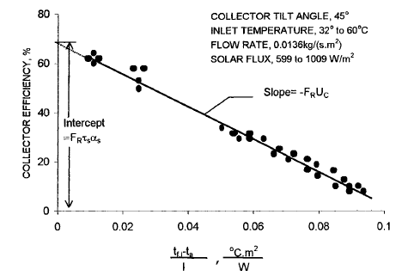
Fig. Thermal efficiency curve for a double-glazed flat-plate liquid type solar collector

Slide 53
Testing Standards for solar thermal collectors
Standard testing procedures adopted by regulating agencies in various countries establish ways of comparing the thermal performance of various collectors under the same conditions.
The thermal performance standards established by the American Society of Heating, Refrigeration and Air-Conditioning Engineers have been accepted for thermal performance testing of solar thermal collectors.
ASHRAE Standard 93-77 specifies the procedures for determining the time constant, thermal performance and the incidence angle modifier of solar thermal collector using a liquid or air as working fluid.

Slide 54
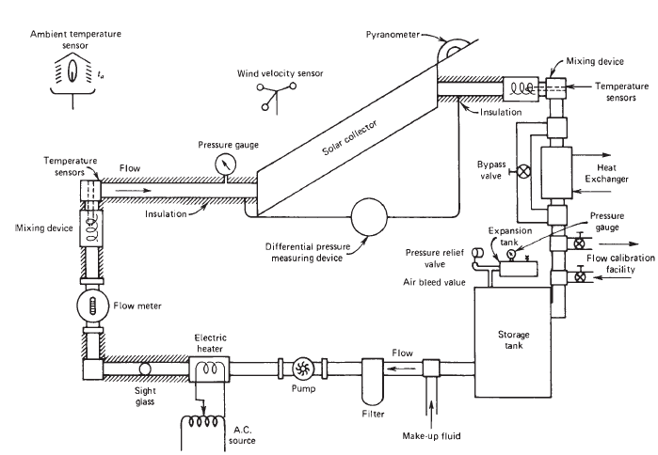
Fig. Closed-loop test setup for liquid heating flat-plate collectors. From ASHRAE Standard 93–2003

Slide 55

Time Constant
In order to avoid the transient effects, performance of a collector is measured and integrated over at least the time constant of the collector.
The time constant is measured by operating the collector under steady or quasi-steady conditions with a solar flux of at least 790W/m² and then abruptly cutting the incident flux to zero, while continuing to measure the fluid inlet (T_{f,i}) and exit (T_{f,e}) temperatures. The fluid inlet temperature is maintained at  1 ºC of the ambient temperature.
The time constant is then determined as the time required to achieve

Slide 56
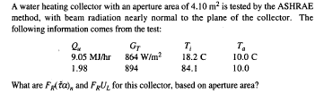
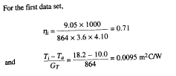


Example

Slide 57
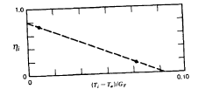

Slide 58
Solar air heating systems
Air has been used as the working fluid in solar-heating systems since world war II. Air systems have several advantages that can lead to their use in small installations in single-and multifamily residences.
In addition, air systems are well suited to crop drying and air preheating in certain processes.
In all air-based solar heating systems a particle-bed storage device is used. Although water offers a higher storage density than most solids, the difficulty of economically exchanging heat from an air stream to a liquid storage fluid stream precludes its use.
The advantages and disadvantages of air and liquid systems are summarized below.

Slide 59
Advantages
  No freezing problem
  No internal corrosion problem with dry air
  No boiling or pressure problems
  Simple and reliable
  No heat exchanger between collector-storage and storage-building loops
  Disadvantages
  because of its poor heat transfer properties, special care is required to improve the heat transfer of air.
  Due to its low density, large volume is needed to be handled
  Since the thermal conductivity of air is low, it cannot be used as storage fluid.
  In the absence of proper design, the cost of air heater can be very high

Slide 60
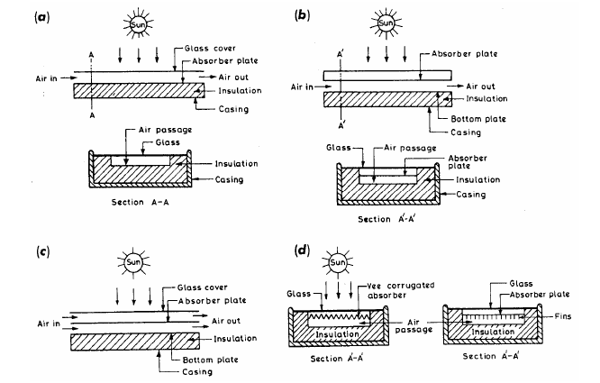
Fig. 4.5 Schematic diagram of air heaters

Slide 61
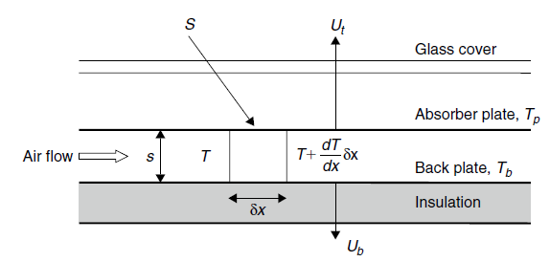
Thermal Analysis of Air Collectors
A schematic diagram of a typical air heating flat plate solar collector is shown in fig. below.
The air passage
is a narrow duct with the surface of the absorber plate serving as the top cover.
Fig. Schematic diagram of an air heating collector

Slide 62


The thermal Analysis presented for flat plate collectors applies equally well here, except for the fin efficiency and the bond conductance.
An energy balance on the absorber plate of area (1 x δx) gives:
Eq. 1
An energy balance on the air stream volume (sx1xδ x) gives
Eq. 2

Slide 63



An energy balance on the back plate area (1xδx) gives
Eq. 3
As U_{b} is much smaller than U_{t}, U_{L} ≈U_{t}. Therefore, neglecting U_{b} and solving for Eq.3 for T_{b} gives
Eq. 4
Substituting Eq. 4 in Eq. 1 gives
Eq. 5
Where
Eq. 6

Slide 64




Substituting Eq. 4 into Eq. 2 gives
Eq. 7
Finally combining Eq. 5 and Eq. 7 gives
Eq. 8
Where F’ = Collector efficiency factor for air collectors, given by
Eq. 9
The initial condition of Eq. 8 are T = Ti at x=0. Therefore the temperature distribution of the air in the duct is given by :
Eq. 10

Slide 65

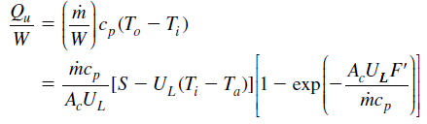

The Temperature of the air at the outlet of the collector is obtained from Eq. 10 , using x = L and considering A_{c} = WL
Eq. 11
The energy gain of the air stream is given by
Eq. 12
Using the equation for the heat removal factor Eq. 12 can be given as:
Eq. 13

Slide 66
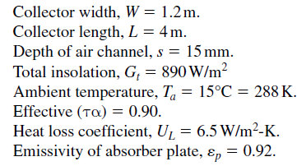

Example
Estimate the outlet air temperature and efficiency of the collector shown in fig below for the following collector specifications.

Slide 67
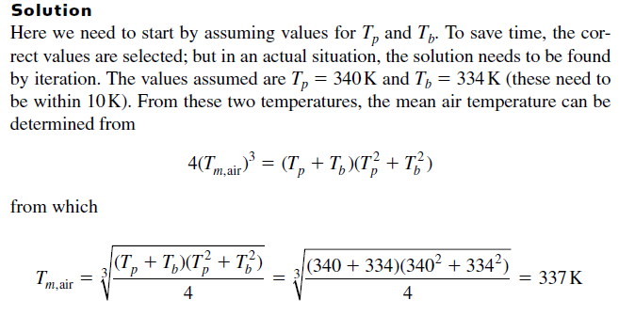
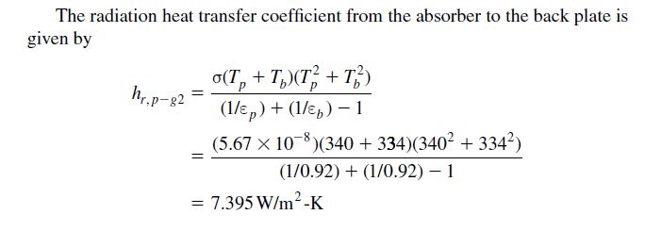

Slide 68
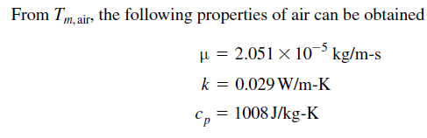
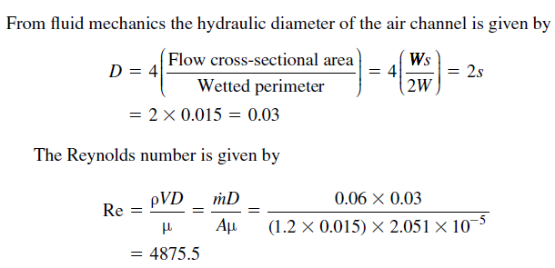

Slide 69
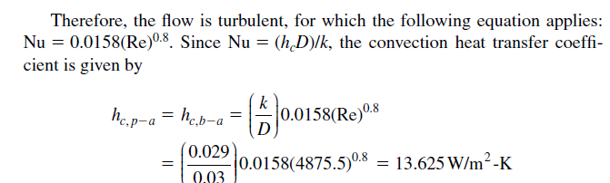

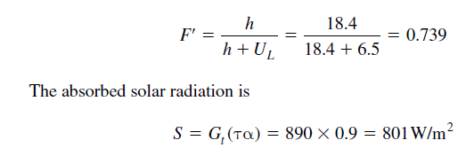

Slide 70
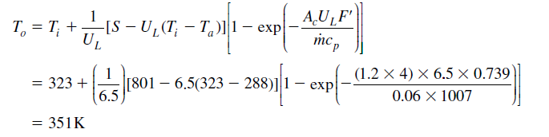
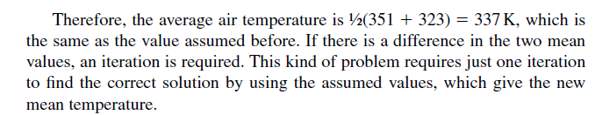

The outlet temperature is
The heat removal factor is

Slide 71


Finally the useful energy gain and collector efficiency are :

Slide 72
Concentrating Solar Collectors
For many applications it is desirable to deliver energy at temperatures higher than those possible with flat-plate collectors. Energy delivery temperatures can be increased by decreasing the area from which heat losses occur.
This is done by interposing an optical device between the source of radiation and the energy absorbing surface.
The small absorber will have smaller heat losses compared to a flat-plate collector at the same absorber temperature.
Many designs have been set forth for concentrating collectors. Concentrators can be:
        reflectors or refractors,
        Cylindrical or surfaces of revolution
        Continuous or segmented

Slide 73







Slide 74

Receivers can be:
        Convex, flat or concave
        Covered or uncovered.
        Many modes of tracking are also possible. Concentration rations can vary over several orders of magnitude.
        With this wide range of designs, it is difficult to develop general analyses applicable to all concentrators.
        Concentration of solar radiation is achieved by reflecting or refracting the flux incident on an aperture area Aa onto a smaller receiver/absorber area Ar.
        An optical concentration ratio, CR_{o},is defined as the ratio of the solar flux I_{r} on the receiver to the flux I_{a} on the aperture.

Slide 75
                A geometric concentration ratio CR is based on the areas, or
Concentrators can have concentration ratios from low values less than unity to high values of the order of 10⁵ . Increasing ratios mean increasing temperatures at which energy can be delivered and increasing requirements for precision in optical quality and positioning of the optical system.
The cost of delivered energy from a concentrator system is a function of the temperature at which it is available. At highest range of concentration and correspondingly highest precision of optics, concentrating collectors are termed solar furnaces which are used to study properties of materials at high temperatures and other high temperatures processes.

Slide 76
Types of concentrators
Solar concentrator technology can be divided into two main types:
Low concentration non-tracking technology, which uses all the radiation that strikes the collector aperture. Such systems have proved to be quite useful for low-temperature-heat production although they are characterized by poor energy throughput.
High concentration solar tracking systems, which use only the direct beam component of radiation. It yields to high-temperature-heat production and has been successfully used for generating electricity.

Slide 77

Parabolic Troughs
This is the most widely deployed type. It usually consists of long and curved mirror surfaced troughs, which concentrate sunlight on a liquid inside a tube that runs parallel to the mirror and situated within the focal line.
The usual operation is one axis solar tracking. A very successful example is the solar power plant (354 MWe) at Kramer Junction, California, USA (see figure below).

Slide 78
Central Receivers
Central Receivers or Power Towers consist of a fixed receiver mounted on a tower, surrounded by a large array of mirrors known as heliostats.
Each heliostat individually tracks the sun and reflects its rays onto the receiver, which then absorbs the heat. Within the receiver, a fluid (usually molten salts) convectively removes the receiver’s heat energy and is then transported from the receiver to drive a turbine generator or is simply kept in storage tanks.
The most successful ‘story’ so far (on solar towers), is Solar Two, developed in the California, USA. This power plant features a design in which a 17-acre field of heliostat mirrors concentrate sunlight on the top of an 80 m tower.

Slide 79

Figure : A picture of Solar Two, the prototype power tower. Some 1,926 heliostat mirrors are used to produce 10 million watts of electricity.

Slide 80

Parabolic Dish Concentrators
As their name suggests, these are parabolic-shaped (ideally) point-focus concentrators that reflect solar energy onto a receiver mounted at the focal point. Parabolic dishes typically use dozens of curved reflective panels made of glass or laminated films.
The concentrated sunlight at the receiver may be utilized directly by a cycle heat engine mounted on the receiver, or simply heats a fluid that is transported for storage.

Slide 81
Terminologies
Collector : applied to the total system including the receiver and concentrator.
Receiver: that element of the system where the radiation absorbed and converted to some other energy form. It includes the absorber, its associated covers, and insulation.
Concentrator: part of collector that directs radiation onto the receiver.
Aperture: part of the concentrator opening through which the solar radiation enters the concentrator.

Slide 82


Consider the circular concentrator with aperture area Aa and receiver area A_{r} viewing the sun of radius r at distance R. The half angle subtended by the sun is s.
Assuming the sun as a black body, the radiation from the sun on the aperture

Slide 83





Slide 84

The higher the temperature at which energy is to be delivered the higher must be the concentration ratio and the more precise must be the optics of both the concentrator and the orientation system.
The figure below shows practical ranges of the concentration ratios and types of optical systems needed to deliver energy at various temperatures.
The “lower limit” curve represents concentration ratios at which the thermal losses will equal the absorbed energy; higher ratios will then result in useful gain. The shaded range corresponds to collection efficiencies of 40 to 60% and represents a probable range of operation.

Slide 85

Fig. Relationships between concentration ratio and temperature of receiver operation

Slide 86
Thermal Performance of Concentrating Collectors
Calculation of the performance of concentrating collectors follows the same general outlines as for flat-plate collectors.
The absorbed radiation per unit area of aperture must be estimated from the radiation and the optical characteristics of the concentrator and receiver.
Thermal losses from the receiver must be estimated, usually in terms of a loss coefficient U_{L} which is based on the area of the receiver.
It is difficult to present a single general method of estimating thermal losses for receivers, and ultimately each receiver geometry must be analyzed as a special case. But the nature of the thermal losses are the same as for flat-plat exchangers.

Slide 87



As an example of calculation of thermal loss coefficient U_{L}, consider an uncovered cylindrical absorbing tube that might be used as a receiver with a linear concentrator. Assume that there are no temperature gradients around the receiver tube.
The loss coefficient considering convection and radiation from the surface and conduction through the support structure is
The linearized radiation coefficient can be calculated from
Where is the mean temperature for radiation

Slide 88



Slide 89




For linear concentrators fitted with evacuated cylindrical absorbers

Slide 90





Example

Slide 91





Slide 92




Slide 93


Next consider the factors which account for temperature gradients on the receiver. The development is analogous to that for flat plate collectors.
The overall heat transfer coefficient from (based on the outside tube diameter) from the surroundings to the fluid is

Slide 94







Slide 95


Following similar procedure used to drive useful heat gain for flat plate collector, for concentrating collector the useful heat gain will be

Slide 96

Example

Slide 97


Optical performance of Concentrating collectors
Concentrating collectors have optical properties that vary substantially with the geometry of the device.
The following general concepts can be applied to all concentrators, although the ways in which they are applied vary with configuration.
An equation for S, the absorbed radiation per unit area of unshaded aperture, can be written as
Where : I_{b} is the incident beam radiation measured on the plane of aperture
❒ is the specular reflectance of the surface
is the incidence angle modifier

Slide 98


Intercept factor
The intercept factor is defined as the fraction of the reflected radiation that is incident on the absorbing surface of the receiver. This concept is particularly useful in describing imaging (intermediate concentration) concentrators .
An example of an image formed in the focal plane of a linear concentrator is shown in fig below.
If the receiver extends from A to B the intercept factor will be
Fig. Flux distribution in the focal plane of a concentrator

Slide 99

Ray Tracing Diagrams
Ray tracing diagrams are helpful in understanding the distribution of concentrated flux on the receiver and to design the receiver-absorber configurations.
They are drawn by tracing a beam of parallel rays secularly reflected from the reflector surface. The figure below shows simple examples of ray tracing diagrams for a circular reflector and a parabolic reflector.
Fig. Examples of ray tracing diagrams for parabolic reflector and circular reflector

Slide 100

From the figure it is easy to understand that a receiver for a linear parabolic trough could be designed as a small diameter tube, while a larger area rectangular surface would be required for a linear circular trough.
The figure below demonstrates that the size of the receiver can be reduced, and therefore concentration increased, by using a smaller rim angle.
Fig. Focusing of parallel rays of light using circular mirrors with different rim angles

Slide 101
If a parabolic or circular reflecting concentrator tracks the sun in such a way that the axis of symmetry is always parallel to the solar beam, the reflected flux will be incident on the receiver.
If the tracking is not perfect or if the concentrator is not designed to track, the beam may make an angle with the axis of symmetry. In which case the incident beam will not focus on the receiver unless the receiver design is modified.
Fig. Concentration by a parabolic reflector for beam radiation

Slide 102

Tracking errors will penalize a parabolic concentrator more severely than a circular concentrator. Therefore, a parabolic concentrator requires more accurate sun tracking for best utilization
In order to formulate a ray-tracing procedure suitable for numerical computation, laws of reflection and refraction are used in vector form .
In order to trace a ray we first find the incident point at the reflecting surface , then a unit normal to the surface and finally the reflected ray.

Slide 103
Solar Desalination
Desalination is the process of separating salt from saline water, which is a mixture of pure water and salt, in order to obtain fresh water.
Water salinity due to dissolved salts can be expressed in four classes as; fresh water (<0.05%salinity), brackish water (0.05–3% salinity), saline water (3–5% salinity) and brine (>5% salinity) .
The most important property of the desalinized water and thus the parameter observed through the process is salinity. Salinity can be expressed in particles per million (ppm) or salt mass fraction (mf_{s}). 1000 ppm salinity equals to a salinity of 0.1%, or a salt mass fraction of mf_{s} = 0.001.

Slide 104
Although about two-third of the feed water for desalination process is the sea water, waste water (about 6%), river water (about 8%) and brackish water (about 19%) are also used as desalination water especially at places distant from the sea.
Actually, feed water with low salt concentration is preferable for the stills, where available, since it causes less contamination and scale formation in the system.
Total fresh water consumption in the world can be classified into three categories; about 70% is used for irrigation, 20% is used for industrial purposes, and only 10% of the fresh water is consumed for domestic uses as drinking and cleaning water.
In case of a shortage of fresh water, desalination is a way to produce usable and drinkable fresh water from any source of saline water to meet the demand.

Slide 105
Solar Stills
Solar water desalination is a well-known and proven technique which has been used for a long time at remote areas and places suffering from shortage of potable quality water.
A very fortunate aspect of the solar water distillation technique is that when fresh water demand is at its peak, solar insolation is also high (especially hot seasons).
Solar stills can be used to produce fresh water from salt water in a very cheap, simple and easy way. They are preferred for small-scale fresh water needs of people in remote places instead of transporting fresh water.

Slide 106

The figure below shows the schematic view of a double-slope symmetrical basin still (also known as, roof type or greenhouse type).
Solar irradiation passes through a cover and falls onto the black bottom surface of the still causing the surface and contained salt or brackish water to warm up.
Heated water evaporates and rises up until it touches to the inner side of the cover where it condenses and forms fresh water drops.
Since the cover of the still is designed with a tilt angle, these drops are moved by gravitational forces towards the distilled water collecting channels.

Slide 107



Slide 108
The weak point of solar stills is the significant amount of heat loses because its large surfaces are in contact with the ground and air.
Solar stills are mainly of two types according to their operation modes and modifications as active or passive solar stills.
Active solar stills typically use a secondary external heat sources such as; collector/concentrator panel, solar pond, hybrid PV/T systems, waste thermal energy from any chemical/industrial plant, etc. If there is no supplementary external heat source, the system is called a passive solar still

Slide 109


Slide 110
Basin type solar stills(most widely used type) have been modified into several types according to their cover designs such as; single slope, double slope, V type and hemispherical as shown in Figure below. Average distillate production rate of a standard single-basin still is between 0.005 and 0.011 m³ m⁻² day⁻¹ depending on the insulation quality

Slide 111

Figure 13.
Common design of solar stills: (a). single-slope basin still, (b). double-slope basin still, (c). V-type solar still, (d). Hemispherical type solar still [41]

Slide 112


Thermal Analysis of Solar Still
The figure below shows the major energy flows in a still while it is operating with corresponding thermal network
N.B:Terms for leakage, edge losses, entering
feedwater, and leaving brine or product are not shown.
Figure. The major energy transport mechanisms in a basin-type still with thermal network

Slide 113
The objective of still design is to maximize Q_{evap}, the transport of absorbed solar radiation to the cover-condenser by water vapor, as this is directly proportional to still productivity.
All other energy transfer from basin to surroundings should be suppressed as far as is possible.
Most energy flows can be evaluated from basic principles, but terms such as leakage and edge losses are difficult to quantify and may be lumped together in a catchall term determined experimentally for a particular still.

Slide 114
The thermal network for a basin-type still is similar in principle to a flat-plate collector, but with three differences.
    Energy transfer from basin to cover occurs by evaporation-condensation in addition to convection and radiation.
    The losses from the back of the still are to the ground. The depth of the water in the still is usually such that its capacitance must be taken into account.
    There is no useful energy gain in the sense of that of a flat-plate collector; still output is measured by the evaporation-condensation transfer from basin to cover.

Slide 115

An energy balance on the water in the basin (and the basin itself), per unit area of basin, can be written as
where the subscripts, e, r, c, and k represent evaporation-condensation, radiation, convection, and conduction, respectively. The subscripts b and g refer to basin and glazing (cover), and τ_{c} is the transmittance of the cover and the water film or droplets on its underside.
The capacitance of the glazing will normally be small compared to that of the water and basin. In most modern still designs the pitch of the covers is small and the cover area is approximately the same as the basin area.

Slide 116


An energy balance on the cover, neglecting its capacitance and solar energy absorbed by it, can be written as
Dunkle (1961) provides convenient ways of estimating the terms for internal heat transfer in the still for use in these equations.
As recommended by Dunkle,the radiation exchange between basin and cover, q_{r,b−g}, is calculated by

Slide 117
The convective heat loss from hot water surface in the still to the glass cover can be calculated from the following expression :
Where h’_{c} is the convective heat transfer coefficient, the value of which depends on many parameters like temperature of water and glass, density, conductivity, specific heat, viscosity, expansion coefficient of fluid, and spacing between water surface and glass cover.
Dunkle suggested an empirical relation for the convective heat transfer coefficient as given below :
where p_{wb} and p_{wg} are the vapor pressures of water in millimeters of mercury of the solution in the basin at T_{b} and of water at the cover temperature T_{g}. Temperatures are indegrees kelvin.

Slide 118

The heat transfer by evaporation-condensation is
Heat loss through the ground and periphery q_{k} is difficult to compute since the soil temperature is unknown. Moreover, the heat conducted in the soil during daytime comes back in the basin during night time.
However, it can be computed from the following simple relation if still has insulation under the basin,
.
where U_{G} is an overall loss coefficient to ground assuming the ground to be at a temperature equal to ambient. This term should be small in a large, well-designed still.

Slide 119

If the basin is very shallow and well insulated, the heat capacity term can be neglected and steady-state solutions found.
However, for practical reasons, most stills will have sufficient depth that the capacitance of the basin should be considered.
If the still is not well insulated, an effective ground capacitance will also have to be considered by writing another differential equation relating energy stored in a layer of ground to heat flows into and out of that layer.
The instantaneous efficiency of a still at any time is defined as the ratio of the heat transfer in the still by evaporation-condensation to the radiation on the still:

Slide 120
Solar Drying
Drying is a process of moisture removal due to simultaneous heat and mass transfer. Agricultural products, especially fruits and vegetables require hot air in the temperature range of 45–60˚C for safe drying. When any agricultural product is drying under controlled condition at specific humidity as well as temperature it gives rapid superior quality of dry product.
Drying involves the application of heat to vaporize moisture and some means of removing water vapor after its separation from the food products. It is thus a combined and simultaneous heat and mass transfer operation for which energy must be supplied.

Slide 121
The removal of moisture prevents the growth and reproduction of microorganisms like bacteria, yeasts and molds causing decay and minimizes many of the moisture-mediated deteriorative reactions.
It observed that reduction in weight and volume, minimizing packing, storage, and transportation costs and enables storability of the product under ambient temperatures.
The purpose of a dryer is to supply more heat to the product than that available naturally under ambient conditions, thus increasing sufficiently the vapour pressure.
The dryer also significantly decreases the relative humidity of the drying air, and by doing so, its moisture-carrying capability increases, thus ensuring sufficiently low equilibrium moisture content.

Slide 122

The material to be dried is placed on a screen (wire mesh) in the drying chamber (cabinet) of the drier. Heated air is passed upward through the bed of material to be dried.

Slide 123
During the evaporation of moisture from the surface of the material to be dried into the air stream, a quantity of heat equal to the latent heat of evaporation plus the sensible heat necessary to bring the water to the temperature of the air is abstracted from the surrounding.
A steady state is observed only when the two types of transport phenomena - the heat flow into the wet surface and the mass flow of water from the surface of the material into the air stream - are in balance.

Slide 124

For Example as shown in the Psychometric chart if ambient air at temperature Ta = 20 ºC and relative humidity φ = 70% is used to remove moisture from a material until an equilibrium of φ = 90% is reached, the temperature of the drying air will reduce to T_{a2} =17.25 ºC and the humidity ratio, ω, would change from 0.0135 kg vapor/kg dry-air to 0.0146 kg vapor/kg dry air, or Δω = 0.0011 kg vapor/kg dry air

Slide 125

If ambient air at temperature Ta = 20 ºC and relative humidity φ = 70% is heated to T_{a1} = 40 ºC, then the relative humidity would reduce to about φ = 22%.
If this heated air is used to remove moisture from a material of φ = 70% until an equilibrium of φ = 90% is reached, the temperature of the drying air will reduce to T_{a2} = 22.5 ºC and the humidity ratio, ω, would change from 0.0135 kg vapor/kg dry-air to 0.0207 kg vapor/kg dry air, or Δω = 0.0072 kg vapor/kg dry air. This means that the capability of the heated air for dehydration is over 6.5 times greater than ambient or unheated air.

Slide 126
Classification of Solar Dryers
Drying equipment may be classified in several ways. The two most useful classifications are based on (1) the method of transferring heat to the wet solids or (2) the handling characteristics and physical properties of the wet material.
The first method of classification reveals differences in dryer design and operation, while the second method is most useful in the selection of a group of dryers for preliminary consideration in a given drying problem.

Slide 127

Figure . Classifications of dryers and drying modes

Slide 128


Slide 129



Slide 130


The Solar Tunnel-Dryer

