Slide 1
Chapter 4
Frame Relay

Slide 2
Introduction
Packet-Switching Networks
Switching Technique
Routing
X.25
Frame Relay Networks
Architecture
User Data Transfer
Call Control

Slide 3
Packet-Switching Networks
Basic technology the same as in the 1970s
One of the few effective technologies for long distance data communications
Frame relay and ATM are variants of packet-switching
Advantages:
flexibility, resource sharing, robust, responsive
Disadvantages:
Time delays in distributed network, overhead penalties
Need for routing and congestion control

Slide 4
Circuit-Switching
Long-haul telecom network designed for voice
Network resources dedicated to one call
Shortcomings when used for data:
Inefficient (high idle time)
Constant data rate

Slide 5
Packet-Switching
Data transmitted in short blocks, or packets
Packet length < 1000 octets
Each packet contains user data plus control info (routing)
Store and forward

Slide 6
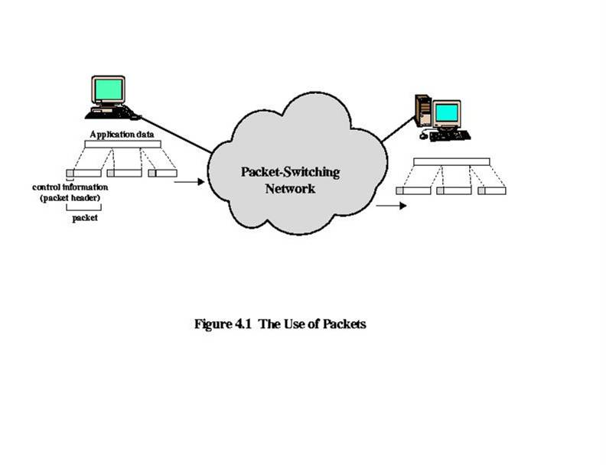
Figure 4.1 The Use of Packets

Slide 7
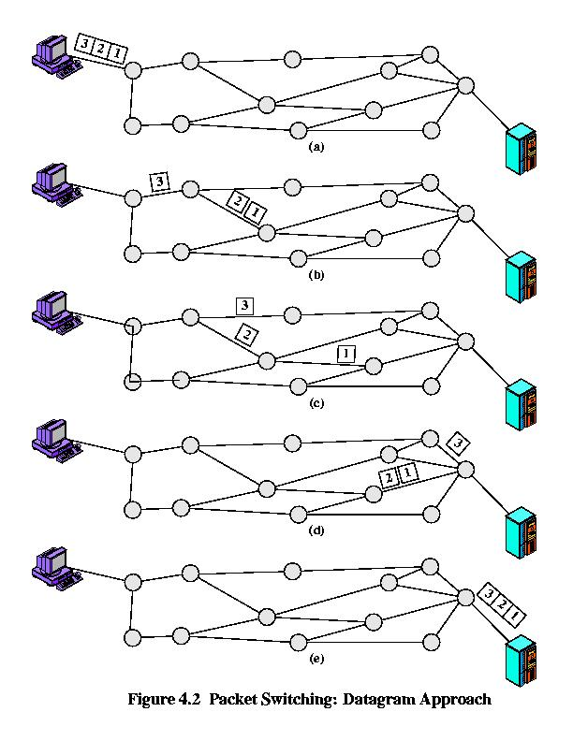
Figure 4.2 Packet Switching: Datagram Approach

Slide 8
Advantages over Circuit-Switching
Greater line efficiency (many packets can go over shared link)
Data rate conversions
Non-blocking under heavy traffic (but increased delays)

Slide 9
Disadvantages relative to Circuit-Switching
Packets incur additional delay with every node they pass through
Jitter: variation in packet delay
Data overhead in every packet for routing information, etc
Processing overhead for every packet at every node traversed

Slide 10
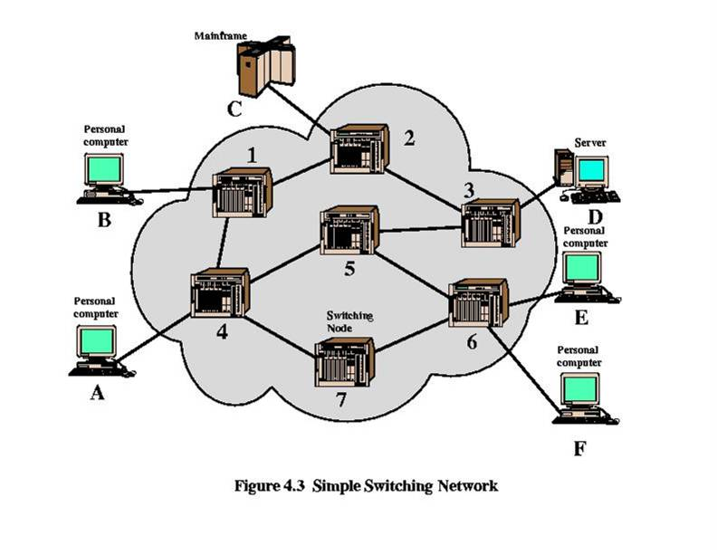
Figure 4.3 Simple Switching Network

Slide 11
Switching Technique
Large messages broken up into smaller packets
Datagram
Each packet sent independently of the others
No call setup
More reliable (can route around failed nodes or congestion)
Virtual circuit
Fixed route established before any packets sent
No need for routing decision for each packet at each node

Slide 12
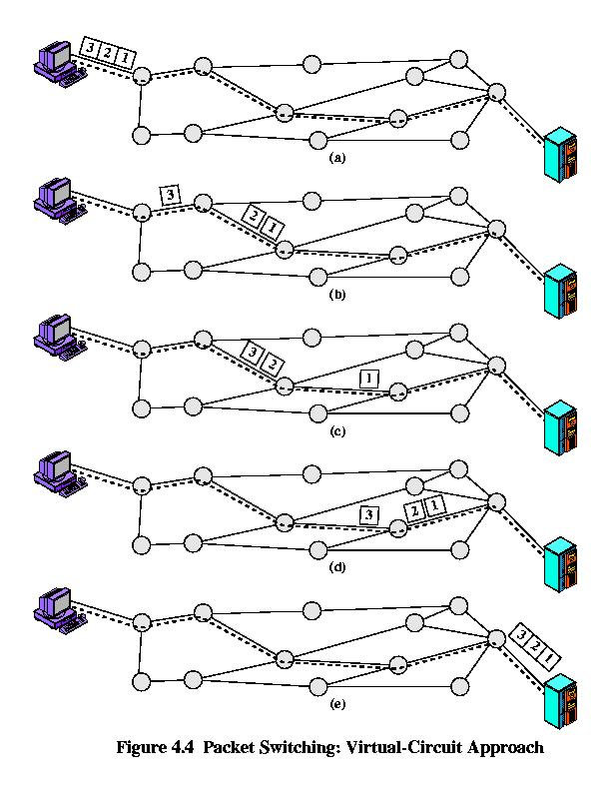
Figure 4.4 Packet Switching: Virtual-Circuit Approach

Slide 13
X.25
3 levels
Physical level (X.21)
Link level (LAPB, a subset of HDLC)
Packet level (provides virtual circuit service)

Slide 14
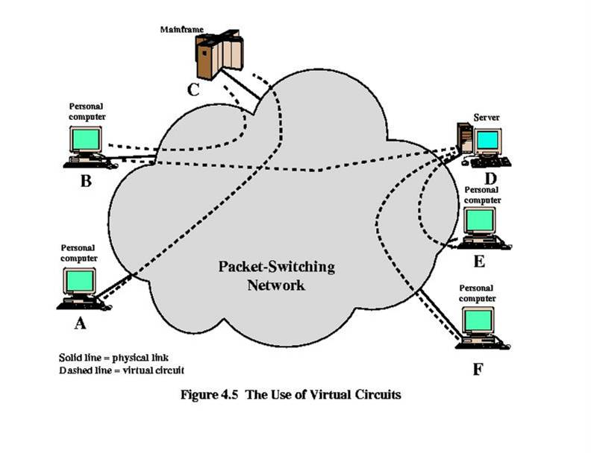
Figure 4.5 The Use of Virtual Circuits

Slide 15
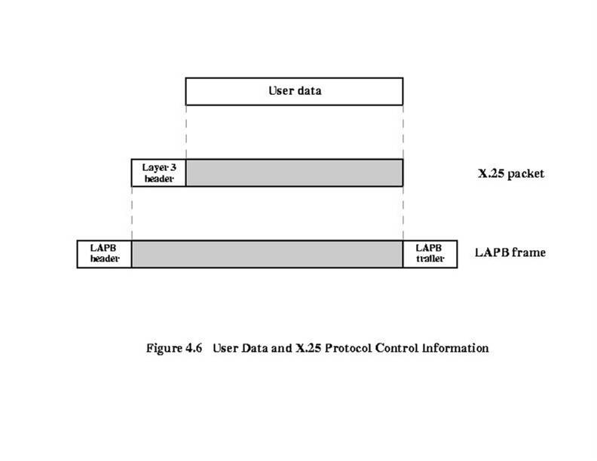
Figure 4.6 User Data and X.25 Protocol Control Information

Slide 16
Frame Relay Networks
Designed to eliminate much of the overhead in X.25
Call control signaling on separate logical connection from user data
Multiplexing/switching of logical connections at layer 2 (not layer 3)
No hop-by-hop flow control and error control
Throughput an order of magnitude higher than X.25

Slide 17
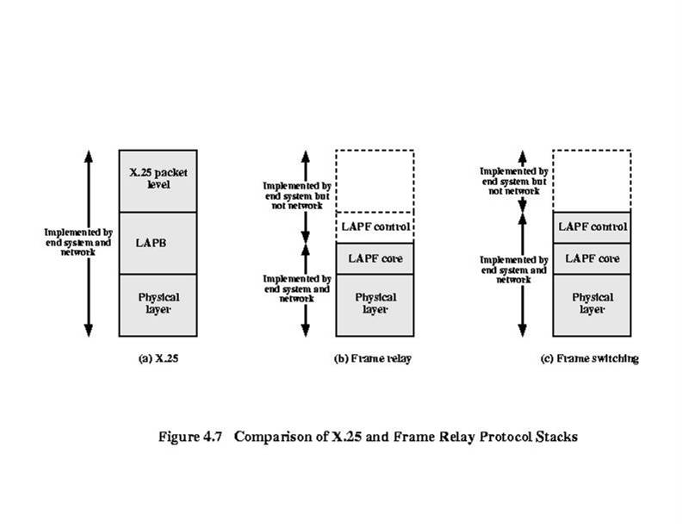
Figure 4.7 Comparison of X.25 and Frame Relay Protocol Stacks

Slide 18
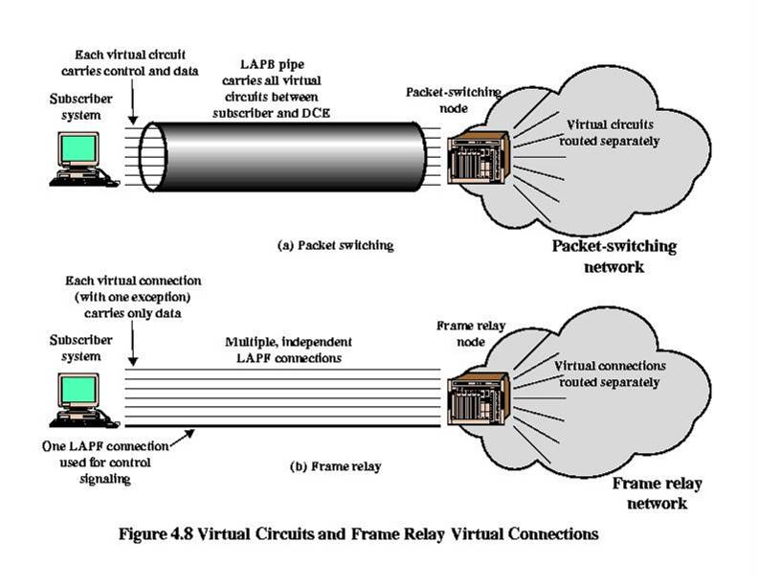
Figure 4.8 Virtual Circuits and Frame Relay Virtual Connections

Slide 19
Frame Relay Architecture
X.25 has 3 layers: physical, link, network
Frame Relay has 2 layers: physical and data link (or LAPF)
LAPF core: minimal data link control
Preservation of order for frames
Small probability of frame loss
LAPF control: additional data link or network layer end-to-end functions

Slide 20
LAPF Core
Frame delimiting, alignment and transparency
Frame multiplexing/demultiplexing
Inspection of frame for length constraints
Detection of transmission errors
Congestion control

Slide 21
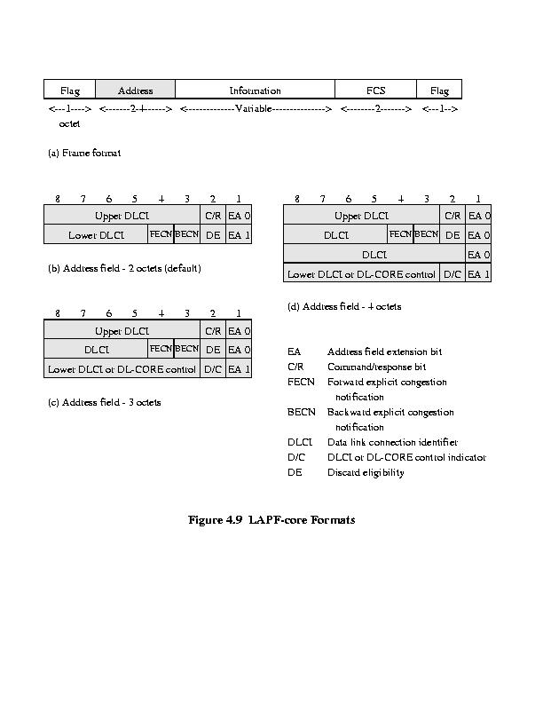
Figure 4.9 LAPF-core Formats

Slide 22
User Data Transfer
No control field, which is normally used for:
Identify frame type (data or control)
Sequence numbers
Implication:
Connection setup/teardown carried on separate channel
Cannot do flow and error control

Slide 23
Frame Relay Call Control
Frame Relay Call Control
Data transfer involves:
Establish logical connection and DLCI
Exchange data frames
Release logical connection

Slide 24
Frame Relay Call Control
4 message types needed
SETUP
CONNECT
RELEASE
RELEASE COMPLETE

