Slide 1
Chapter 5
Asynchronous Transfer Mode
(ATM)

Slide 2
Introduction
ATM Protocol Architecture
Logical connections
ATM Cells
Service categories

Slide 3
ATM Protocol Architecture
Fixed-size packets called cells – simplifies the processing required at each ATM node – high data rate operation of ATM.
Streamlined: minimal error and flow control – this reduces the overhead of processing ATM cells and reduces the number of overhead bits required with each cell, thus enabling ATM to operate at high data rates
2 protocol layers relate to ATM functions:
  Common layer providing packet transfers
  Service dependent ATM adaptation layer (AAL)
AAL maps other protocols to ATM

Slide 4
Protocol Model has 3 planes
The Physical layer involves the specification of a transmission medium and a signal encoding scheme. That data rates specified at the physical layer include 155.2 and 622.08 Mbps. Other data rates, both higher and lower are possible.
User Plane – provides for user information transfer, along with associated controls (e.g., flow control, error control)
Control Plane – performs call control and connection control functions.
Management Plane – includes plane management, which performs management functions related to a system as a whole and provides coordination b/n all the planes, and layer management, which performs management functions relating to resources and parameters residing in its protocol entities.

Slide 5
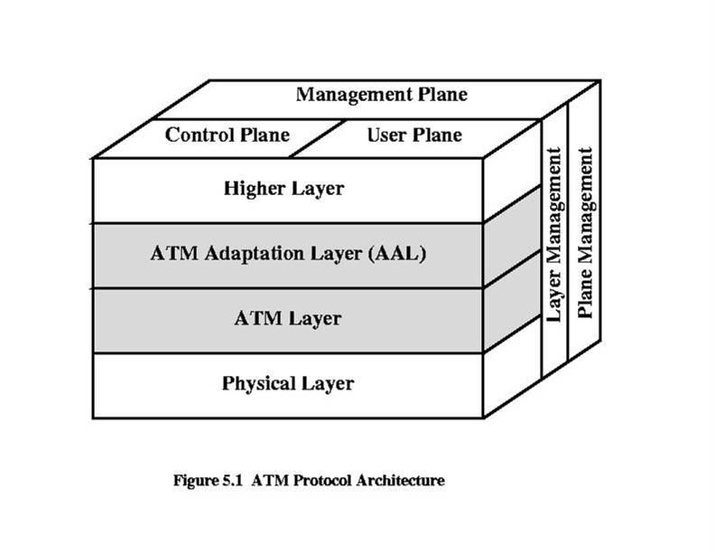
Figure 5.1

Slide 6
Logical Connections
Logical connections are referred to as VCCs)
  VCC (Virtual Channel Connection): a logical connection analogous to virtual circuit in X.25 or data link connection in FR
  Is setup b/n two end users through the ntk and a variable-rate, full-duplex flow of fixed–sized cells are exchanged over the connection.
  VCCs are also used for user-ntk exchange (control-signaling) and ntk-ntk exchange (ntk mgmnt and routing)
VPC (Virtual Path Connection): a bundle of VCCs with same endpoints. This helps contain the control cost by grouping connections sharing common paths through the ntk into a single unit.

Slide 7
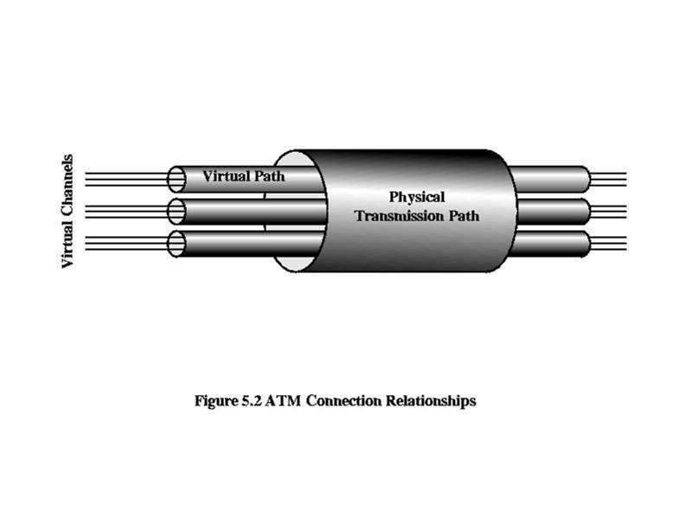
Figure 5.2

Slide 8
Advantages of Virtual Paths
Simplified network architecture – ntk transport functions can be separated into VCCs and VPCs.
Increased network performance and reliability – ntk deals with fewer, aggregated entities.
Reduced processing and short connection setup time – much of the work is done when the VP is set up. A capacity can be reserved on a VPC in anticipation of later calls arrivals
Enhanced network services – user may define closed user groups or closed ntks for VC bundles

Slide 9
VCC Uses
Between end users – to carry end-to-end user data.
Between an end user and a network entity – used for user-to-ntk control signaling.
Between 2 network entities – used for ntk traffic management and routing functions.

Slide 10
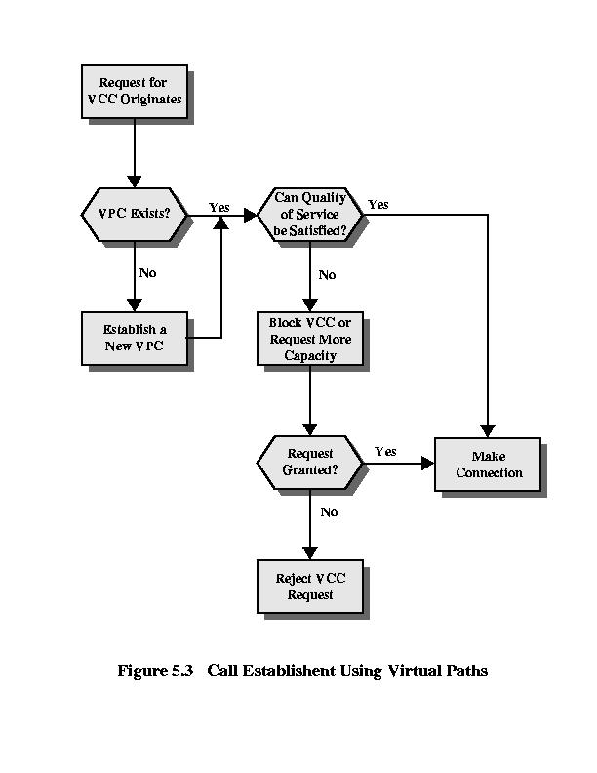
Figure 5.3

Slide 11
VPC/VCC Characteristics – ITU-T recommendation I.150
Quality of Service (QoS) – a user of a VCC is provided with a QoS specified by parameters such as cell loss ratio and cell delay variation.
Switched and semi-permanent virtual channel connections. A switched VCC is an on-demand connection, w/c requires call control signaling for setup and tearing down. A semi-permanent VCC is one that is of long duration and is set up by configuration or network management action.
Cell sequence integrity – the sequence of transmitted cells within a VCC is preserved.
Traffic parameter negotiation and usage monitoring – traffic parameters can be negotiated b/n a user and the network for each VCC. The input of cells to the VCC will be monitored by the ntk to ensure that the negotiated parameters are not violated.
(VPC only) virtual channel identifier restriction within a VPC – one or more VPC identifiers may be reserved for ntk use.

Slide 12
Control Signaling
A mechanism to establish and release VPCs and VCCs and takes place on a separate connections from those that are being managed.
4 methods for VCCs:
  Semi-permanent VCCs – may be used for user-to-user exchange. In this case, no control signaling is required.
  Meta-signaling channel – a permanent low data rate channel dedicated to setup VCCs that can be used for call control.
  User-to-network signaling virtual channel – a metasignaling channel b/n user and network
  User-to-user signaling virtual channel – a metasignaling channel b/n ntk and network

Slide 13
Control Signaling
3 methods for VPCs
  Semi-permanent – A VPC can be established on a semi-permanent basis by prior agreement. In this case, no control signaling is required.
  Customer controlled – in this case, the customer uses a signaling VCC to request the VPC from the network.
  Network controlled – in this case, the ntk establishes a VPC for its own customers. The path may be ntk-to-ntk, user-to-ntk or user-to-user.

Slide 14
ATM Cells
Fixed size
5-octet header
48-octet information field
Small cells reduce delay for high-priority cells
Fixed size facilitate switching in hardware

Slide 15
Header Format
Generic flow control – to control cell flow only at the local user-ntk interface. Used to alleviate short-term overload conditions in the ntk.
Virtual path identifier (VPI)
Virtual channel identifier (VCI)
Payload type
Cell loss priority
Header error control

Slide 16
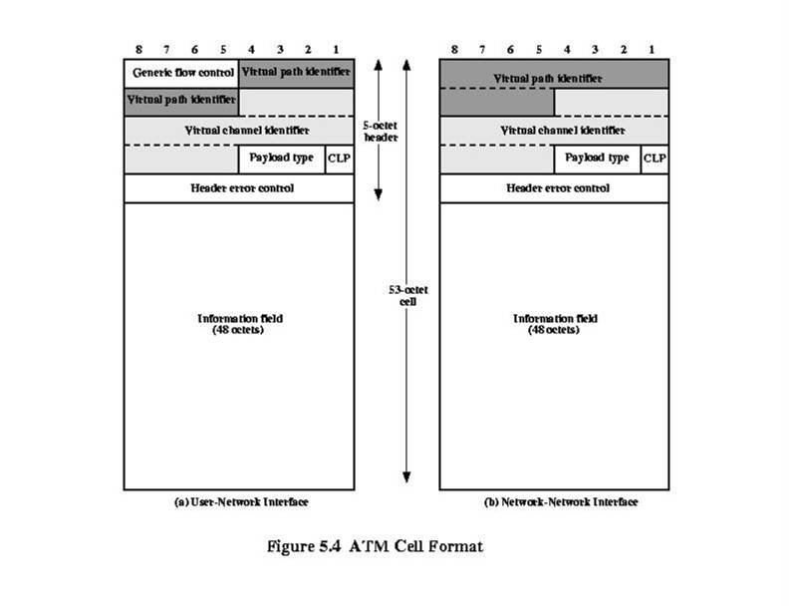
Figure 5.4

Slide 17
Header Error Control
8-bit field calculated based on remaining 32 bits of header. Generating polynomial used is X^8+X^2+X+1.
error detection
in some cases, error correction of single-bit errors in header
2 modes:
  error detection
  Error correction

Slide 18
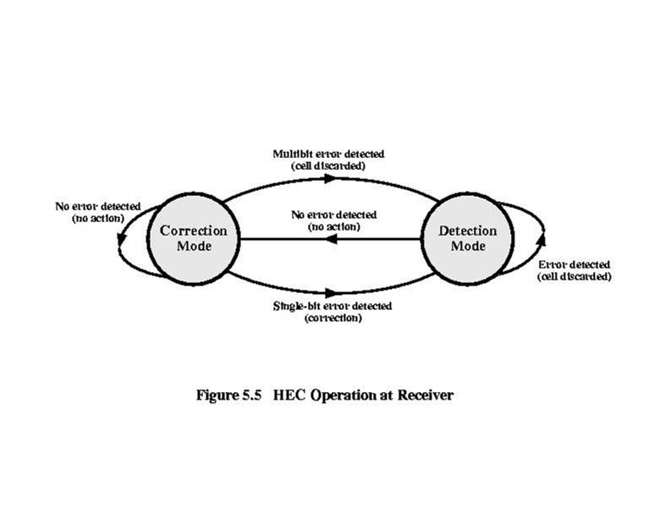
Figure 5.5

Slide 19
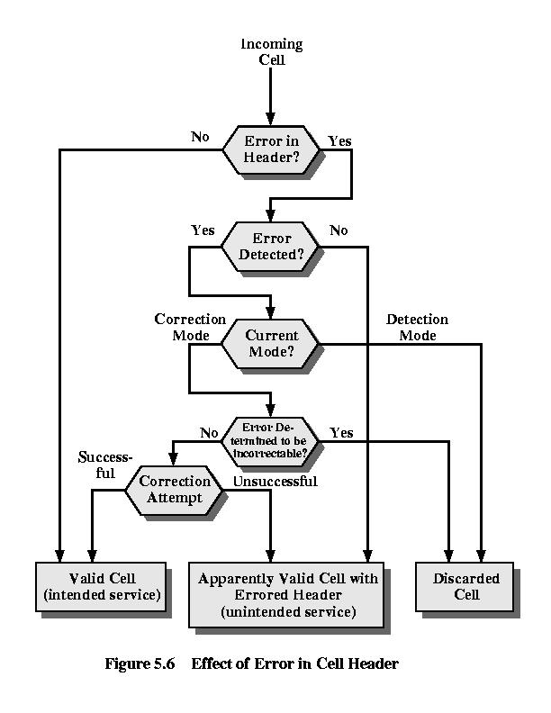
Figure 5.6

Slide 20
Service Categories
An ATM ntk is designed to be able to transfer many types of traffic simultaneously, including real-time flows such as voice, video and bursty TC flows.
Although each such traffic flow is handled as a stream of 53-octet cells traveling through a virtual channel, the way in w/c each data flow is handled with the ntk depends on the characteristics of the traffic flow and the requirements of the application.
For example, real-time video traffic must be delivered within minimum variation in delay.

Slide 21
Service Categories – Cont’d
ATM service categories, w/c are used by an end system to identify the type of service required, have been defined by the ATM forum as follows.
Real-time service – the most important distinction among applications concerns the amount of delay and the variability of delay, referred to as jitter, that the application can tolerate.
  Constant bit rate (CBR) – simplest service to define. Used by apps that require a fixed data rate that is continuously available during the connection lifetime and a relatively tight upper bound on transfer delay. Videoconferencing, interactive audio (e.g. telephony), audio/video distribution (e.g. TV, distance learning), Audio/Video retrieval (video-on-demand, audio library)
  Real-time variable bit rate (rt-VBR) – tightly constrained delay and delay variation. What is their difference with CBR apps?
Notes:
Slides with details for these?

Slide 22
Service Categories – Cont’d
Non-real-time service – intended for apps that have bursty traffic characteristics and do not have tight constraint on delay and jitter.
  Non-real-time variable bit rate (nrt-VBR) – e.g. for data transfers that have critical response time requirements like airline reservation, banking transactions and process monitoring.
  Unspecified bit rate (UBR) – this service is suitable for apps can tolerate delays and some cell losses, w/c is typically true of TCP-based traffic. With UBR, cells are forwarded based on a FIFO basis using the capacity not consumed by other services; both delays and variable loses are possible. Referred to as best-effort service. E.g. include remote terminal (e.g. telecommuting) and text/data/image transfer, messaging and so on.
  Available bit rate (ABR) – from book page 105.
  Guaranteed frame rate (GFR) – designed specifically to support IP backbone sub-networks. From book
The fig. in the next slide suggest how a ntk allocates resources during a steady-state period of time (no additions and deletions for VCs)

Slide 23
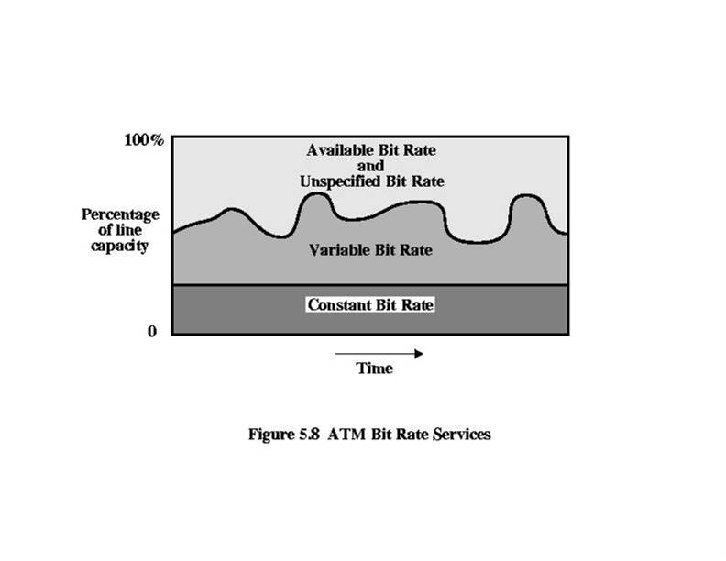
Figure 5.8

