Slide 1
Chapter 6
High-Speed LANs

Slide 2
Introduction
Fast Ethernet and Gigabit Ethernet
High-speed Wireless LANs

Slide 3
Emergence of High-Speed LANs
2 Significant trends
  Computing power of PCs continues to grow rapidly
  Network computing
Examples of requirements
  Centralized server farms
  Power workgroups
  High-speed local backbone

Slide 4
Classical Ethernet
Bus topology LAN
10 Mbps
CSMA/CD medium access control protocol
2 problems:
  A transmission from any station can be received by all stations
  How to regulate transmission

Slide 5
Solution to First Problem
Data transmitted in blocks called frames:
  User data
  Frame header containing unique address of destination station

Slide 6
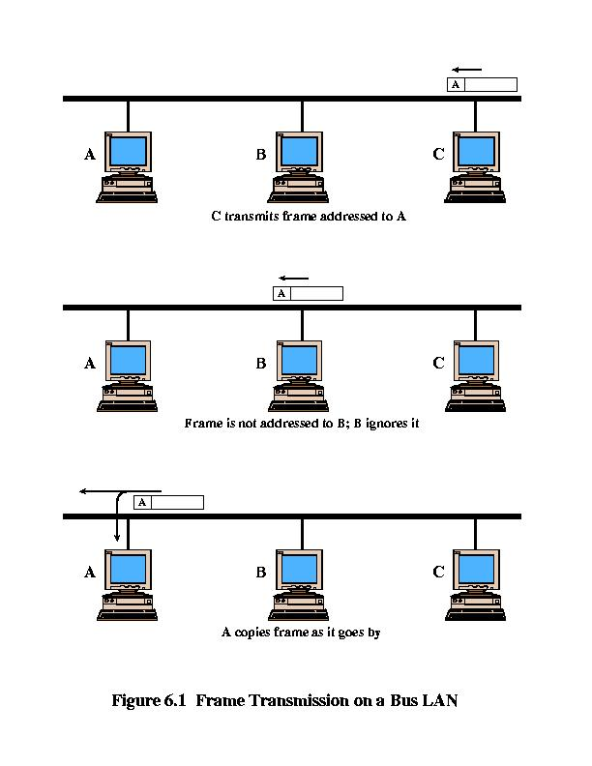
Figure 6.1

Slide 7
CSMA/CD
Carrier Sense Multiple Access/ Carrier Detection
If the medium is idle, transmit.
If the medium is busy, continue to listen until the channel is idle, then transmit immediately.
If a collision is detected during transmission, immediately cease transmitting.
After a collision, wait a random amount of time, then attempt to transmit again (repeat from step 1).

Slide 8
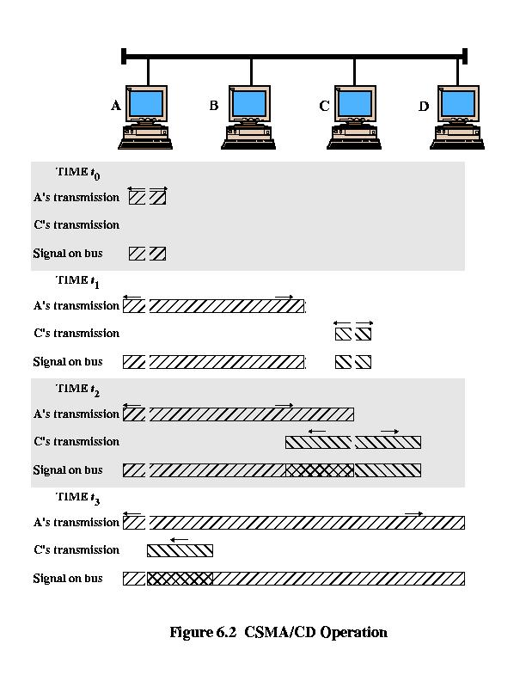
Figure 6.2

Slide 9
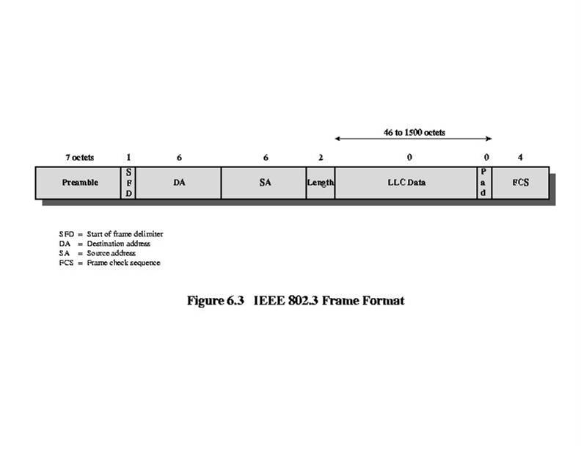
Figure 6.3

Slide 10
Medium Options at 10Mbps
<data rate> <signaling method> <max length>
10Base5
  10 Mbps
  50-ohm coaxial cable bus
  Maximum segment length 500 meters
10Base-T
  Twisted pair, maximum length 100 meters
  Star topology (hub or multipoint repeater at central point)

Slide 11
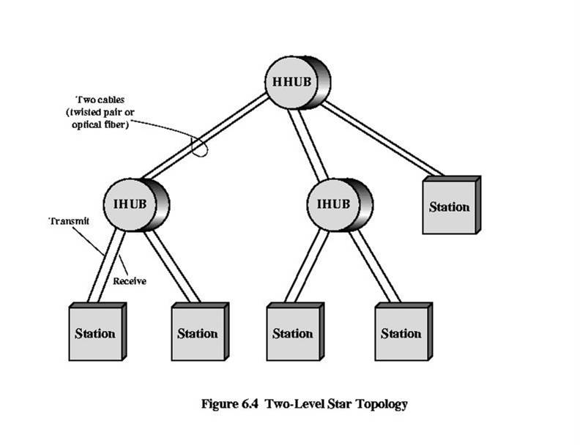
Figure 6.4

Slide 12
Hubs and Switches
Hub
Transmission from a station received by central hub and retransmitted on all outgoing lines
Only one transmission at a time
Layer 2 Switch
Incoming frame switched to one outgoing line
Many transmissions at same time

Slide 13
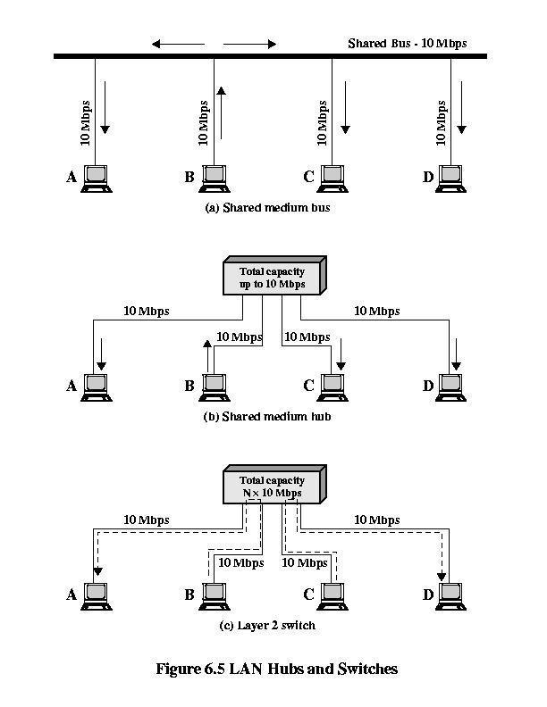
Figure 6.5

Slide 14
Bridge
Frame handling done in software
Analyze and forward one frame at a time
Store-and-forward
Layer 2 Switch
Frame handling done in hardware
Multiple data paths and can handle multiple frames at a time
Can do cut-through

Slide 15
Layer 2 Switches
Flat address space
Broadcast storm
Only one path between any 2 devices
Solution 1: subnetworks connected by routers
Solution 2: layer 3 switching, packet-forwarding logic in hardware

Slide 16
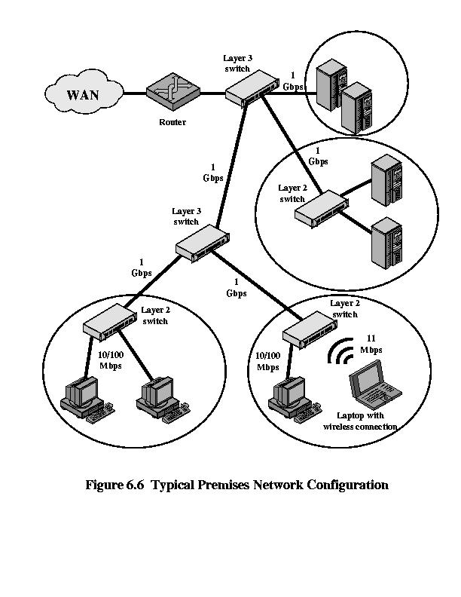
Figure 6.6

Slide 17
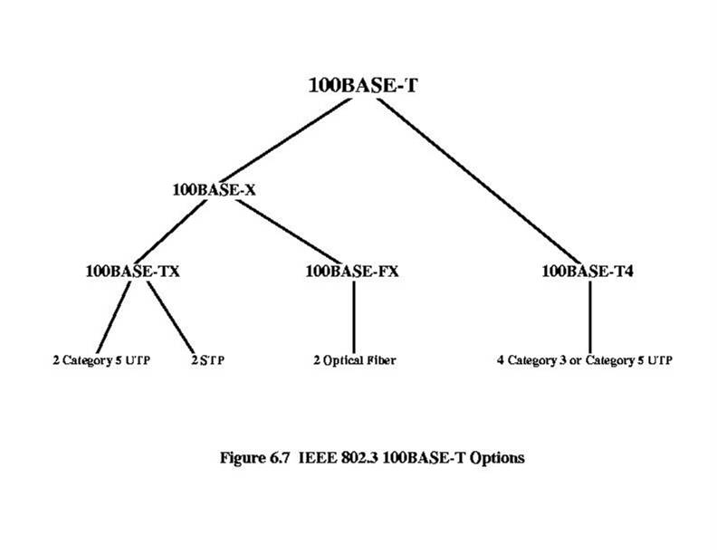
Figure 6.7

Slide 18
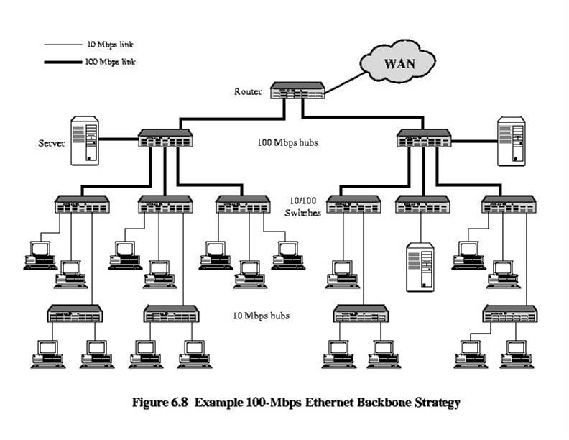
Figure 6.8

Slide 19
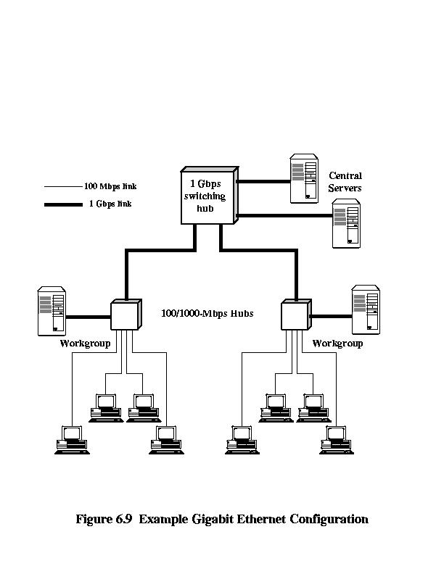
Figure 6.9

Slide 20
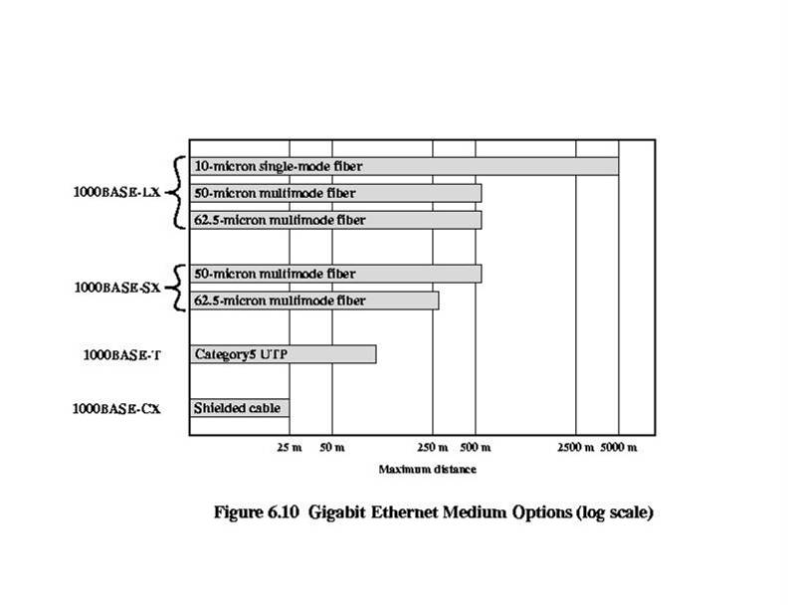
Figure 6.10

Slide 21
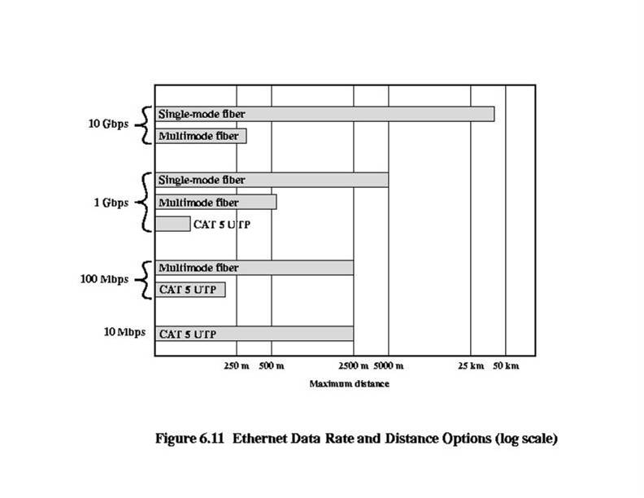
Figure 6.11

Slide 22
Benefits of 10 Gbps Ethernet over ATM
No expensive, bandwidth consuming conversion between Ethernet packets and ATM cells
Network is Ethernet, end to end
IP plus Ethernet offers QoS and traffic policing capabilities approach that of ATM
Wide variety of standard optical interfaces for 10 Gbps Ethernet

Slide 23
Wireless LAN Requirements
Throughput
Number of nodes
Connection to backbone
Service area
Battery power consumption
Transmission robustness and security
Collocated network operation
License-free operation
Handoff/roaming
Dynamic configuration

Slide 24
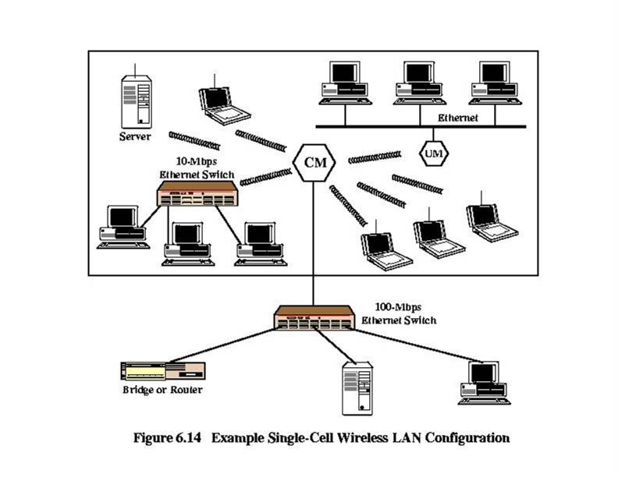
Figure 6.14

Slide 25
IEEE 802.11 Services
Association
Reassociation
Disassociation
Authentication
Privacy

Slide 26
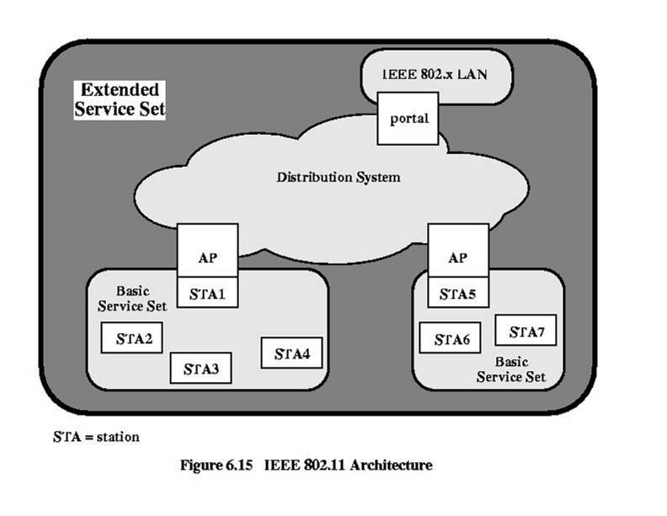
Figure 6.15

Slide 27
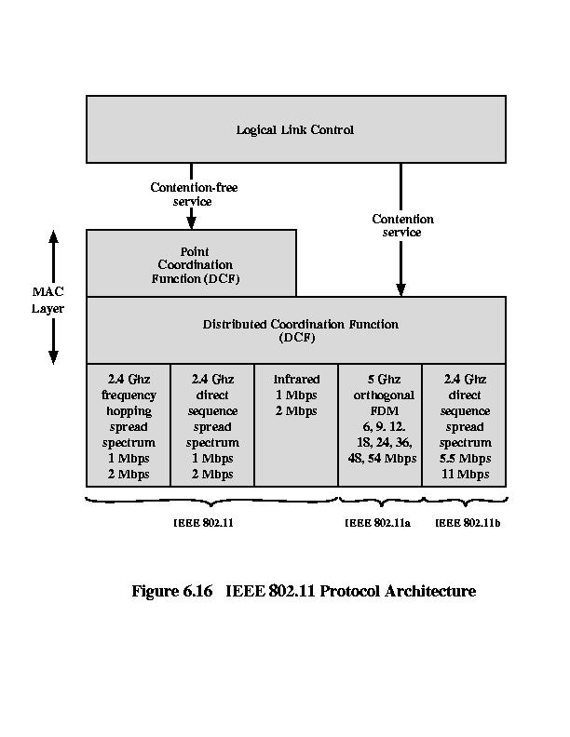
Figure 6.16

Slide 28
Important Assumption
For CSMA/CD protocol to work in a wired LAN, the ff assumption must work.
  Signal from any computer in a ntk must reach all computers in the network. The CD mechanism won’t work without this assumption.
However, in WLAN, the above assumption may not hold. Hence at the MAC level, we do not go for CD
Another consequence of signal not reaching all the computers in a network is that computers in a network may not be able to communicate directly.
For two computers to be able to communicate, service of another computer in the network or a fixed infrastructure, namely, an Access Point (AP), is used.

Slide 29
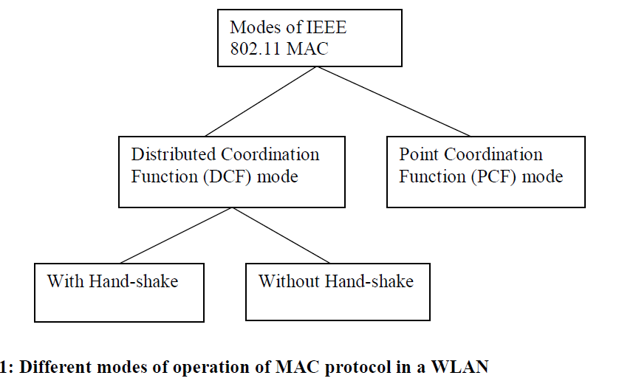
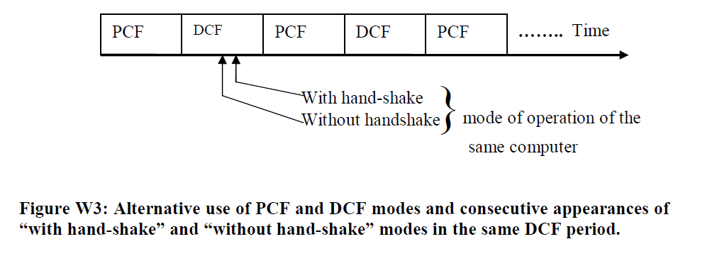
Different modes of operation of IEEE 802.11 MAC protocol

Slide 30
Cont’d
The IEEE 802.11 standard says that implementation of the PCF mode of operation is optional.
The DCF mode of operation is not suitable for real-time traffic. Rather, data delivery is made on a best effort basis—the network makes an effort to deliver data across the wireless medium, but there is no guarantee of bandwidth or bound on delay.
The IEEE 802.11 standard says that implementation of the DCF mode of operation is mandatory, that is, the DCF mode of operation must be supported by a network card claiming to implement IEEE 802.11.

Slide 31
Important Note
The two modes of DCF operation, namely with hand-shake and without handshake, are not mutually exclusive. Rather, both coexist, and the two modes can be selected on a packet basis. For example, the dotRTSThreshold variable in the MAC management database can be used to choose a certain mode of operation. The dotRTSThreshold variable is initialized with an integer value representing a threshold packet length in bytes.
If the length of a data packet is equal to or greater than the dotRTSThreshold value, then the MAC layer chooses the “with hand-shake” mode. On the other hand, if the packet length is smaller than the dotRTSThreshold value, then the “without hand-shake” mode is chosen to transmit the data packet.

Slide 32
Problems in a Wireless LAN
There are three problems in a wireless LAN, which are not found in wired LANs. These problems are as follows:
  Hidden terminal problem
  Exposed terminal problem
  Inability to detect collision.

Slide 33
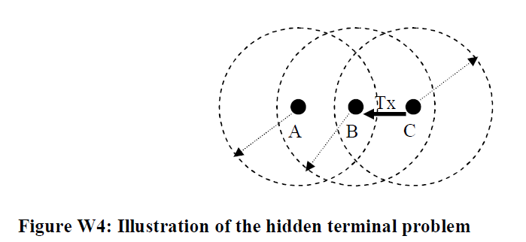
Hidden Terminal Problem

Slide 34
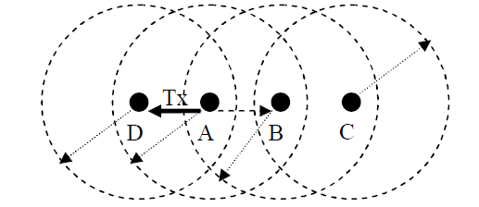

Exposed Terminal Problem

Slide 35
Inability to Detect Collision
Ideally, a sender should detect collision at a receiver, because it is the collision at the receiver that matters.
In a wired LAN, collision is detected at the sender’s end by assuming that signals from all computers can reach all other computers.
However, this assumption does not hold in a wireless LAN as it has been explained in the context of the hidden terminal problem.
Another reason for the difficulty in not being able to detect collision is that many wireless devices use half duplex transceivers to simplify transceiver design. That is, a half-duplex wireless device turns on its transmitter and receiver in an alternating manner.

Slide 36
Transmit condition and virtual carrier sensing
Because of inability to detect collision and sensing media by PHY is not enough to avoid problems like the hidden terminal problem – So we need another sensing mechanism
Before a computer can transmit anything—data or control packets—it is essential to detect idleness of the medium.
In a wired LAN, it was sufficient to detect idleness by sensing the physical medium.
However, in a wireless LAN, because of the hidden terminal problem, it is not enough to sense the medium to know whether or not the medium is idle. In addition to carrier sensing at the PHY level, the WLAN MAC protocol uses the concept of virtual carrier sensing to tackle the hidden terminal problem.

Slide 37
Cont’d
In virtual carrier sensing, a computer monitors the transmission of all control packets that it can receive, utilizes the duration information contained in those packets, and infers whether or not the medium is idle at its intended receiver.
Thus, the medium is said to be idle if the PHY level carrier sensing mechanism detects no carrier and it is inferred from the virtual carrier sensing mechanism that the intended receiver within its radio range is not receiving data.

Slide 38
Cont’d
Virtual carrier sensing is implemented by using two concepts as listed below:
  Control frames (or, packets)
    Request-To-Send (RTS) frame
    Clear-To-Send (CTS) frame
Network Allocation Vector (NAV): This is a scalar, integer variable held by each computer.

Slide 39
Cont’d
Computers update and interpret their NAV variables as follows.
  Each computer has its own NAV with an initial value of 0.
  NAV represents for how long the medium is likely to remain busy.
  The unit of time information in NAV is microseconds.
  NAV is decremented by 1 with the elapse of each microsecond of real time.
  When NAV = 0, it is no more decremented.
  NAV is updated using the duration field in a received control frame as follows:
    NAV = Max(NAV, duration value received in a control frame)
  NAV = 0 means no pre-announced transmission is going on in the vicinity.
  Idle medium is defined as absence of carrier AND NAV = 0.

Slide 40
Timing Relationship between RTS and CTS
The hand-shake mechanism using RTS and CTS control frames has been illustrated in the figure next. In the figure we assume that computer A wants to send a data frame to computer B, C is a computer within the radio range of A, and D is a computer within the radio range of B. We also assume that D is out of range of A, and C is out of range of B.
The four frames, namely RTS, CTS, DATA, and ACK, are separated by a time interval known as Short Inter Frame Space (SIFS).
The idea behind this spacing is to maintain a logical association between these frames. Because of propagation delay and the delay involved in computing a response to a frame, there is a need to have an allowed time gap between logically related frames.

Slide 41
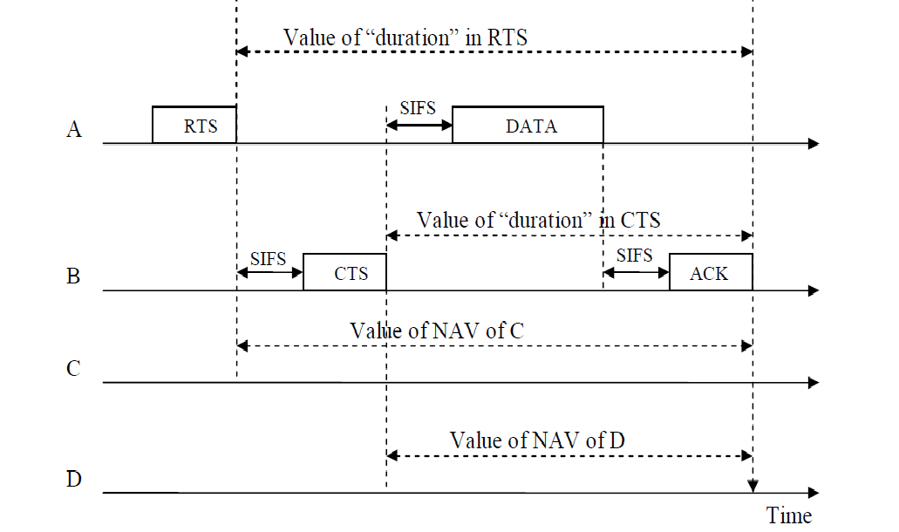
Timing Relationship between RTS and CTS

Slide 42
Why do we need the ACK frame?
There is no ACK frame in Ethernet, or CSMA/CD.
In Ethernet Upper layer protocols deal with lost frames and re-transmit. Why not here in the wireless case?
Consider the BER in wired and wireless media – the prob. Of bit error. Consider also bothering upper layer protocols that have significant delay for retransmission.

Slide 43
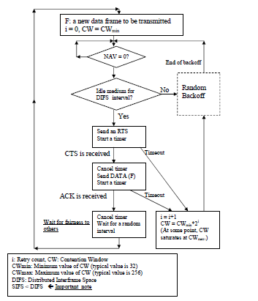
Hand-Shake mode of DCF Operation – Sender’s Behavior

Slide 44
The Random Backoff Protocol
The backoff mechanism in the WLAN protocol works differently from the backoff mechanism in CSMA/CD protocol for Ethernet as follows.
  Choose a random number in the range [0, CW]. A variable, called Backoff Time Counter (BTC) is initialized with the chosen random number. The unit of time represented by the BTC variable is denoted by aSlotTime, where aSlotTime accounts for propagation time and transceiver switching time (switching time between transmitter and receiver and vice versa.)
  BTC is decremented by 1 if the channel is idle for aSlotTime.
  Stop decrementing the BTC if the medium is busy.
  Resume decrementing the BTC after finding the channel to be idle for DIFS interval. Thus, whenever the channel is found to be busy, decrementing of BTC is done after finding the channel to be idle for DIFS interval immediately after the busy period ends. Once the channel is idle for at least DIFS interval, subsequent decrement is done for each idle period of aSlotTime interval
  BTC = 0 means that the backoff process has finished.

Slide 45
Important Note
Note the important relationship between SIFS and DIFS in the form of SIFS < DIFS.
In the DCF mode, a computer senses the medium to be idle for at least a DIFS period.
Thus, even if the computer finds the medium to be idle for SIFS period between frames in the sequence {RTS, CTS, DATA, ACK}, it does not initiate a transmission in order to not disturb an ongoing communication.
Thus, the relationship SIFS < DIFS is very important.
A recommended equality relationship between SIFS and DIFS is: DIFS = SIFS + 2*aSlotTime

Slide 46
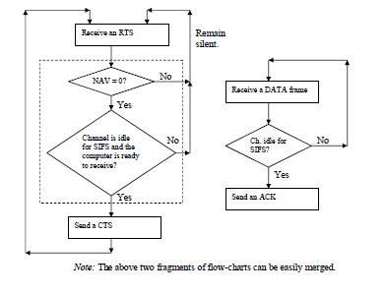
Hand-shake mode of DCF Operation (Receiver’s Behavior

