Slide 1
Chapter 1
Introduction

Slide 2
Introduction
History of control system and adaptive control
Closed loop control system and terminologies
Control system objectives
Adaptive control definition

Slide 3
History of control system and adaptive control
Control system
  Nature has its own control mechanisms
  Man has used various methods to control his environment since the beginning of life on earth
  1769 James Watt’s centrifugal speed governor
  1868-1905 theoretical stability methods developed
  1950 advent of digital computers and their application in control

Slide 4
Control system fundamentals and terminologies
Definition:
A controller is one that modifies the behavior of un unknown plant to modify certain performance requirements
Set point/reference value
  Desired value that the output should have
  Can be constant value or time varying
Controlled variable
  Variable at the output of a system which we want to modify or adjust
Manipulated variable
  Is the variable or input to the plant which is used to modify the behavior of the plant or used to modify the controlled variable

Slide 5
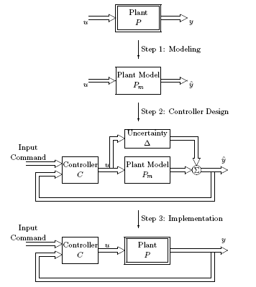
Steps of controller design
Modeling
Design of controller
Implementation

Slide 6
Control system objectives
The objective of any control system is
  To drive the plant or system outputs to wards a desired value which is usually given as reference input
  To achieve a given performance criteria
    MSE
    SSE
    ISE

Slide 7

Adaptive control
Definition
  A controller which redesign it self sensing the changes in the operating condition of the plant that it controls.
Example: earliest application of adaptive control theory is for autopilot system
  Let the dynamics of an aircraft at a given altitude, speed and other dynamics

Slide 8
Adaptive control definition contd…
As the air craft moves, Ai, Bi, Ci and Di are changed
This changes can be sensed from the output of the plant(air craft)
Then the controller parameters can be affected to accommodate the changes

Slide 9
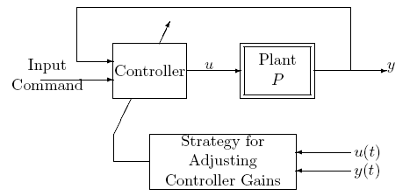
Adaptive controller
An example

Slide 10
Two parts of adaptive control
In any adaptive control
  Control law
  Adaptive law
Control law – is the main controller which generates the control signal
Adaptive law- is the way the parameters of the controller are adjusted

