Slide 1
Chapter 1
Introduction to Nonlinear systems

Slide 2
Contents
Nonlinear system definition
Some important properties of nonlinear systems
  Response to sinusoidal signal
  Equilibrium points
  Limit cycle
  Bifurcation
  Chaos
Types of nonlinearity
Examples of nonlinear systems

Slide 3
Nonlinear system definition and Relevance
Nonlinear system
  System is said to be nonlinear when it is not linear
Linear systems are easy to analyze and have well developed methods
Why study nonlinear system
  All physical systems are nonlinear
  To expand range of operation
  Nonlinearity may be added for some advantage, compensate for other nonlinearities

Slide 4
Nonlinear system representation
Nonlinear system representation
  Transfer function based method is not feasible
  State space method is used
Linear system
Nonlinear system
Example:

Slide 5
Some important properties of NLS
Linear system
  If input x is sinusoidal of frequency ω, the output y will be of same frequency with different amplitude and phase
nonlinear system
  Output of the system will have different frequency, multiple of the original input or something completely different from original

Slide 6
Properties Cont…
Equilibrium points
  Multiple equilibrium points
Chaos
  unpredictable time variation
Bifurcation
  The shift in equilibrium point and nature when a parameter changes
Limit cycle
  Sustained oscillation dependent on initial condition

Slide 7


Equilibrium points
Consider a nonlinear state space model given by
A vector xo is called an equilibrium if
This means when a system has an equilibrium point,
  the system moves to the equilibrium point from any initial condition
  The system remains at the equilibrium point if it starts from it
Equilibrium points are solutions of the differential equation
Each solution point determines an equilibrium point

Slide 8

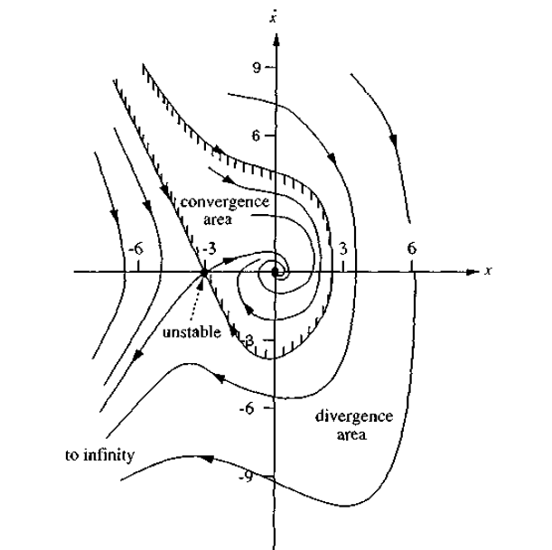
Equilibrium points
Consider the system given by
Determine the equilibrium points

Slide 9
Equilibrium points
Equilibrium points are also known as singular points
  The slope of the phase portrait at the equilibrium points is indeterminate
Stability is completely determined by the nature of the singular points for linear system but for nonlinear system limit cycle should also be considered

Slide 10


Properties of nonlinear systems
Existence of solution
  In linear systems, a solution to the system differential equation always exists and is unique
  However in nonlinear systems, solution may not exist or may not be unique
  To guarantee the existence and uniqueness of solution, conditions must be satisfied
  For a nonlinear system differential given by
  Two conditions for global existence are:
    Where kT and hT are constants

Slide 11


Properties of nonlinear systems
The above condition is called global Lipschitz condition
Example: check if the following nonlinear system satisfies global Lipschitz condition
  A)
  B)

Slide 12
Common Physical Nonlinearity
There are few common types of nonlinearity
  saturation,
  friction,
  backlash,
  dead zone,
  relay,
  multi variable nonlinearity
Saturation nonlinearity
  The Saturation nonlinearity imposes upper and lower bounds on output of a system, when the input signal is out of a given range.

Slide 13
Common Physical Nonlinearity
Saturation nonlinearity
Friction
  There are two types of friction nonlinearity
    coulomb (static) friction
    viscous (dynamic) friction
  Coulomb friction is a nonlinearity which introduces a discontinuity at zero input.
  Viscous friction introduces a drag force proportional to the velocity of the input

Slide 14
Common Physical Nonlinearity
Backlash
  The Backlash nonlinearity is a type where a change in input causes an equal change in output. However, when the input changes direction, an initial change in input has no effect on the output.
  The amount of side-to-side play in the system is referred to as the dead band.
  The dead band is centered about the output
  An Example of backlash nonlinearity is the one which occurs in the meshing of two gears. The input and output are both shafts with a gear on one end, and the output shaft is driven by the input shaft. Extra space between the gear teeth introduces play. The width of this spacing is the Dead band width parameter. If the system is disengaged initially, the output (the position of the driven gear) is defined by the Initial output parameter

Slide 15
Common Physical Nonlinearity
Dead zone
  This is a type of nonlinearity where the output remains zero until the input is greater than a certain amount.
  This is mathematically expressed as
Relay
  this is a nonlinearity where the output remains zero until input is equal to a switch on point and above the switch on point the output becomes a positive constant but when the input decreases the output remains at the positive constant value until the input is below a switch off point which is less than the switch on point.

Slide 16

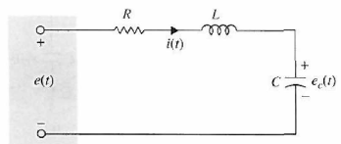


Example: nonlinear RLC
Consider an RLC circuit where capacitor has property that its capacitance varies inversely with voltage
Determine the ss model of the system assuming capacitor voltage as output

Slide 17
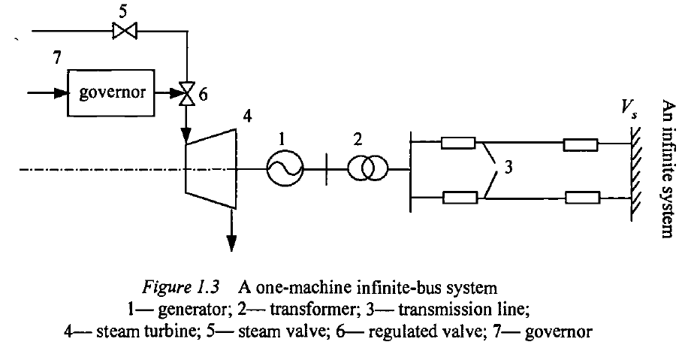
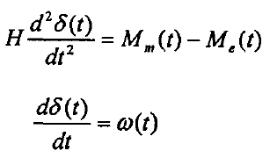

Examples of nonlinear systems
Power system- steam turbine connected to infinite bus
From Newton’s second law
Taking electrical torque

Slide 18


Examples
Steam generator connected to infinite bus
Where

Slide 19
Exercise
Study the three examples given in Slotin in terms of the nonlinear system property
Study the system dynamics of any of the following nonlinear systems
  Magnetic levitation system
  3DOF robot manipulator
  Space craft model

