Slide 1
Chapter 1
Digital system representation and analysis

Slide 2
Contents
Sampled data systems
  Need for sampling
  Types of sampled data systems
Digital system representation and analysis
Stability anaslsys in digital systems

Slide 3
Feedback control
Closed loop Control system
  Input to a controlled system/plant is determined as a function of the system/plant output
  Some mechanism to sense the plant output
  Controller to computer the desired input to the system so as to achieve a desired goal
    Disturbance rejection
    Steady state error
    Transient performance
    Sensitivity to parameter variation
  Actuator drives the plant taking input from controller

Slide 4
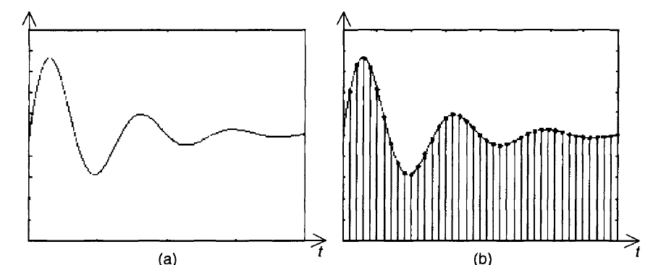
Sampled data systems
Digital control system always involves sampled data systems
Sampling is the process of converting a continuous analog signal to a discrete signal
x(t)
t=KT
x*(t)=x(KT)

Slide 5
Sampled data systems
Sampled signals
  Easier to transmit
  Easily regenerated
  Easy for coding
  Can be easily multiplexed
Sampled control
  Multiple use of expensive equipment
  Usually in controlled system data are available/modified in certain instants only
    Radar control, chemical analysis, SCR
  Naturally discrete
    Stepping motor, encoders

Slide 6
Sampled data systems
Sampler is introduced to improve dynamic behavior of control loop
  Better reliability
  Better sensitivity behavior
  No drift
  Noise reduction
  Less weight
  Less hardware cost
  Less software/ maintenance cost

Slide 7
Sampled data systems
Types of sampling
  PAM
  PWM
  PFM
PAM preserves linearity of system and is used in control
There are three basic types of sampled data systems

Slide 8
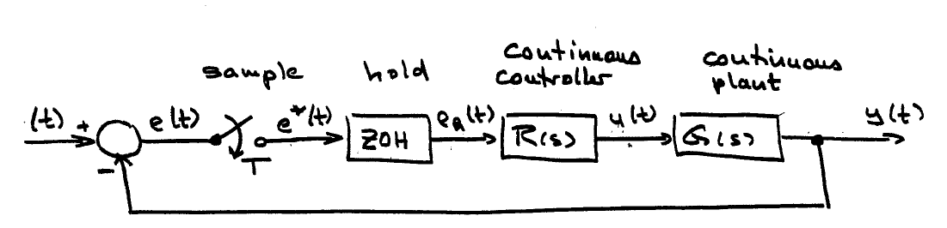
Types of sampled data systems
Sampled data system used with continuous controller and continuous plant

Slide 9
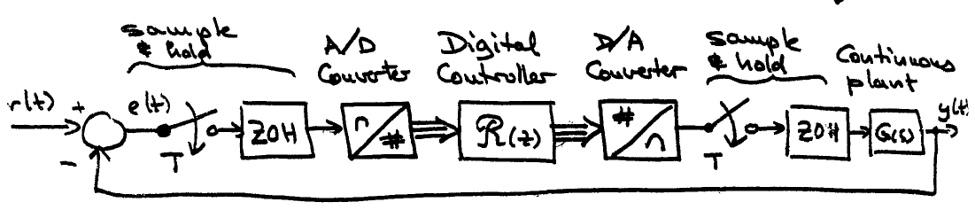
Types of sampled data systems
Sampler used with digital controller but continuous plant

Slide 10
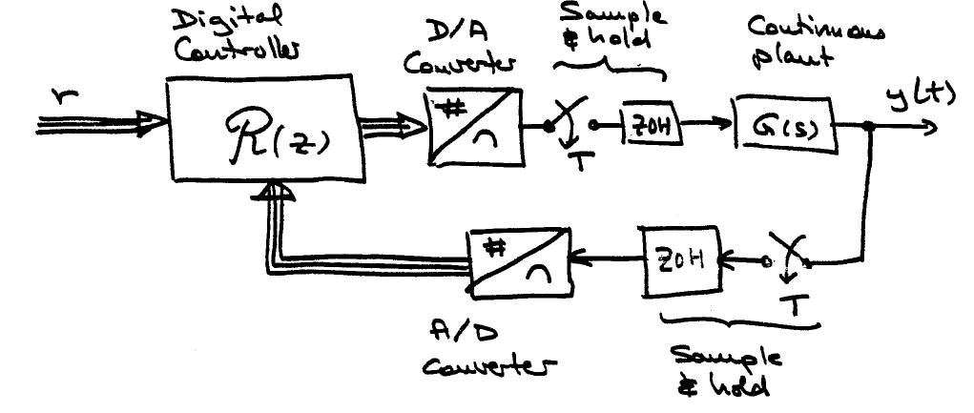
Types of sampled data systems
Sampler used with digital controller and continuous plant

Slide 11
Sampled data systems- Analysis
Ideal sampler- have infinite switching frequency
The output of the ideal sampler x*(t) is a series of impulse signals whose amplitude is equal to the original signal x(t)
X*(t) is then given as
In the Laplace transform,
X(s) X*(s)

Slide 12
Sampled data systems
The Laplace transform of the sampled signal x*(t) is defined as
Example: determine the value of X*(s) for x(t)=u(t) and
It may be difficult to find closed form of X*(s) from the equation given in (1.1)
(1.1)

Slide 13
Sampled data systems
Example: Find X*(s) when X(s) is given by
Another closed form expression for X*(s) is
Properties of X*(s)
  1. X*(s) is period in s with period jws
  2. If X(s) has a pole at s=s1, then X*(s) will have poles at s=s1+jnws

Slide 14
Sampled data systems
The frequency spectrum of x*(t) is obtained by using Fourier transform
X*(jw) is obtained by replacing s=jw in the Laplace transform since x(t)=0 for t<0.
Hence X*(jw) is given by
Effect of sampling on frequency spectrum is to repeat or replicate the frequency spectrum centered at ±kωs with k=1,2,3…

Slide 15


Sampled data systems
The sampling theorem- sampling should be performed at frequency at least twice the maximum frequency of the original signal x(t)
  Where fs is sampling frequency and fmax is maximum frequency of signal
When sampling frequency is less than Nyquest frequency, aliasing occurs.
For reconstruction of sampled data signals, filter is required- low pass filter

Slide 16
Sampled data systems- reconstruction
Data hold
  in all sampled data systems, data hold systems are used
  It approximates an ideal low pass filter
  It converts the sampled signal into a continuous time signal
  There are three types of data hold circuits
    Zero order, first order and second order data hold

Slide 17
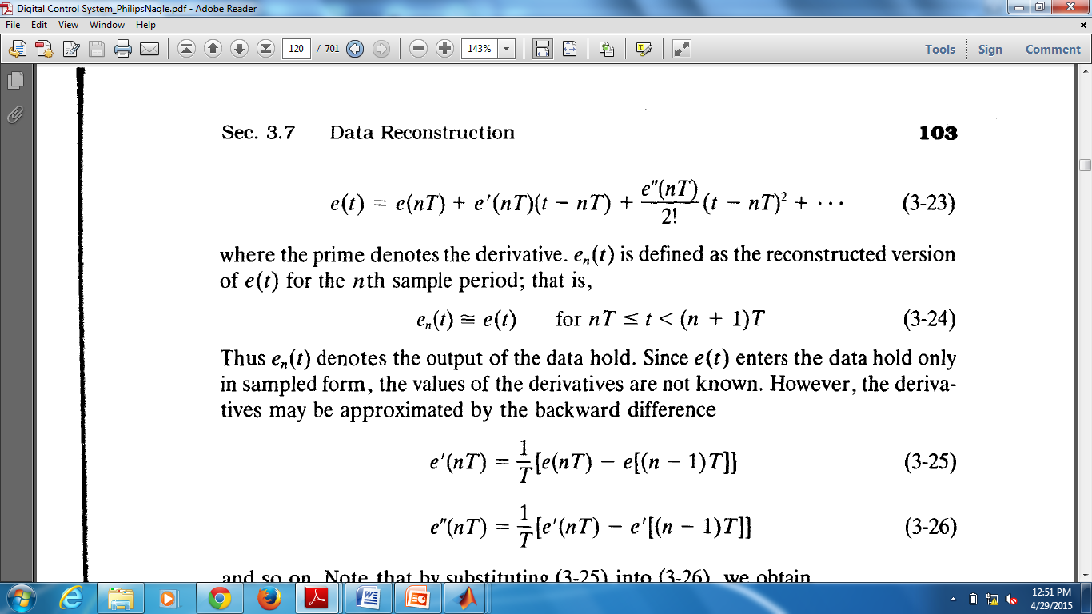
Data reconstruction
If the input of a sampler is given by e(t) and en(t) is used to denote the reconstructed signal, then
  Where e’(nT) is the derivative of e(t) at nT and e’’(nT) is second derivative
Order of the data hold is determined by the number of terms used to approximate en(t)
    First term only –zero order hold
    Two terms only- first order hold
    Three terms only – second order hold

Slide 18
Data reconstruction
Taking numerical approximation of e’(t) and e’’(t)
  Zero order hold is given as
  The transfer function is then
en(t)=e(nT)

Slide 19
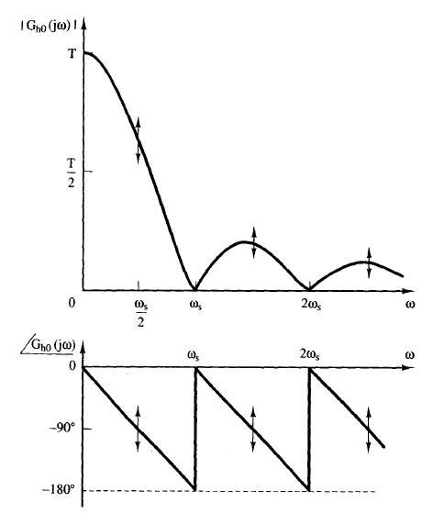
Data reconstruction contd…
In the frequency domain, the ZOH is given as

Slide 20
Data reconstruction contd…
First order hold
  Contains the first two terms of Taylor series expansion of en(t)
  Where the derivative e’(nT) is given by
  Hence the transfer function of FOH is given by
en(t)=e(nT)+e’(nT)(t-nT) nT<t<(n+1)T

Slide 21
Data converters
Data conversion from analog to digital and vice versa is a critical part in digital control
  Analog to digital converter
    Interface sensors to digital controller
  Digital to analog converter
    Interfaces digital controller to actuator/plant
DAC is a practical hold circuit
  Reference voltage( full scale voltage)
  Resolution

Slide 22
Data converters
ADC converts analog signal to digital
  No of bits of the ADC
  Conversion time
  Various types of converters are used
    Select converter based on the cost/conversion time

Slide 23
Exercise
1) If the input of an ideal sampler is e(t)=2cos(ω1t) where ω1 <ωs/2 , draw the Fourier transform of the output E*(jw). Discuss also the effect of varying ω1
2) Draw the frequency response characteristics of a FOH.
3) List at least 3 commercially available ADC and DAC and compare their performances

Slide 24
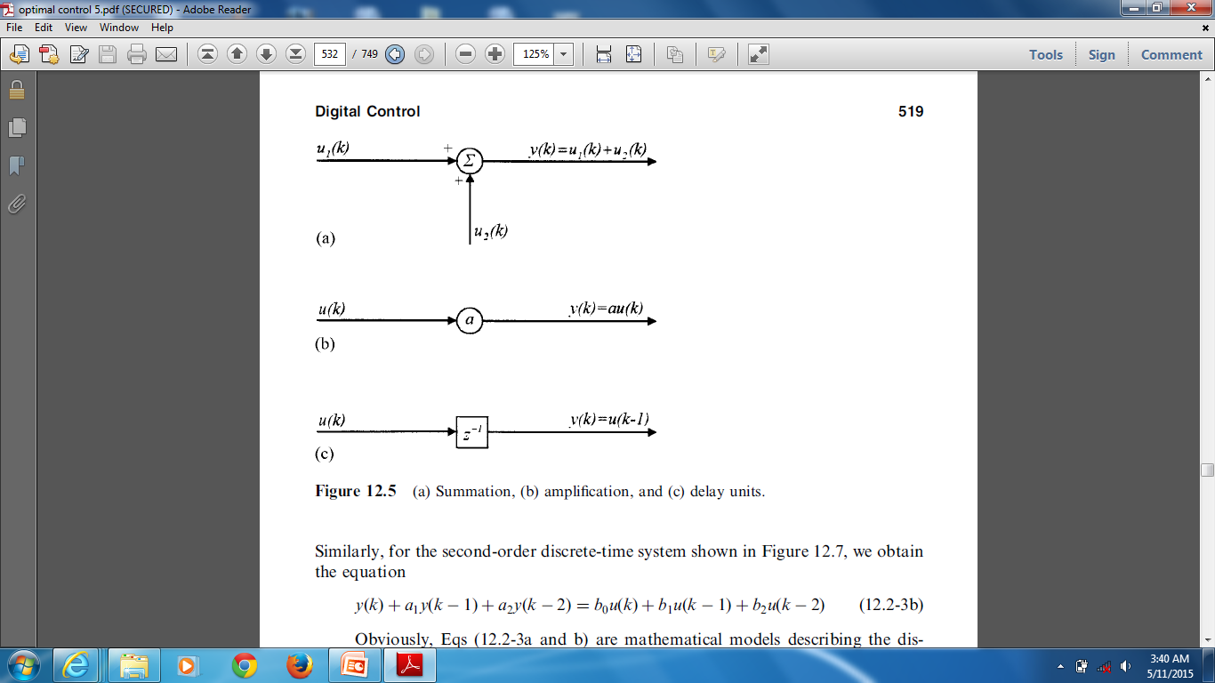
Description of discrete time systems
Linear time invariant causal system involves
  Summation unit
  Delay unit
  Amplification unit
The interconnection of the three elements form discrete time system
  Summation unit

Slide 25
Description of discrete time systems
  Amplification
  delay units
Block diagram description of a first order and second order discrete time systems
  First order system

Slide 26
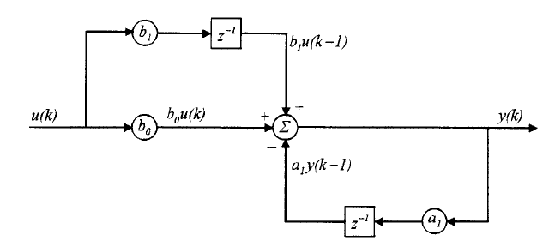
Description of discrete time systems
  Block diagram of first order system
  For second order system

Slide 27
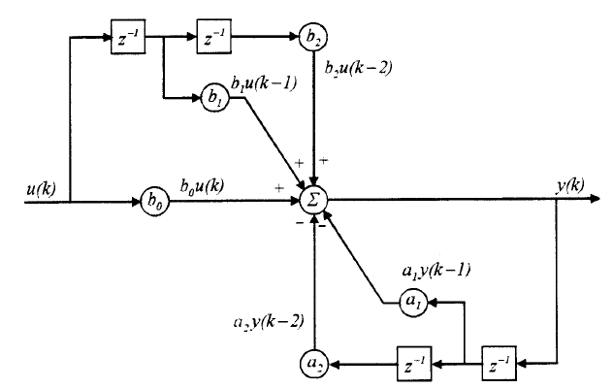
Description of discrete time systems
  Block diagram of second order system
Generally four methods are used
  Difference equation
  Transfer function method
  Impulse response method
  State space method

Slide 28
Description of discrete time systems
1) Difference equation method
  General form is
    The initial conditions y(-1),y(-2) etc should be given
  Difference equation may be obtained from differential equations describing systems or continuous controllers
    Example: digital PI controller
2) Transfer method
  A transform method used for digital systems is Z-transform
  It is a transform for number sequences

Slide 29
Description of discrete time systems
The Z transform is defined as
Example: 1) find E(z) if e(k)=1 for all k
  2) Find the z transform of the signal obtained by sampling the signal
The inverse z-transform is a transform given by

Slide 30
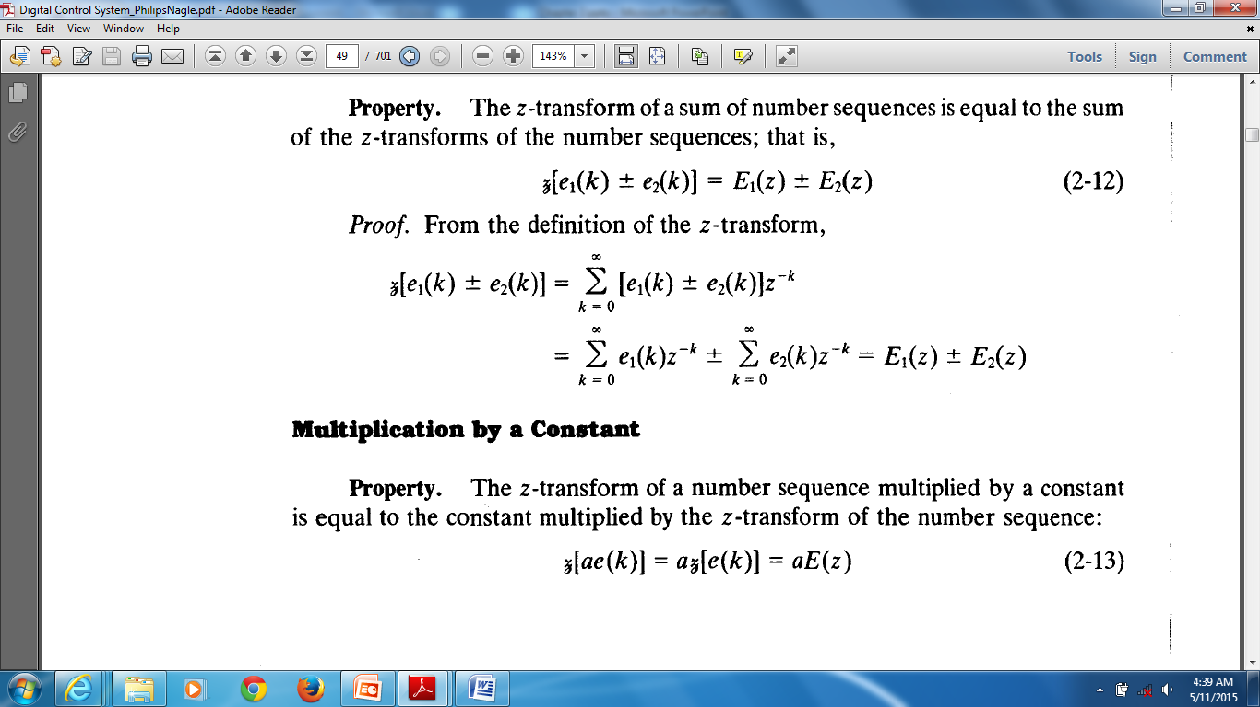
Description of discrete time systems
Properties of z-transform
  Addition and subtraction
  Multiplication by a constant
  Real translation: if E(z) is z transform of e(k)

Slide 31
Description of discrete time systems
Properties of z-transform contd…
  complex translation
    Example: find the z transform of
  Initial value
    Given E(z) as Z transform of e(k) , then
  final value
    Given E(z) as Z transform of e(k) , then

Slide 32
Description of discrete time systems
Properties of Z transform contd
  Example: Apply the final and initial value properties to the Z transform of sample of unit step function and check its values
  Applying initial value property
  Applying final value property

Slide 33
Description of discrete time systems
2. Transform methods
Similar to continuous time systems:
  the transfer function of a discrete time system is given by H(z) which is a ratio of Z-transform of output Y(z) to the Z transform of the input U(z)
Can be written as ratio of two polynomials

Slide 34
Description of discrete time systems
3) Impulse response method
  Consider a unit impulse sequence
  When the input to a discrete system is the unit impulse sequence,
  the output of the system y(k)=h(k), H(z)=ℑ[h(k)] assuming initial condition of system is zero
δ(k)
Discrete time system
y(k)=h(k)

Slide 35
Description of discrete time systems
4. State space method
  State equation is set of first order difference equations
  the state space or state equation of discrete time systems is
  Taking the Z transform of input and output
  The impulse response h(k) is obtained from inverse transform of H(z)

Slide 36
Analysis of discrete time systems
Analysis of discrete time systems is finding the response of discrete time systems
  Can be performed in four different ways
    Difference equation method
    Z transform method
    Impulse response method
    State space methods
Each method has its own advantage and disadvantage
Difference equation method is useful for computer programming

Slide 37
Analysis of discrete time systems
Analysis based on difference equation
  Difference equations can be solved using
    Manual method – to compute output y(k) for each k value manually.
    Computer programs – to write a computer program that can compute y(k) for each k
    Z transform method – convert the difference equation to an algebric equation in z and solve for y(k) in closed form
Example: find y(k) for the sequence

Slide 38
Analysis contd…
Manual method
  y(0)=u(0)-u(-1)-y(-1)=1-0-0=1
  y(1)=u(1)-u(0)-y(1)=0-1-1=-2 and so on
Computer program – write a program using any programming language
Z transform method
  Consider the following difference equation
  Using real translation property,

Slide 39
Analysis contd…
For the example given
Then Y(z) can be solved using transform method

Slide 40
Analysis contd…
Analysis based on transform method
  This is computing the output y(k) from the inverse transform of Y(z)
  There are four methods to solve the inverse z transform
    Power series method – divide num by den
    Partial fraction method- expand E(z)/z
    Use the Inversion formula given by
    Discrete convolution

Slide 41
Analysis contd…
Example: 1) find the value of e(k) when E(z) is given by
  Using power series method
    use long division to obtain e(k) , 0,1,3,7,15…
Example 2: find e(k) when E(z) is given by
  Using partial fraction expansion

Slide 42
Analysis contd…
Exercise : find y(k) when Y(z) is given by
  a)
  b)

Slide 43
Analysis contd…
Using the inversion formula
  When computing y(k) using the inversion formula, the following equivalent formula is used
  Example: find y(k) when Y(z) is given by
  Residue at z=1 is -1 and at z=2 is 2k

Slide 44
Analysis contd…
Exercise: find y(k) when Y(z) is given by
Discrete convolution technique
  Write the output Y(z) as product of two simpler algebraic expressions,
  then find the inverse of Y1(z) and Y2(z)
  Find Y(z) as discrete convolution using

Slide 45
Analysis contd…
Example: compute y(6) using discrete convolution when Y(z) is given by
  Assume that
  y1(k)= 1 for all k and y2(k)=2 power of (k-1)
  Then y(6)=127

Slide 46
Analysis contd…
Analysis using impulse response method
  When the impulse response of a discrete system h(k) is given, the output y(k) can be obtained using
    A) Y(z)=H(z)U(z) and then using the inverse method
    B) y(k)=h(k)*u(k)
Analysis based on state equation- given state space equation of a discrete system

Slide 47
Analysis contd…
Example: find the transition matrix, states and output of a discrete time system when the state equation is given by
  The transition matrix is Φ(k)=ℑ-1[z(zI-A)]-1
  The states x(k) and output y(k) can be computed using formulas given above

Slide 48
State equation method
Derive the state equation and signal flow graph for the system given by
Rewrite the equation in power of z-1,

Slide 49
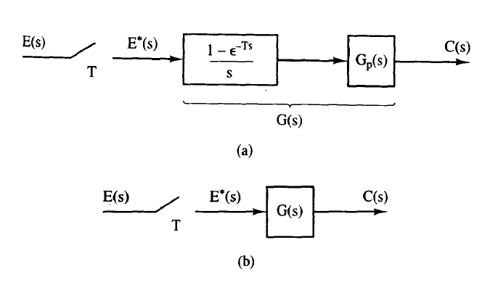
Stability of digital systems
Open loop discrete time systems
  Consider a sampled data systems shown below

Slide 50
Introduction
Open loop discrete time systems
  Using the transform method, C(z)=E(z)G(z)
  Example: In the system shown above, if the plant Gp(s)=1/s(s+1), find C(z) and c(kT)
    Solution:

Slide 51
Introduction
Open loop discrete time systems
  For the system above, the steady state value is 1. This is obtained by using the final value theorem.
  The DC gain is the G(z) as z→1
  When there are cascaded systems, the output of the cascaded system may vary depending on the location of the samplers
  Example: consider the following three sampled data systems, find C(z) for the three cases

Slide 52
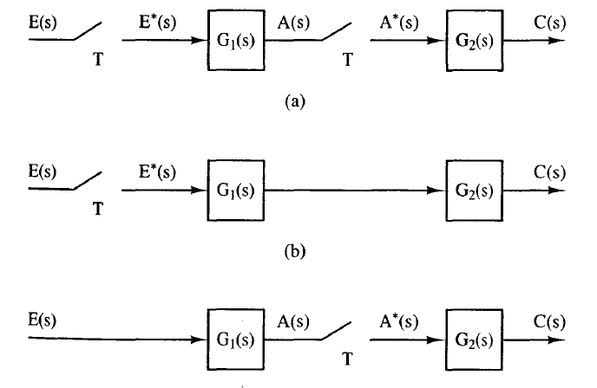
Introduction
Open loop discrete time systems

Slide 53
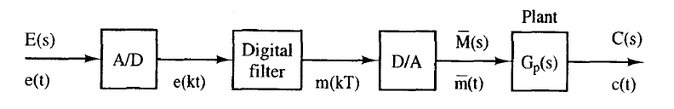
Introduction
Open loop discrete time systems
  When the system has digital filters, the open loop output is obtained by using the Z-transform of the difference equation
  Example: for the system shown below, find the output

Slide 54
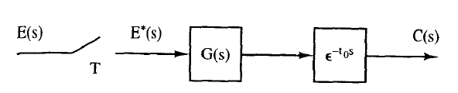
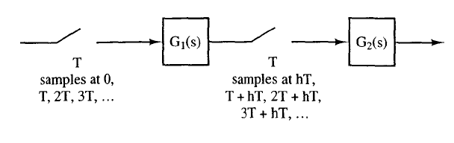
Introduction
Open loop discrete time systems
  Exercise: Determine the expression for the output of the following systems

Slide 55
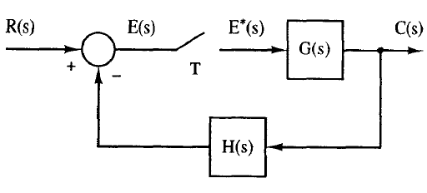
Introduction
Closed loop discrete time systems
  Closed loop discrete systems contain samplers either in the forward or feedback path or in both paths
  The output can be derived by using the methods used for open loop.
  Consider the closed loop system below

Slide 56
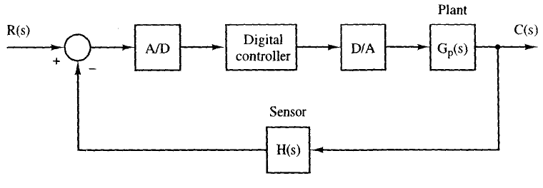
Introduction
Closed loop discrete time systems
  When the closed loop system contains digital filters, the system output is obtained by using the cascade of the digital filter and analog parts
  For example: for the system below, the output is given as

Slide 57
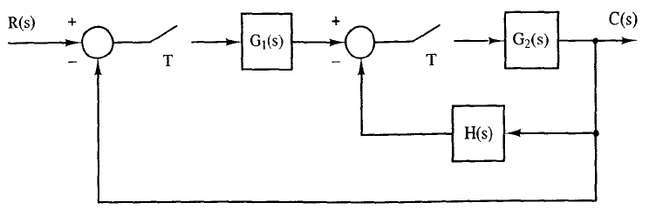
Introduction
Closed loop system
  When the system contains multiple samplers, the closed loop system output is obtained by
    Drawing the signal flow graph of the original system
    Writing equations to each sampler input
    Combining the equations

Slide 58
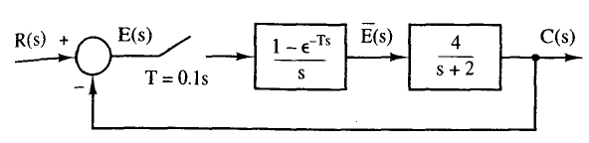
Introduction
System time response for discrete time systems
  Is obtained using the inverse transform method ones the output z transform is obtained
  Example: for the temperature control system shown below, determine the output when the input is unit step

Slide 59
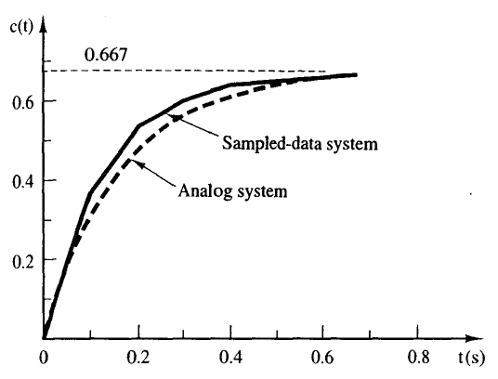
Introduction
System time response
  Using the Z transform of unit step input and
  The closed loop output and its inverse become

Slide 60
Introduction
System time response
  For a general closed loop system with single sampler and single loop, the output is given as
  Then using partial fraction expansion
  Which yields

Slide 61
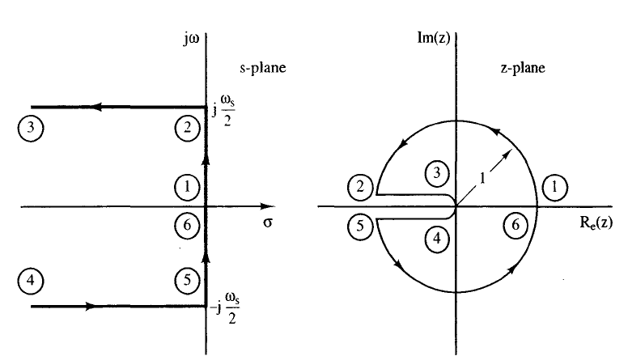
Introduction
System time response
  Mapping of the s-plane in the z-plane,
    the left half of the s-plane maps to a unit circle in the z-plane
    The right half maps to a point out of the unit circle in z plane

Slide 62
Introduction
System time response
  Generally, for a system given by transfer function
  S-plane poles are given by
  Z plane poles are

Slide 63
Introduction
System time response
  If the z-plane complex pole is given as
    The damping ration, natural frequency and time constant can be obtained as

Slide 64
Stability Analysis
Definition
  Consider a nonlinear discrete system given by
  Assume that u(kT)=0 for k>ko and x(kT) is the solution when the initial condition is x(koT) and is the solution when the initial condition is
The solution x(kT) is stable if for some ε>0, there exists δ(ε,ko)>0 such that

Slide 65
Stability Analysis
Asymptotic stability
  The system above is said to be asymptotically stable iff it is stable and
Stability from characteristic equation
  Consider a system whose output after partial fraction expansion is given by
  The system will be stable if all poles are inside the unit circle

Slide 66
Stability
Characteristic equation
  For a system whose output is given by
  The characteristic equation is
  For stability
    Roots of the characteristic equation must lie with in the unit circle
    If any root is on the unit circle, system is marginally stable
    If any root is out side the unit circle, system is unstable

Slide 67
Stability
Characteristic equation
  When the system is described in state space, as
  The system transfer function is given as
  Then the characteristic equation is given by

Slide 68
Bilinear Transformation
Is a transformation which transforms the z-plane to a new plane, w-plane
The transformation is given by
By this transformation, the unit circle in z-plane transforms to the imaginary axis of w-plane

Slide 69
Bilinear transformation
The stable region of the w-plane is the left half plane.
This enables the RH, Bode plot and other frequency domain analysis to be performed on discrete systems
On the unit circle in z-plane,
Hence the frequency in s-plane ω and the frequency in w plane are related by

Slide 70
RH criteria
Is a systematic way of determining the stability of a continuous system without actually solving the characteristic equation
In digital systems, simple RH can not be applied but following method is used
  Convert the z domain transfer function to w plane by using Bilinear transformation
  Determine the characteristics equation
  apply RH as continuous system

Slide 71
Jury’s stability test
Is a similar method to the RH which can be directly applied to characteristic equation in z domain
Consider a characteristic equation given by

Slide 72
Jury’s stability test
The entries in the third row and above are calculated by
The necessary and sufficient condition for stability is then
(1)
(2)

Slide 73
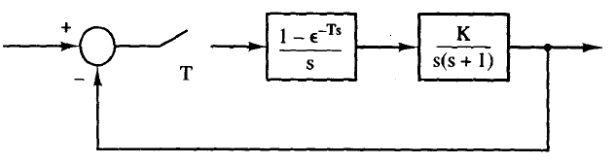
Jury’s stability test
Example: For the system shown below, determine the stability of the system when T=0.1s
The characteristic equation of system is given by where G(z) is again given by

Slide 74
Jury’s stability test
Substituting T=0.1 and solving for G(z)
Hence the characteristic equation is
Jury’s table is
Applying group 1 constraints, for stability K>0 and K<20.3
0.00468K+0.905 | 0.00484z-1.905z | 1

Slide 75
Jury’s stability test
Steps
  From the given system description obtain the characteristic equation
  Apply group 1 constraints, it any one fail, then system is unstable, stop
  If group 1 constraints are valid, start filling Jury’s table and check the condition at each row. If condition fails, system is unstable stop
  If all constraints are fulfilled, then system is stable
Example: for a system having ff characteristic equation, check stability using Jury’s test

Slide 76
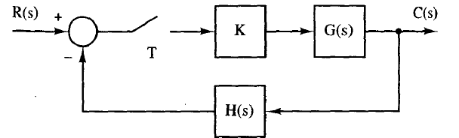
Frequency response techniques
Root locus method- consider a closed loop system shown below.
The characteristic equation of the system is 1+KGH(z)=0
The root locus of this system will be drawn using the standard steps of continuous system

Slide 77
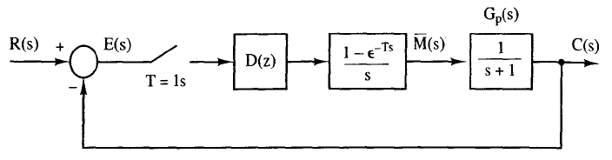
Frequency response techniques
Root locus method
  Example: Draw the root locus of the following system if D(z)=K
  The characteristic equation of the system is
  Where

Slide 78
Frequency response techniques
Example: using Z-transform table and T=1, the final characteristic equation becomes
The root locus becomes

Slide 79
Frequency response techniques
Bode plot- is another frequency response technique
  Graphical method which draws the magnitude and phase of the closed loop response as a function of frequency
  For discrete time systems two methods can be followed
    Form the characteristic equation of the system in z
    Change to w plane and plot bode plot or
    Draw the bode plot in z domain and convert it to s domain using the conversion formula

