Slide 1
Chapter 2
Data Acquisition and Instrument Interface

Slide 2
Contents
Data acquisition
Instrument automation system
Building blocks
Signal analysis
I/O port configuration with instrument bus protocols
ADC/DAC,DIO, counters/times,
PC hardware structure, timing, interrupts, DMA, software and hardware installation,
Programming and simulation of Instrument automation

Slide 3
Data Acquisition System
A data acquisition system consists of many components that are integrated to:
Sense physical variables (use of transducers)
Condition the electrical signal to make it readable by an A/D board
Convert the signal into a digital format acceptable by a computer
Process, analyze, store, and display the acquired data with the help of software

Slide 4
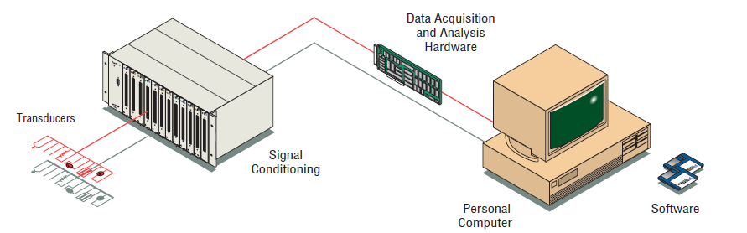
Data acquisition system
Schematic diagram of a typical DAQ system

Slide 5
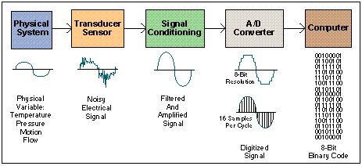
Data Acquisition System Block Diagram

Slide 6
Transducers
Sense physical phenomena and translate it into electric signal.
Temperature
Pressure
Light
Force
Displacement
Level
Electric signals
ON/OFF switch

Slide 7
Transducers and Actuators
A transducer converts temperature, pressure, level, length, position, etc. into voltage, current, frequency, pulses or other signals.
An actuator is a device that activates process control equipment by using pneumatic, hydraulic or electrical power. For example, a valve actuator opens and closes a valve to control fluid rate.

Slide 8
Signal Conditioning
Signal conditioning circuits improve the quality of signals generated by transducers before they are converted into digital signals by the PC's data-acquisition hardware.
Examples of signal conditioning are
signal scaling,
amplification,
linearization,
cold-junction compensation,
filtering, attenuation,
excitation,
common-mode rejection, and so on.

Slide 9
Signal Conditioning
One of the most common signal conditioning functions is amplification.
For maximum resolution, the voltage range of the input signals should be approximately equal to the maximum input range of the A/D converter.
Amplification expands the range of the transducer signals so that they match the input range of the A/D converter.
For example, a x10 amplifier maps transducer signals which range from 0 to 1 V into the range 0 to 10 V before they go into the A/D converter.

Slide 10
Signal Conditioning
Electrical signals are conditioned so they can be used by an analog input board. The following features may be available:
Amplification
Isolation
Filtering
Linearization

Slide 11
Data Acquisition
Data acquisition and control hardware generally performs one or more of the following functions:
analog input,
analog output,
digital input,
digital output and
counter/timer functions.

Slide 12
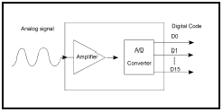
Analog Inputs (A/D)
Analog to digital (A/D) conversion changes analog voltage or current levels into digital information. The conversion is necessary to enable the computer to process or store the signals.

Slide 13
Analog Inputs (A/D)
The most significant criteria when selecting A/D hardware are:
1. Number of input channels
2. Single-ended or differential input signals
3. Sampling rate (in samples per second)
4. Resolution (usually measured in bits of resolution)
5. Input range (specified in full-scale volts)
6. Noise and nonlinearity

Slide 14
Analog to Digital (A/D) Converter
Input signal
Sampling rate
Throughput
Resolution
Range
Gain

Slide 15
A/D Converter: Sampling Rate
Determines how often conversions take place.
The higher the sampling rate, the better.
16 Samples/cycle
Analog
Input
8 Samples/cycle
4 Samples/cycle

Slide 16
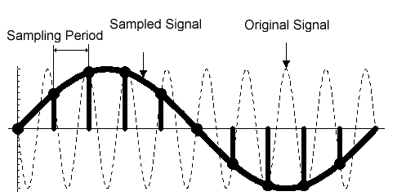
A/D Converter: Sampling Rate
Aliasing.
Acquired signal gets distorted if sampling rate is too small.

Slide 17
A/D Converter: Throughput
Effective rate of each individual channel is inversely proportional to the number of channels sampled.
Example:
100 KHz maximum.
16 channels.
100 KHz/16 = 6.25 KHz per channel.

Slide 18
A/D Converter: Range
Minimum and maximum voltage levels that the A/D converter can quantize
Ranges are selectable (either hardware or software) to accurately measure the signal

Slide 19
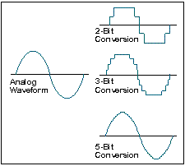
A/D Converter: Resolution

Slide 20
Analog Outputs (D/A)
The opposite of analog to digital conversion is digital to analog (D/A) conversion. This operation converts digital information into analog voltage or current. D/A devices allow the computer to control real-world events.
Analog output signals may directly control process equipment. The process can give feedback in the form of analog input signals. This is referred to as a closed loop control system with PID control.
Analog outputs can also be used to generate waveforms. In this case, the device behaves as a function generator.

Slide 21
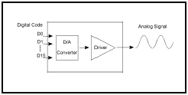
Analog Outputs (D/A)

Slide 22
Data Acquisition Software
It can be the most critical factor in obtaining reliable, high performance operation.
Transforms the PC and DAQ hardware into a complete DAQ, analysis, and display system.
Different alternatives:
Programmable software.
Data acquisition software packages.

Slide 23
Programmable Software
Involves the use of a programming language, such as:
C++, visual C++
BASIC, Visual Basic + Add-on tools (such as VisuaLab with VTX)
Fortran
Pascal
Advantage: flexibility
Disadvantages: complexity and steep learning curve

Slide 24
Data Acquisition Software
Does not require programming.
Enables developers to design the custom instrument best suited to their application.
Examples: TestPoint, SnapMaster, LabView, DADISP, DASYLAB, etc.

Slide 25
Designing a DAS: Factors to Consider
Is it a fixed or a mobile application?
Type of input/output signal: digital or analog?
Frequency of input signal ?
Resolution, range, and gain?
Continuous operation?
Compatibility between hardware and software. Are the drivers available?
Overall price.

Slide 26
SCADA system
Supervisory needs- Control actions need confirmation
Data acquisition +supervisory control=SCADA
Basic elements
Interface in the field
Scan interfaces (real and reactive power, current, voltage, switch and CB position)
Transmission to central station
Processing and display
Determine control actions
Transmitting request for control to the field equipment
Monitoring the completion of control request
Building data base

Slide 27
Anatomy of SCADA
Control center – main computer, router, data historian, HMI and engineering workstation
Collect data, analyze trends and events, generates action
Communication link – any long distance communication system: fiber, cable and RF
Serial communication protocol
Filed sites – RTU or PLC
Local control of actuators

Slide 28
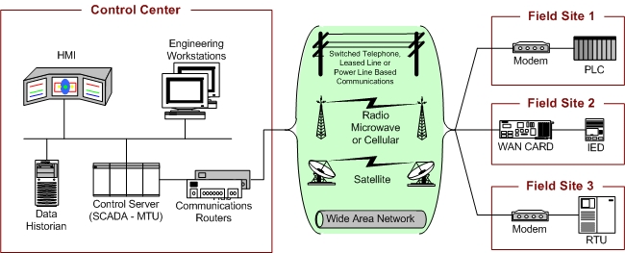
Anatomy of SCADA system

Slide 29
SCADA communication
Point to point- takes many communication channel
Series – good in simplicity but channel sharing has problems
Series star- one channel per device, decreased efficiency and increase system complexity
Multi drop – same as series star

Slide 30
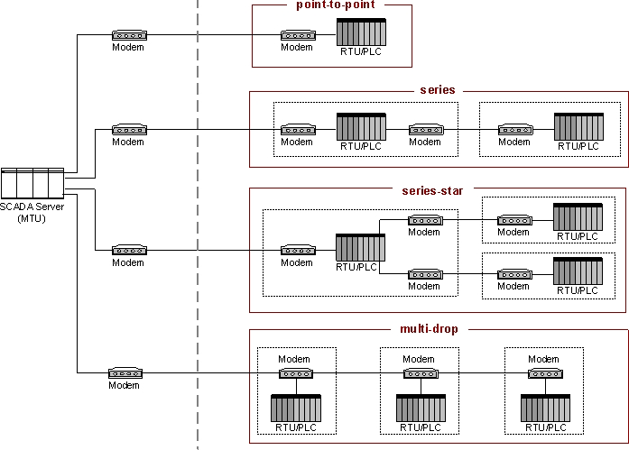
Basic SCADA communication topology

Slide 31
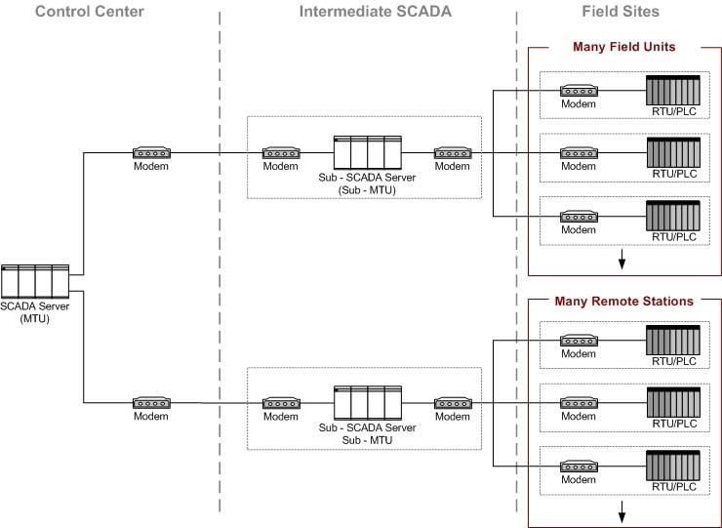
Large SCADA comm. topology

Slide 32
Implementation Examples
A SCADA system with one primary control and three field sites
Control center to field site communication takes place using point to point
Radio telemetry
WAN
Backup control is provided for redundancy
Field sites can be accessed through WAN for maintenance

Slide 33
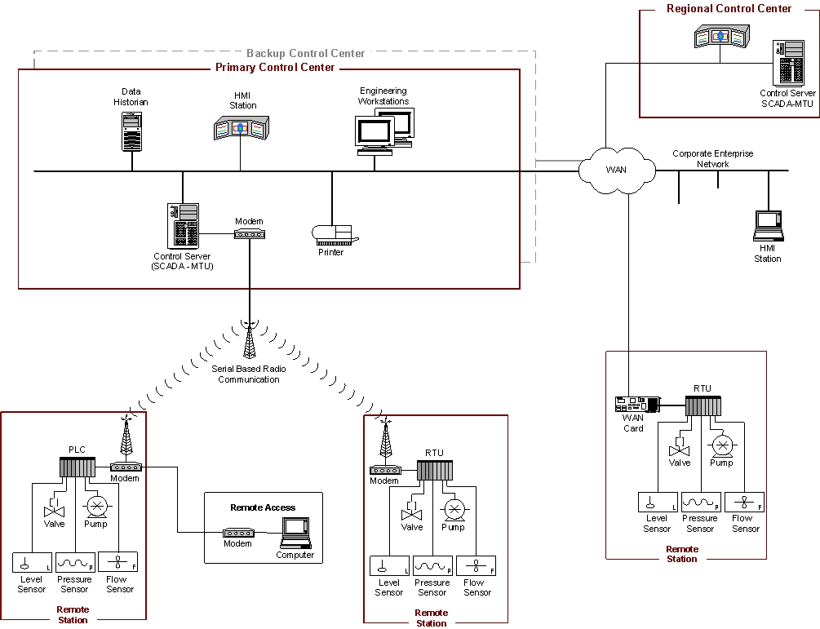
System implementation- Industrial

Slide 34
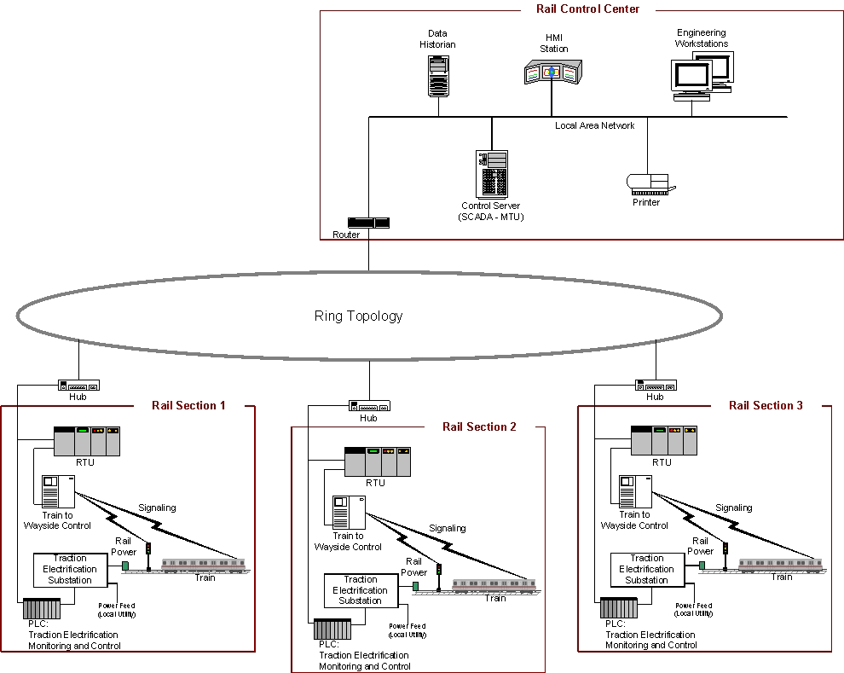
Railway control using SCADA

Slide 35
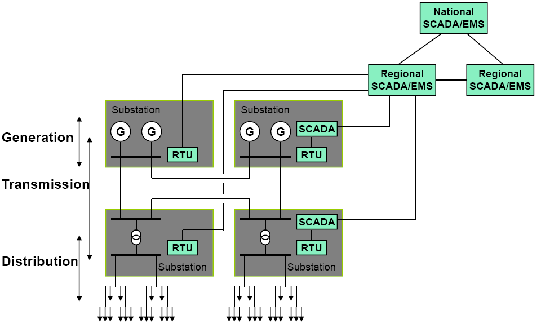
Power System Example

Slide 36
Instrument automation
There are four basic classes of instrument automation system
Industrial automation system
Building automation system
Power system automation
Process automation system

Slide 37
Protocols and Standards
Data comm. Involves transfer of data from source to destination
Data can be
Analog- telephone lines
Digital – modern comm. Systems
Receiver and Transmitter should agree on how data is encoded . This agreement is known as a protocol

Slide 38
OSI model
Is a layered architecture for data communication
It has seven layers- each layer has its own interface and protocol

Slide 39
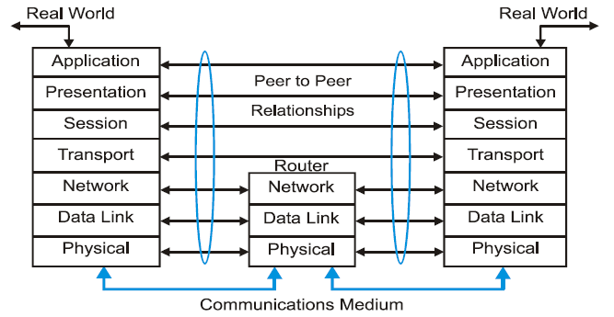
OSI model

Slide 40
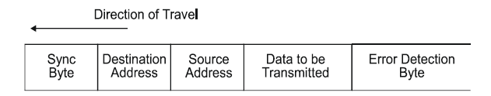
OSI model
The main part of the OSI model is the protocol
Protocol – defines how data is to be framed for transmission
Protocol format

Slide 41
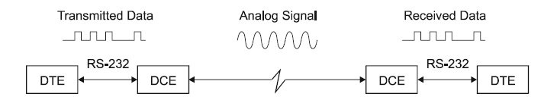
RS 232 Standard Interface
Defines the standard electrical and mechanical interface between DTE and DCE
It defines serial communication interface
Serial data communication

Slide 42
RS 232 standard
It supports
Both half duplex
Full duplex communication
In the industry it is used to interface
PLC with other PLC
RTU with main computer

Slide 43
MODBUS and other standards
Is an application layer protocol
Supports comm. between client/server
Where there is different types of buses or networks
It does not specify any specific hardware
It has modbus request and modbus reply messages

Slide 44
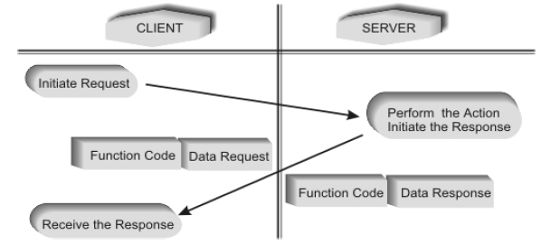
Modbus

Slide 45
Modbus contd…
The parameters exchanged between client and server have
What to do, function code – function code
With what input or output – data exchange
There are classes of function code
Class 0 – useful commands for both client and server
Read registers
Write registers

Slide 46
Modbus protocol
Class 1 – interoperable set of commands
Read coils
Read input discrete
Read input registers
Write coils
Force single coil
Class 2- comprises the data transfer functions for routine operation
force multiple coils
Read/write registers

Slide 47
Modbus plus
Is a modbus protocol with specific hard ware
Used for LAN connection of industrial system
It can be used to control a remote device

Slide 48
Device net and its accessories
Device net
is low level device oriented network
It can connect sensors and actuators with controllers
It is based on controller area network which uses multi-byte message format
It can support up to 64 nodes
Four conductor cable provides both power and data communication

Slide 49
Device net
It supports baud rates of 125,250 and 500K baud
It implements layer 3 and layer 4
It is a routable system

Slide 50
Profibus
Its name comes from process field bus
Is widely accepted standard common in process control and in large assembly and material handling systems
It allows single cable wiring of multi-input sensors, pneumatic valves, complex intelligent devices, smaller sub-networks and operator interface

Slide 51
Profibus
It uses 9 pin D type connector or 12mm round quick-disconnect connectors
Max number of nodes is 127 with speeds varying from 9600bps to 12Mbps
The message size can be up to 244 bytes of data per node per message
Polling and token passing are used as medium access methods

Slide 52
Profibus
It supports two types of devices
Master – control the bus and when they have the right to pass message, they may do so with out any remote request- active stations
Slave – remote devices such as transmitters/ sensors and actuators – acknowledge message sent to them or send data up on request from master

Slide 53
Programming and Simulation of Instrument Automation
Fuel management system for 2000KVA diesel generator set with 1000liters day fuel tank and 13000liters bulk fuel tank. The system should have display for fuel level, alarm system, automatic refill of the day fuel tank, checking for battery level and recharge system
Guest room management system with objectives of
Reduce the energy use
Improve guest comfort
Should have digital thermostat, presence detector, blinds, card reader, DND, master switch, mini bar detection, light scene control system etc

Slide 54
Programming and automation of instrument automation

