Slide 1
Chapter 2
Gain Scheduling Adaptive controllers

Slide 2
Contents
Model of a system/ plant
  State space models
  Input/output models
  Plant parametric models
Stability
  Input/output stability
  Lyapunove stability
Gain scheduling adaptive controller

Slide 3
Model of a plant
A plant model can be given by
  State space model
  Input output model
  Plant parametric model
The type of model to be used depends on the design method to be followed and the type of the plant

Slide 4
State space model
State
  set of variables which at some initial time to together with the input completely describes the behavior of the system for t≥to
State space
  N dimensional space of the state variables
  For 2 variables, 2D space
  If at time to,
  X1=2, x2=1
x2
x1

Slide 5
State space model
In state space modeling
  Use smallest number of states
  States may be none measureable
For a linear system, state of a system is described by a set of first order differential equations in terms of the state variables and input of the system

Slide 6
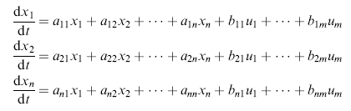
State space method
State equation, linear system
In matrix form
The output of the system is related to input and state as

Slide 7
State space model
In the above representation
  X is n dimensional state vector
  Y is p dimensional output vector
  U is m dimensional input vector
  A is n by n dimensional state matrix
  B is n by m dimensional input matrix
  C is p by n dimensional output matrix
  D is p by m dimensional matrix

Slide 8
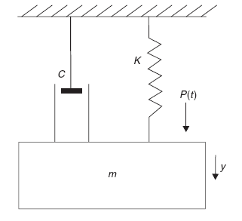
Example of a linear system
Write down the state and output equation for the spring mass damper system below

Slide 9
Solution
Let the state variables be the displacement and the velocity of the mass
States
  X1=y
  X2=dy/dt
Output
  The displacement y
Input variable u is the pressure input p(t)

Slide 10



Solution contd…
Applying Newton’s second Law, net force is equal to product of mass and acceleration
Rewriting
Writing the equation as first order differential equations using state variables(x1 and x2)

Slide 11


Solution contd…
In matrix form the state space model becomes
The output equation is

Slide 12
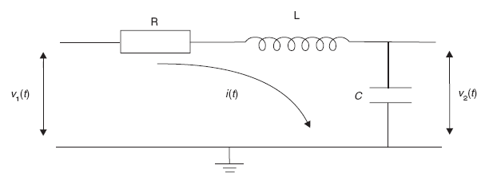
Exercise
Derive the state space model of the following RLC network if the states are V2(t) and i(t)

Slide 13

State space model
For a general nonlinear plant
f and g are nonlinear functions
State space model is advantages for
  MIMO system analysis
  Digital computer implementation of control systems

Slide 14

Input –output method
Is model of a system using TF
Transfer function
  The ratio of the LT of the output of the system to the input of the system with initial conditions set to zero
Steps
  1. write the defining differential equations of the system
  2. take the Laplace transform with zero initial conditions
  3. Re-arrange the equations as output/input

Slide 15
Input-output method contd…
In the above representation
  If m<n, the system is said to be proper
  If all the roots of the numerator have real parts in the negative half s-plane, the system is said to be minimum phase
  If all the roots of the denumerator have real parts in the negative half of the s-plane the system is said to be stable

Slide 16

Example: A double cart inverted pendulum system
The defining dynamic equation of the system is given below
Following the steps listed above

Slide 17

Parametric model
Consider a plant represented by nominal model
Elements of the matrices (A,B, C) contain the ( + 2n) elements and they are plant parameters

Slide 18


Parametric model contd…
Linear parametric model
  Consider a linear system whose dynamics is represented by nth order differential equation
  If parameters and signals are grouped separately

Slide 19
Plant parametric model
Helps to estimate the parameters of the plant from measurement of input u and output y
plant
u
y
Parametric model
Plant parameters

Slide 20

Plant parameterization
Example 1 consider the differential equation
Writing it in parametric form
(Eq. *)
Where

Slide 21
Plant parametric model
From (Eq. *), to calculate the four parameters
We need, u and its second derivatives u(2), fourth derivative and second derivative of y and y itself
But only u and y are measurable
Filter u and y using
where

Slide 22



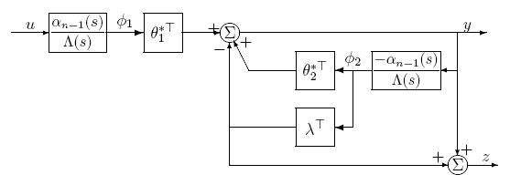
Parametric model contd…
After filtering
Where

Slide 23
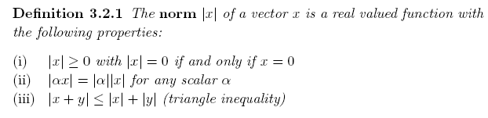
Stability
Norm of a vector and matrix
  In stability study norm is an important concept
  Size or length of a vector

Slide 24
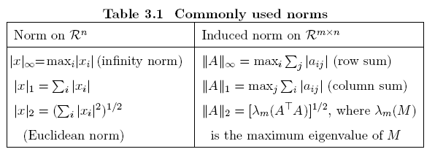
Common norms

Slide 25
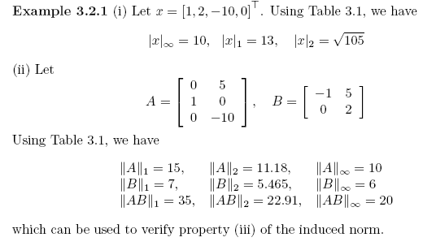
Example for norm

Slide 26



Norm for functions
For functions, norms are defined as
For p=[1 ∞)
The infinity norm is

Slide 27


Input-output stability
Consider a system with transfer function H(s) and input u with output y
We say the above system is Lp stable iff

Slide 28

Lyapunov stability
Consider a dynamic system given by
Assume that f(x,t) is
  Continuous in t
  Uniform in t
A point x* is said to be an equilibrium point if
F(x*,t)=0

Slide 29
Lyapunov stability
The point x*
  is said to be locally stable if the system remains near x* when it starts from point near x*
  Asymptotically stable if it is locally stable and if all solutions starting from near x* end at x*

Slide 30
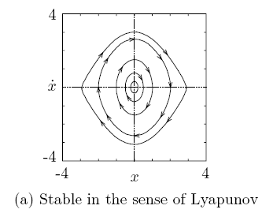
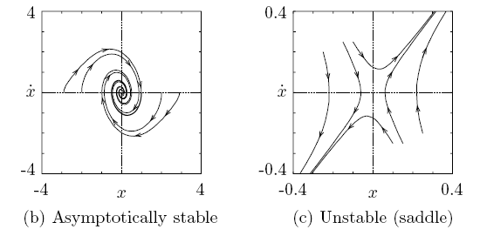
Lyapunov stability

Slide 31
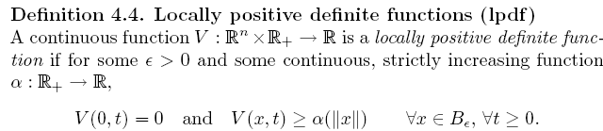
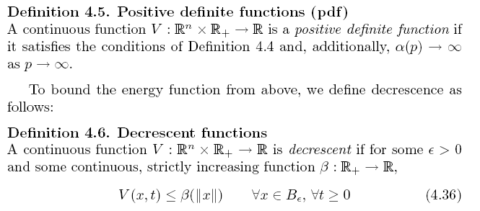
Lyapunov direct method
Definitions

Slide 32
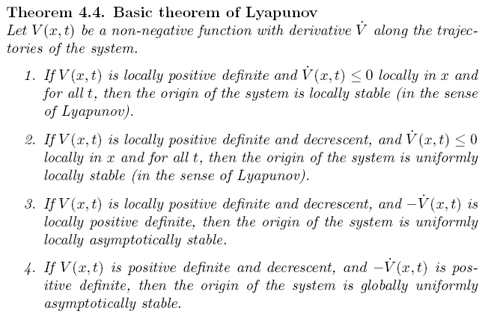
Lyapunov direct method

Slide 33
Gain scheduling controller
Gain scheduling is an adaptive control strategy, where the gain of the system is determined and based on its value the controller parameters are changed.
In many cases, it is possible to find measurable variables that correlate well with changes in process dynamics.
These variables can then be used to change the controller parameters.
This approach is called gain scheduling because the scheme was originally used to measure the gain and then change, that is, schedule the controller to compensate for changes in the process gain.

Slide 35
The system can be viewed as having two loops.
There is an inner loop composed of the process and the controller
Outer loop contains components that adjust the controller parameters on the basis of the operating conditions.
Gain scheduling can be regarded as mapping from process parameters to controller parameters.
It can be implemented as a function or a table lookup.
The concept of gain scheduling originated in connection with the development of flight control systems.
In this application, the Mach number and the altitude are measured by air data sensors and used as scheduling variables. This was used, for instance, in the X-15.
In process control the production rate can be often chosen as a scheduling variable, since time constants and time delays are often inversely proportional to production rate.
Gain scheduling is thus a very useful technique for reducing the effects of parameter variations.

Slide 36
Advantages:
Parameters can be changed quickly in response to changes in plant dynamics
This strategy is very easy to apply if the plant dynamics depends in a well known fashion on a relatively few easily measurable variables
Drawbacks:
It is an open-loop adaptation scheme, with no real learning or intelligence
The design required for its implementation is enormous.

Slide 37
Design of gain scheduling controllers
The key issue in the design of gain scheduling controllers is the determination of variables that can be used as scheduling variables.
One criterion for selection of the scheduling variable is that these auxiliary variables must reflect the operating conditions of the plant.
Ideally there should be simple expressions for how the controller parameters relate to the scheduling variables.
It is thus necessary to have a good insight into the dynamics of the process if gain scheduling is to be used.

Slide 38
Design of gain scheduling controllers
Design of gain scheduling controllers can be carried out by one of the following techniques:
  Gain scheduling based on measurement of auxiliary variables
  Time scaling based on the production rate and
  Nonlinear transformations
It should be noted here that by linearizing of nonlinear actuators, we get a very improved performance, but this should not be regarded as gain scheduling because, gain scheduling should consist of a measurement of variable related to the operating condition of the process.

Slide 39
But often it is not easy to determine the controller parameters as a function of measured variables.
The design of controller must then be redone for different working points of the process. Some care must also be taken if the measured signals are noisy. They should be filtered properly before they are used as scheduling variables.

