Slide 1
Earth Rotation
Lecture 10

Slide 2
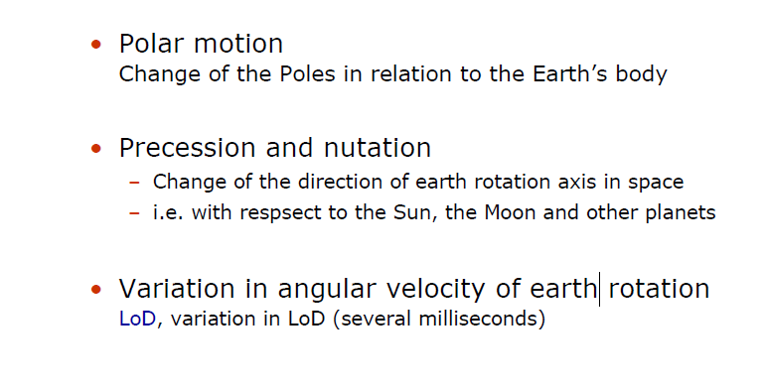
Earth Rotation

Slide 3
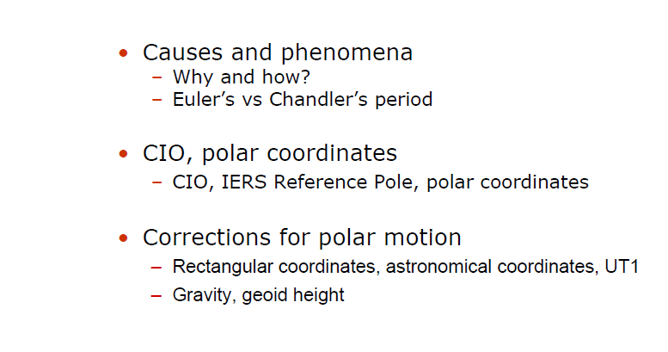
Polar Motion

Slide 4
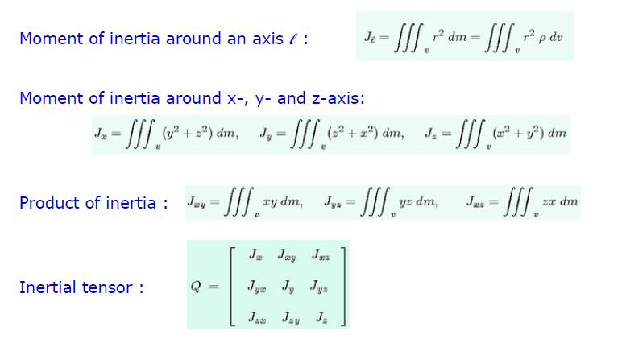
Moment of Inertia for a rigid body

Slide 5
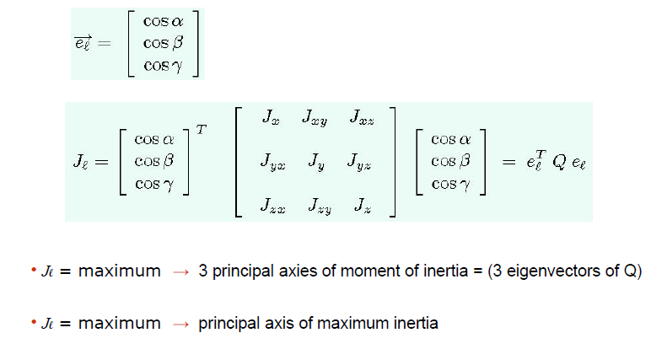
Principal axes of moment of inertia

Slide 6
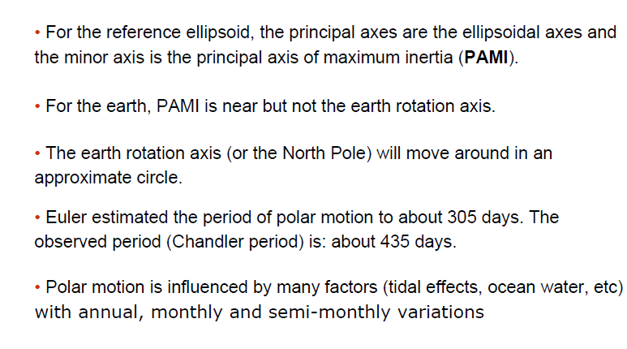
Polar motion

Slide 7
Polar Motion 1995.0-1998.5; Mean Pole 1900-1997

Slide 8
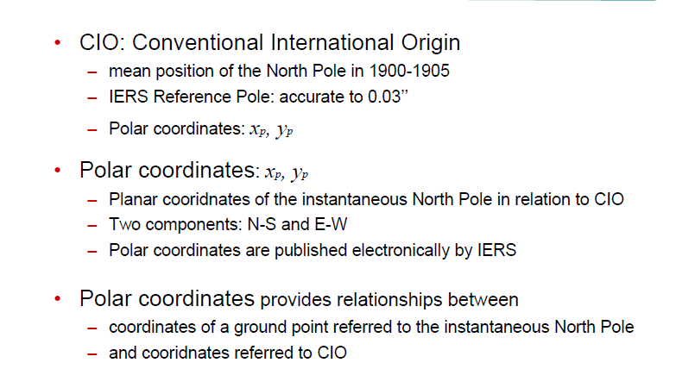
Reference Pole: CIO

Slide 9
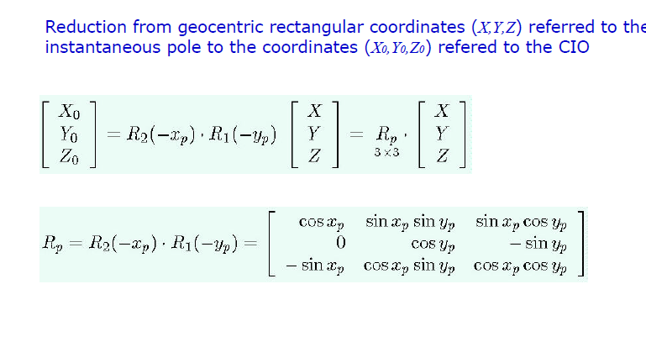
Reduction of Coordinates for Polar Motion

Slide 10
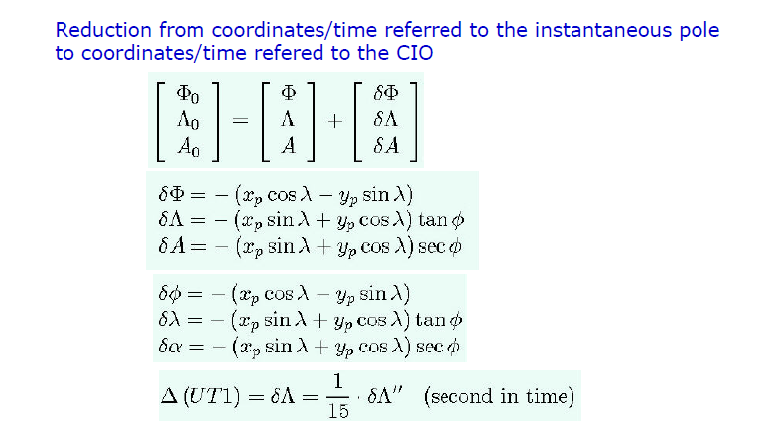
Reduction of Coordinates for Polar Motion

Slide 11
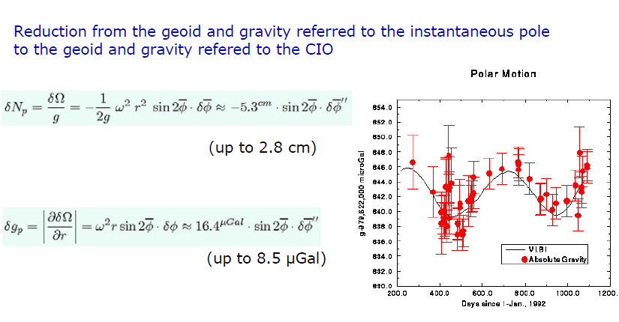
Reduction of Coordinates for Polar Motion

Slide 12
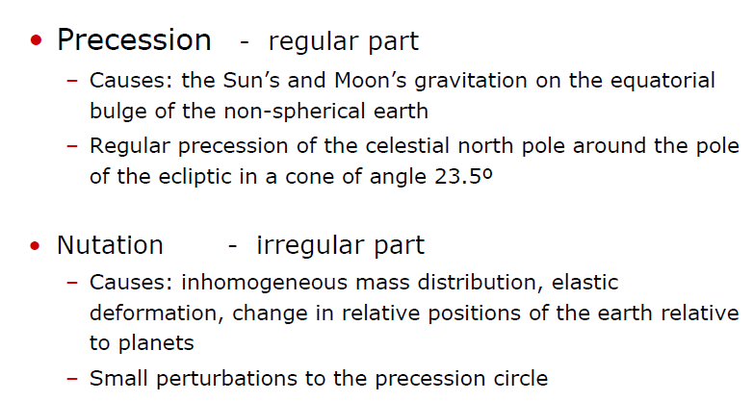
Precession and Nutation

Slide 13
Precession and Nutation

Slide 14
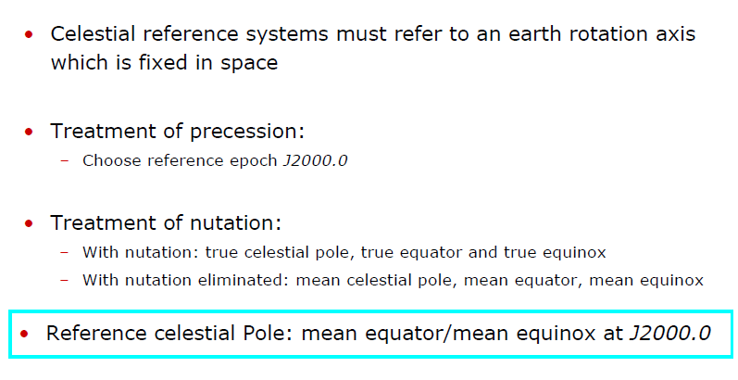
Effects of Precession and Nutation

Slide 15
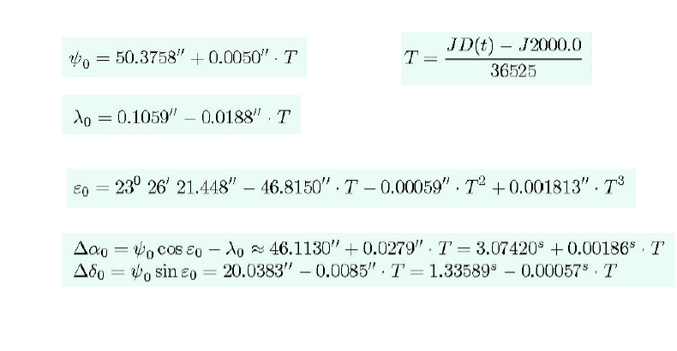
Changes due to precession

Slide 16
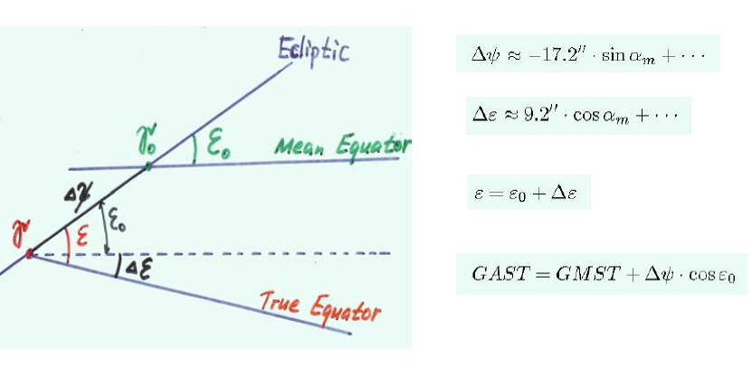
Nutation parameters

Slide 17
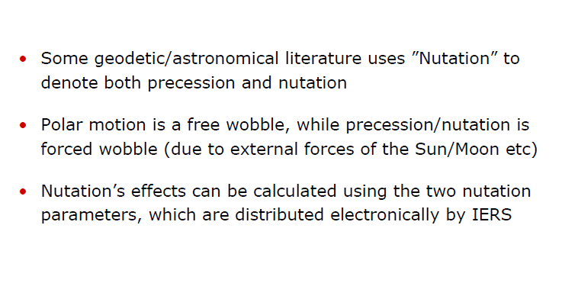
Comments

Slide 18
Reduction of precession and nutation

Slide 19
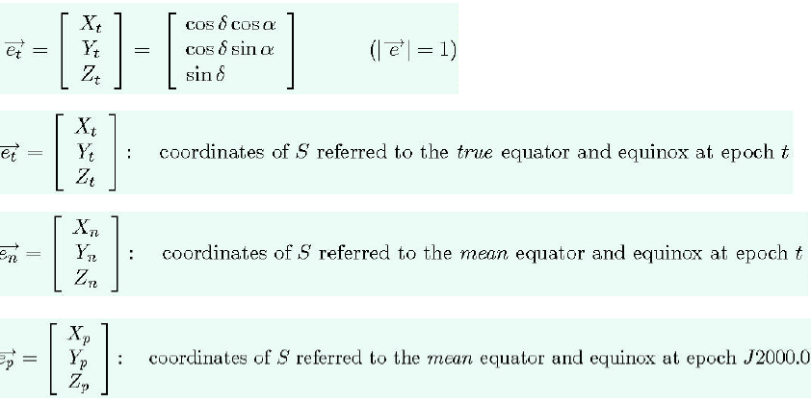
Reduction of precession and nutation

Slide 20
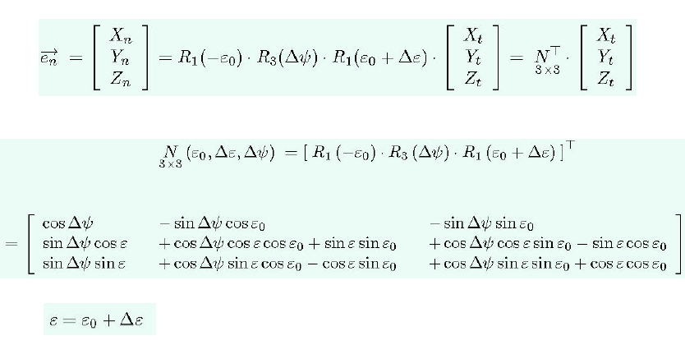
Reduction of nutation

Slide 21
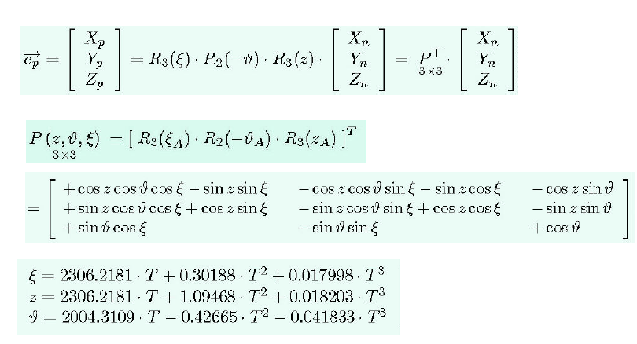
Reduction of precession

Slide 22
Variation in Length of Day (LoD)

