Slide 1
Celestial vs terrestrial reference systems
Lecture 11

Slide 2
Celestial vs terrestrial reference systems
Celestial vs Terrestrial Reference Systems
  Celestial reference system and reference frame: ICRS / ICRF
  Terrestrial reference system and reference frame: ITRS / ITRF
  EOP. Transformation from ICRF to ITRF
WGS 84

Slide 3
Geodetic reference systems
Geodetic reference systems are fundamental requisites for accurate and reliable geodetic results
Highly accurate, consistent and reliable realizations of the terrestrial reference systems are required for measuring and mapping the Earth’s surface and its variations in time.
These terrestrial reference frames are the basis for many practical applications, such as
  national and regional geodetic networks,
  engineering,
  precise navigation,
  geo-information systems,
  for scientific investigations in the Earth’s system (e.g., tectonic plate motion)

Slide 4
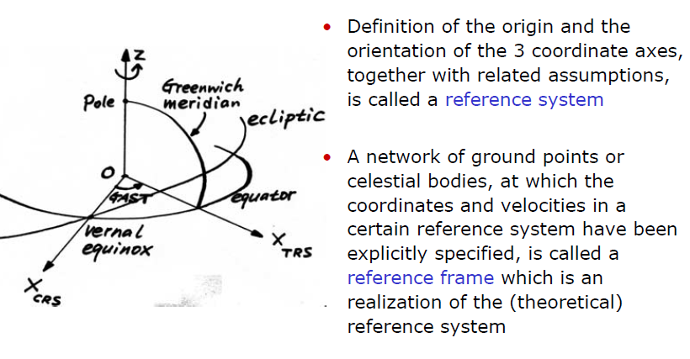
Reference system vs reference frame

Slide 5
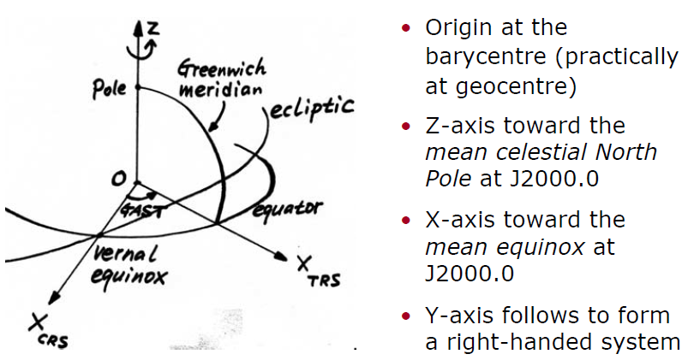
International Celestial Reference System (ICRS)

Slide 6
International Celestial Reference Frame (ICRF)

Slide 7
International Celestial Reference Frame (ICRF)

Slide 8
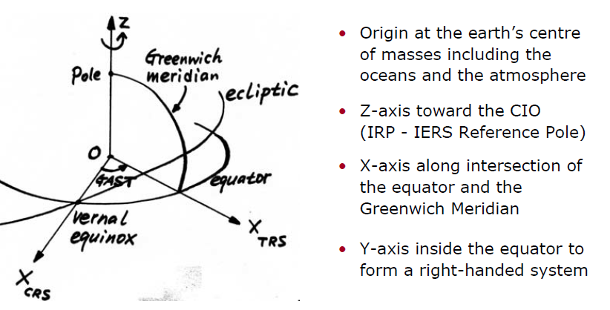
International Terrestrial Reference System (ITRS)

Slide 9
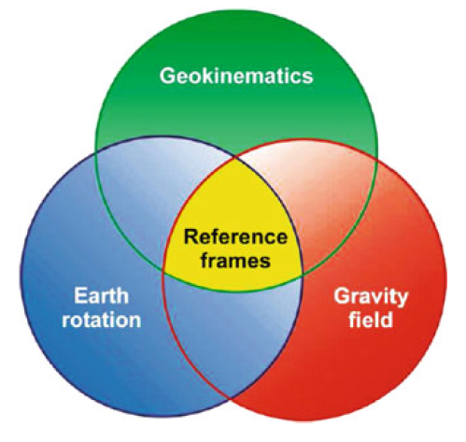
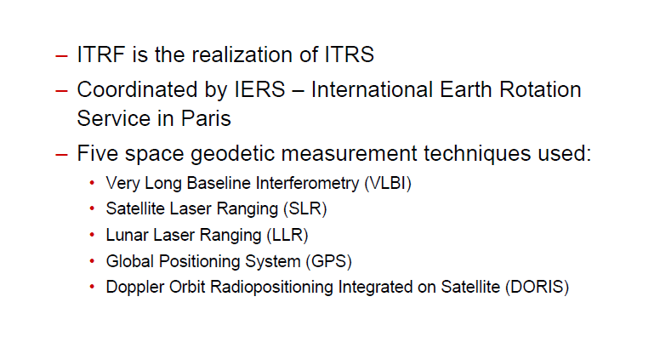
International Terrestrial Reference Frame (ITRF)

Slide 10
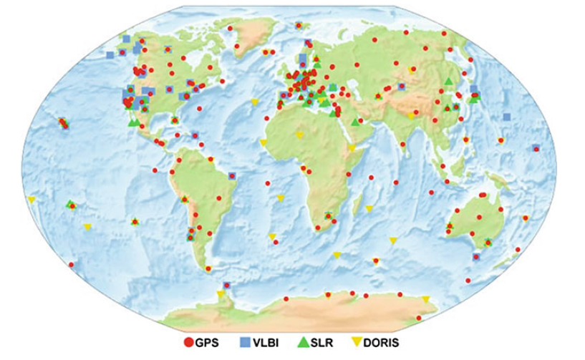
Spatial distribution of technique-specific station networks

Slide 11
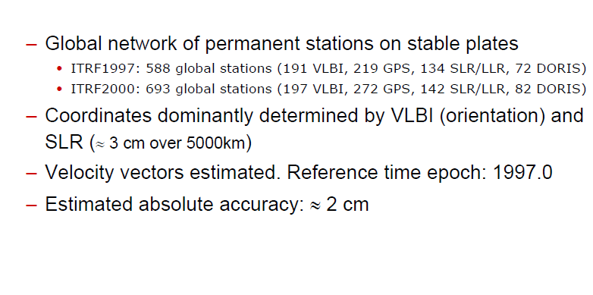
International Terrestrial Reference Frame (ITRF)

Slide 12
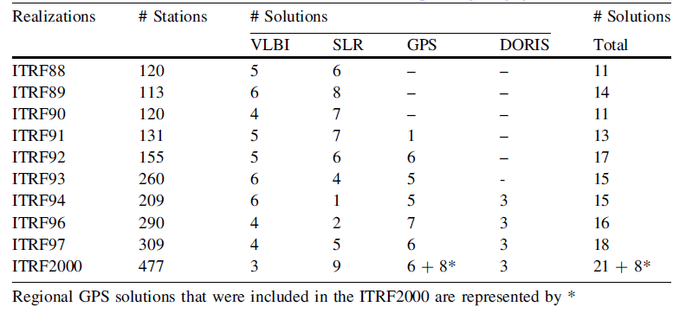
History of ITRS Realizations

Slide 13
Global Network of ITRF 2000

Slide 14
Station coordinates/velocities of ITRF 2000

Slide 15
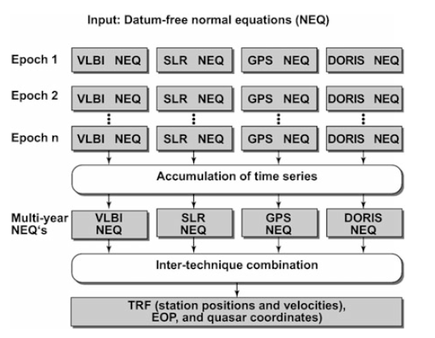
ITRF2008 Data Analysis
A new strategy has then been applied, for the first time, to the ITRF2005 computations and was then also adopted to generate the ITRF2008. It is based on a
time series of input solutions/normal equations with station positions and Earth
orientation parameters (EOP) of the different space techniques

Slide 16
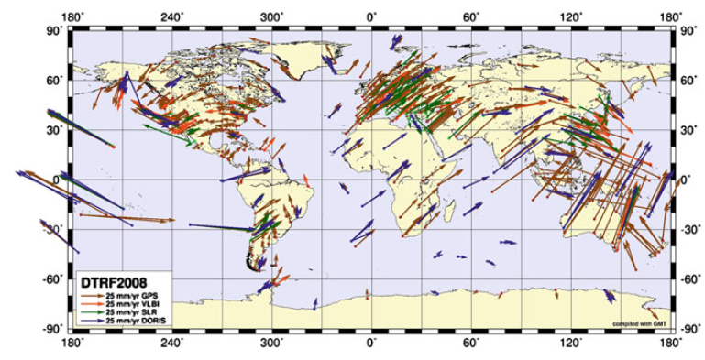
Horizontal station velocities of the DTRF2008 solution computed at DGFI

Slide 17
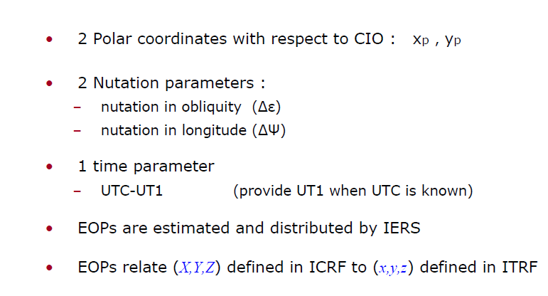
Earth Orientation Parameters (EOP)

Slide 18
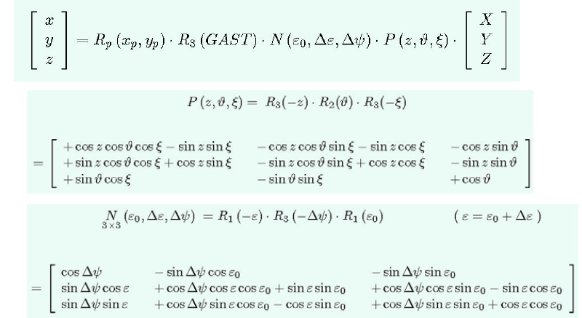
Transformation from ICRF to ITRF

Slide 19
Computation of GAST

Slide 20
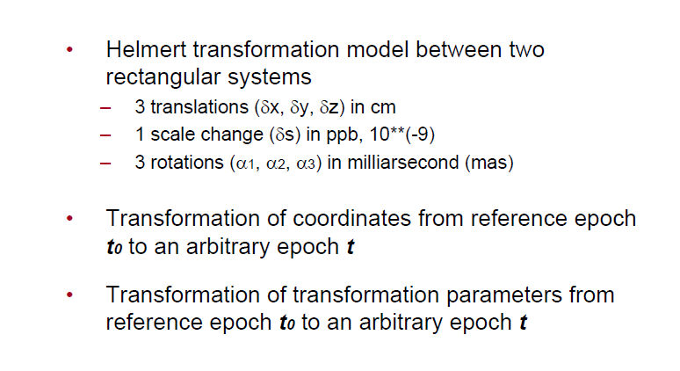
Transformation between ITRFyy

Slide 21
Transformation between ITRFyy

Slide 22

Transformation parameters

Slide 23
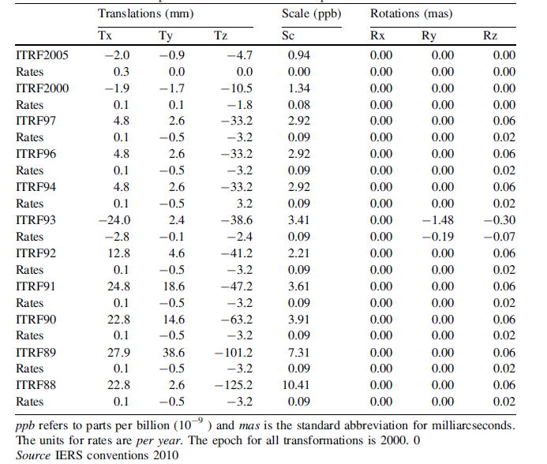
Transformation parameters from ITRF2008 to past ITRF realizations

Slide 24
Navy Navigation Satellite System (NNSS)
Developed for US strategic nuclear submarines (Polaris) in 1960’s
6 polar satellites at 600km
4 ground monitoring stations defining World Geodetic System 1972
Doppler effects of satellite signals are measured by ground receivers
10 meters accuracy achieved with dual frequency receivers
Also called TRANSIT or Doppler system

Slide 25
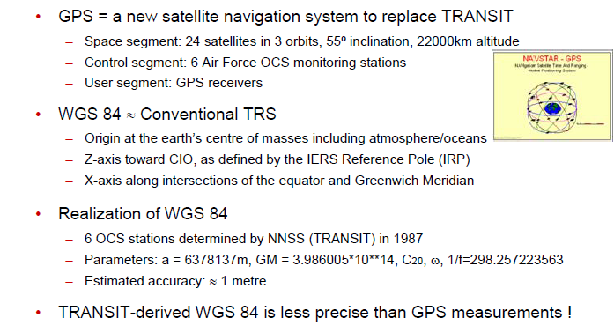
World Geodetic System 1984 (WGS 84)
6

Slide 26
Ellipsoids of WGS 84 and GRS 80

Slide 27
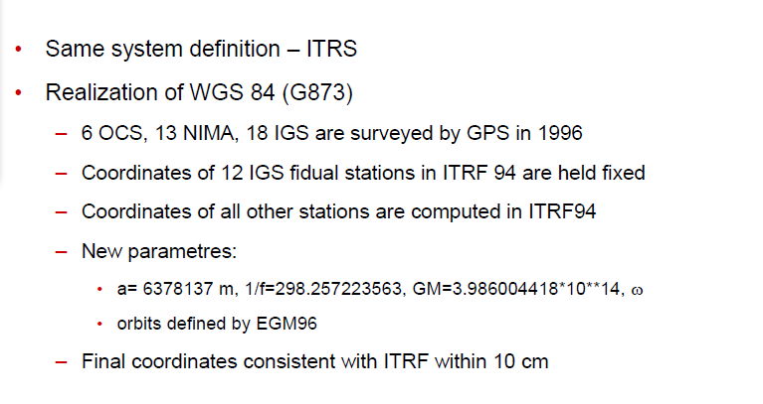
WGS 84 (G703, G873)

Slide 28
NIMA and Air Force OCS Tracking Stations

Slide 29
Geodetic Infrastructure
Reference Frame
Geodetic Network
National Projection
Height System
Gravity Network
Geoid Model

