Slide 1
3D Helmert transformation
Lecture 12

Slide 2
3D Helmert Transformation
Helmert model for 3D Cartesian coordinates´transformation
  3 translations (δx, δy, δz)
  1 scale change (δs) in ppm, 10^(-6)
  3 rotations (α₁, α₂,α₃)
Estimation of 3D transformation parameters
  Coordinates in two systems at n (>3) points
  Helmert model for small scale changes and small rotations
  Least squares adjustment: estimation of transformation parameters
  Rigorous linearization of the Helmert transformation model

Slide 3
Introduction
The transformation of points from one coordinate system to another is a common problem encountered in surveying and mapping.
For instance, a surveyor who works initially in an arbitrary coordinate system on a project may find it necessary to transform the coordinates to the Adindan UTM coordinate system.
This coordinate transformation considered as a three-step process that involves:
  1. Scaling to create equal dimensions in the two coordinate systems. (if it is conformal transformation)
  2. Rotation to make the reference axes of the two systems parallel.
  3. Translations to create a common origin for the two coordinate systems.

Slide 4
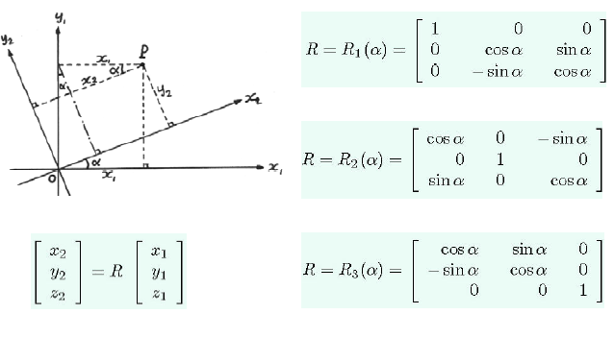
Rotation Matrices

Slide 5
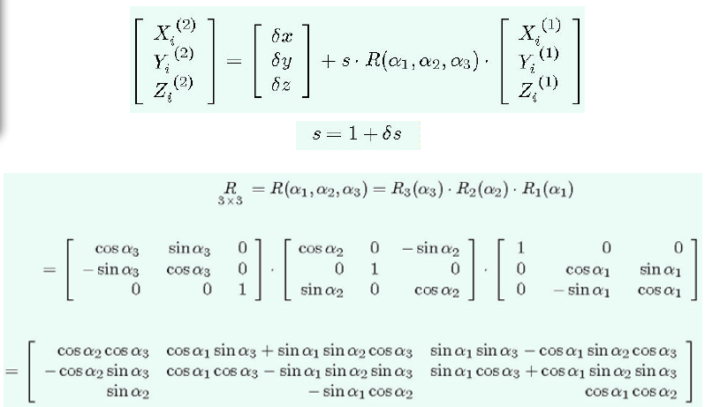
Helmert transformation between 2
Cartesian coordinate systems

Slide 6
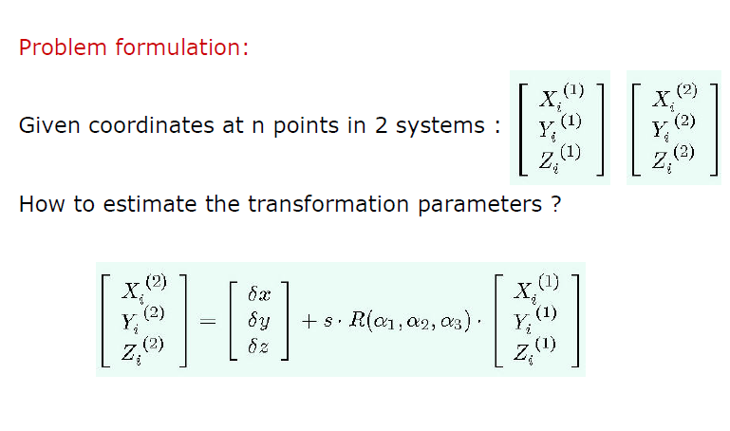
Estimation of transformation parameters

Slide 7
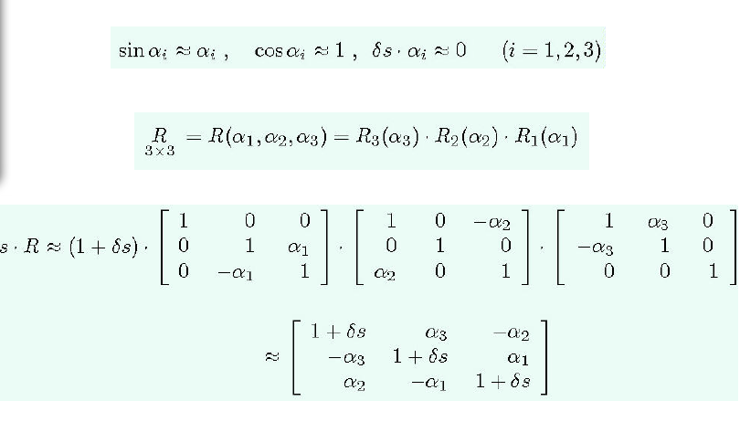
Linear Helmert model with small scale change and small rotations

Slide 8
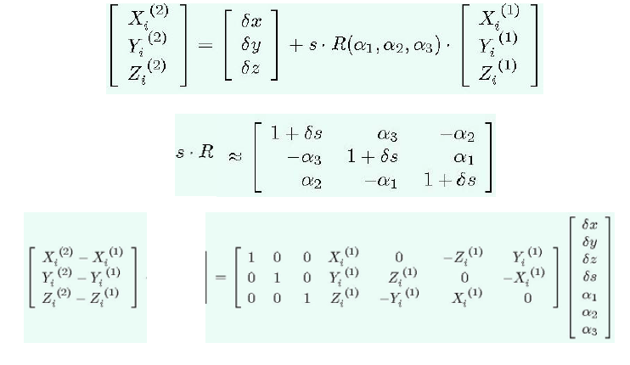
Approximation of Helmert model

Slide 9
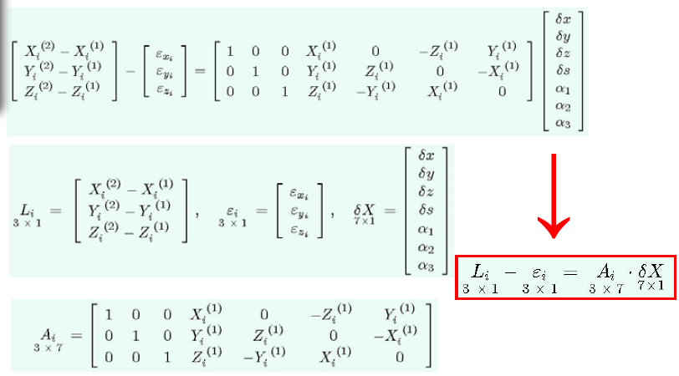
Helmert model with residuals

Slide 10
Linear observation equations for 1 point

Slide 11
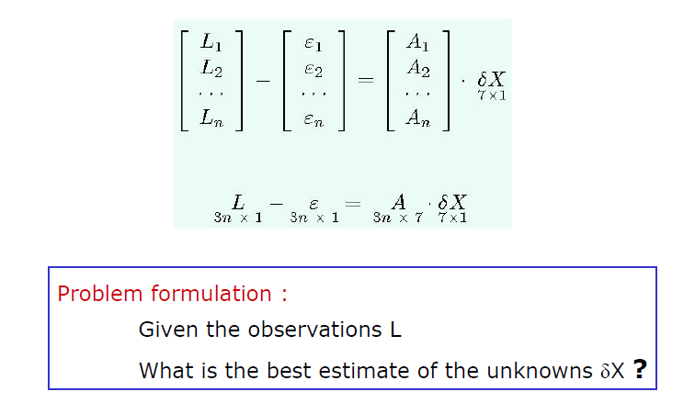
Linear observation equations for n points

Slide 12
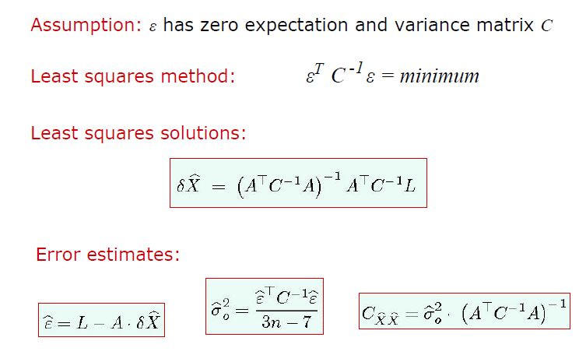
Least squares solutions

Slide 13
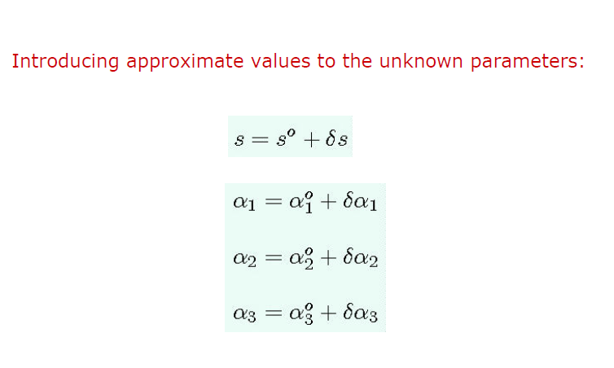
Rigorous linearization of Helmert model

Slide 14
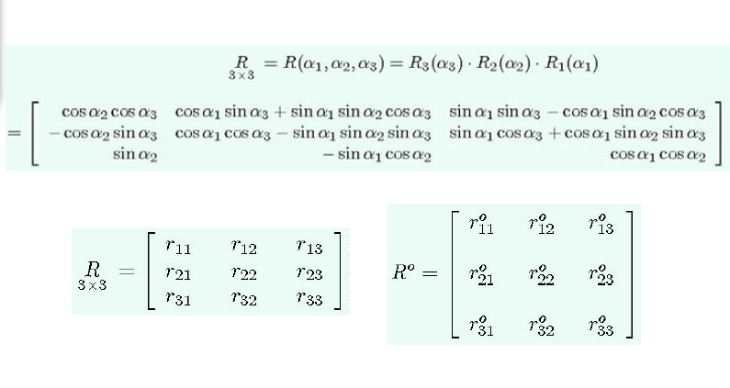
True and approximate rotation matrix

Slide 15
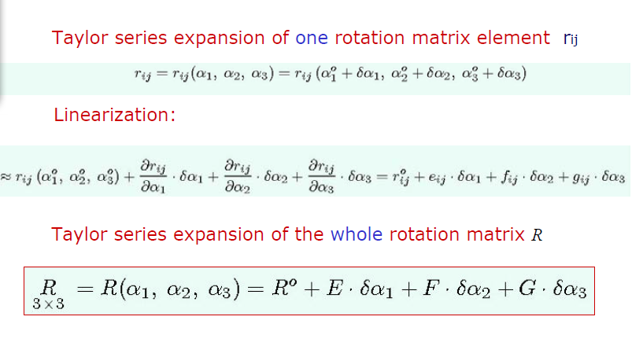
Series expansion of the rotation matrix

Slide 16
Derivatives of the rotation matrix

Slide 17
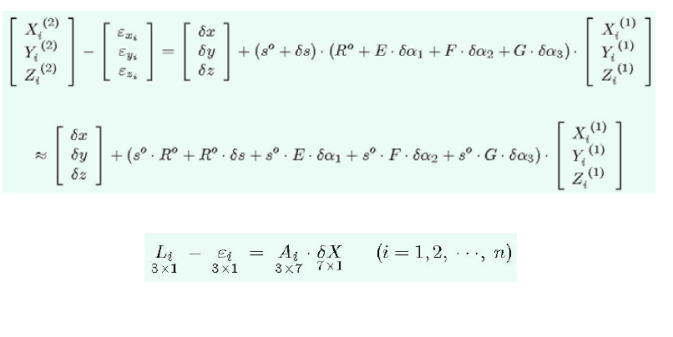
Linearization of Helmert model

Slide 18
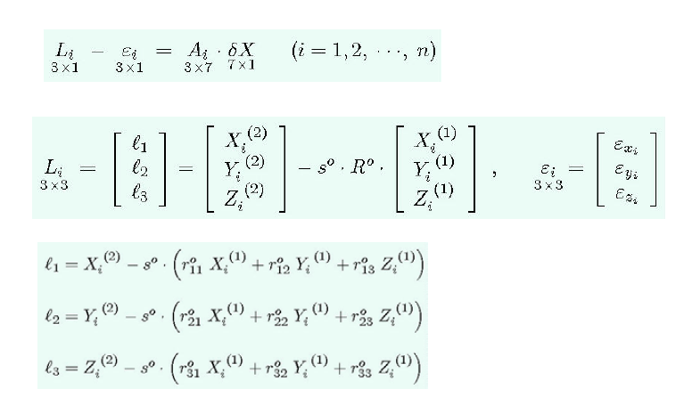
Linearized Helmert model for 1 point

Slide 19
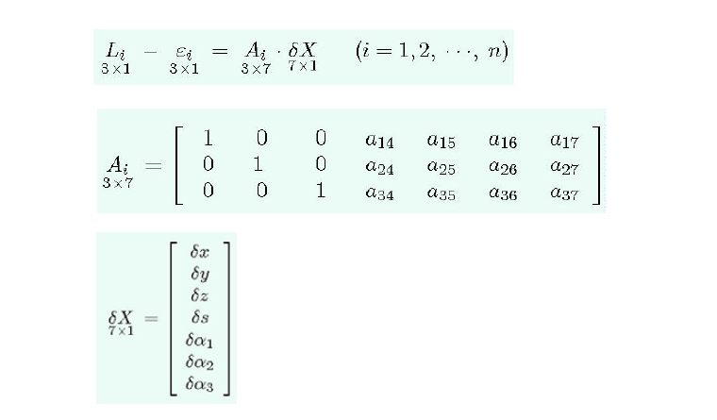
Linearized Helmert model for 1 point

Slide 20
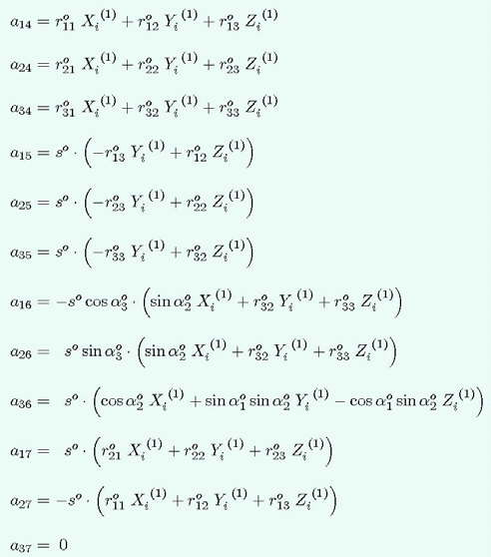
Coefficients of the matrix A

Slide 21
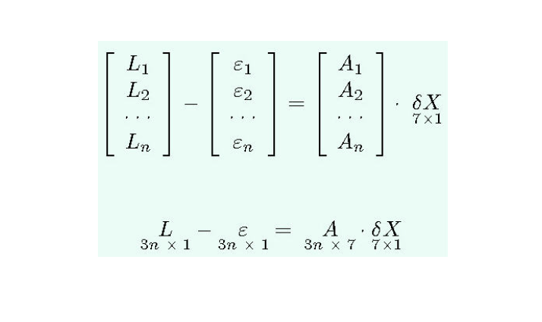
Linearized Helmert model for n points

Slide 22
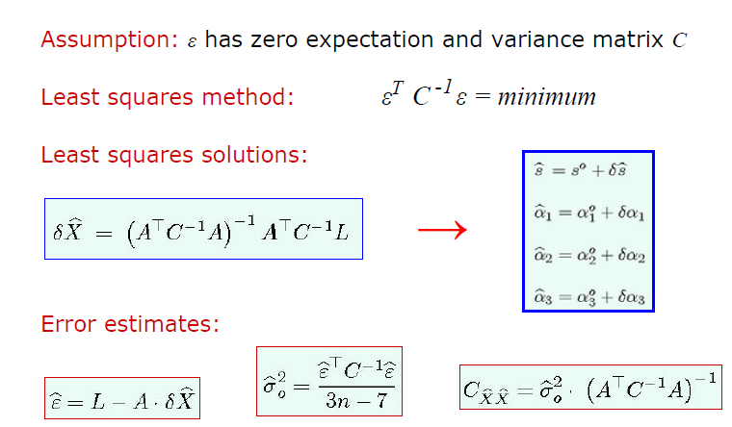
Least squares solutions

Slide 23
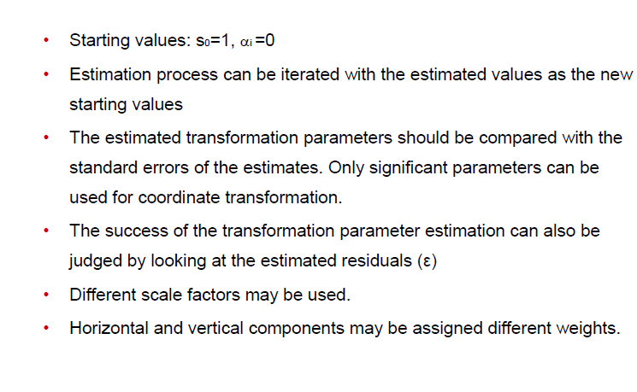
Remarks on transformation parameters

