Slide 1
Reference System & Coordinate Transformation
LECTURE 01 - INTRODUCTION

Slide 2
Why You need this course?
Coordinates are the most fundamental information in geospatial databases
Many different types of coordinate systems in use
Exchange of geospatial data needs well-defined coordinate systems
Transformation of data between traditional systems and modern (GNSS-based) systems information in geospatial databases
The problem: 2 + 1 ≠ 3
Triangulation (2D) + levelling (1D) ≠ GPS (3D)

Slide 3
Representation of the earth’s surface
By plane (plane surveying)
By spherical surface (R=6371 km)
By the geoid ( or mean sea level)
By an ellipsoid of revolution (with two different axis equatorial and polar)

Slide 4
Shape of the Earth
We normally think of the
earth as a sphere
However, it is actually an ellipsoid,
slightly larger in radius at the
equator than at the poles

Slide 5
Surfaces related to the earth
The continental area of the earth surface is irregular
  Mt Everest at 8848m above the sea level
67% of earth surface is covered by the sea. The sea level is much smoother than the natural surface of the earth
Global Mean Sea Level (MSL) is a part of a special equipotential surface in the earth’s gravity field, called the geoid
The geoid coincides with the sea level and extends below the continent
Reference ellipsoid is most close to the geoid in the least squares sense

Slide 6
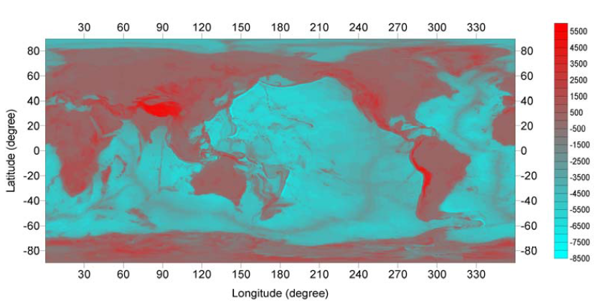
Earth’s natural surface

Slide 7
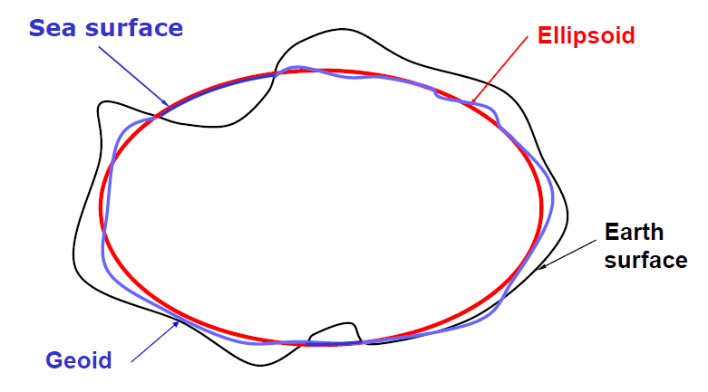
Fitting an ellipsoid to the geoid

Slide 8
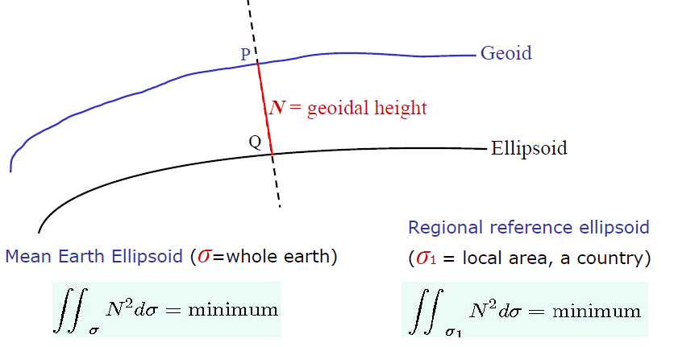
The geoid-ellipsoid separation

Slide 9
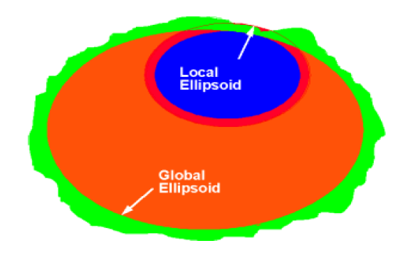
Local vs global ellipsoids

Slide 10
World Geoid JGM2S (Ellipsoid: GRS80)

Slide 11
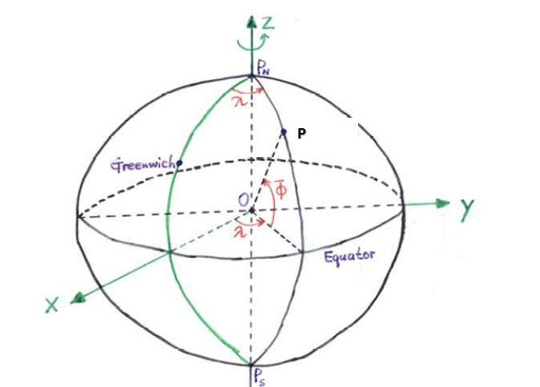
A spherical earth

Slide 12
Concepts of spherical trigonometry
A plane through the spherical center cuts the sphere along a great circle. The shortest distance between two points on the sphere is along the great circle through the two points.
The length of a part of a great circle can be expressed by its geocentric angle → angular distance, spherical distance. Distances/lengths on the sphere have angular units (radian, deg/min/sec)
Three great circles form a spherical triangle
On a spherical earth, positions can be defined by spherical coordinates (geocentric latitude, longitude)

Slide 13
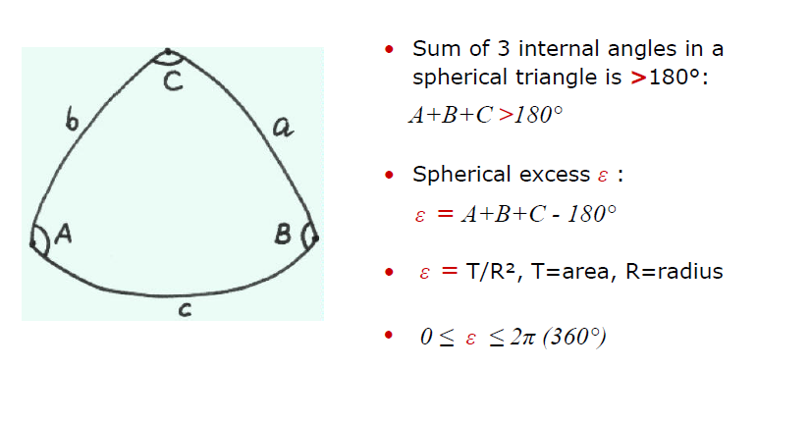
Spherical excess ε

Slide 14
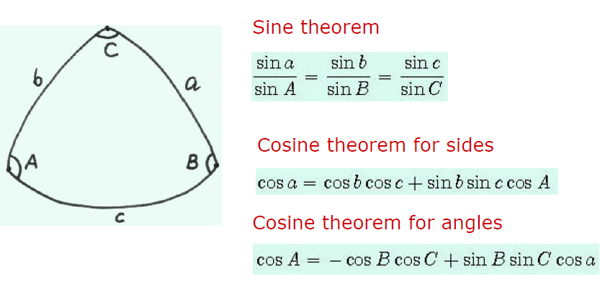
Spherical trigonometry

Slide 15
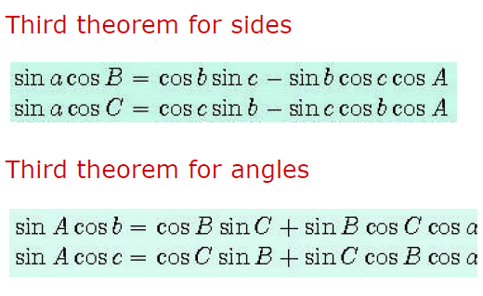
Spherical trigonometry

Slide 16
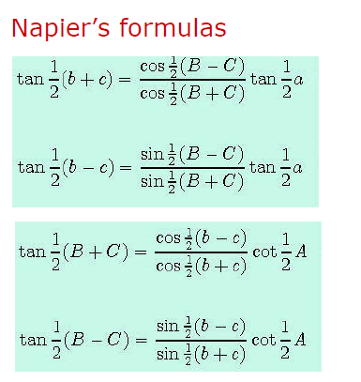
Spherical trigonometry

Slide 17
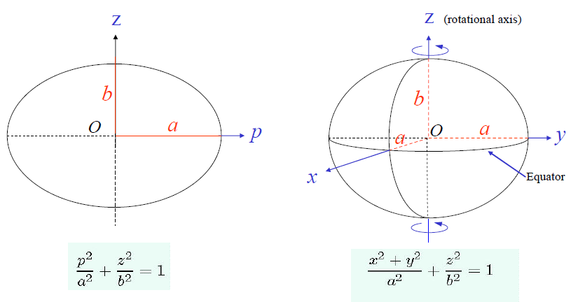
Ellipsoid (Spheroid)
Rotate an ellipse around the minor axis

Slide 18
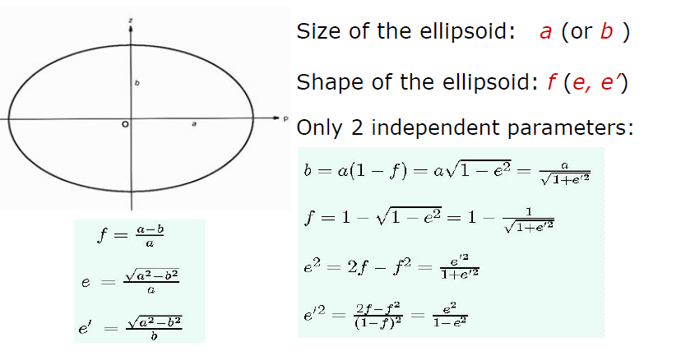
Ellipsoidal Parameters

Slide 19
Widely used reference ellipsoids
Name | Year | a (m) | 1/f | Remarks
Clarke | 1880 | 6 378 249.145 | 293.465 | Ethiopia
GRS 80 | 1980 | 6 378 137 | 298.257 222 101 | Recomm. by IAG
WGS 84 | 1984 | 6 378 137 | 298.257 223 563 | Used in GPS
Hayford | 1910 | 6 378 388 | 297 | N America, ED 87

Slide 20
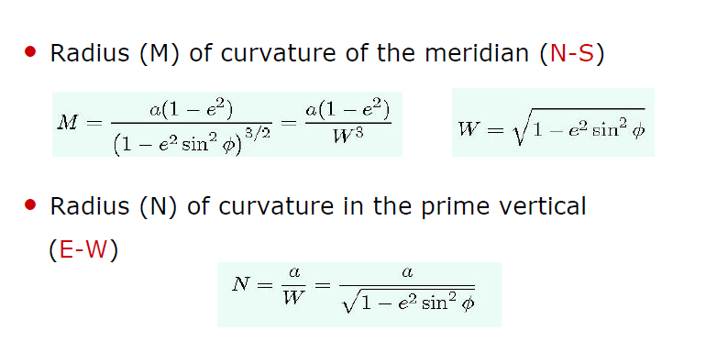
Radius of curvature on the ellipsoid

Slide 21
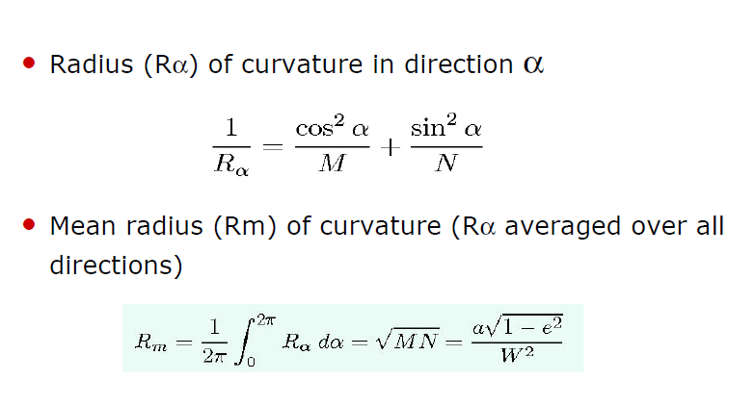
Radius of curvature on the ellipsoid

Slide 22
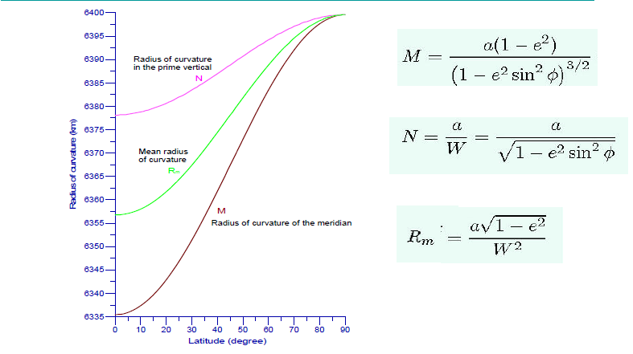
Radius of curvature on the ellipsoid

Slide 23
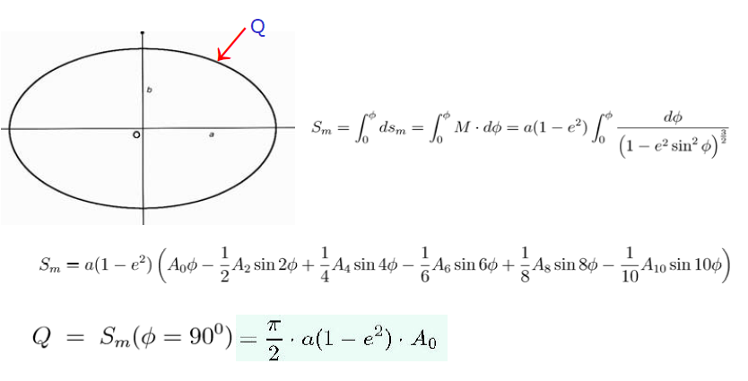
Length of the Meridian Arc

Slide 24
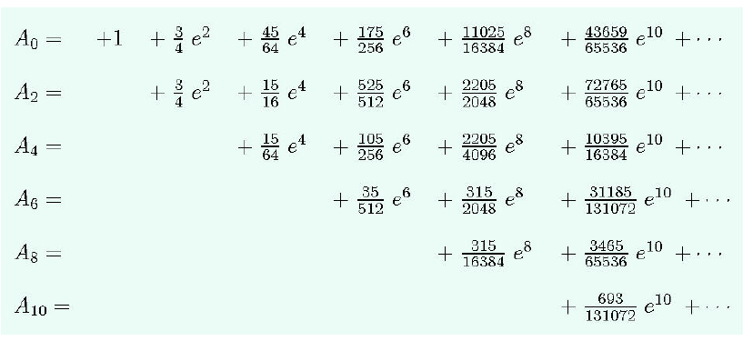
Length of the Meridian Arc

Slide 25
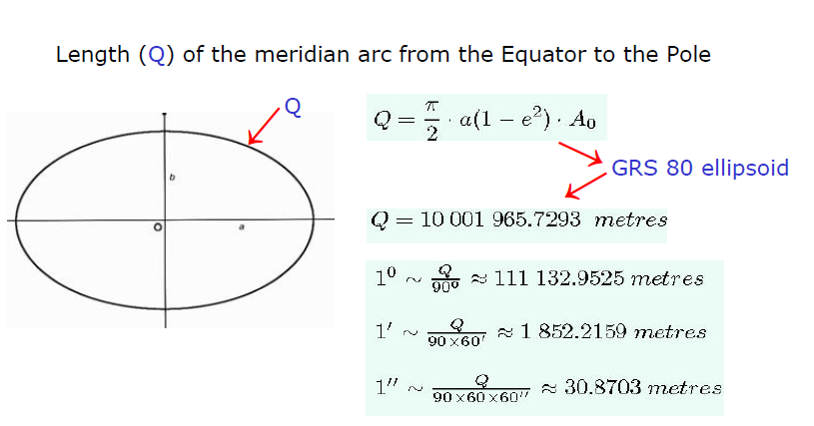
Length of the Meridian Arc

Slide 26
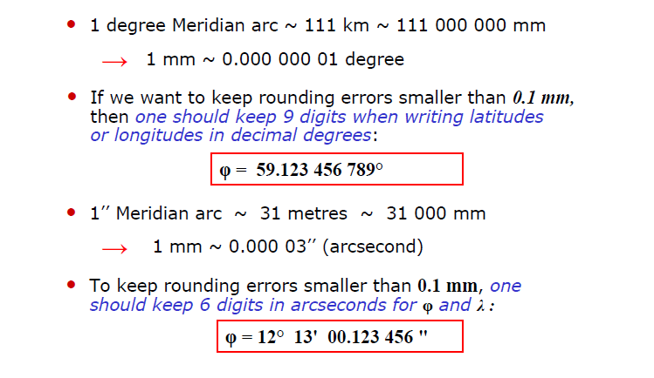
How to keep rounding errors < 0.1 mm

