Slide 1
Coordinate systems on the ellipsoid
Lecture 02

Slide 2
Coordinate systems on the ellipsoid
Rectangular coordinates vs spherical coordinates.
Geodetic coordinates (φ, λ, h) and (x,y,z)
Definition. a point on the ellipsoid; a point above ellipsoid
Reduced latitude for a point on the reference ellipsoid
definition. Relations among 3 types of latitudes
from reduced latitude to (x,y,z)
Transformation from (x, y, z) to (φ, λ, h)
a point on the ellipsoid. a point above the ellipsoid
Differential formulas between (x, y, z) to (φ, λ, h)
Topocentric coordinates
Changes among (x,y,z), geodetic and topocentric coordinates

Slide 3
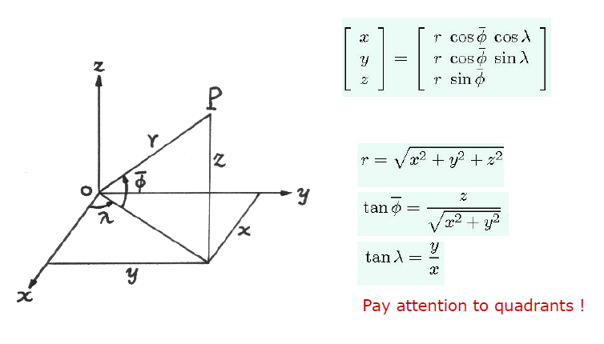
Rectangular vs spherical coordinates

Slide 4
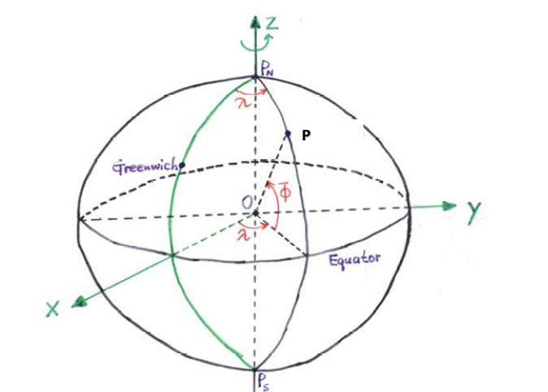
A spherical earth

Slide 5
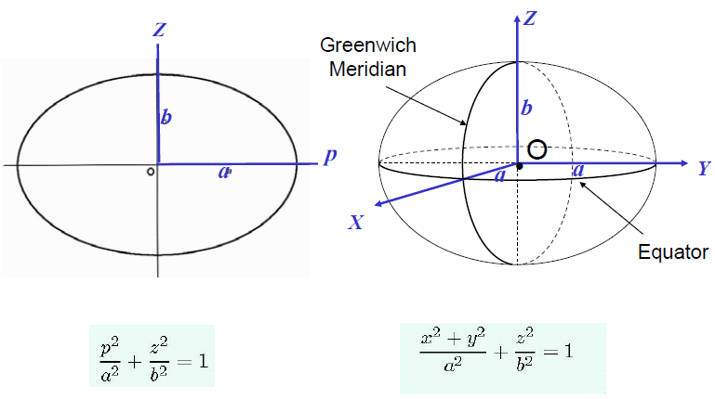
From ellipse to ellipsoid of revolution

Slide 6
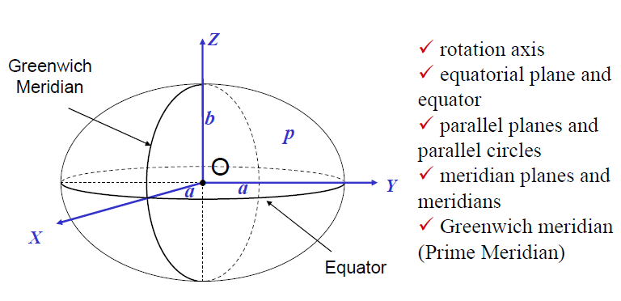
Geometry of an ellipsoid of revolution

Slide 7
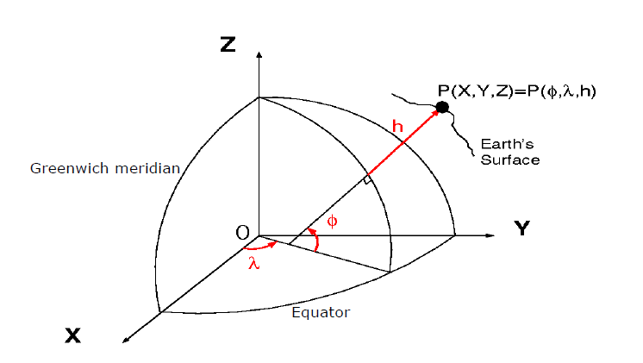
Definition of Geodetic Coordinates

Slide 8
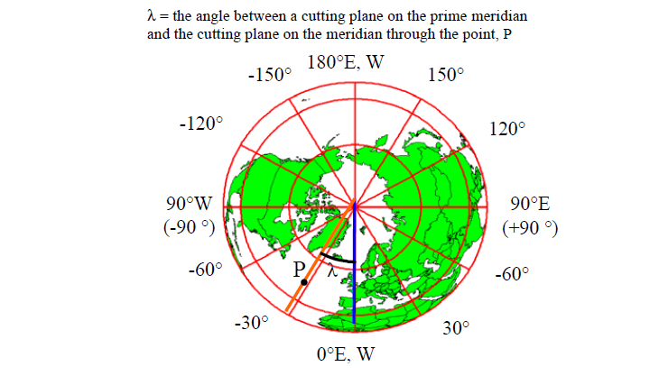
Definition of Longitude, λ

Slide 9
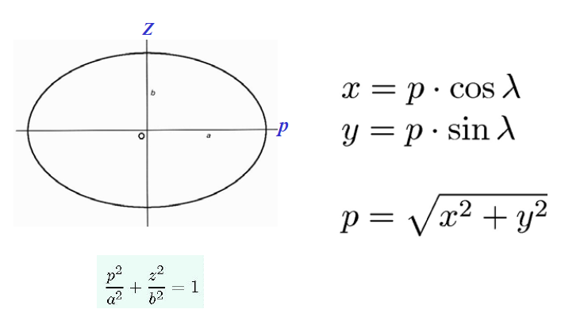
Relation between x, y and p, λ

Slide 10
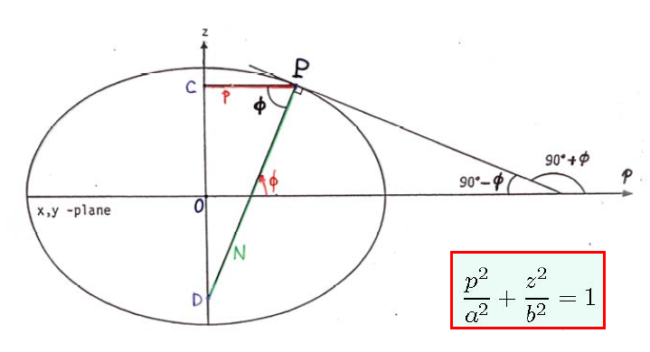
Meridian ellipse and latitude

Slide 11
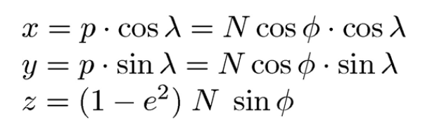
Point P on the reference ellipsoid

Slide 12
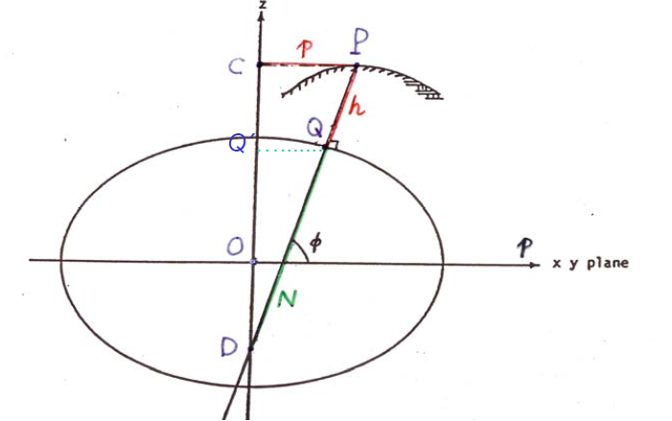
Point P above the reference ellipsoid

Slide 13
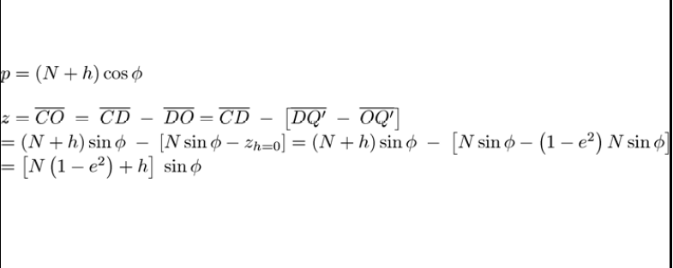
Point P above the reference ellipsoid

Slide 14
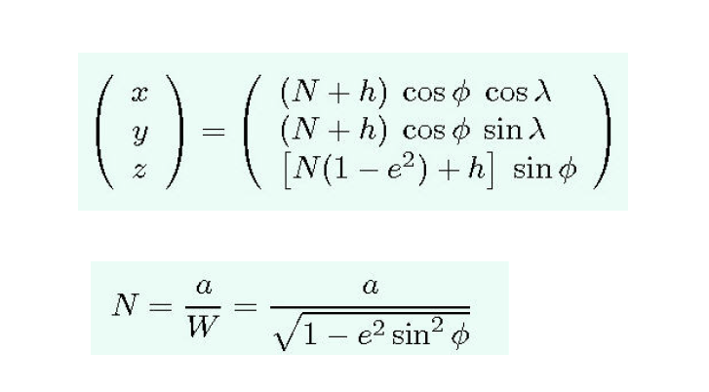
From geodetic to Cartesian coordinates

Slide 15
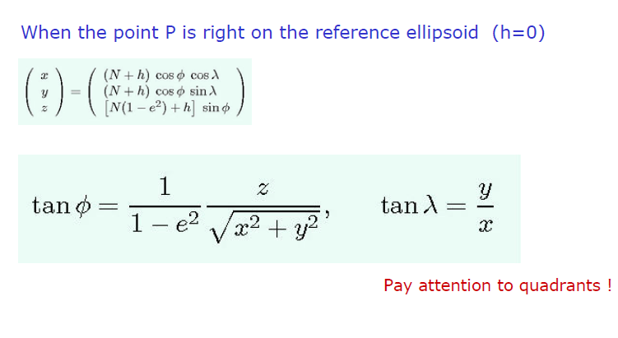
Transformation from Cartesian coordinates to geodetic coordinates

Slide 16
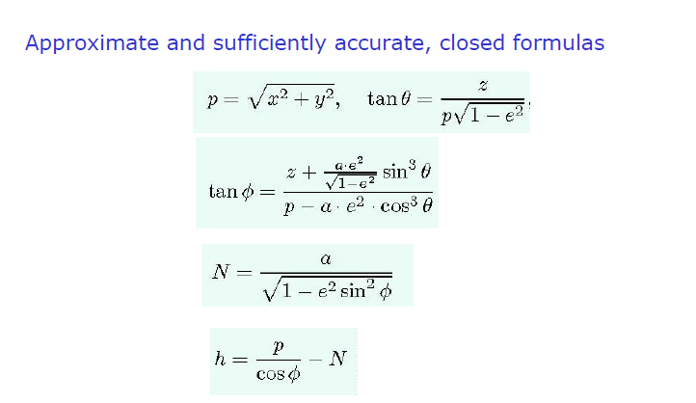
Transformation from Cartesian coordinates to geodetic coordinates

Slide 17
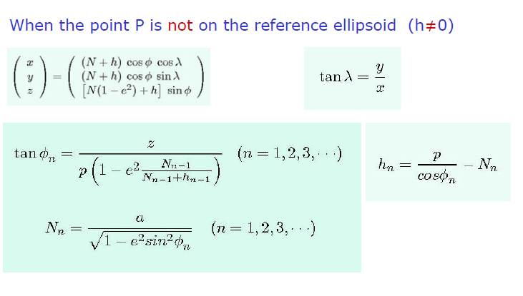
Transformation from Cartesian coordinates to geodetic coordinates

Slide 18
Transformation from Cartesian coordinates to geodetic coordinates
When the point P is not on the reference ellipsoid (h≠0)
Iterative computation of latitude and height:
n=0 : assume h0 = 0,
n=1 : → φ1 → N1 → h1
n=2 : → φ2 → N2 → h2
n=3 : → φ3 → N3 → h3
………………………………………….
n-1 : → φn-1 → Nn-1 → hn-1
n : → φn → Nn → hn

Slide 19
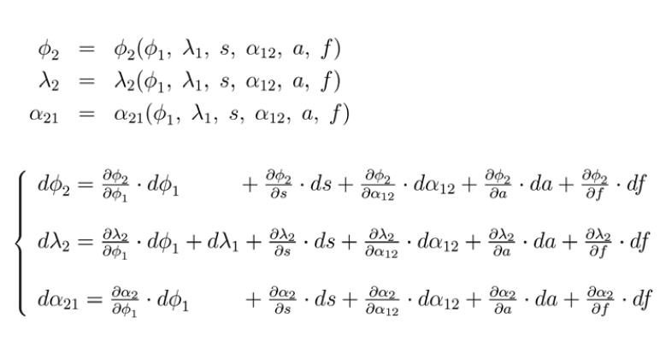
Helmert’s differential formulas

Slide 20
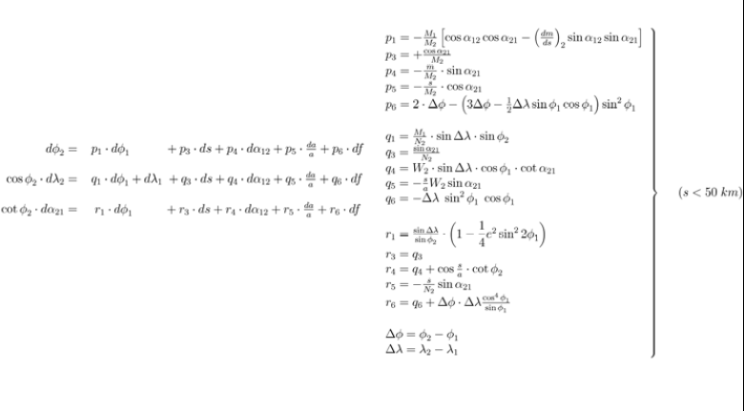
Helmert’s differential formulas

Slide 21
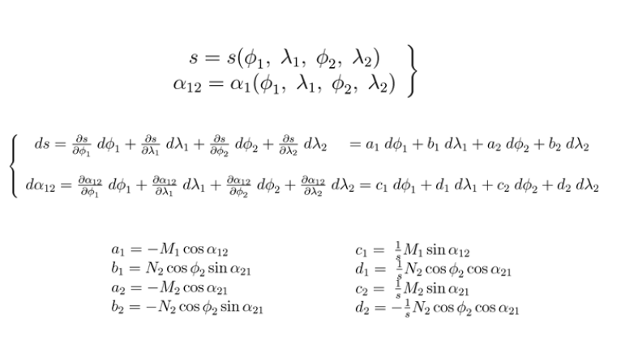
Inverse formulas

Slide 22
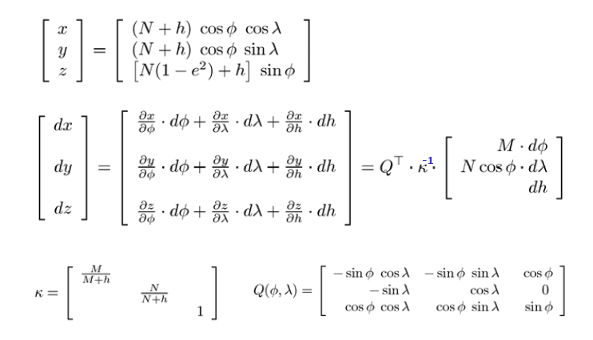
Geodetic versus Cartesian coordinates

Slide 23
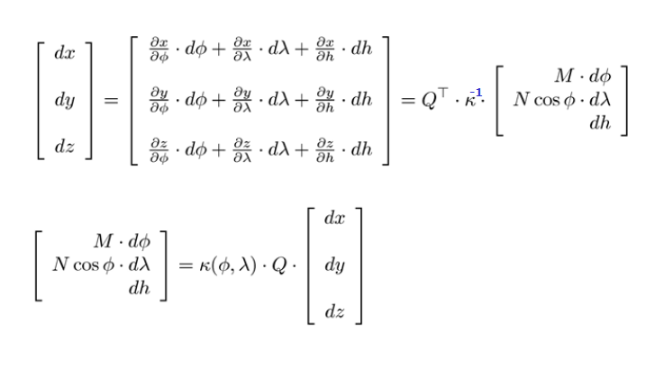
Geodetic versus Cartesian coordinates

Slide 24
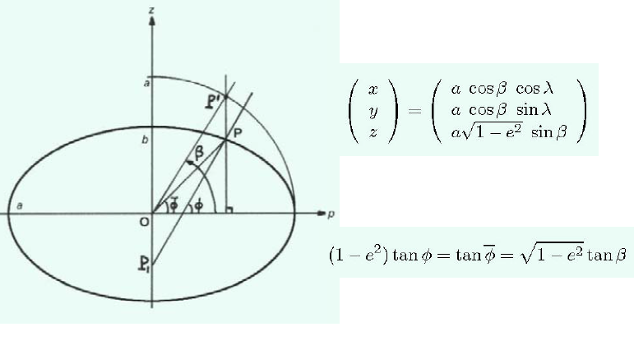
3 types of latitude on the ellipsoid

Slide 25
Topocentric coordinates
Origin at a ground point P (Xp, Yp, Zp)
Horizontal axes toward the North (N) and East (E)
Vertical axis upward along the plumb line (U)
P-NEU forms a left-handed system
The plumb line can be approximated by the ellipsoidal normal

Slide 26
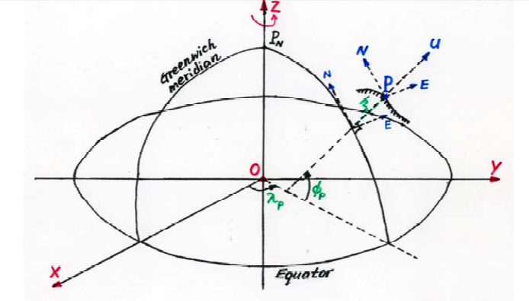
Topocentric coordinates

Slide 27
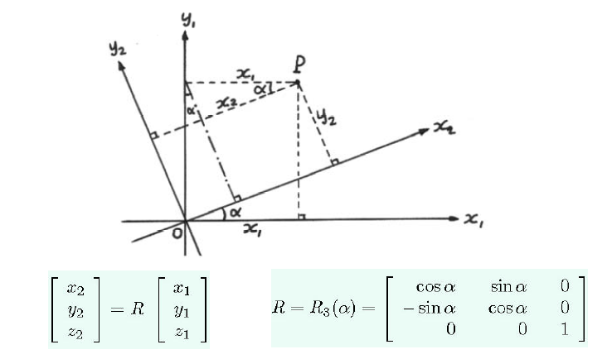
Rotation around the z-axis

Slide 28
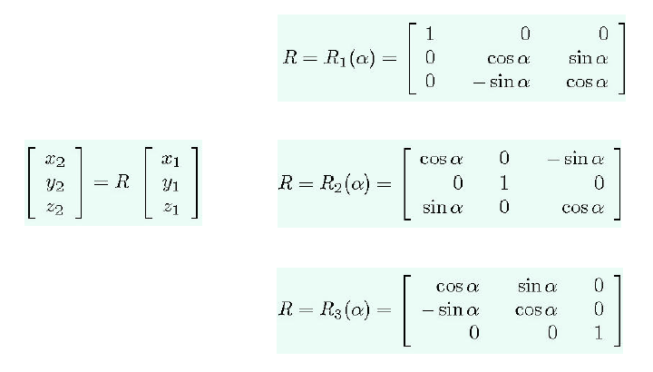
Rotation Matrices

Slide 29
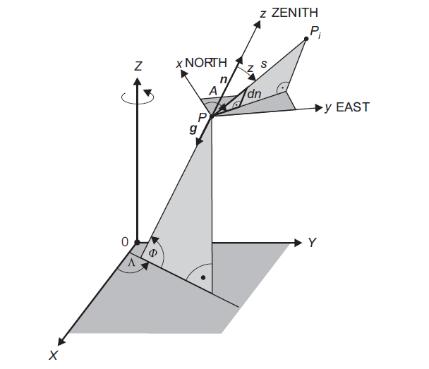
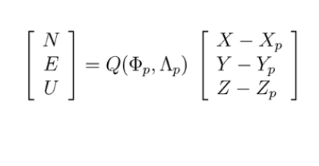
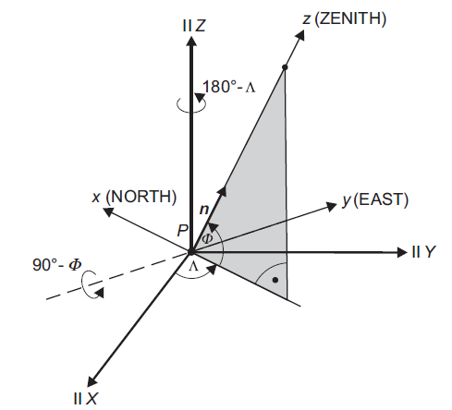
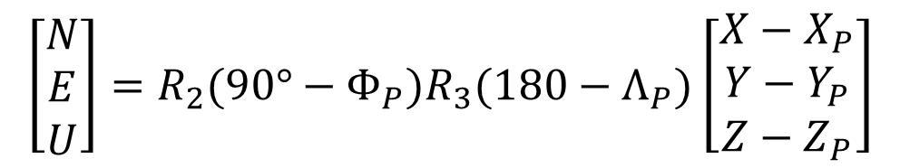
Topocentric coordinates
$$\left[\begin{matrix}N \\ E \\ U\end{matrix}\right]=R_{2}(90°−Φ_{P})R_{3}(180−Λ_{P})\left[\begin{matrix}X−X_{P} \\ Y−Y_{P} \\ Z−Z_{P}\end{matrix}\right]$$

Slide 30
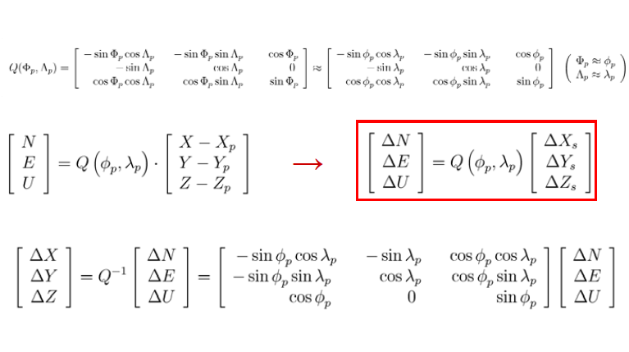
Topocentric coordinates

