Slide 1
Geodetic lines
Lecture 03

Slide 2
Geodetic lines & basic geodetic problems
Definitions: geodetic lines, geodetic triangles, geodetic azimuth, normal sections vs geodetic lines
Three basic equations of geodetic lines
Clairaut’s equation
Basic geodetic problems on the plane, on the sphere, on the reference ellipsoid

Slide 3
Definition of Geodetic lines
Point P on a curve ℓ situated on the reference ellipsoid
Osculating plane of P
If the osculating plane of P always contains the ellipsoidal normal at P, then ℓ is a geodetic line
Between two points on the ellipsoidal surface, the shortest distance is along the geodetic line between the two points

Slide 4
Geodetic triangle
3 geodetic lines form a geodetic triangle

Slide 5
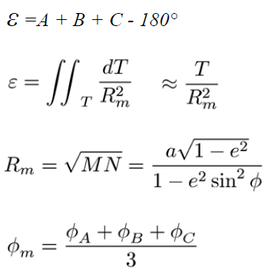
Geodetic excess

Slide 6
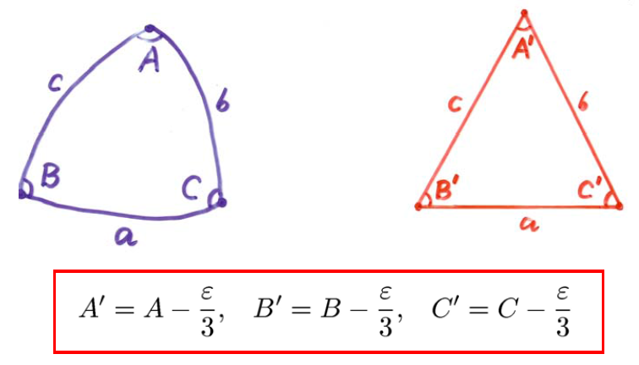
Approximation of a geodetic triangle by a planar triangle

Slide 7
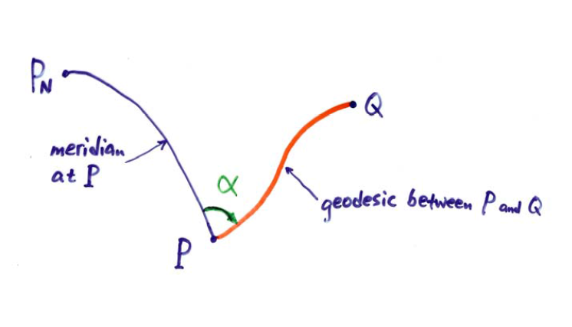
Geodetic azimuth

Slide 8
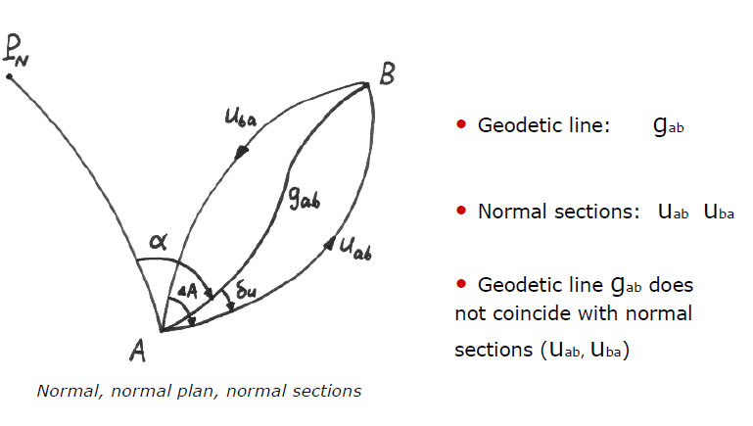
Geodetic line & normal sections

Slide 9
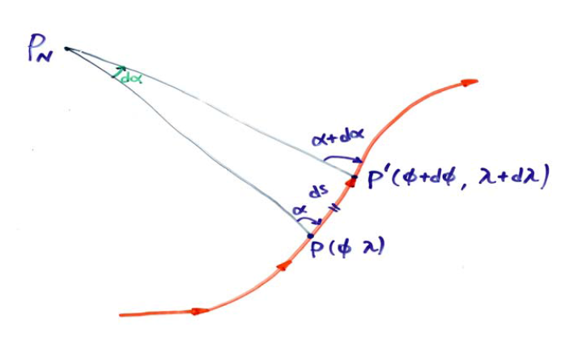
Differential change along a geodetic line

Slide 10
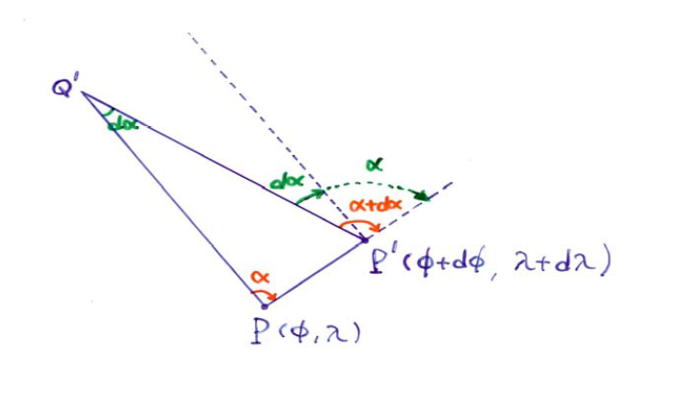
Azimuth change along a geodetic line

Slide 11
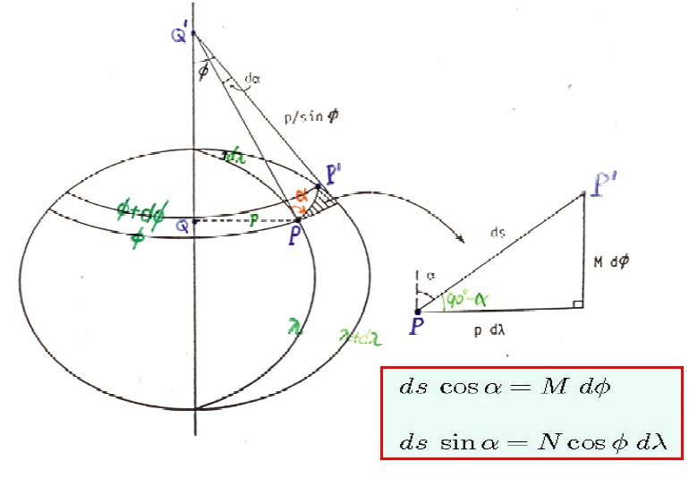

Slide 12
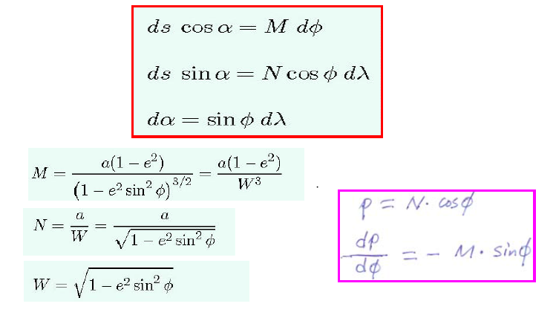
Basic equations of Geodetic lines

Slide 13
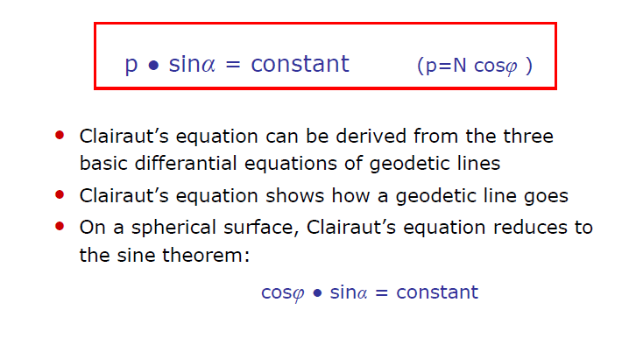
Clairaut’s equation of geodetic lines

Slide 14
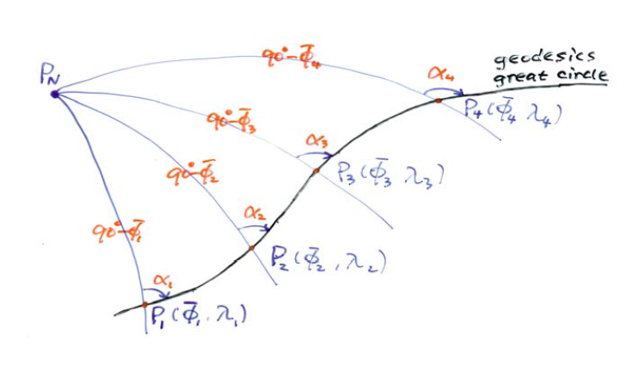
Clairaut’s equation on the sphere
(= sine theorem)

Slide 15
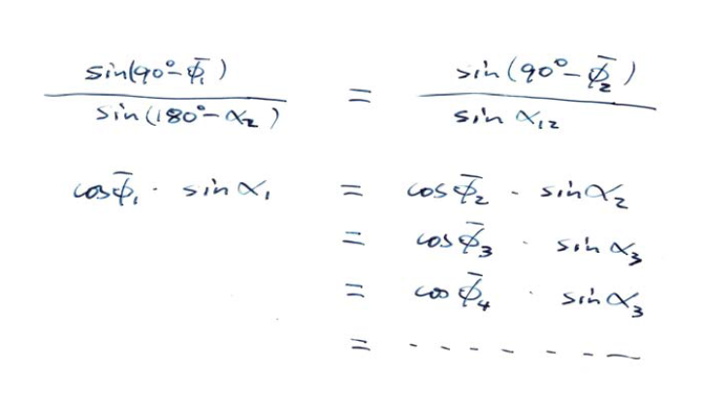
Clairaut’s equation on the sphere

Slide 16
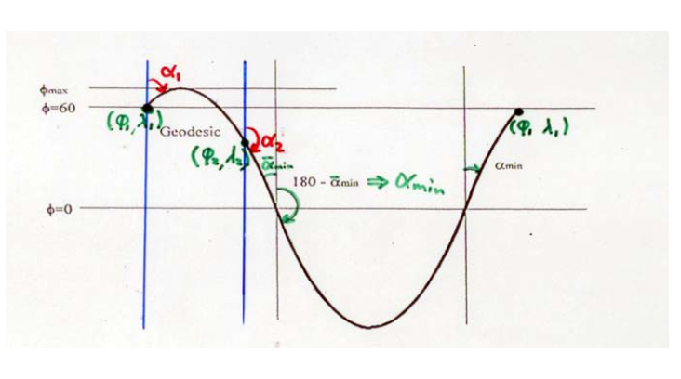
Example of one geodesic

Slide 17
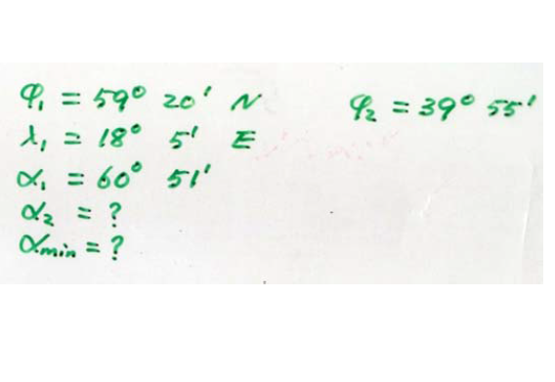
Example of one geodesic

Slide 18
Basic geodetic problems
• Basic problems on the plane
• Basic problems on the sphere
Basic problems on the reference ellipsoid
– Outline of solutions
– Gauss method of mean arguments
– Bessl’s method for long distances
– Example: maritime boundary delimitation
– Example: global triangulation on the ellipsoid

Slide 19
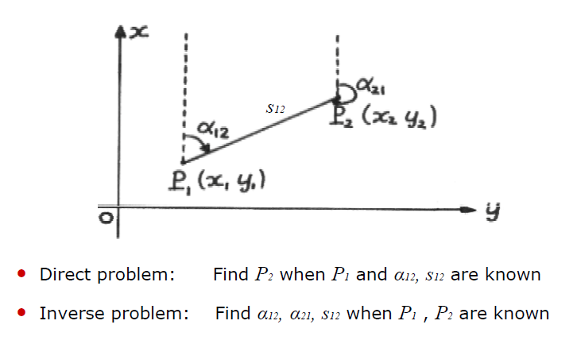
Basic problems on the plane

Slide 20
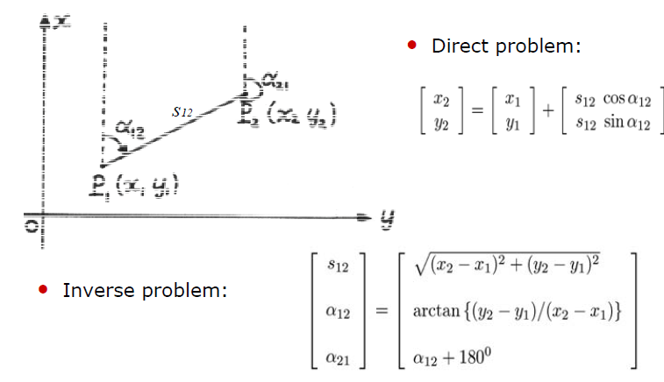
Basic problems on the plane

Slide 21
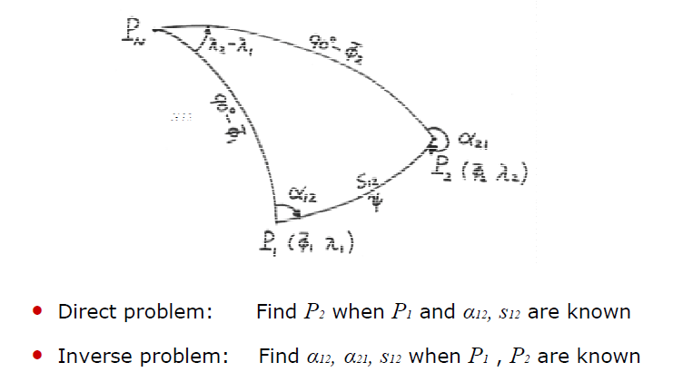
Basic problems on the sphere

Slide 22
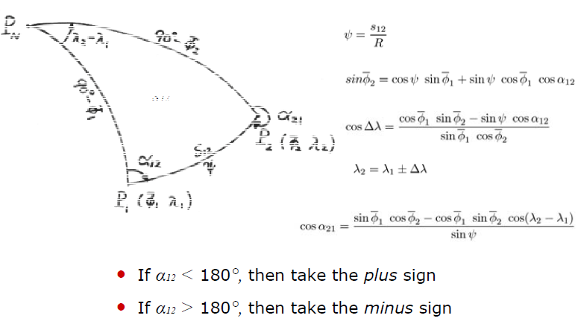
Direct problem on the sphere

Slide 23
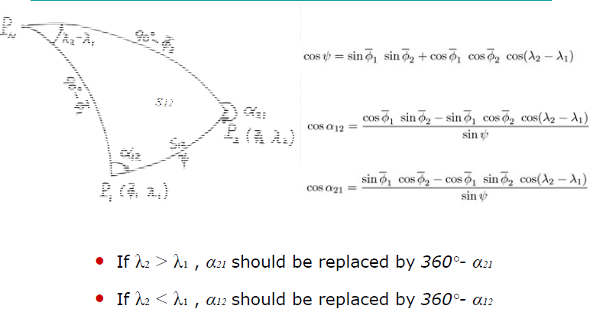
Inverse problem on the sphere

Slide 24
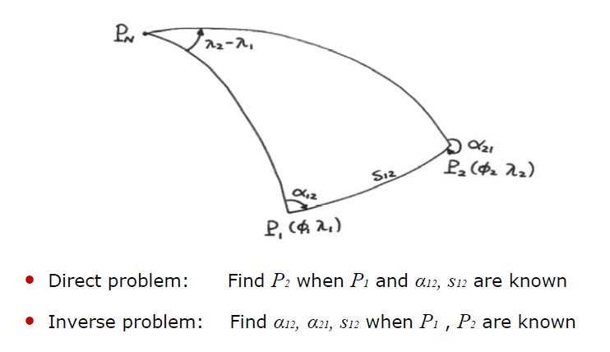
Basic problems on the ellipsoid

Slide 25
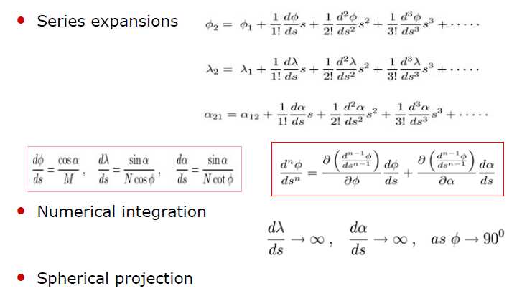
Methods for BGPs on the ellipsoid

Slide 26
Gauss’ method of mean arguments for medium distances <600km
• Series expansion around the average latitude
• Series expansion up to 4th terms
• Accurate for medium distances up to 600 km
• Solution to the inverse problem is straight-forward
• Solution to the direct problem is evaluated iteratively.
– Spherical solution can be the initial values

Slide 27
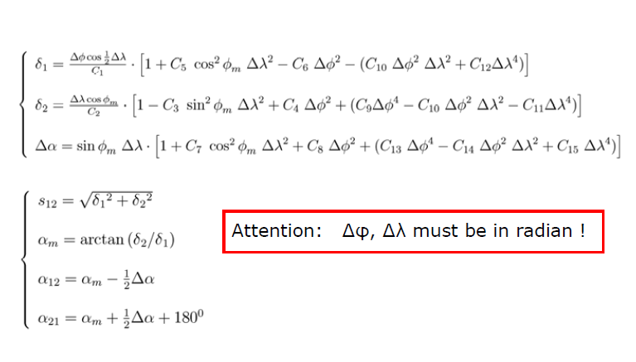
Gauss’ method of mean arguments
Solution to the inverse problem

Slide 28
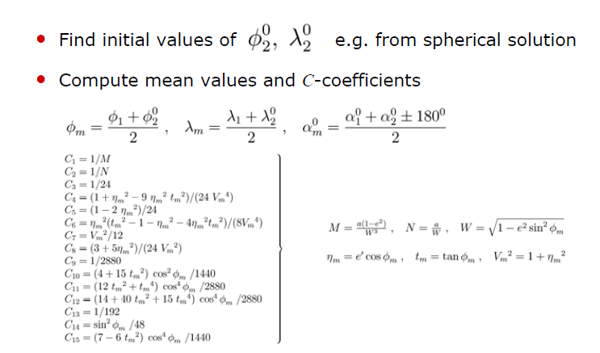
Gauss’ method of mean arguments
Solution to the direct problem

Slide 29
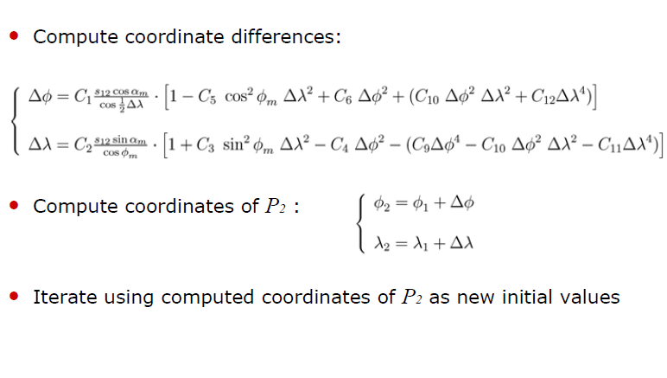
Gauss’ method of mean arguments
Solution to the direct problem

Slide 30
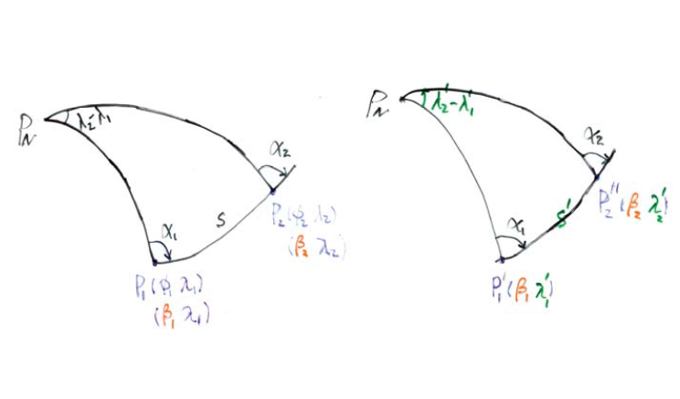
Bessel’s spherical projection

