Slide 1
Basic concepts of map projections
Lecture 04

Slide 2
Map projections: basic concepts
Types of map projections
Curvlinear coordinate systems
Scales of map projections
Tissot’s indicatrix and principal axes
Properties of map projections

Slide 3
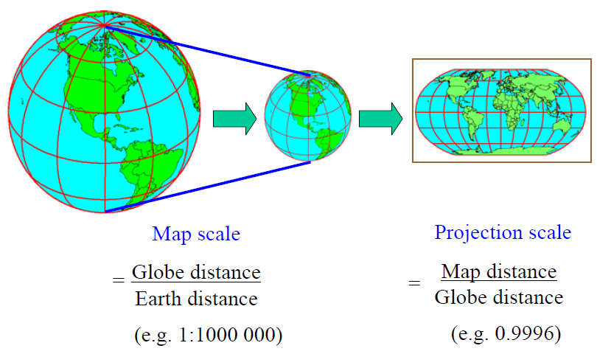
Map projections: basic concepts

Slide 4
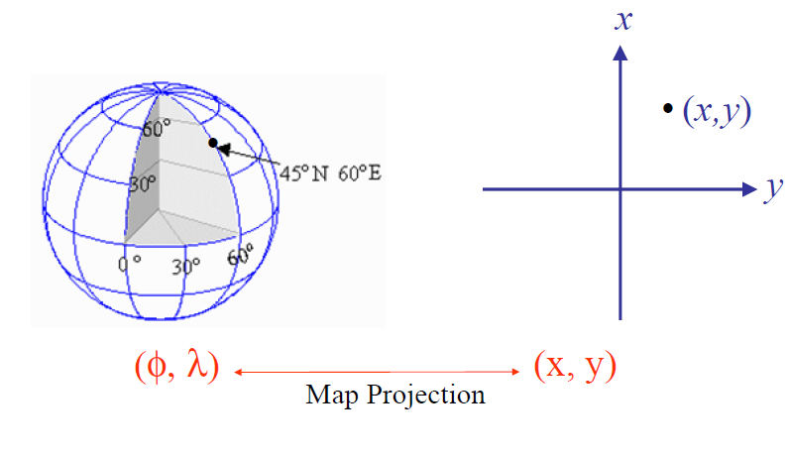
Geodetic vs projected coordinates

Slide 5
Classification of map projections
Different projection surfaces
Relation of projection surfaces to earth surface
Relation of axis/normal of the projection surface to the earth’s polar axis

Slide 6
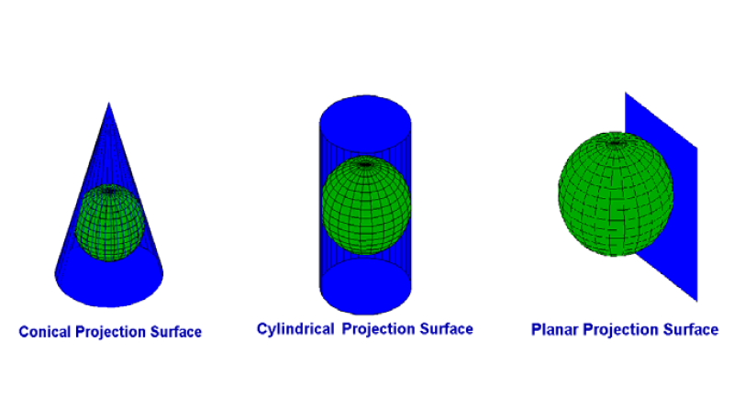
Classification by projection surfaces

Slide 7
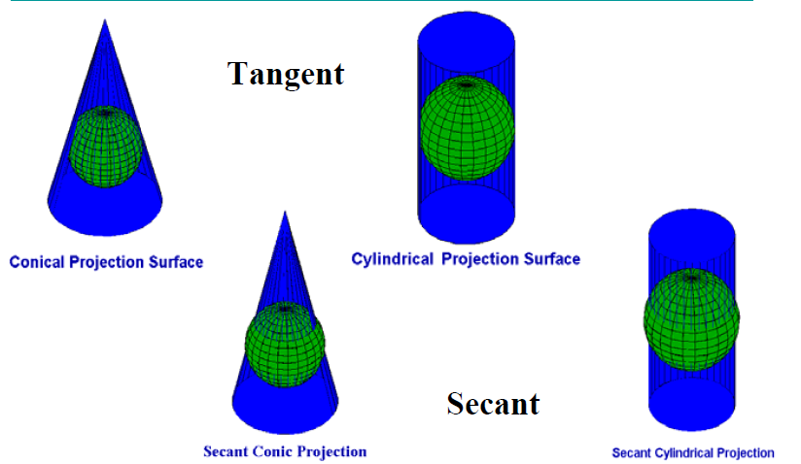
Relation of projection surface to earth surface

Slide 8
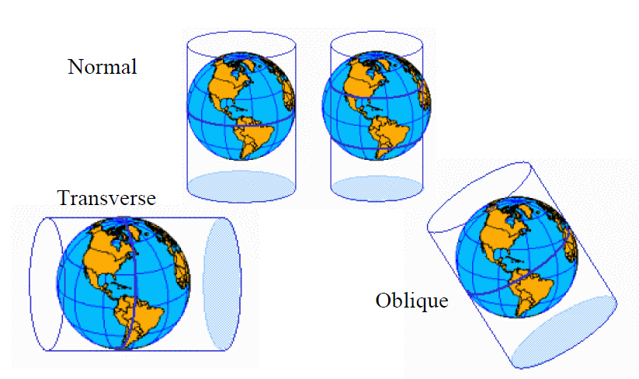
Relation to the polar axis

Slide 9
Properties of map projections
Conformal projections
Angles not changed
Shape of small figures not changed
Same scale in all directions at the same point
(but: different scales at different points!)
Equal-area projections (equivalence)
Area of small figures unchanged => angles changed
Equidistant projections (equidistance)
Some distances not changed (meridians, parallels)

Slide 10
Types of Projections
Conic (Albers Equal Area, Lambert Conformal Conic) - good for East-West land areas
Cylindrical (Transverse Mercator) - good for North-South land areas
Azimuthal (Lambert Azimuthal Equal Area) - good for polar/global views

Slide 11
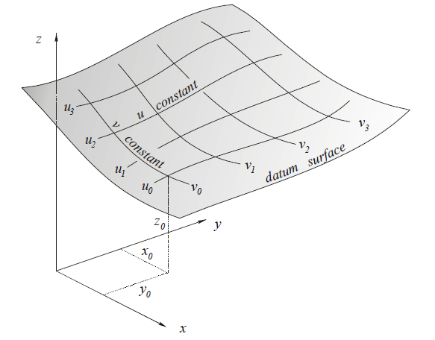
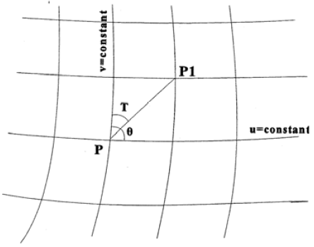
Curvlinear coordinate system

Slide 12
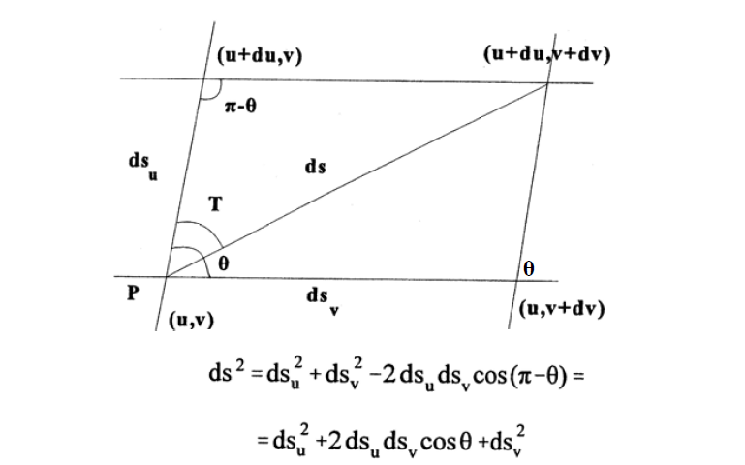
Distance differential (metric)

Slide 13
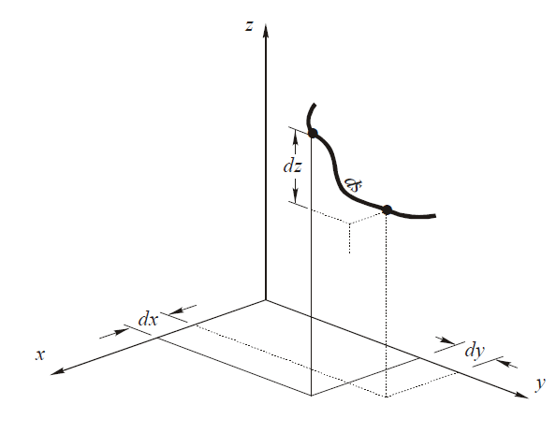
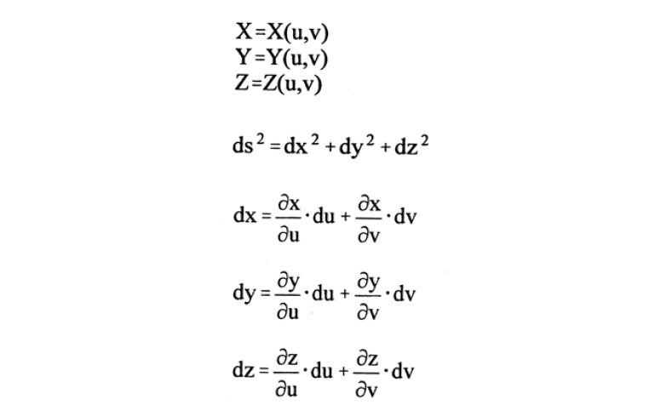
Distance differential

Slide 14
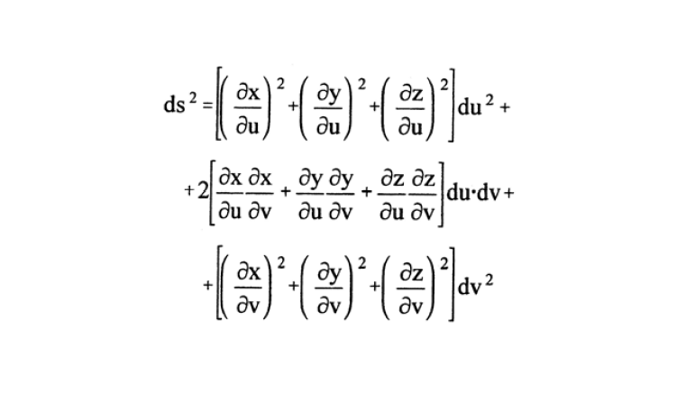
Distance differential

Slide 15
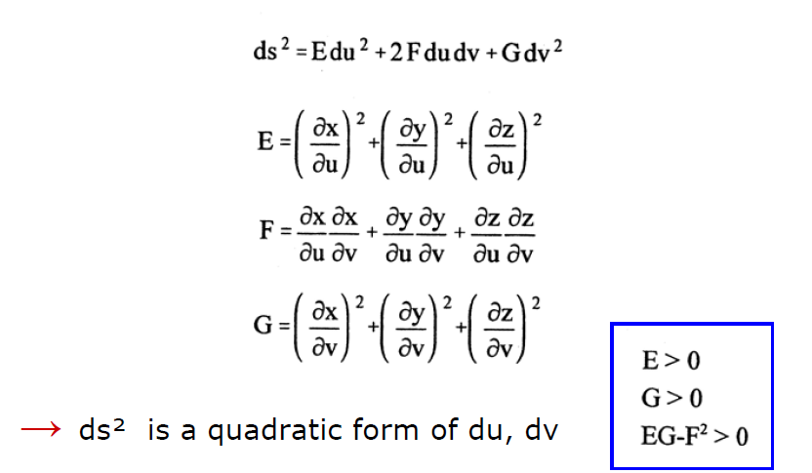
Distance differential

Slide 16
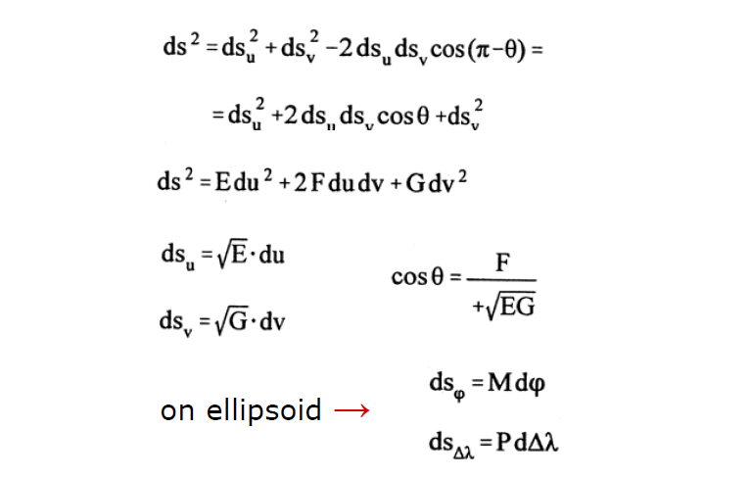
Distance differential

Slide 17
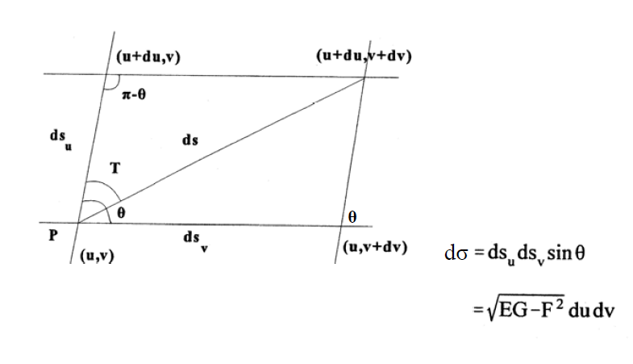
Area of the parallelogram

Slide 18
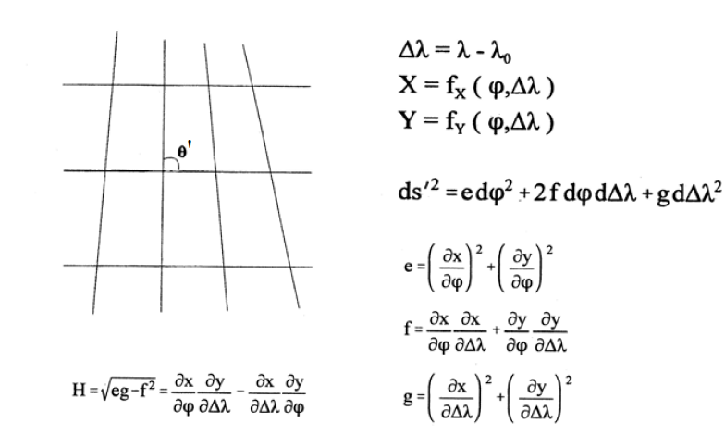
Differentials on projection plane

Slide 19
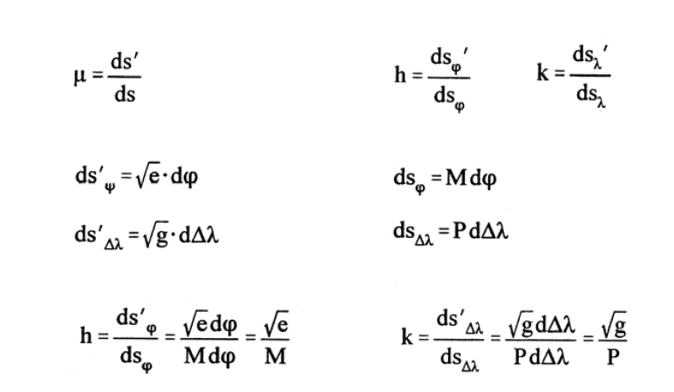
Linear scales of map projections

Slide 20


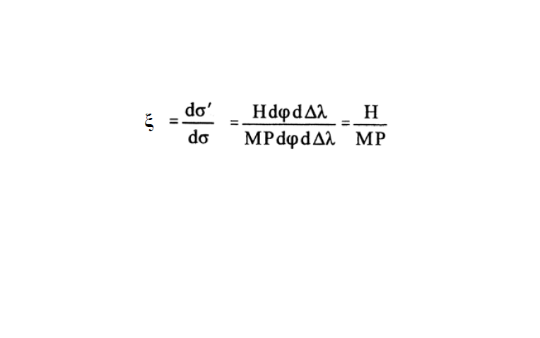
Area scale of map projections

Slide 21
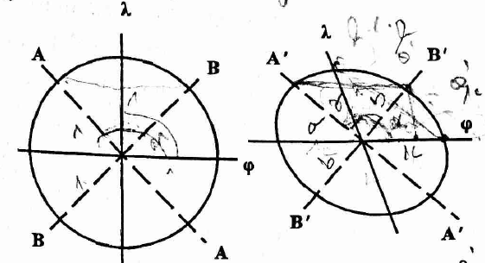
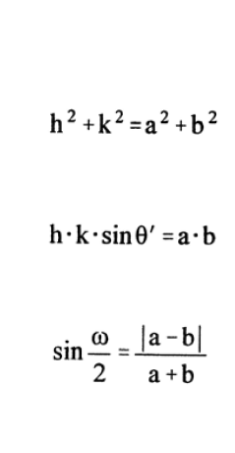
Tissot’s indicatrix
The indicatrix is the perfect small ellipse which occurs in any map projection which an infinitely small circle on earth is projected to the plane.

Slide 22
Tissot’s indicatrix & projection properties
Conformal projections: a=b, ω=0
The indicatrix is a circle
Equal-area projections: a•b =1
Shape and size distortion
Equidistant projections: h=1.0 for meridians and certain parallel circles

Slide 23
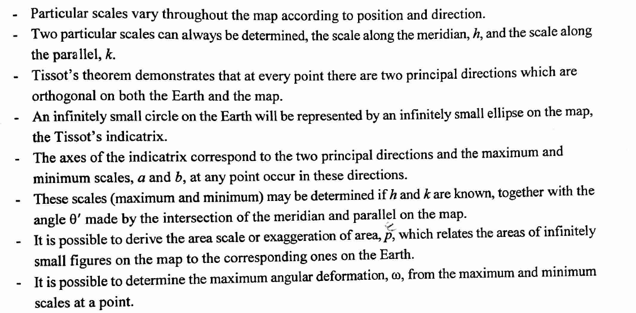
Summary

Slide 24
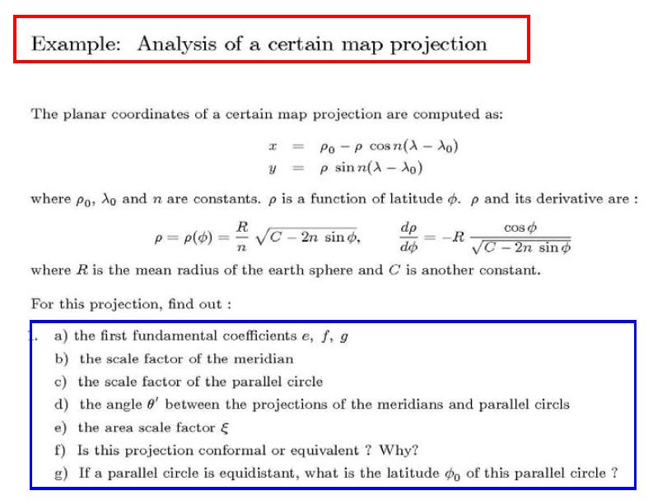

Slide 25
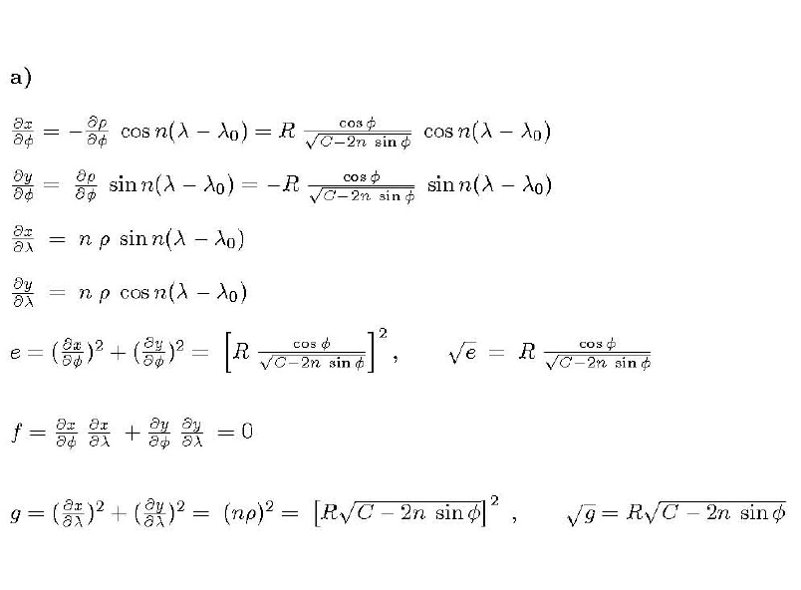

Slide 26
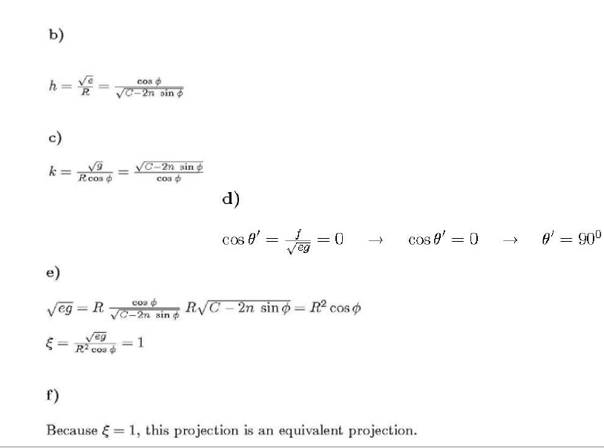

Slide 27
