Slide 1
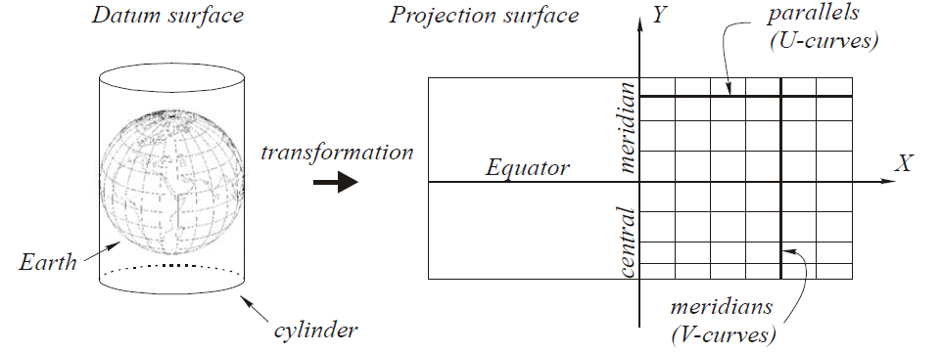
Cylindrical projections
Lecture 05

Slide 2
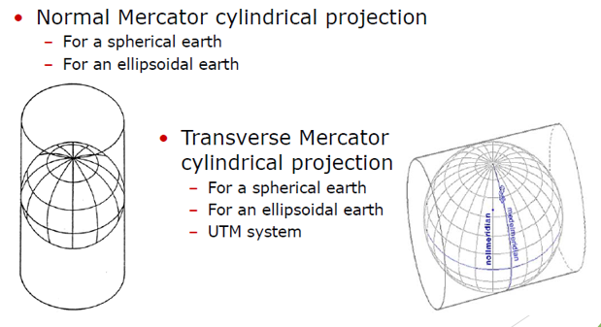
Cylindrical map projections

Slide 3
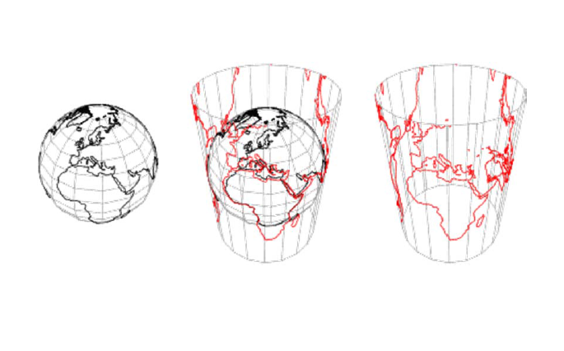
Normal ”glass” projection

Slide 4
Normal Mercator projection

Slide 5
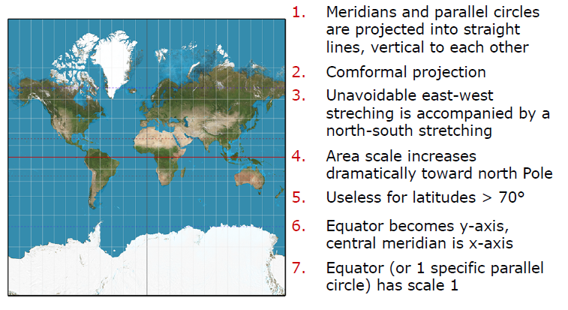
Characters of Normal Mercator projection

Slide 6
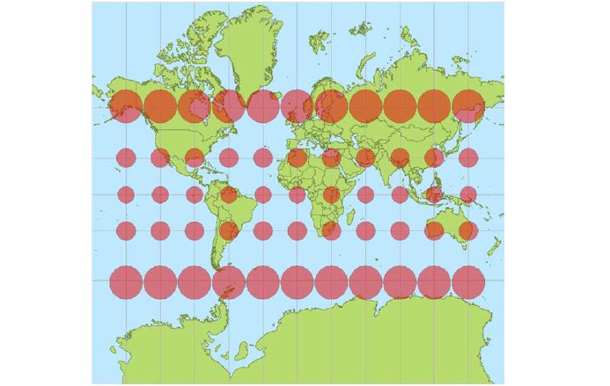
Normal Mercator projection for a sphere

Slide 7
NASA Blue Marble images

Slide 8
Mercator World Map by Rumold Mercator, 1587

Slide 9
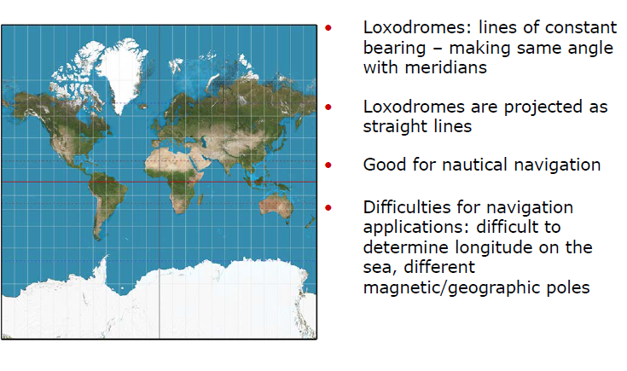
Characters of Normal Mercator projection

Slide 10
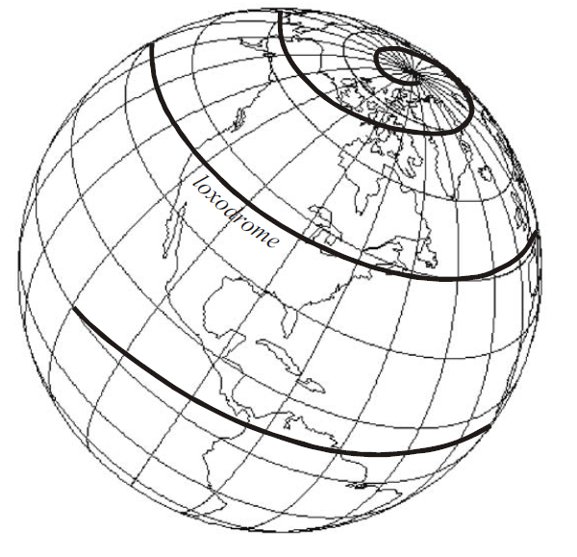
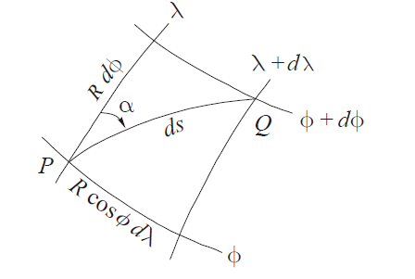
loxodrome
A loxodrome or plumb line is a curved line on the sphere (or ellipsoid) such that every element of the curve ds intersects a meridian at a fixed angle α. In marine and air navigation, aircraft and ships sailing or flying on fixed compass headings are moving along loxodromes, hence knowledge of loxodromes is important in navigation

Slide 11
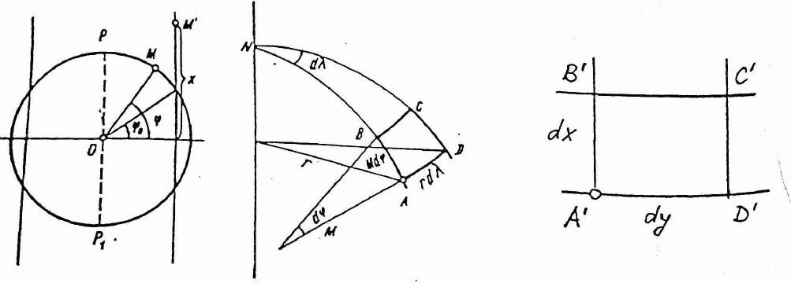
Normal Mercator projection for a sphere

Slide 12
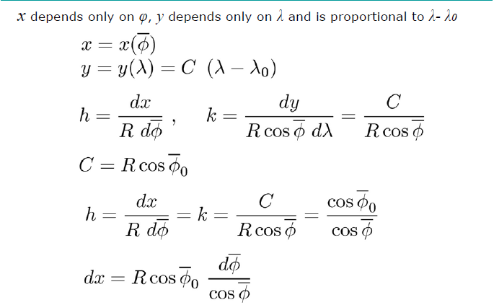
Normal Mercator projection for a sphere

Slide 13
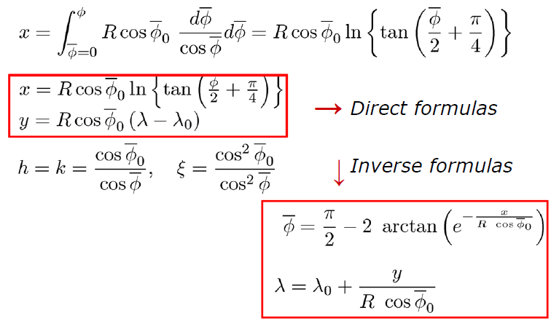
Normal Mercator projection for a sphere

Slide 14
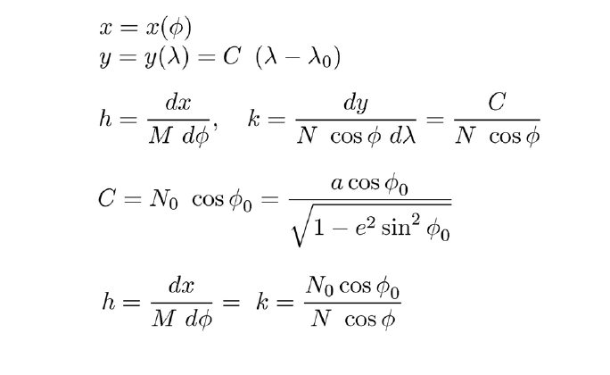
Normal Mercator projection for an ellipsoid

Slide 15
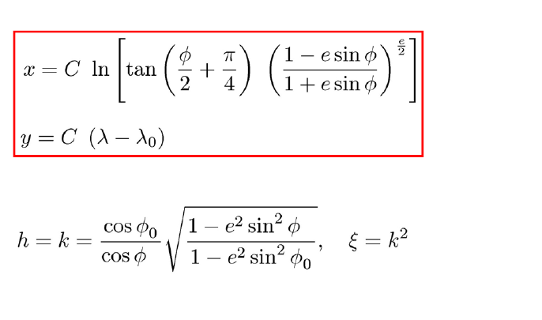
Normal Mercator projection for an ellipsoid

Slide 16
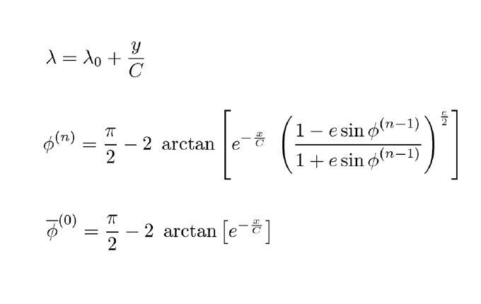
Normal Mercator projection for an ellipsoid

Slide 17
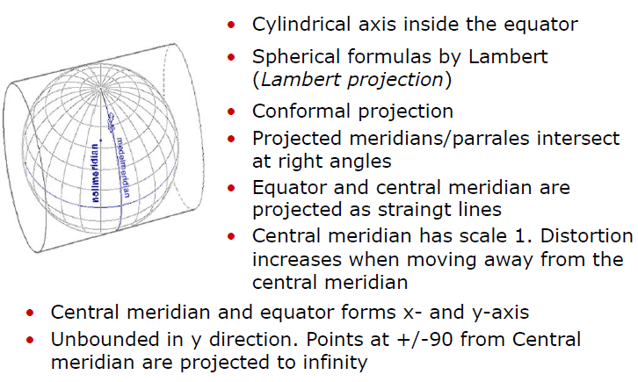
Transversal Mercator projections for a sphere

Slide 18
Spherical TM projection (EW truncated)

Slide 19
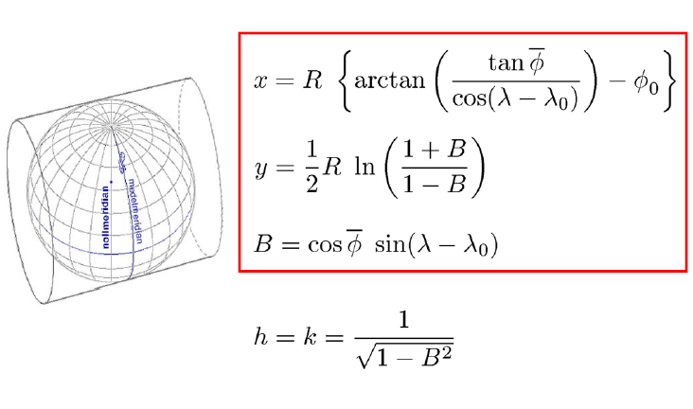
Spherical TM, Direct formulas

Slide 20
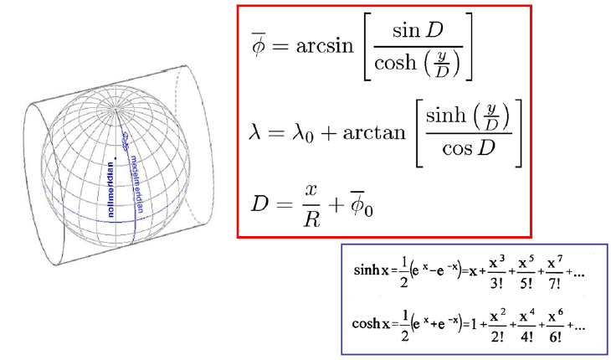
Spherical TM, Inverse formulas

Slide 21
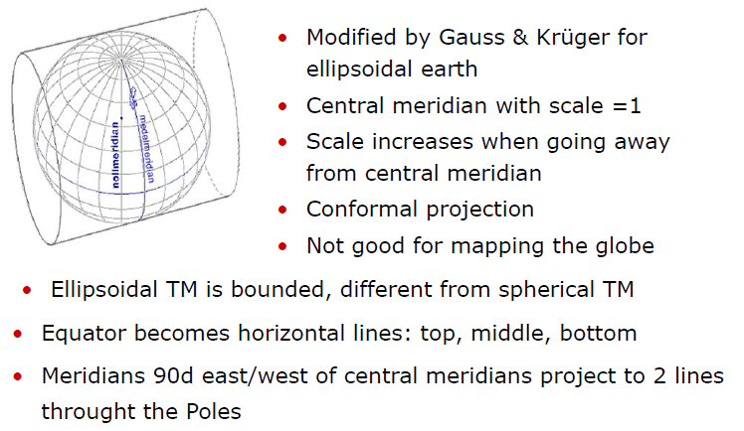
Gauss-Krüger map projections

Slide 22
Ellipsoidal TM projection

Slide 23
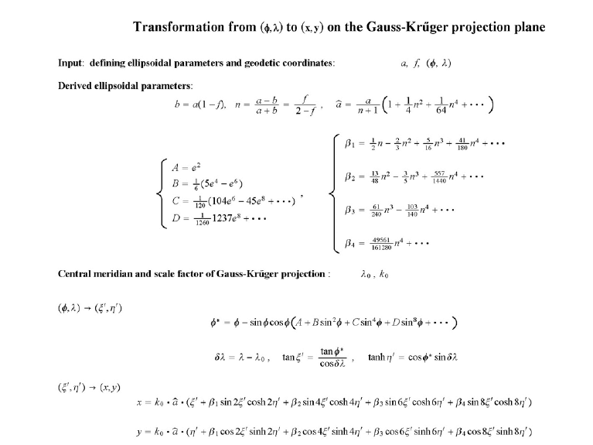

Slide 24
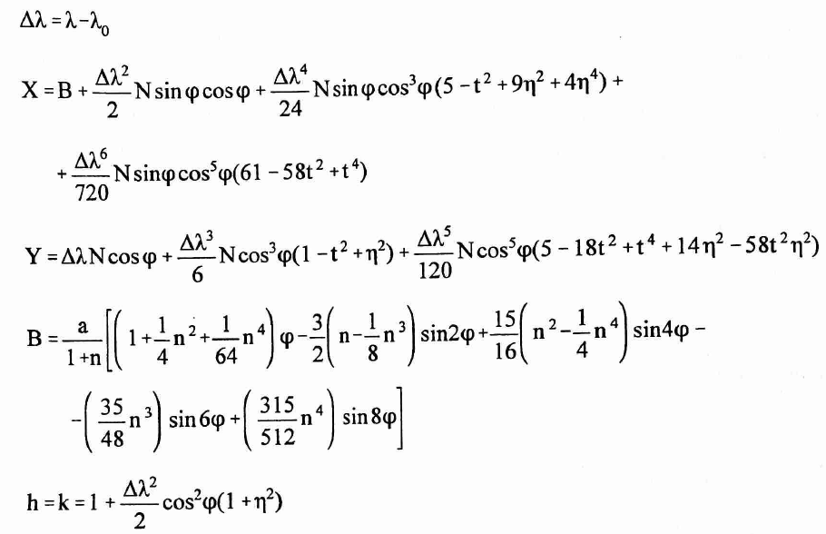
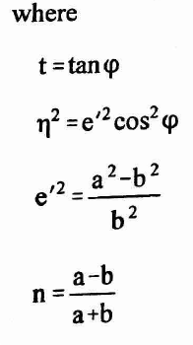


Slide 25
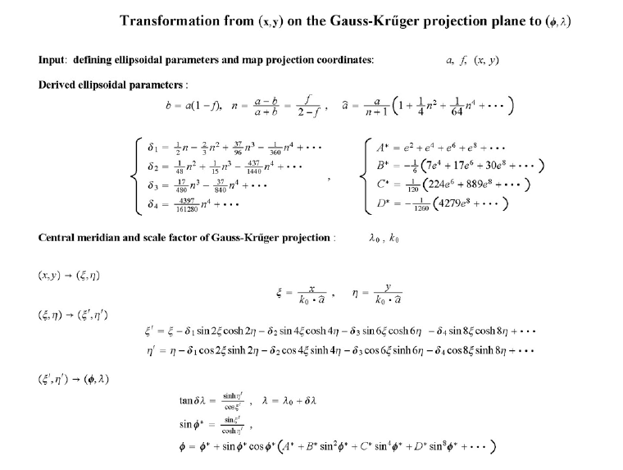

Slide 26
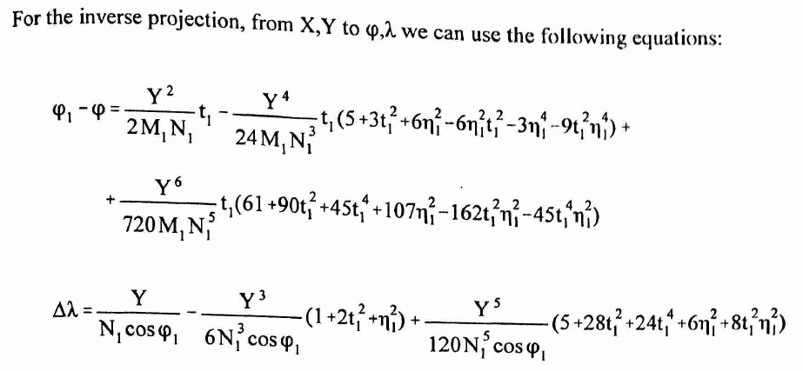
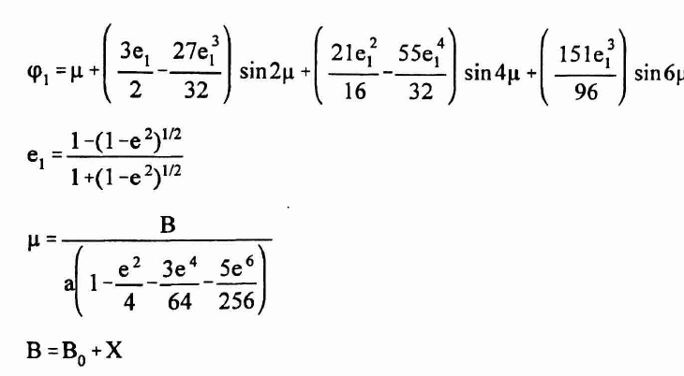

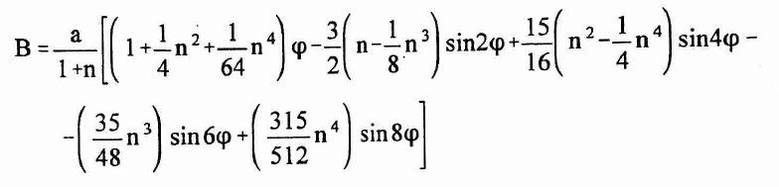
ϕ₁
Where Bo is calculated using
for ϕ_{o}

Slide 27
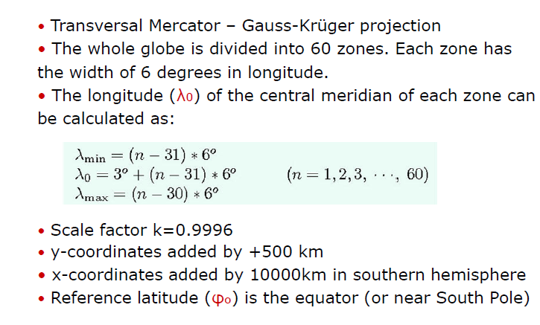
Universal Transverse Mercator - UTM

Slide 28
Definition of UTM Zones

Slide 29
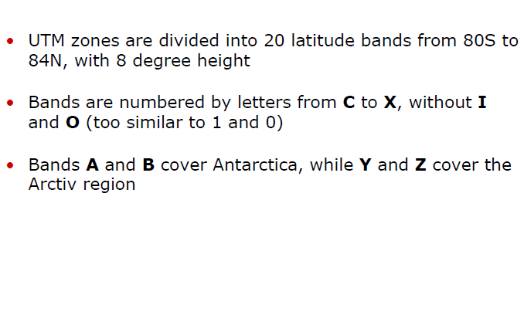
Latitude bands in UTM system

Slide 30
Ethiopian Map projection: UTM 36,37, 38
Based on geodetic datum Adindan
Use Clarke 1880 ellipsoid: a= 6 378 249.145, f=1/293.465
UTM 36, 37, 38
Central meridian: λ₀ =33°, 39° 45°
Scale factor k=0.9996
x-coordinates are added by +500 km
Reference latitude (φo), is the equator

