Slide 1
Geodetic astronomy
Lecture 06

Slide 2
Geodetic astronomy
Celestial sphere
Celestial coordinates (of a celestial body)
  Horizon coordinate system
  Equatorial coordinate system
  Ecliptic coordinate system
Concepts of time
  Sidereal time, solar time, atomic time/UTC/GPST
Astronomical positioning

Slide 3
Celestial sphere
Elements on the sphere
  zenith, horizon
  celestial North pole, celestial equator
  local meridian
  zenith and meridian at Greenwich
  astronomical latitude and longitude
  apparent motion
The Sun and the ecliptic
  ecliptic, obliquity
  Sun’s apparent motion
  Vernal vs Autumn equinox
  polar circle

Slide 4
Introduction
Celestial coordinate systems are used to define the coordinates of celestial bodies such as stars.
The distance from the earth to the nearest star is more than 10⁹ earth radii, therefore, the dimensions of the earth are almost negligible compared to the distances to the stars.
A second consequence of these great distances is that, although the stars themselves are believed to be moving at velocities near the velocity of light, to an observer on the earth this motion is perceived to be very small, very rarely exceeding one arcsecond per year.
Relatonship between the earth and stars can be closely approximated by considering the stars all to be equidistant from the earth, on the surface of the celestial sphere, the dimension of which is so large that the earth can be considered as a dimensionless point at the center.
Although this point may be dimensionless, relationships between directions on the earth and in the solar system can be extended to the celestial sphere.

Slide 5
Introduction
The earth's rotation axis is extended outward to intersect the celestial sphere at the north celestial pole (NCP) and south celestial pole (SCP).
The earth's equatorial plane extended outward intersects the celestial sphere at the celestial equator.
The gravity vertical at a station on the earth is extended upwards to intersect the celestial sphere at the zenith (Z), and downwards to intersect at the nadir (N).
The plane of the earth's orbit around the sun (the ecliptic plane) is extended outward to intersect the celestial sphere at the ecliptic.
The line of intersection between the earth's equatorial plane and the ecliptic plane is extended outwards to intersect the celestial sphere at the vernal equinox or first point of Aries, and the autumnal equinox. The vernal equinox is denoted by the symbol γ, and is the point at which the sun crosses the celestial equator from south to north.

Slide 6
Introduction
There are two fundamental differences between celestial systems and terrestrial or orbital systems. First, only directions and not distances are considered in celestial coordinate systems.
In effect this means that the celestial sphere can be considered the unit sphere, and all vectors dealt with are unit vectors.
The second difference is related to the first, in that the celestial geometry is spherical rather than ellipsoidal as in terrestrial and orbital systems, which simplifies the mathematical relationships involved.
There are four main celestial coordinate systems, called the ecliptic, right ascension, hour angle, and horizon.
Sometimes the right ascension and hour angle systems are referred to collectively as equatorial systems.

Slide 7
Celestial sphere

Slide 8
Celestial sphere – the ecliptic

Slide 9
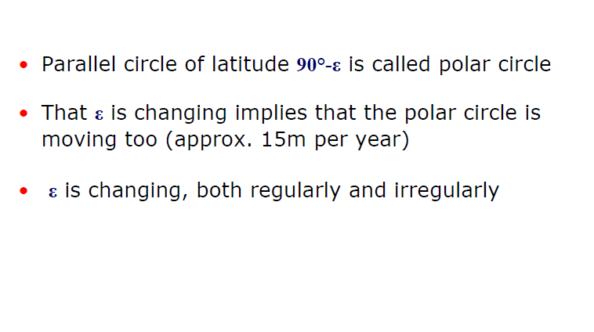
Polar circle

Slide 10
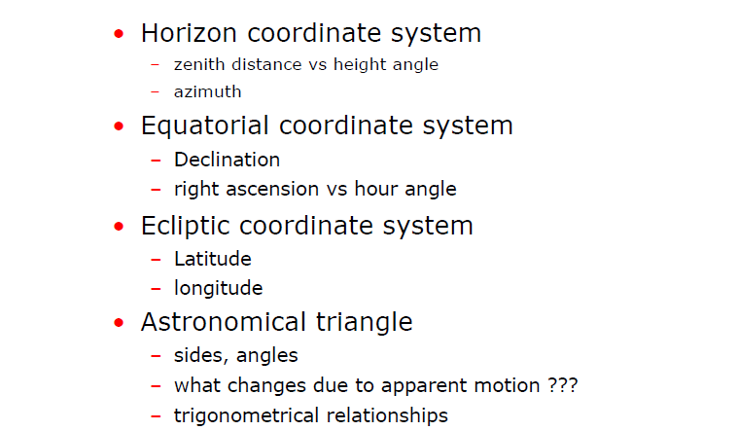
Celestial coordinates of celestial bodies

Slide 11
Horizon coordinates A and z (or h)
Azimuth: A
Zenith distance: z
Height angle: h

Slide 12

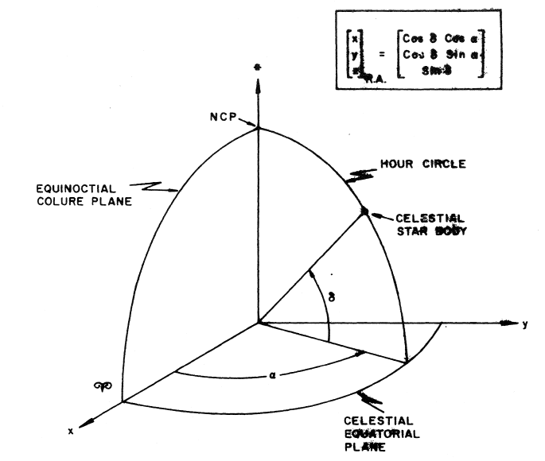
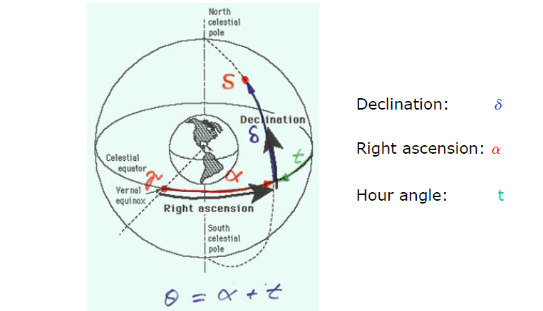

Slide 13
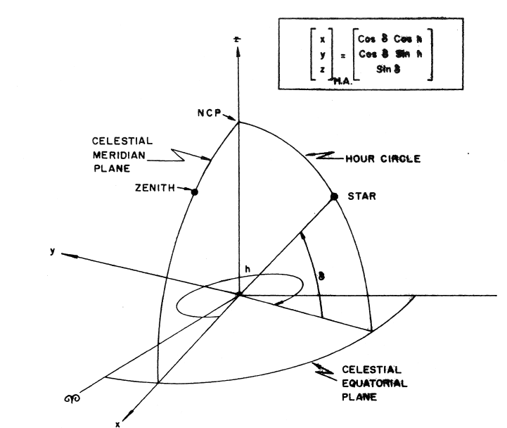
Equatorial coordinate – hour angle

Slide 14
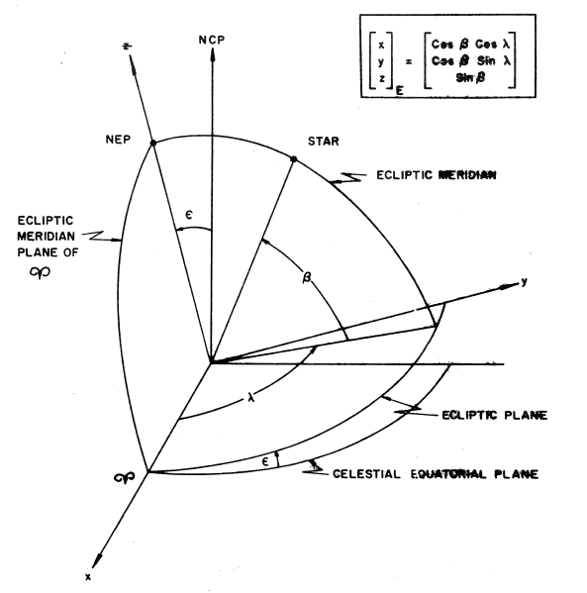
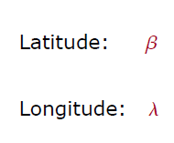
Ecliptic coordinates β and λ

Slide 15
Astronomical triangle
What are the sides and angles ?
Which quantity changes with time due to apparent motion ?

Slide 16
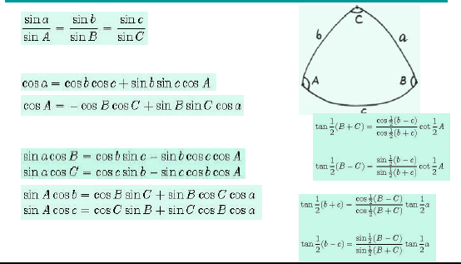
Spherical trigonometry

Slide 17
Trigonometric formulas for the astronomical triangle

Slide 18
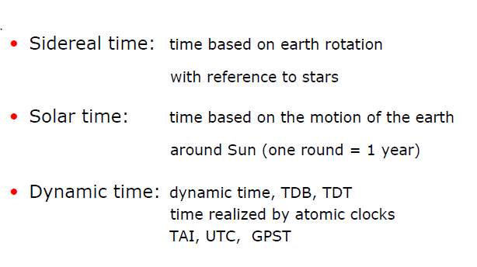
Concepts of time

Slide 19
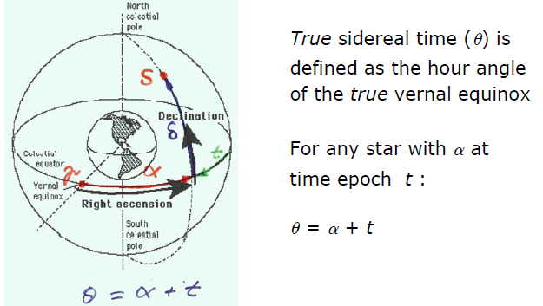
Definition of Sidereal time

Slide 20
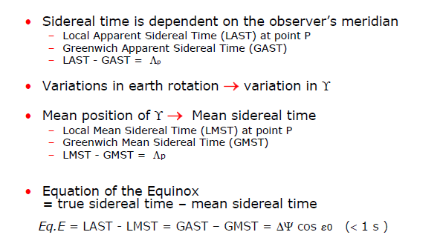
Sidereal time

Slide 21
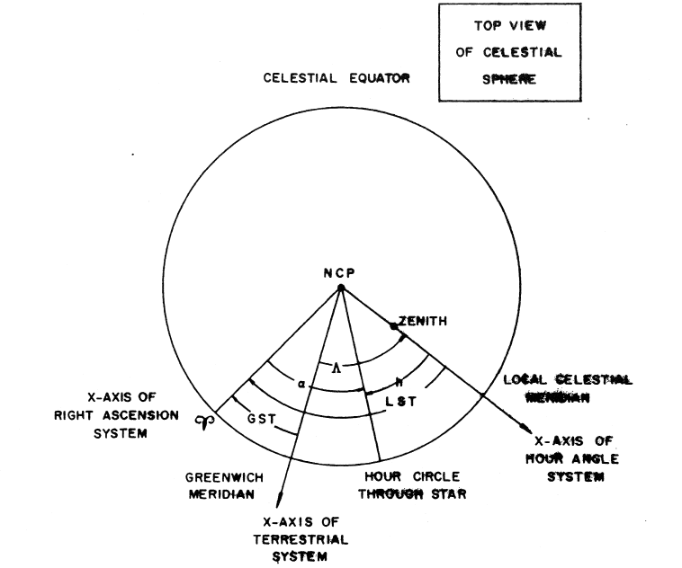
Time, Longitude, and Right Ascension

Slide 22
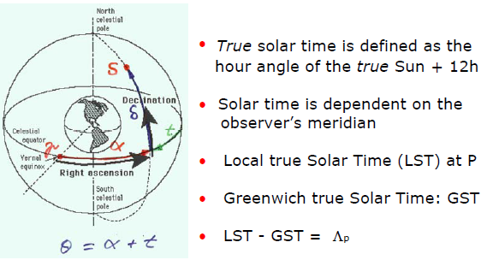
Definition of True Solar time

Slide 23
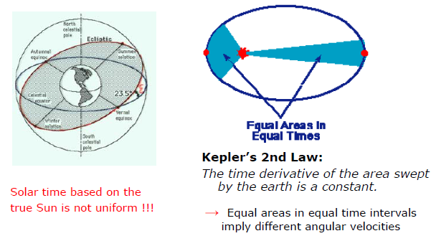
Non-uniform motion of the Earth

Slide 24
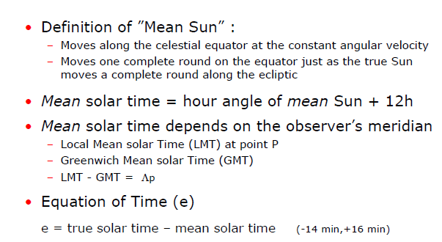
Definition of Mean Solar time

Slide 25
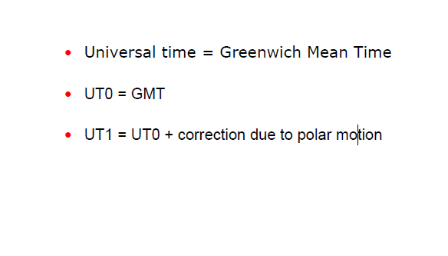
Universal Time (UT)

Slide 26
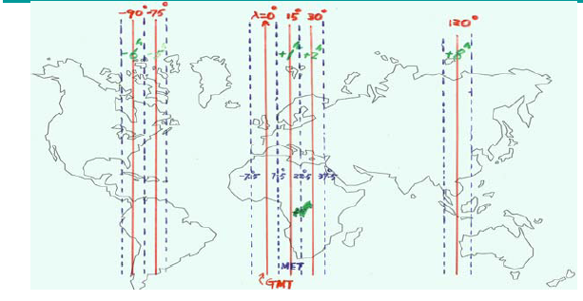
Zone time (mean solar time)
Zone time: mean solar time referred to the mid-meridian of a zone with longitude difference of 15 degrees
Ethiopian time: ET = GMT + 3h

Slide 27
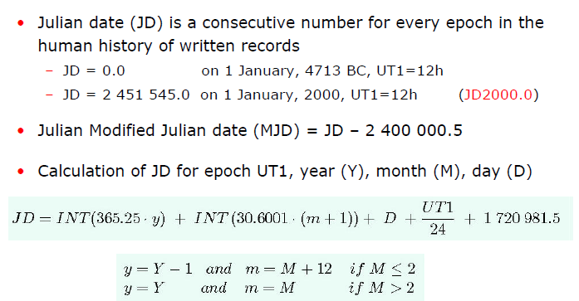
Julian date

Slide 28
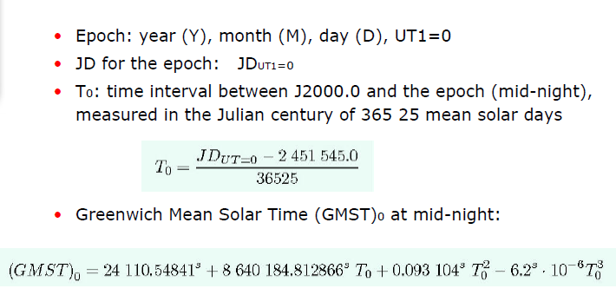
Greenwich Mean Sidereal Time (GMST)₀ at mid-night (UT1=0)

Slide 29
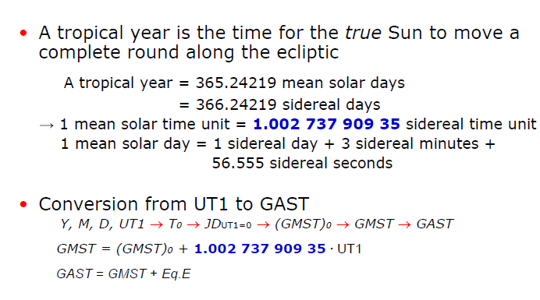
Conversion from Mean Solar Time UT1 to Greenwich Mean Sidereal Time GAST

Slide 30
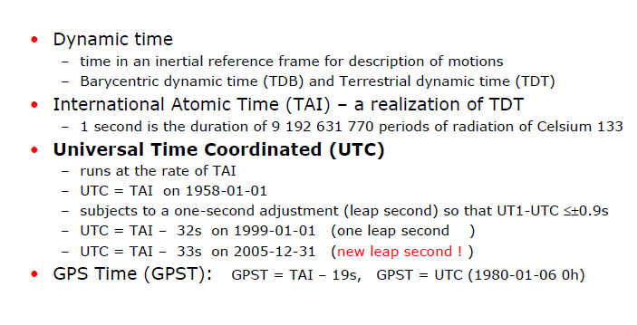
Universal Time Coordinated (UTC)

Slide 31
Variation of UT1-UTC

Slide 32
Variation of UT1-UTC

Slide 33
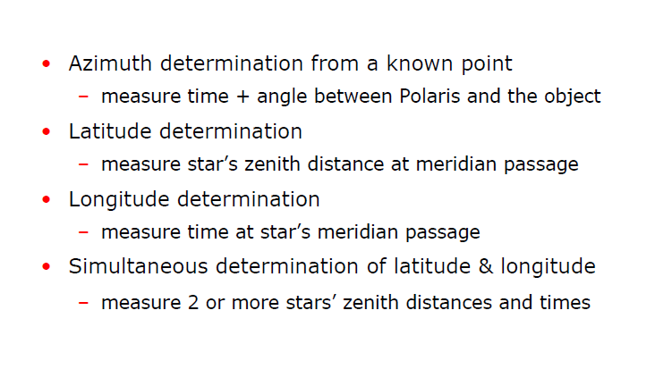
Astronomical Positioning

Slide 34
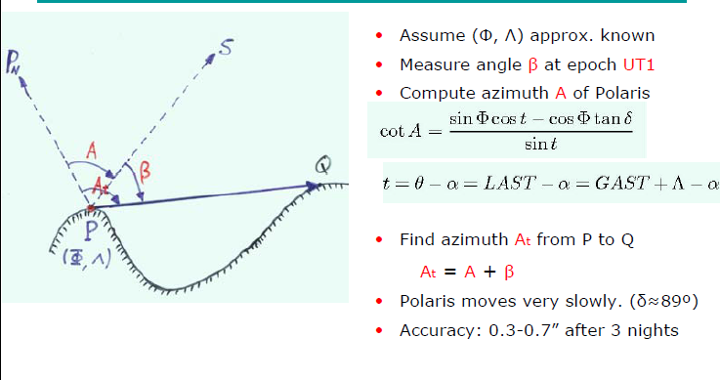
Azimuth determination with Polaris

Slide 35
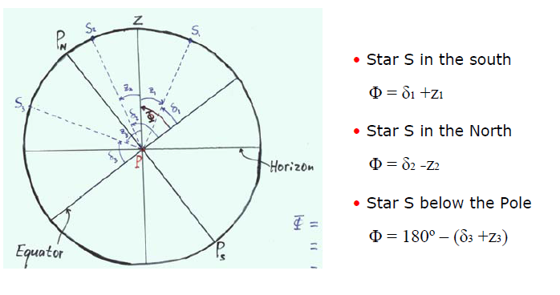
Latitude determination

Slide 36
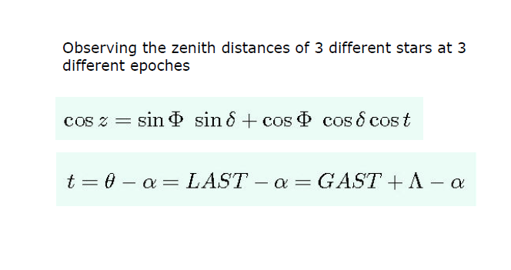
Simultaneous determination of (Φ, Λ)

