Slide 1
Astrogeodetic triangulation and geodetic datums
Lecture 07

Slide 2
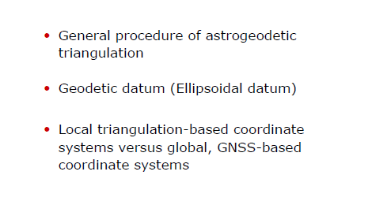
Astrogeodetic triangulation and geodetic datums

Slide 3
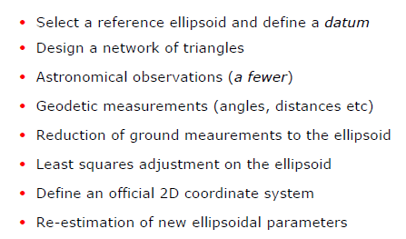
General procedures

Slide 4
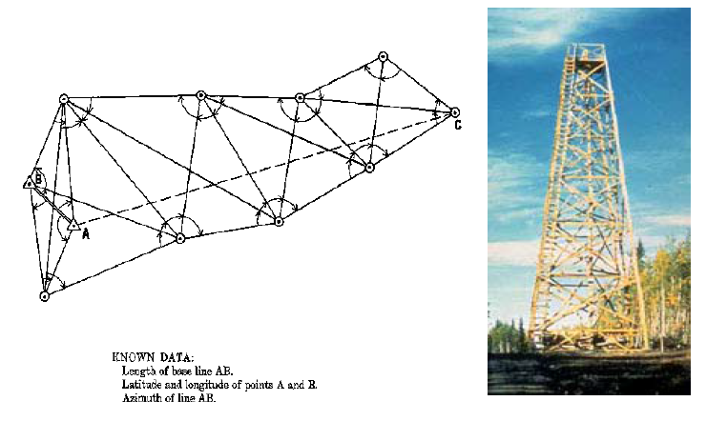
Principle of Triangulation

Slide 5
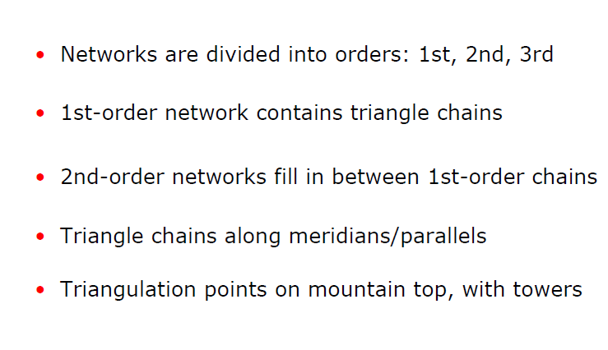
Astrogeodetic networks

Slide 6
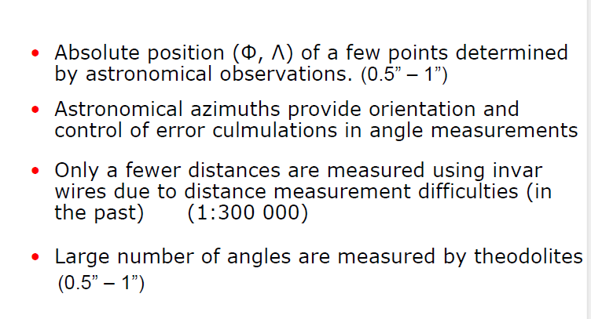
Astrogeodetic measurements

Slide 7
History of surveying and Mapping in Ethiopia
The origins of the Ethiopian Mapping Agency (EMA) date back to1954.
The Blue Nile Geodetic Network project – 1957 – 1961
The second phase – 1967 – 1971 for densification
Starting from 1971 EMA produce 1:50, 000 topographic maps – covering 85% of the country

Slide 8
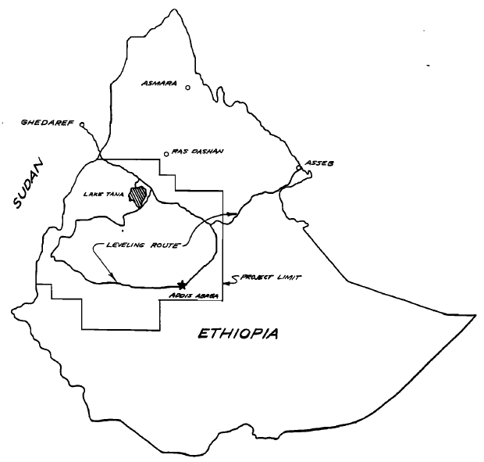
Level Net – 1957-1961

Slide 9
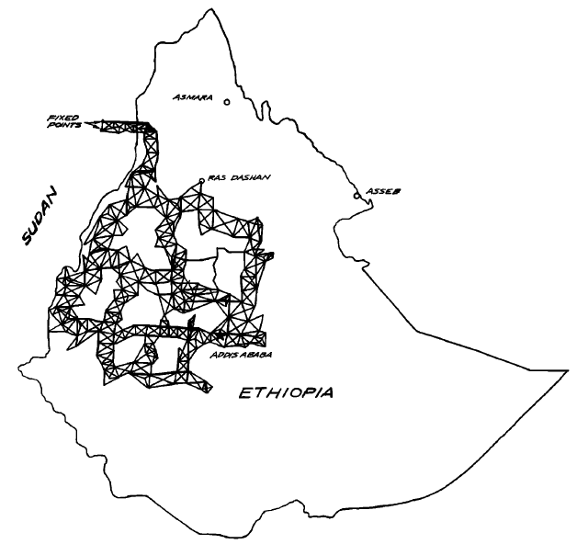
Triangulation Network – 1957-1961

Slide 10
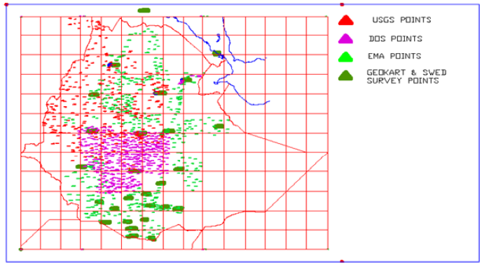
Ground Control Points

Slide 11
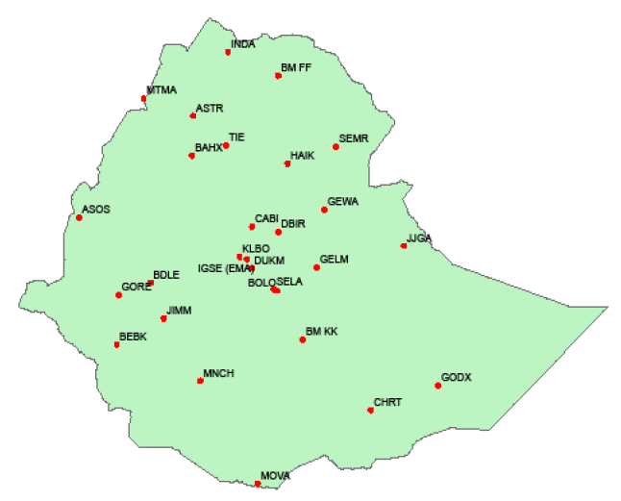
Primary GCPs

Slide 12
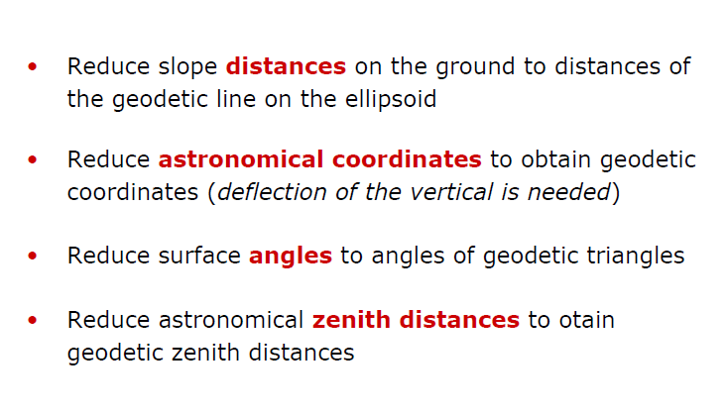
Reduction of ground measurements down to the reference ellipsoid

Slide 13
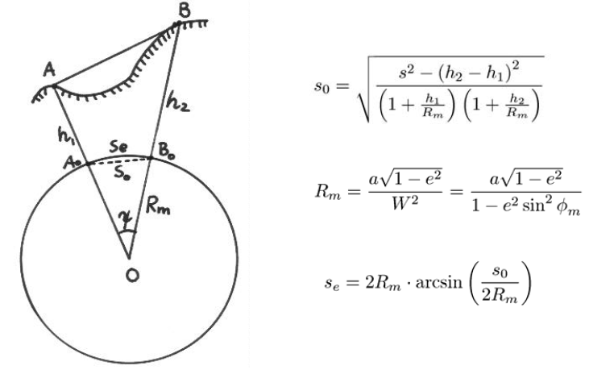
Reduction of slope distances

Slide 14
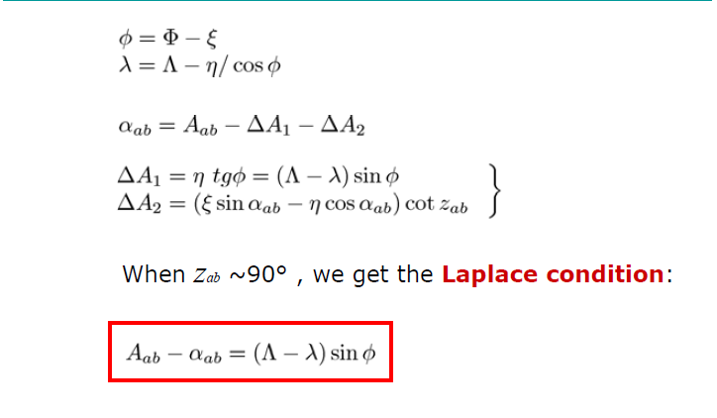
Reduction of astronomical coordinates

Slide 15
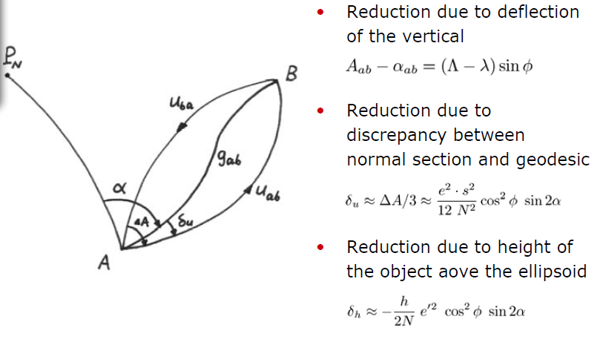
Reduction of ground directions (angles)

Slide 16
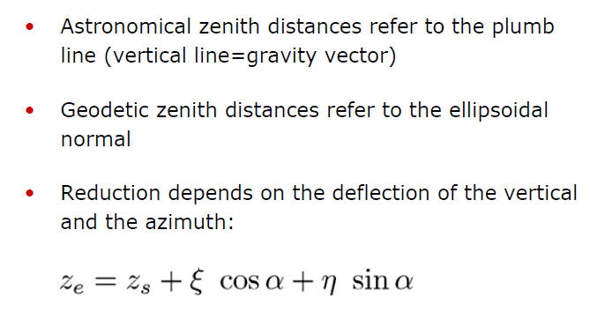
Reduction of astronomical zenith distance

Slide 17
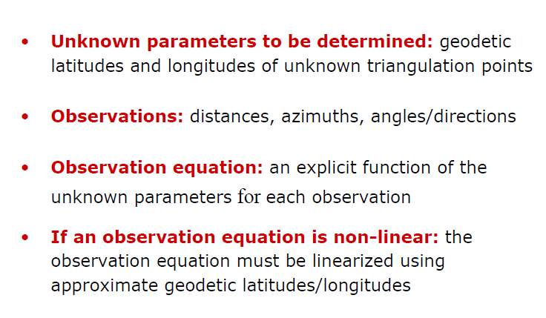
Least squares adjustment on the reference ellipsoid

Slide 18
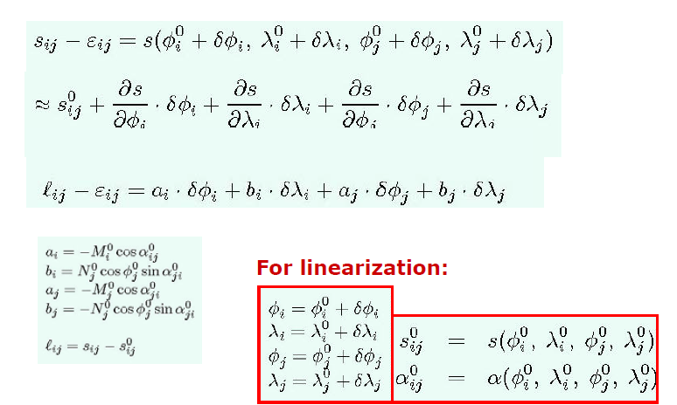
Observation equation of a distance

Slide 19
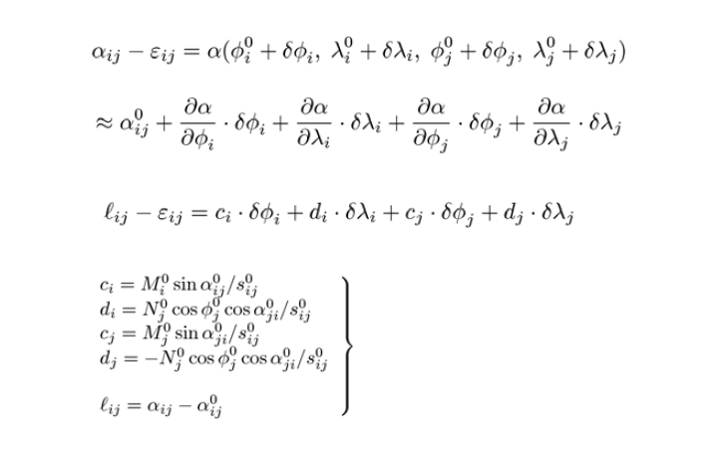
Observation equation of an azimuth

Slide 20
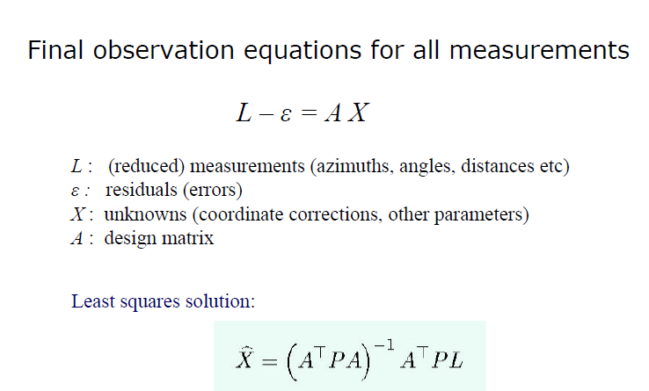
Least squares adjustment on the reference ellipsoid

Slide 21
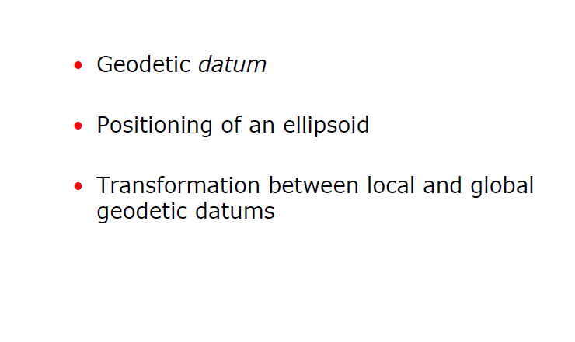
Geodetic (ellipsoidal) datum

Slide 22
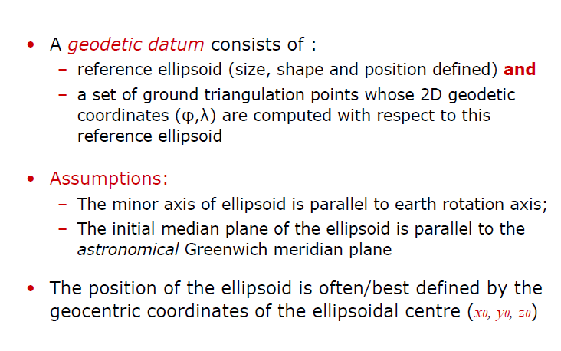
Geodetic datum (ellipsoidal datum)

Slide 23
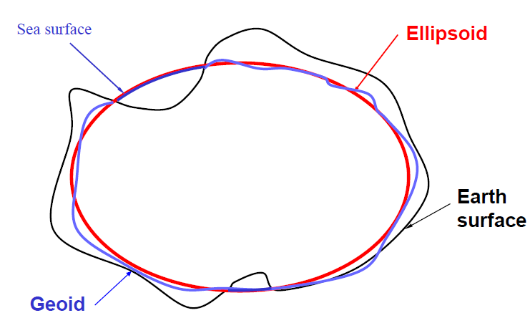
Fitting ellipsoids to the geoid

Slide 24
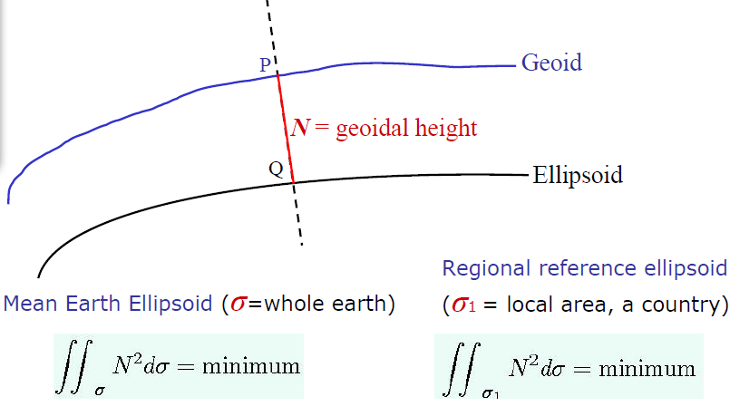
The geoid-ellipsoid separation

Slide 25
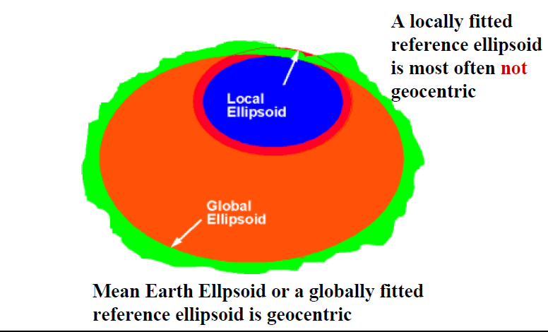
Local vs global ellipsoids

Slide 26
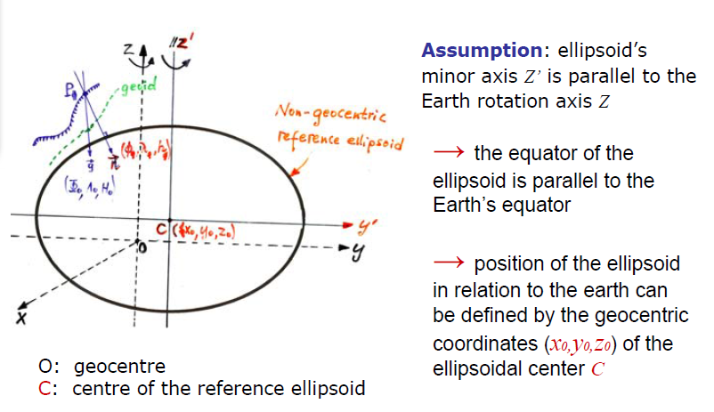
Positioning of the ellipsoid

Slide 27
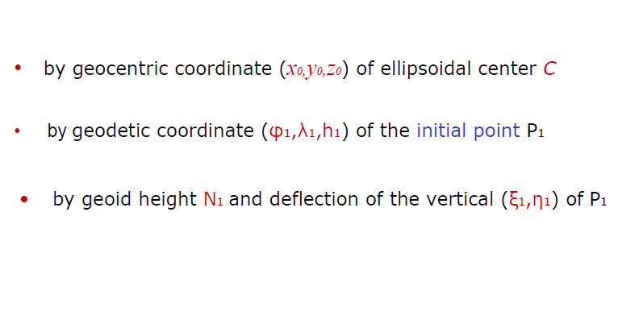
2 (or 3) ways to position the ellipsoid

Slide 28
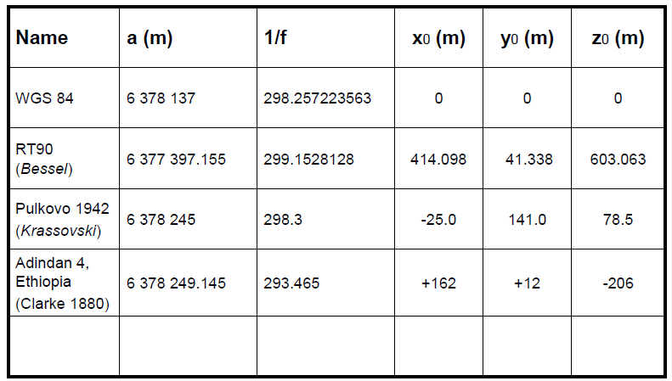
Geodetic datum parametres

Slide 29
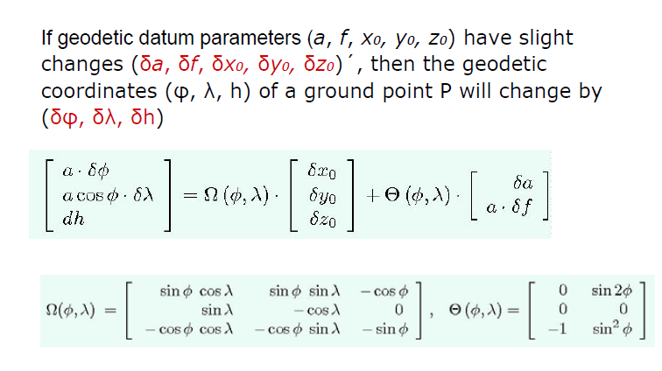
Coordinate change due to geodetic datum change

Slide 30
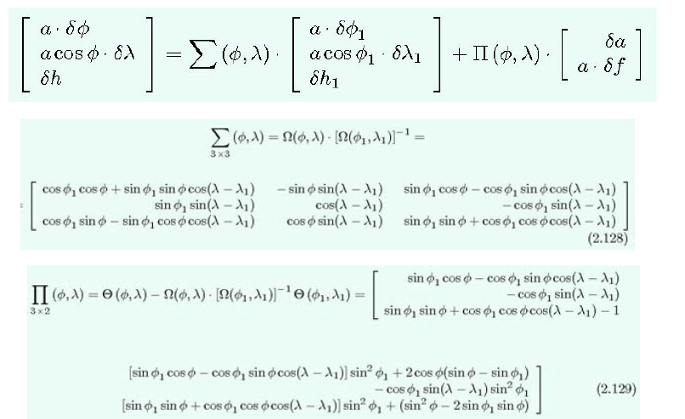
Coordinate change due to geodetic datum change

Slide 31
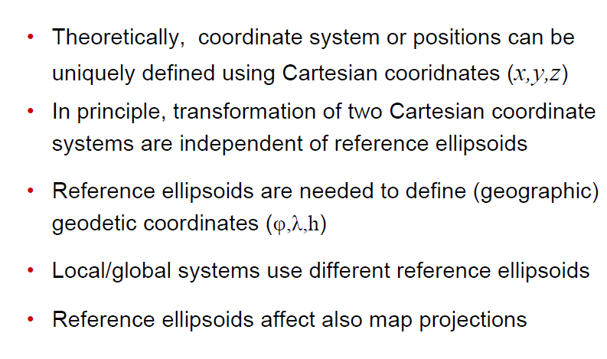
Local triangulation vs global systems: Reference ellipsoids

Slide 32
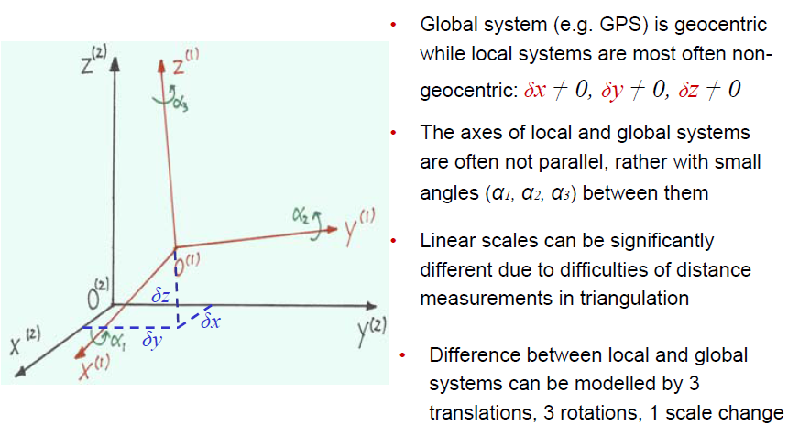
Local triangulation system vs global geocentric systems

Slide 33
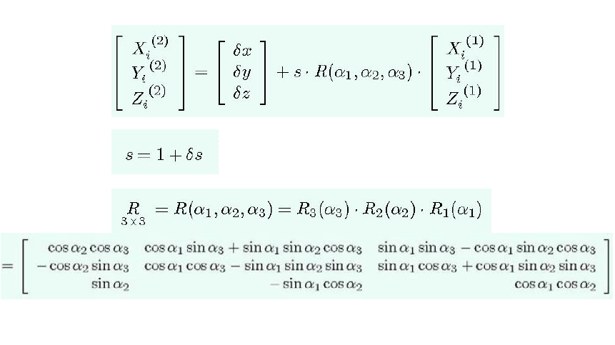
Helmert transformation between 2 Cartesian coordinate systems

Slide 34
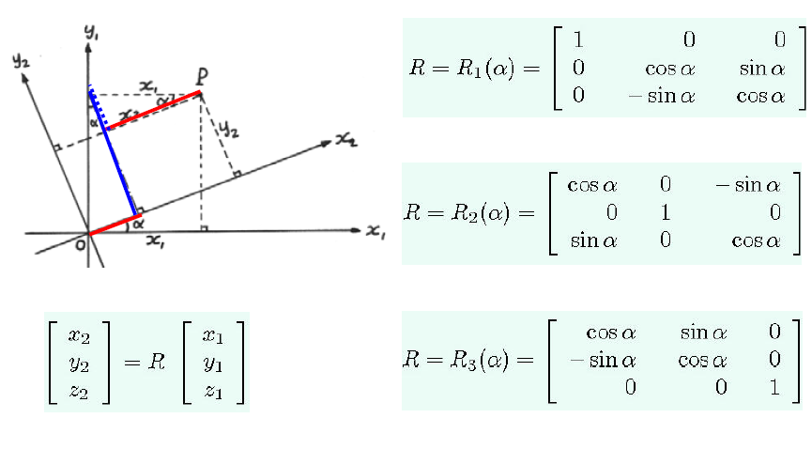
Rotation Matrices

Slide 35
Helmert transformation parameters
From System 1: To System 2: | WGS 84 Adindan, Ethiopia
δx (metre): | +165 (+162)
δy (metre): | +11 (+12)
δz (metre): | -206
δs (ppm): | 0 ?
α1 (arcsecond): | 0 ?
α2 (arcsecond): | 0 ?
α3 (arcsecond): | 0 ?

Slide 36
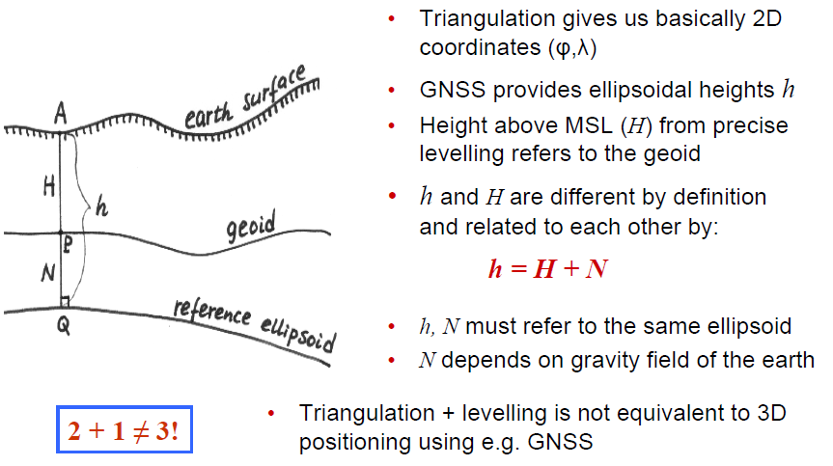
Local triangulation system Vs gloal coordinate systems

Slide 37


Steps from WGS84 to Local system
(φ,λ,h) _{WGS84} → (x,y,z) _{WGS84}
(x,y,z) _{WGS84} → (x,y,z) _{ADINDAN}
(x,y,z) _{ADINDAN} → (φ,λ,h) _{ADINDAN}
(φ,λ) _{ADINDAN} → (x, y) _{UTM}
( h ) → (H)
Clarke 1880 ellipsoid

