Slide 1
Gravity, Geoid and Height Systems
Lecture 08

Slide 2
Gravity, Geoid and Height Systems
Problem of geometrical levelling
GPS vs levelling
Gravity, gravity potential, equipotential surface
Theoretical misclosure of geometrical levelling
Height systems
Orthometric, normal vs dynamic heights
Computational procedures of precise levelling
Normal gravity field of the reference ellipsoid
Definition. Normal gravity formula. Mean normal gravity
Height reference systems and height networks
Ethiopian Leveling

Slide 3
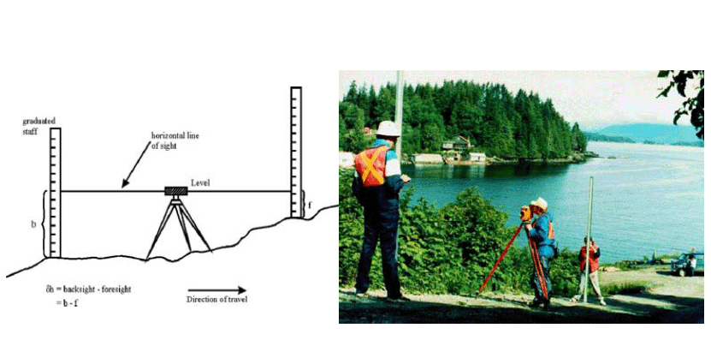
Height differences from levelling

Slide 4
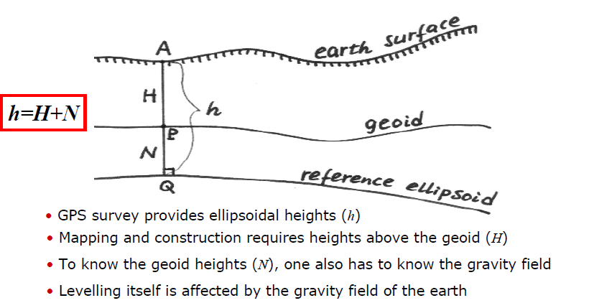
GPS versus levelling

Slide 5
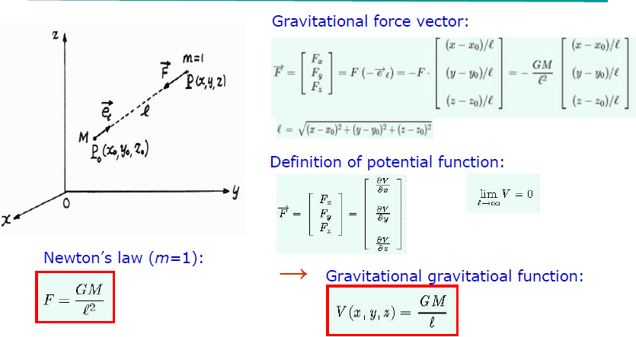
Gravitation of a point mass (M)

Slide 6
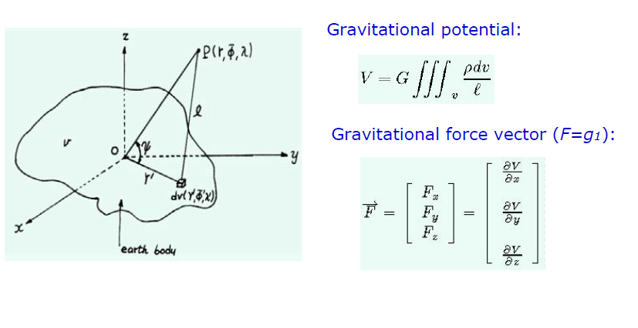
Gravitation of the earth’s masses

Slide 7
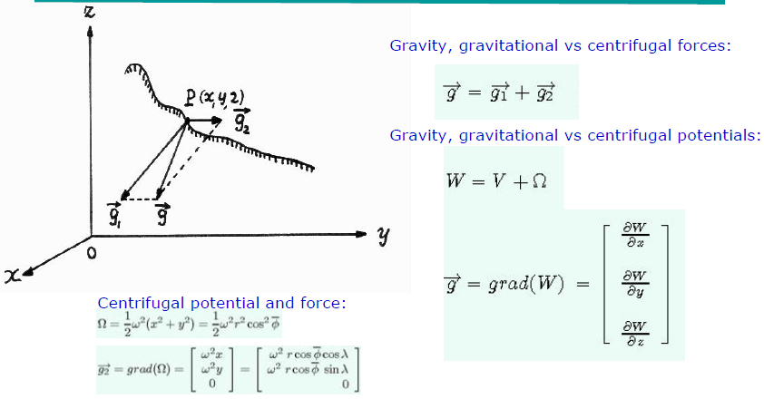
Gravitation, rotation and gravity

Slide 8
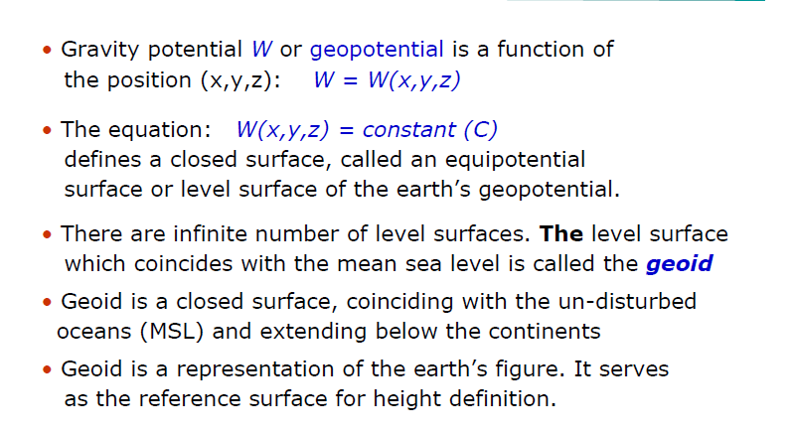
Equipotential surfaces and the geoid

Slide 9
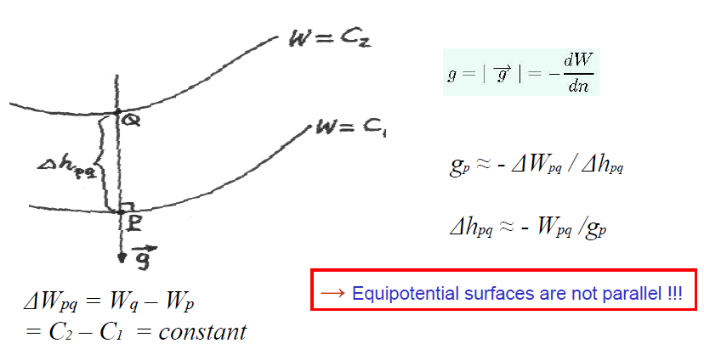
Distance between two close equipotential surfaces

Slide 10
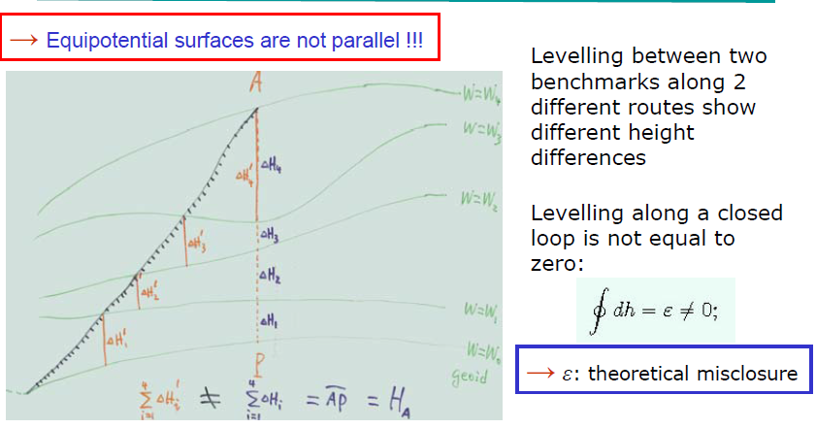
Theoretical misclosure (ε) of levelling

Slide 11
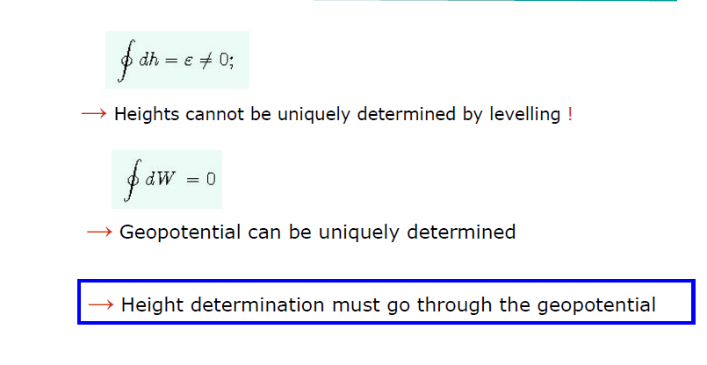
Height vs geopotential

Slide 12
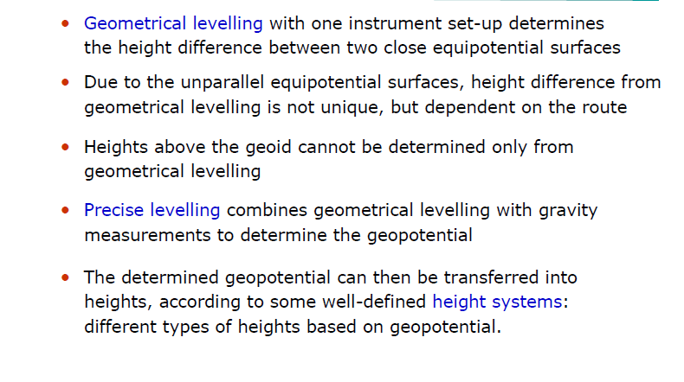
Precise levelling

Slide 13
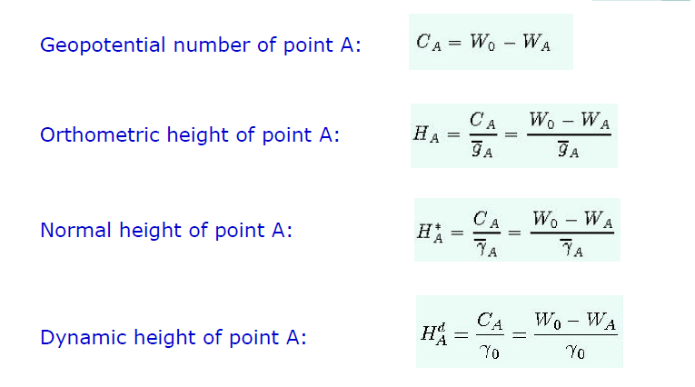
Height Systems

Slide 14
Concepts of Height Systems

Slide 15
Principle of Precise levelling

Slide 16
Principle of Precise levelling

Slide 17
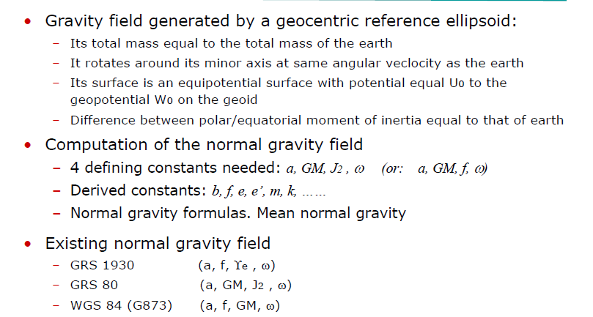
Normal Gravity Field of Reference Ellipsoid

Slide 18
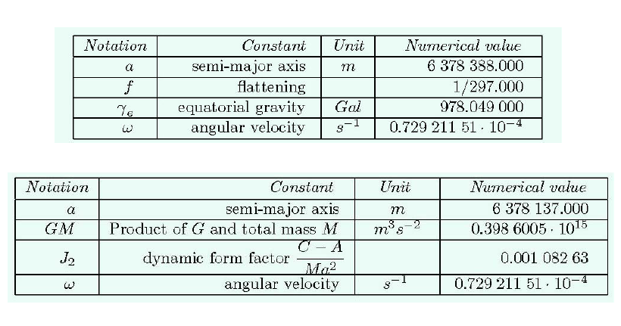
Defining Constants of GRS 1930 and GRS 1980

Slide 19
Derived Constants of GRS 80

Slide 20
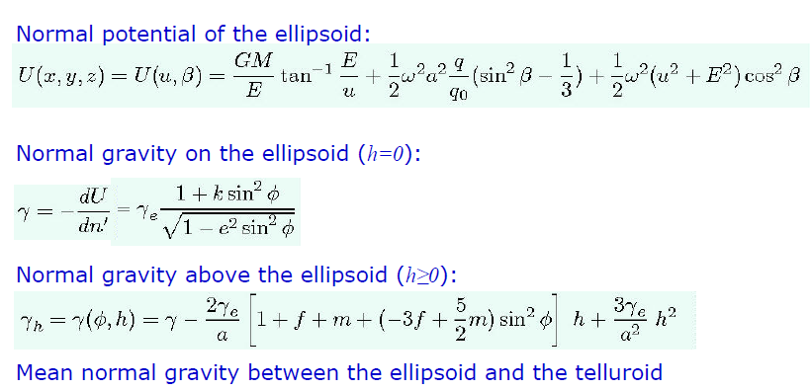
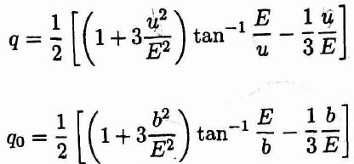

Normal Gravity Field of A Reference Ellipsoid

Slide 21
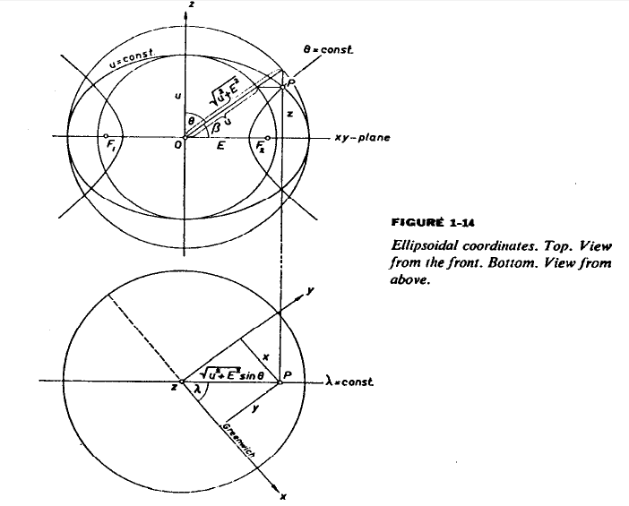

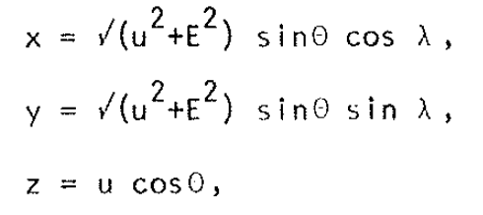

Slide 22
Vertical Datum in Ethiopia
The height system in Ethiopia was established by the US Geodetic Survey starting from 1957 to 1961 for the Blue Nile River watershed project.
The project covers west-central Ethiopia
Further densification of control points was made from 1963 – 1971 to cover the whole Ethiopia

Slide 23
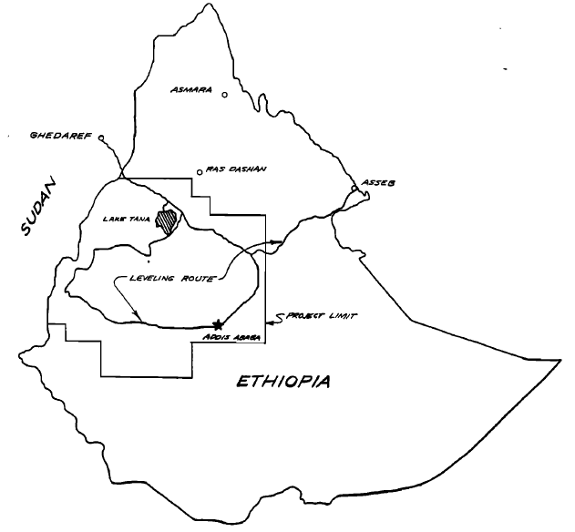
1957-1961 Level Net
(Blackwell, 1962)

Slide 24
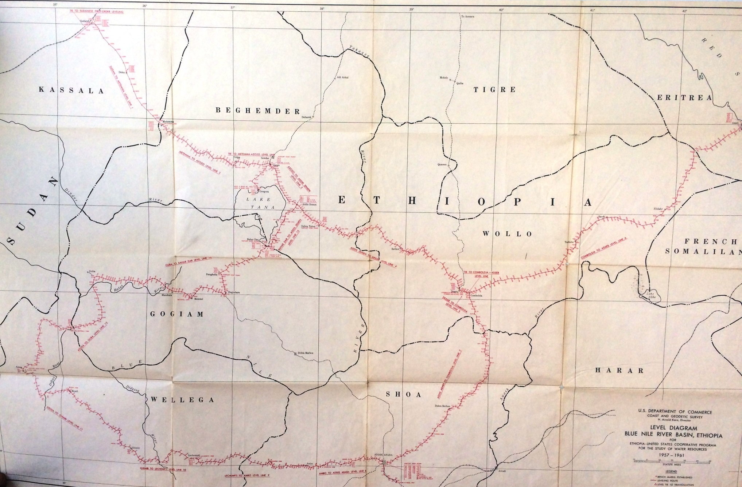
Level net (1957-1961)
Ethiopia Geodetic Survey (1957 - 1961).

Slide 25
Vertical Datum in Ethiopia
The Ethiopian vertical datum refers the mean sea level at Alexandria, Egypt. (Blackwell, 1962)
The leveling work starts from a control point in Sudan (Gedarif) comes from Alexandria, Egypt carried through about 2800 km
A level line run from Gedarif station to the Red Sea with closure error of 18 cm. (1282.3 km)
The mean sea level at Assab derived from a 12-year series of tidal observation by the Italian Government

Slide 26
Vertical Datum in Ethiopia
There is a large loops for the leveling work (Addis Zemen → Kombolcha → Addis Ababa → Addis Zemen)
The closure error of the large loop was 40 cm in 2112.7 km
The maximum rate of correction for long link (between Addis Zemen and Kombolcha) was 0.26 mm/km

Slide 27
Leveling procedure
Bench marks well established (Rock, metal, brass disk)
All lines are double run
Apply correction for the level data
Systematic error
Orthometric corrections based on theoretical values of gravity (due to non-parallelism of level surface)
A least square adjustment of the level net

Slide 28
A kind of cross check
A level run to Red Sea
The Level data also compared with previous survey made along railway from Djibouti – Addis Ababa from 1912 to 1935.

Slide 29
Accuracy of the level work
The final elevations obtained as the result of the least square adjustment are probably good within ± 3 meters except those station above 13° latitude.
The elevation of these stations are good only ± 10 meters (Blackwell, 1962)

Slide 30
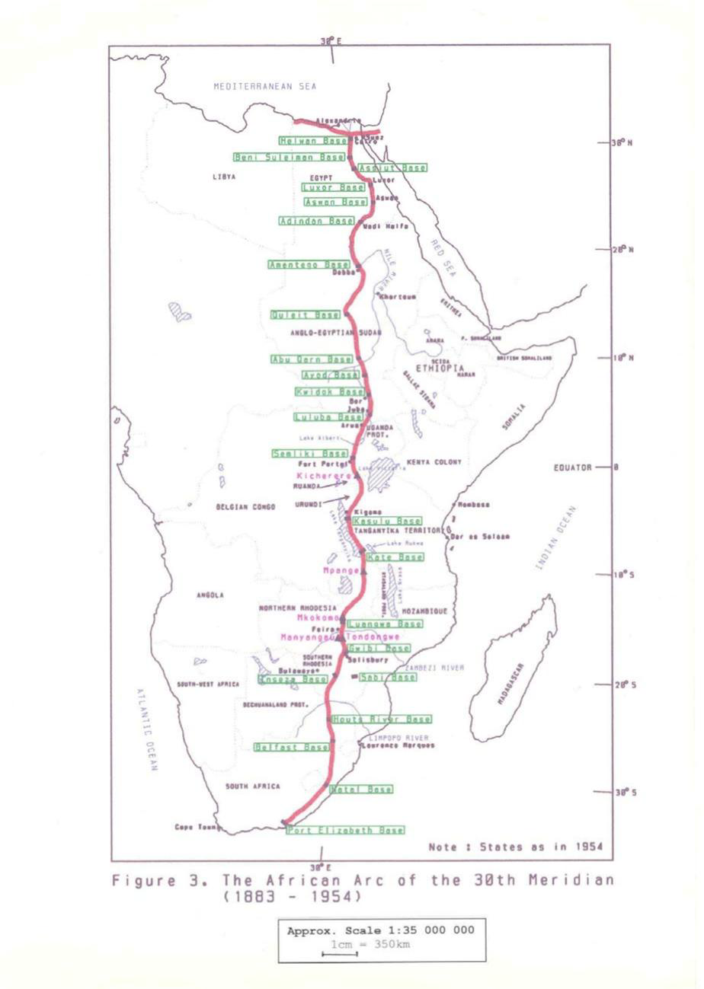
Result (1957-1961)
960 leveling bench marks
365 triangulation stations tied to 30th Meridian African Datum

