Slide 1
Course Contents
Unit 1 – The concept of Research - Introduction
Unit 2 – Types of Research
Unit 3 – Process in Research Proposal Development
Unit 4 – Process in Conducting Research
Unit 5 – Research Ethics
Unit 6 – Reporting Research Findings

Slide 2
About the Course
Generic
Concept of scientific research (what it is, how to plan and
conduct)
Self learning
Do the exercises for better understanding
For maximum benefit –
    read ahead,
    attend all lectures and
    actively participate

Slide 3
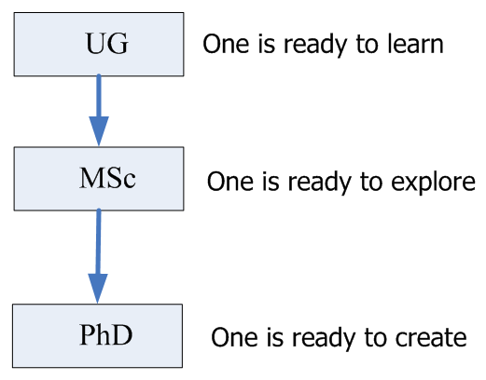
Defining MSc and PhD

Slide 4
What is MSc Program?
MSc, a process of
  Identifying a research area of interest
  Learning to carry out a research project
  Identifying problems
  Analyzing/ dissecting problems
  Designing/developing solutions
  Proving/Substantiating solution
  Reporting

Slide 5
Outcome of MSc program
Understand the issues of concerns within the area of specialization
Know the leading researchers/research groups in the area of study
Know the relevant industries/companies
Identify your research strength and weaknesses (theoretical, experimental; materials, processes, components/devices, system)
Conduct research with minimal guidance

Slide 6
Unit
1
The Concept of Research

Slide 7
Unit Objectives
Identify sources of knowledge
Define the concept of research
Explain the purpose of research
Differentiate Research Method and methodology
Understand Philosophy of research

Slide 8
Lesson 1. Sources of Knowledge
Two major approaches to acquire knowledge:
  Unscientific knowledge/common sense
  Scientific knowledge/Science

Slide 9
1.1 Types of unscientific Sources of knowledge
The method of tenacity - Automatic acceptance of beliefs without exploring them.
  E.g. 1. Black injera has high Fe content.
  2. The sun rises in the east.
  3. Ethiopians have burned faces.
  Problems:
  Knowledge by familiarity alone – no proof of its truth
  No means for correcting ideas which are proved to be not true.

Slide 10
Cont’d …
The method of Authority - Accepting information we have been told by authority figure.
  E.g. 1. smoking affects our health
  Problem:
  It is only useful and beneficial if the authority
  figure is knowledgeable in the area.

Slide 11
Cont’d …
The a prior method/deductive reasoning - Reason and logic are the basic tools for a priori method.
  E.g.1. Ayele’s family are tall.
  Alemitu is in Ayele’s family
  Therefore, Alemitu is tall. _False
  Conclusion from false premises.
  E.g. 2. Human being is mortal
  Alemu is a human being.
  Therefore, Alemu is mortal. _True

Slide 12
Cont’d …
Commonsense - Knowledge acquired from past experience or from our perceptions of the world.
It is good for routines aspects of daily life but hinders to widen our knowledge.
  E.g. The price of teff increases if the rainy season fails

Slide 13
1.2 Scientific method as a Source of knowledge
Knowledge acquired systematically. i.e. evaluate observation by our bodily senses or measuring devices.
It is sometimes seen as a controlled extension of commonsense knowledge.
Therefore, science relies on information that is verifiable unlike commonsense.
Science differs from commonsense:
  uses conceptual schemes and theoretical structures.
  gives explanations or reasoning for different observed phenomena.

Slide 14
Scientific Vs. Unscientific Research
Scientific research:
Focuses on solving problems and pursues a step-by-step
logical, organized, and rigorous method. i.e.
  identify the problems
  collect data
  analyze and
  draw valid conclusions
Non-scientific research:
Based on experience and intuition

Slide 15
Cont’d …
Science:
  Systematically build theoretical structure
  Test them for internal consistency
  test empirically subject aspects of the phenomenon.
Logical steps in scientific research:
  Problem statement
  Tentative explanations
  Information gathering
  Test of hypothesis
  Make conclusions

Slide 16
Cont’d …
Expectations from scientific research:
  General rules drawn
  Objective evidences collected
  Testable statements made
  A skeptical attitude to all claims
  Creative, public and productive

Slide 17
Cont’d …
Limitations of scientific research:
  Cannot have answer for all questions
  Results may not be applied everywhere
  Imperfection in the measurement devices
  The scope and limitations of your work has to be clearly defined.
The work that will not be undertaken is described
as the delimitations of the research.

Slide 18
Lesson 2. Definition and purpose of research
What Research Is Not
Research isn’t information gathering:
  Gathering information from resources such as books or magazines isn’t research.
  No contribution to new knowledge.
Research isn’t the transportation of facts:
  Merely transporting facts from one resource to another doesn’t constitute research.
  No contribution to new knowledge although this might make existing knowledge more accessible.

Slide 19
2.1 Scientific Research -Definition
What Research Is
Research is:
“…the systematic process of collecting and analyzing information (data) in order to increase our understanding of the phenomenon about which we are concerned or interested.”
Research must be systematic and follow a series of steps
and a rigid standard protocol.

Slide 20
2.1 Scientific Research -Definition
What Research Is
Research is:
an attempt to achieve systematically and with the support of data the answer to a question, the resolution to a problem, or the greater understanding of a phenomenon
a process of generation of new information and testing of ideas.

Slide 21
2.1 Scientific Research -Definition
What Research Is
Definition by WHO:
  Research is a quest for knowledge through diligent search or investigation or experimentation aimed at the discovery and interpretation of new knowledge.
Definition by Advanced Learner’s Dictionary:
  A careful investigation or inquiry specially through search for new facts in any branch of knowledge

Slide 22
2.1 Scientific Research -Definition
In general we learn from the definition:
Any scientific research is systematic - follows a clear procedure so that the experiment can be replicated and the results verified.
All scientific research has a goal, repeated and refined experimentation gradually reaching an answer.
Scientific research is impartial, objective, empirical and logical
Scientific research leads to the development of generalizations, principles or theories, resulting in to some extent in prediction and control of events.

Slide 23
2.1 Scientific Research -Definition
Typical features of scientific research:
  systematic – ordered, planned and disciplined
  Controlled – confidence in research outcomes
  Empirical – putting beliefs, ideas, or assumptions to a test ; and
  Critical – many truths are tentative and are subject to change as a result of subsequent research.

Slide 24
2.2. Purpose of Scientific Research
The purpose of research is problem solving and acquiring new knowledge.
It also reduces the complexity of problems.
In short, research is used for the purposes of:
  describing phenomena
  explaining phenomena
  predicting phenomena
  controlling phenomena
  comparing phenomena

Slide 25
2.2. Purpose of Scientific Research
Description – pictorial account of the phenomenon being studied.
  It is the first step to do in scientific research.
  It find answers to the questions “what, who and where”.
  E.g. 1. Study on properties of water in solid and liquid state
  “the behavior of water in the solid and liquid state” has to be
  described first before testing why it is so.
  E.g. 2. Study on a biography of Tedy Afro.
  Who is Tedy Afro after all? –has to be described first.

Slide 26
2.2. Purpose of Scientific Research
Explanation – exploring the causes of the occurrence of certain event.
  It find answers to the questions “why”.
  E.g. 1 Why does ice have lower density than water?
  E.g. 2 Why Tedy Afro is much more popular singer than others at present ?

Slide 27
2.2. Purpose of Scientific Research
Prediction – generalizing about what will happen in the future.
E.g. The different qualities of Tedy as mentioned ….makes him popular – generalization based on collected data/observation.
From the analysis of observed data, Tedy looks remain popular – prediction from his past works

Slide 28
2.2. Purpose of Scientific Research
Control – intervene and subsequently observe an expected result.
E.g. Tedy will remain popular if ….. – intervention of the researcher. Showing that the research was not done without aim.

Slide 29
2.2. Purpose of Scientific Research
Comparison – explore whether two or more groups are similar or different on a certain behavior or vice versa.
  E.g. Is there gender difference in terms of level of participation in politics
  E.g. Are Tedy’s songs are different in their substance from others.
  E.g Any connection between bio-chemistry and medical science?

Slide 30
2.3 Characteristics of scientific research
Is directed toward the solution of a problem;
Is based upon observable experience or empirical evidence;
Demands accurate observation and description;
Gathers information from primary or secondary sources.
Follow carefully designed procedures, always applying rigorous analysis.
Requires expertise
Requires patience and unhurried activity
Carefully recorded and reported
Sometimes requires courage
Emphasizes in the development of generalizations, principles and theories.
Strives to be objective and logical.

Slide 31
2.3 Characteristics of scientific research
Aim
Rigorous
Testability
Replicability
Precision and Confidence
Objectivity
Generalizability
Parsimony

Slide 32
2.3 Characteristics of scientific research
Aim
The purpose of scientific research is clear – problem
solving.
E.g - least cost design of hydraulic structures
- optimum allocation of irrigation water to beneficiaries
Research begins with a problem.
  This problem need not be Earth-shaking.
  Address only an important question.
  Remember that the Aim is to advance knowledge.
Sources of problems: Observation, literature reviews, professional conferences, etc.

Slide 33
2.3 Characteristics of scientific research
Rigorous
  Based on good theoretical base and sound methodology
  Careful and scrupulous
  E.g all parameters which affect the design of the structure must be considered
Testability
  Test theoretical model by simulation or experiment
  Analysis of performance parameter against design
  parameter

Slide 34
2.3 Characteristics of scientific research
Replicability
  The same relationship stands repeatedly under the same design parameters
Precision and Confidence
  Precision refers to closeness of the findings to reality
  Confidence refers to the probability that our estimations are correct
Objectivity
  Conclusions drawn from the analysis of data must be objective
  Proven from trend in data
  Supported by theoretical model

Slide 35
2.3 Characteristics of scientific research
Generalizability
  Scope of applicability
  The wider, the better
E.g. Model Equation developed which is applicable for design
of weirs and barrages.
Parsimony
  Simplicity in explaining the phenomena or problem
  Assumptions are critical
  Minimize the dependant variable

Slide 36
2.4 Research method and methodology
Research Methods –
  the techniques/ procedures used to collect and analyse data.
E.g. surveys, interviews, observations, etc.
Research methodology –
  A theory and analysis of how research does or should proceed, Or
  Discussions of how research is done, or should be done, and the critical analysis of methods of research
    It involves the researchers assumptions
Assumptions are those things that the researcher is taking for granted.

Slide 37
What is Research?
Discovery of new things that have been independently verified by other professionals.
Something new to humanity (not just new to you or your group).

Slide 38
The Scientific Method
The Outcome is Recognised
as a Major contribution
to the field
Prior
knowledge
An idea
Submit
Report,
Thesis,
Journal
or
Conference
Paper
Discovery
Independent verification:
literature, experiment,
numerical model,
analytical model, etc
Independent verification:
literature,
numerical model,
analytical model, etc
Assessors

Slide 39
The Research Community
All use the same scientific method.
All follow the same ethical principles.
All use the same language and terms.
All provide information to the world-wide community reported in a full and open manner.
All acknowledge the previous work of others.

Slide 40
Lesson 3. Philosophy of Research
Major philosophical issues about knowledge:
1. Epistemological issues:
  Epistemology – studies the nature of knowledge and the process by which knowledge is acquired and validated.
  Methodology – concerned with how we come to know.
The difference of the two is that the former involves the philosophy of how we come to know and the later involves the practice of knowing something.
  E.g The area of a circle - Pie x square of the diameter – Epistemological
  To arrive at the area of a circle, the sum of the areas of piece
  of rectangles inscribed in a circle.

Slide 41
Philosophy – cont’d …
2. Positivism and post positivism
  Positivism – believing that the goal of knowledge is simply to describe the phenomena that we experience.
Three tents of positivism:
    Scientific attention should be restricted to observable facts.
    The method of the physical sciences should also be applied to the social sciences.
    Science is objective and value free.

Slide 42
Philosophy – cont’d …
Post–positivism – believing that scientific reasoning and common sense reasoning are essentially the same process.
Post-positivists believe that everyone of us construct our view of the world based on our perception of it. It is hard to believe that scientists in the same field would perfectly see the reality as it is.
As a human being, scientists are inherently biased by their cultural experiences, worldviews, etc.
The difference between positivism and post-positivism is not in kind but it is in terms of degree.

Slide 43
Group Discussion
Group yourself into two
      Group 1 –
      Group 2 –
1. Raise a point of discussion on sources of knowledge
(unscientific/scientific)
2. Raise a point of discussion on philosophical perspectives
Discuss the two points to your fields of study or any
professional experience.
Present the gist of discussions
End of Unit 1

Slide 44
Unit
2
Types of Research

Slide 45
Types of Research
Research is an attempt to achieve systematically and with the support of data the answer to a question, the resolution to a problem, or the greater understanding of a phenomenon.
Research may be classified:
based on purpose
  Basic and applied
Based on how it is done
  Exploratory, descriptive, Empirical, Qualitative and quantitative, etc.
Based on source of data
  Primary and secondary

Slide 46
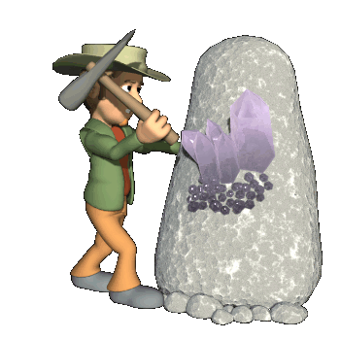
Lesson 1. Types of research based on purpose
Research could be undertaken to solve:
  theoretical problems – basic research.
  practical problems – applied research.
Excavating Human Behaviors

Slide 47
Basic Research
Also known as pure or fundamental research
Objective:
  Advancement of knowledge(formulating or expanding theory)
  Understanding of theoretical relationship between variables
  Exploratory in nature (discovery of knowledge)
  Requires rigorous and structured type of analysis
  Usually without any practical end in mind
  Example:
    At what point in human history did logical thought arise?
    What is the mind-body connection?
    Is computer important in everyday life?
    Existence of life on mars
    Fuzzy logic for solving complex integral equations

Slide 48
Applied Research
Solve specific, practical questions
Can be exploratory, but descriptive and explanatory
  i.e. Involves precise measurement of the characteristics and describes relationships between variables of a studied phenomenon
  employs methodology that is not as rigorous as that of basic research.
  yields findings that can be evaluated in terms of local applicability and not in terms of universal validity.
    Example:
    Search for alternative energy sources for Ethiopia.
    What is the most efficient and effective vaccine against influenza?
    How can communication among workers in large companies be improved?

Slide 49
Lesson 1 – Cont’d …
The purpose of research is testing theories and apply it to real situations.
Most new research questions originate from theories
Researchers of all disciplines use theories to help them describe facts.
Theories are strengthened by test results
  Example:
  Discovery of electromechanical induction by Michael Faraday leads to the invention of electric devices such as radios and generators.
  The discovery of radio active isotopes are now vital for medical treatment of various diseases, and also used by archeologists.
"It's important to realize that support for basic science is the seed that allows the medical applications and technology to grow."
Prof. Ramakrishnan
(2009 Nobel prize winner for chemistry)
Notes:
theories normally are a set of related statements that explain a set of facts

Slide 50
Lesson 1 – Cont’d …
Therefore,
basic and applied research are not mutually exclusive.
There are researches that have both theoretical and practical implications.
The distinction is a matter of emphasis rather than a true dichotomy.
  Example:
  Finite difference technique for subsurface flow analysis in hydraulic structure design.

Slide 51

Lesson 2. Types of research based on how it is done
Exploratory research is most commonly unstructured, “informal” research that is undertaken to gain background information about the general nature of the research problem.
Exploratory research is usually conducted when the researcher does not know much about the problem and needs:
  additional information or desires new or more recent information.
  To define terms
  To clarify problems and hypotheses
  To establish research priorities
  Example:
  Addis Ababa housing project – for construction of cost
  effective, functional houses – conducting research on
  “What kind of houses the people really need?”
  Assessment of structural stability of Gilgel gibe dam.

Slide 52
Lesson 2 – Cont’d …
    Therefore, exploratory research:
    provides significant insight into a given situation but not usually useful for decision making by itself.
    helps to determine the best research design, data collection method and selection of subjects.
    Example: Why our sales are declining?
  A variety of methods are available to conduct exploratory research:
      Secondary Data Analysis
      Surveys
      Case Analysis
      Focus Groups

Slide 53

Lesson 2 – Cont’d …
EMPIRICAL RESEARCH
It finds a solution empirically (based on observation and experience more than upon theory and abstraction).
i.e. the research bases its findings on direct or indirect observation as its test of reality.
It can be qualitative & quantitative.
Statistical formulas are fundamental to forming logical, valid conclusions.
Example: - physical model tests in engineering
- Proving the Darcy-Weisbach equation
Empirical & theoretical/conceptual research complements each other in developing an understanding of the phenomena, in predicting future events.

Slide 54


Lesson 2 – Cont’d …
Experimental Research
An experiment is a research situation where at least one independent variable, called the experimental variable, is deliberately manipulated or varied by the researcher.
Explores cause and effect relationships.
It is common in medical and agricultural sciences.
  Example:
    Effect of different levels of fertilizer application on the yield of maize.
    Eating too many bananas causes constipation

Slide 55
Lesson 2 – Cont’d …
Primary and secondary research
  Primary/field research – the collection of data that does not already exist.
  Primary Data: data collected from participants through methods such as telephone, mail, online, and face-to-face (quantitative), and observation studies and focus groups (qualitative)
  Secondary/desk research – the summary, collection and/or synthesis of existing research
Secondary Data: accessing data through sources such as the
internet and library

Slide 56
Lesson 2 – Cont’d …
Qualitative research is research undertaken to gain insights concerning attitudes, beliefs, motivations and behaviors of individuals to explore a social or human problem and include methods such as focus groups, in-depth interviews, observation research and case studies.
  observations of any behavior that occurs naturally
  not conducted under tight controlled conditions
  goal - describe what is happening & qualify the description with language that clearly illustrates what happened
  does not rely on a lot of numerical calculations
  does not manipulate independent variables
  does not administer a test or treatment
  is flexible in the way knowledge is pursued and developed
  Example:
  Many studies in the field of anthropology falls here.

Slide 57
Lesson 2 – Cont’d …
Quantitative research is research concerned with the measurement of attitudes, behaviours and perceptions and includes interviewing methods such as telephone, intercept and door-to-door interviews as well as self-completion methods such as mail outs and online surveys.
    Relies on strict experimental control
    Uses numerical information to describe behavior
    Numerical in nature
    Primary tool of collection is tests
    Procedures are examined for reliability,
    validity, and objectivity
    Extensive planning
    Example:
    Survey on the prevalence of HIV/AIDS in Hawassa town

Slide 58


Lesson 2 – Cont’d …
Correlational research-
  makes comparisons, looking for trends or tendencies.
  Better understand the conditions and events that we encounter (what goes with what)
  To predict future conditions and events.
  Correlations do not show cause and effect. i.e. Detects relationships between variables but does NOT say that one variable causes another.
Example: Association of Watershed management and erosion rate
A positive correlation between ice cream and murder rates. Does that mean that ice cream causes murder?

Slide 59
Group Discussion
Group yourself into four
  Formulate research topics (basic, applied or a combination) in your field of specialization and
  Give reasons why a topic is labeled as basic, applied or both? Discuss
  Present the gist of discussions.
Example on research topics
The design and analysis of computer algorithms
The Economic Impacts of Unacceptable Web Site Download Speeds
Study on urban people perceptions towards condominium houses.
How do you label topic no. 3.? Is it a quantitative or qualitative research?

Slide 60
Group Discussion
Example on research topics – Structural Engineering
(taken from 2010 ASCE, Journal of Structural Engineering)
Wind Analysis of a Suspension Bridge: Identification and FEM Simulation
Study on urban people perceptions towards condominium houses.
Seismic Damage Detection of a Full-Scale Shaking Table Test Structure.
Bearing Strength of Cold-Formed Steel Bolted Connections Using Oversized Holes without Washers
Response of High Strength Concrete Columns under Design Fire Exposure.
Modelling Spatially Unrestricted Pedestrian Traffic on Footbridges
Finite Element Modeling of Nonlinear Behavior of Masonry-Infilled RC Frames.

Slide 61
Group Discussion
Example on research topics –Geotechnical Engineering
(taken from 2010 ASCE, Journal of Geotechnical and Geoenvironmental
Engineering)
Performance of Geosynthetic-Encased Stone Columns in Embankment Construction: Numerical Investigation
Compaction Characteristics of Municipal Solid Waste
Mechanistic Corrections for Determining the Resilient Modulus of Base Course Materials Based on Elastic Wave Measurements

Slide 62
Next class
Read the thesis dissertation abstracts and identify:
    –The research problem
    –Why is the research problem interesting/important?
    –Research sub-problems
    –Hypotheses

Slide 63
Thank you

Slide 64
Unit
3
Process in Research Proposal Development

Slide 65
LESSON 1. What is a research proposal?
What is a research proposal?
  It is a detailed plan of your study.
  It is a document which sets out your ideas in an easily accessible way.
  The intent of written proposal is to present a focused and scholarly presentation of a research problem and plan.
  Describe the researcher’s idea for a new study.

Slide 66
LESSON 1. What is a research proposal?
Why you need to prepare a research proposal?
  to help you (as student) to focus and define your research plans.
  These plans are not binding and subject to change , as you progress in the research. However, they are an indication to your faculty of your direction and discipline as a researcher.
  Needs approval from the graduate research committee to start the work
  It impresses the senior as a potential researcher
  It serves as a contract between you and funder.

Slide 67
LESSON 1 – cont’d …
What a proposal should contain? It contains a description of:
What do you want to do? – research question
Why do you want to do it? – Any information gap
Why is it important? – any practical importance or knowledge advancement
Who has done similar work? - background
How are you going to do it? -methodology
How long will it take? – plan of work

Slide 68
LESSON 2 – Components of a Research proposal
The most logical order of a research proposal is:
  Title /research topic
  Summary/Abstract
  Introduction/background
  Objectives
  Literature review
  Questions and/or Hypothesis
  Materials, Methods and procedures
  Work plan
  Budget and funding
  References
  Appendices/Annexes

Slide 69
LESSON 2 – Components of a Research proposal
The Format - Guideline
Front page: Title, name of the researcher, department.
Second page: content
Third page: Abstract: Not more than 200words.
Fourth – sixth page: with bold headings: Introduction, objectives, Literature review; hypothesis, materials and methods; data analysis
Seventh page: Work plan, budget
Last page: References: Not more than 10.

Slide 70
LESSON 1 – cont’d …32q
1. Title /Research topic
Identifying a research topic is the first step in proposal development
The criteria for selecting is:
  Relevance/significance
  Avoidance of duplication
  Urgency of data needed
  Feasibility of study
  Applicability of results
  Your Interest and knowledge to the area
  Ethical acceptability

Slide 71
LESSON 2 – Components of a Research proposal
What the Title/Research topic should be?
    the fewest possible words that adequately describe the contents of the study.
  It is a label; not a sentence
  It shouldn’t contain any abbreviations
  It appears in a proposal on a separate page – Title page
  The title page has no page number and is not counted.
  The title page is the “main gate” which invites the reader to enter the research proposal.

Slide 72
LESSON 2 – Components of a Research proposal
Summary/Abstract – a one page brief summary of the thesis proposal.
  It shows that your work fits with the topic
  It shows what a contribution your work will make.
  It should specify the research question and how it is going to be answered.
  Do not put any information not stated in the main text.
  Never contain references, figures and tables.
  It comes first but written last.
  It is the most read part next to the topic

Slide 73
LESSON 2 – Components of a Research proposal
Introduction/Background – background information of the research proposal.
  It establishes a framework for the research so that so that readers can understand how it is related to other research
  It shows what the gap in the area is.
  It shows what a contribution your work will make.
  It should motivate the reader to read the whole paper
  Should site the most recent and relevant works, and
  should explain why work is required.
  Should be written from general to specific

Slide 74
LESSON 2 – Components of a Research proposal
Statement of the problem – the issue that leads to the need for the study.
  It answer the question ‘Why does this research be conducted?’
  The foundation for everything to follow in the proposal.

Slide 75
LESSON 2 – Components of a Research proposal
Objective/aim of the study – aim which the enquirer seeks to bring about as a result of completing the research.
  Objectives should be simple, specific, stated in advance, stated using action verbs
  Objectives can be classified into:
    General objective – showing what exactly to be studied, and states the desired outcomes from the study.
    Specific objectives – shows in greater detail the specific aims of the research project.
To study the effect of use of web site technology on distance learning.

Slide 76
LESSON 2 – Components of a Research proposal
Literature review – a description of the literature very relevant to your study.
  Gives an overview of what has been said, who the key authors in the area are, what are the prevailing theories and hypothesis, etc.
  Relevant materials could be from books, journal articles, theses and dissertations, government reports, etc.
Be very careful to check your sources when doing your literature review.
Many trade magazines are not peer reviewed.

Slide 77
LESSON 2 – Components of a Research proposal
The process of conducting a literature review:
Identify key terms
Locate literature
Critically evaluate and select the literature (worthy of inclusion; topic, site, and accessibility relevance)
Always keep record and Organize the literature
Write a review as much as possible by rephrasing unless it is a universal law/rule.
Abebe (2005) has reported that …
Frequent Internet use, particularly among college students, has become a highly controversial issue (Anderson, 2001; Davis et al., 1999; Grayson and Schwartz, 2000).
As stated by Alemu (2009), …

Slide 78
LESSON 2 – Components of a Research proposal
Research Questions and/or Hypothesis – the speculative proposition of the problem statement.
  Hypothesis is a derivation of a particular assertion or prediction. It is subject to test for confirmation or reject. i.e. an educated guess, or a prediction of causal relationships that can be tested.
  Question is an interrogative statement that can be answered by data.
Does the use of web site technology in the classroom deter students from enrolling in a distance education class?
Question
The use of web site technology in the classroom deter students from enrolling in a distance education class.
Hypothesis

Slide 79
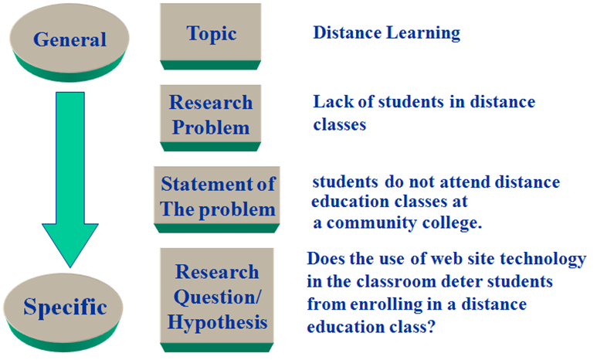
LESSON 2 – Components of a Research proposal
Formulation of research question/hypothesis

Slide 80
Summary
on
Statement of the problem, research questions, Hypothesis, and objectives
Statement
of the problem
Research
Questions
Hypotheses
Research
Objectives
Overall
Direction
Raise questions
to be answered
Make predictions
about expectations
State Goals
Intent
Form
One or more
sentences
One or more
questions
One or more
statements
One or More
Objectives
Placement
End of
Introduction
End of the introduction, after the literature review, or in a separate section of the study
End of the
introduction

Slide 81
LESSON 2 – Components of a Research proposal
Materials and methods, and procedures – a detail description of the activities and the methodological steps you will take to achieve your objectives.
Depending upon the type of study, it includes:
  Description of study area, study design and study participants
  Materials or devices used
  Sampling technique and sample size used
  Methods of data collection
  Method (s) of data analysis, etc.

Slide 82
LESSON 2 – Components of a Research proposal
Study design - the practical way in which the research is conducted according to a systematic attempt to generate evidence to answer the research question.
Depending upon the type of study, it could be:
  Observational studies – the researchers stand apart from events taking place in the study
  Experimental/intervention studies – the investigator tests the effect of an intervention on the events taking place in the study.
includes description of and rationale (brief) for selection of participants, methods of data collection and analysis, and procedures you will use to ensure ethical practice
includes a statement about the delimitations (boundaries) of the study

Slide 83
LESSON 2 – Components of a Research proposal
What does the methodology section do?
Shows the reader how it is being set for looking answers to the research question.
It should reflect the capability of research worker to complete the research work.
The proposed methods must be appropriate to the type of research work.

Slide 84
LESSON 2 – Components of a Research proposal
Work plan – a schedule that summarizes the different components of a research proposal and how they will be implemented. Here,
  Different phase/components of the study should be stated
  Describe the activities in each phase.
  Indicate time frame to accomplish the various aspects of the study.
  Be realistic: compare with the existing workload; duties
  Could be presented in table, chart or graph.

Slide 85
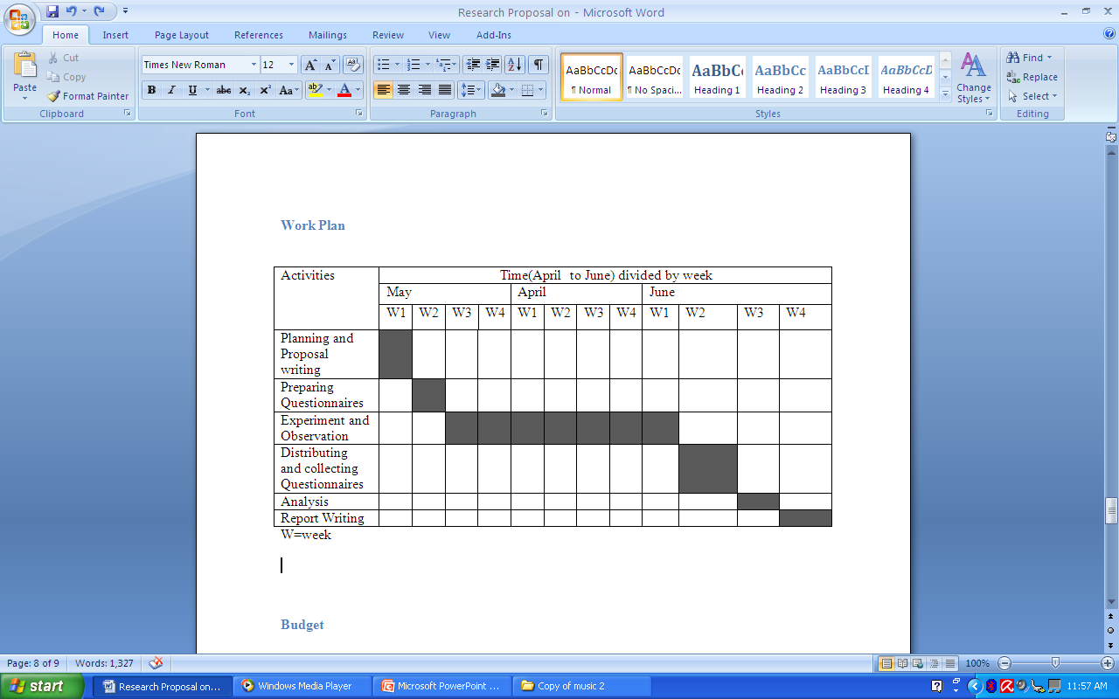
LESSON 2 – Components of a Research proposal
Work Plan – Gantt Chart

Slide 86
LESSON 2 – Components of a Research proposal
Week | Action
1-3 | Literature search Primary research (talk to relevant people)
3-5 | Develop and pilot questionnaire Continue literature search
5-7 | Analyses pilot work and revise questionnaire Ask relevant people for comment
7-11 | Send out questionnaire Categories returned
11-12 | Send out reminder letter for non-responses Continue to categories returned questionnaire
12-16 | Data input Data analyses
16-20 | Write report Prepare oral presentation

Slide 87
LESSON 2 – Components of a Research proposal
Budget and funding – the cost of conducting research.
  Budget items need to be explicitly stated with justification
  Costs are typically:
    Direct costs – personnel, consumable supplies, equipments, travel, publication, etc.
    Indirect costs – overhead and administrative costs.

Slide 88
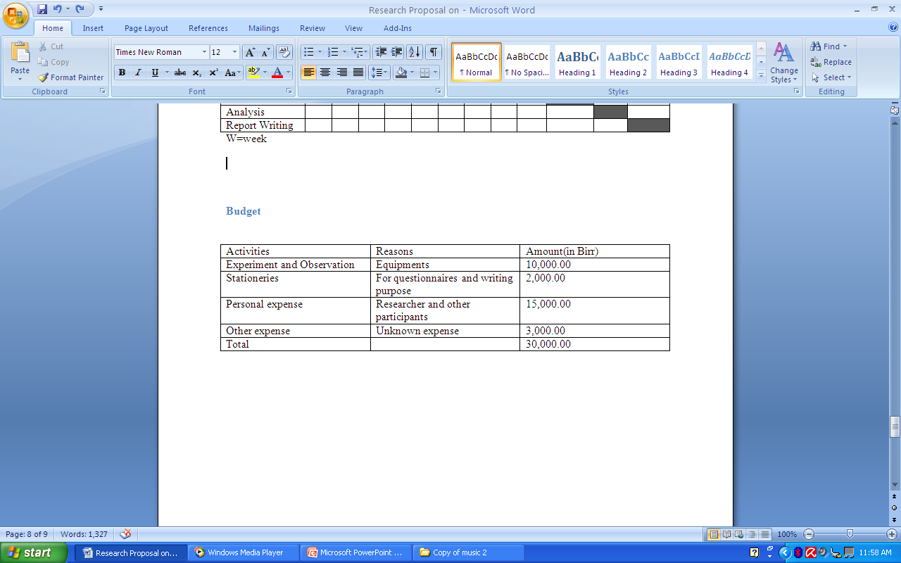
LESSON 2 – Components of a Research proposal
Budget

Slide 89
LESSON 2 – Components of a Research proposal
Resource | quantity | Unit cot | Total (Birr)
Good quality personal recorder with battery indicator light, self-turning mechanism and headphones | 1 | 1090.99 | 1090.99
10 90-minute audio cassette tapes | 60 | 10 | 160
Long life batteries | 20 | 8 | 160
Second class postage stamps | 40 |  | 2800
Stationary-paper, envelope, paper clips, ring binder, scissors | - | - | 500.76
Travel expense-petrol, overnight stay at five location |  |  | 1990.95
Advert in local paper |  |  | 30.70
Leaflets (1000) |  |  | 210.90
Total Expenditure |  |  | 6944.30

Slide 90
LESSON 2 – Components of a Research proposal
References – citation of all the information that you obtain very related to your research area.
  The style of writing list of references varies from one discipline to another.
Abebe T. 2005. Frequent use of internet use and distance learning. Journal of Computer Science. Vol.1, pp. 200-205.
Anderson, A.T. and B.D. Sharma. 2001. Frequent use…..
Andersont, A.T., B.D. Sharma and R.S. Garg. 2007. Freuent use ….
Abebe, T. 2005. Applied Physics. Selam printing press, 4th ed. Addis Ababa.

Slide 91
LESSON 2 – Components of a Research proposal
Appendices/annexes – additional information provided for the reader. These include, for example,
  Dummy tables
  Biographical data
  Questionnaire, forms, etc.

Slide 92
Research proposal Writing
Before start writing, ask yourself …
Do I have the clear research question?
Have I read broadly and deeply in that area?
Have I discussed the topic with peers?
Have I enough time and fund to start?
Do I feel support from faculty and friends?
Do I know what I want to say before writing?

Slide 93
Research proposal Writing
In proposal writing, be prepared
To make mistakes and to learn.
To write and rewrite many times.
To spend many hours looking for information.
To have your writing criticized.
To feel confused and hopeless sometimes.

Slide 94
Tips for Successful Proposal Writing
Make it simple
  Avoid showy language, unnecessary jargon, and double speak by cutting down every unnecessary words/statements.
Read your work loud
  A sentence that is difficult to say will be difficult to read.

Slide 95
Tips for Successful Proposal Writing
Revise, revise, revise.
  Check spelling and grammar.
  Each sentence must follow logically from the before: chain of ideas.
  Every sentence must contain one idea only.
Put an end to it
  Set a time frame for writing the proposal
  The faster you finish the proposal and submit it, the less time you have wasted thinking about writing it.

Slide 96
Ethics in Proposal Writing
Avoid plagiarism
  Plagiarism is presenting someone else’s ideas or words as though they were your own.
Avoid cut and paste
  Do not cut and paste from articles.

Slide 97
Thank you

Slide 98
Group Discussion
  Identify a researchable topic in your field of specialization
  Formulate statement of the problem, research question
  Write the objectives of conducting the research
Finally, present the gist of discussion for your colleagues for
its improvement.

Slide 99
Title
The impact of the dynamics of water resources development and institutional change on poverty alleviation and stability of the environment

Slide 100
Research Question
What has been the path of water resources development in the Chi-Mun river basin and what have been the different types of adjustment to water scarcity and water quality degradation? To what extent are these problems generated, rather than natural?
How is the observed pattern of agrarian/economic change linked to local changes (population growth, migration, etc), to water resources development (dams, irrigation systems…), to exogenous factors (development of agribusiness, political changes…) and to national policies?
What is the governance of the decision-making process? How are choices justified? What information is available and used? These questions will be applied to past evolutions and to planned projects (water grid, diversion from Laos, etc): how to enhance informed deliberative governance for the future?

Slide 101
Example:
The study will first address the past transformations of the Chi-Mun river basin; periodize changes and draw lessons on how agrarian change and water resources development are interrelated with multiple variables such as population growth, development of agro-business and food markets, decentralization / democratization processes, and local / national politics and policies. It will build on a comprehensive deconstruction/re-evaluation of planning documents, focusing on development visions and their justifications (both macro-economic considerations and assumptions, and key technical parameters that are put forward to justify a variety of different types (small, medium, largescale) of water resources developments.
The present situation will be investigated thoroughly, analysing in detail the current management of water at different nested scales in the basin, establishing water accountings, and examining governance patterns of both current management and planned projects.
Study Design – How are you going to carry out the research (the process)

Slide 102
Research Method – Technique used to collect data and analysis
Planning hypotheses and impacts of irrigation development will be tested against field reality during two small case studies which are to be selected during the first 3 months of work, to highlight the techniques, economics, and politics of water resources developments at different scales.
At the same time, the case studies will assess critical environmental impacts and evaluate the distribution of involuntary costs among affected societies. It is proposed to select case study sites
across different scales within the Chi-Mun river basin: 1 Large-scale irrigation system, 1 Large-scale pump-irrigation system, 1 small-scale pump-irrigation system, 1 medium / small-scale tank irrigation
project, 1 water-grid-style pipe system; and critically link case study findings to existing studies

Slide 103
Unit
4
Process in Conducting Research

Slide 104
Lesson 1. The research process
Stages in the research process:
  Conceptualization – idea on the research process
    Identifying a Problem
    Literature review
    Specifying a purpose
  Contextualization – putting your research in the context of others –(unit 3)
  Data collection and analysis – (this unit addresses)
  Reporting – writing up of your research and presentation (unit 6)

Slide 105
Research methods – Data collection and Analysis
To collect data, choose the most suitable research method for your study according to the type of research/approaches used.
  Quantitative research – involving numerical and statistical data. The emphasis is on quantitative observations.
  Qualitative research – gathering non-numerical data. The emphasis is on qualitative results.
  Example:
    Effect of 1mg/day folic acid to pregnant women on the
    birth weight of their babies.– qualitative or quantitative?

Slide 106
Research methods – Common Types
Observation studies
Questionnaires
Interviews
Focus groups
Document analysis
Mathematical modeling
The experimental method
Survey
Correlational study

Slide 107
Research methods – Common Types
Observation studies- the process of observing and recording events.
  Especially useful for studying human or animal behavior
  Two types – participant (observer as participant) and non-participant
  E.g. Study on weight gain of selected sheep breeds which are exposed to the same environment.
  Study on social norms of Awera Amba community.
  Morphological processes of lower Awash river channel
  Data collection:
  no perfect example; varies with the type of problem
  often through writing up of notes
  may also involve taping or filming
  graphs, charts

Slide 108
Research methods – Common Types
Questionnaires – a tool where respondents answers to questions.
  It could be open or closed/fixed.
  It is flexible and can be applied on almost any topic of research.
Data collection:
Questionnaire forms (hard copies), web based questionnaires.
E.g. Why do you apply for graduate program? – closed
1 – to expand my knowledge
2 - to earn a better salary after graduation
3 – to get promotion
4 – no specific reason

Slide 109
Research methods – Common Types
Interviews – tools where questions are delivered in a face to face encounter.
  It is limited to cases where the subjects of study are human.
  It can be approached in pure quantitative (structured) and pure qualitative (not structured) angle as of questionnaire.
  Mainly interviews are semi-structured
  Data collection:
  Structured one – ticking/writing on a form
  Less structured data – taping and taking notes

Slide 110
Research methods – Common Types
Focus groups – a type of interview but targeting only carefully selected individuals usually who do not know each other.
  It is useful in providing qualitative data.
  E.g. Study on identification of corrupted politicians.

Slide 111
Research methods – Common Types
Document analysis/content analysis – the process of using any kind of document, films, photographs, books, etc, for analysis for a particular research interest.
  It is an indirect form of research wherein original data is not generated.
  It is a non-reactive method.
  Reliability and validity are the central concerns
  Typical example: The Da Vinci Code

Slide 112
Research methods – Common Types
Mathematical modeling – used to analyze relationships between different variables and to predict possible outcomes, or causal effects.
  Can be developed analytically or through conducting experiment.
E.g.
    Development of a modified universal Soil Loss Equation for Andit Tsed woreda, North Shewa, Ethiopia.
    Development of Intensity-Duration-frequency curves for Southern Ethiopia.

Slide 113
Research methods – Common Types
The experimental method – involves setting up an experiment in order to test a particular theory or hypothesis.
  laboratory experiments – small scale study and subjects are studied in a controlled environment.
  E.g. bio-technology, chemistry, medical studies
  field experiments – research conducted outside the laboratory and researcher control of the env’t is reduced.
  E.g. agricultural studies, hydrological studies

Slide 114
Analyzing and Interpreting Quantitative Data
Steps in quantitative analysis and interpretation:
  data preparation
  Data analysis
  Reporting the results
  Discussion of the results

Slide 115
Analyzing and Interpreting Quantitative Data
Preparing the data for analysis:
  Arrange the data according to your need
  If need be, score data first by assigning numeric code
  Create data file in data grid
  Clean database, missing values
Then, Select a statistical program as a tool for analysis:
  Statistical Package for Social Sciences-SPSS is most popular
  Other programs: Mini-tab, Statview, SAS
  Use mainframe, PC or other platforms

Slide 116
Analyzing and Interpreting Quantitative Data
How do you analyze the data?
If statistics is involved, either conduct descriptive analysis:
  Measures of central tendency
  Measures of relative standing
  Descriptive Statistics
  Central Tendency
Variability
Relative standing
Mean
Median
Mode
Variance
Standard Deviation
Range
Z-Score
Percentile Ranks

Slide 117
Analyzing and Interpreting Quantitative Data
Or, Conduct inferential analysis:
  Hypothesis testing
  Confidence interval
Identify a null and alternative hypothesis
Set the level of significance (alpha level) for rejecting the null hypothesis
Compute the sample statistic
Make a decision about rejecting/failing to reject

Slide 118
Analyzing and Interpreting Quantitative Data
  Parametric inferential analysis:
    Correlation coefficient and regression coefficient
    T-test, analysis of variance, analysis of covariance
    Chi-square analysis, etc.

Slide 119
Analyzing and Interpreting Qualitative Data
Codes the Text for
Description to be Used
in the Research Report
Codes the Text for
Themes to be Used
in the Research Report
The Researcher Codes the Data (i.e., locates text
segments and assigns a code to label them)
The Researcher Reads Through Data
( i.e., obtains general sense of material)
The Researcher Prepares Data for analysis
( e.g., transcribes field notes)
The Researcher Collects Data (i.e., a text file, such as
fieldnotes, transcriptions, optically scanned material)

Slide 120
The coding process for qualitative data
Divide text
into segments
of information
Reduce
Overlap and
redundancy
of codes
Initially read
through data
Many
Pages
of Text
Many
Segments
of Text
Codes
reduced
to 20
30-40
codes
Reduce Codes to
5-7 Themes

Slide 121
Interpreting Qualitative Data
Interpretation is not neutral
Reflect about the personal meaning of the data
Compare and contrast personal viewpoints with the literature
Address limitations of the study
Make suggestions for future research

Slide 122

Summary of a research process
Steps in the Research Process
Two Approaches
Research Designs
Quantitative
Qualitative
Identifying a Problem
Reviewing the Literature
Quantitative
Qualitative
Experimental
Correlational
Survey
Specifying a Purpose
Quantitative
Qualitative
Collecting Data
Quantitative
Qualitative
Mixed
Analyze and Interpret Data
Quantitative
Qualitative
Report and Evaluate
Quantitative
Qualitative
Narrative

Slide 123
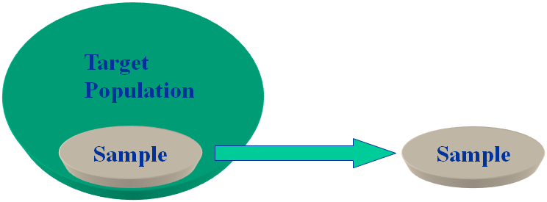
Sampling Terms and Procedures
Population - inclusive group defined by researcher
Sample - representative subset of population
  should contain essential elements of population
  Samples are only estimates
  The difference between the sample estimate and the true population is the “sampling error.”
Population
All teachers in high schools in one city
College students in all community colleges
Population
All high school biology teachers
Students in one community college

Slide 124
Sampling Terms and Procedures
Quantitative Sampling Strategies
Probability Sampling
Non-Probability Sampling
Simple Stratified Systematic
Random Sampling Sampling
Convenience Snowball
Sampling Sampling

Slide 125
Sampling Terms and Procedures
  Types of Sampling:
  Probability Sampling - the selection of individuals from the population so that they are representative of the population
    Random Sampling-process of sampling which assures that any subject in the population has an equal probability of being in the sample
    Systematic counting-uses list to choose every nth person from the population
    Stratified Random-used when researcher believes the population has distinct subgroups.
E.g. if population has 45% men, then we make sure sample is 45% men

Slide 126
Sampling Terms and Procedures
  Non-Probability Sampling - the selection of participants because they are available, convenient, or represent some characteristic the investigator wants to study.
    Convenience Sampling - participants are selected because they are willing and available to be studied
    Snowball Sampling - the researcher asks participants to identify other participants to become members of the sample.

Slide 127
Thank you

Slide 128
Example 1.
- Individual/group work:
Choose appropriate research method and methodology for the research title you have already identified
Develop a mini-proposal. Follow the recommended proposal writing format
Prepare a power point and present your plan.

Slide 129
Example 1.
Title : Accounting policies of all industries in the U.S.
Research question : Will it be practical if all industries in the U.S are required to have standardized account policies, subject to one set of rules and conditions?
Objectives : To examine the effect of standardized account policies on the
activities of industries in the US
Proposed research design :
• Visit several companies and industries to get those companies’ accounting
officers views on this subject (50% of research)
• Visit a few banks to get opinions from one of their management staff
on this subject (30%)
• Browse through accounting journals, financial newspapers and the net
for articles related to the subject in question (20%)
• Browse through recent FASB and SEC publications (20%)

Slide 130
Example 2.
Title : Domestic oil launch in the UK
Research question :
Objectives : To examine attitudes to the use of Olive oil in the home
Proposed research design :
• The research has both quantitative and qualitative research components.
In the qualitative research, focused research will be used to explore and
understand the attitudes of potential customers towards a new brand.
In case of the quantitative research, carry out a telephone study using
questionnaire to measure how widespread these attitudes are.

Slide 131
Example 2.
Research Method:
Qualitative:
1. Population and sampling – four groups are proposed with the following profiles……
Quantitative: we have made to carry out 200 interviews in housholdes of different sizes….. We have set interlocking qoutas as follows ….
Analysis : …
Timing/ work plan: The table below shows the time frame to conduct the research …
Week | Activity
1-4 | Desk research
4-6 | Qualitative field work

Slide 132
Example 2.
Budget: The cost break down of the budget required to carry out the research is shown as below.
Phase | Description | Budget
Desk research | $1000 to purchase relevant reports $..... Net browsing $..... | $3250
Quantitative | interviews | $10000
Qualitative research | Four focus groups | $8000
 | Total | $20,250

Slide 133
Unit
5
Research Ethics

Slide 134
The research Ethics - basic
  Ethics –norms for conduct.
  Norms - guidelines for authorship copyright and patenting policies, data sharing policies, confidentiality rules in peer review, etc.
Ethical norms - ‘body of principles governing right and wrong’.

Slide 135
The research Ethics - basic
  Aims of research – knowledge, truth and avoidance of error.
  Anything which is different from this is unethical.
Research misconduct/unethical research:
  Falsification – altering data
  Fabrication – creating data
  Plagiarism – borrowing ideas or words without appropriate attribution
  Misrepresenting research data
  Copyright (legal protection of intellectual property)
    Original works of authorship (books, software)
    Covers the particular expression of an idea in the work

Slide 136
The research Ethics - importance
Promote the aims of research (knowledge, truth and avoidance of error)
Promote the values essential to collaborative work ( trust, accountability, mutual respect, and fairness)
Ensure that researchers can be held accountable to the public
Help to build public support for research
Promote moral and social values (human rights, animal welfare, health and safety)

Slide 137
Ethical Codes of Practice
Many learned bodies have published ethical codes of practice, for example:
  Medical Research Council
  Economic and Social Research Committee
  Welcome Trust
  The Nuffield Foundation
  British Society of Criminology
  The British Sociological Society
  National research ethics guidelines – Ministry of Science and Technology, Ethiopia

Slide 138
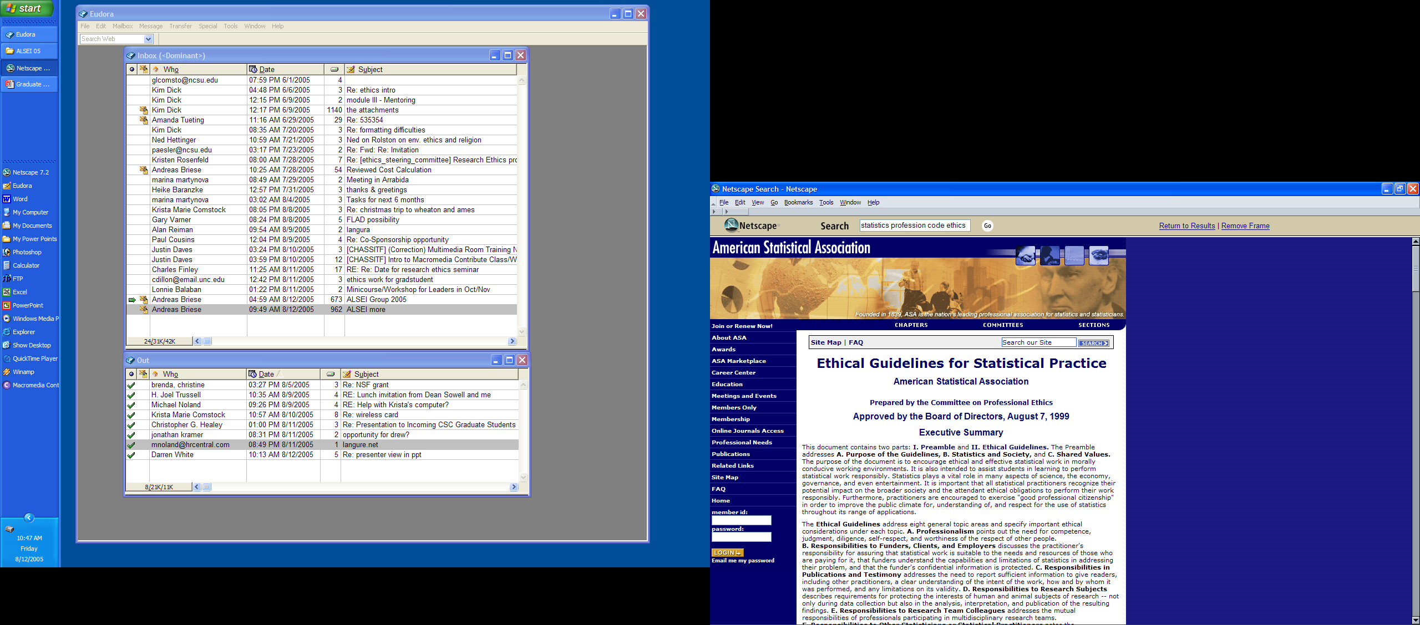
Ethical Codes of Practice

Slide 139
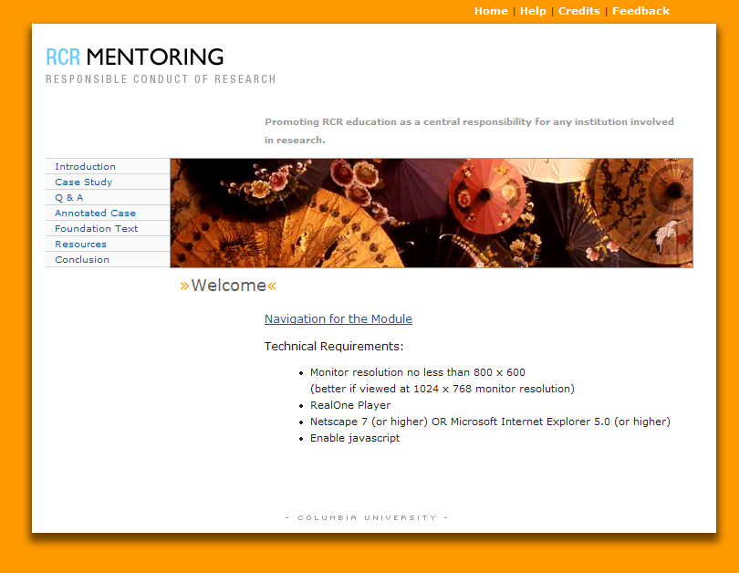
Ethical Codes of Practice
http://ccnmtl.columbia.edu/projects/rcr/rcr_mentoring/

Slide 140

Ethical Codes of Practice
http://www.primr.org/

Slide 141
Research Ethics –Additional Note
Here are controls over research involving human subjects:
  Legal obligations
  Professional code of ethics
  Pre-Clearance from Relevant Regulators
E.g. Typically, University Ethics Committee
  Free and Informed Consent (voluntary participation)

Slide 142
Ethical Code Development
Some ethical principles many codes addresses:
  Honesty – in reporting data, results, methods, procedures. No fabrication, falisify, etc.
  Objectivity – strive to avoid bias in experimental design, data analysis, etc.
  Integrity – keeping promises and agreements
  Carefulness – avoid carless errors and negligence; critically examine your work, etc.
  Openness – share data, results, ideas, etc. And, be open to criticism.
  Respect for intellectual property – honour patents, copyrights, etc. No use of unpublished data without permission. Give credit when credit is due.

Slide 143
Ethical Code Development
  Confidentiality – protect confidential communications such as paper submitted for publication, etc.
  Legality – know and obey relevant laws institutional and government policies
  Animal care – use proper respect and care when animals are used in research.
  Human study participants’ protection – minimize harms and risks and maximize benefits; respect human dignity, privacy; take special precautions with vulnerable, special, sick populations, minority groups, etc.

Slide 144
Ethical Dilemma
  Ethical dilemma - when an incident arises that causes you to question how you should react.
    What would you do if faced with a difficult issue in research integrity? There are no right or wrong answers, but your opinion will surely help others to make their best choice.
If doing what is right produces something bad, or if doing what is wrong produces something good, the force of moral obligation may seem balanced by the reality of the good end.
Example:
A patient who appeared to a doctor is in critical condition but refuses to take or accept any care or treatment. What shall the doctor do?

Slide 145
Group Discussion
Take the following case studies.
Each group discuss the ethical implications of the case study
Articulate your position on the ethical implications of the case study.
Come up with suggested measures that has to be taken by the researcher
Present the essence of your discussion
Case 1.
With the aim of teaching the people in town X about the extent of HIV/AIDS in the town, he planned, without their knowledge, to test bloods of patients who appear to his clinic.
Is this kind of research ethical?

Slide 146
Group Discussion
Case 1.
With the aim of teaching the people in town X about the extent of HIV/AIDS in the town, he planned, without their knowledge, to test bloods of patients who appear to his clinic.
Is this kind of research ethical?
Case 2.
Do you think that research on cloning is ethical?
Case 3.
A patient who appeared to a doctor is in critical condition but refuses to take or accept any care or treatment. What shall the doctor do?
Case 4
Do you think that abortion is ethical?

Slide 147
Thank you

Slide 148
The research Ethics - Theories
Theories of Ethics –
  Utilitarianism – predicts that the thing that benefit many is ethically accepted.
  Deontology – adhering to obligations and duties when analyzing an ethical dilemma.
  Rights – what is considered right by the society given priority.
  Virtue – judging a person by his character rather than by action.
  Casuist – compares a current ethical dilemma with examples of similar ethical dilemmas and their outcomes.

Slide 149
The research Ethics - Theories
Ms. Jones owns several apartment buildings in a city of high seismic hazard. One of the apartment buildings is a wood-framed structure designed in the early 1960s. The building has 5 stories with a fairly open, ground-level parking area.
The local government has recently endorsed some tax and other incentives for property owners to retrofit certain classes of buildings that are considered seismically hazardous, including apartments with this type of "tuck-under parking" configuration. Ms. Jones contracts with a local structural engineering firm to provide a seismic evaluation and conceptual retrofit design for the apartment building.
The evaluation concludes that the building has a soft lower story and suffers from a lack of adequate shear wall and diaphragm capacity throughout the height of the building. The result is that mitigation of the hazards to a basic "life safety" performance level for the design level earthquake (10% chance of exceedance in 50 years) will require that the building be vacated for a substantial period of time for the construction.
The residents of the building, who are primarily low-income families, on month-to-month leases, with very few options for alternate housing, find out about this seismic study and, as a unanimous group, appeal to the building owner not to go ahead with the work out of fear of being displaced. Ms. Jones relays the tenants' concerns to her structural engineer, who suggests an alternative upgrade approach using exterior elements. This option would allow the tenants to continuously occupy the building, although there will be some minor interior impacts. Assume that the expected level of seismic performance is essentially the same for both options.
Cost estimates for the total project (hard and soft costs) were prepared for both options. Assume that the exterior option is approximately 25% greater than the interior option. Assume also that the tax benefits throughout the useful life of the building do not offset the cost of the seismic renovation. In addition the exterior option has significant aesthetic impacts on the building, of which Ms. Jones and her architectural consultant are not too fond.
Which option should Ms. Jones pursue?

Slide 150
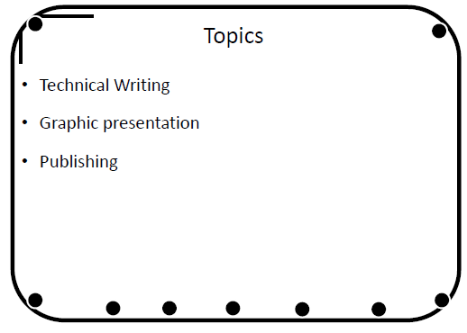

Slide 151
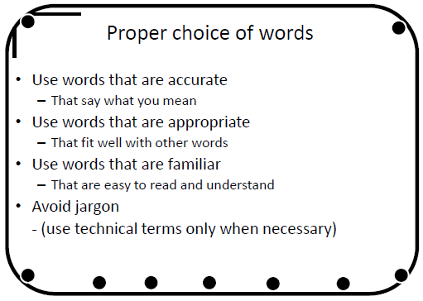

Slide 152
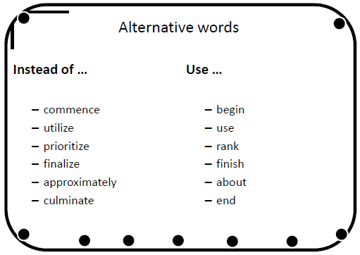

Slide 153
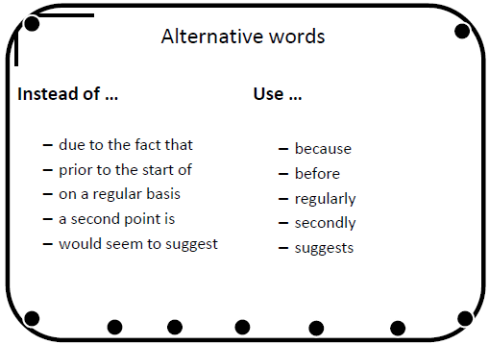

Slide 154
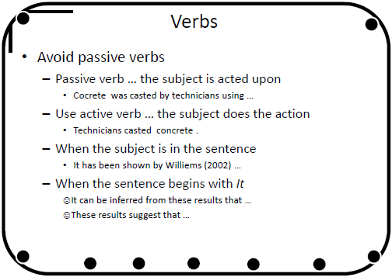

Slide 155
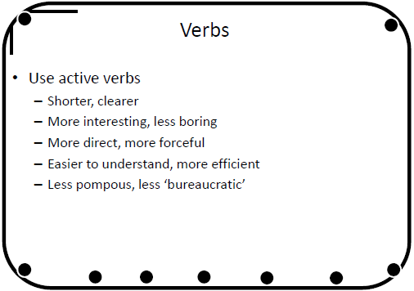

Slide 156
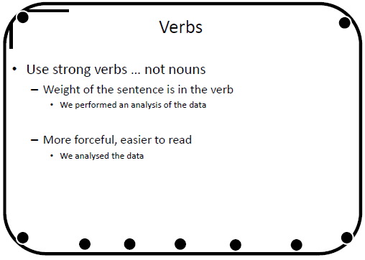

Slide 157
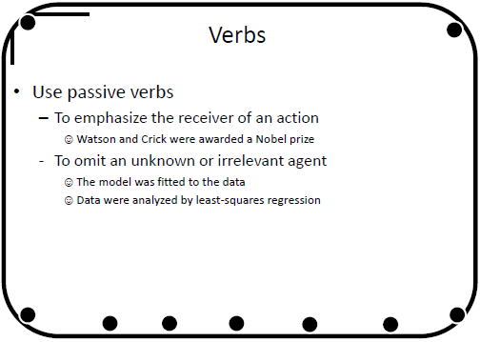

Slide 158
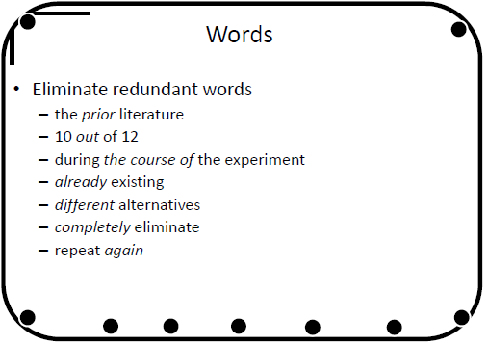

Slide 159
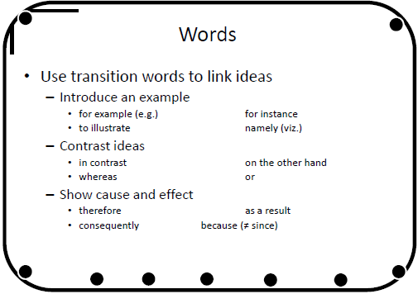

Slide 160
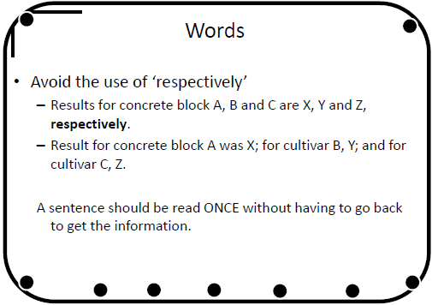

Slide 161
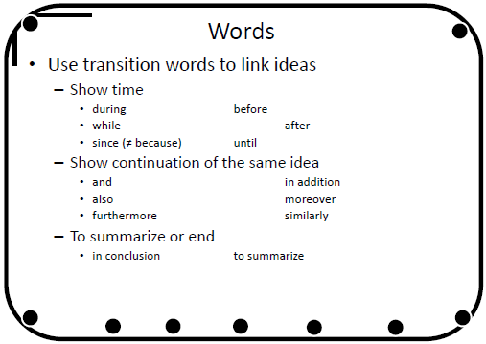

Slide 162
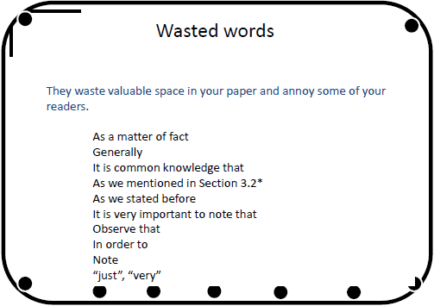

Slide 163
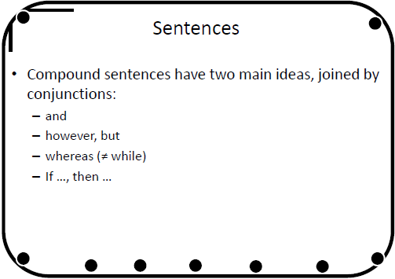

Slide 164
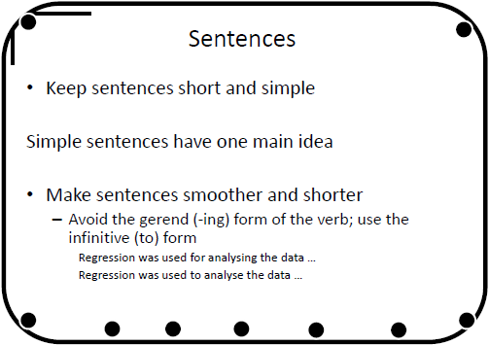

Slide 165
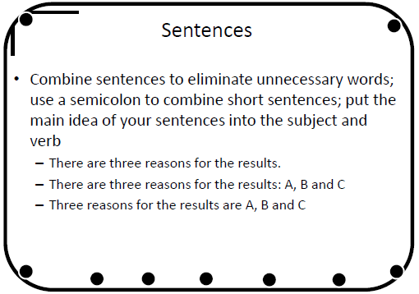

Slide 166
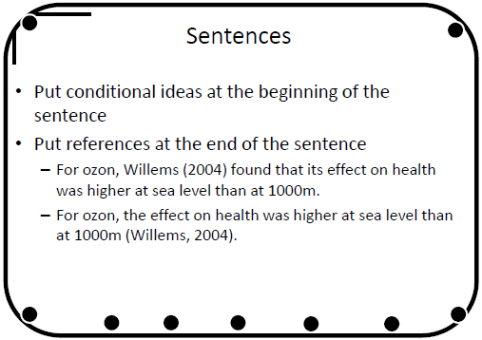

Slide 167
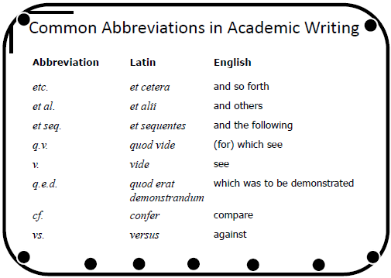

Slide 168
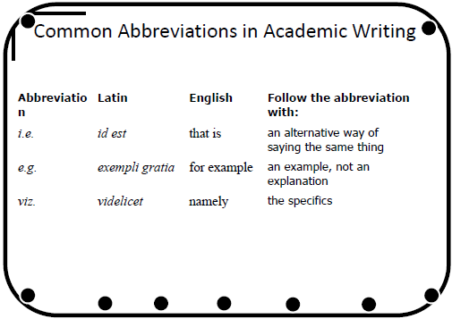

Slide 169
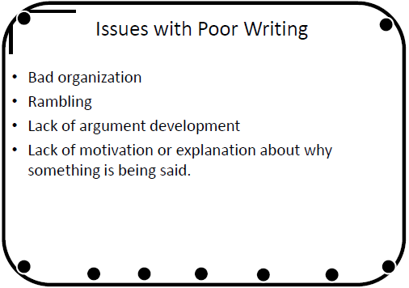

Slide 170
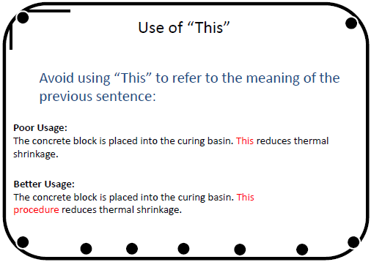

Slide 171
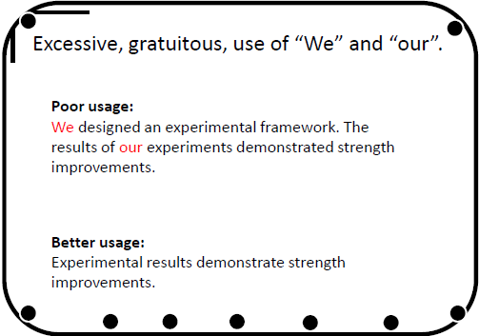

Slide 172
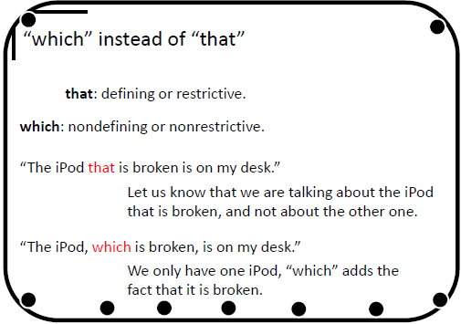

Slide 173
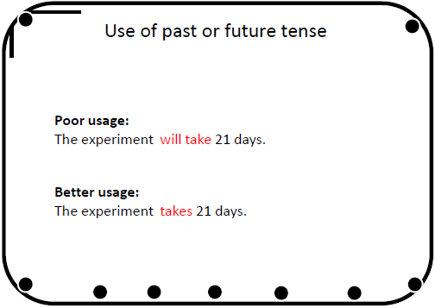

Slide 174
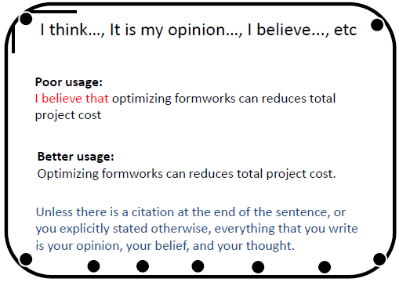

Slide 175
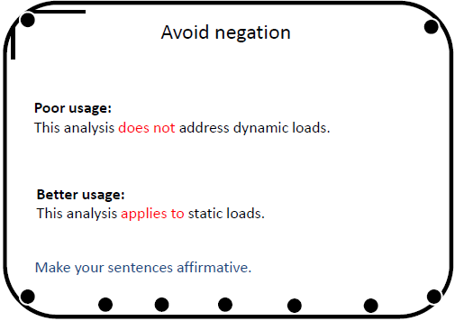

Slide 176
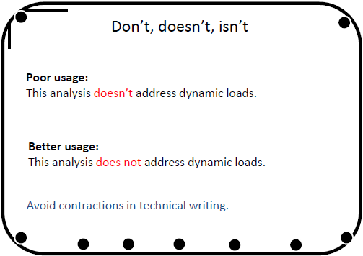

Slide 177
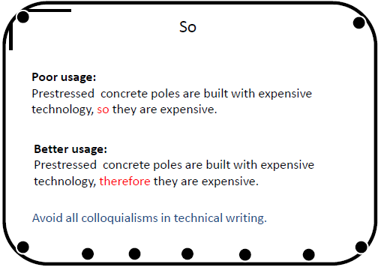

Slide 178
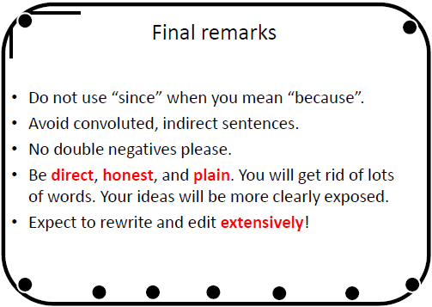

Slide 179
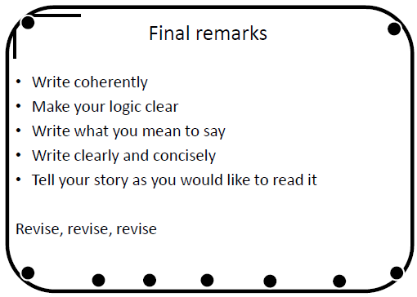

Slide 180
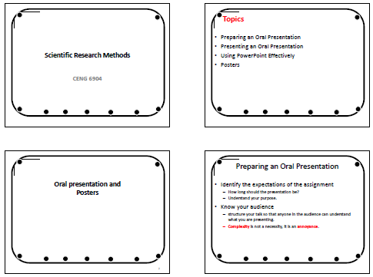

Slide 181
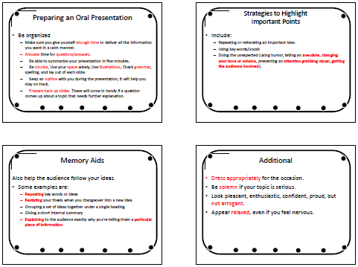

Slide 182
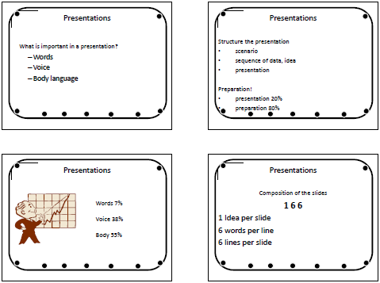

Slide 183
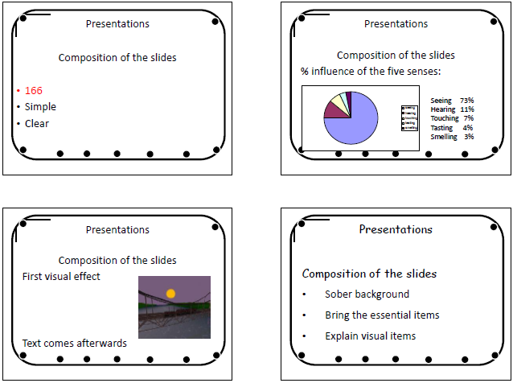

Slide 184
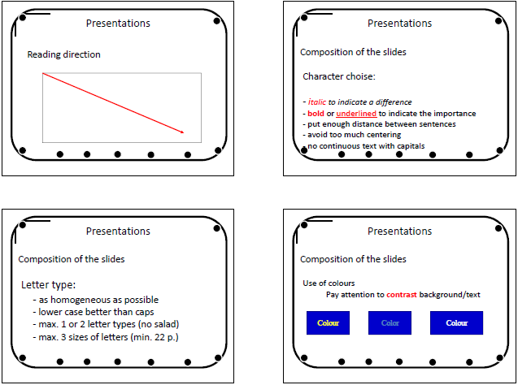

Slide 185
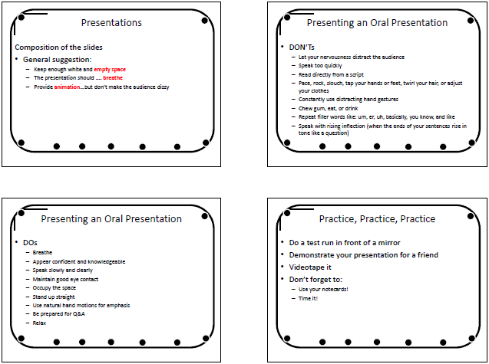

Slide 186
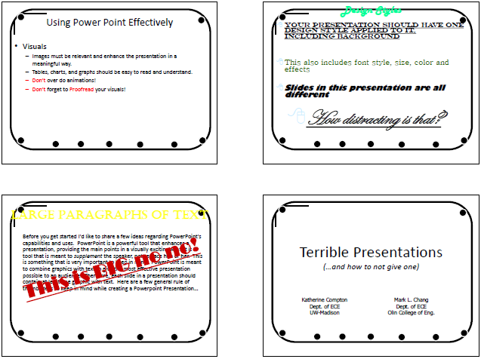

Slide 187
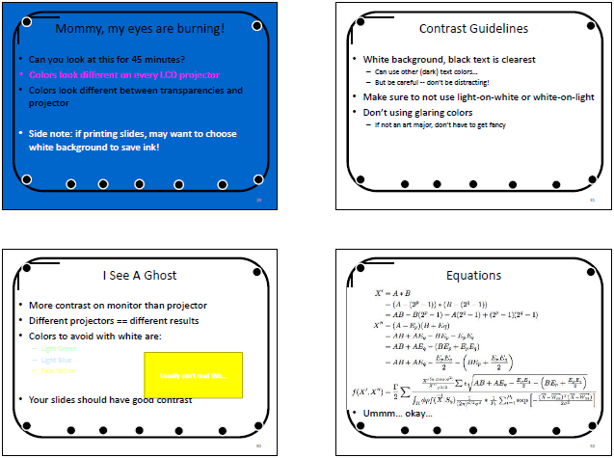

Slide 188
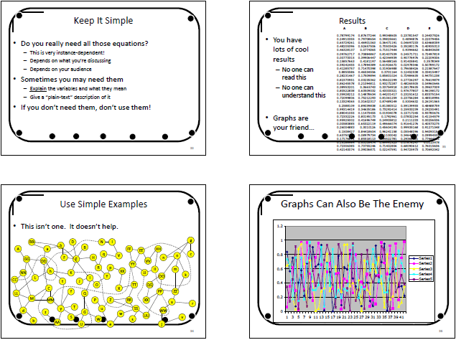

Slide 189
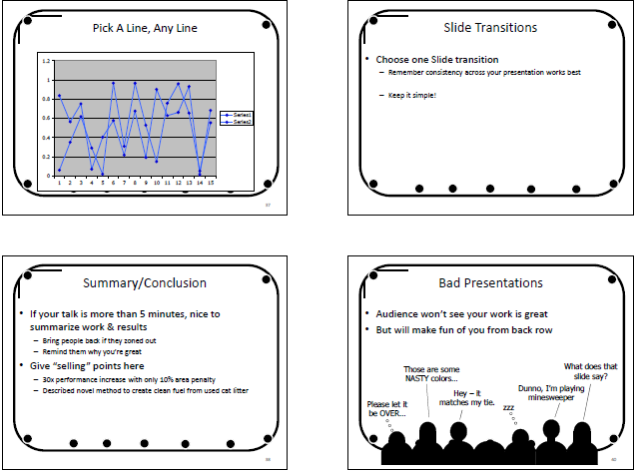

Slide 190
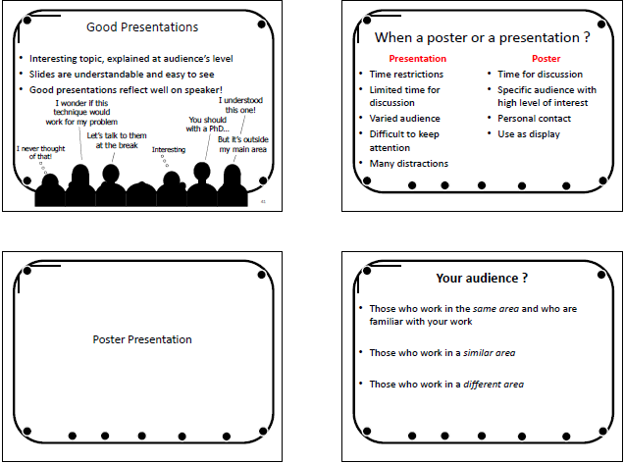

Slide 191
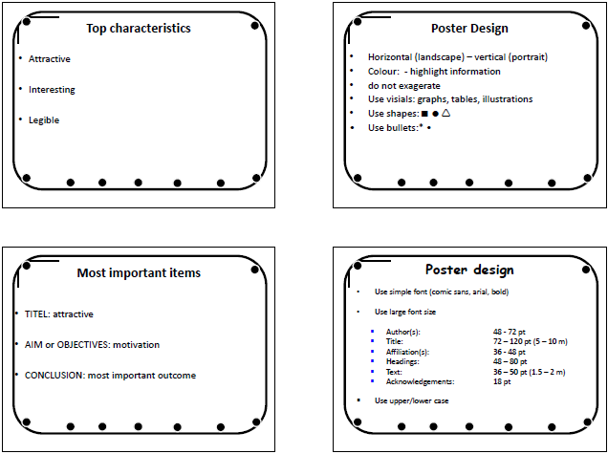

Slide 192


Slide 193


Slide 194


