Slide 1
Part I – Water Supply
CHAPTER 1
TYPE OF WATER SUPPLY SYSTEMS

Slide 2
OUTLINE
WATER SUPPLY SYSTEM FRAMEWORK
SOURCE
SECTOR
SETTLEMENT PATTERN
LOCATION
ENVIRONMENT
MANAGEMENT
SITUATION

Slide 3
POLICY/ GOVERNANCE
(Operating rules and regulations)
WATER
(SUPPLY)
POPULATION
(DEMAND)
WATER SUPPLY SYSTEM
SOCIO-ECONOMY
(DEMAND)
ENVIRONMENT
(Availability / Climate / Pollution)
SETTLEMENT
(Demand Centre)

Slide 4
Key Questions of System Approach
What/Where is the source of water?
What is the number/density/ settlement pattern of population?
What is the socio-economic status?
What is the prevailing environmental condition?
What is the policy, legal and institutional – governance condition?

Slide 5
SOURCE
Conventional & Non-Conventional
Conventional
Surface Water
Groundwater
Non-Conventional
Rainwater Harvesting
Fog harvesting
Wastewater recycling

Slide 6
Conventional Sources
Surface Water
Groundwater
Rivers
Diversion
Dam
Lakes
Ponds
Springs /gravity-artisian
Wells - Hand-dug/Shallow/Deep
High/Low yield
Local / Regional

Slide 7
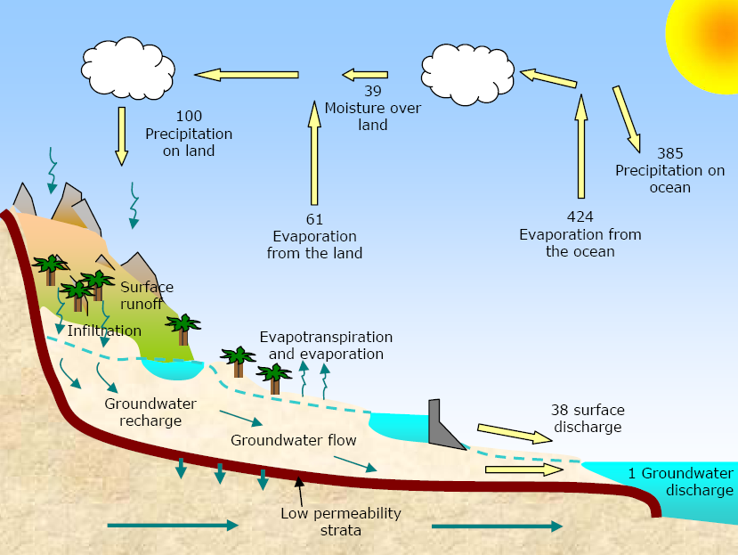
Hydrologic Cycle

Slide 8
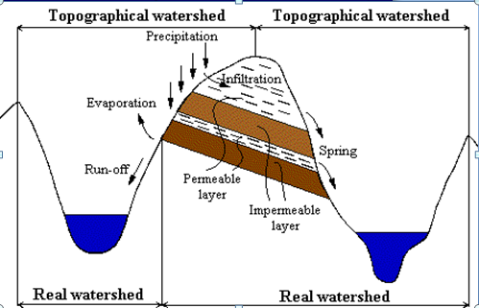
Catchment area….
If a permeable soil covers an impermeable substrate, the topographical division of watershed will not always correspond to the line that is effectively delimiting the groundwater.

Slide 9
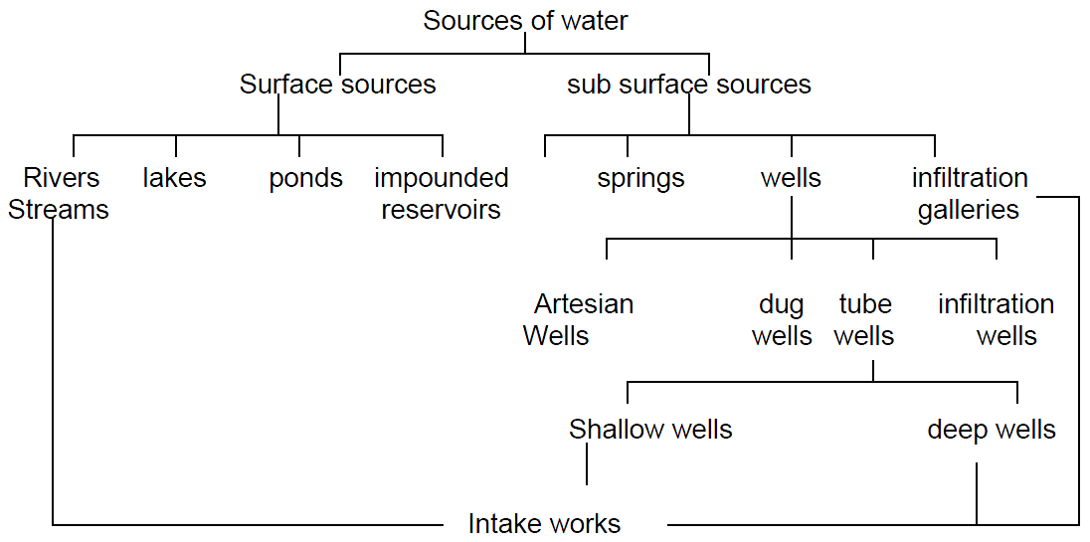

Slide 10
RAINFALL
TOPOGRAPHY
TEMPRATURE

Slide 11
No. | Basin Name | Type | Source | Area (km²) | Terminal | Water Resource Potential (Billion m³)
1 | Wabishebele | R | Bale Highland | 202220 | Indian Ocean | 3.4
2 | Abay | R | West, Southwest Highland | 199912 | Mediterranean Sea | 54.4
3 | Genale Dawa | R | Bale Highland | 172259 | Indian Ocean | 6.0
4 | Awash | R | North Wollo Highland | 110000 | Terminal Lakes (Internal) | 4.9
5 | Tekeze | R | North Wollo Highland | 82350 | Mediterranean Sea | 8.2
6 | Denakil | D | No flow | 64380 | Internal | 0.86
7 | Ogaden | D | Central, Western Highland | 77120 | Internal | 0
8 | Omo-Gibe | R | Western Highland | 79000 | Rudolph Lake (Internal) | 16.6
9 | Baro-Akobo | R | Western Highland | 75912 | Mediterranean Sea | 23.23
10 | Rift Valley Lakes | L | Arsi and Central Highland | 52000 | Chew Bahir | 5.64
11 | Mereb | R | Adigrat Highland | 5900 | Swamp in Sudan | 0.72
12 | Aysha | D | No flow | 2223 | Intenal | 0

Slide 12
GROUNDWATER AVAILABILITY

Slide 13
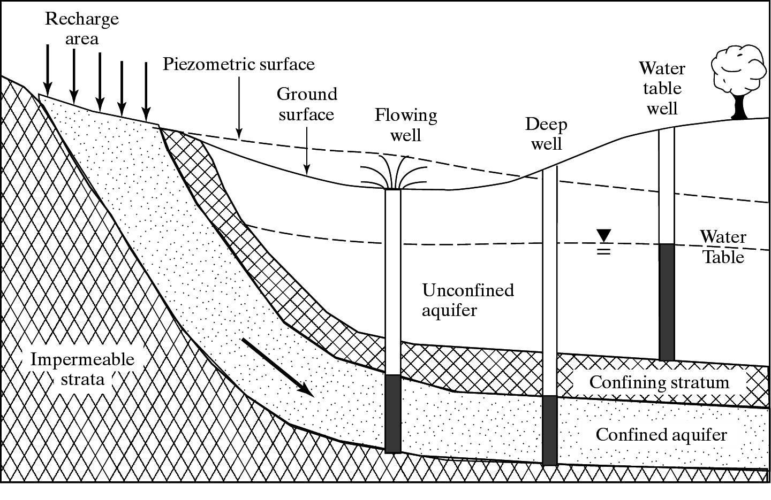
Aquifer Types and Properties

Slide 14
Groundwater Recharge Area for Akaki Well field
Notes:
Around Modjo, previously drilled wells depth upto 250 m in pyroclastic rocks, were having a yield not greater than 10 l/s and transmissivity a maximum of 200 m2/day. In the recent drilling for Ada'a project thew pyroclastic rocks was penetrated at depth of 343 meter and the yield of bore holes is very high >100 l/s and the transmsiisvity is >10,000 m2/day

Slide 15
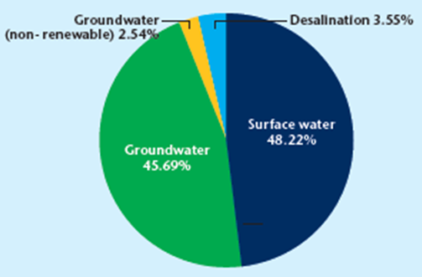
Global Sources of Drinking Water

Slide 16
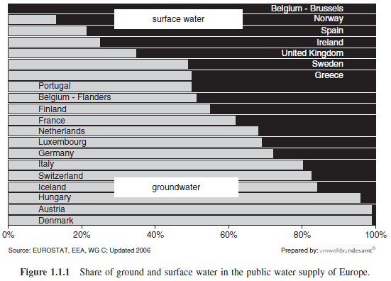
Groundwater- a major source of water supply

Slide 17
SECTOR
Domestic
Non-domestic
Public
Commercial
Industrial
Livestock

Slide 18
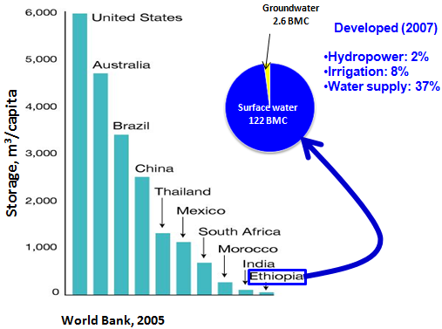
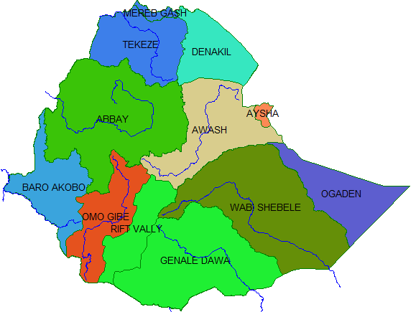
Water Resources Devt. in Ethiopia

Slide 19
SETTLEMENT PATTERN
Urban
Small towns
Metropolitan
Rural
Sedentary
Pastoralists
Agro-pastoralist

Slide 20
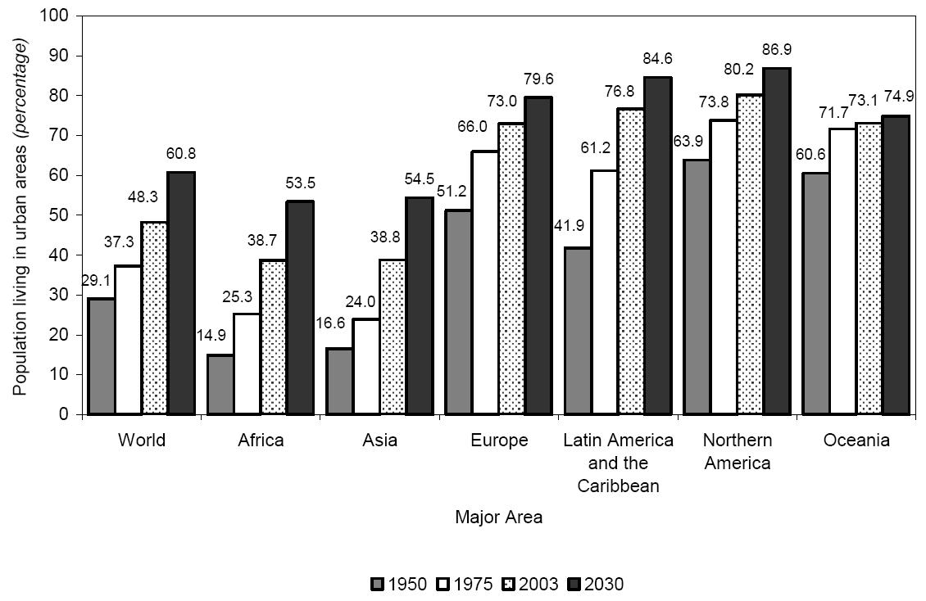
Percentage of population residing in urban areas by region: 1950 - 2030
Source: WORLD URBANIZATION PROSPECTS: THE 2003 REVISION
20
Notes:
Latin America and the Caribbean is highly urbanized, with 77 per cent of its population living in urban settlements in 2003. This proportion is twice as high as those for Africa and Asia.

Slide 21
Location
Source relative to Users
Within short distance
Distant
Within same administrative jurisdiction or not
Upstream/Downstrea

Slide 22
Environment
Climatic
Arid areas
Wet areas
Availability
Water stressed/ scarce
Water abundant
Pollution
Natural environment
Downstream of major settlement…

Slide 23
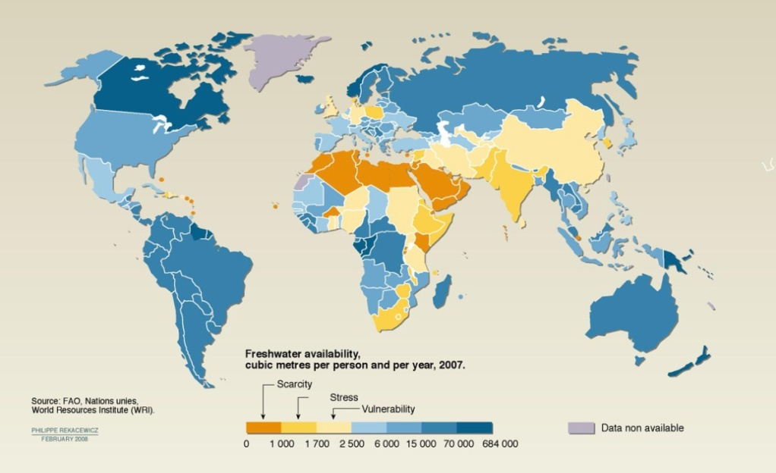
WATER SCARCITY – FRESH WATER AVAILABILITY

Slide 24


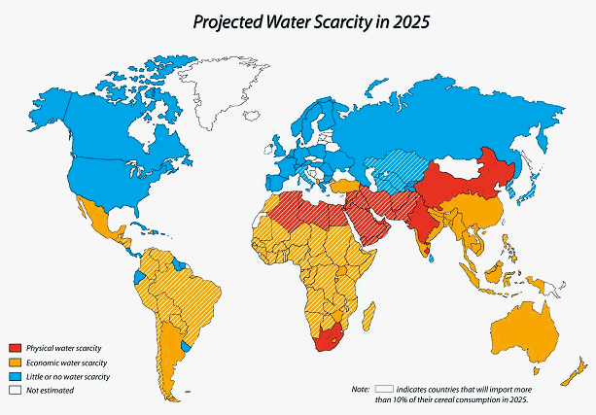
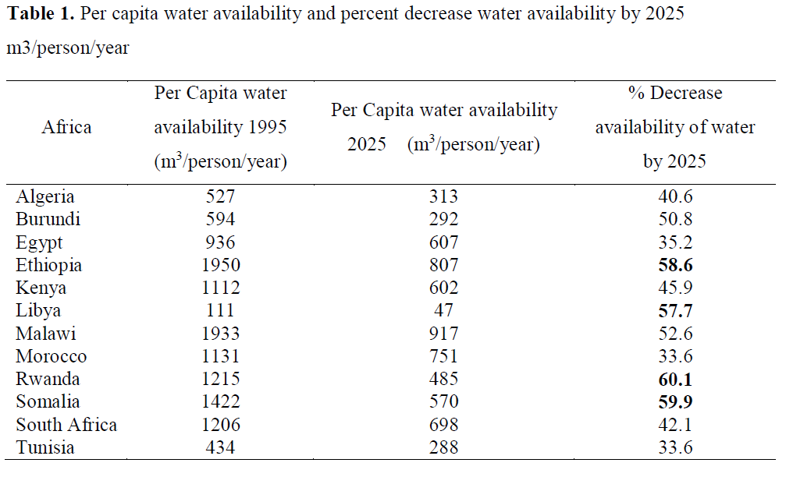

WATER SCARCITY – FRESH WATER AVAILABILITY
Combination of Physical and Economic Scarcity

Slide 25
Management
Cost Recovery vs Operation Management
Municipalities / Utilities vs Community
Public / Private
Centralized /Decentralized
Basin / Administrative
Abstraction / Use

Slide 26

WASH/Recent, Current & Future
WHO and UNICEF conduct pilot projects focusing on rural sanitation
Reduce disease through introduction of safe water technologies and demonstration of excreta disposal methods.
United Nations Conference on Water in 1977
Adopt programmes with realistic standards for quality and quantity to provide water for urban and rural areas by 1990, if possible
Changed universal access goal from 1990 to 2000
Water
Supply and Sanitation Collaborative Council (WSSCC) established
Report from the League of Nations Health Organization on water supply and sewage treatment
1990
1936
1950s
1970s
Environmental Sanitation
Field activities
Community Water Supply
Health and Environment
Water and Sanitation
Health and Development
1948
1960s
1980s
1990s
WHO established, Committee on Environmental Sanitation established
Promote the improvement of environmental hygiene, including sanitation. Minimize the burden of water associated ill-health.
Established Community Water Supply (CWS) Programme
Develop water supplies that were adequate, in quality and quantity, to provide for all public, agricultural and industrial needs
International Drinking Water Supply and Sanitation Decade
Priority to the poor, less privileged and to water scarce areas
Emphasized focus on high-risk communities and sanitation
Notes:
IDWSSD
commitment of national Governments to provide all people with water of safe quality and adequate
quantity and basic sanitary facilities by 1990, according priority to the poor and less privileged and to
water scarce areas; and (c) larger allocation to this sector from the total resources available for general
economic and social development

Slide 27
“Changing Principles of International Development”: Community Participation
Community ‘participation’ (Free labor)
Community Management
Community Empowerment in Decision-Making
Supply-Driven Model
Demand-Driven Model (Community Control)
Community Management PLUS
Notes:
Supply Driven – a donor such as the WB provides money for capital and resources to finance and build a water supply or sanitation project. The communities are often selected by an outside party (government or WB). They can accept or decline the development project, but they do not pursue it themselves.
Through the 70s and 80s people started realizing there were a lot of failed projects. The concept of community or individual “ownership” emerged, and behind it the thinking that ownership could be increased if people participated in the project. Perhaps then they would feel as though the project is their own and have personal or group incentives to take care of it (or pay for it to be taken care of).
Since then “community participation” has been the title for a lot of things, from free labor → community management → community empowerment (here the community has more autonomy in decision-making but is still presented options from which to choose.
The “demand-driven” model is a change in the paradigm of supply-driven development, since communities are supposed to demonstrate they want the development project by pursuing it and/or putting their own resources into it. It usually requires an upfront cash contribution, among other things that Robert will later discuss.
The demand-driven model has had more success than the supply driven model, but is still not a magic bullet. Over the past 5 or 10 years there has been more attention paid to whether there is post-construction support provided to the communities, whether through technical assistance or training, capital or expertise for major repairs or replacements, financial management training, etc. This is the Community Management “plus” model. Which is the Demand-driven model but it acknowledges that communities aren’t likely to be sustainable when left completely on there own after the project funding runs out. So this attempts to provide more long term post-construction support, even if gradually faded out. There’s been some interesting studies on the topic of PCS, including a study in Bolivia, Ghana, and Peru that Dr. Whittington and Dr. Jenna Davis from Stanford were involved in, so if you are interested you can follow up with me afterwards.

Slide 28
SITUATON
Normal
Emergency
Within System
Natural or Manmade Emergencies
Flood / Drought
War

Slide 29
Water Emergencies
Basic Problem in Emergencies:
Water, Sanitation, Food, Shelter and Health,
Water Problems can be:
Shortage
Drought or Artificial
Too little source/Quantity (mainly)
Excess
Flood
Quality (mainly)

