Slide 1
Part II Sanitary Systems
Chapter 2C : Type of Treatment System
Geremew Sahilu (PhD)/ Abstracted from Dr. Agizew’s Presentation for MoWIE Training

Slide 2
Goals of Wastewater Treatment
Wastewater is 99-99.9% water and 0.1-1% solids. The main task in treating the wastewater is simply to remove the solids.
Stabilization of the solids
Proper reuse/disposal
Ultimate purposes:
  Protecting public health
  Protecting the environment

Slide 3
WWT Feasibility Study Components
Design horizon (e.g. 20 years) and staging periods (e.g. 7-10 years)
Influent quantity and quality characterization
Wastewater treatment objectives and effluent quality requirements
Site selection for WWTP
Initial screening of WWT alternatives
Preliminary design of the promising alternatives (sizing of units, power, equipment and resource requirements, process flowsheet, plant layout, sludge management)
Economic evaluation of alternatives
ESIA
Selection of alternative for further detail design

Slide 4
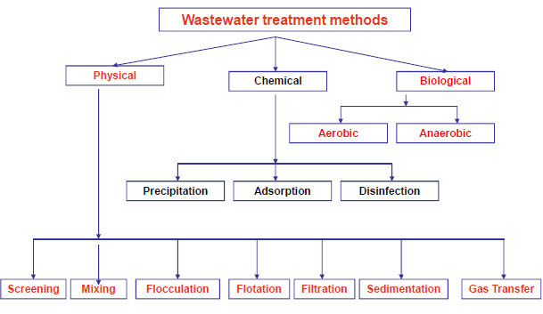

Slide 5
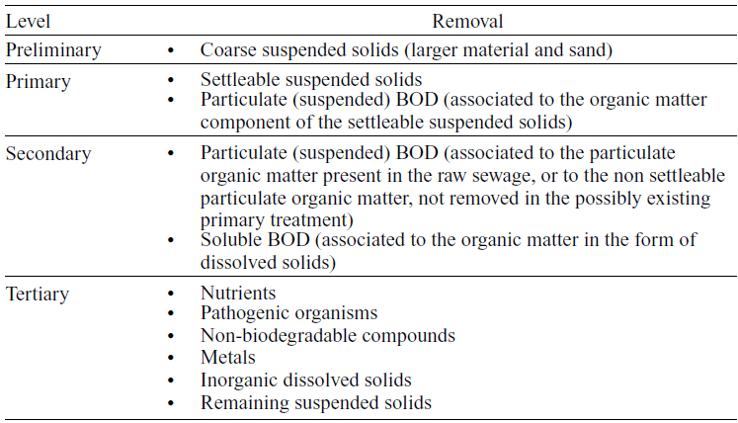
Wastewater Treatment Levels

Slide 6
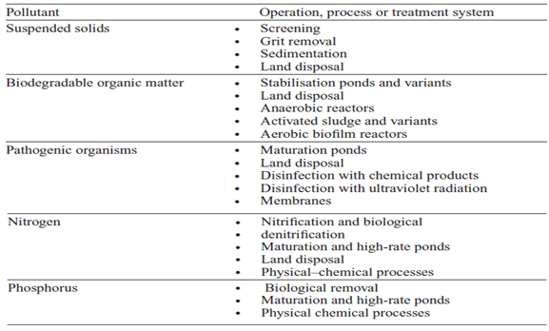
Common Treatment Operations and Processes for Removal Pollutants from Sewage

Slide 7
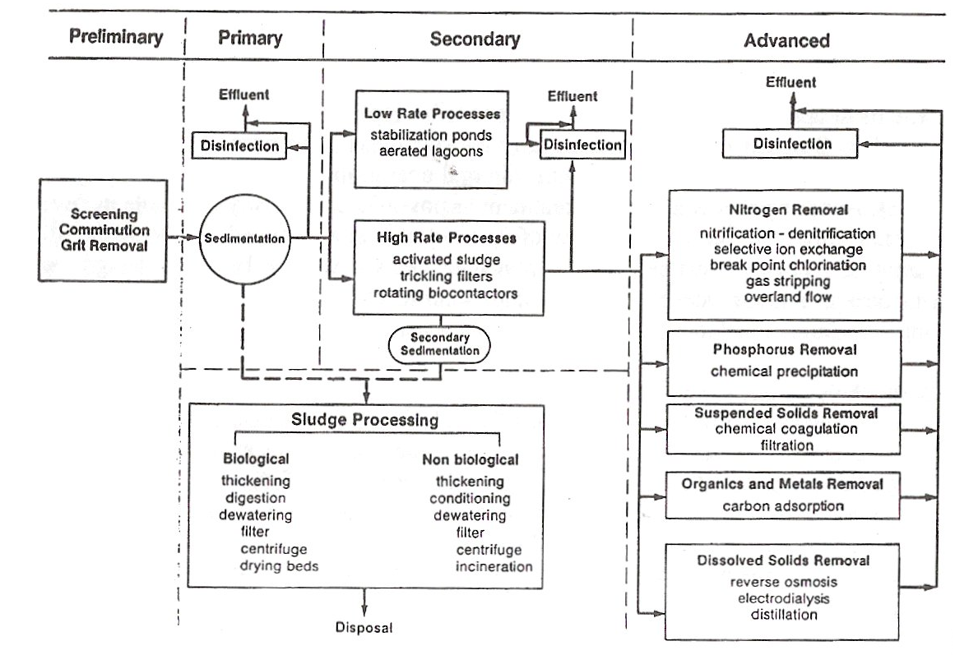
Generalized WWT Flow Diagram

Slide 8
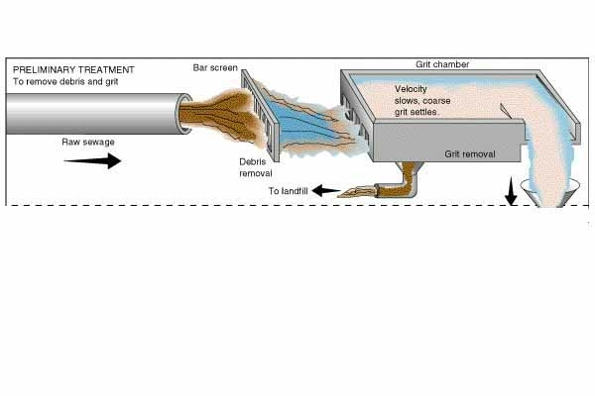
Preliminary Treatment
Removes large objects and non-degradable materials
Protects pumps and equipment from damage

Slide 9
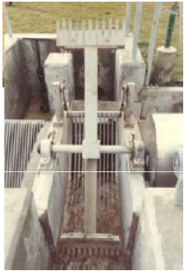
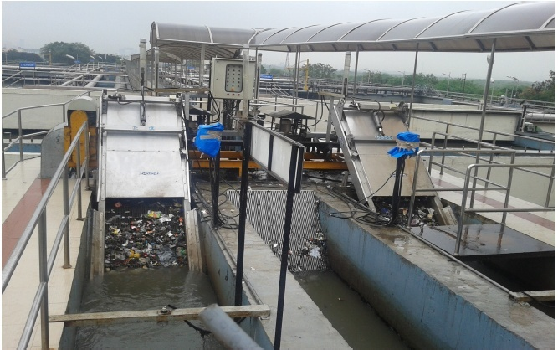
Preliminary Treatment- Screening
Objective | Removal of course solids
Types of screens | Fine/medium/coarse
Cleaning of screens | Manual/mechanical
Benefits | Protection of pumps
Coarse screening | 20mm clear spacing in bars
Fine screening | 60mm clear spacing in bars

Slide 10
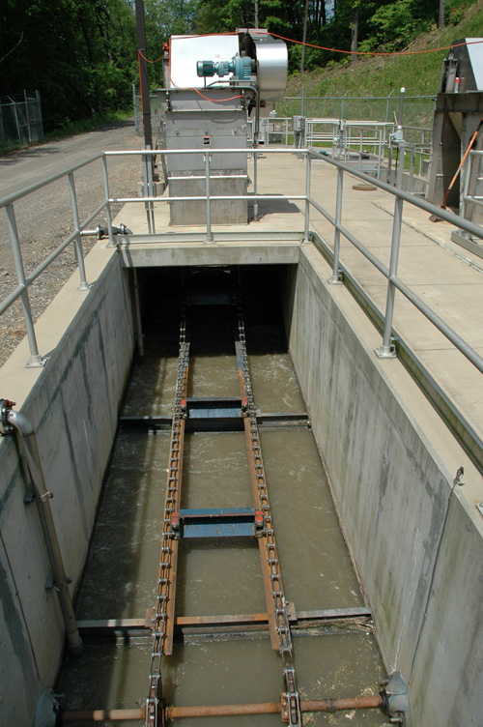
Preliminary Treatment- Grit Removal
Objective | Removal of inorganic solids like sand to protect moving mechanical equipment
Principle | Gravity separation: effective size 0.15mm; specific gravity- 2.65
Types | Manual- Rectangular channel Mechanical- Circular tank
Grit removal mechanism | Screw classifier/reciprocating classifier

Slide 11
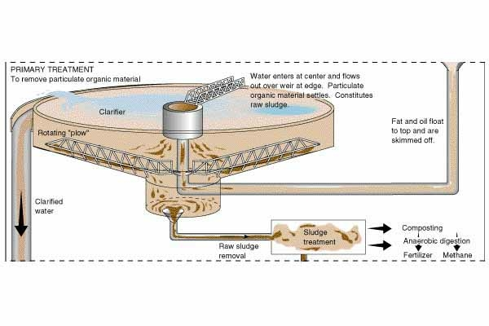
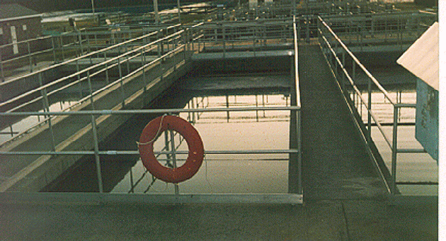
Primary Treatment
Wastewater flow is slowed down and suspended solids settle to the bottom
Reduces the suspended solids and the B.O.D. of the wastewater

Slide 12
Efficiency of Primary Clarifier
100
90
settleable
80
solids
70
TSS
60
50
Efficiency (%)
40
30
BOD
5
20
10
0
0
1
2
3
4
5
Residence time HRT
(h)

Slide 13
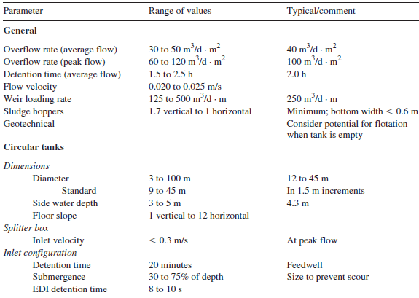
Typical Design Criteria for Primary Sedimentation Basins

Slide 14
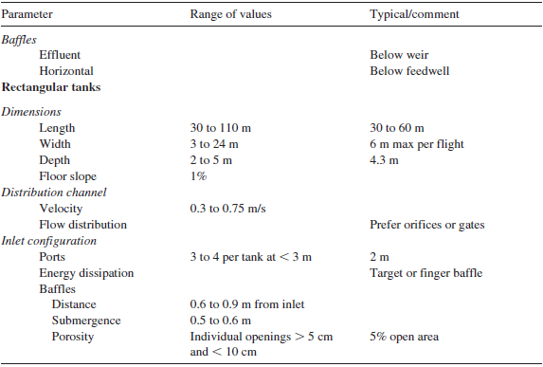
Typical Design Criteria for Primary Sedimentation Basins

Slide 15


Biological Treatment
Objectives of biological treatment:
  To stabilize the organic content
  To remove nutrients such as nitrogen and phosphorus
Types:
Aerobic Processes
Anoxic Processes
Anaerobic Processes
Combined Aerobic-Anoxic-Anaerobic Processes
Pond Processes
Attached Growth
Suspended Growth
Combined Systems
Aerobic
Maturation
Facultative
Anaerobic
Aerobic
Anaerobic

Slide 16
Examples of Treatment Technologies
Suspended growth
Attached growth
Dual biological
Trickling filters
Biotowers
Rotating biological contactors
Activated sludge
Stabilization ponds
Aerated lagoons
Containment ponds
Constructed wetlands
Plug flow
Complete mix
Oxidation ditch
Contact stabilization
Sequencing batch reactors
Conventional
Extended aeration
High rate
Step feed
Tapered aeration

Slide 17
Major Aerobic Biological Processes
Type of Growth | Common Name | Use
Suspended Growth | Activated Sludge (AS) | Carbonaceous BOD removal (nitrification)
 | Aerated Lagoons | Carbonaceous BOD removal (nitrification)
Attached Growth | Trickling Filters | Carbonaceous BOD removal. nitrification
 | Roughing Filters (trickling filters with high hydraulic loading rates) | Carbonaceous BOD removal
 | Rotating Biological Contactors | Carbonaceous BOD removal (nitrification)
 | Packed-bed reactors | Carbonaceous BOD removal (nitrification)
Combined Suspended & Attached Growth | Activated Biofilter Process Trickling filter-solids contact process Biofilter-AS process Series trickling filter-AS process | Carbonaceous BOD removal (nitrification)

Slide 18
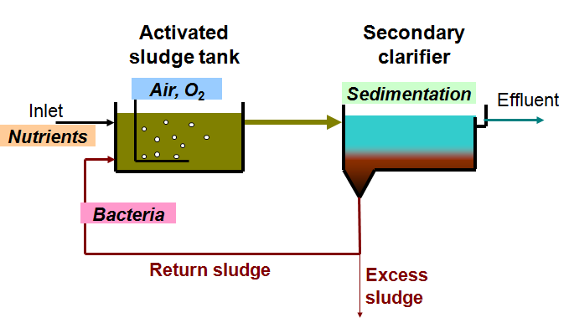
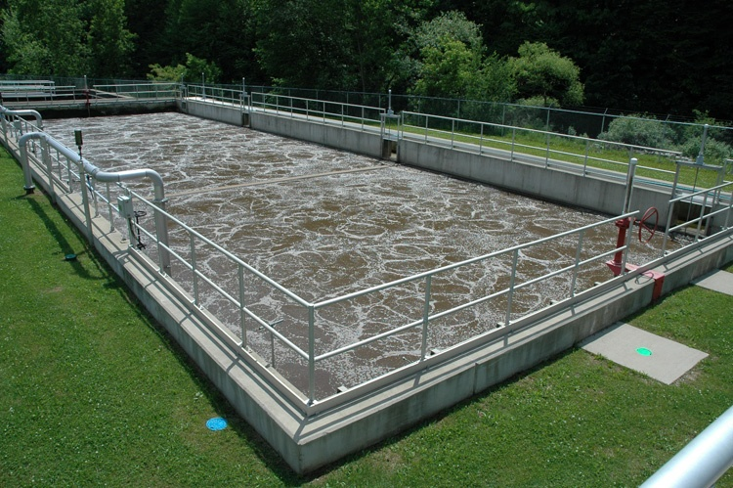
Activated Sludge Process
The aeration tank contains a suspension of the wastewater and microorganisms, the mixed liquor. The liquor is mixed by aeration devices (supplying also oxygen)
A portion of the biological sludge separated from the secondary effluent by sedimentation is recycled to the aeration tank
Aeration
Aeration Basin

Slide 19
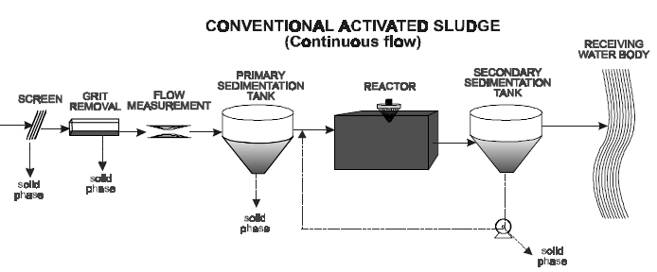
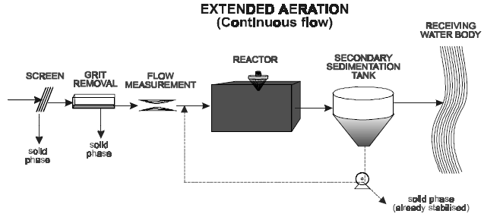
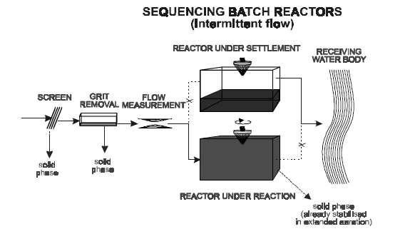
Some Activated Sludge Configurations

Slide 20
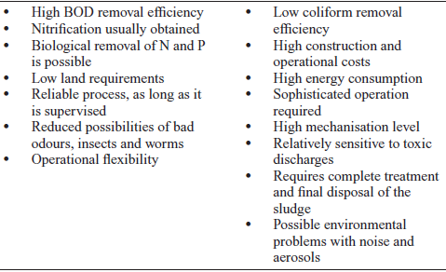
CAS: Advantages/Disadvantages
Advantage
Disadvantage

Slide 21
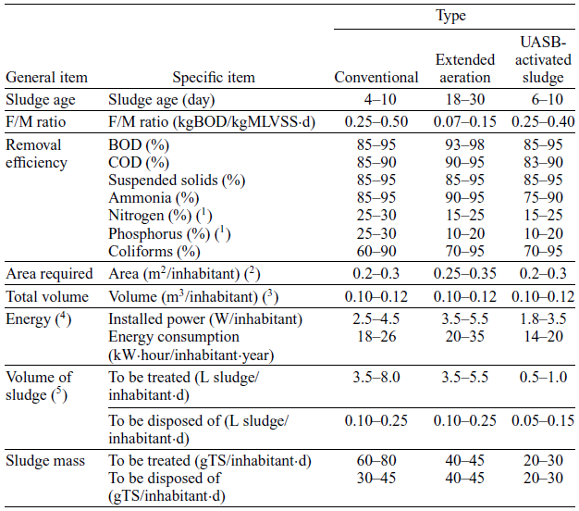
Main characteristics of activated sludge systems

Slide 22
Biological Nitrogen removal
Aerobic tank
Anoxic tank
Aeration
Methanol
Influent
BOD + Nitrification
Denitrification
Effluent
Return sludge
Return nitrate
WAS
WAS
Nitrification in aerobic environment
Organic matter + O₂ → NH₃ + CO₂ + microorganisms
NH₃ + 2O₂ → NO₃⁻ + H⁺ + H₂O + microorganisms
Denitrification in an anoxic environment (no free oxygen)
Organic matter + NO₃⁻ → N₂ + microorganisms

Slide 23
Biological Nitrogen removal
Anoxic tank
Aerobic tank
Secondary clarifier
Influent
Denitrification
BOD + Nitrification
Effluent
Return nitrate
WAS
Return sludge

Slide 24
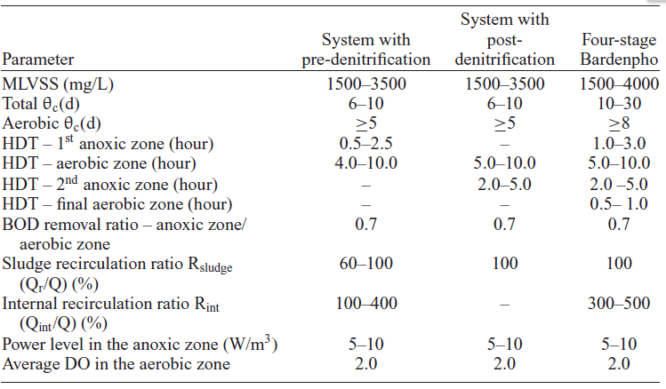
Design criteria for biological nitrogen removal

Slide 25
Two-stage biological P removal
Secondary clarifier
Anaerobic tank
Aerobic tank
Influent
Effluent
Return sludge
WAS

Slide 26
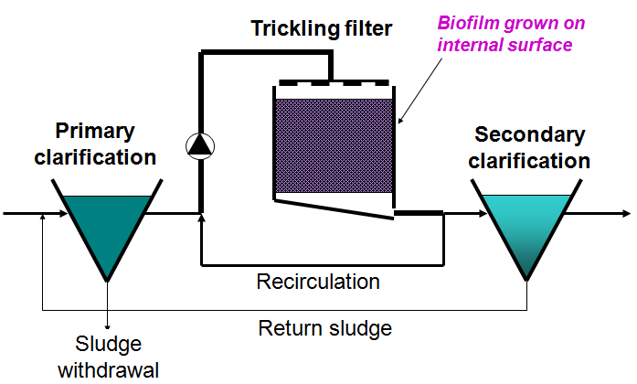
Trickling Filters
The trickling filter or biofilter consists of a bed of permeable medium of either rock or plastic
Microorganisms become attached to the media and form a biological layer or fixed film. Organic matter in the wastewater diffuses into the film, where it is metabolized. Periodically, portions of the film slough off the media

Slide 27
Advantages/Disadvantages
Advantages
Good quality (80-90% BOD₅ removal) for 2-stage efficiency could reach 95%
Moderate operating costs (lower than activated sludge)
Withstands shock loads better than other biological processes
Disadvantages
High capital costs
Clogging of distributors or beds
Snail, mosquito and insect problems

Slide 28
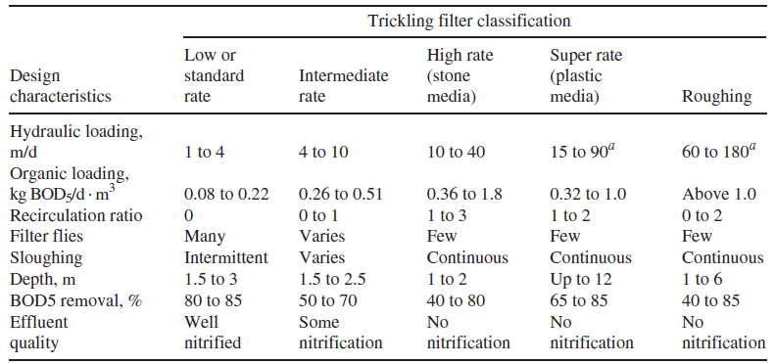
Comparison of Different Types of Trickling Filters

Slide 29
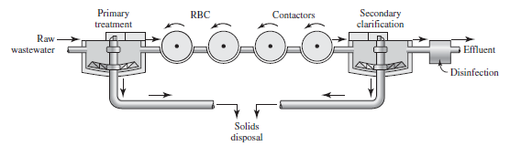

Rotating Biological Contactors
It consists of a series of circular disks of polystyrene or polyvinyl chloride that are submerged in wastewater and rotated slowly through it
The disk rotation alternately contacts the biomass with the organic material and then with atmosphere for adsorption of oxygen
Excess solids are removed by shearing forces created by the rotation mechanism

Slide 30
RBC: Advantages/Disadvantages
Advantages
Short contact periods
Handles a wide range of flows
Easily separates biomass from waste stream
Low operating costs
Short retention time
Low sludge production
Excellent process control
Disadvantages
Need for covering units installed in cold climate to protect against freezing
Shaft bearings and mechanical drive units require frequent maintenance

Slide 31
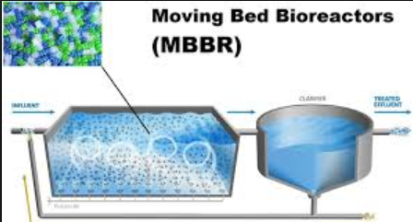

Moving Bed Bioreactor
The Moving Bed Bio Reactor (MBBR) process utilize the attached bio-film and provides smaller footprint solution for with lower capital and operating costs.
The suspended biomass carriers are designed to create a large surface area for biofilm growth.
Uses small, plastic elements to support the growth of biofilm in the reactor
Benefits include:
  An enhanced biological wastewater treatment process without increasing the plant footprint
  MBBR process is ideally suited for retrofit/upgrade of existing installation with minimum changes in the existing setup.
Typical design criteria:
  MLSS: 100 to 250 mg/L
  MCRT: 0.15 days
  HRT: 3 hours

Slide 32
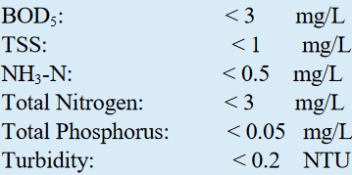
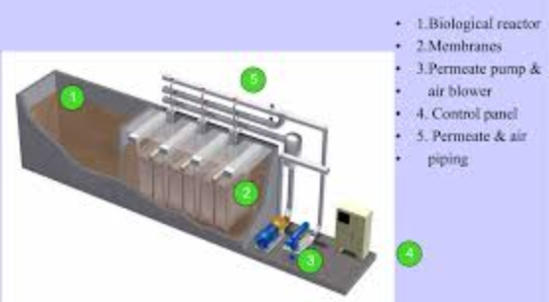
Membrane Bio-Reactor (MBR)
A new method for wastewater treatment, integrates membrane separation and biotechnology
Rejects activated sludge and macromolecular organic matter in aerobic tank/MBR tank with membrane separation plant, thus saving the use of secondary sedimentation tank.
Consequently, the concentration of activated sludge rises greatly, the HRT and the SRT could be controlled separately, and difficult degraded matters are constantly degraded and reacting in reactor.
Effluent quality
MBR-AA

Slide 33
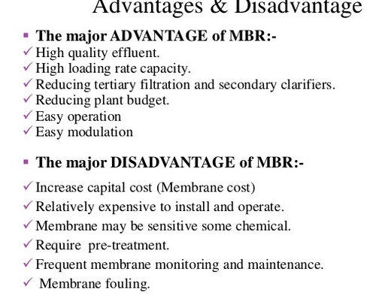
Advantages/Disadvantages of MBRs

Slide 34
Major Anaerobic Biological Processes
Type of Growth | Common Name | Use
Suspended Growth | Anaerobic Contact Process | Carbonaceous BOD removal
 | Upflow Anaerobic Sludge-Blanket (UASB) | Carbonaceous BOD removal
Attached Growth | Anaerobic Filter Process | Carbonaceous BOD removal, waste stabilization (denitrification)
 | Expanded Bed | Carbonaceous BOD removal, waste stabilization

Slide 35
Anaerobic Contact Process
Untreated wastewater is mixed with recycled sludge solids and then digested in a sealed reactor
The mixture is separated in a clarifier
The supernatant is discharged as effluent, and settled sludge is recycled

Slide 36
ACP: Advantages/Disadvantages
Advantages
Methane recovery
Small area required
Volatile solids destruction
Disadvantages
Heat required
Effluent in reduced chemical form requires further treatment
Requires skilled operation
Sludge to be disposed off is minimal

Slide 37
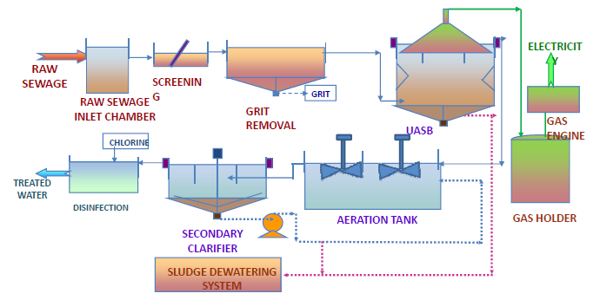
Upflow Anaerobic Sludge Blanket Reactor

Slide 38
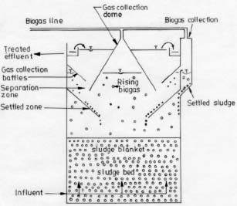
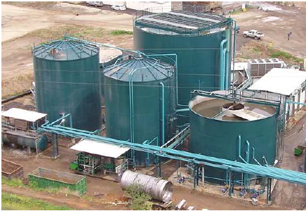
UASB: Upflow Anaerobic Sludge Blanket
Wastewater flows upward through a sludge blanket composed of biological granules that decompose organic matter
Some of the generated gas attaches to granules that rise and strike degassing baffles releasing the gas
Free gas is collected by special domes
The effluent passes into a settling chamber

Slide 39
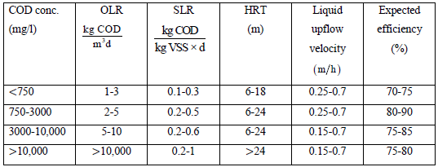
Recommended Design Criteria for UASB

Slide 40
UASB
Advantages
Disadvantages
Requires less power than aerobic processes
Biogas genarated can be used as fuel or electricity
UASB alone does not treat the sewage to desirable limits; therefore, downstream aerobic treatment is compulsory
Requires very large space due to post treatment
Recovery of biogas is not sufficient to produce substantial electricity in case of municipal wastewater

Slide 41
UASB: Advantages/Disadvantages
Advantages
Low energy demand
Low land requirement
Low sludge production
Less expensive than other anaerobic processes
High organic removal eficiency
Disadvantages
Long start-up period
Requires sufficient amount of granular seed sludge for faster start-up
Significant wash out of sludge during initial phase of process
Lower gas yield than other anaerobic processes

Slide 42
Pond Treatment Processes
Common Name | Comments | Use
Aerobic Stabilization Ponds | Treatment with aerobic bacteria; oxygen is supplied by algal photosynthesis and natural surface reaeration; depth of 0.15 to 1.5 m | Carbonaceous BOD removal
Maturation (tertiary) Ponds | Use aerobic treatment; applied loadings are low to preserve aerobic conditions | Secondary effluent polishing and seasonal nitrification
Facultative Ponds | Treatment with aerobic, anaerobic and facultative bacteria; the pond has 3 zones: a surface aerobic zone, a bottom anaerobic zone, and an intermediate zone partly aerobic-anaerobic | Carbonaceous BOD removal
Anaerobic Ponds | Treatment with anaerobic bacteria; depths of up to 9.1 m to conserve anaerobic conditions | Carbonaceous BOD removal (waste stabilization)

Slide 43
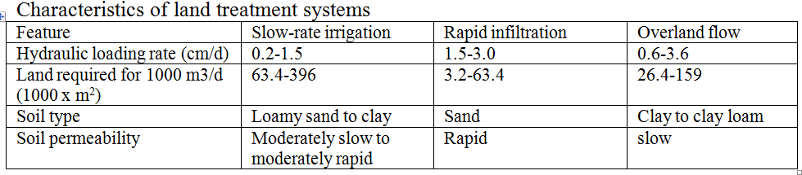
Land treatment methods
Application of wastewater on the land
Plants and soil play roles in pollutant removal
Three types of application:
  Slow rate infiltration
  Rapid infiltration
  Overland flow

Slide 44
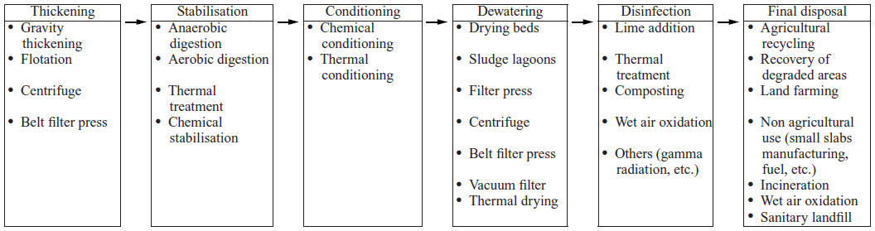
Sludge Management Stages and Processes

Slide 45
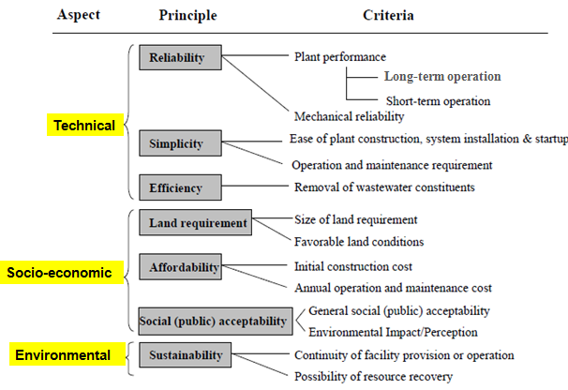
Criteria for WWT Technology Selection

Slide 46
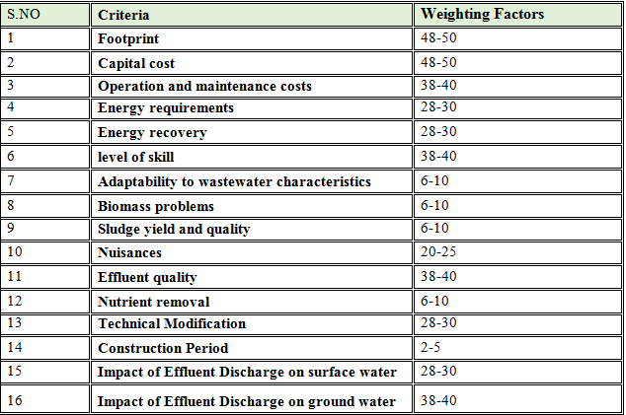
WWTT selection criteria used in AA

Slide 47
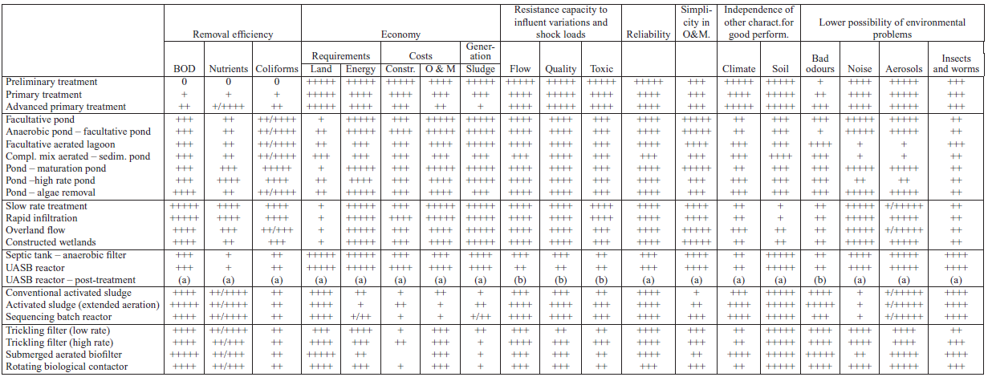
Relative Evaluation of Main Sewage Treatment Technologies

Slide 48
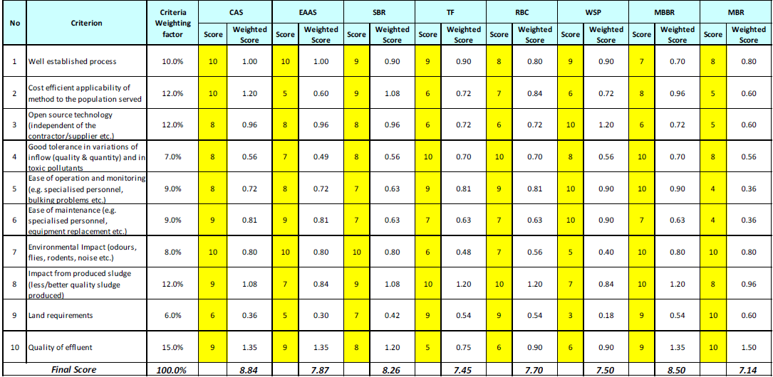
Example: Selection of BWWTT by MCA method

Slide 49
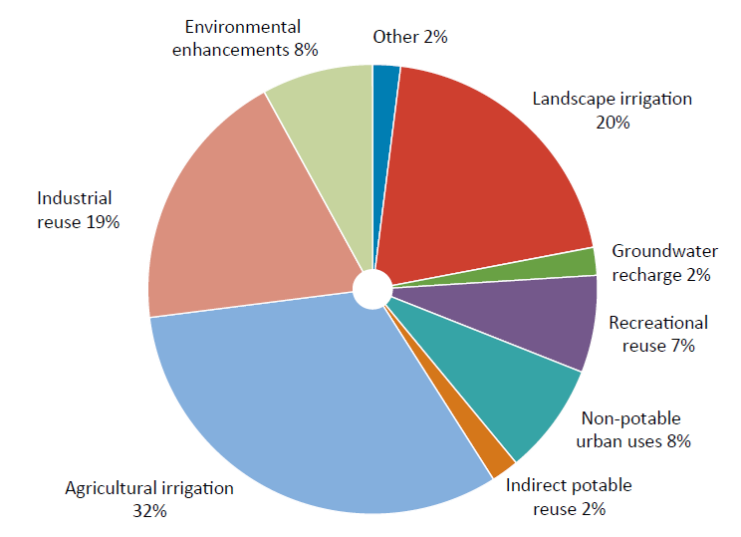
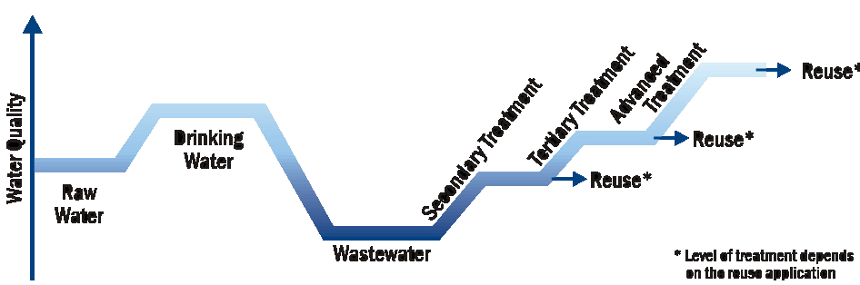
4. Treated Wastewater Reuse
Overview of Global treated wastewater reuse (GWI 2009)
Fit-for-purpose

Slide 50
Cases: Wastewater Treatment in AA

Slide 51
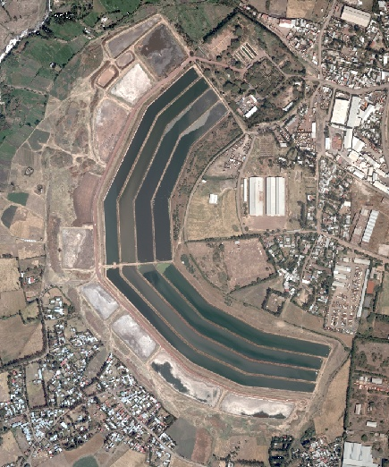
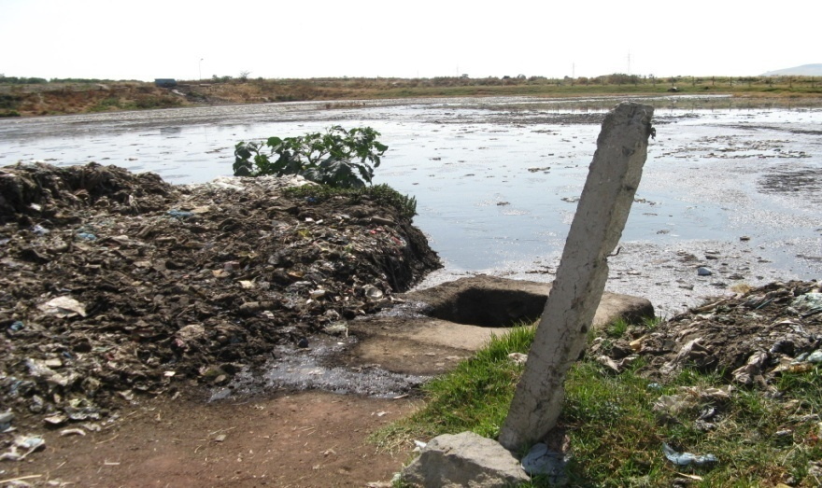
Kality Stabilization Pond
The largest pond (Facultative + Maturation)
Treating upto 10 000 m3/d
Pond compound area 20 ha
New WWTP: 100 000 m3/d
Existing pond
UASB
TF
Unrestricted irrigation
Sludge drying bed

Slide 52
Kality Stabilization Pond- Performance
Parameter | Unit | Influent quality | Effluent quality
BOD5 | mg/L | 229-324 | 41-55
COD | mg/L | 480-697 | 123-142
TSS | mg/L | 188-237 | 63-79
TN | mg/L | 85-95 | 30-43
TP | mg/L | 13-16 | 9-12
T. Coliform | MPN/100ml | 28-90 billion | 0.33-0.34 billion
Source:(Mengesha, 2011)

Slide 53
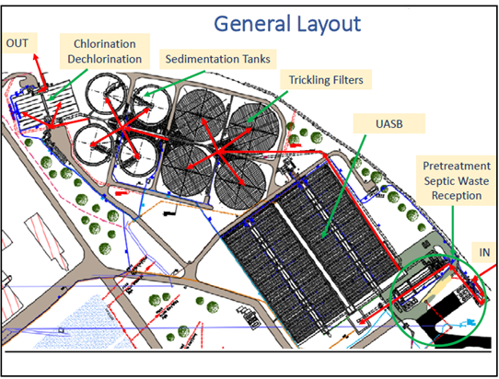
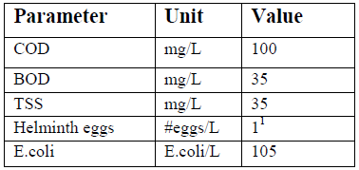
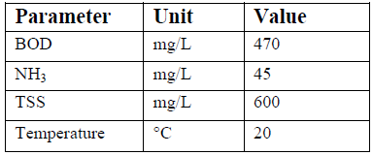
New Kality Wastewater Treatment Plant
Effluent
Influent

Slide 54
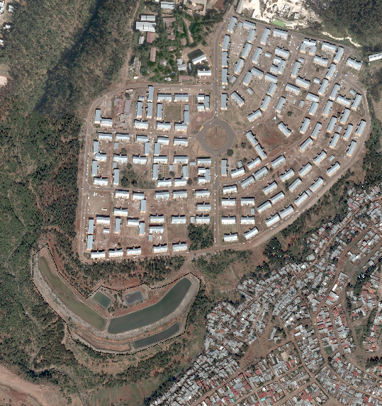
Mikililand Stabilization Pond
Highly concentrated influent due to
shortage of water
Pond not performing well
Options for improvement:
Upgrade it to aerated pond
Use highly active microbes

Slide 55
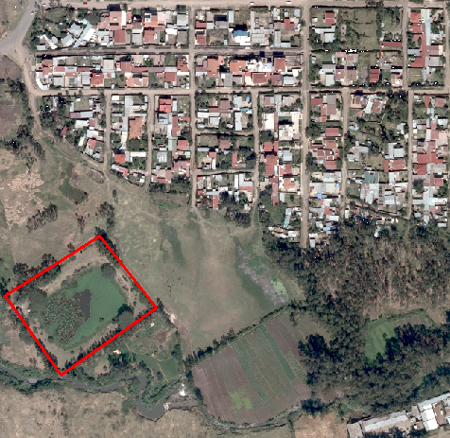
Notes on the operating Wastewater Treatment Plants
Bole Homes Aerated Pond
Built long time ago
Abundant plant growth
No clear plan of improvement

Slide 56
THANK YOU !!

