Slide 1
Part I – Water Supply
CHAPTER 2a
COMPONENTS OF WATER SUPPLY SYSTEMS
Physical

Slide 2
OUTLINE
PHYSICAL
  SOURCE
  STORAGE
  TREATMENT
  TRANSMISSION
  DISTRIBUTION
INSTITUTIONAL
  ASSET MANAGEMENT
  ENVIRONMENTAL MANAGEMENT

Slide 3
POLICY/ GOVERNANCE
(Design Standards /Operating rules and regulations)
WATER
(SUPPLY)
POPULATION
(DEMAND)
WATER SUPPLY SYSTEM
SOCIO-ECONOMY
(DEMAND)
ENVIRONMENT
(Availability / Climate / Pollution)
SETTLEMENT
(Demand Centre)

Slide 4
Source
Water Supply system begin with Source / Supply side
The Source Component is directly related to the overall demand of the system
Sources are developed to cater mainly the maximum day demand
Usually, water supply sources are expected to satisfy the maximum day demand when the supply is minimal / during ??? (Surface or Groundwater)
Source is directly related to climatic conditions of the area / catchment or basin

Slide 5
Factors affecting source determination
Factors | Details
POPULATION | Size and growth rate
SETTLEMENT | Rural or urban
SOCIO-ECONOMY | Prevailing economic activity and living standard
ENVIRONMENT | Climate/Hot or cold/ Arid, semi arid / Pollution risk /Protection requirement
POLICY / GOVERNANCE / STANDARDS | Water Right/ Water Abstraction Guidelines /Supply standard /minimum

Slide 6
Storage / Source
Bridging gap with seasonal variation
Basically depends on the degree of variability of rainfall and the water demand
Usually mass curves or tabular calculation of cumulative deficiency is used to determine the quantity of storage
Different types of dam are constructed depending on the specific conditions of the site / Usually for more than the usual design period
GW is considered as Natural storage but pumping or withdrawal rate should be less than natural recharge rate / Can be phased within design period
River diversion does not require seasonal storage / Minimum flow covers maximum daily demand

Slide 7
River Intake Yield
Hydrological yield
  No storage
  Minimum storage (7 days) / Could also be less than that
Yield constrained by different factors
Methods of estimation:
  Flow duration curve
  Statistical analysis on natural flows
  Probability plot of low flows

Slide 8
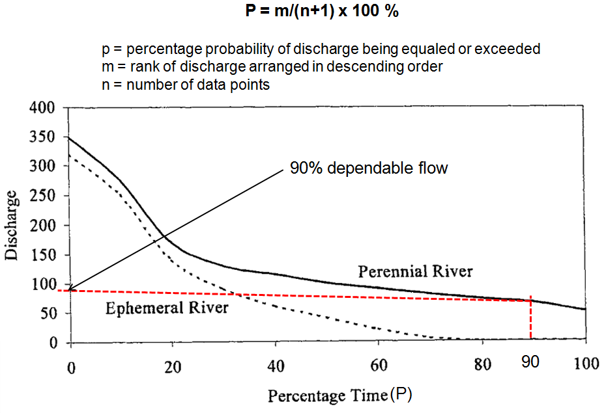
Flow duration curve

Slide 9
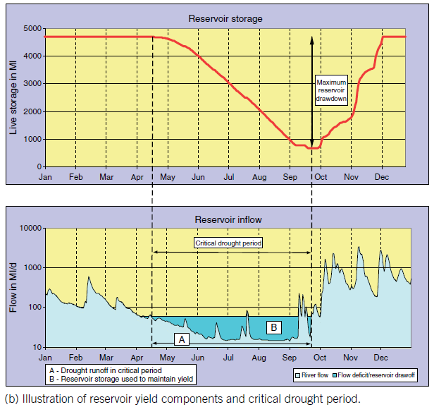
Yield of Direct Supply Impounding Reservoirs

Slide 10
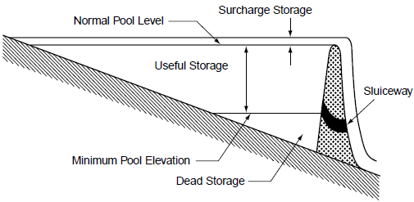
Reservoir Characteristics

Slide 11
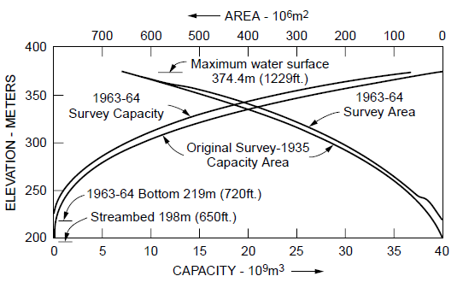
Reservoir Capacity-Elevation Curve

Slide 12
Catchment and Reservoir Yield
Catchment yield is total yearly runoff volume entering or passing the outlet point of a catchment
Net inflow into a reservoir can be obtained by adjusting the catchment yield for losses that include evaporation, seepage and required minimum downstream flows
Reservoir yield is the amount of water that can be drawn from a reservoir in any specified time interval

Slide 13
Reservoir Yield
  Safe (Firm) Yield: maximum quantity of water that can be guaranteed during a critical dry period (lowest natural flow period)
  Secondary Yield: water available in excess of safe yields during periods of high flow

Slide 14
Storage-Yield Relationship
Two Types of Problems:
  The storage required at a given site to supply a given yield (planning)
  Determine the yield from a given amount of storage (final design)

Slide 15
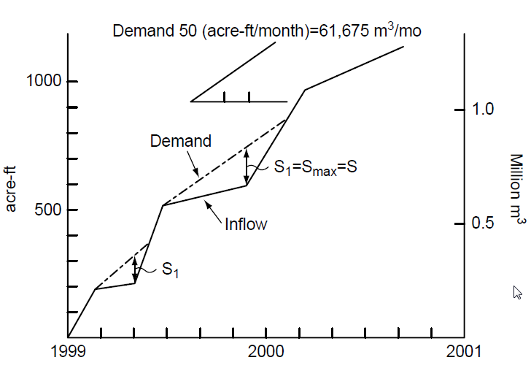
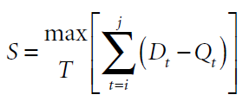
Reservoir Capacity given Yield
(Rippl Diagram/Mass curve)

Slide 16
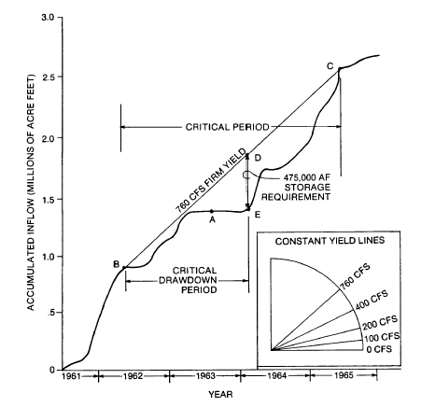
Mass Curve & Constant Yield Lines

Slide 17
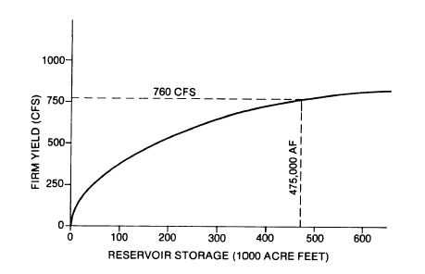
Firm Yield Curve
Notes:
Constructed by plotting the storage required to meet various yield values

Slide 18
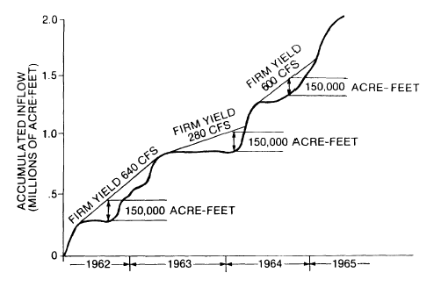
Yield given Storage
Yield = Flattest Slope

Slide 19

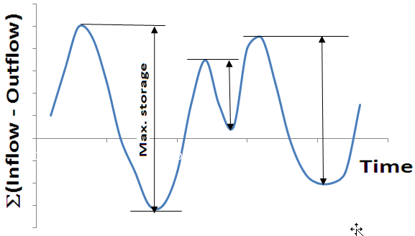
Reservoir Capacity Determination using Sequence Peak Algorithm
An alternative to Rippl diagram when:
  Long data series is used
  Demand varies

Slide 20
Site selection of a dam:
Following the important factors considered for the selection of site for a dam:
Catchment characteristics
Length of dam
Height of dam
Foundation conditions
Availability of suitable Spillway location
Availability of suitable construction materials
Storage capacity
Construction and maintenance cost
Access to the site
Options for diversion of river during construction
Compensation cost for property and land acquisition
Quality of water
Sediment transport
Environmental conditions

Slide 21
Intake site selection criteria
Avoid locations that are near wastewater discharge points and pollution hazard is likely as well as areas with poor water circulation.
Select locations that enable withdrawal of water from a range of levels- lowest to highest levels.
Magnitude and direction of stream or current velocities should be such that they do not affect the function and stability of the intake structure. The limiting velocity should be 0.6 m/s and avoid locating a river intake at the curved part of the river.
Reliable access roads and power sources should be available to facilitate operation and maintenance of the intake structure
The site for intakes should be near to treatment plant
Sites that interfere with navigation requirements, if any, should not be considered
Locations that result in major environmental impacts should be avoided

Slide 22
Intake Design Considerations
Design capacity = Q max-day
Intake velocity should be ≤ 8 cm/s so that suspended matters and fishes do not enter into the conveyance system. Too low velocities that require large intake ports should also be avoided.
The vertical positions of top and bottom intake ports should be such that good quality water is withdrawn. Locate the top intake port at a distance not less than 2 m from the normal water level and the bottom port at least 1 m above the bottom.
Major parameters of design:
  Size and layout of the intake port(s)
  Layout and bar arrangement of coarse screens
  Location and size of fine screen
  Head losses in the intake port, coarse and fine screens
  A check on the stability of the intake structure

Slide 23
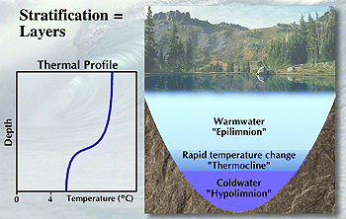
Lake/Reservoir Stratification
Vertical stratification in lakes
  Epilimnion
  Thermocline
  Hypolimnion
Water is most dense at 4°C.

Slide 24
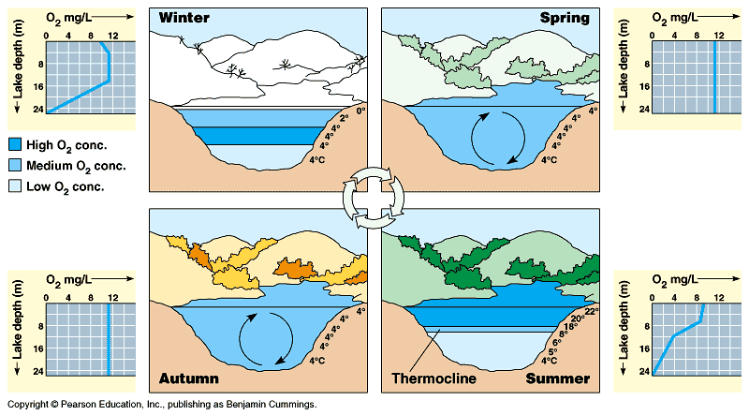

Slide 25
Implications of Lake/Reservoir Stratification for Water Quality
  Water in the hypolimnion layer has bad quality due to anaerobic condition
  During summer water in the epilimnion layer is not of good quality due to abundant algal growth
  Good quality water can be withdrawn from just below the thermocline layer during summer
  During winter better quality water can be withdrawn from the epilimnion layer
  During spring and autumn extensive treatment may be required due to mixing up of bad and good quality water

Slide 26
Groundwater Exploration
Surface exploration
Subsurface exploration
Less costly than subsurface investigations
1. Geologic methods
2. Remote Sensing
3. Surface Geophysical Methods
(a) Electric Resistivity Method
(b) Seismic Refraction Method
(c) Seismic Reflection Method
(d) Gravimetric Method
(e) Magnetic Method
(f) Electromagnetic Method
(g) Ground Penetrating Radar
and others
1. Test drilling
  geologic log
  drilling time log
  Water level measurement
2. Geophysical logging/borehole geophysics
  Resistivity logging
  Spontaneous potential logging
  Radiation logging
  Temperature logging
  Caliper Logging
  Fluid Conductivity logging
  Fluid velocity logging
3. Tracer tests and others

Slide 27
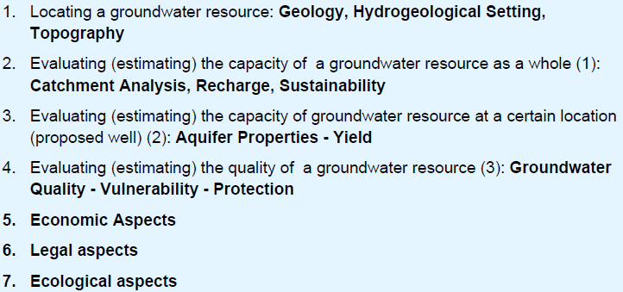
Finding suitable well location-
Pre-drilling investigations

Slide 28
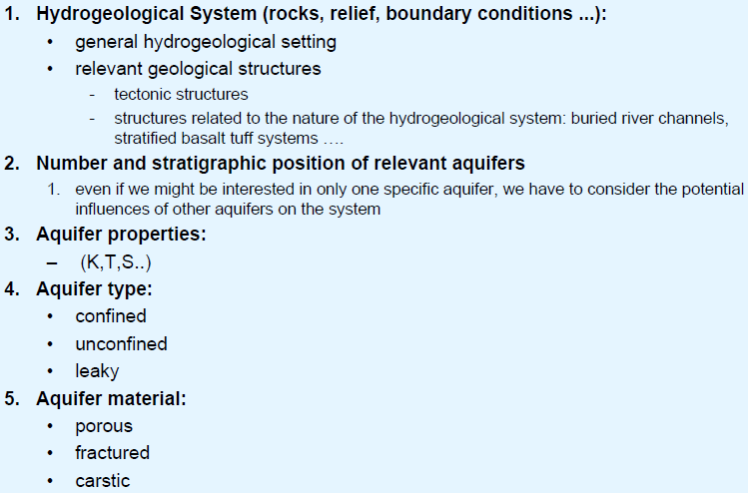
Hydrogeological conditions

Slide 29
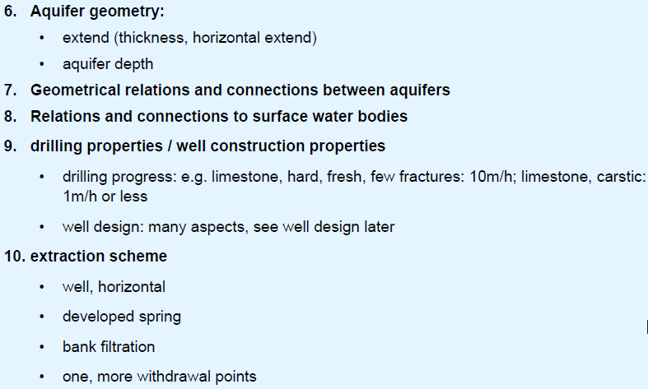
Hydrogeological conditions…

Slide 30
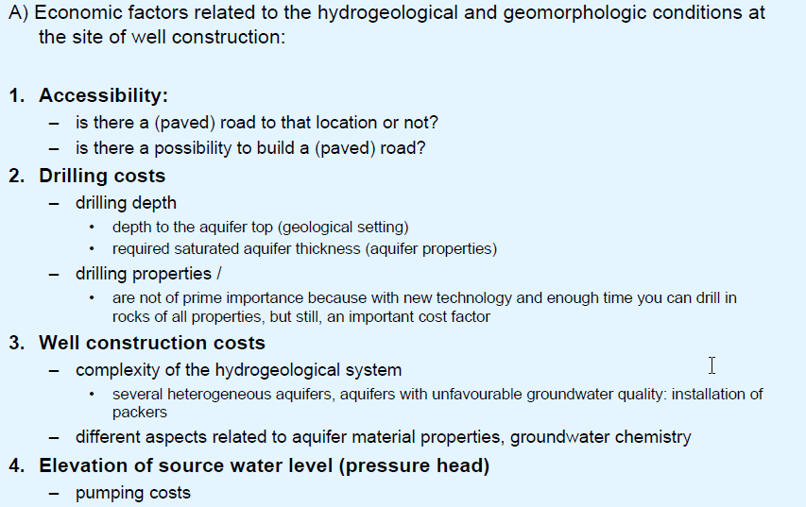
Economic factors

Slide 31
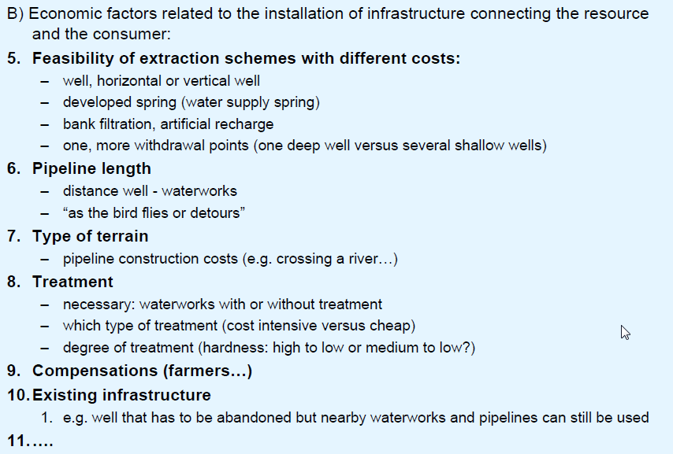
Economic factors…

Slide 32
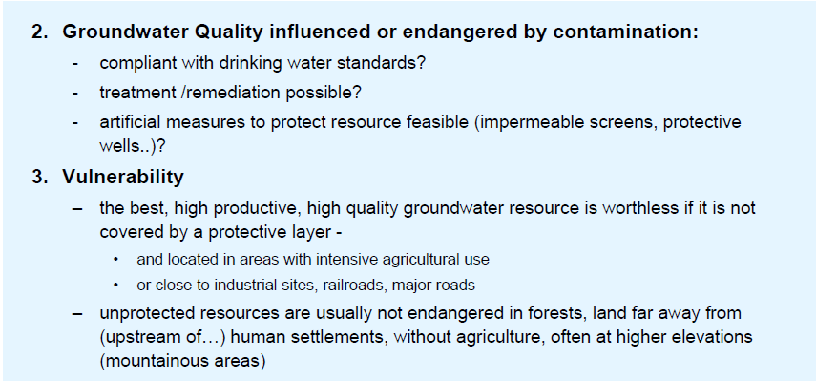
Groundwater quality, vulnerability, protection

Slide 33
Transmission
Transmission lines could be between a source and treatment plant or a treatment plant to a reservoir just before a demand center
Common characteristics of a transmission line is there is no withdrawal from a transmission line
Transmission line could be either a gravity or pumping line or a combination
There could pressure breaking and/or service reservoirs in a transmission system
Management of pressure and leakage is the main issue in the transmission component

Slide 34
Treatment
Treatment is necessary for any type of source the degree and the type differs from source to source
Conventional Treatment Process are usually applicable for surface water
GW requires minimal treatment except in special cases like GW with higher level of Fluoride, Arsenic,…
Sources downstream of towns or anyother development with point and non-point of sources of pollution require more intensive and combination of treatment process
Treatment plants can be phased within the design period

Slide 35
Distribution
Distribution component delivers the water to users
Usually, have service reservoirs, have main, primary, secondary and tertiary lines, pumps and various appurtenances like – Gate valves / air release valves, blow of valves, …
Reservoirs, distribution lines, pumps can be phased within the design period
However, some components like pipes can serve more than one design period
Distribution systems are designed to satisfy the peak hour demand / Balancing done through service reservoir
NRW / Contamination are biggest risks in this component

