Slide 1
Part I Ch4 Alternative Water Supply Sources

Slide 2
Alternative Water Supply Sources
Why alternative sources?
  Dwindling supply from traditional sources
  Development, operation and maintenance of centralized systems are expensive
Alternatives
  Rainwater harvesting
  Grey water reuse
  Desalination
  Cloud seeding

Slide 3
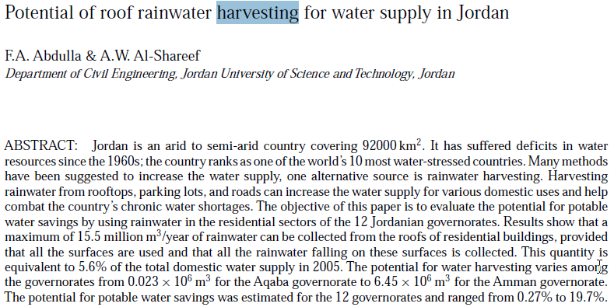
Rainwater Harvesting

Slide 4
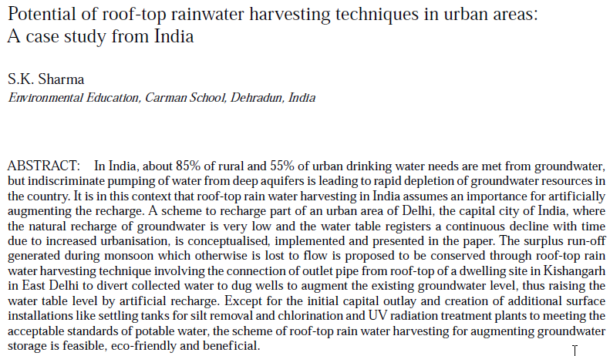

Slide 5
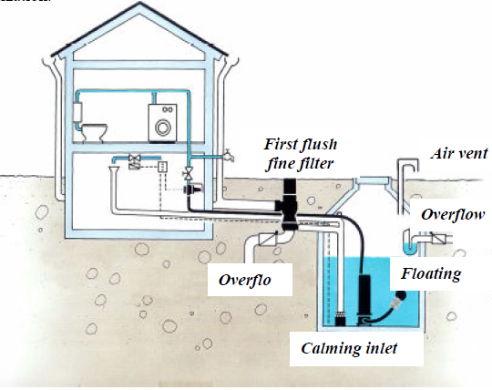
Rainwater Harvesting
Rainwater can be used for non-potable purposes like toilet flushing, washing, etc
Contributes to the reduction of diffuse pollution

Slide 6
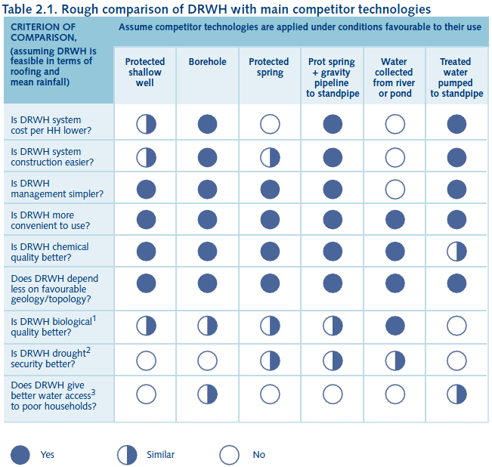
Comparison of DRWH with other sources

Slide 7
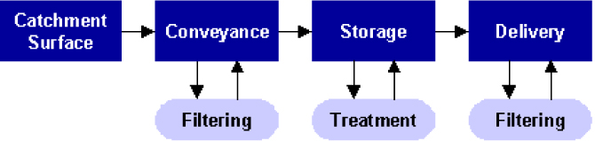
Elements of Rainwater Harvesting System
Rainfall Harvesting Potential (RHP)
RHP = Rainfall x Collector Area x Runoff coefficient
Amount runoff that can be supplied to the user U
U = Storage efficiency x RHP

Slide 8
Collector-Roof characteristics
Type | Runoff coefficient | Notes
G I Sheets | > 0.9 | Excellent quality water. Surface is smooth and high temperatures help to sterilize bacteria.
Tile (glazed) | 0.6 – 0.9 | Good quality water. Unglazed can harbor moulds. Contamination can exist in tile joints.
Asbestos sheets | 0.8 – 0.9 | New sheets give good quality water. No evidence of carcinogenic effects by ingestion. Slightly porous so reduce runoff coefficient and older roofs harbor moulds and even moss.
Organic (Thatch) | 0.2 | Poor quality water Little first flush effect High turbidity due to dissolved organic material which does not settle.

Slide 9
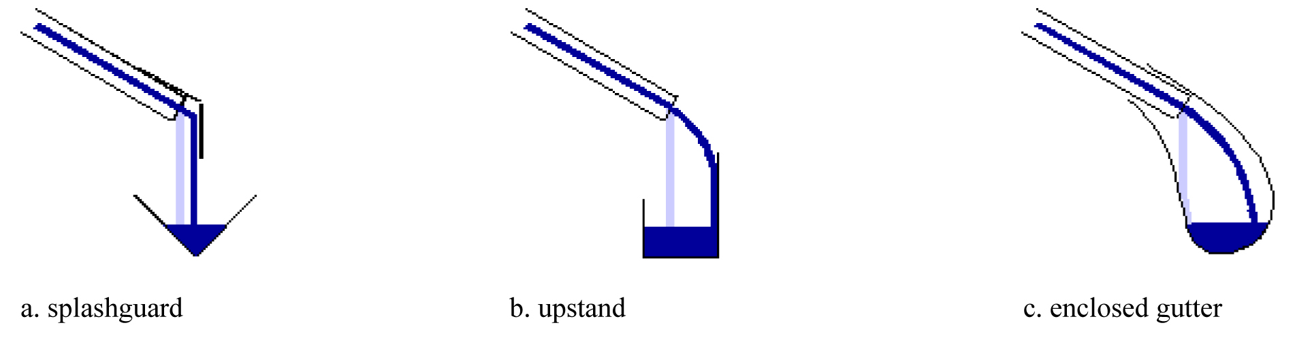
Conveyance- Gutter & downpipe
Water conveyance
Q = A v = A 1/n R^2/3 S^1/2
Interception
Gutter type
a) Plastic b) Aluminum c) Steel
d) Wood & Bamboo e) Half Pipe f) flexible guttering

Slide 10
Storages
Material
Precast concrete
Steel
Plastic
Ferro cement
Bricks
Shape
Sphere
Cylinder
Half sphere
Cube
Location
Above ground
Underground

Slide 11
Figure 5 Breakdown of average daily per capita water demand, Jemo I condominium site, Addis Ababa, 2015

Slide 13
Water consumption rate related to demand at Jemo I condominium site, Addis Ababa 2015

Slide 14
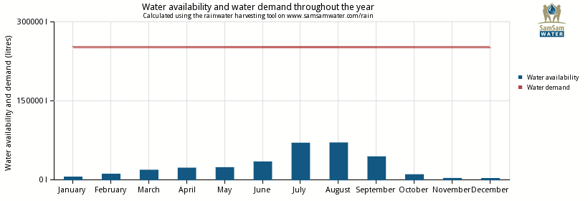
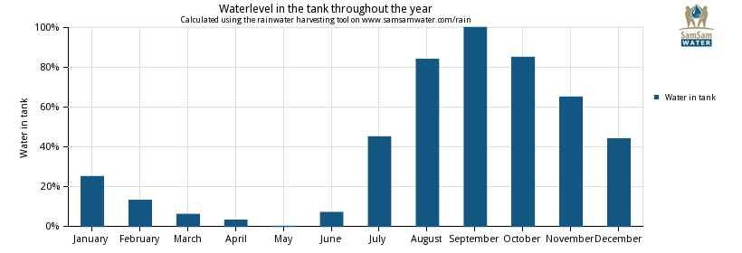
Single Residential Building Considering All Demand

Slide 15
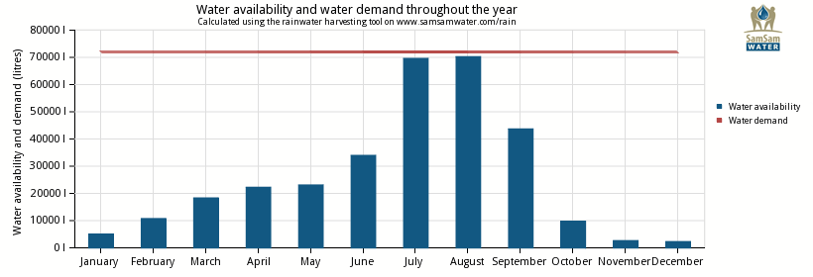
Single Residential Building Considering Non-Potable Demand

Slide 16
Percentage of demand that can be addressed by the RWH at Jemo I condominium site, Jemo Addis Ababa, 2015

Slide 17
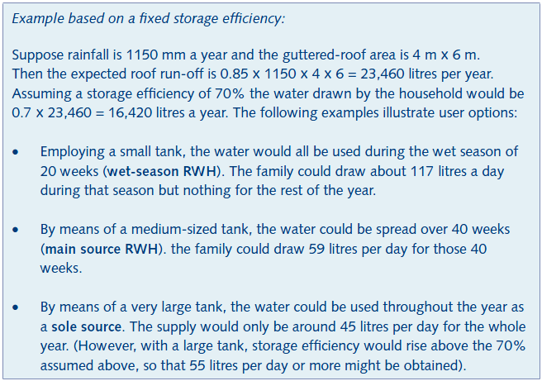
How much water can be harvested?

Slide 18
Grey water Reuse

Slide 19
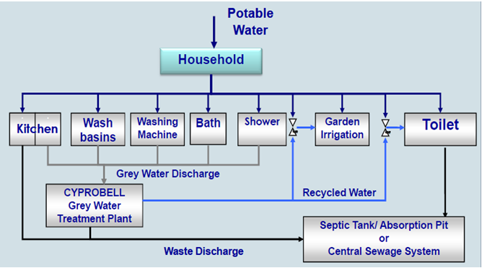
Sources of Grey water

Slide 20
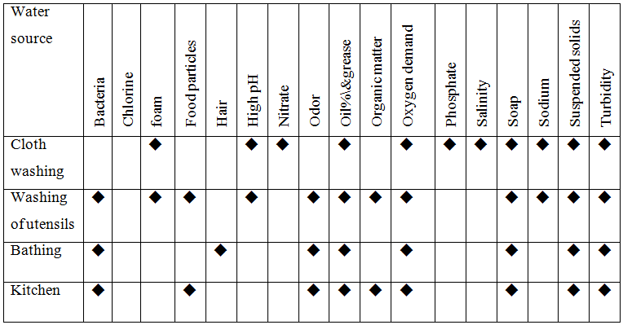
Characteristics of Greywater

Slide 21
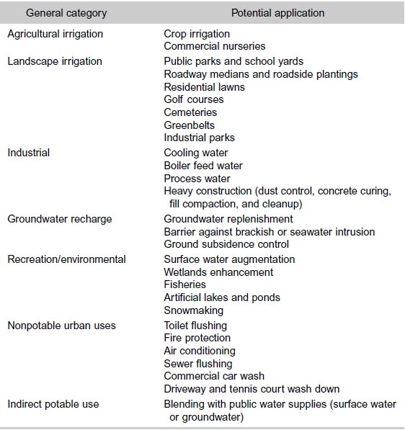
Water Reuse- Potential Applications

Slide 22
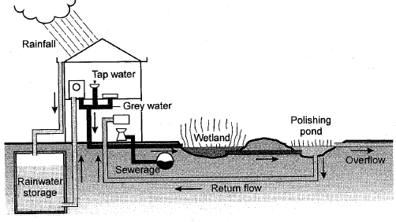
Use of Rainwater and Grey water

Slide 23
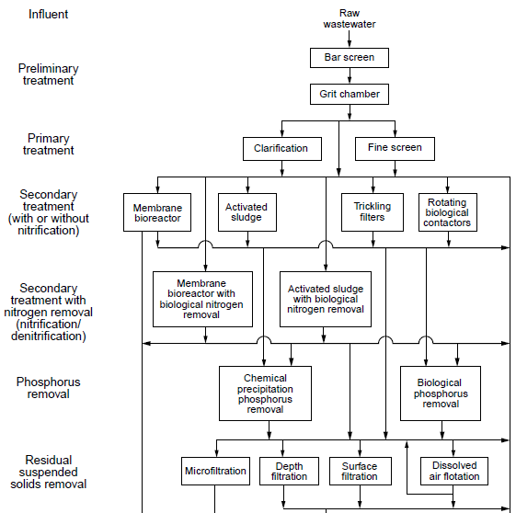
Treatment matrix for reclamation and reuse of wastewater

Slide 24
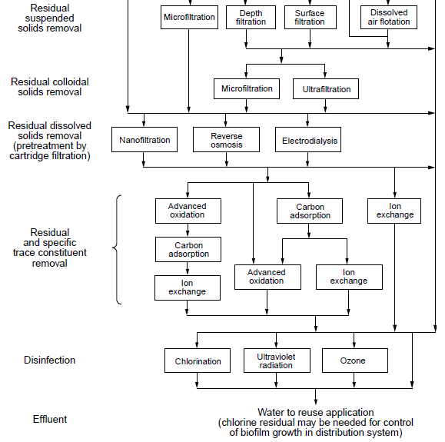
Treatment matrix for reclamation and reuse of wastewater

Slide 25
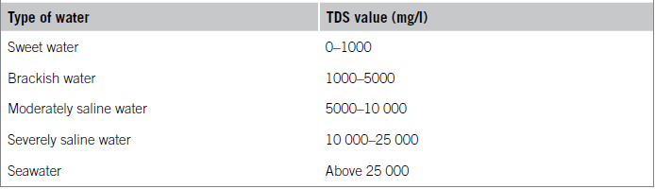
Desalination of Water with high TDS

Slide 26
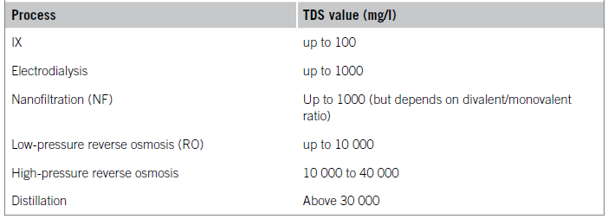
Desalination Technologies

