Slide 1
Part II Sanitary Systems
Chapter2b : Component Treatment System
Geremew Sahilu (PhD)

Slide 3
Outline
Level
Location
Nature

Slide 4
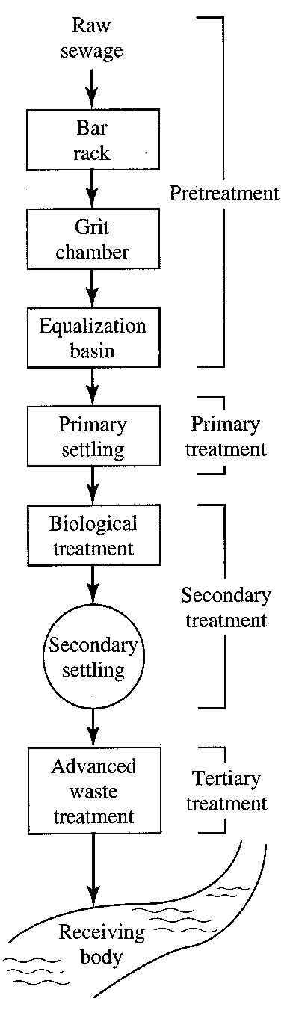
Conventional wastewater treatment - LEVELS
  Pretreatment – removes materials that can cause operational problems, equalization optional
  Primary treatment – remove ~60% of solids and ~35% of BOD
  Secondary treatment – remove ~85% of BOD and solids
  Advanced treatment – varies: 95+ % of BOD and solids, N, P

Slide 5
LOCATION – Addis Ababa as a Case
    Centralized (Catchment)
    Decentralized (Specific Settlement)
    Onsite (Septic Tanks…)

Slide 6
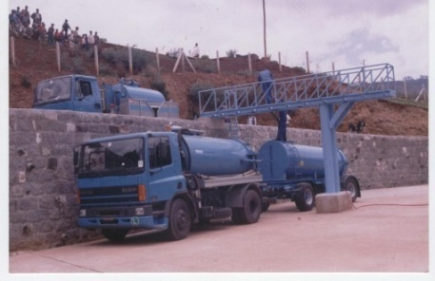
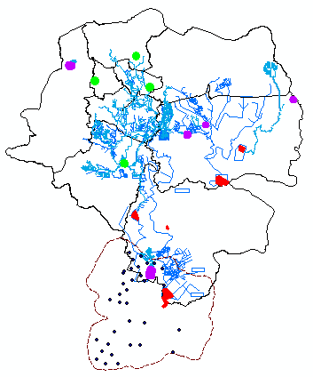
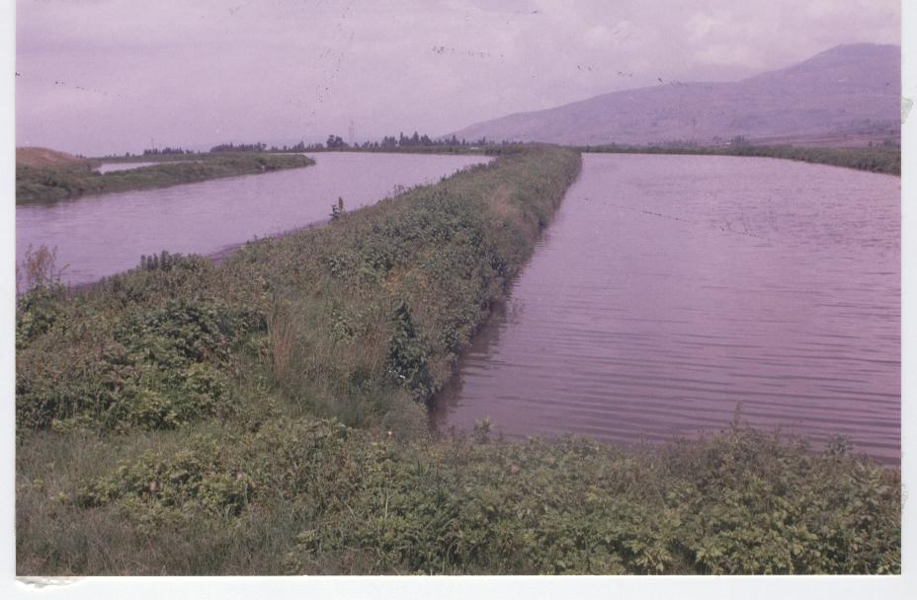
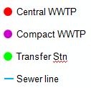
Issues of Wastewater in AA
Collection service coverage
(Sewered + Vacuum Truck)= 28 %
WW Treatment capacity
(Existing + Planned) < 300 000 m3/d
Required design capacity for 50% of the generated waste in 10 yrs ≈ 400 000 m3/d
Low level of wastewater reuse
Akaki
Well-field

Slide 7
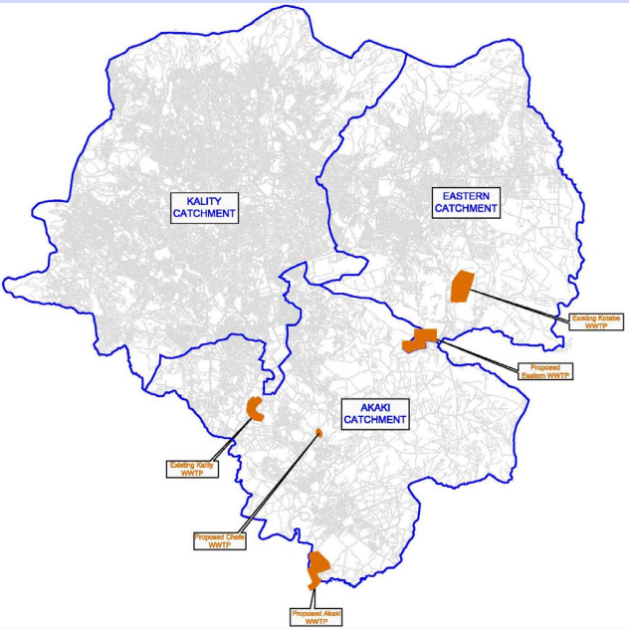
100,000m³/day
UASB + TF + Pond
12,500m³/day
UASB + TF
4,000m³/day
Oxidation Ditch
80,000m³/day
Oxidation Ditch
60,000m³/day
Sewerage Master Plan
Centralized

Slide 8
TYPE OF TOILET FACILITIES (2007)
70+ % Latrines (Not Water Based)

Slide 9
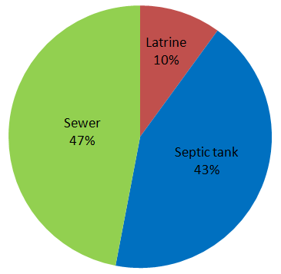
Addis Ababa
Ongoing/Planned Interventions
Increasing the sewerage system coverage
New wastewater treatment plants
Use of MBRs at condominium sites
Wastewater sludge use
Biogas from wastewater
Proposed sanitation systems of AA in 2020
(Based on AAWSA Business Plan, 2011)

Slide 10
ON-SITE COLLECTION AND TREATMENT
OF WASTEWATER
• When flush toilets are used, on-site collection and treatment of the wastewater (combined toilet flush water and grey water) is required if population densities are too low to make centralized collection of wastewater economical.
In locations where sewers and a centralized wastewater treatment system are not available, on site disposal must be used

Slide 11
SEPTIC TANK AND LEACH FIELD
• A typical system consists of a settling chamber (e.g., septic tank) from which the liquid supernatant is discharged to a leach field
• A typical leach field consists of perforated pipes that distribute the water at the base of a gravel-lined ditch
• The degree of treatment provided by the soil is highly dependent on local factors (e.g., soil type, temperature, and distance to groundwater), and poorly designed systems can cause significant groundwater contamination

Slide 12
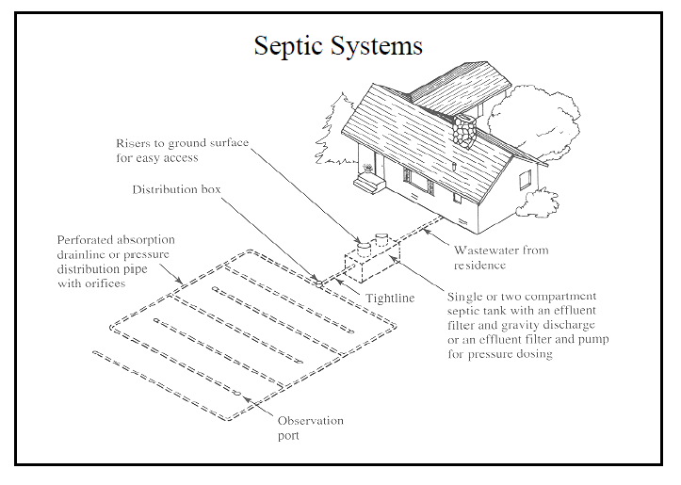

Slide 13
OPTIONS FOR FURTHER ON-SITE TREATMENT
• Additional treatment of wastewater at the household level may be desirable, either to enable reuse of treated effluent or because the soil conditions in the leach field do not provide adequate treatment
• A wide range of technologies is available. – For example, an intermittent sand filter can be used, which mimics soil treatment. Pressurized wastewater is distributed at the top in intermittent doses, and a bio-film on the unsaturated sand provides treatment as the water trickles through
• Another option, which has received significant attention recently, is constructed wetlands
• Other options mimic larger scale processes, but many are very expensive, and few have undergone rigorous, long-term testing

Slide 14
Natural Systems
• Waste stabilization ponds
• Constructed wetlands
• Soil-based treatment

Slide 15
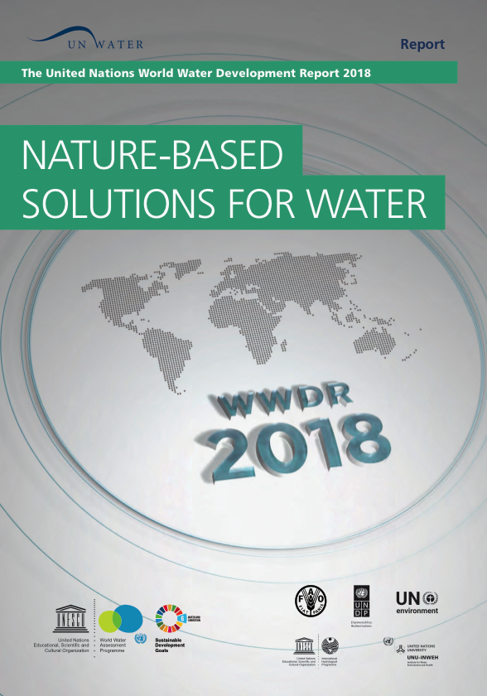
Nature Based Solutions and Water
NBS for Managing Water Availability
NBS for Managing Water Quality
NBS for Managing Water Related Risks, Vulnerablitiy and Climate Change
Etc…

Slide 16
NATURAL TREATMENT SYSTEMS (NTSs)
• Rely on ecological processes to treat wastewater
• Their main advantages are
- lower cost, lower energy inputs (typically zero), and less O&M (fewer mechanical systems), and they can potentially provide habitat and aesthetic value
• Natural systems are largely controlled by environmental variables (e.g., temperature, sunlight, wind); thus, their performance is variable, although they can operate effectively in most climates.

Slide 17
NTSs…
• NTSs are commonly used in industrialized countries to treat the wastewater from small- and medium sized communities (typically <100,000 inhabitants).
• In developing countries, an NTS will often be preferable to mechanical treatment
• NTSs are particularly well suited to preparing wastewater for reuse in irrigation

Slide 18
WASTE STABILIZATION PONDS
• Are the most widely used NTS and can provide complete treatment of wastewater, although pretreatment to remove sand and grit is still necessary
• A typical WSP system consists of a series of constructed ponds, ranging from 0.5 to several meters in depth
• The initial pond can be anaerobic or facultative (aerobic layer overlying anaerobic layer), and the final maturation pond(s) should be aerobic
• The total detention times are long, ranging from weeks to months

Slide 19
WASTE STABILIZATION …
• Bacteria consume soluble organic matter and then settle to the bottom of the pond
• Algae provide oxygen via photosynthesis to aerobic bacteria
• Nutrients are removed to some extent by a range of processes
• Pathogens are removed efficiently both by settling and inactivation (in maturation ponds), which is primarily due to sunlight-mediated processes
• Subsequent disinfection is not usually needed.

Slide 20
WASTE STABILIZATION …
• Effluent from a well-operating WSP can be
– directly used for irrigation or aquaculture
– discharged directly to surface waters, as the algae do not exert an immediate oxygen demand
• To protect sensitive water bodies from eutrophication, however, additional removal of algae and nutrients (e.g., by rock filter or wetland) may be required
• Advanced, integrated pond systems (AIPSs) can be used to more closely control and improve treatment performance over conventional WSPs

Slide 21
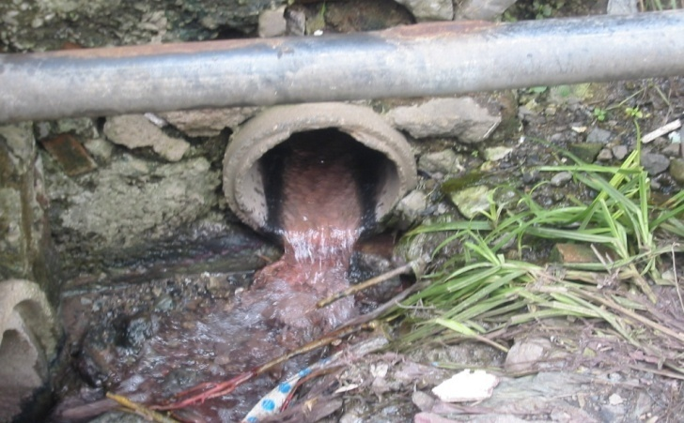
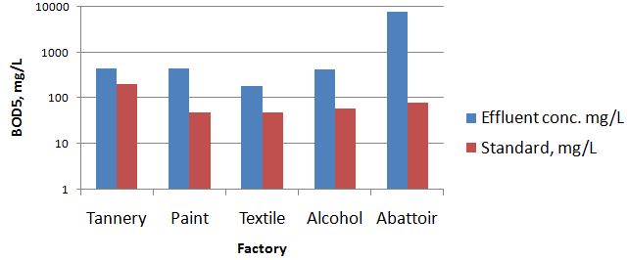
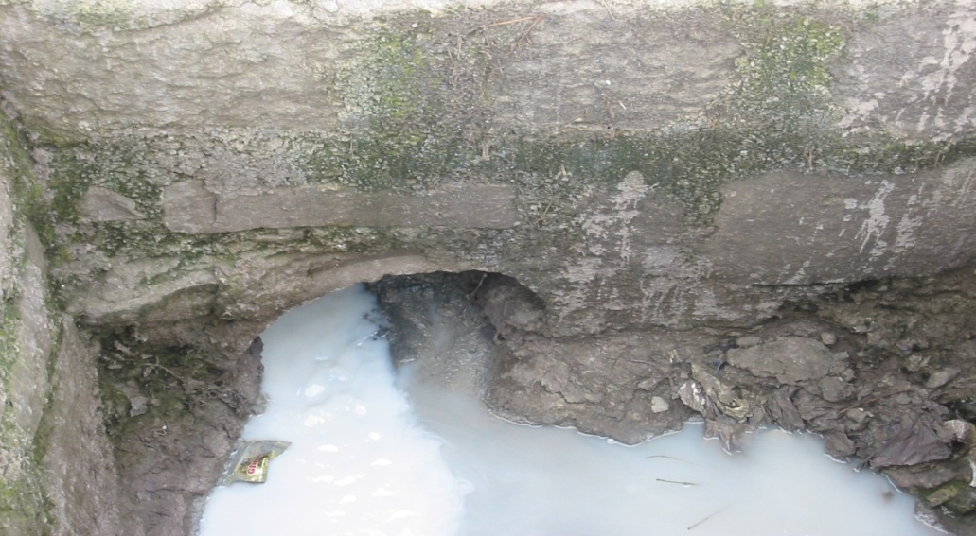
Water Pollution
WW at Kality Stabilization Pond
Parameter | Unit | Influent quality | Effluent quality
BOD5 | mg/L | 229-324 | 41-55
COD | mg/L | 480-697 | 123-142
TSS | mg/L | 188-237 | 63-79
TN | mg/L | 85-95 | 30-43
TP | mg/L | 13-16 | 9-12
T. Coli | MPN/100ml | 28-90 billion | 0.33-0.34 billion

Slide 22
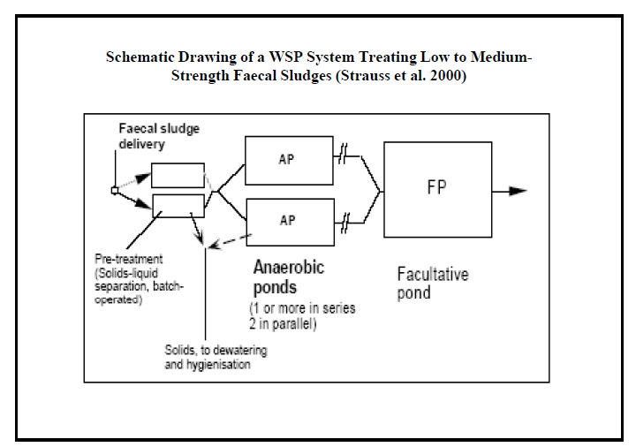

Slide 24
Functions and requirements of ponds
Pond | Main function | Design factors
Anaerobic Facultative Maturation | Treat strong organic waste (70% reduction in BOD5) BOD removal Fecal coliform removal (99.9%) | Depth: 2-4 m Detention time: 5 days Temp/pH: > 15°C/>6 Depth: 1-1.5 m Exposed to wind Large land area Desludging: 10-15 years Depth: 1-1.5 m
Processes in a facultative pond

Slide 25
CONSTRUCTED WETLANDS
• Are most commonly used for secondary or tertiary treatment and are preceded by a septic tank, anaerobic reactor, WSP, or mechanical treatment plant
• CWs have shallower depths than WSPs ( approx. 0.5 m), are planted with emergent vegetation, and also have algae in open water areas.

Slide 27
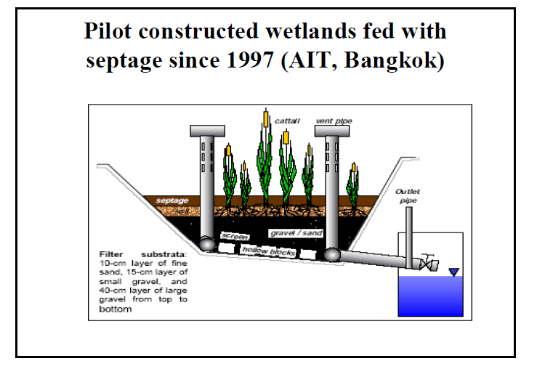

Slide 28
CWS…
• The vegetation can be based on native plants and serves several important functions,
– including supporting growth of microorganisms on plant roots, stems, and litter; uptake of wastewater constituents; interception and filtration of particulate matter; and modification of system hydraulics
• CWs require more land area than WSPs but are particularly well suited for “polishing,” such as removing particles, nitrate, pathogens, and heavy metals.

Slide 31
SOIL-BASED TREATMENT
• The application of wastewater to land combines treatment (as the water filters through the soil) and disposal, and it is one of the oldest forms of wastewater management
• Slow rate processes are similar to irrigation and are most attractive when integrated with crop production
• Alternatively, rapid infiltration basins can be used to increase the infiltration rate (decreasing the required land area)

Slide 32
ENGINEERED SYSTEMS

Slide 33
THANK YOU !!

