Slide 1
URBAN DRAINAGE
Quantities of Sanitary Sewage and
Storm Water
Geremew Sahilu (PhD)

Slide 2
OUTLINE
Wastewater flow rates
Hydraulic Design of Sewers
Sewer Appurtenances
Sanitary Engineering pumps

Slide 3
Quantities of Sanitary Sewage and Storm Water
Sanitary Sewage /Dry Weather flow (DWF)
  Wastewater flow rates
  Factors affecting DWF
  Variation in Rate of Flow
Storm Water
  Storm water flow estimation
    Rational
    Empirical and other methods

Slide 4
Sanitary Sewage (DWF)
Sanitary Sewage can be divided in to two
  Domestic Sewage – Waste obtained from residential areas and institutions
  Industrial Sewage (Trade waste) – Sewage coming from manufacturing units and others (commercial…)

Slide 5
Source of Sanitary Sewage
Water supplied by water works authority consumed for domestic purpose for flushing WCs, Urinals, washing clothes, bathing…
From residents getting water from own or private sources
Water supplied to industries for manufacturing process
Water supplied to schools, cinemas, hotels, …
Water taken by industries from private and other sources
Infiltration of groundwater into sewers through loose joints
Unauthorized entrance of rain water in sewer lines

Slide 6
Factors Affecting Sanitary Sewage (DWF)
Infiltration and Ex-filtration
Rate of Water Supply
Population
Type of Area Served (residential/commercial/Industrial)
Effect of growth of population on per capita production of Sewage

Slide 7
…Factors – Infiltration/Ex-Filtration
Infiltration is entrance of groundwater to sewers through leaking joints.
  Infiltration unnecessarily increases the quantity of sewage
Ex-filtration is reverse process of infiltration. Leaking sewage percolates into ground surrounding the sewer
  Ex-filtration pollutes groundwater , very dangerous if wells are drilled for use in the vicinity
Both infiltration and ex-filtration can be minimized/prevented by:
  adopting strong sewers
  constructing water tight joints

Slide 8
…Factors – Infiltration/Ex-Filtration
Quantity of Infiltration Depends on:
  Depth of sewer invert below groundwater table – higher depth more infiltration
  Sewer size
  Materials of the sewer
  Length of sewer line laid under groundwater table
  Nature and type of soil in which sewer line is laid
  Type of Joints
  Workmanship during laying of sewer lines

Slide 9
…Factors – Infiltration/Ex-Filtration
Quantities of Infiltration can be expressed :
  Liters /hectare of area/day
    Total area of which the sewer line serve is calculated
    Flat rate of infiltration assumed depending on the factors affecting infiltration
    Amount of infiltration calculated by multiplying the area with assumed rate
  Liter/ kilometer length of sewer/day
    Rate of infiltration expressed per unit length of sewer and can vary widely
  Liter/centimeter diameter/kilometer length/day
    Best to assess rate of infiltration – greater the diameter larger the amount of infiltration

Slide 10
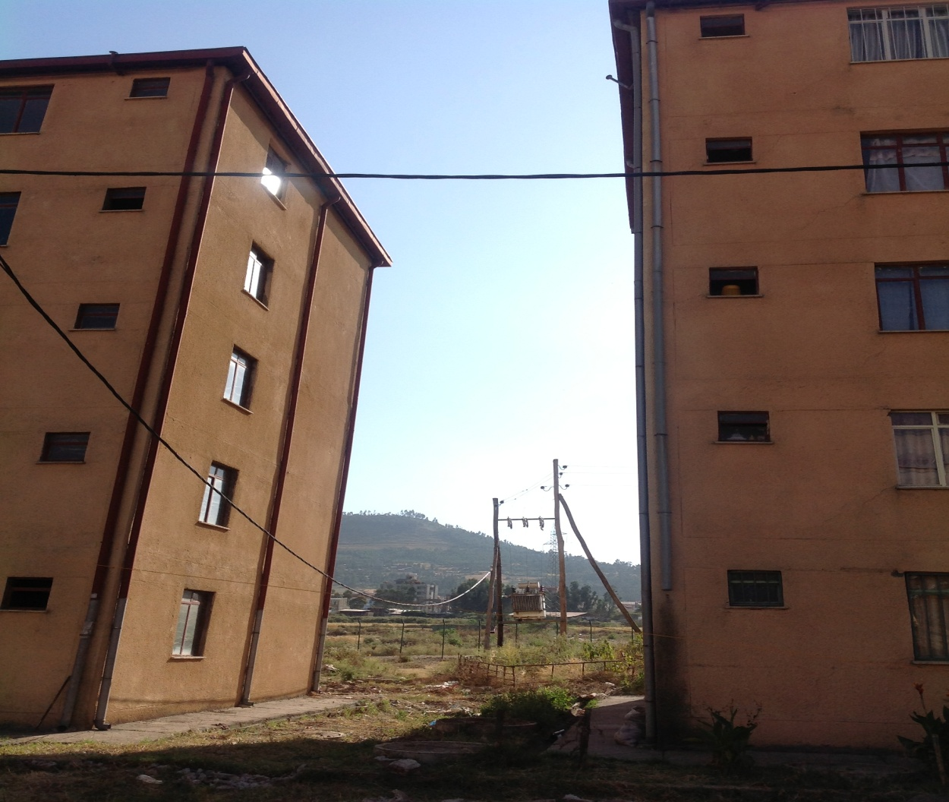
Jemmo Condominium
Tilting Block
Exfiltration?

Slide 11
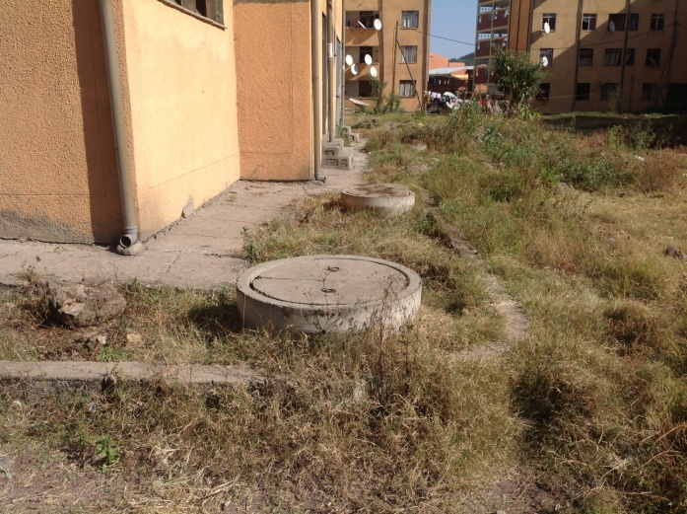

Slide 12
Table 3. Water quality test taken from five test boreholes
No. | Parameters | Unit | BH-1 | Bh-5 | Bh-7 | Bh-12 | Bh-13 | Waste Water
1 | pH |  | 7.7 | 7.3 | 7.5 | 7.2 | 7.1
2 | Turbidity | NTU | 520 | 1050 | 1400 | 1020 | 1450
3 | Total Hardness | mg/l | 30 | 35 | 40 | 30 | 40
4 | Total Suspended solids | mg/l | 499 | 1567 | 2469 | 1434 | 2696 | 100 - 350
5 | Nitrate | mg/l | 59.2 | 90 | 320 | 85 | 95 | 20 - 85
6 | Phosphate | mg/l | 3.55 | 5.61 | 13.55 | 5.6 | 5.65 | 4 - 18
7 | BoD | mg/l | Ni | 12 | 4.4 | 9.6 | 77 | 110 - 400
8 | E Coli |  | positive | positive | positive | positive | positive

Slide 13
…Factors – Rate of Water Supply
Rate of water supply may be fully available in the form of sewage ; But
  Reduction can occur due to consumption, evaporation, gardens and lawn, fire fighting
  Private sources and infiltration increases sewage
Hence, careful analysis should be made while determining the relation b/n rate of water supply and sewage quantity
  Usually reduction and increase are assumed to cancel out each other and
  Rate of sewage is assumed to be 70 to 80 % rate of water supply

Slide 14
…Factors – Rate of Water Supply
Before deciding on the rate of sewage following factors should be analyzed:
  Use of water – uses such as filling tanks of locomotives, gardens, lawns, etc. could not produce sewage
  Pressure in pipelines - if water is supplied with very high pressure more water is likely consumed (leakage through faulty joints, valves, etc. increased thus sewage increases)

Slide 15
…Factors – Population
Like water supply, sewage quantity increases with increase in population
Different methods of population forecasting can be used to determine the future population (Reading Assignment)
  Arithmetical progression method
  Geometrical progression method
  Decreasing rate of increase method
  Graphical extension method
  Comparison with other cities method

Slide 16
…Factors – Type of Area Served
Type of area to be served affects quantity of sewage
  Quantity of sewage in Industrial, commercial and residential area can not be the same
    Industrial depends on type of product/manufacturing use
    Commercial the type and extent of business
    Residential rate of water use
Quantity of sewage can be expressed liter per person per day and multiplied by population to get the total sewage quantity

Slide 17
…Factors – Effect of growth of population on per capita production
Rate of increase in water and subsequently sewage increase with rise in population
City population increases since people are attracted by economic development in urban areas
If there is economic development consumption of water per capita increase hence sewage
In USA it has been found that the percentage increase in the per capita use of water is equal to 5% of the percentage in population

Slide 18
Variation in the rate of sewage
Rate of flow from any area varies with the season, the day, the hour and other conditions
Max and min flow are controlling factors of design of sewers
Capacity of sewer must be :
  Sufficient to carry the minimum load
  Laid on sufficient slope that deposits will not occur during periods of minimum flow
Maximum and minimum rates are usually percentages of average rate of flow.

Slide 19
Variations…
Hourly, daily, and seasonal variations of sewage flow for a city affects design and operations of:
  Sewer lines
  Pumping stations
  Treatment Plants
  Flow control equipment
If annual average rate of flow is taken as 100 liters:
  Maximum seasonal flow = 120 liter
  Maximum monthly flow = 140 liter
  Maximum Daily amount = 150 to 180 liter
  Maximum hourly amount = 200 to 300 liter

Slide 20
Empirical relationship b/n maximum and average rates of sewage flow in residential areas
Maximum and average flows are related in different empirical formula:
  Babbit formula – Q = 5q/P^{0.2}
  Harmon’s formula - Q = q * (14/(4+P^{0.5}))
  Where : Q = The maximum rate of sewage flow
  q = The average rate of flow
  P = Population in thousands

Slide 21
Empirical…
For Rough estimate and comparative purposes:
  The ratio of average to minimum flow and
  Maximum to average flow are considered as same
Relationship between maximum, average, and minimum ratio of flow in commercial and industrial districts varies greatly among cities and industries
It can not be formulated with reasonable accuracy for all conditions
Prediction can be made based on study of similar districts

Slide 22
Data from Indian Towns
Town Population | Water Supply liter/capita day | Sewage production in liter/capita/day
5000 - 200000 | 130 -160 | 115
200,000 – 500,000 | 160 - 180 | 135
500,000 - 1,000,000 | 180 - 200 | 160
> 1,000,000 | 200 - 250 | 180 - 200

Slide 23
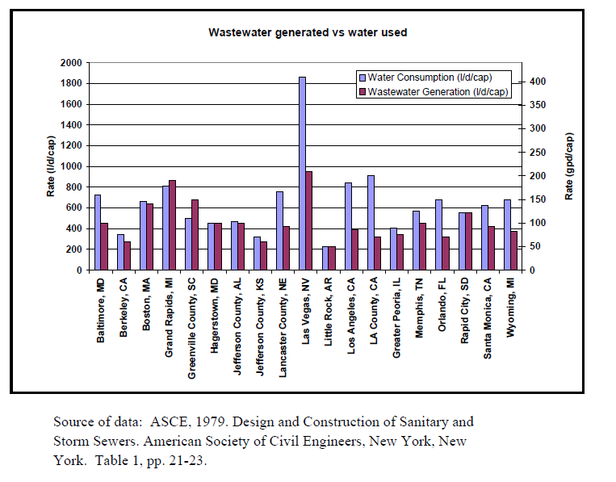

Slide 24
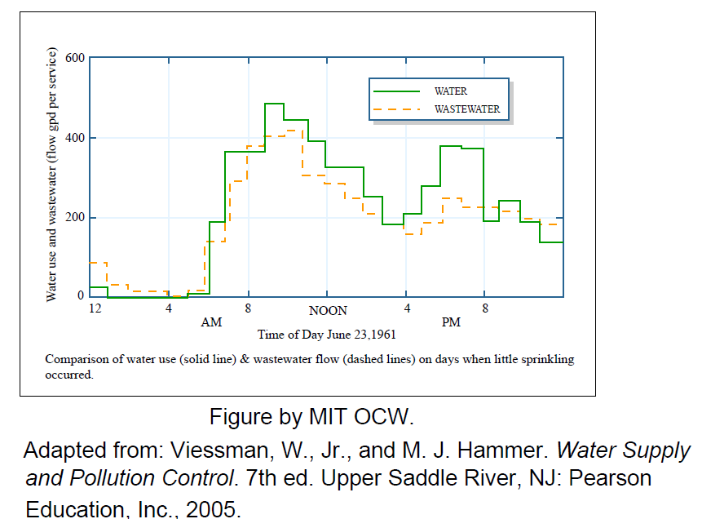

Slide 25
Variation in network components
A network of sewer in a city comprises of
  Domestic
  Lateral
  Branch
  Main
  Trunk or Outfall
Variations in flow in domestic and lateral sewers is maximum as they receive sewage directly from the source
Various sewers of drainage system network are not designed for average annual flow but for higher discharges to cater for peak flow

Slide 26
Variation… Design flow
No. | Sewers | Times of average rate of annual flow for which sewer is to designed
1 | Domestic | 6
2 | Laterals | 4 - 6
3 | Branch | 3
4 | Main | 2.5
5 | Trunk or outfall | 2

Slide 27
Factor of average of flow
No. | Types and size of sewers | Times of average flow for which sewer can be allowed to be used
1 | Trunk and outfall sewers above 125 cm in diameter | 1.5
2 | Main sewers up to 100 cm diameter | 2
3 | Branch sewers up to 50 cm diameter | 3
4 | Lateral and small size sewers up to 25 cm diameter | 4

Slide 28
Minimum Flow
Minimum domestic flows occur around mid night
When active while using bath or flushing lateral sewers receive the flow but could be empty immediately
Hence fluctuations in lateral flows is maximum since they are directly linked to usage at domestic levels
  Thus minimum flow in laterals is as low as 30 % of average flow
But in mains the variation/fluctuation is reduced as laterals join at different points and all flow does not reach a point at a time
  Thus minimum flow in the main and trunks may vary from 50 to 70% of the average flow

Slide 29
Storm Water / Storm Sewage
Introduction
Quantity of Storm water
  Factors affecting
  Methods of estimation

Slide 30
Storm…/Introduction
All rainfall does not convert to storm as part of it percolate and partly evaporate
Remaining part is called storm water or storm sewage
Storm water should be disposed in open drainage or underground sewers
Separate system of sewerage two lines are laid one for storm water the other for sewer; while for combined only one pipe is laid
For whatever system, storm water sewer is not designed for peak flow
If storm sewers are designed for peak flow, the diameters will be too large and hence investment cost
Lesser flows can be considered and the difference is that it will take more time and there will be some overflow
In the case of separate system the overflow would not create nuisance

Slide 31
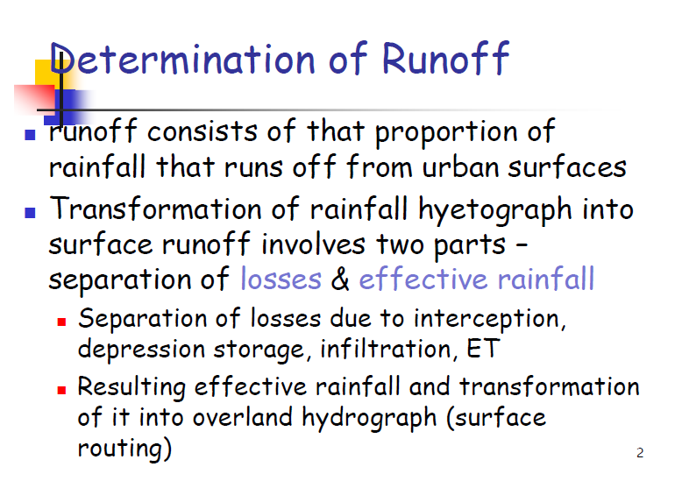

Slide 32
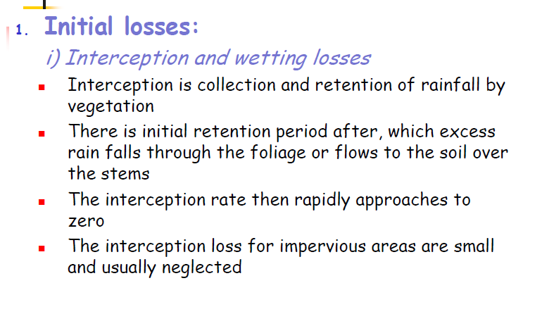

Slide 33
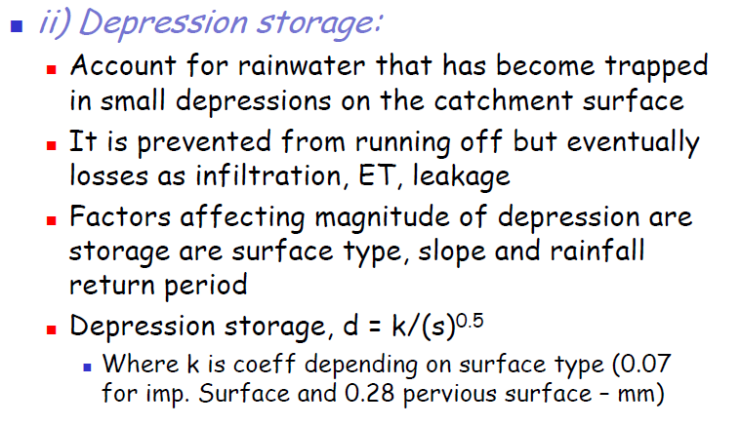

Slide 34
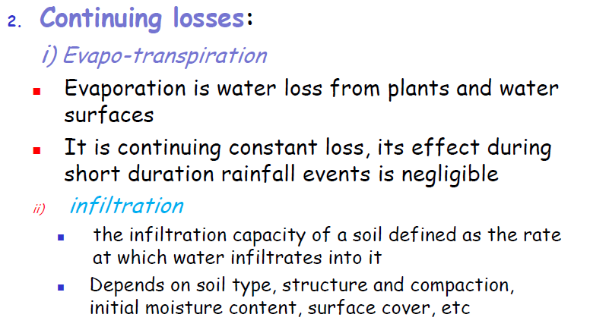

Slide 35
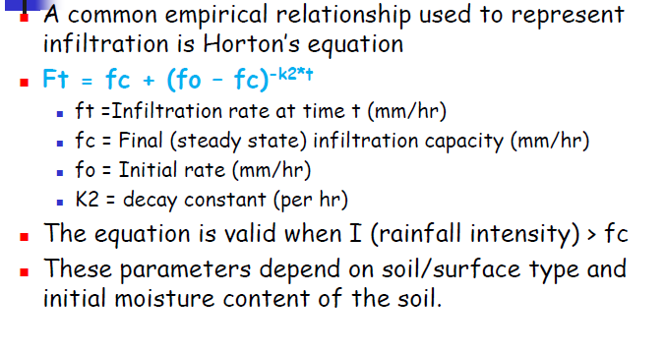

Slide 36
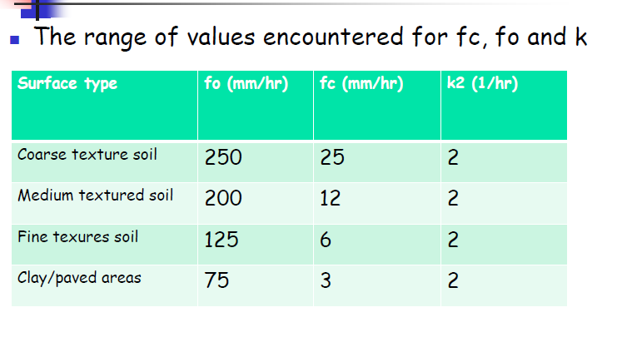

Slide 37
Storm…/Quantity-Factors
Quantity of storm water depends mainly on the following factors
  Rainfall
  Nature of surface over which the rainfall takes place
  Intensity of rainfall
Other factors are:
  Area of catchment (larger area /more)
  Shape and slope of catchment (fan & steep / more)
  Obstruction to flow in different forms (trees, fields, grass…)
  Initial state of the catchment area with respect to wetness (saturated / more)
  Number and size of ditches present in the area (more ditches/less)

Slide 38
Storm…/Quantity-Factors/Rainfall /Intensity
Total quantity of rainfall is the basic source of storm water
  The larger the quantity of rainfall the more storm water
  Total rainfall can be measured with Simson’s rain gauge (reading assignment)
Intensity of rainfall is the amount of rainfall in unit time (minute, hour or day)
  Intensity of rainfall is expressed in millimeters or centimeters/hour
  Two types of rainfall gauges are used to measure intensity
    Tipping-bucket type and
    Weighing device type (reading assignment)

Slide 39
Storm…/Quantity-Factors/Rainfall /Intensity
Maximum Rainfall Rates
  Very intensive storm is not frequent
    Ordinary storm occurs once in 5 to 10 years
    An extra-ordinary storm once in 10 to 15 years and
    A rare or extremely storm once in 100 years
  Different return periods have corresponding peak floods
    Even 100 years can be exceeded
    100 years can occur but another flood of similar magnitude can occur at any time (but unlikely to do so in immediate future)

Slide 40
Storm…/Quantity-Factors/Rainfall /Intensity
Rainfall Intensity Curves
  Represents the maximum rate that may be expected once in the period
  Curves can be used to estimate the maximum quantity of storm water which will have to be dealt with at an interval of 5, 10, 15, 25, 50 years
  In some areas curves are used highly while in others less if planners decide to allow overflow of some flood

Slide 41
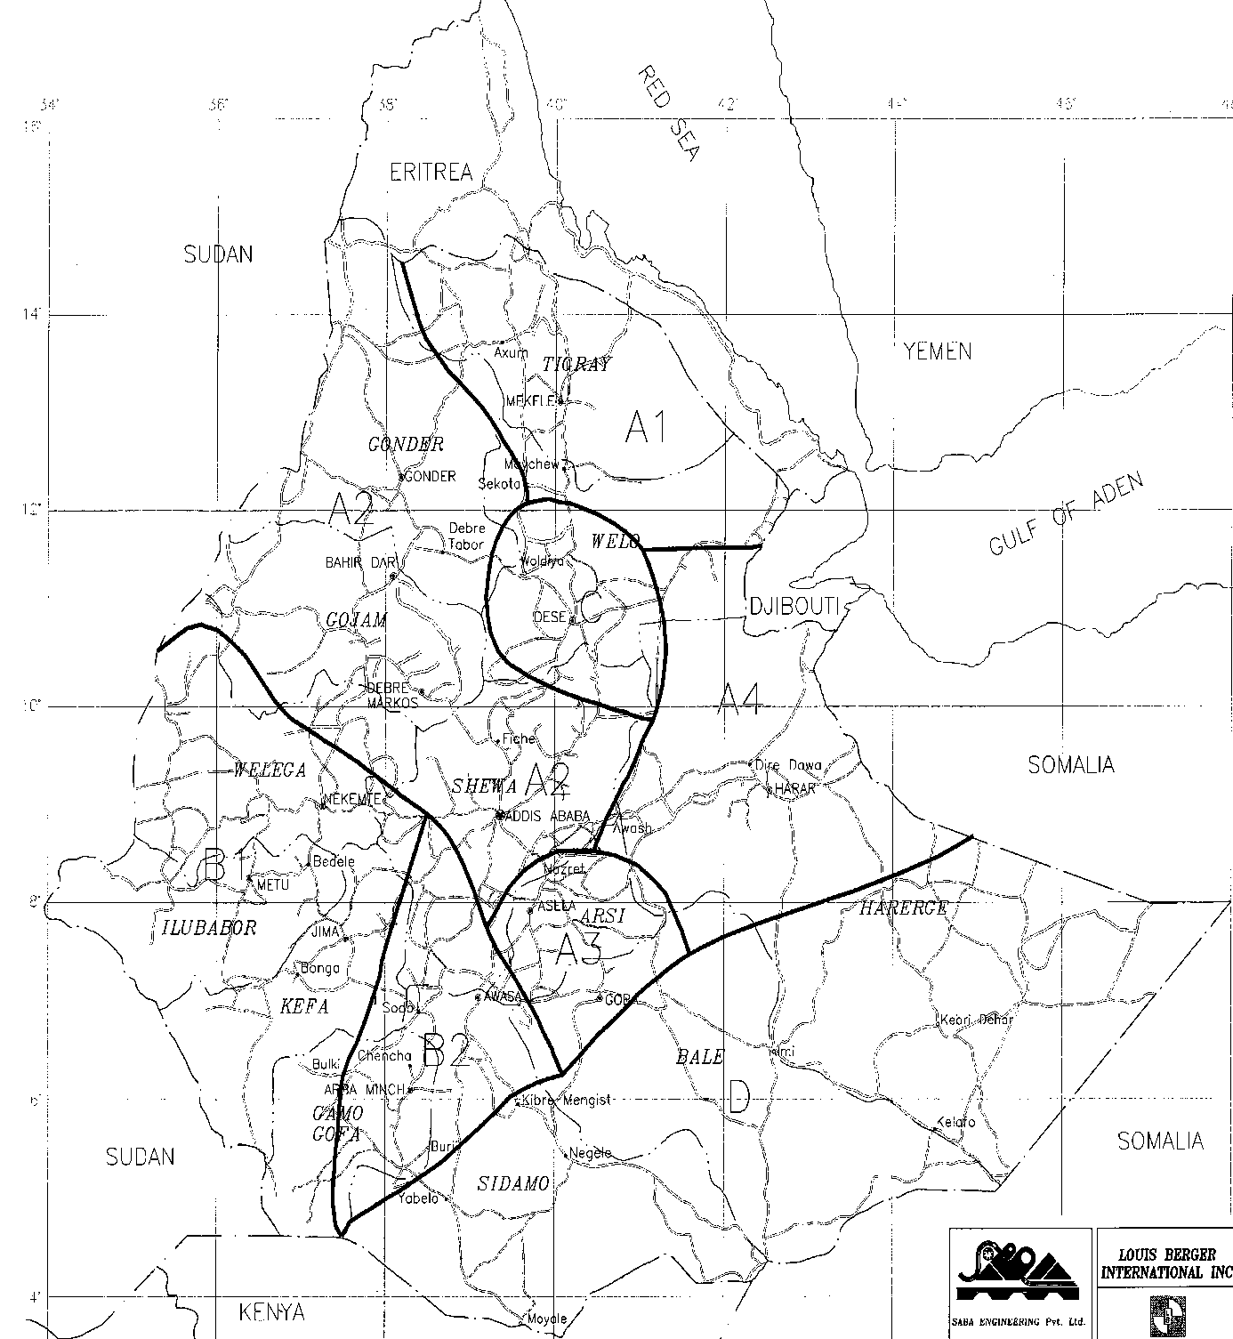

Slide 45
Storm…/Quantity-Factors/Rainfall /Intensity
Time of Concentration
  All storm from catchment would not reach storm sewer outfall at one time
  Areas nearer to outfall reach first and those further reach latter hence maximum flow is reached when all area is contributing to the flow
  At this time the flow in the sewer becomes equal to the rate of precipitation over the whole area
  Storm water at outfall begin reducing when the rain stops
  The time taken for the flow in a sewer to build upto maximum is known as the time of concentration

Slide 46
Storm…/Quantity-Factors/Rainfall /Intensity
Time of concentration is made up of
  Time of entry
    Time taken for rain water to run over roof and road surfaces etc. along gutters, channels and drains prior to reaching sewer
  Time of flow
    Time of flow through sewers to point at which rate of flow is assessed
Difference between the two:
  Time of entry has to be estimated or found by experiments, being dependent upon unknown factors
  Time of flow can be calculated to a reasonable degree of accuracy, being dependent on gradient and hydraulic mean depth of the sewers

Slide 47
Storm…/Quantity-Factors/Rainfall /Intensity
Time of Entry varies depending on the type of surface
  Unpaved public parks have longer and greater than
  Steeply sloping roof or a short length drain
Time from unpaved park can be so long it could be possible to neglect in the calculation of flow since it would arrive late

Slide 48
Peak runoff factor
r·A
Q_{R}
r_{max}·A
Q_{P}
Runoff duration
Rain duration

Slide 49
Peak runoff factor ψ_{P} and coefficient α_{P}
Surface material | α_{P} | Housing density | ψ_{P}
Metal and Stone roof | 0,95 | Class I 350 Inh/ha | 0,8
Roofing tile and felt | 0,90
Flat roof | 0,50 – 0,70 | Class II 250 Inh/ha | 0,60 – 0,65
Asphalt road | 0,85 – 0,90
Rough road surface | 0,75 – 0,85 | Class III 150 Inh/ha | 0,40 – 0,52
Gravel road | 0,25 – 0,60
Gravel path | 0,15 – 0,30 | Class IV 100 Inh/ha | 0,25 – 0,46
Unpaved area | 0,10 – 0,20
Park and Garden | 0,05 – 0,10 | Class V no housing | 0,05 – 0,35
Meadow, Forest | 0

Slide 50
Rain-runoff-process in two steps
Runoff production
r·A
Q
Runoff concentration
Time

Slide 51
Rain duration to produce maximum runoff
r_{a}
Q_{a}
t_{R} < t_{C}
t_{R}
t_{C}
r_{b}
A
Q_{b}
t_{R} = t_{C}
t_{C}
2 t_{C}

Slide 52
Rain duration to produce maximum runoff
A
Q_{c}
r_{c}
t_{R} > t_{C}
t_{R}
t_{R}+t_{C}
Concentration time = surface runoff time + flow time in sewer

Slide 53
Assumption of decisive rain duration with a lack of information
Class | Sloppe | Impervious fraction | t_{R}
1 | < 1% | ≤ 50% | 15 min
1 2 3 4 | < 1% 1% - 4% 4% - 10% > 10% | > 50% > 50% > 50% ≤ 50% | 10 min
4 | > 10% | > 50% | 5 min

Slide 54
Storm…/Quantity-Methods of Estimation
There are two methods which are generally used to estimate quantity of storm water
  Rational method
  Empirical formulae method

Slide 55
Storm…/Quantity-Methods of Estimation
Rational Method
  Most commonly used method to estimate quantity of storm water
    Q = AIR / 360
      Q = quantity of run off water in m³/s
      A = drainage area in hectares
      I = Intensity of rainfall in mm/hr
      R = Coefficient of run off
    Q = 28 AIR
      Q = quantity of run off water in liters
      A = drainage area in hectares
      I = Intensity of rainfall in cm/hr
      R = Coefficient of run off
Extreme care should be taken in determining run-off coefficient and intensity of rainfall
Results can vary based on the assumption of value by different persons
The method is useful for smaller catchment up to 400 hectares

Slide 56
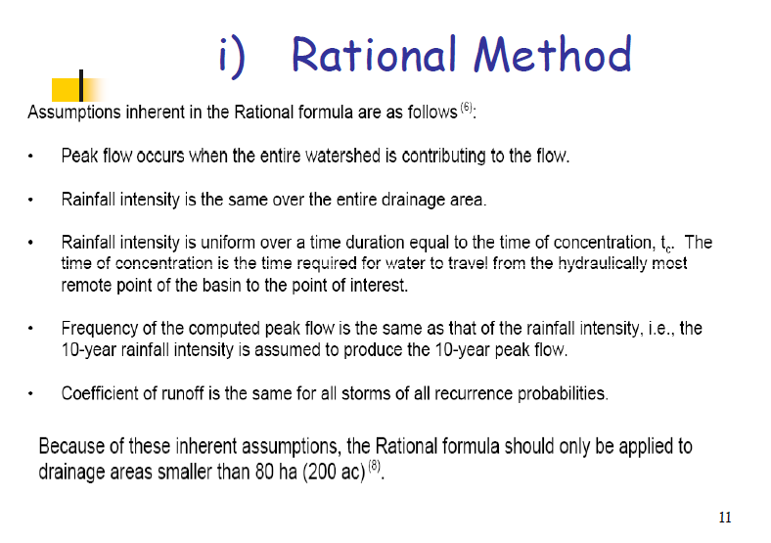

Slide 57
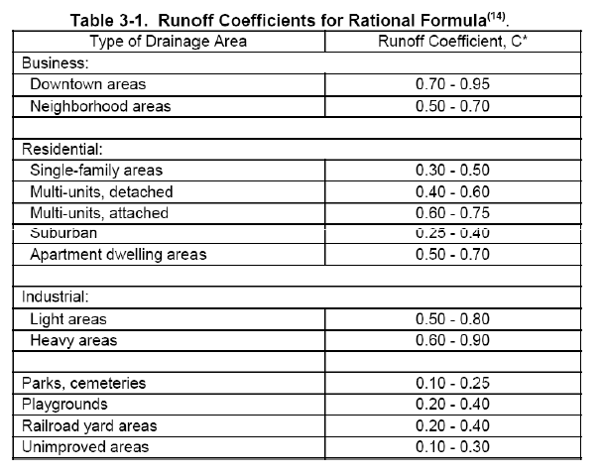

Slide 58
Storm…/Quantity-Methods of Estimation/Run-off coefficient
No. | Type of Surface | Run-off coefficient (Kuichling’s)
1 | Water tight roof surface | 0.7 – 0.95
2 | Asphalt pavement in good conditions | 0.85 – 0.90
3 | Pavement of stone, bricks etc, in good condition | 0.75 – 0.85
4 | Pavements of stone, bricks and blocks with open joints | 0.50 – 0.70
5 | Inferior type of stone, brick or block pavements with open joints | 0.40 – 0.50
6 | Gravel road and surfaces | 0.15 – 0.30
7 | Water bound macadam roadways | 0.25 – 0.60
8 | Parks lawns, gardens etc. | 0.10 – 0.25
9 | Unpaved streets, rail road yards and open grounds etc. | 0.10 – 0.30
10 | Forest and wooded areas depending on the ground surface and soil characteristics | 0.10 – 0.30

Slide 59
Storm…/Quantity-Methods of Estimation
No. | Type of Surface | Run-off coefficient (Fruhling’s)
1 | Highly congested areas like business | 0.85
2 | Thickly populated areas | 0.75
3 | Areas with semi-detached houses | 0.65
4 | Sub- urban areas with detached houses | 0.45 – 0.55
5 | Extreme sub-urban areas thinly populated | 0.35

Slide 60
Storm…/Quantity-Methods of Estimation
No. | Type of Surface | Run-off coefficient (For quick calculation)
1 | Thickly populated area | 0.70 – 0.90
2 | Half area thickly populated and half area populated in the form of open bungalows | 0.50 – 0.70
3 | The whole area having open bungalows | 0.25 – 0.50
4 | For the area where rare isolated have been constructed | 0.10 – 0.25

Slide 61
Storm…/Quantity-Methods of Estimation/ Intensity
Intensity of rainfall, i.e. ‘I’ in centimeters per hour can be estimated by the following formulae:
  I = 76.0 / (t + 10) when t is 5 to 20 minutes
  I = 102.0 / (t + 20) when t is 20 to 100 minutes
Kuichling formulae suitable for conditions for USA (inches per hour); t = time in minutes
  I = 266.7 / (t+20) for storms occurring once in 10 years
  I = 305 / (t + 12) for storms occurring once in 15 years

Slide 62
Storm…/Quantity-Methods of Estimation
Run-off coefficients in the above table does not remain constant.
  They change with the duration of rainfall period.
  Longer rainfall duration saturates the surface and more water is changed to run-off increasing the value of coefficient
Town development results more and more of open areas get developed or get built up and the run-off coefficient goes on increasing
  Essential to select value of run-off coefficient considering the future development of the town

Slide 63
Storm…/Quantity-Methods of Estimation
Empirical Formulae
  For very large area, empirical formulae are used and give satisfactory result where rational method fails
  Usually applicable only under certain conditions such as slope, rate of rainfall etc.
  Empirical formulae usually do not have theoretical explanation and are entirely based on practical experience

Slide 64
Storm…/Quantity-Methods of Estimation
Empirical Formulae
  i) Burki-Ziegler formula (earliest and developed by a Swiss Engineer)
  Q = 296 CRA (S/A)^{1/4}
    Q = Run-off in liters per second
    C = Constant which depends on the nature of ground surface varying from 0.5 to 0.9 with average value 0.7
    R = Maximum rate of rainfall in mm per hour over the full area
    A = Area in hectares
    S = Slope of the sewer m per 1000 m length of sewer
  ii)McMath’s formula (USA/St Luis local condition
  Q = 292 CRA (S/A)^{1/5}
    Where Q, C, R, A and S are same as above but C varies from 0.3 to 0.9

Slide 65
Storm…/Quantity-Methods of Estimation
Fannings formula
  Q = 3125 A^{5/8}
Talbot’s formula
  Q = 87000 A^{1/4}
Dicken’s formula
  Q = 14 CA ^{¾}
Ryve’s formula
  Q = 15 CA^{2/3}
Inglis’s formula
  Q = 123100 A / (A +10.35)^{1/2}
  For all where
  Q = Runoff in liters per second
  A = Area in square kilometers
Values of C
Dickens’
C = 250 for very large area
= 850 for average size area having 60 to 125 cm of annual rainfall
1600 for small areas
Ryve’s C = 450 to 675

Slide 66
Storm…/Quantity-Methods of Estimation
Metcalf and Edds’s formula
  Q = 28.316 [(25000/(2.471 A + 125)) + 15]
    Where Q = Runoff in litres/sec
    A = Area in hectares

Slide 67
Example 1
Workout the ratio of DWF and WWF of city having the following particulars
  Area = 30000 hectares
  Water supply rate = 200 l/c/d
  Population = 1.8 million
  Intensity of rainfall = 15 mm/hr
  Average impermeability factor = 0.5
    Assume that 60% of water supplied reaches the sewer.
    Comment on the result

Slide 68
… Example 1
Solution
1 ) DWF (Q) = Population x Water Supply Rate x Conversion factor
= 1.8 x 10⁶ x 0.2x 0.6 m³/day
= 216000 m³/day
= 2.5 m³/s
2) WWF (Q) = AIR/360
= 30000x15x0.5/360
= 625 m³/s
Ratio = DWF/WWF = 2.5 / 625 = 0.004 = 0.4 %
Comment : As the ratio is on a very low side, it will not be desirable to adopt combined system of sewerage. Recommendation should be a separate system of sewerage

Slide 69
Example 2
A population of 20,000 is residing over an area of 30 hectares are supplied with a daily water supply rate of 135 liter per day. If the coefficient of run-off is 0.25 and the time of concentration of rain is one hour, for how much discharge the sewer line will have to be designed?

Slide 70
…Example 2
Rainfall Intensity (I) = 102/(t + 20)
= 102/(60 + 20)
= 1.275 cm/hour
= 12.75 mm/hour
WWF (Q) = AIR/360 (m³/s) or 28 AIR (l/s)
= 28x30x1.275x0.25
= 267.75 l/s
If all water consumed turned to sewer
DWF (Q) = (20000x135x1)/ (24x60x60) = 15.6 l/s
Let sewer be designed for double of the available DWF and one time of storm water
Total Q = 267.75 + 2(15.6) = 298.95 l/s

