Slide 1
SEWERAGE and
URBAN DRAINAGE
Lecture 4 – Hydraulic Design of Sewers
Geremew Sahilu (PhD)

Slide 2
OUTLINE
Natural Methods of Wastewater Disposal
Primary Treatment of Sewage
Biological Treatment of Sewage
Tertiary Treatment System
History/Current Status
Principle of Sanitation
Collection and Conveyance of Sewage
Wastewater flow rates
Hydraulic Design of Sewers
Sewer Appurtenances
Sanitary Engineering pumps

Slide 3
Hydraulic Design of Sewers
Introduction
Hydraulic Formula
Minimum and Maximum Flows
Hydraulic Elements of Sewers
Storm Water Drains

Slide 4
Hydraulic Design … Introduction
Hydraulic properties of sewage and water are considered identical in sewer design
Number of empirical formulae are used for flow sewage in pipes and channels
Formulas which are applicable in the design of water mains can not be adopted in the design of sewers due to the following :
  Water mains run under pressure and does not need gradient and deep excavations while sewers on the other hand flow under gravity and have to be laid with definite gradient in downward direction
  Water flowing in water mains are practically free of solid particles while sewage contains large amount of settllable particles hence the sewage must be laid at gradient that settlement of suspended particles does not take place and sewers are not choked

Slide 5
Hydraulic Design … Formulae
Hydraulic Formula
  Sewers are designed for flow under gravity
  There are various formulae to determine velocity in sewer
  Charts, diagrams and graphs can be used to determine velocity in sewers

Slide 6
Hydraulic Design … Formulae
Chezy’s Formula :
  V = C (RS)^{1/2}
  Where : V = Velocity in m/sec
  R = Hydraulic radius
  S = Slope of longitudinal gradient
  C = Chezy’s Constant
Chezy’s constant is complex which depends on size, shape, roughness, hydraulic radius and values of C can be obtained from
2. Kutter’s Formula – Gives Chezy’s Constant
C = (23 + 0.00155/S +1/n)/ (1 + (23 + 0.00155/S)n/R^{1/2})
Where R and S are as in Chezy’s formula and n = Rugosity factor or roughness coefficient

Slide 7
Values of Kutter’s n
No. | Type of material | Value of n
1 | Smooth earthen channel | 0.020
2 | Corrugated iron pipes | 0.021
3 | Earthen channel in average condition | 0.025
4 | Earthen channel not maintained properly | 0.030
5 | Rough channels in rock cutting | 0.030
6 | Cast Iron pipes | 0.013
7 | Brick sewers Flush pointed Plastered smooth Rough brick work or stone masonry | 0.015 0.013 0.017
8 | Smooth cement plastered surface | 0.010
9 | Concrete surface or unplanned timber | 0.012
10 | Vitrified clay pipe or stoneware pipe In good condition In poor condition | 0.013 0.015

Slide 8
Selected values of Chezy’s C
Type of channel bed | Mean value of C
Smooth cement | 90
Well-laid brickwork | 70
Cement concrete | 70
Natural channel ( in good condition) | 35
Natural channel ( in bad condition) | 25

Slide 9
Hydraulic Design … Formulae
3. Manning’s Forumla
  V = R^{2/3} S^{1/2}/n
    Where V, R and S are as given in Chezy’s formula and
    n is the same as given by Kutter
  Bazin’s Formula
  V = (157.6/(1.81 + K/R^{1/2}))x(RS)^{1/2}
  Where V, R and S are as given in Chezy’s formula and K is Bazin’s constant whose values for different surfaces are given in Table

Slide 10
Bazin’s Constant K
No. | Nature of Surface of Sewer | Value of K
1 | Rough earthen channels | 3.17
2 | Good earthen channels | 1.54
3 | Smooth rubble masonry surface | 0.833
4 | Rough brick and concrete surface | 0.50
5 | Smooth brick and concrete surface | 0.29
6 | Very smooth surfaces | 0.11
As a rough guide for sewers K = 0.3 can be taken

Slide 11
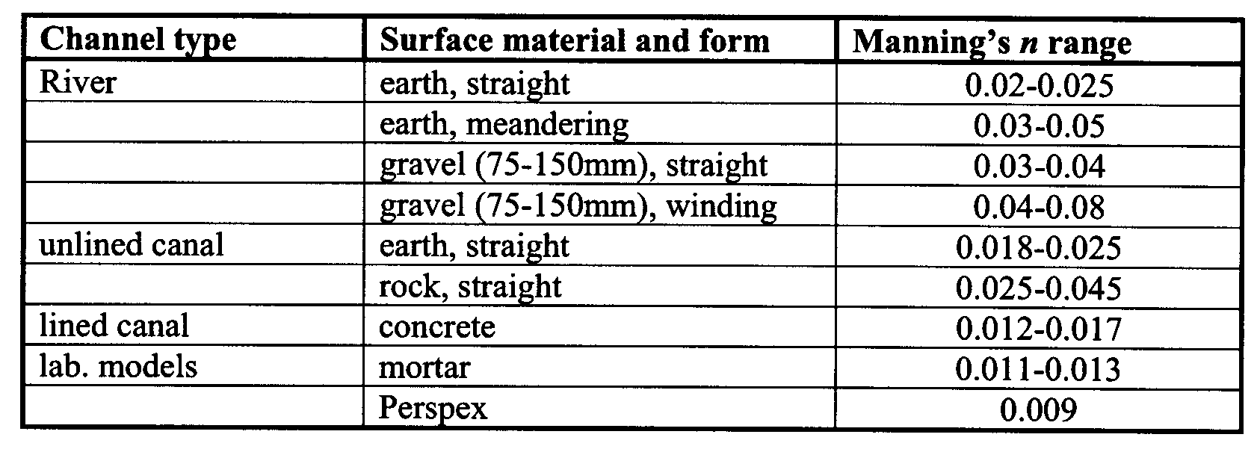
Manning ‘n’ values for various materials

Slide 12
Hydraulic Design … Formulae
5. Crimp’s and Burge’s Formula
V = 83.45 R^{2/3} S^{1/2}
Where V, R and S are as given in Chezy’s formula and it is developed from Manning’s formula by putting value of n = 0.012; It is most commonly used in U.K.
6. Hazen and William’s Formula
V = 0.85 CR^{0.63} S^{0.54}
C is constant whose values for different types of surfaces are given

Slide 13
Values of C in Hazen and William’s Formula
No. | Type of Material | Value of C
1 | Stoneware pipes in good condition, cement lined pipes etc | 110
2 | Wood stave pipe | 120
3 | New C.I. pipe | 130
4 | Pipe with very smooth inside surface (PVC…) | 140
5 | Brick sewers in good condition and C.I. pipe | 150

Slide 14
Hydraulic Design … Using Tables and Monograms
Design of Sewers can be simplified by using tables and/or monograms
Various tables are developed using mainly Manning’s formula or its derivatives like Crimps formula
Usually tables are developed using fixed n = 0.013 and for other n values ratio is used to determine velocity or flow
Values for various grades can also be referred from such tables

Slide 15
Hydraulic Design … Minimum and Maximum Velocity
Minimum Velocity
To avoid silting up and choking of sewers a certain minimum velocity has to be maintained
Such a minimum velocity is known as self-cleansing velocity
Self-cleansing velocity can not be maintained for 24 hrs as sewage flow fluctuates and during minimum flow generally velocity developed is less than self-cleansing
To avoid trouble in sewers : having self –cleansing velocity at least once in a day if possible twice is necessary.

Slide 16
Hydraulic Design … Minimum and Maximum Velocity
Minimum Velocity…
Shield formula
  V =[((8K/f)((ρ_{s} - ρ )/ ρ )gd]^{1/2}
    Where f = Darcy’s coefficient of friction having a value of 0.03 for usual types of sewers
    K = Characteristics of solid particles carried in suspension by sewage. Its values in SI units varies from 0.06 to 0.04 for organic and inorganic solids, respectively
    ρ_{s} = Specific gravity of the particles. For inorganic particles 2.65 and for organic 1.2
    ρ = Specific gravity of transporting liquid which is water in the case of sewage – approximately 1.
    g = gravitational constant
    d = diameter of the particle to be carried in suspension in mm

Slide 17
Hydraulic Design … Minimum and Maximum Velocity
Minimum Velocity…
  Sewage usually contains particles of coarser sand 1 mm (S.G. 2.65) and organic solids of diameter of 5 mm (S.G. 1.2)
  Velocity essential to keep this particles in suspension is 0.5 m/s hence sewers should be designed to develop at least 0.5 m/s
  For design purpose average velocity may be assumed twice the absolute minimum - 1 m/s

Slide 18
Hydraulic Design … Minimum and Maximum Velocity
Minimum Velocity…
Besides transportation certain minimum velocity should be kept for:
  Economical reasons since very low velocities require greater cross-sectional area for a particular flow
  Hygienic and economical reasons since slow velocity implies longer time for the sewage to reach sewer outfall this makes the sewage stale and highly septic affecting sewer material and staff in handling
  Larger velocities are required to ensure that as soon as sewage is developed it reaches the outfall point within the shortest time possible while it is Fresh – which is easy to handle

Slide 19
Hydraulic Design … Minimum and Maximum Velocity
Self-cleansing Velocity and Grades
  Velocity of flow in sewers depends on
    Longitudinal slope or gradient
    Hydraulic radius
    Coefficient of Roughness
  Coefficient of roughness is considered as constant for same sewer material hence slope and hydraulic radius are the major variables
  For a particular depth and discharge the flow velocity is governed by slope.
  Hence, determining the slope of sewer that will result in cleansing velocity the main task of a designer

Slide 20
Gradient Values for specific velocities
(according to Crimp’s and Burge’s Formula)
 | Slopes 1 in … for developing a velocity of … (m/sec)
Diameter (mm) | 0.75 | 0.9 | 1.05
100 | 90 | 75 | 60
150 | 150 | 165 | 78
225 | 265 | 180 | 135
300 | 385 | 270 | 195
375 | 520 | 355 | 265
450 | 660 | 460 | 340
525 | 820 | 570 | 415
600 | 970 | 680 | 500
675 | 1100 | 790 | 580
750 | 1300 | 910 | 670
900 | 1700 | 1200 | 850
1050 | 2100 | 1450 | 1050
1200 | 2500 | 1700 | 1250

Slide 21
Self-cleansing velocity for different sizes of sewer (Badwin Latham)
Diameter (mm) | Self-cleansing velocity in m/sec
150 - 300 | 1.0
300 - 600 | 0.75
above 600 | 0.60

Slide 22
Hydraulic Design … Minimum and Maximum Velocity
Limiting Velocities in Sewers
  Sewers for domestic sewage should be designed that the velocity of flow does not go below 0.6 m/sec but in general velocity of 0.9 m/sec is desirable
  Likewise, it is also desirable to limit velocity of flow to about 3 m/sec, though, greater velocity will not usually create any adverse effect unless undesirable amount of grit is carried in the sewage

Slide 23
Hydraulic Design … Minimum and Maximum Velocity
Limiting Velocities in Sewers
  At higher velocities solid particles (grit) are dragged over the sewer causing rubbing action and damaging the sewer inner surface reducing the life time of sewer
  In hilly areas such problem is prominent because of steep slope and presence of grit is more in sewage
  Thus maximum velocity should be limited to avoid this phenomenon

Slide 24
Limiting Maximum Velocities in Sewers that should not be exceeded
No. | Type of sewer | Velocity (m/sec)
1 | Brick sewers | 2.0 – 2.5
2 | Stoneware or vitrified clay sewers | 3.0 – 3.5
3 | Concrete sewers | 2.5 – 3.0
4 | Cast iron sewers | 3.5 – 4.0

Slide 25
Hydraulic Design … Effect of variation of flow
Effect of Variation in Flow on Velocity
  Sewage flow in sewers is not constant but varies with time
  Such variation affects, depth of flow which in turn has impact on hydraulic radius and hence velocity

Slide 26
Hydraulic Design … Flow in partially filled sewer
Patterns of variation in velocity and other characteristic of flow are function of the sewer shape
Mostly circular sewers are used and their pattern of velocity and other characteristics are dealt with here
D
θ
d

Slide 27
Hydraulic Design … Flow in partially filled sewer
Fig. shows circular sewer running partly full
Let θ be the angle subtended by sewer surface at the centre of the sewer
Let D = Sewer diameter
  A = Cross-sectional area of full sewer = (π /4 ) D²
  P = Perimeter of the full sewer = πD
  V = Velocity of flow when running full
  Q = AV = Discharge while flowing full

Slide 28
Hydraulic Design … Flow in partially filled sewer
When flowing partially full let,
  d = depth of flow
  a = Cross-sectional area of flow
  p = wetted perimeter
  v = Actual velocity of flow
  q = av = discharge when running partially full
Units of various features of sewer running full and partially full are the same

Slide 29
Hydraulic Design … Flow in partially filled sewer
From the fig. d = D/2 – (D/2) cos θ/2
  cos θ/2 = (1- 2d/D)
  Proportionate depth = d/D = ½ (1 - cos θ/2 ) …. (Eqn. 1)
    a = (π /4 ) D² x (θ/360) – ((D/2) cos θ/2 )((D/2) sin θ/2 )
    = ( D² / 4)(πθ/360 - sin θ/2 )
  Proportionate area = a/A = ( D² / 4)(πθ/360 - sin θ/2 )x4/ D²
    θ/360 - sin θ/2/π (….. Eqn. 2)
  Proportionate perimeter = p/P = θ/360 … (Eqn. 3)

Slide 30
Hydraulic Design … Flow in partially filled sewer
Hydraulic Radius = Area / Perimeter
  Proportionate Hydraulic Radius = Proportionate Area/Proportionate wetted perimeter
  = (θ/360 - sin θ/2π) / (θ/360 )
  = (1 - sin θ x 360/2πθ) …..(Eqn. 4)
As per Manning’s formula velocity of flow for a particular flow varies as R^{2/3}
    = Proportionate Velocity = Proportionate hydraulic radius (R^{2/3} )
    = (1 - sin θ x 360/2πθ) ^{2/3} …..(Eqn. 5)

Slide 31
Hydraulic Design … Flow in partially filled sewer
Proportionate discharge = q/Q = av/AV = a/A x v/V
  = Proportionate area x Proportionate Velocity
  (θ/360 - sin θ/2π) x (1 - sin θ x 360/2πθ) ^{2/3} …..(Eqn. 6)
In all six equations except θ all are constant
By giving different values for θ all six proportionate elements (hydraulic elements) can be calculated as shown in table.

Slide 32
Hydraulic Design … Hydraulic Elements of Circular Sewer (Fair and Gegears Book)
Proportionate values of depth, area, perimeter, velocity, discharge, and hydraulic radius and roughness
d/D | a/A | p/P | r/R | v/V | q/Q | N/n
1.00 | 1.000 | 1.000 | 1.000 | 1.000 | 1.000 | 1.000
0.90 | 0.949 | 0.857 | 1.192 | 1.124 | 1.066 | 0.93
0.80 | 0.858 | 0.705 | 1.217 | 1.140 | 0.988 | 0.89
0.70 | 0.748 | 0.631 | 1.185 | 1.120 | 0.838 | 0.85
0.60 | 0.626 | 0.564 | 1.110 | 1.072 | 0.671 | 0.82
0.50 | 0.500 | 0.500 | 1.000 | 1.000 | 0.500 | 0.80
0.40 | 0.373 | 0.444 | 0.857 | 0.902 | 0.337 | 0.79
0.30 | 0.252 | 0.369 | 0.684 | 0.776 | 0.196 | 0.78
0.20 | 0.143 | 0.296 | 0.482 | 0.615 | 0.088 | 0.79
0.10 | 0.052 | 0.205 | 0.254 | 0.401 | 0.021 | 0.81
0.00 | 0.000 | 0.000 | 0.000 | 0.000 | 0.000 | 0.000

Slide 33
Hydraulic Design … Hydraulic Elements of Circular Sewer (Fair and Gegears Book)
The following can be concluded from the table
  Kutter’s n is not constant with depth of flow and can reduce up to 20%
  Circular sewer while running full or half full have the same hydraulic radius and velocity of flow thus discharge is exactly half of full capacity when it is flowing half
  Maximum velocity of flow is not produced when the sewer is running full but at 81% of full depth.

Slide 34
Hydraulic Design … Hydraulic Elements of Circular Sewer (Fair and Gegears Book)
  Why? As the depth of flow increases beyond mid-depth, the proportionate area rises more rapidly than proportionate wetted perimeter and this result in increasing the proportionate hydraulic radius and velocities to more than one
  When the depth of flow decreases below the mid-depth, the reverse takes place – the area decreases more rapidly than the wetted perimeter and hence the proportionate hydraulic radius decreases to less than unity
  Though the decrease in proportionate velocities will not be so sharp since the area is decreasing so fast, the discharge gets affected to the maximum

Slide 35
Hydraulic Design … Design of partially filled sewer
As mentioned before, hydraulic parameters of sewer vary with depth of flow
Computation of area of flow, velocity, and discharge is difficult
Utilizing chart to determine these parameters is necessary
First step determining the area, discharge and velocity when the area is flowing full
Then the necessary multiplier for the partly flowing full is read from chart

Slide 36
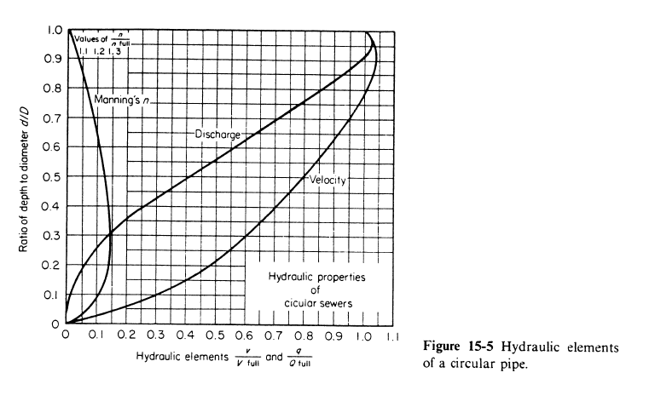

Slide 37
Example 1
A combined sewer of circular section is to be laid to serve a particular area. Calculate the size from the following data
Area to be served = 100 hectares
Population = 90,000
Maximum velocity of flow = 300 cm/sec
Time of entry = 3 minutes
Time of flow = 17 minutes
Rate of water supply = 240 l/c/d
Impermeability factor = 0.5
Assume additional data where necessary

Slide 38
…Example 1
Solution
Sewage
DWF (average) = 90000 x 240 /(24x60x60) = 250 l/s
Assuming a multiplying factor of 2,
Maximum discharge = 2 x 250 = 500 l/s
Storm water
tc = Time of Entry + Time of flow = 3 + 17 = 20 minutes
I = 76 / (t+10) = 76/(20+10) = 2.53 cm/hr = 25.3 mm/hr
Q = AIR/360 = 100x25.3x0.5/360 = 3.528 m3/s = 3528 l/s

Slide 39
…Example 1
Combined Discharge = Sewage + Storm Water
= 500 + 3528
= 4028 l/s
= 4.028 m³/s
Assuming the sewer to run full at the time of maximum flow
Q = AV ⇒ A = Q/V = 4.028/3.0 but A = πd²/4
⇒ d = 1.308 m, thus provide a circular sewer of d = 1.4 m

Slide 40
Exercise
A circular sanitary sewer is designed to carry the maximum flow of sewage while flowing 70% full at a velocity of 0.9. If the ratio of maximum/average and average/minimum flow are 2.5 and 2.0 respectively; Find out
The proportionate depth of flow and
the velocities of flow generated at the time of (a) average and (b) minimum flow
Variation in value of N may be neglected

Slide 41
Why Circular pipes
Circular pipes the following advantages:
  They are easily manufactured
  A circular section gives the maximum area for a given perimeter, and thus gives the maximum hydraulic radius when running full or half full; It is therefore the most efficient section at this flow condition (when compared with other sections) (if depth of flow is half full and above)
  It is the most economical section since it utilizes minimum quantities of material
  The circular section has uniform curvature all round, and hence it offers less opportunities for deposits

Slide 42
Circular v/s egg shaped
Circular suitable when variation in discharge is not large /Separate system/ not for combined
For combined system egg shaped sewers are (also called ovoid sewers) are more suitable
  Advantage is slightly higher velocity for low flow over a circular sewer of equal capacity
But has disadvantage
  Unstable small end of egg down and should support the upper section weight
  Difficult to construct
  Expensive as more material is required
  If no sufficient gradient not self cleansing
Was used formerly but because of disadvantage it becomes obsolete these days

Slide 43
Why open channel flow???
In Sewer lines there is limitation on depth of flow due to ventilation consideration?
  Sewers are not designed to run full even at ultimate peak flows
    Small size sewers up to 0.4 m dia up to half full
    0.4 to 0.9 m dia at 2/3 full
    > 0.9 at ¾ full
Sewer run under pressure only when they are designed as forced mains (pump) / and as inverted siphons

Slide 44
Different formulas chronology
1775 : Chezy
  V = C (RS)^{1/2}
1869 : Kutter
C = (23 + 0.00155/S +1/N)/ (1 + (23 + 0.00155/S)N/R^{1/2})
1890 : Manning
V = R^{2/3} S^{1/2}/n
1902 : Hazzen and Williams formula
V = 0.85 CR^{0.63} S^{0.54}

