Slide 1
Storm water Quality
Lecture 7

Slide 2
Why Bother ???
Over 60% of existing water quality problems are the result of non-point source pollution linked to storm water runoff
Storm water runoff can degrade the quality of wetlands, surface water and groundwater
This impacts the ecological, recreational and aesthetic attributes of these resources
Degraded surface and groundwater can cause or lead to human health impacts

Slide 3
Hydrologic Response
Pre- Development
40% Evapo-Transpiration
10-15%
Runoff
45 - 50%
Recharge

Slide 4
Hydrologic Response
Post- Development
30 % Evaporation
55 %
Runoff
10% or greater impervious cover enough to impact stream channels
15 %
Recharge

Slide 5
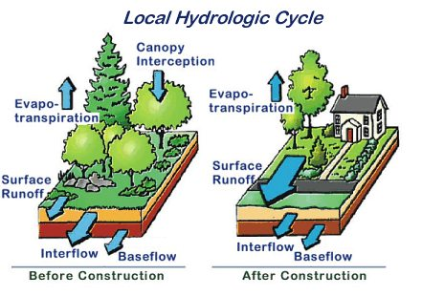
Hydrologic Cycle

Slide 6
Pollution
As stormwater flows across streets and lawns, it picks up chemical pollutants
All pollution in a river basin accumulates in the common water body

Slide 7
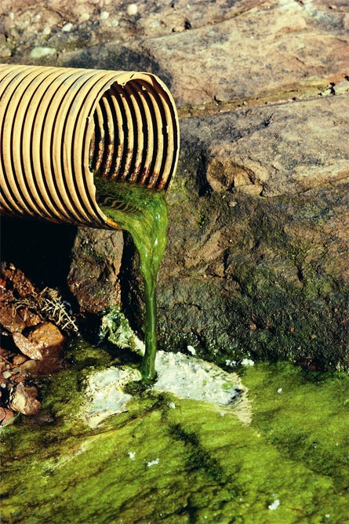
Types of Pollution
Point Source Pollution
Nonpoint Source Pollution
Definition-localized source of pollution, usually industrial and coming from a pipe
  Examples
    Industry
Definition- general and indirect water pollution from many diffuse sources
Examples
  Agricultural Runoff
  Animal Waste
  Residential Property Runoff
  Parking Lot and Road Runoff
http://www.liverpool.nsw.gov.au/LCC/INTERNET/me.get?site.sectionshow&PAGE1230&BODY
Notes:
*Key to Point Source Pollution is that it is conveyed through a pipe into a water body.
*The next slide is sources of nonpoint source pollution. All runoff is non-point source pollution.

Slide 8
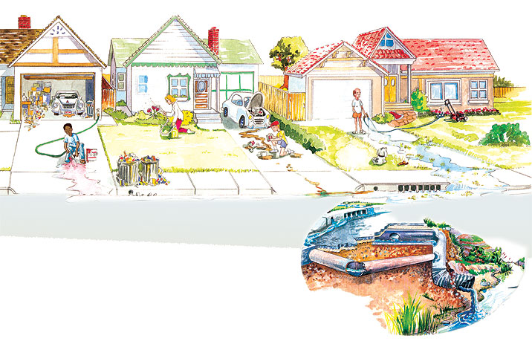
What’s wrong with this picture?
http://www.ncstormwater.org/pages/workbook_pollution_solutions.html
Notes:
Find at 8 things wrong with this picture.
Oil leaking from car in garage
Chemicals in garage stored improperly
Washing paint brush in driveway
Overflowing trashcans
Over-fertilizing
Changing oil in driveway and spilling
Dog poop on lawn
Washing grass clippings down driveway
THESE ARE ALL NON-POINT SOURCES OF POLLUTION
THESE ARE A FEW EXAMPLES OF RESIDENTIAL POLLUTION. SMALL THINGS THAT YOU DO ON YOUR PROPERTY AFFECTS WATERWAYS. AS WATER PICKS UP POLLUTANTS AND IS WASHED INTO THE SEWER SYSTEM, IT EVENTUALLY ENDS UP IN A RIVER (OR A BAY).

Slide 9
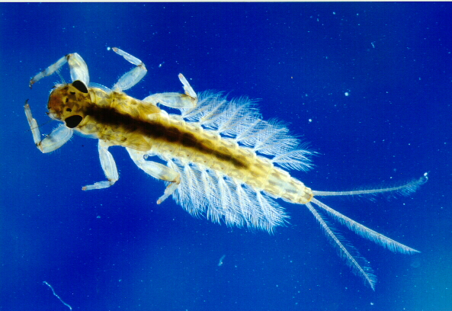
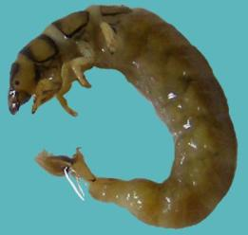
Visual Indicators of
Water Quality
Diverse Organisms
  Bugs as Indicators of Water Quality
    Mayflies and Caddisflies cannot tolerate water pollution, therefore their presence in a water body indicates good water quality.
Mayfly larvae
http://swittersb.files.wordpress.com/2008/08/mayfly20nymph.jpg
Caddisfly larvae
http://www-staff.lboro.ac.uk/~gymfj2/Caddisfly.htm
Notes:
These are visual indicators of water quality.
Caddisflies and Mayflies spend their larval stages in water.
Shown in the picture, Caddisfies make casings on rocks in the water.

Slide 10
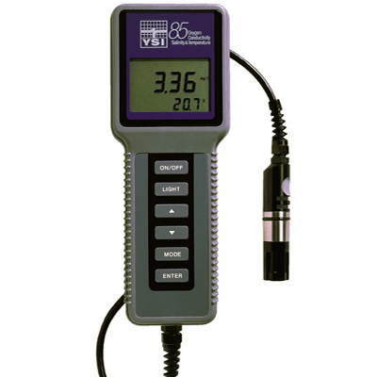
Measuring Water Quality
Dissolved Oxygen
Water Temperature
pH
  Extremely high or low levels of any of these indicate poor water quality
A YSI Meter is used to measure these quantities.
Notes:
There are other instruments to do these tests individually.

Slide 11
Watershed Development and Water Pollution
Increase in the rate, amounts and types of pollutants
Particulate Matter (TSS)
Nutrients (nitrogen and phosphorus)
Heavy Metals (lead, zinc, copper, etc.)
Petroleum Hydrocarbons
Pathogenic Organisms
Others (acid rain, pesticides, road salt, algal by-products)

Slide 12
Types of NPS Pollution
Litter
Lawn Fertilizers
House/garden Pesticides
Household Hazardous Products (e.g. paint thinner)
Motor Oil
Car Washing
Pet Waste

Slide 13

Water Quality –
Stormwater Constituents
Sediment
Nutrients: nitrogen and phosphorous
Oil, grease, and organic chemicals
Bacteria and viruses
Salt
Metals
Notes:
Now water quality impacts of stormwater are recognized as a major detriment to the environment.

Slide 14
Storm water Constituents
Median Concentrations (EPA Study b/n 1979 to 1983)
Constituent | Units | Urban | Non-Urban
Total Suspended Solids (TSS) | mg/l | 67-101 | 70
Chemical Oxygen Demand (COD) | mg/l | 57-73 | 40
Total Phosphorous (P) | μg/l | 201-383 | 121
Total Kjeldahl Nitrogen | μg/l | 1179-1900 | 965
Nitrate + Nitrite | μg/l | 558-736 | 543
Lead | μg/l | 104-144 | 30
Copper | μg/l | 27-33 | --
Zinc | μg/l | 135-226 | 195
Notes:
Between 1979 and 1983 EPA studied stormwater runoff characteristics in its Nationwide Urban Runoff Program. It was the most comprehensive study of urban stormwater. The program studied 81 specific sites and over 2,300 storm events across the United States. The concentrations of stormwater constituents were measured for various land uses as well as undeveloped areas. The median concentrations of the stormwater constituents is shown here. The range given for the urban runoff sources includes residential, mixed and commercial uses. Results of the NURP show that there is a significant increase in pollutant loads from urban areas compared to undeveloped areas.

Slide 15
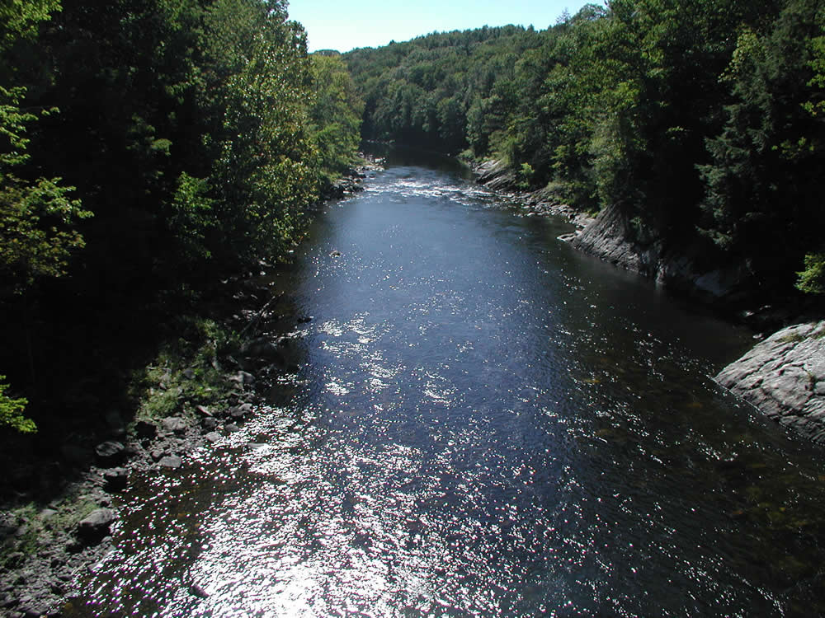
Inland Natural Systems
Notes:
Natural system – can absorb most impacts of the hydrologic cycle
Wetland buffering – storage, recharge/infiltration, attenuation
Supports biological diversity

Slide 16
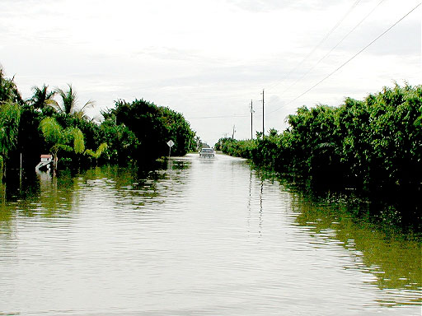
Water Quantity Effects
Increased flooding potential
Changes to streambed morphology
http://www.forester.net, 2002

Slide 17
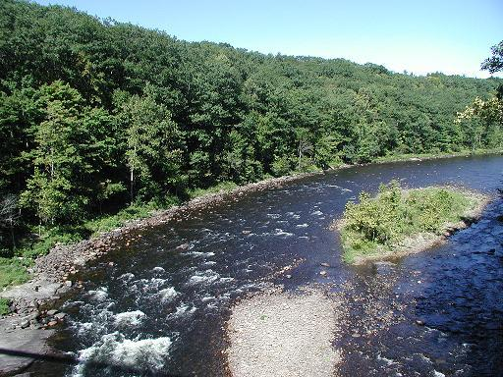
Water Quantity Effects
Decrease in base flows

Slide 18
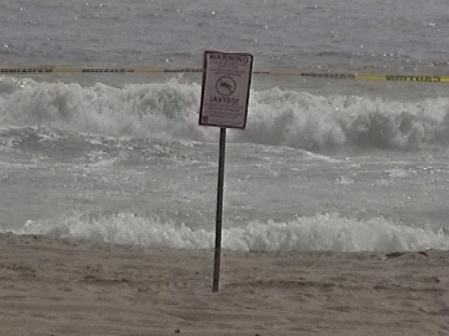
Water Quality Effects
Increased pollutant load
  Habitat degradation
  Public health and recreation impacts
Sean Chamberlain, 2002

Slide 19
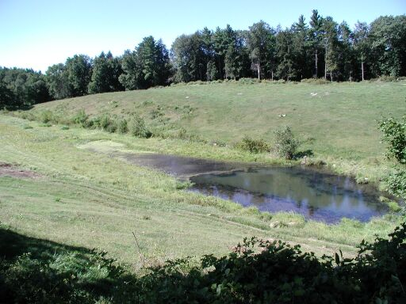
Water Quality Effects
Nutrient and Sediment Transport

Slide 20
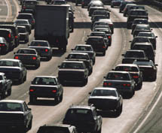
Stormwater Pollution Sources
Urban runoff
Construction
Agriculture
Forestry
Grazing
Septic systems
Recreational boating
Habitat degradation
Physical changes to stream channels
http://www.sierraclub.org/sprawl, 2002

Slide 21
Storm water Management Challenges
Variability of Flows (Duration, Frequency, Intensity)
Difference between peak control and treatment objectives
Different water quality constituents require different treatment mechanisms
Site-to-site variability of quantity and quality
Maintenance of non-centralized treatment units
Monitoring and measurement

Slide 22
Storm water Management Standards
No new untreated storm water discharges allowed
Post-development peak flow discharge rates < pre-development peak rates
Minimize loss of recharge to groundwater
Remove 80% of average annual total suspended solids (TSS) load (post development)
Discharges from areas with higher potential pollutant loads require use of specific BMPs

Slide 23
Storm water Management Standards
Storm water discharges to critical area require use of approved BMPs designed to treat 1 inch runoff volume (post development)
Redevelopment sites must meet the Standards
Construction sites must utilize sediment and erosion controls
Storm water systems must have an operation and management plan

Slide 24
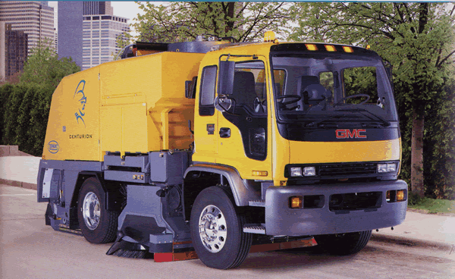
Non-Structural BMPs
Pollution prevention/source control
Street sweeping
Storm water collection system cleaning and maintenance
Low impact development and land use planning
Snow and snowmelt management
Public Education
http://www.tennatoco.com/stormwater, 2002

Slide 25
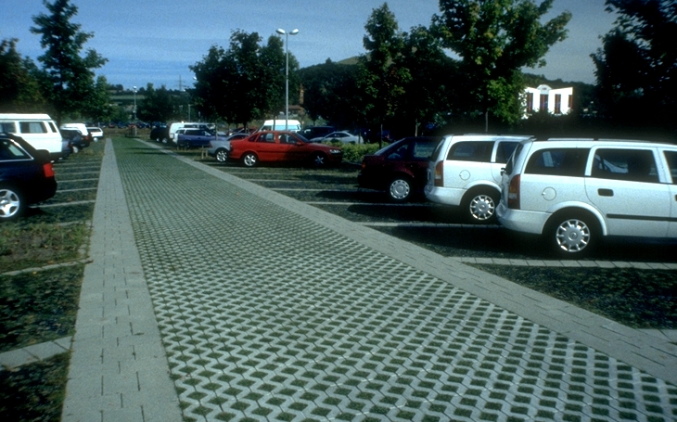
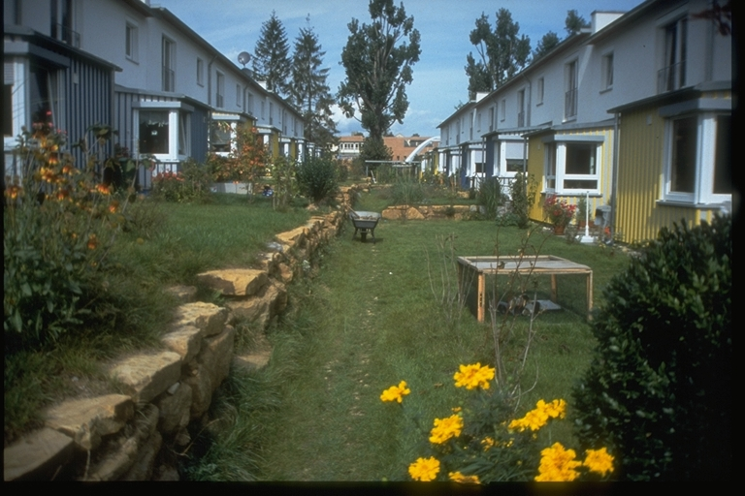
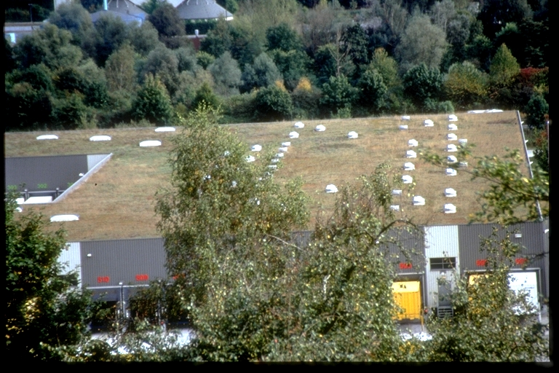
Better Design
Green roofs
High Density
Grassed/Porous Pavement
http://www.lrcusace.army.ml, 2002

Slide 26
Structural BMPs
Detention/Retention and Vegetated Treatment: detention basins, wet retention ponds, constructed wetlands, water quality swales
Filtration: sand and organic filters
Advanced Sedimentation/Separation: hydrodynamic separators, oil and grit chamber
Infiltration: infiltration trenches, infiltration basins, dry wells (rooftop infiltration)
Pretreatment: water quality inlets, hooded and deep sump catch basins, sediment traps (forebays), and drainage channels
Source: MADEP/MACZM Massachusetts Stormwater Management, Volume 2: Stormwater Technical Handbook, March 1997

Slide 27
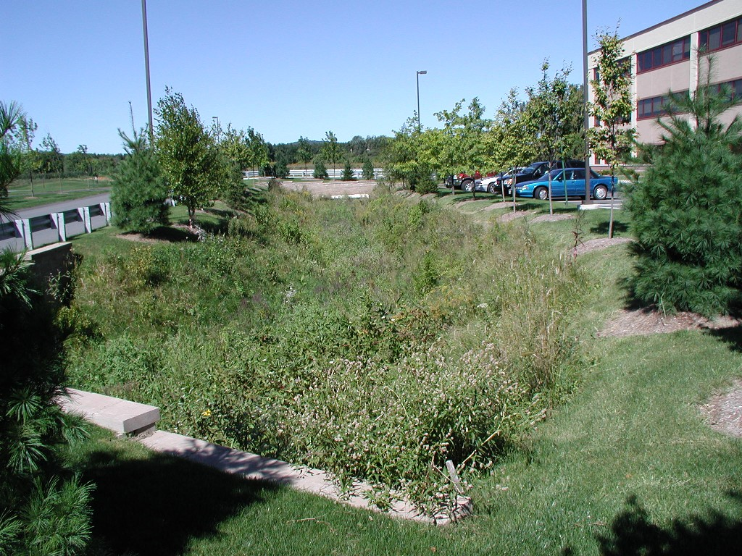
Detention Basins
TSS Removal Efficiency:
  60-80% average
  70% design
Key Features:
  Large area
  Peak flow control
Maintenance: low
Cost: low to
moderate
Notes:
Advantages:
Least costly BMP that controls both quantity and quality
Good retrofitting option for existing basins
Removes TSS and sorbed pollutants
Beneficial habitat
Less hazards than permanent pools
Disadvantages:
Infiltration is negligible
Removal of soluble pollutants minimal
Moderate to high maintenance requirements
Potential contributor to downstream warming
Potential sediment resuspension after large storms

Slide 28
Detention Basins…
Advantages:
  Least costly BMP that controls both quantity and quality
  Good retrofitting option for existing basins
  Removes TSS and sorbed pollutants
  Beneficial habitat
  Less hazards than permanent pools
Disadvantages:
  Infiltration is negligible
  Removal of soluble pollutants minimal
  Moderate to high maintenance requirements
  Potential contributor to downstream warming
  Potential sediment resuspension after large storms

Slide 29
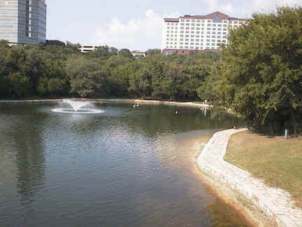
Wet (Retention) Ponds
Removal Efficiency:
  60-80% average
  70% design
Key Features:
  Large area
  Peak flow control
Maintenance: low to moderate
Cost: low to high
http://www.txnpsbook.org, 2002
Source: MADEP/MACZM Massachusetts Stormwater Management, Volume 2: Stormwater Technical Handbook, March 1997
Notes:
Advantages:
Removes TSS and sorbed pollutants
Aesthetically pleasing - can increase adjacent values if planned properly
Pond sediment removal schedule is generally less frequent than for other BMPs
Disadvantages:
More costly than detention basins
Infiltration is negligible
Requires large land area
Potential contributor to downstream warming

Slide 30
Wet Retention…
Advantages:
  Removes TSS and sorbed pollutants
  Aesthetically pleasing - can increase adjacent values if planned properly
  Pond sediment removal schedule is generally less frequent than for other BMPs
Disadvantages:
  More costly than detention basins
  Infiltration is negligible
  Requires large land area
  Potential contributor to downstream warming

Slide 31
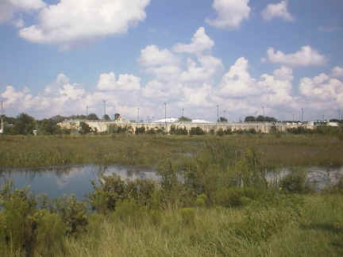
Constructed Wetlands
Removal Efficiency:
  65-80% average
  70% design
Key Features:
  Large area
  Peak flow control
  Biological treatment
Maintenance: low to moderate
Cost: marginally higher than wet ponds
http://www.txnpsbook.org, 2002
Source: MADEP/MACZM Massachusetts Stormwater Management, Volume 2: Stormwater Technical Handbook, March 1997
Notes:
Advantages:
Relatively low maintenance costs
High pollutant removal efficiency
Enhance aesthetics
Disadvantages:
Large land requirements
Until vegetation is established, lower pollutant removal efficiencies
High construction costs

Slide 32
Constructed Wetland…
Advantages:
  Relatively low maintenance costs
  High pollutant removal efficiency
  Enhance aesthetics
Disadvantages:
  Large land requirements
  Until vegetation is established, lower pollutant removal efficiencies
  High construction costs

Slide 33
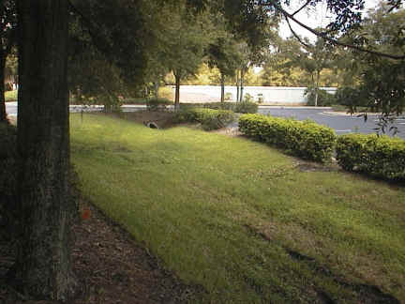
Water Quality Swales
Removal Efficiency:
  60-80% average
  70% design
Key Features:
  Higher pollutant removal rates than drainage channels
  Transport peak runoff and provide some infiltration
Maintenance: low to moderate
Cost: low to moderate
http://www.txnpsbook.org, 2002
Source: MADEP/MACZM Massachusetts Stormwater Management, Volume 2: Stormwater Technical Handbook, March 1997
Notes:
Advantages:
Control peak discharges by reducing runoff velocity and promoting infiltration
Provides pretreatment by trapping sediments
Generally less expensive than curve and gutter systems
Disadvantages:
Higher degree of maintenance than curb and gutter systems
Subject to damage from off-street parking and snow removal

Slide 34
Water Quality Swales…
Advantages:
  Control peak discharges by reducing runoff velocity and promoting infiltration
  Provides pretreatment by trapping sediments
  Generally less expensive than curve and gutter systems
Disadvantages:
  Higher degree of maintenance than curb and gutter systems
  Subject to damage from off-street parking and snow removal

Slide 35
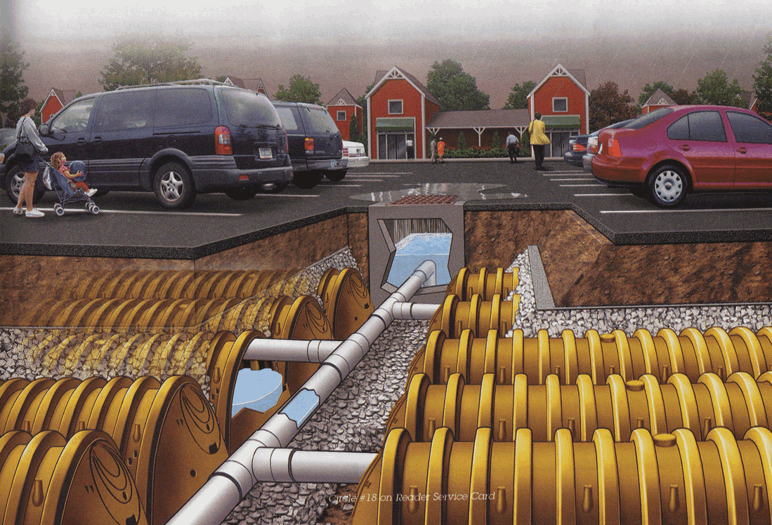
Infiltration Trenches/Basins
Removal Efficiency:
  75-80% average
  80% design
Features:
  Preserves natural water balance on site
  Susceptible to clogging
  Reduces downstream impacts
Maintenance: high
Cost: moderate to high
StormTech, subsidiary to Infiltrator Systems, Inc, 2002
Source: MADEP/MACZM Massachusetts Stormwater Management, Volume 2: Stormwater Technical Handbook, March 1997
Notes:
Advantages
Promotes groundwater recharge
Reduces downstream flooding and protects streambank integrity
Preserves natural water balance on site
High degree of runoff pollution control
Reduces size and cost of downstream water control facilities
Utilized where space is limited
Disadvantages:
High failure rate due to improper siting, design, construction and maintenance
Generally restricted to small drainage areas
Potential for groundwater contamination
Requires frequent maintenance
Susceptible to clogging

Slide 36
Infiltration Trenches…
Advantages:
  Promotes groundwater recharge
  Reduces downstream flooding and protects stream bank integrity
  Preserves natural water balance on site
  High degree of runoff pollution control
  Reduces size and cost of downstream water control facilities
  Utilized where space is limited
Disadvantages:
  High failure rate due to improper siting, design, construction and maintenance
  Generally restricted to small drainage areas
  Potential for groundwater contamination
  Requires frequent maintenance
  Susceptible to clogging

Slide 37
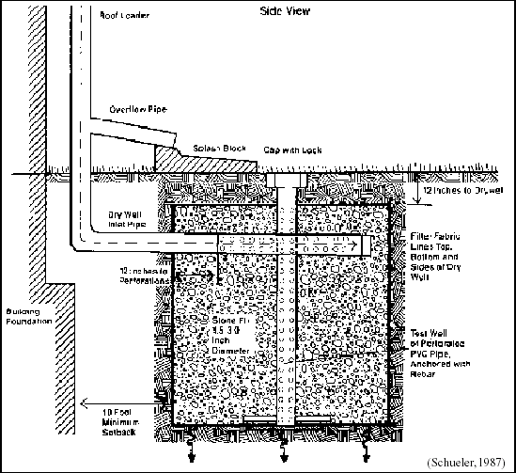
Dry Wells
Removal Efficiency:
  80% average
  80% design
On-site infiltration
For untreated storm water from roofs only (copper excluded)
Source: MADEP/MACZM Massachusetts Stormwater Management, Volume 2: Stormwater Technical Handbook, March 1997

Slide 38
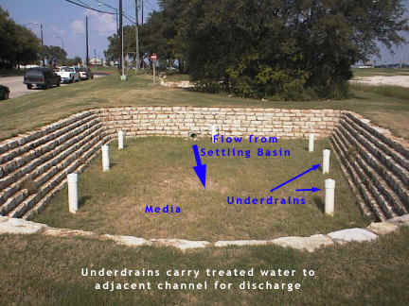
Sand and Organic Filters
Removal Efficiency:
  80% average
  80% design
Design Features:
  Large area
  Peak flow control
Maintenance: high
Cost: high
http://www.txnpsbook.org, 2002
Source: MADEP/MACZM Massachusetts Stormwater Management, Volume 2: Stormwater Technical Handbook, March 1997

Slide 39
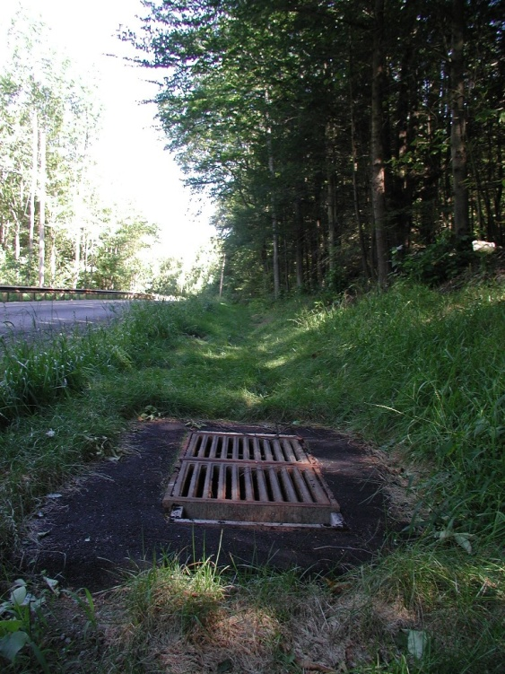
Inlets and Catch Basins
Removal Efficiency:
  15-35% average
  25% design
Design Features:
  Debris removal
  Pretreatment
Maintenance: moderate to high
Cost: low to high
Source: MADEP/MACZM Massachusetts Stormwater Management, Volume 2: Stormwater Technical Handbook, March 1997

Slide 40
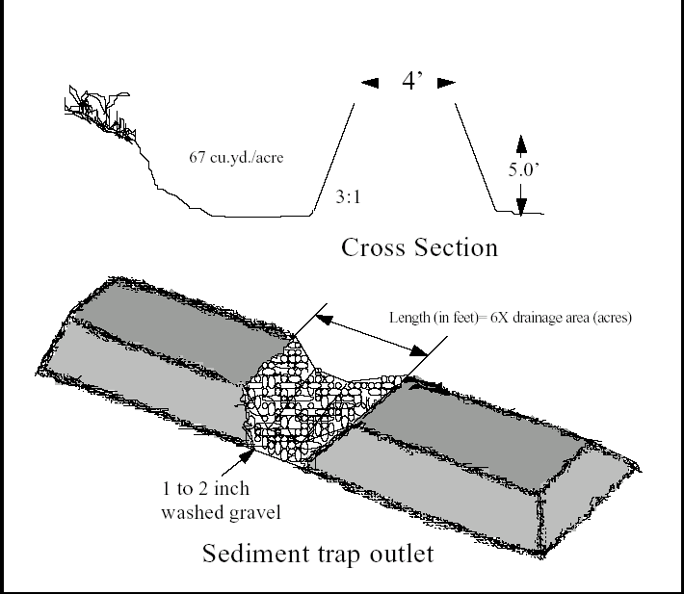
Sediment Traps/Forebays
Removal Efficiency:
  25% average
  25% design
Design Features:
  Pretreatment
  Retrofit expansion
  Larger space requirement than inlet.
Maintenance: moderate
Cost: low to moderate
Source: MADEP/MACZM Massachusetts Stormwater Management, Volume 2: Stormwater Technical Handbook, March 1997

Slide 41
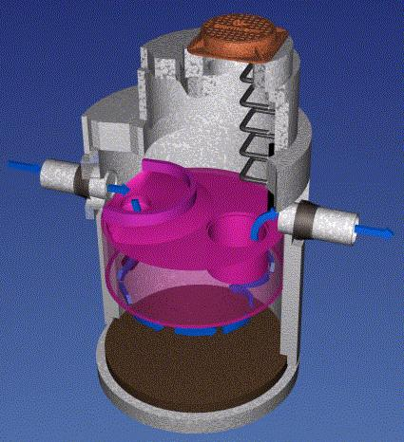
Innovative BMPs - Advanced Sedimentation
Removal Efficiency:
  50-80% average
  80% design
Design Features:
  small area
  Oil and Grease control
Maintenance: moderate
Cost: moderate
Rinker Inc, 2002

Slide 42
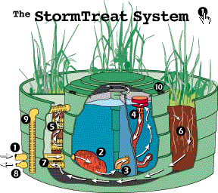
Innovative BMPs - Sand Filtration
Removal Efficiency:
  50-80% average
  80% design
Design Features:
  small area
  Nutrient and pathogen (potential)
Maintenance: moderate
Cost: moderate
Stormtreat Inc, 2002

Slide 43
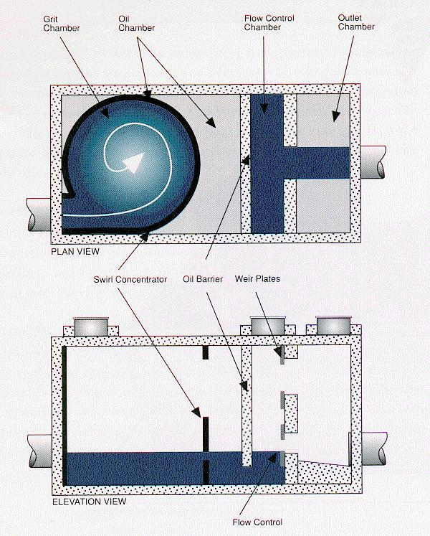
Innovative BMPs - Hydrodynamic
Removal Efficiency:
  50-80% average
  80% design
Design Features:
  small area
  Oil and Grease control
Maintenance: moderate
Cost: moderate
Vortechs Inc, 2002

Slide 44
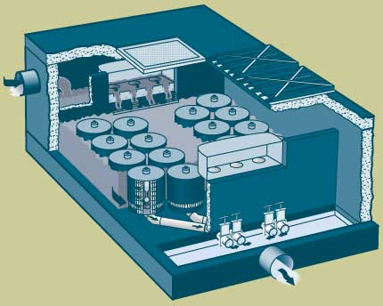
Innovative BMPs – Media Filtration
Removal Efficiency:
  50-80% average
  80% design
Design Features:
  small area
  Oil and Grease control
Maintenance: moderate
Cost: moderate
Stormwater Management Inc, 2002

Slide 45
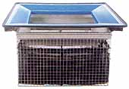
Innovative BMPs – Inlet Inserts
Removal Efficiency:
  To be determined
Design Features:
  Retrofit
  Construction
  Oil and Grease control
Maintenance: moderate
Cost: moderate
http://www.stormdrainsfilters.com, 2002

Slide 46









Water Quality Monitoring
TARP- Technology Acceptance Reciprocity Program
Address technology review and approval barriers in policy and regulations;
Accept the performance tests and data from partner’s review to reduce subsequent review and approval time;
Use the Protocol for state-led initiatives, grants, and verification or certification programs; and
Share technology information with potential users in the public and private sectors using existing state supported programs
CA
IL
MA
MD
NJ
NY
PA
VA
TX

Slide 47
Performance Verification - TARP
Storm Event Criteria to Sample
  More than 0.1 inch of total rainfall.
  A minimum inter-event period of 6 hours, where cessation of flow from the system begins the inter-event period.
  Obtain flow-weighted composite samples covering a minimum of 70 % of the total storm flow, including as much of the first 20 % of the storm as possible.
  A minimum of 10 water quality samples (i.e., 10 influent and 10 effluent samples) should be collected per storm event.
Determining a Representative Data Set
  At least 50 % of the total annual rainfall must be sampled, for a minimum of 15 inches of precipitation and at least 15, but preferably 20, storms.

Slide 48
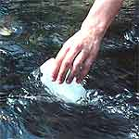
Performance Verification - TARP
Storm water Sampling Locations
  Sampling locations for storm water BMPs should be taken at inlet and outlet.
Sampling Methods
  Programmable automatic flow samplers with continuous flow measurements should be used
  Grab samples used for: pH, temperature, cyanide, total phenols, residual chlorine, oil and grease, total petroleum hydrocarbons (TPH), E coli, total coliform, fecal coliform and streptococci, and enterococci.
Storm water Flow Measurement Methods
  Primary and secondary flow measurement devices are required.

Slide 49
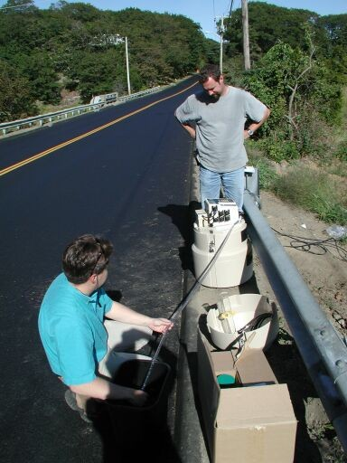
Performance Verification - TARP
Sample Data Quality Assurance and Control
  Equipment decontamination,
  Preservation,
  Holding time,
  Volume,
  QC samples (spikes, blanks, splits, and field and lab duplicates),
  QA on sampling equipment
  Packaging and shipping,
  Identification and labeling, and
  Chain-of-custody.

Slide 50
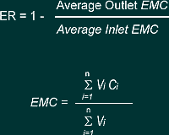
Performance Verification - TARP
Calculating BMP Efficiencies (ASCE BMP Efficiencies Task 3.1)
Process efficiencies or removal rates should be determined from influent and effluent contaminant concentration and flow data.
  Efficiency Ratio,
  Summation of Loads,
  Regression of Loads,
  Mean Concentration, and
  Efficiency of Individual Storm Loads.
  Note: The Efficiency Ratio method is preferred.

Slide 51
Pollutant Levels
Pollutants in storm water include solids, oxygen-consuming materials, nutrients, hydrocarbons, heavy metals and trace organics, and bacteria.
The average quality of ‘clean’ and ‘dirty’ catchments can vary by a factor of ten, and the variation in quality between storm water events for any single catchment can vary by a factor of three (Ellis, 1986)
Runoff quality will depend upon a number of factors, including:
  • geographical location
  • road and traffic characteristics
  • building and roofing types
  • weather, particularly rainfall.

Slide 53
Pollutant levels…
The most common methods used to quantify storm water quality are :
  Event mean concentrations,
  Regression equations/rating curves and
  Build-up/wash off models

Slide 54
Pollutant levels…
Event mean concentrations
  In this simplest of methods, the assumption is made that storm water has a constant concentration, such as those given in Table 6.2.
  Thus, the method lends itself to easy integration with standard flow (not quality) simulation models.
  The method cannot represent variations in quality within the storm,
  Therefore, it is most suitable in situations where calculation of total pollutant load only is required.

Slide 55
Pollutant levels…
Regression equations
  In this approach, the quality of storm water is statistically regressed against a number of describing variables, e.g. catchment characteristics or land use.
  Regression equations can usually be relied on to give good representations on the catchment(s) on which they were based and perhaps similar ones.
  They will be less accurate on other catchments, but can often give a reasonable first approximation.

Slide 56
Pollutant levels…
Build-up
  The most common model-based approach to quality representation is by separately predicting pollutant build-up and wash-off.
  In practice, the distinction between these two processes is not clearly defined.
  The factors affecting build-up of pollutants on impervious surfaces include:
    land use
    population
    traffic flow
    effectiveness of street cleaning
    season of the year
    meteorological conditions
    antecedent dry period
    street surface type and condition.

Slide 57
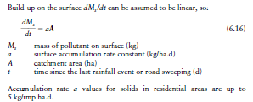
Pollutant levels…

Slide 58
Pollutant levels…
Detailed observation of sites in the US (Sartor and Boyd, 1972) revealed that, despite there being no rainfall or street cleaning, the pollutant deposition often has a reducing rate of increase rather than a uniform linear increase.
The first-order removal concept can be used to represent this, which implies that equilibrium is reached when the supply rate of pollutants matches their removal:

Slide 59

Pollutant levels…
The equilibrium mass on the catchment is therefore A (a/b).
Novotny and Chesters (1981) reported values for b from a US medium density residential area of 0.2–0.4 d1.
Studies in London (Ellis, 1986) suggest equilibrium is reached within 4–5 days where vehicle-induced re-suspension is dominant.
The leveling-off phenomenon is most profound in areas where:
  • adjacent pollution traps (pervious areas) are available
  • vehicle-induced wind and vibration is high.
This will be the case on motorways and trunk roads, and in busy commercial/ industrial areas.

Slide 60
Pollutant levels…
Wash off
  Wash off occurs during rainfall/runoff by raindrop impact, erosion or solution of the pollutants from the impervious surface.
  Important factors include:
    rainfall characteristics
    Topography
    solid particle characteristics
    street surface type and condition.

Slide 61
Pollutant levels…
The simplest approach is to assume there is effectively an infinite store of pollutants always available on the surface to be washed off, and hence no build-up.
Experimental evidence suggests this assumption may be valid in British conditions (Mance and Harman, 1978).
Washoff can then be modelled as a function of rainfall intensity:

Slide 62


Pollutant levels…

Slide 63

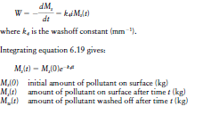
Pollutant levels…

Slide 64
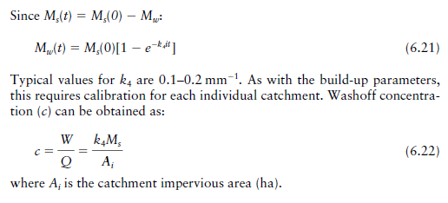
Pollutant levels…

Slide 65
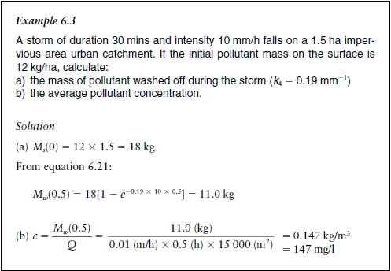
Pollutant levels…

Slide 66
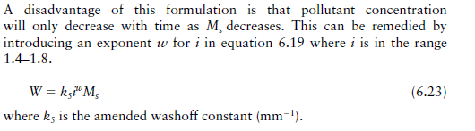
Pollutant levels…

