Slide 1
Structured cabling and Installation
Lecture One
By: Eyob Gebretinsae

Slide 2
Data Cables
  Contents
  Introduction
  Copper Cables
    Twisted Pair Cables
    Coaxial Cables

Slide 3
Introduction
Structured cabling is the design and installation of a cabling system that will support multiple hardware uses and be suitable for today’s needs and those of the future.
With a correctly installed system, current and future requirements can be met, and hardware that is added in the future will be supported
Structured cabling design and installation is governed by a set of standards that specify wiring data centers, offices, and apartment buildings for data or voice communications

Slide 4
Cable is the medium through which information usually moves from one network device to another.
There are several types of cable which are commonly used with LANs.
The type of cable chosen for a network is related to the network's topology, protocol, and size.

Slide 5
Coper Cables/Twisted Pair Cables
Twisted pair cabling is a type of wiring in which two conductors of a single circuit are twisted together for the purposes of improving electromagnetic compatibility.
Twisted pair cables have become a standard in data networks
These types of cables are characterized by their low cost, flexibility and ease of installation, as well as constant technological improvements.
Alexander Graham Bell, popularly known as the inventor of the telephones, was the first person to twist copper pairs to reduce crosstalk between the lines.

Slide 6
Ethernet copper cables adopted the same technique to reduce crosstalk between internal wires (XT) and external wires (AXT).
Each pair is twisted with a different number of twists per inch to help eliminate interference from adjacent pairs and other electrical devices.
The tighter the twisting, the higher the supported transmission rate and the greater the cost per foot.

Slide 7
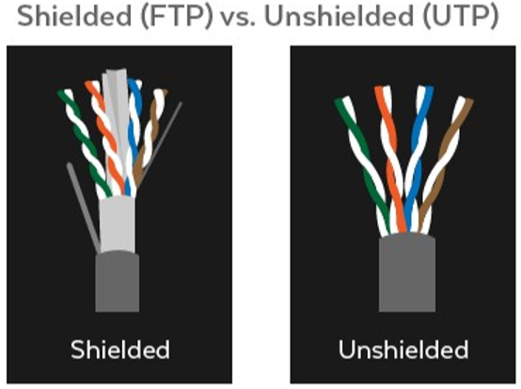
Shielded (FTP) vs. Unshielded (UTP)
Twisted pair copper comes in shielded an unshielded forms.
Shielded copper cable includes protective conductive coating such as braided strands of copper, copper tape or conductive polymer to reduce noise interference.

Slide 8
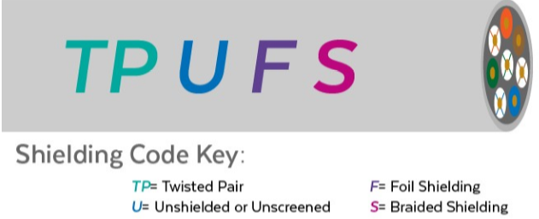
Shielded copper pairs
There are many types of shielded copper pairs.
  Sheathing can also envelop all four data pairs.
  Sheathing can wrap around twisted pairs.
There are two sections to a shielded “code”.
The first letter signifies the type of shield used to enclose all four twisted pairs of an Ethernet cable.

Slide 9
Unshielded Twisted Pair, or UTP, includes no shielding and is ideal for most common LAN environments
Shielded twisted copper pairs, are reserved for networking environments with higher frequencies.
Shielded cables can also help to extend the maximum distance of the cables.
An Unshielded cable is marked with a (U), a cable with Foil Shielding is marked with an (F), and a cable with Braided Shielding is marked with an (S).
The second portion of the code, describes if a twisted pair is foiled (F) or Unfoiled (U). TP stands for Twisted Pair.

Slide 10
Types of Shielded Ethernet Cables
F/UTP–Foiled/Unshielded Twisted Pair
Common in Fast Ethernet deployments, this cable will have a foil shield that wraps around unshielded twisted pairs.
S/UTP–Braided Shielding/ Unshielded Twisted Pair
This cable will wrap a braided shield around unshielded twisted pairs.
SF/UTP–Braided Shielding + Foil/Unshielded Twisted Pairs
This cable braids a shield around a foil wrap to enclose unshielded twisted pairs.

Slide 11
S/FTP–Braided Shielding/Foiled Twisted Pair
This cable wraps a braided shield around all four copper pairs. Additionally, each twisted pair is enveloped in foil.
F/FTP-Foiled/Foiled Twisted Pair
This cable encloses all copper pairs in foil. Additionally, each twisted pair is enveloped in foil.
If you must place cable in environments with lots of potential interference, or if you must place cable in extremely sensitive environments that may be susceptible to the electrical current in the UTP, shielded twisted pair may be the solution

Slide 12
U/FTP-Unshielded/Foiled Twisted Pairs
This cable only envelopes the twisted pairs in foil.
U/UTP-Unshielded/Unshielded Twisted Pair
No sheathing is used. Standard Cat5e cable are examples of U/UTP cables.
It may be susceptible to radio and electrical frequency interference (it should not be too close to electric motors, fluorescent lights, etc.).

Slide 13
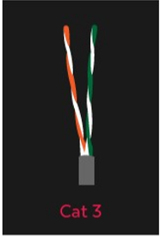
Category 3
Cat3 cable is an earlier generation of Ethernet
With the ability to support a maximum frequency of 16 MHz, this type of Ethernet can still be used for two line telephone systems and 10BASE-T networks.
CAT3 cable can also be used for alarm system installation or similar applications.
CAT3 cable can have 2, 3, or 4 copper pairs (though uncommon).

Slide 14
Category 5 and Category 5e
Cat5 Ethernet, introduced 10/100 Mbps Ethernet over distances of up to 100 meters, also known as Fast Ethernet
Though Cat5 and Cat5e cables are physically similar, Category 5e Ethernet adheres to more stringent IEEE standards
“E” is for enhanced, meaning a lower-noise version where the potential for crosstalk is reduced

Slide 15
Crosstalk is interference that transfers from adjacent wires.
Cat 5e supports speeds of up to 1000 Mbps.
It’s flexible enough for small space installations like residences, though it is still used in commercial spaces.
Cat5e is your least expensive option. 100-250Mhz/1 Gbps/100m.
Cat5e cable features 1.5-2 twists per cm
The amount of twists per cm varies upon each cable manufacturer

Slide 16
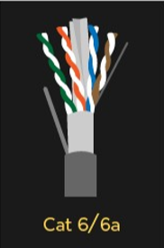
Category 6 and Category 6a
Cat6 wiring can support up to 10 Gbps and frequencies of up to 250 MHz.
While Cat5e cable features 1.5-2 twists per cm, Cat6 cables are more tightly wound and feature 2 or more twists per cm.
Cat6 cables also sport thicker sheaths in comparison to Cat5e.
Though standard Ethernet supports distances of up to 100 meters, CAT6 cable only supports 37-55 meters (depending on crosstalk) when transmitting 10 Gbps speeds.

Slide 17
Cat 6 cables are also great Ethernet cables for gaming due to their high data transfer speeds and dependability.
250Mhz /10 Gbps /100m.
Cat6a supports bandwidth frequencies of up to 500 MHz, twice the amount of Cat6 cable, and can also support 10Gbps like its predecessor
However, unlike Cat6 cabling, Cat6a can support 10 Gigabit Ethernet at 100 meters.
The stronger sheathing makes Cat6a cabling considerably thicker than Cat6, also making it less flexible to work with, and therefore, better suited for industrial environments at a lower price point.
250-500Mhz/10 Gbps /100m.

Slide 18
Category 7 and Category 8
Cat7 can also support 10 Gbps, but laboratory testing has successfully shown its ability to transmit up to 40 Gb at 50 meters and even 100 Gb at 15 meters
Cat7 offers extensive shielding to reduce signal attenuation
Both individual pairs are shielded, with an additional layer of shielding over the entire cable.
The shielding needs to be grounded and Cat7 also requires special GigaGate45 (GG45) connectors to take full advantage of higher performance features.
Cat7 is suited for use in datacenters and large enterprise networks.
Note: 600Mhz/10Gbps/100m (40Gbps at 50m/100Gbps at 15m).

Slide 19
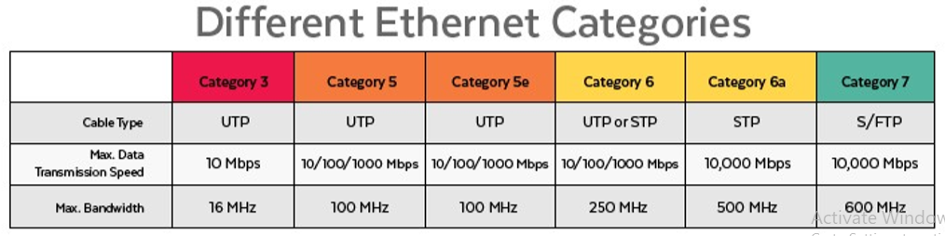
Cat8 cable is still in the development stage and not yet ratified.
it will be able to support 25GB and 40Gb Ethernet.
Cat8 will be able to support even faster transmission rates at distances of up to 30 meters.

Slide 20
What type of cabling to use once deciding on a CAT types
Each cable category has various types of insulation or shielding that installers need to take into consideration before using.
The price difference between the various types can range anywhere from $100 to $600+ per roll depending on type.
You have to Answer the following type of questions before deciding what type of Cat cable are appropriate for a site

Slide 21
  Are you looking for burial cables with UV protection?
  Will the cables be in walls?
  Is flame resistance cabling required for the installation?
  What is the minimum speed required in the network infrastructure?
  What is the distance between the node and the rack?
  For what purpose dose the cable used for?

Slide 22

Coper Cables/Coaxial Cables
Coaxial cabling has a single copper conductor at its center.
A plastic layer provides insulation between the center conductor and a braided metal shield.
The metal shield helps to block any outside interference from fluorescent lights, motors, and other computers.

Slide 23
Coaxial cabling is difficult to install, it is highly resistant to signal interference
It can support greater cable lengths between network devices than twisted pair cable
Coaxial cables are used in high frequency transmission, especially for transmitters and receivers, computers, radio and TV transmissions.

Slide 24
Common Types of Coaxial Cable
RG6 Solid Copper Coaxial Cable
The RG6 cable is a thin cable that can easily be coiled or bent for residential installation within a wall or ceiling.
This includes connecting aerial antennas, satellite dishes and cable television.
A key benefit of the RG6U cable, and a reason for its popularity, is that it often replaces RG59 cables, an earlier form of coaxial video/audio cable.
RG11 Solid Copper Coaxial Cable
RG11 coax cable is a thick, inflexible cable used to minimize signal loss in long runs, RG11 is typically run outside or underground.

Slide 25
RG59 Solid Copper Coaxial Cable
RG59 is another popular cable in residential settings, the RG59 functions similarly to the RG6 but has an even thinner center conductor
This difference makes the RG59 the best choice for short runs and low frequency transmissions within the home, but otherwise inferior to the RG6U cable in other applications.

