Slide 1
Structured cabling and Installation
Lecture Six
By: Eyob Gebretinsae

Slide 2
Structured cable Installation and installation guide lines
  Contents
5.2. Structured cabling design tools
5.3. PVC layout designs and Labeling
5.4. Cable layout design and Labeling
5.5. Rack component design and Labeling

Slide 3
Structured cabling design tools
Visio
AutoCAD

Slide 4
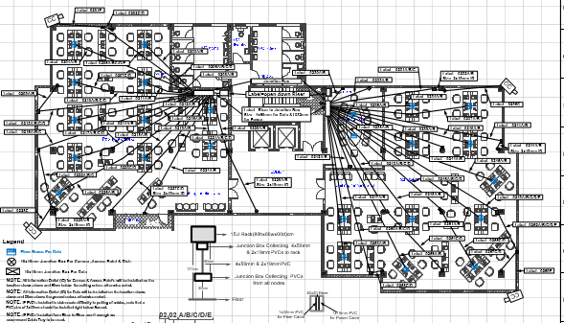
PVC layout designs and Labeling

Slide 5
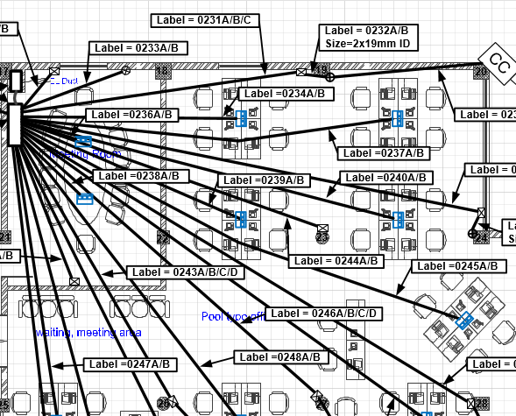

Slide 6
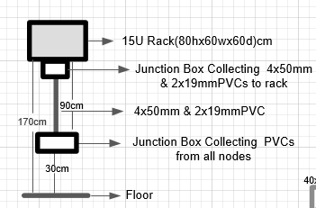
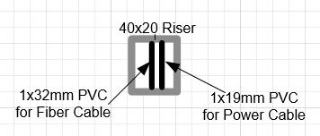

Slide 7
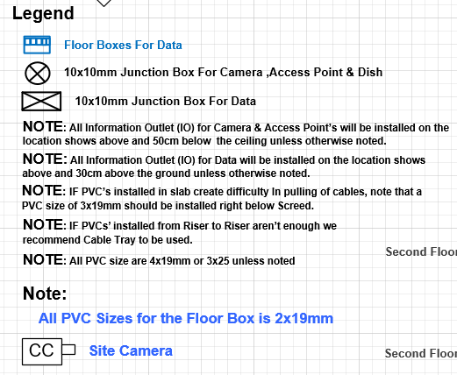

Slide 8
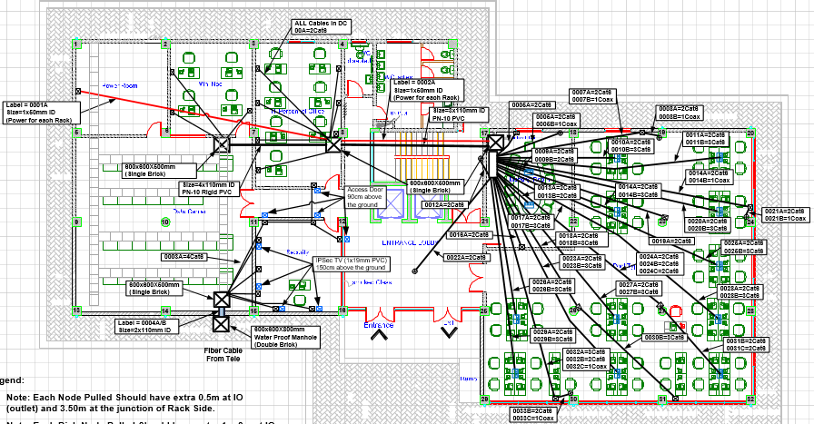
Cable layout design and Labeling

Slide 9
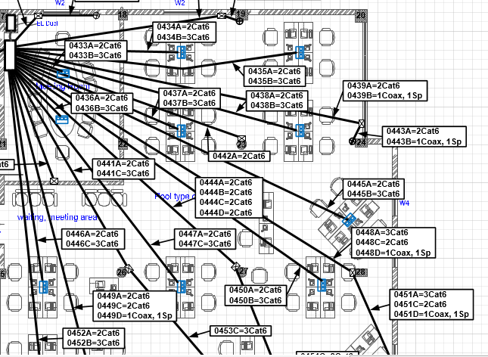

Slide 10
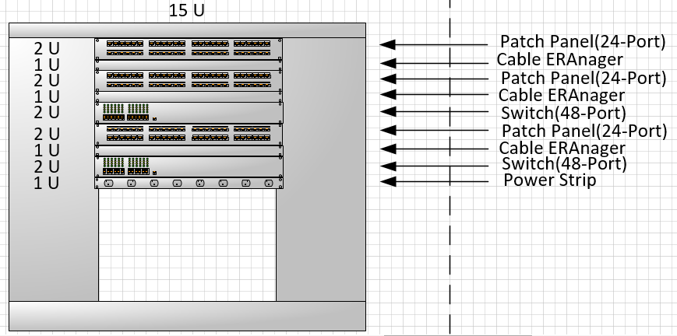
Rack component design and Labeling

Slide 11
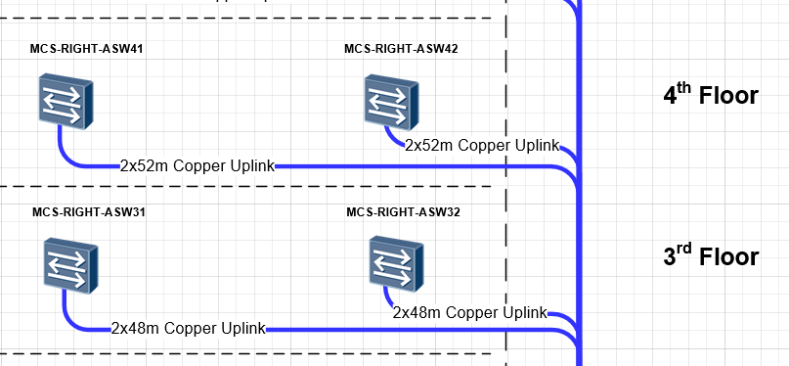
Back bone cable design

Slide 12
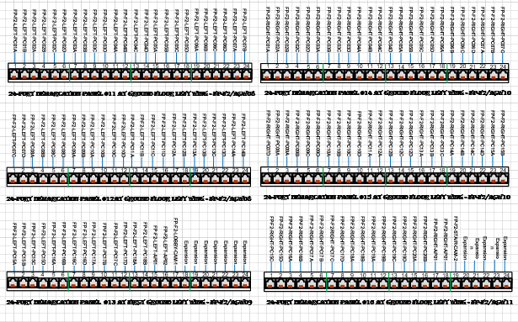
Labeling

Slide 13
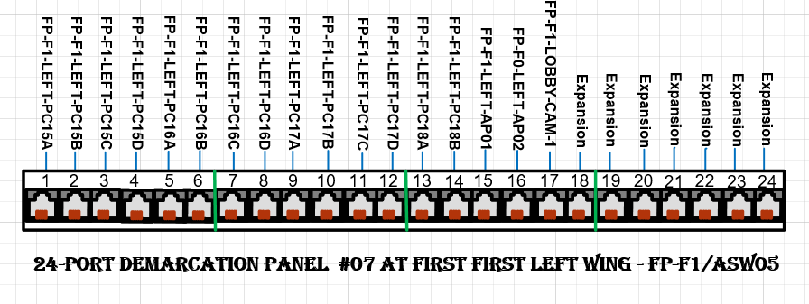

Slide 14
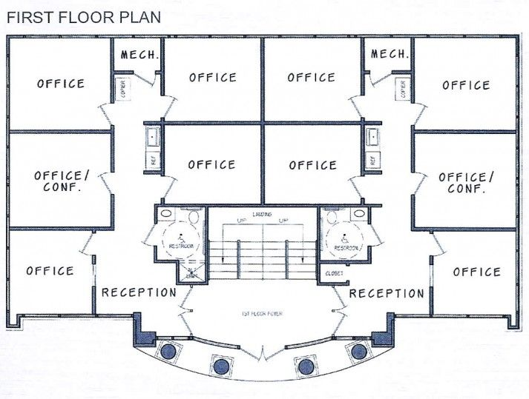
Example
Assume that we have typical floor design for G+2 Building
Let us have at least two speakers per corridor
Let us have one TV on conference room and one TV on reception room
One access point at reception
Assume the floor rack will be mounted on one of the Mech room
And lets have one camera point on each floor and one on the main gate

Slide 15
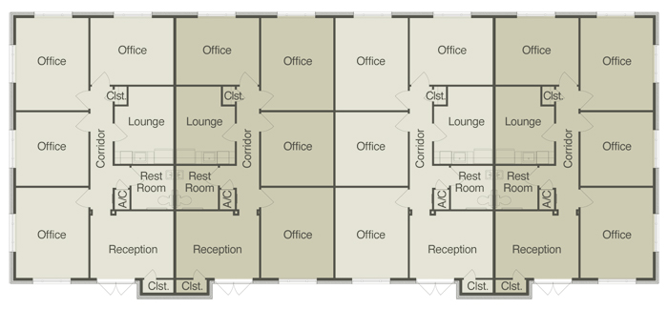
Exercise

Slide 16
Design Cable layout on the drawing
Design rack layout
Design the back bone cable
Prepare the BoQ
Assumptions
  Assume that you have typical floor design for G+4 Building
  Let us have at least three speakers per corridor
  Let us have one TV on each reception room and two on each lounge
  One access point on each reception room
  Assume the floor rack will be mounted on one of the right up corner office

