Slide 1
Chapter Six: Integration Testing
Sem. II - 2020
Department of Software Engineering
ITSC-AAIT
Dr. Sunkari

Slide 2
The Concept of Integration Testing
A software module is a self-contained element of a system
Modules are individually tested; commonly known as unit testing
Next major task is to put the modules, i.e., pieces together to construct the complete system
Construction of a working system from the pieces is not a straightforward task because of numerous interface errors
The objective of system integration testing (SIT) is to build a “working” version of the system
Putting modules together in an incremental manner
Ensuring that the additional modules work as expected without disturbing the functionalities of the modules already put together
Integration testing is said to be complete when
The system is fully integrated together
All the test cases have been executed
All the severe and moderated defects found have been fixed.

Slide 3
The Concept of Integration Testing
The major advantages of conducting SIT are as follows:
Defects are detected early
It is easier to fix defects detected earlier
We get earlier feedback on the health and acceptability of the individual modules and on the overall system
Scheduling of defect fixes is flexible, and it can overlap with development.

Slide 4
Types of Interfaces
Three common paradigms for interfacing modules:
Procedure call interface
Shared memory interface
Message passing interface
The problem arises when we “put modules together” because of interface errors
Interface errors
Interface errors are those that are associated with structures existing outside the local environment of a module, but which the module uses.
Notes:
Procedure call Interface – (RMI) A procedure in one module calls a procedure in another module. The caller passes on control to the called module. The caller can pass data to the called procedure, and the called procedure can pass data to the caller while returning control back to the caller.
Shared Memory Interface
memory shared b/n two modules. Data are written into the memory block by one module and are read from the block by the other.
Message Passing Interface
One module prepares a message by initializing the fields of a data structure and sending the message to another module. This form of module interaction is common in client–server-based systems and web-based systems.

Slide 5
Types of Interface Errors
Construction
Inadequate functionality
Location of functionality
Changes in functionality
Added functionality
Misuse of interface
Misunderstanding of interface
Data structure alteration
Inadequate error processing
Additions to error processing
Inadequate post-processing
Inadequate interface support
Initialization/value errors
Violation of data constraints
Timing/performance problems
Coordination changes
Hardware/software interfaces
Notes:
Construction Error- Interface Variation mismatch b/n .h file and .cpp file or inappropriate use of headers
Inadequate functionality – implicit assumptions about the other functionality
Misuse of Interface - parameters type variation, number variation ….

Slide 6
Granularity of System Integration Testing
System Integration testing is performed at different levels of granularity
Intra-system testing
This form of testing constitutes low-level integration testing with the objective of combining the modules together to build a cohesive system.
Inter-system testing
It is a high-level testing phase which requires interfacing independently tested systems.
Pairwise testing
In pairwise integration, only two interconnected systems in an overall system are tested at a time.
The purpose of pairwise testing is to ensure that two systems under consideration can function together, assuming that the other systems within the overall environment behave as expected.
Notes:
Inter System Testing (Interoperability Testing)– To ensure interconnection b/n application works correctly. Between independently tested systems
Intra System Testing – Between units in a module

Slide 7
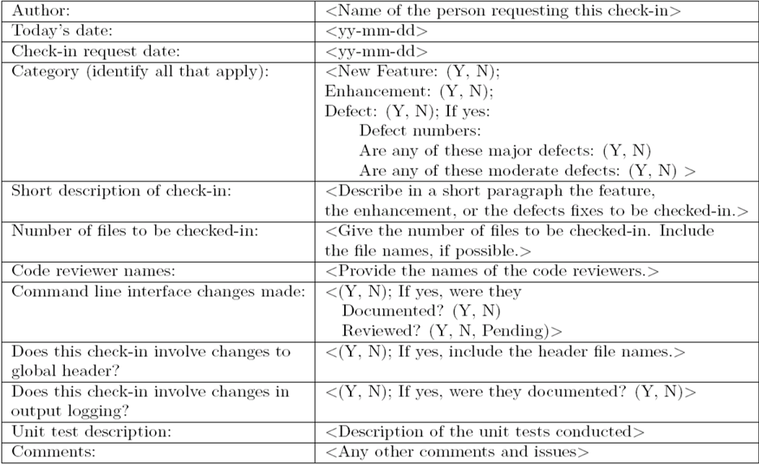
System Integration Techniques
Common approaches to perform system integration testing
Incremental
Top Down
Bottom Up
Big Bang
Sandwich
Pre-requisite
A module must be available to be integrated
A module is said to be available for combining with other modules when the module’s check-in request form is ready.

Slide 8
Software Image and Build
A software image is a compiled software binary.
A build is an interim software image for internal testing within an organization
Constructing a build is a process by which individual modules are integrated to form an interim software image.
The final build is a candidate for system testing
Constructing a software image involves the following activities
Gathering the latest unit tested, authorized versions of modules
Compiling the source code of those modules
Checking in the compiled code to the repository
Linking the compiled modules into sub - assemblies
Verifying that the subassemblies are correct
Exercising version control
Notes:
Subassembly – a unit assembled separately but designed to be incorporated w/ other units into larger manufactured product.

Slide 9
Incremental
Integration testing is conducted in an incremental manner as a series of test cycles
In each test cycle, a few more modules are integrated with an existing ones, tested to generate larger builds.
The complete system is built, cycle by cycle until the whole system is operational for system-level testing.
The number of SIT cycles and the total integration time are determined by the following parameters:
Number of modules in the system
Relative complexity of the module ( Cyclomatic Complexity)
Relative complexity of the interfaces between the modules
Number of modules needed to be clustered together in each test cycle
Whether the modules to be integrated have been adequately tested before
Turnaround time for each test-debug-fix cycle.
Notes:
Cyclomatic Complexity – Software metrics, used to indicate the complexity of the system by measuring the number of linearly independent paths through a program source code.

Slide 10
Incremental
A release note containing the following information accompanies a build.
What has changed since the last build?
What outstanding defects have been fixed?
What are the outstanding defects in the build?
What new modules, or features, have been added?
What existing modules, or features, have been enhanced, modified, or deleted?
Are there any areas where unknown changes may have occurred?
A test strategy is created for each new build and the following issues are addressed while planning a test strategy.
What test cases need to be selected from the SIT test plan?
What previously failed test cases should now be re-executed in order to test the fixes in the new build?
How to determine the scope of a partial regression tests?
What are the estimated time, resource demand, and cost to test this build?

Slide 11
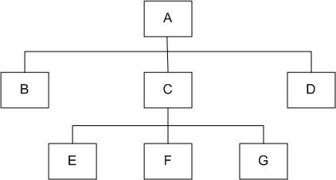
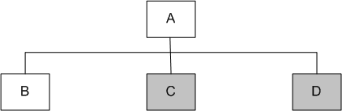
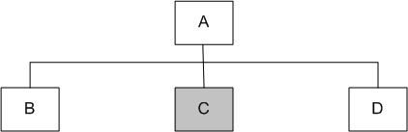
Top-down
Module A has been decomposed into modules B, C, and D
Modules B, D, E, F, and G are terminal modules.
First integrate modules A and B using stubs C` and D` (represented by grey boxes)
Next stub D` has been replaced with its actual instance D
Two kinds of tests are performed:
Test the interface between A and D
Regression tests to look for interface defects between A and B in the presence of module D
A module hierarchy with three levels and seven modules
Top-down integration of modules A and B
Top-down integration of modules A, B and D
Notes:
TD Integration – used in order to simulate the behavior of the lower level modules that are not integrated yet.
Stubs: are modules that are used as a temporary replacement for the called module and gives the same out put as the called modules.
Stubs are also used when the software needs to interact w/ the external system.
Regression Test- Previously Tested and Functioning software works fine after integrating it with other systems/modules.

Slide 12
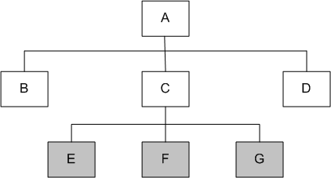
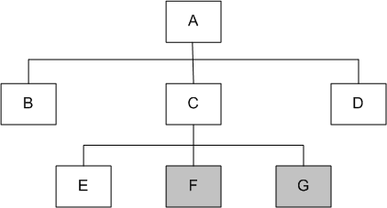
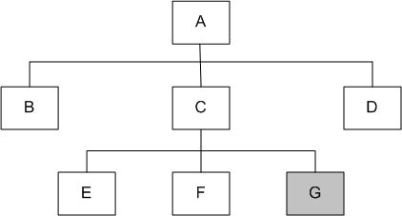
Top-down
Stub C` has been replaced with the actual module C, and new stubs E`, F`, and G` are incorporated
Perform tests as follows:
first, test the interface between A and C;
second, test the combined modules A, B, and D in the presence of C
The rest of the process depicted in the right hand side figures.

Slide 13
Top-down
Advantages
The SIT engineers continually observe system-level functions as the integration process continue
Isolation of interface errors becomes easier because of the incremental nature of the top-down integration
Test cases designed to test the integration of a module M are reused during the regression tests performed after integrating other modules.
Disadvantages
It may not be possible to observe meaningful system functions because of an absence of lower level modules and the presence of stubs.
Test case selection and stub design become increasingly difficult when stubs lie far away from the top-level module.

Slide 14
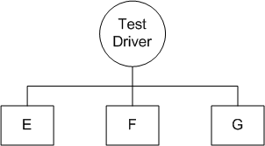
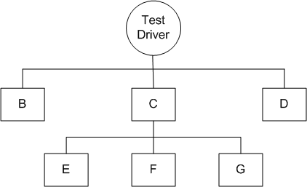
Bottom-up
We design a test driver to integrate lowest-level modules E, F, and G
Return values generated by one module is likely to be used in another module.
The test driver mimics module C to integrate E, F, and G in a limited way.
The test driver is replaced with actual module , i.e., C.
A new test driver is used
At this moment, more modules such as B and D are integrated
The new test driver mimics the behavior of module A
Finally, the test driver is replaced with module A and further tests are performed

Slide 15
Bottom-up
Advantages
One designs the behavior of a test driver by simplifying the behavior of the actual module
If the low-level modules and their combined functions are often invoked by other modules, then it is more useful to test them first so that meaningful effective integration of other modules can be done
Disadvantages
Discovery of major faults are detected towards the end of the integration process, because major design decision are embodied in the top-level modules
Test engineers can not observe system-level functions from a partly integrated system. In fact, they can not observe system-level functions until the top-level test driver is in place.

Slide 16
Big-bang and Sandwich
Big-bang Approach
First all the modules are individually tested
Next all those modules are put together to construct the entire system which is tested as a whole.
Sandwich Approach
In this approach a system is integrated using a mix of top-down, bottom-up, and big-bang approaches
A hierarchical system is viewed as consisting of three layers.
The bottom-up approach is applied to integrate the modules in the bottom-layer
The top layer modules are integrated by using top-down approach
The middle layer is integrated by using the big-bang approach after the top and the bottom layers have been integrated.

Slide 17
Software and Hardware Integration
Integration is often done in an iterative manner
A software image with a minimal number of core modules is loaded on a prototype hardware.
A small number of tests are performed to ensure that all the desired software modules are present in the build.
Next, additional tests are run to verify the essential functionalities
The process of assembling the build, loading on the target hardware, and testing the build continues until the entire product has been integrated

Slide 18
Hardware Design Verification Tests
A hardware engineering process consists of four phases
Planning and specification
Design, prototype implementation, and testing
Integration with the software system
Manufacturing, distribution and field service
A hardware Design Verification Test (DVT) plan is prepared and executed by the hardware group before the integration with software system

Slide 19
Hardware Design Verification Tests
The main hardware tests are as follows:
Diagnostic Test
Electrostatic Discharge Test
Electromagnetic Emission Test
Electrical Test
Thermal Test
Environment Test
Equipment Handling and Packaging Test
Acoustic Test
Safety Test
Reliability Test
Notes:
Diagnostic Test - imbedded in the basic input – output system (BIOS) component and are executed automatically whenever the system powers up. Performed as a kind of sanity test of the hardware module. Sanity Test – run- through test to make sure functionalities are preserved roughly.
Electrostatic discharge test – sudden flow of electricity b/n charged objects.
Electromagnetic emission test – no excessive radiation
Thermal – the system can stand temperature and humidity changes.
Equipment Handling and Packaging Test – Ensures the products robustness for shipping and packaging.
Acoustic Test – is the machines Decibel tolerable?

Slide 20
Hardware and Software Compatibility Matrix
H/W and S/W compatibility information is maintained in the form of a compatibility matrix.
It documents different revisions of the H/W and S/W that will be used for official release of the product.
An Engineering Change Order (ECO) is a formal document that describes a change to the hardware and software.
An ECO document includes the hardware software compatible matrix.
It is distributed to the operation, customer support and sales teams of the organization.

Slide 21
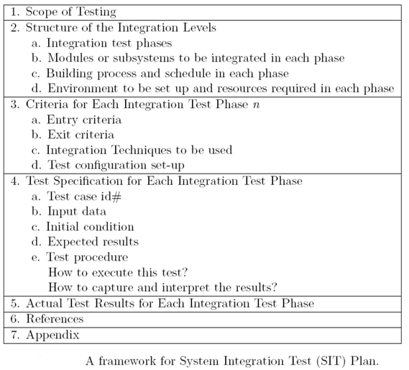
Test Plan for System Integration

Slide 22
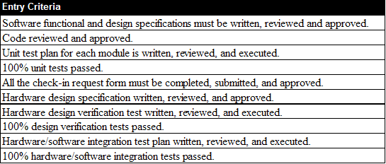
Test Plan for System Integration

Slide 23
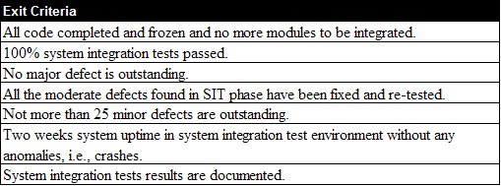
Test Plan for System Integration

Slide 24
Test Plan for System Integration
Categories of System Integration Tests:
Interface integrity
Internal and external interfaces are tested as each module is integrated
Functional validity
Tests to uncover functional errors in each module after it is integrated
End-to-end validity
Tests are designed to ensure that a completely integrated system works together from end-to-end
Pairwise validity
Tests are designed to ensure that any two systems work properly when connected by a network
Interface stress
Tests are designed to ensure that the interfaces can sustain the load
System endurance
Tests are designed to ensure that the integrated system stay up for weeks
Notes:
Internal Interface – connection Inside the computer’s cabinet
External Interface – a connection to the LAN side of the router.

Slide 25
Off-the-self Component Integration
Organizations occasionally purchase off-the-self (OTS) components from vendors and integrate them with their own components.
Useful set of components that assists in integrating actual components
Wrapper: It is a piece of code that one builds to isolate the underlying components from other components of the system.
Glue: A glue component provides the functionality to combine different components.
Tailoring: Components tailoring refers to the ability to enhance the functionality of a component
Tailoring is done by adding some elements to a component to enrich it with a functionality not provided by the vendor.
Tailoring does not involve modifying the source code of the component.
Notes:
Wrapper – function that used to call another routine w/ additional functionality
Glue – Glue Code🡪 used to adapt different parts of incompatible software.
Does not add any functionality.
Tailoring – adding elements to OTS w/ the intention of enhancement

Slide 26
Off-the-self Component Testing
OTS components produced by the vendor organizations are known as commercial off-the-shelf (COTS) components.
A COTS component is defined as:
A unit of composition with contractually specified interfaces and explicit context dependencies only. A software component can be deployed independently and is subject to composition by third parties
Three types of testing techniques are used to determine the suitability of a COTS component:
Black-box Component Testing: This is used to determine the quality of the component
System-level Fault Injection Testing: This is used to determine how well a system will tolerate a failing component.
Operational System Testing: This kind of tests are used to determine the tolerance of a software system when the COTS component is functioning correctly.
Notes:
Black Box Component Testing -

Slide 27
Built-in Testing
Testability is incorporated into software components
Testing and maintenance can be self-contained
Normal mode
The built-in test capabilities are transparent to the component user
The component does not differ from other non-built-in testing enabled components.
Maintenance mode
The component user can test the component with the help of its built-in testing features
The component user can invoke the respective methods of the component, which execute the test, evaluate autonomously its results, and output the test summary
Notes:
Built in Self Test or Built in Testing permits a machine to test its self

Slide 28
Reading
Software Testing and Quality Assurance: Theory and Practice
Page [190-223]
And read other online references

