Slide 1
Cybersecurity Overview Chapter One
Notes:
Lecture slides by Lawrie Brown for “Network Security Essentials”, 4/e, by William Stallings, Chapter 1 – “Introduction”.

Slide 2
The art of war teaches us to rely not on the likelihood of the enemy's not coming, but on our own readiness to receive him; not on the chance of his not attacking, but rather on the fact that we have made our position unassailable.
—The Art of War, Sun Tzu
Notes:
This quote from the start of Chapter 1 sets the scene for why we want to study these issues.

Slide 3
The combination of space, time, and strength that must be considered as the basic elements of this theory of defense makes this a fairly complicated matter. Consequently, it is not easy to find a fixed point of departure.
— On War, Carl Von Clausewitz
Notes:
This quote from the start of Ch 1 reflects a fundamental principle that we must understand the strength of the algorithms we use in order to have a suitable level of security.

Slide 4
Introduction
Information security is a topic of extreme importance
the ubiquitous nature of today’s Internet has accelerated the importance of this area to a new and critical level.
It is vital, that in today’s world, one must have confidence information their information remain secret as they pass through elements encountered along the communication path from source to destination
Notes:
The NIST Computer Security Handbook [NIST95] defines the term computer security as shown on this slide. This definition introduces three key objectives that are at the heart of computer security as we see on the next slide.

Slide 5
A Definition of Computer Security
security is “the quality or state of being secure—to be free from danger.
The protection of information and its critical elements, including the systems and hardware that use, store, and transmit that information
The protection afforded to an automated information system in order to attain the applicable objectives of preserving the integrity, availability and confidentiality of information system resources (includes hardware, software, firmware, information/data, and telecommunications)
Organizations must enforce multiple layers of security
Physical, personnel, operational, communication, network, and information security
Notes:
The NIST Computer Security Handbook [NIST95] defines the term computer security as shown on this slide. This definition introduces three key objectives that are at the heart of computer security as we see on the next slide.

Slide 6
A Definition of Computer Security …
This definition introduces three key objectives that are at the heart of computer security.
Confidentiality
Data confidentiality :Assures that private or confidential information is not made available or disclosed to unauthorized individuals
Privacy : Assures that individuals control what information to be collected and stored and by whom and to whom about them
Integrity
Data integrity: Assures that information are changed only in authorized manner
System integrity: Assures that a system performs its intended function in an unimpaired manner,
Availability : Assures that systems work promptly and service is not denied to authorized users
Notes:
The NIST Computer Security Handbook [NIST95] defines the term computer security as shown on this slide. This definition introduces three key objectives that are at the heart of computer security as we see on the next slide.

Slide 7
Cybersecurity
Cybersecurity is a collection of defensive technologies (hardware/software), processes and practices designed to protect networks, computers, programs and information from attack, damage or unauthorized access in order to secure systems that are connected to the Internet.
Cybersecurity protects against threats using defensive measures, including
information assurance,
computer systems, and applications hardening,
malware protection,
access control,
information infrastructure protection, and
Network security
Notes:
The NIST Computer Security Handbook [NIST95] defines the term computer security as shown on this slide. This definition introduces three key objectives that are at the heart of computer security as we see on the next slide.

Slide 8
Key Objectives of Security
Confidentiality: Preserving authorized restrictions on information access and disclosure, including means for protecting personal privacy and proprietary information.
A loss of confidentiality is the unauthorized disclosure of information.
Integrity: Guarding against improper information modification or destruction, including ensuring information nonrepudiation and authenticity.
A loss of integrity is the unauthorized modification or destruction of information.
Availability: Ensuring timely and reliable access to and use of information.
A loss of availability is the disruption of access to or use of information or an information system.

Slide 9
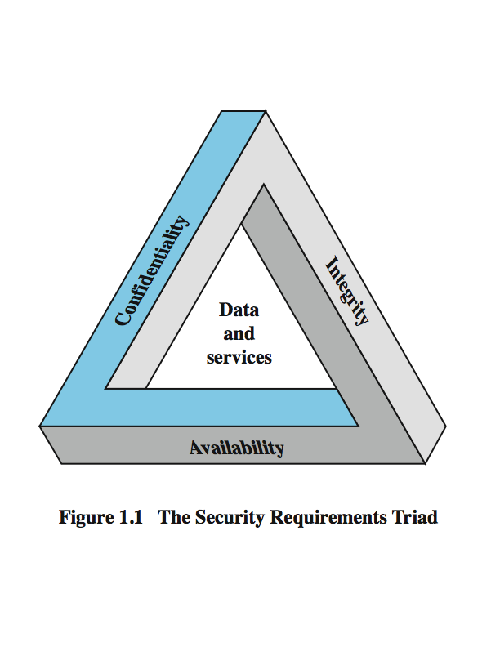
Key Security Concepts
These three concepts form what is often referred to as the CIA triad
The three concepts embody the fundamental security objectives for both data and for information and computing services
Notes:
These three concepts form what is often referred to as the CIA triad (Figure 1.1). The three concepts embody the fundamental security objectives for both data and for information and computing services. FIPS PUB 199 provides a useful characterization of these three objectives in terms of requirements and the definition of a loss of security in each category:
• Confidentiality (covers both data confidentiality and privacy): preserving authorized restrictions on information access and disclosure, including means for protecting personal privacy and proprietary information. A loss of confidentiality is the unauthorized disclosure of information.
• Integrity (covers both data and system integrity): Guarding against improper information modification or destruction, and includes ensuring information non-repudiation and authenticity. A loss of integrity is the unauthorized modification or destruction of information.
• Availability: Ensuring timely and reliable access to and use of information. A loss of availability is the disruption of access to or use of information or an information system.
Although the use of the CIA triad to define security objectives is well established, some in the security field feel that additional concepts are needed to present a complete picture. Two of the most commonly mentioned are:
• Authenticity: The property of being genuine and being able to be verified and trusted; confidence in the validity of a transmission, a message, or message originator.
• Accountability: The security goal that generates the requirement for actions of an entity to be traced uniquely to that entity.

Slide 10
Key Objectives of Security …
Additional Goals of security are
Authenticity :The property of being genuine and being able to be verified and trusted; confidence in the validity of a transmission, a message, or message originator.
This means verifying that users are who they say they are and that each input arriving at the system came from a trusted source.
Authorization: a security measure that verifies whether you have permission to access the specific resources
Access control: A security measure that permits access to the various resources by the user or process.

Slide 11
Key Objectives of Security …
Accountability and non-repudiation : The security goal that generates the requirement for actions of an entity to be traced uniquely to that entity.
This supports nonrepudiation, deterrence, fault isolation, intrusion detection and prevention, and after-action recovery and legal action
Since truly secure systems are not yet an achievable goal, we must be able to trace a security breach to a responsible party.
Systems must keep records of their activities to permit later forensic analysis to trace security breaches or to aid in transaction disputes.

Slide 12
Levels of Impact
3 levels of impact from a security breach
Low - The loss could be expected to have a limited adverse effect on organizational operations, organizational assets, or individuals (mission, minor damage, financial loss, harm to individuals…)
Moderate - The loss could be expected to have a serious adverse effect on organizational operations, organizational assets, or individuals (mission, huge damage, financial loss, harm to individuals…)
High - The loss could be expected to have a severe or catastrophic adverse effect on organizational operations, organizational assets, or individuals (severe mission , major damage , financial loss, individual (catastrophic ) …)
Notes:
We can define three levels of impact on organizations or individuals should there be a breach of security (i.e., a loss of confidentiality, integrity, or availability). These levels are defined in FIPS PUB 199:
• Low: The loss could be expected to have a limited adverse effect on organizational operations, organizational assets, or individuals. A limited adverse effect means that, for example, the loss of confidentiality, integrity, or availability might (i) cause a degradation in mission capability to an extent and duration that the organization is able to perform its primary functions, but the effectiveness of the functions is noticeably reduced; (ii) result in minor damage to organizational assets; (iii) result in minor financial loss; or (iv) result in minor harm to individuals.
• Moderate: The loss could be expected to have a serious adverse effect on organizational operations, organizational assets, or individuals. A serious adverse effect means that, for example, the loss might (i) cause a significant degradation in mission capability to an extent and duration that the organization is able to perform its primary functions, but the effectiveness of the functions is significantly reduced; (ii) result in significant damage to organizational assets; (iii) result in significant financial loss; or (iv) result in significant harm to individuals that does not involve loss of life or serious, life-threatening injuries.
• High: The loss could be expected to have a severe or catastrophic adverse effect on organizational operations, organizational assets, or individuals. A severe or catastrophic adverse effect means that, for example, the loss might (i) cause a severe degradation in or loss of mission capability to an extent and duration that the organization is not able to perform one or more of its primary functions; (ii) result in major damage to organizational assets; (iii) result in major financial loss; or (iv) result in severe or catastrophic harm to individuals involving loss of life or serious life threatening injuries.

Slide 13
Examples of Security Requirements
confidentiality – student grades
integrity – patient information
availability – bank service
Notes:
We now provide some examples of applications that illustrate the requirements just enumerated.
• Confidentiality - Student grade information is an asset whose confidentiality is considered to be highly important by students. Grade information should only be available to students, their parents, and employees that require the information to do their job. Student enrollment information may have a moderate confidentiality rating. While still coveredby FERPA, this information is seen by more people on a daily basis, is less likely to be targeted than grade information, and results in less damage if disclosed. Directory information, such as lists of students or faculty or departmental lists, may be assigned a low confidentiality rating or indeed no rating. This information is typically freely available to the public and published on a school's Web site.
• Integrity – Consider a hospital patient's allergy information stored in a database. The doctor should be able to trust that the information is correct and current. Now suppose that an employee (e.g., a nurse) who is authorized to view and update this information deliberately falsifies the data to cause harm to the hospital. The database needs to be restored to a trusted basis quickly, and it should be possible to trace the error back to the person responsible. Patient allergy information is an example of an asset with a high requirement for integrity. Inaccurate information could result in serious harm or death to a patient and expose the hospital to massive liability.
• Availability - The more critical a component or service, the higher is the level of availability required. Consider a system that provides authentication services for critical systems, applications, and devices. An interruption of service results in the inability for customers to access computing resources and staff to access the resources they need to perform critical tasks. The loss of the service translates into a large financial loss in lost employee productivity and potential customer loss.

Slide 14
Computer Security Challenges
not simple
must consider potential attacks
procedures used counter-intuitive
involve algorithms and secret info
must decide where to deploy mechanisms
battle of wits between attacker / admin
not perceived on benefit until fails
requires regular monitoring
too often an after-thought
regarded as impediment to using system
Notes:
Computer security is both fascinating and complex. Some of the reasons follow:
1. Computer security is not as simple as it might first appear to the novice. The requirements seem to be straightforward, but the mechanisms used to meet those requirements can be quite complex and subtle.
2. In developing a particular security mechanism or algorithm, one must always consider potential attacks (often unexpected) on those security features.
3. Hence procedures used to provide particular services are often counterintuitive.
4. Having designed various security mechanisms, it is necessary to decide where to use them.
5. Security mechanisms typically involve more than a particular algorithm or protocol, but also require participants to have secret information, leading to issues of creation, distribution, and protection of that secret information.
6. Computer security is essentially a battle of wits between a perpetrator who tries to find holes and the designer or administrator who tries to close them.
7. There is a natural tendency on the part of users and system managers to perceive little benefit from security investment until a security failure occurs.
8. Security requires regular monitoring, difficult in today's short-term environment.
9. Security is still too often an afterthought - incorporated after the design is complete.
10. Many users / security administrators view strong security as an impediment to efficient and user-friendly operation of an information system or use of information.

Slide 15
OSI Security Architecture
ITU-T X.800 “Security Architecture for OSI”
defines a systematic way of defining and providing security requirements
for us it provides a useful, if abstract, overview of concepts we will study
Notes:
To assess effectively the security needs of an organization and to evaluate and choose various security products and policies, the manager responsible for security needs some systematic way of defining the requirements for security and characterizing the approaches to satisfying those requirements. This is difficult enough in a centralized data processing environment; with the use of local and wide area networks the problems are compounded. ITU-T Recommendation X.800, Security Architecture for OSI, defines such a systematic approach. The OSI security architecture is useful to managers as a way of organizing the task of providing security.

Slide 16
Information Security Terms
Access: ability to use, manipulate, modify, or affect another subject or object.
Asset : The organizational resource that is being protected
Threat - A potential for violation of security, which exists when there is a circumstance, capability, action, or event that could breach security and cause harm. That is, a threat is a possible danger that might exploit a vulnerability.
Attack - An assault on system security that derives from an intelligent threat; that is, an intelligent act that is a deliberate attempt (especially in the sense of a method or technique) to evade security services and violate the security policy of a system.
Control, safeguard, or countermeasure: Security mechanisms, policies, or procedures that can successfully counter attacks, reduce risk, resolve vulnerabilities, and otherwise improve the security within an organization.

Slide 17
Information Security Terms …
Exploit: A technique used to compromise a system.
Exposure: A condition or state of being exposed. In information security, exposure exists when a vulnerability known to an attacker is present.
Loss: A single instance of an information asset suffering damage or unintended or unauthorized modification or disclosure. When an organization’s information is stolen, it has suffered a loss.
Risk: The probability that something unwanted will happen.
Vulnerability: A weaknesses or fault in a system or protection mechanism that opens it to attack or damage.

Slide 18
Aspects of Security
3 aspects of information security:
security attack - Any action that compromises the security of information owned by an organization.
security mechanism- A process (or a device incorporating such a process) that is designed to detect, prevent, or recover from a security attack.
security service- A processing or communication service that enhances the security of the data processing systems and the information transfers of an organization.
The services are intended to counter security attacks, and they make use of one or more security mechanisms to provide the service.
Notes:
The OSI security architecture focuses on security attacks, mechanisms, and services. These can be defined briefly as follows:
• Security attack:

Slide 19
Security Attacks and Malware
Attacks on the Internet information infrastructure originate from the four corners of the world and can be absolutely devastating.
The attacks on hosts are generated through malware and can easily gain unauthorized access to critical information.
Malware comes in five distinct categories/capabilities:
Spyware,
Viruses,
Worms
Trojans and Rootkits
Another form of attack is the denial of service (DoS) attack in which legitimate users are denied access to resources.
These DoS attacks will typically exhaust the server’s memory and processing capacity and/or exhaust the link bandwidth.
For the attack to work its purpose their should be vulnerability to computer system

Slide 20
Security Attacks and Malware …
Based on X.800 and RFC 2828,
passive attacks and active attacks.
Passive attack : attempts to learn or make use of information from the system but does not affect system resources.
Passive attacks are in the nature of eavesdropping on, or monitoring of, transmissions. The goal of the opponent is to obtain information that is being transmitted. Two types of passive attacks are: release of message contents , traffic analysis
Active attacks : attempts to alter system resources or affect their operation and can be subdivided into four categories: masquerade, replay, modification of messages, and denial of service:

Slide 21
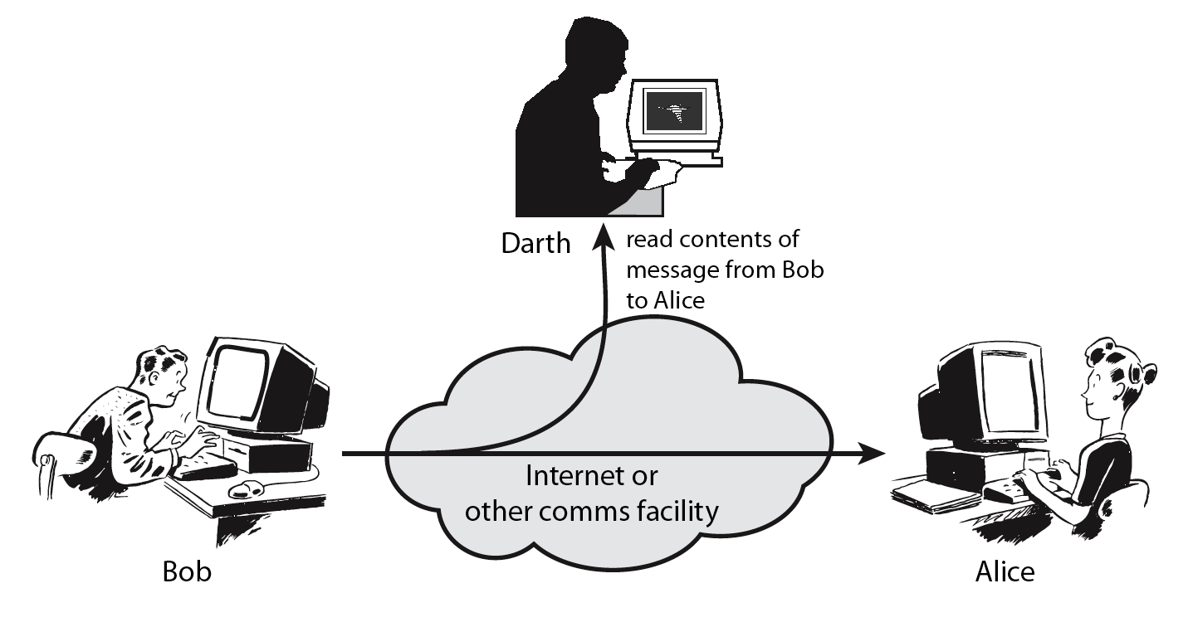
Passive Attacks (1) Release of Message Contents
Notes:
A useful means of classifying security attacks, used both in X.800 and RFC 2828, is in terms of passive attacks and active attacks. A passive attack attempts to learn or make use of information from the system but does not affect system resources.
Passive attacks are in the nature of eavesdropping on, or monitoring of, transmissions. The goal of the opponent is to obtain information that is being transmitted. Two types of passive attacks are:
+ release of message contents - as shown above in Stallings Figure 1.2a here
+ traffic analysis - monitor traffic flow to determine location and identity of communicating hosts and could observe the frequency and length of messages being exchanged
These attacks are difficult to detect because they do not involve any alteration of the data.

Slide 22
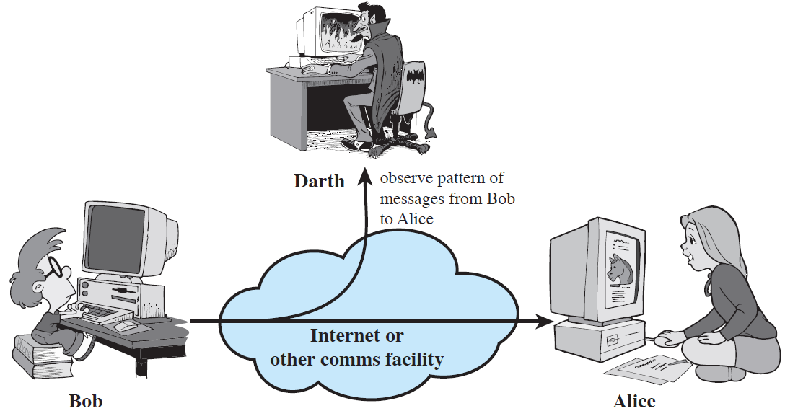
Passive Attacks (2) Traffic Analysis

Slide 23
Passive attacks do not affect system resources
Eavesdropping, monitoring
Two types of passive attacks
Release of message contents
Traffic analysis
Passive attacks are very difficult to detect
Message transmission apparently normal
No alteration of the data
Emphasis on prevention rather than detection
By means of encryption

Slide 24
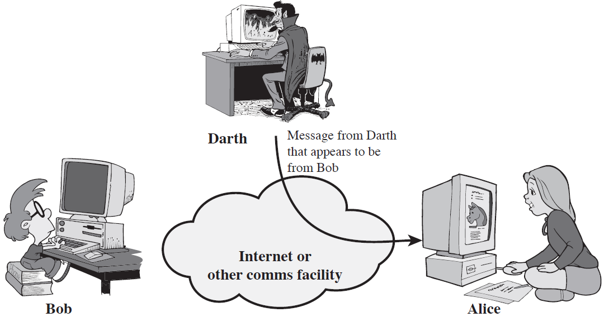
Active Attacks (1) Masquerade

Slide 25
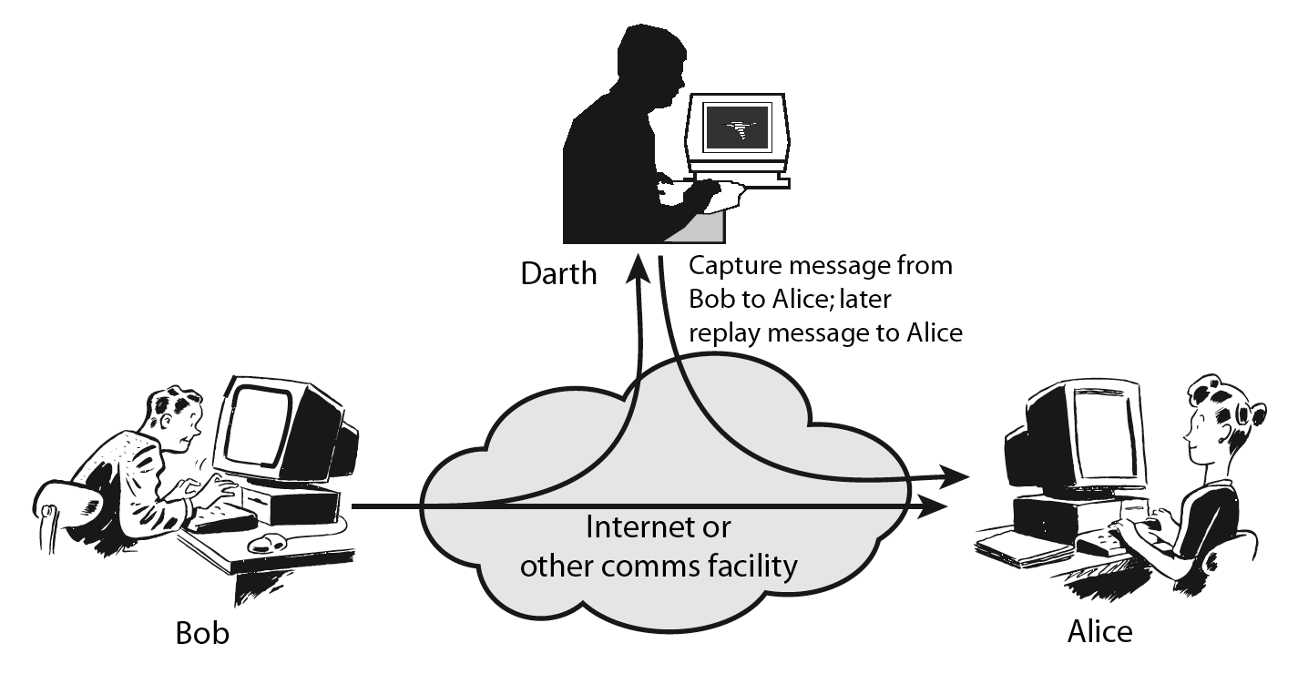
Active Attacks (2) Replay
Notes:
Active attacks involve some modification of the data stream or the creation of a false stream and can be subdivided into four categories: masquerade, replay, modification of messages, and denial of service:
masquerade of one entity as some other
replay previous messages (as shown above in Stallings Figure 1.3b)
modify/alter (part of) messages in transit to produce an unauthorized effect
denial of service - prevents or inhibits the normal use or management of communications facilities
Active attacks present the opposite characteristics of passive attacks. Whereas passive attacks are difficult to detect, measures are available to prevent their success. On the other hand, it is quite difficult to prevent active attacks absolutely, because of the wide variety of potential physical, software, and network vulnerabilities. Instead, the goal is to detect active attacks and to recover from any disruption or delays caused by them.

Slide 26
Active Attacks (3) Modification of Messages

Slide 27
Active Attacks (4) Denial of Service

Slide 28
Active attacks try to alter system resources or affect their operation
Modification of data, or creation of false data
Four categories
Masquerade
Replay
Modification of messages
Denial of service: preventing normal use
A specific target or entire network
Difficult to prevent
The goal is to detect and recover

Slide 29
Security Service
enhance security of data processing systems and information transfers of an organization
intended to counter security attacks
using one or more security mechanisms
often replicates functions normally associated with physical documents
which, for example, have signatures, dates; need protection from disclosure, tampering, or destruction; be notarized or witnessed; be recorded or licensed
Notes:
Consider the role of a security service, and what may be required.
Note both similarities and differences with traditional paper documents, which for example:
have signatures & dates;
need protection from disclosure, tampering, or destruction;
may be notarized or witnessed;
may be recorded or licensed

Slide 30
Security Services
X.800:
“a service provided by a protocol layer of communicating open systems, which ensures adequate security of the systems or of data transfers”
RFC 2828:
“a processing or communication service provided by a system to give a specific kind of protection to system resources”
Notes:
State here a couple of definitions of “security services” from relevant standards. X.800 defines a security service as a service provided by a protocol layer of communicating open systems, which ensures adequate security of the systems or of data transfers. Perhaps a clearer definition is found in RFC 2828, which provides the following definition: a processing or communication service that is provided by a system to give a specific kind of protection to system resources; security services implement security policies and are implemented by security mechanisms.

Slide 31
Security Services (X.800)
Authentication - assurance that communicating entity is the one claimed
have both peer-entity & data origin authentication
Access Control - prevention of the unauthorized use of a resource
Data Confidentiality –protection of data from unauthorized disclosure
Data Integrity - assurance that data received is as sent by an authorized entity
Non-Repudiation - protection against denial by one of the parties in a communication
Availability – resource accessible/usable
Notes:
This list is taken from Stallings Table 1.2 which provides details of the 5 Security Service categories and the 14 specific services given in X.800.
This list includes the various "classic" security services which are traditionally discussed. Note there is a degree of ambiguity as to the meaning of these terms, and overlap in their use. The broad service categories are:
authentication is concerned with assuring that a communication is authentic. Two specific authentication services are defined in X.800: Peer entity authentication: provides corroboration of the identity of a peer entity in an association; and Data origin authentication: provides corroboration of the source of a data unit.
access control is the ability to limit and control the access to host systems and applications via communications links.
confidentiality is the protection of transmitted data from passive attacks, and the protection of traffic flow from analysis.
integrity assures that messages are received as sent, with no duplication, insertion, modification, reordering, replay, or loss.
availability is the property of a system / resource being accessible and usable upon demand by an authorized system entity, according to performance specifications for the system.

Slide 32
Security Mechanism
feature designed to detect, prevent, or recover from a security attack
no single mechanism that will support all services required
however one particular element underlies many of the security mechanisms in use:
cryptographic techniques
Notes:
Now introduce “Security Mechanism” which are the specific means of implementing one or more security services. Note these mechanisms span a wide range of technical components, but one aspect seen in many is the use of cryptographic techniques.

Slide 33
Security Mechanisms (X.800)
specific security mechanisms:
encipherment, digital signatures, access controls, data integrity, authentication exchange, traffic padding, routing control, notarization
pervasive security mechanisms:
trusted functionality, security labels, event detection, security audit trails, security recovery
Notes:
Some examples of mechanisms from X.800. Note that the “specific security mechanisms” are protocol layer specific, whilst the “pervasive security mechanisms” are not. We will meet some of these mechanisms in much greater detail later.
See Stallings Table 1.3 for details of these mechanisms in X.800, and Table 1.4 for the relationship between services and mechanisms.

Slide 35
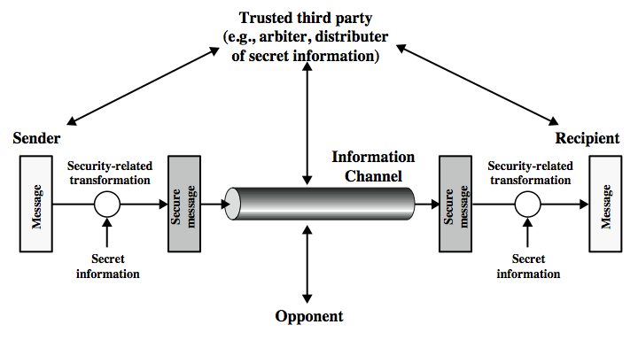
Model for Network Security
Notes:
In considering the place of encryption, its useful to use the following two models from Stallings section 1.6.
The first, illustrated in Figure 1.4, models information being transferred from one party to another over an insecure communications channel, in the presence of possible opponents. The two parties, who are the principals in this transaction, must cooperate for the exchange to take place. They can use an appropriate security transform (encryption algorithm), with suitable keys, possibly negotiated using the presence of a trusted third party. Parts One through Four of this book concentrates on the types of security mechanisms and services that fit into the model shown here.

Slide 36
Model for Network Security
using this model requires us to:
design a suitable algorithm for the security transformation
generate the secret information (keys) used by the algorithm
develop methods to distribute and share the secret information
specify a protocol enabling the principals to use the transformation and secret information for a security service
Notes:
This general model shows that there are four basic tasks in designing a particular security service, as listed.

Slide 37
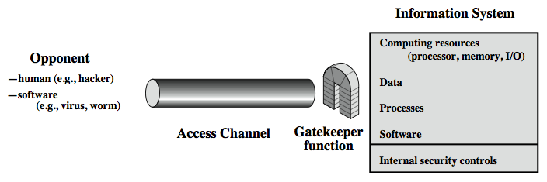
Model for Network Access Security
Notes:
The second, illustrated in Figure 1.5, model is concerned with controlled access to information or resources on a computer system, in the presence of possible opponents. Here appropriate controls are needed on the access to and within the system, to provide suitable security.
The security mechanisms needed to cope with unwanted access fall into two broad categories (as shown in this figure). The first category might be termed a gatekeeper function. It includes password-based login procedures that are designed to deny access to all but authorized users and screening logic that is designed to detect and reject worms, viruses, and other similar attacks. Once either an unwanted user or unwanted software gains access, the second line of defense consists of a variety of internal controls that monitor activity and analyze stored information in an attempt to detect the presence of unwanted intruders. These issues are explored in Part Four.

Slide 38
Model for Network Access Security
using this model requires us to:
select appropriate gatekeeper functions to identify users
implement security controls to ensure only authorised users access designated information or resources
Notes:
Detail here the tasks needed to use this model.

Slide 39
Standards
NIST: National Institute of Standards and Technology
FIPS: Federal Information Processing Standards
SP: Special Publications
ISOC: Internet Society
Home for IETF (Internet Engineering Task Force) and IAB (Internet Architecture Board)
RFCs: Requests for Comments

Slide 40
Defensive Measures for Cybersecurity
There are different classes of security mechanisms to employ to defend itself against malware that is expanding in both scope and sophistication.
In order to be active in the business and use the Internet, defensive measures have to be used
Name Security check Action taken Firewall TCP/IP packet header inspection Block IDS TCP/IP packet header and content inspection Alert IPS TCP/IP packet header and content inspection Block and alert VPN: SSL/TLS Authentication, encryption and integrity Communication protection VPN: Ipsec Authentication, encryption and integrity Communication protection NAC Host health inspection, authentication, encryption and
integrity Access control

Slide 41
The Firewall, the Intrusion Detection System (IDS) and the Intrusion Prevention System (IPS)
malware is capable of destroying the Internet and everyone attached to it,
Three of the methods that are employed to protect systems are the Firewall, the Intrusion Detection System (IDS) and the Intrusion Prevention System (IPS
These elements are typically placed at critical entry and exit points to protect vital assets, such as a server farm, a financial database, or something else of significant value. .

Slide 42
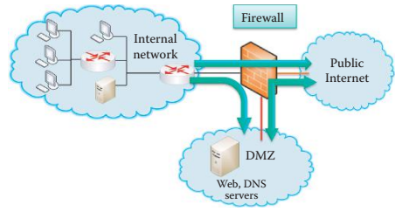
The Firewall
Host firewalls are used in a computer’s OS/application to protect the host.
Network firewalls are used to protect the entrance to a network and block packets based on the IP address and port number in the header.
In addition, a stateful inspection is performed in order to maintain a state transition table for a connection.
Its purpose is to isolate an organization’s internal network.
The firewall permits transmission from the organization to either the public Internet or the Demilitarized Zone (DMZ), as well as transmission from the DMZ to the Internet.
However, it blocks traffic into the organization from either the public Internet or the DMZ

Slide 43
IDS/IPS
Both IDS and IPS are used to monitor potentially malicious traffic by inspecting the entire packet
IDS will let the packet pass, but sends an alert to the network administrator,
while IPS will block a malicious packet and send a message to the network administrator
IDS/IPS is strategically placed at the entrance to an organization. From this point it can detect a wide range of attacks.
Attackers typically perform network mapping, in the form of reconnaissance, port scans and TCP stack scans that can be detected/blocked by the IDS/IPS.
It can also detect denial of service bandwidth-flooding attacks, worms and viruses, as well as both OS and application vulnerability attacks.

Slide 44
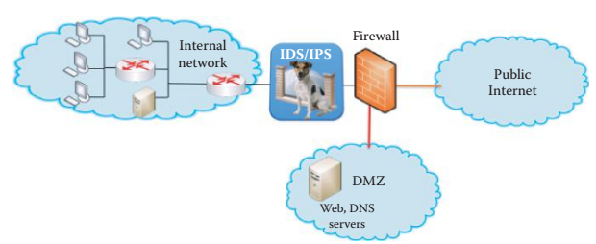
IDS/IPS …
Signature-based detection methods used in IDS/IPS and anti-virus software are ineffective against any zero-day or mutated malware.
The IDS generates too many false positive alarms, which make it difficult for administrators to identify meaningful attacks.
On the other end, the IPS only blocks the packets that are definitely malicious while other malicious packets pass through.
It is the responsibility of every user to take precautionary measures, by employing the help of currently available defense products, when surfing the Internet.
Today’s fully featured routers contain within them the firewall and IDS/IPS functions, which can be configured to perform the specified functions

Slide 45
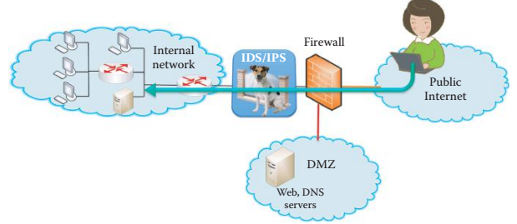
Virtual Private Networks (VPN) and Access Control
While it is clear that defensive measures must be applied at every possible location,
The communication, which often carries sensitive information, must also be protected.
There are several methods that can be employed with information transmission.
Among them are encryption, authentication and authorization.
For example, Secure Socket Layer/Transport Layer Security (SSL/TLS) is used between the session and transport layers for such things as Internet shopping and web mail.
The Internet Protocol Security (IPsec) is used in the network layer for such things as a virtual private network (VPN)
VPN is allowed to pass through a corporate firewall

Slide 46
Virtual Private Networks (VPN) and Access Control…
Organizational network access control (NAC) is agent-based NAC deployed at each host and central control server.
Only healthy hosts that are certified by their agents can have network access, and security policy enforcement is a main feature of NAC in an enterprise network.
802.11i is used in the data link layer for WiFi or 802.11 WLAN;
organizational access control using Active Directory based on Kerberos is used for user access control,
RADIUS/AAA protocol is employed for authentication and 802.1x is placed in layer 2 for WiFi and LAN authentication.
Today’s routers, have IPsec or SSL/TLS VPN functions built right into the unit.
Therefore, one can simply configure the router to perform the functions desired.

Slide 47
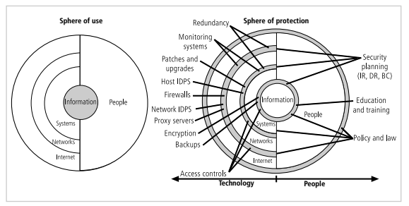
Design of Security Architecture
Spheres of Security
the foundation of the security framework.
Generally speaking, the spheres of security illustrate how information is under attack from a variety of sources.
Information security is designed and implemented in three layers:
policies, people (education, training, and awareness programs), and technology, commonly referred to as PPT.
Each of the layers contains controls and safeguards that protect the information and information system assets that the organization values

Slide 48
Design of Security Architecture …
Levels of Controls
Information security safeguards provide three levels of control: managerial, operational, and technical.
Managerial controls are security processes that are designed by strategic planners and implemented by the security administration of the organization.
Management controls set the direction and scope of the security process and provide detailed instructions for its conduct,
It also describe the necessity and scope of legal compliance, and set guidelines for the maintenance of the entire security life cycle.

Slide 49
Design of Security Architecture …
Operational controls are management and lower-level planning functions that deal with the operational functionality of security in the organization, such as
disaster recovery and incident response planning.
Operational controls address personnel security, physical security, and the protection of production inputs and outputs.
In addition, operational controls guide the development of education, training, and awareness programs for users, administrators, and management.
Finally, they address hardware and software systems maintenance and the integrity of data.

Slide 50
Design of Security Architecture …
Technical controls are the tactical and technical implementations of security in the organization.
Technical controls are the components put in place to protect an organization’s information assets.
They include logical access controls, such as
identification, authentication, authorization, accountability (including audit trails), cryptography, and the classification of assets and users.

Slide 51
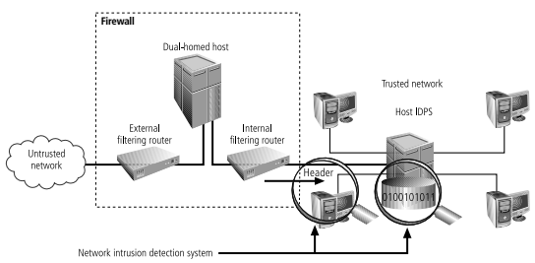
Design of Security Architecture …
Defense in Depth
One of the basic tenets of security architectures is the layered implementation of security.
This layered approach is called defense in depth.
To achieve defense in depth, an organization must establish multiple layers of security controls and safeguards,
which can be organized into policy, training and education, and technology,
Implementing multiple types of technology and thereby precluding that the failure of one system will compromise the security of information is referred to as redundancy.
Redundancy can be implemented at a number of points throughout the security architecture, such as in firewalls, proxy servers, and access controls.

Slide 52
Integrated Defense
Defense in Depth can be implemented using an integrated defense for an enterprise network using the following formula
Integrated defense = endpoint security software + cloud + NAC + IDS/IPS + Firewall
Endpoint security software contains a lot of protection such as
Malware signatures
Real-time code emulation
Advanced heuristics
A cloud-centric feedback loop from actual users, such as reputation services that blocks bad IP addresses, URLs, and files
Application controls that are effective in decreasing the endpoint attack surface
Tools provide kernel level, hypervisor level, or CPU level protection to protect against rootkits
The NAC uses centralized policy enforcement for endpoint security, that can be configured in accordance with the role of the user and associated devices and employed by the user for authorizing access.

Slide 53
Attacks on the Power Grid and Utility Networks
In addition to the security issues associated with financial entities, such as credit cards and bank accounts, there are attacks on portions of the critical infrastructure such as utilities.
These industrial-control systems (ICS) and their networks are used to control water, chemical and energy systems.
Only about half a dozen major manufacturers, such as Siemens and GE, make these systems.
Most ICS’s employ either Microsoft Windows or Linux OS.

Slide 54
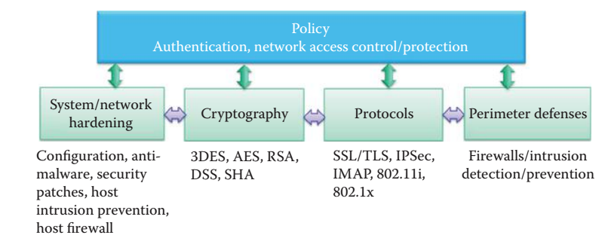
Network and Information Infrastructure Defense Overview
In general, many feature-rich systems are not developed with security in mind e.g.,
web2.0/AJAX has too many weaknesses.
It is almost impossible for implementations to consider all security issues, and buffer overflows become the “IEDs” of these systems.
In addition, there are weaknesses in protocol implementations, e.g., DNS and older versions of SSL, SSH, FTP, and the like.
Furthermore, many attacks are not even technical in nature, such as phishing, impersonation, social engineering, etc.
It is imperative that mechanisms be established and used extensively to counter and eliminate them
A security policy dictates the security measures that are deployed for protecting the infrastructure.

Slide 55
Network and Information Infrastructure Defense Overview …
Overall security is clearly a cooperative effort, with centralized management, that involves all hosts and network/security equipment.
Security mechanisms range from soup to nuts and include hardware and software-based methods.
OS and applications must be hardened in hardware devices such as smartphones, computers, servers, switches, routers, and regularly patched with security updates
For example,
unnecessary applications must be uninstalled and unused TCP/UDP ports must not be left open.
In addition, there must security policy for these devices and their access to the information infrastructure.

Slide 56
Network and Information Infrastructure Defense Overview ...
Cryptography also plays a critical role in protecting an infrastructure.
cryptographic hash functions for authentication,
Symmetric key encryption, public-key infrastructure and certificates for authentication, and
pseudo-random generators to ensure freshness and eliminate replays.
Another important technique is the use of authentication and key establishment within a domain.
Kerberos is an excellent authentication method supported by every OS

Slide 57
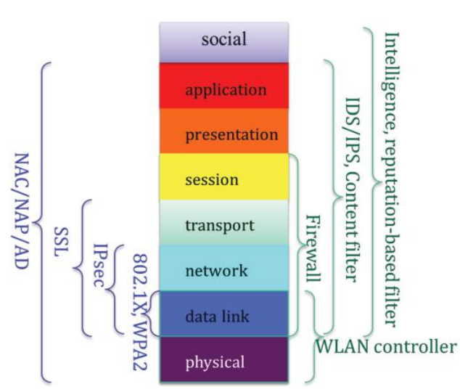
Defense for the Enterprise
Intelligence and a reputation-based filter can be deployed to protect web and email access, and is especially important in countering the rapidly changing nature of the malware.
IDS/IPS and a content filter can be used to perform deep packet inspection based on the knowledge of applications.
Firewalls can be useful in filtering packets based on the packet header information.

Slide 58
Defense for the Enterprise
WLAN controllers can be deployed to monitor the spectrum and detect rogue access points.
802.1X and WPA2 can be used to protect data link layer communications.
IPsec is a VPN protocol that protects network layer communications.
SSL/TLS is widely used for protecting transport layer communications
Network access control/protection (NAC/NAP) and AD can be used to protect an information infrastructure by monitoring the health of every host based on all available defense hardware and software.

Slide 59
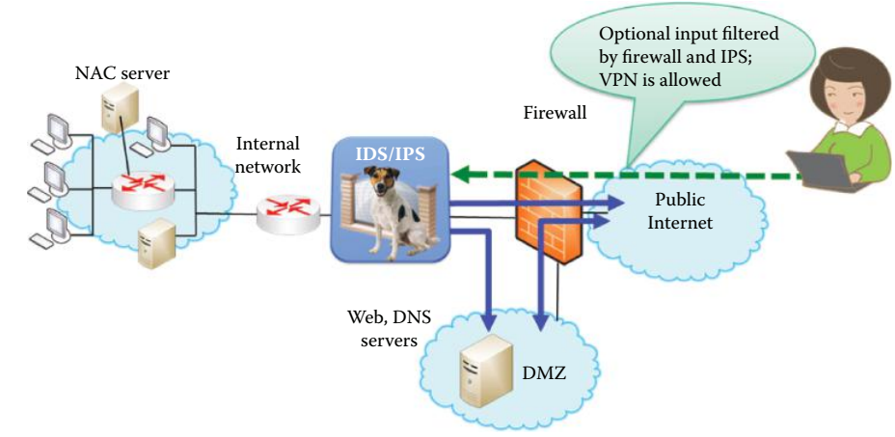
Defense for the Enterprise …
A firewall and IDS/IPS are used for guarding the entrance of the enterprise network.
VPN is typically used for remote access to the enterprise network and is allowed by the firewall.
A Demilitarized Zone (DMZ) is established in order to permit the outside Internet to access public information of the enterprise network, such as DNS, web and email servers.
Internal hosts can also access the servers in the DMZ and the Internet.
However, the hosts in the Internet are blocked by the firewall from accessing the internal network, and these external hosts can access the internal network only through VPN.

Slide 60
Defense for the Enterprise …
Protection via cryptography and protocols includes
symmetric key crypto, which involves encryption for confidentiality and hash for authentication.
public key crypto, which consists of public key encryption, signatures and public key certificates for authentication, and
Protocols based upon crypto, that include VPN and SSL using public key crypto for authentication as well as symmetric key establishment, and symmetric key crypto for encryption.

Slide 61
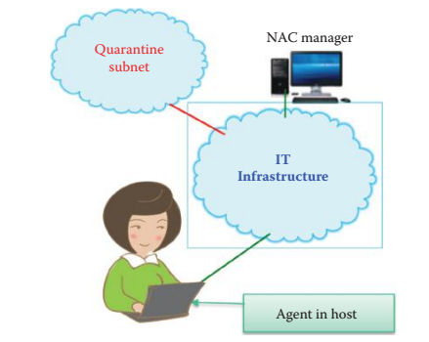
Secure Content (SC) filtering
Secure Content (SC) filtering includes anti-malware, anti-spam, url filtering, and packet content filtering and is referred to as a deep packet inspection of packet payload content
SC filtering is usually provided by a dedicated appliance, or an integrated appliance that may contain a firewall, IDS/ IPS, VPN, etc.
The integrated security appliance is widely deployed at the entrance of important subnets in an organization as a compliment to host-based defense software

Slide 62
penetration test
A penetration test is used for evaluating the security of an enterprise network and hosts by simulating attacks from potential attackers using active exploitation of vulnerabilities.
The purpose of the test is to discover the vulnerabilities that may result from improper configurations, hardware and software, or policy violations.
The discovered vulnerabilities are used for developing mitigation strategies

Slide 63
Contingency planning
NIST provides a guide for viable contingency planning that an organization may adopt for their information systems.
Contingency planning refers to interim measures used to recover information system services after a disruption.
Interim measures may include relocation of information systems and operations to an alternate site, recovery of information system functions using alternate equipment, or information system functions using manual methods.

Slide 64
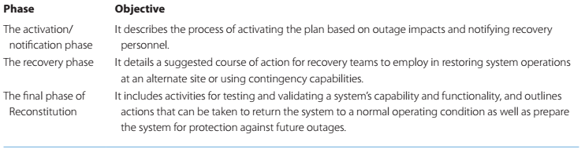
Contingency planning …
This guide presents three sample formats for developing an information system contingency plan based on low-, moderate-, or high-impact levels.
And each format defines three phases that govern actions to be taken following a system disruption

Slide 65
Contingency planning …
The cyber incident response plan establishes procedures to address cyber attacks that occur against an organization’s information system(s).
The procedures are designed to enable security personnel to identify, mitigate, and recover from malicious computer incidents, such as
unauthorized access to a system or data, denial of service, or unauthorized changes to system hardware, software, or data,
e.g., malware, such as a virus, worm, or Trojan horse.

Slide 66
The Critical Infrastructure Protection (CIP) Plan
Critical infrastructure and key resources (CIKR) are those components of the national infrastructure that are deemed so vital that their loss would have a debilitating effect on the safety, security, economy, and/or health of a country
A CIP plan is a set of policies and procedures that serve to protect and recover these national assets as well as mitigate risks and vulnerabilities.
CIP plans define the roles and responsibilities for protection, develop partnerships and information sharing relationships, implement the risk management framework defined in the National Infrastructure Protection Plan (NIPP)

