Slide 1

Applied & Descriptive Ethics

Slide 2

Applied ethics:
Applied ethics is a field of ethics that deals with ethical questions specific to a
  Professional,
  Disciplinary, or
  Practical field.
Or
Deals with difficult moral questions and controversial
moral issues that people actually face in their real lives

Slide 3




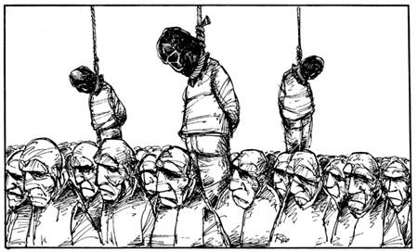
Examples: the moral issues regarding…
Abortion
Euthanasia
Giving to the poor
Sex before marriage
Death penalty
Gay/Lesbian marriage
War tactics
Censorship
so-called “white lies”etc.

Slide 4

white lies
A ​lie that is told in ​order to be ​polite or to ​stop someone from being ​upset by the ​truth.

Slide 5
Philosophers who study applied ethics look to the world around them and analyze the ethical problems they find.
By doing so, the applied ethicist is able to use philosophy as a tool to address important moral issues in various practical disciplines.

Slide 6
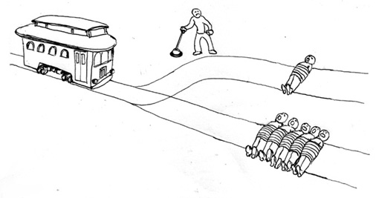
Applied Ethics
Applied ethics is the actual application of ethical theory for the purpose of choosing an ethical action in a given issue.

Slide 7
There are generally two approaches taken in applied ethics.
The first is to apply ethical principles such as
utilitarianism and deontological ethics to each
issue or question.
The second is to generate a situation-based conversation that uses multiple ethical theories.

Slide 8
Utilitarianism, where the practical consequences of various policies are evaluated on the assumption that the right policy will be the one which results in the greatest happiness.
Advantages:
Stresses promotion of happiness and utility.
Disadvantages:
Ignores concerns of justice for the minority population.

Slide 9
Utilitarianism Example:
The use of torture in interrogation.
A utilitarian would consider any action justified if it benefits the greatest number of people. they would hold the view that a criminal or prisoner of war, could be tortured and have his/her rights violated, if doing so would for instance, provide intelligence information that could make the majority of people safer.
The Basic Idea of Utilitarianism :
The Greatest Happiness Principle

Slide 10
Deontological ethics, planning based on 'rules' i.e. that there is a commitment to perform the 'right' action, regardless of actual consequences.
Advantages:
Stresses the role of duty and respect for persons.
Disadvantages:
Underestimate the importance of happiness and social utility.
Example: Human rights should be respected for all people; applied universally.

Slide 11
Major subfields
Applied ethics can be found in almost all kinds of professional fields or social practices.
While medical ethics, environmental ethics,
business ethics, and legal ethics are major subfields.
Applied ethics is found in
human rights, war, media, communication, sports, academic research, publication, and other areas.

Slide 12

Business ethics
Business ethics examines ethical principles and moral or ethical problems that arise in a business environment or economic activities.
Business ethics also discusses ethical question in marketing, accounting, labor including child labor and abusive labor practices, human resource management, political contributions, business acquisitions such as hostile take-overs, production, use of toxic material, intellectual property, information management including information leak, and others.

Slide 13
Legal ethics
Legal ethics refers to an ethical code governing the conduct of people engaged in the practice of law.
In the United States, for example, the American Bar Association has promulgated model rules that have been influential in many jurisdictions.
The model rules address the client-lawyer relationship, duties of a lawyer as advocate in adversary proceedings, dealings with persons other than clients, law firms and associations, public service, advertising, and maintaining the integrity of the profession.
Respect of client confidences, candor toward the tribunal, truthfulness in statements to others, and professional independence are some of the defining features of legal ethics.
American law schools are required to offer a course in professional responsibility, which encompasses both legal ethics and matters of professionalism that do not present ethical concerns.

Slide 14

Environmental ethics
Environmental ethics is the part of environmental philosophy which considers the ethical relationship between human beings and the natural environment. It put forth influence on a large range of disciplines including law, sociology, theology, economics, ecology and geography.
Some of the main topics are global warming, pollution, and issues are closely tied to those of poverty, sustainability, and economic and social justice. Furthermore, since environmental problems often affect beyond the boundaries of nation-states, the issues are tied to the fields of international relations and global governance.

Slide 15

Medical ethics and Bioethics
Medical ethics deals with study of moral values and judgments as they apply to medicine. As a scholarly discipline, medical ethics encompasses its practical application in clinical settings as well as work on its history, philosophy, theology, and sociology. Medical ethics shares many principles with other branches of healthcare ethics, such as nursing ethics.
Medical ethics tends to be understood narrowly as an applied professional ethics, whereas bioethics appears to have worked more expansive concerns, touching upon the philosophy of science and the critique of biotechnology and life science. Still, the two fields often overlap and the distinction is more a matter of style than professional consensus. Some topics include abortion, cloning, euthanasia, eugenics, and others.

Slide 16
Descriptive Ethics

Slide 17
Descriptive ethics is sometimes referred to as comparative ethics because so much activity can involve comparing ethical systems:
Comparing the ethics of the past to the present,
Comparing the ethics of one society to another and
Comparing the ethics which people claim to follow with the actual rules of conduct which do describe their actions.

Slide 18
What is descriptive ethics?
Descriptive ethics is a form of practical research into the attitudes of individuals or groups of people.
Research into descriptive ethics may also investigate people's ethical ideals or what actions societies reward or punish in law or politics.

Slide 19
Summed up:
Meta Ethics: Focuses on the nature of morality.
Normative Ethics: Focuses on the Content of morality.
Applied Ethics: Focuses on the Application of morality.
Descriptive Ethics: Focuses on how people behave.

Slide 20

Thank You

