Slide 1


Slide 2
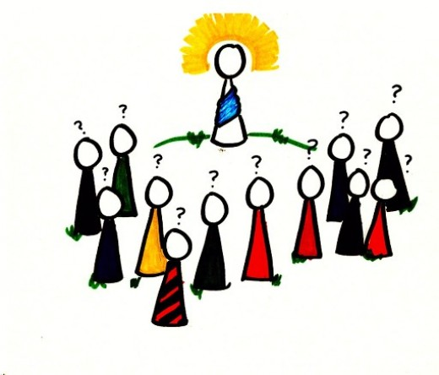
Definition of Value:
Values are principles that allow us to guide our behavior to fulfill ourselves as individuals.
Values have major influence on person's behavior and attitude and serve as broad guidelines in all situations.

Slide 3
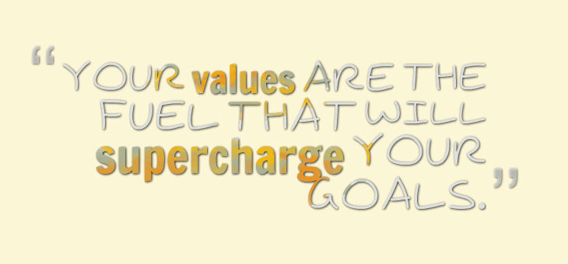

Slide 4
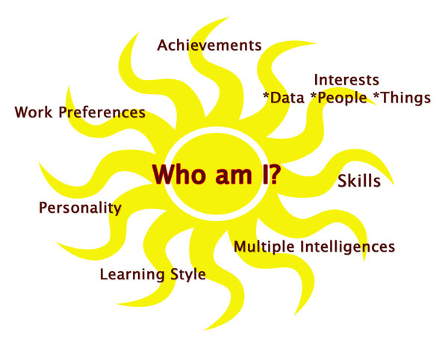
Understanding your Values

Slide 5

If I was to ask you what are your Values, would you know what they are?
And
more importantly, would you know how to utilize them?
If I was to ask you what are your Values, would you know what they are?
And
more importantly, would you know how to utilize them?

Slide 6

When it comes to Happiness, understanding
your values is a fundamental building block.
Your values influence
your behaviors,
your choices,
your emotions.
your habits,
your lifestyle and your social experiences.
Your values are your motivators and give you purpose for getting up in the morning.

Slide 7
How Values Help You?
Values exist, whether you recognize them or not.
Life can be much easier when you acknowledge your values – and when you make plans and decisions that honor them.
Example:
If you value family, but you have to work 70-hour weeks in your job, will you feel internal stress and conflict?
And if you don't value competition, and you work in a highly competitive sales environment, are you likely to be satisfied with your job?

Slide 8
In these types of situations, understanding your values can really help.
When you know your own values, you can use them to make decisions about how to live your life, and you can answer questions like these:
What job should I pursue?
Should I accept this promotion?
Should I start my own business?
Should I compromise, or be firm with my position?
Should I follow tradition, or travel down a new path?
So, take the time to understand the real priorities in your life, and you'll be able to determine the best direction for you and your life goals!

Slide 9

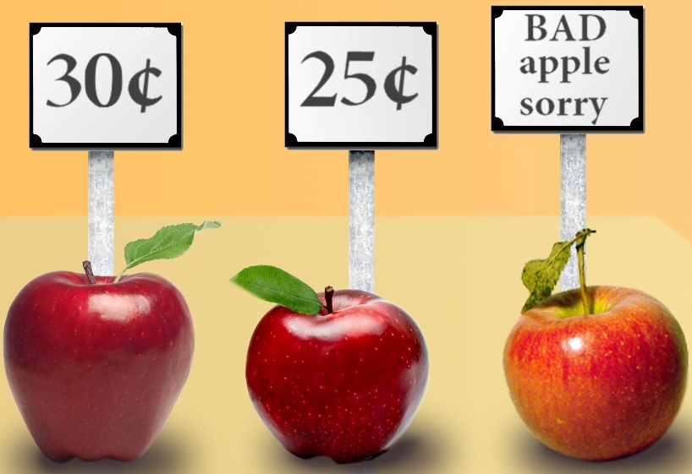
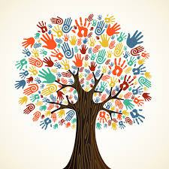
Examples of values are:
success,
honesty,
belonging and health.
Some people suggest that other activities such as reading, swimming or socializing are values, however these would be symptoms of your values.

Slide 10
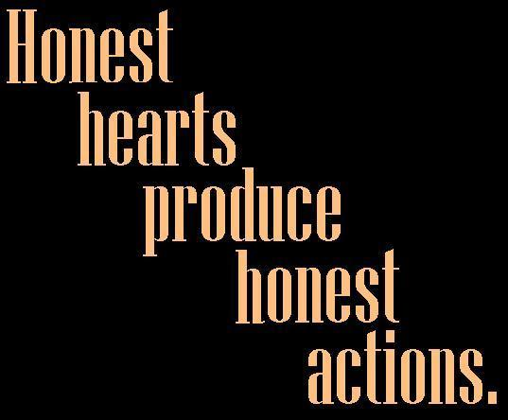

Slide 11
What Are Your Values?
How would you define your values?
Before you answer this question, you need to know what, in general, values are.
Your values are the things that you believe are important in the way you live and work.
They (should) determine your priorities, and, deep down, they're probably the measures you use to tell if your life is turning out the way you want it to.

Slide 12

When the things that you do and the way you behave match your values, life is usually good – you're satisfied and content.
But when these don't align with your personal values, that's when things feel... wrong. This can be a real source of unhappiness.
This is why making a conscious effort to identify your values is so important.

Slide 13

Building our Life
By
Defining our values

Slide 14

Defining Your Values
When you define your personal values, you discover what's truly important to you.
A good way of starting to do this is to look back on your life – to identify when you felt really good, and really confident that you were making good choices.

Slide 15

Step 1: Identify the times when you were happiest
Find examples from both your career and personal life. This will ensure some balance in your answers.
What were you doing?
Were you with other people? Who?
What other factors contributed to your happiness?

Slide 16

Step 2: Identify the times when you were most proud
Use examples from your career and personal life.
Why were you proud?
Did other people share your pride? Who?
What other factors contributed to your feelings of pride?

Slide 17

Step 3: Identify the times when you were most fulfilled and satisfied
Again, use both work and personal examples.
What need or desire was fulfilled?
How and why did the experience give your life meaning?
What other factors contributed to your feelings of fulfillment?

Slide 18
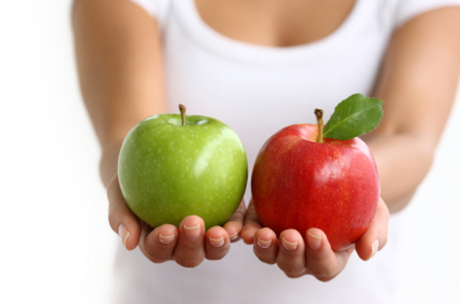
Step 4: Determine your top values, based on your experiences of happiness, pride, and fulfillment
Why is each experience truly important and memorable? Use the following list of common personal values to help you get started – and aim for about 10 top values.
(As you work through, you may find that some of these naturally combine. For instance, if you value philanthropy, community, and generosity, you might say that service to others is one of your top values.)

Slide 19

Step 5: Prioritize your top values
Write down your top values, not in any particular order.
Look at the first two values and ask yourself, "If I could satisfy only one of these, which would I choose?" It might help to visualize a situation in which you would have to make that choice
Keep working through the list, by comparing each value with each other value, until your list is in the correct order.

Slide 20
Step 6: Reaffirm your values
Check your top-priority values, and make sure they fit with your life and your vision for yourself.
Do these values make you feel good about yourself?
Are you proud of your top three values?
Would you be comfortable and proud to tell your values to people you respect and admire?
Do these values represent things you would support, even if your choice isn't popular, and it puts you in the minority?
When you consider your values in decision making, you can be sure to keep your sense of integrity and what you know is right, and approach decisions with confidence and clarity. You'll also know that what you're doing is best for your current and future happiness and satisfaction.
Making value-based choices may not always be easy. However, making a choice that you know is right is a lot less difficult in the long run.

Slide 21
Important Values For Every One
A few basic values in order to survive.
Honesty
Respect
Manners and Discipline
Sharing
Take Responsibility for Your Actions
Love

Slide 22

Culture
Culture is Something that unites people

Slide 23
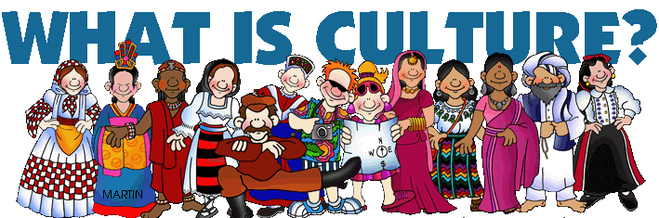

Slide 24
Culture:
Culture ... is that complex whole which includes
knowledge,
belief,
art,
morals,
law,
custom,
and any other capabilities and habits acquired by man as a member of society.

Slide 25
Culture:
‘... the set of
attitudes,
values,
beliefs, and
behaviors
shared by a group of people, but different for each individual, communicated from one generation to the next.’

Slide 26
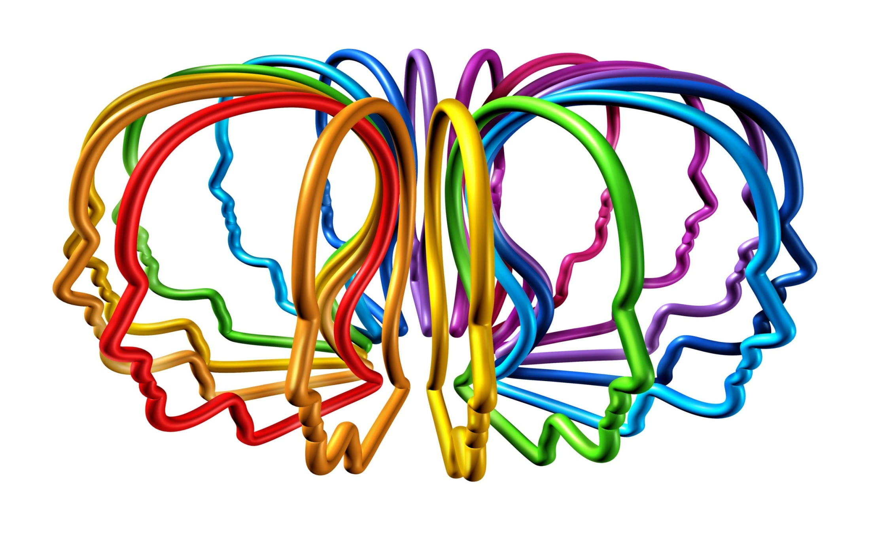
Culture is the way you think, act, and interact.

Slide 27
Some Key Characteristics of Culture
1. Culture is shown at different layers of depth
In analyzing the culture of a particular group or organization it is desirable to distinguish three fundamental levels at which culture displays itself:
(a) observable work of art,
(b) values, and
(c) basic underlying assumptions.

Slide 28
When one enters an organization one observes and feels its artifacts.
This category includes:
everything from the physical layout,
the dress code,
the manner in which people address each other,
the smell and feel of the place,
its emotional intensity, and other phenomena,
to the more permanent archival manifestations such as company records, products, statements of philosophy, and annual reports.

Slide 29
2. Culture influence behavior
For example,
a gesture such as the ‘ring gesture’ (thumb and forefinger touching) may be interpreted as conveying agreement, approval or acceptance in the USA, the UK and Canada, but as an insult or obscene gesture in several Mediterranean countries.
Similarly, choice of clothing can be interpreted differently by different groups of people, in terms of indications of wealth, ostentation, appropriateness, and so on.

Slide 30
3.Culture can be differentiated from both universal human nature and unique individual personality
Culture is learned, not inherited. It derives from one’s social environment, not from one’s genes.
Culture should be distinguished from human nature on one side, and from an individual’s personality on the other (see Fig. 2), although exactly where the borders lie between human nature and culture, and between culture and personality, is a matter of discussion among social scientists.
HUMAN NATURE
SPECIFIC TO INDIVIDUAL
INHERITED & LEARNED
PERSONALITY
SPECIFIC TO
GROUP/CATEGORY
CULTURE
LEARNED
UNIVERSAL
INHERITED

Slide 31
4.Culture influences biological processes
If we stop to consider it, the great majority of our conscious behavior is acquired through learning and interacting with other members of our culture.
Even those responses to our purely biological needs (that is, eating, coughing, defecating) are frequently influenced by our cultures.
For example, all people share a biological need for food. Unless a minimum number of calories is consumed, starvation will occur. Therefore, all people eat. But what we eat, how often we eat, how much we eat, with whom we eat, and according to what set of rules are regulated, at least in part, by our culture

Slide 32
5.Culture is learned
Culture is learned from the people you interact with as you are socialized.
Watching how adults react and talk to new babies is an excellent way to see the actual symbolic transmission of culture among people.
People from different cultures would complete the blank in contrasting ways. The people with whom the children interact will praise and encourage particular kinds of behaviors (such as crying or not crying, being quiet or being talkative).

Slide 33
What is the difference between Values and Culture in a Company?
Culture:
Culture is something man created in order to suit our natural desires.
Value:
principles or standards of behavior;
one's judgement of what is important in life.

Slide 34
What is the difference between society and culture?
People living together is society.
The culture helps us in maintain traditions and conventions to enhance social relations

Slide 35
Types of values
Personal values
Family values
Social-cultural values
Material values
Spiritual values
Moral values

Slide 36
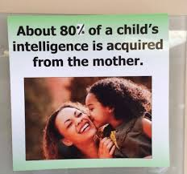

Slide 37
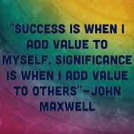

Slide 38

Thank You

