Slide 1


Slide 2

Societal Values

Slide 3
Societal values are the assumptions, beliefs or principles that guide people’s decision-making and actions in society.
A set of consistent values form a ‘value system’, or ethical framework.
Although there is no single value system to which all people subscribe, studies have found that there is considerable agreement about the sets of values recognized and holded by large numbers of People. Some of these values are explored in this sheet.

Slide 4
Two ways of looking at values
Values can be regarded in two different ways:
as descriptions or
as prescriptions.
Regarding values as descriptions means that they are taken to reflect an existing reality, the way things are today. By making comprehensive observations of actual choices made by people as they go about their lives and by interpreting these choices as reflections of underlying values, we can begin to understand which values best describe a particular society or culture.

Slide 5
By contrast,
regarding values as prescriptions means considering them to be (normative) statements about how things ought to be:
statements about which things are good or bad, which actions are right or wrong and
what we should value in a good society.

Slide 6
List of Values of Society
Accomplishment
Accountability
Accuracy
Act on things
Adventure
All for One; One for All
Charity
Children, Nurturing of
Civic Duty
Civic Pride
Civil Rights
Cleanliness, Orderliness
Collaboration
Collective, Needs of the
Commitment
Success, Achievement
Teamwork
Thinking, Thought
Timeliness
Tolerance
Tradition
Tranquility
Truth, Seeking the underlying-
Trust
Valuing Values
Variety
Wealth
Wisdom
Women's Rights
World Unity

Slide 7

Aesthetic Value

Slide 8

Definition
Aesthetic value is the value that an object, event or state of affairs (most paradigmatically an art work or the natural environment) possesses in virtue of its capacity to elicit pleasure (positive value) or displeasure (negative value) when appreciated or experienced .

Slide 9
Everything that is valuable is valuable in a variety of ways.
Art objects often have sentimental value, historical value or financial value.
Wilderness can have economic value as well as recreational value. But great art works are thought to possess a distinctive sort of non-instrumental and non-utilitarian value that is of central concern when they are evaluated as art works.
It might be thought that this value is beauty, but many artworks are not beautiful.
So it is more plausible that beauty is a particular species of the value in question.

Slide 10
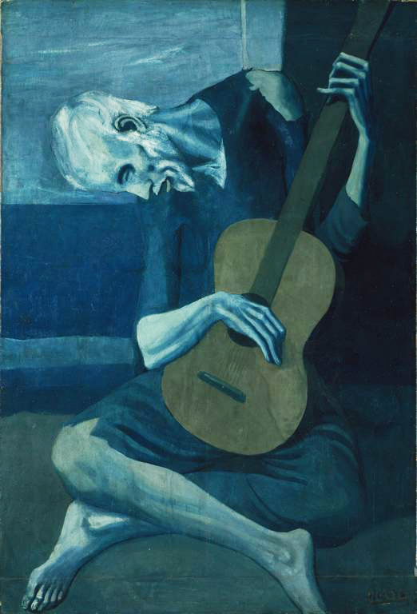
The Old Guitarist is an oil painting by Pablo Picasso created late 1903–early 1904.
It depicts an old, blind, haggard man with threadbare clothing weakly hunched over his guitar, playing in the streets of Barcelona, Spain.
Artist: Pablo Picasso
Period: Picasso's Blue Period
Dimensions: 1.23 m x 83 cm
Created: 1903–1904
Media: Oil paint

Slide 11
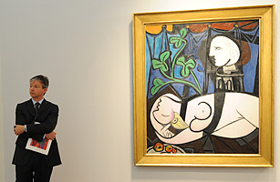
The Most Expensive Painting
Item: Pablo Picasso's Nude, Green Leaves and Bust
Winning Bid: $106.5 million
Sold: 2010

Slide 12
The aesthetic value that a work of art possesses (and most would extend this to the natural environment) has to do with the sort of experience it provides when engaged with appropriately.
If it provides pleasure in virtue of our experience of its beauty, elegance, gracefulness, harmony, proportion, unity, etc., we say that it has positive aesthetic value.
If it provides displeasure in virtue of ugliness, deformity or disgustingness we may say that it has negative aesthetic value.
One important thing to note is that the pleasure or displeasure underwriting aesthetic value is best thought of as directed at the object in question rather than being merely caused by it.

Slide 13
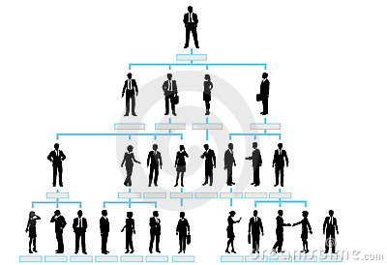
.
Organizational Value

Slide 14
An organization’s values might be thought of as a moral compass for its business practices.
While circumstances may change, ideally values do not.
Vision and mission statements provide direction, focus, and energy to accomplish shared goals.
Writing down a set of commonly-held values can help an organization define its culture and beliefs.

Slide 15
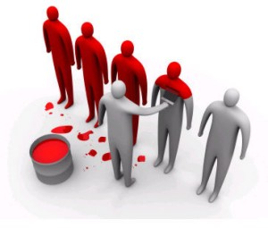
WHAT VALUES CAN LOOK LIKE
This varies from one organisation to another. However there should be a few core values only, They support your vision, shape your culture, and reflect what you value.

Slide 16

1.Teamwork
Listening to and respecting each other whilst working together to achieve mutually beneficial results.
Providing support to one another, working co-operatively, respecting one another’s views, and making our work environment fun and enjoyable.

Slide 17
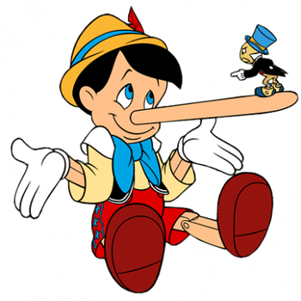
2.Honesty
Being open and honest in all our dealings and maintaining the highest integrity at all times.
All concerns are aired constructively with solutions offered.
Each person is as skilled in some way as another and is entitled to express their views without interruption.

Slide 18

3.Excellence
Always doing what we say we will and striving for excellence and quality in everything we do.
Quality will always delight the client whilst staying within budget limitations.
If we give our word we keep it unless agreed otherwise by all parties.

Slide 19

4.Commitment
Working with urgency and commitment to be successful from individual and company perspectives.
Timeframes are always met unless urgent circumstances mean we have to renegotiate new timeframes with all parties.
Clients’ needs agreed within budgets are met regardless of personal wants.

Slide 20

5.Ownership
Taking ownership of our customers’ needs and being accountable for delivering friendly and professional service.
We are each fully accountable for our work in gaining any possible repeat business with customers.
We understand our customers’ business, prepare for all meetings with them.

Slide 21

6.Recognition
Recognising and rewarding each others contributions and efforts.
All individual successes are celebrated within the team.
Assistance is thanked every time.

Slide 22

7.Customer Service
We enjoy their custom and so they deserve our service -timely, responsive, proactive, meeting their needs and aiming to delight.
At every meeting with our customers we ask them what we could have done better, then implement their suggestions before we meet them again.
Before any accounts are rendered, we check with our customers that they are sufficiently satisfied to pay the agreed account.
All agreements are met.

Slide 23

8.Professionalism
At all times we act with integrity, providing quality service, being reliable and responsible.
We do not upset one another intentionally, always endeavoring to present negative feedback constructively.
We take pride and ownership in all that we do and say.
We never talk about people behind their backs.

Slide 24

9.Personal development
We value learning, feedback, coaching and mentoring.
Coaching and mentoring are commonplace here; we all coach and mentor one another.
All opportunities for our own learning are pursued.
Whenever we undertake a project it is our responsibility to express our training needs and gather the required skills.
We each take responsibility to gain the required development to meet our customers’ needs.
We each take responsibility to gain the required development to be learning consultants.

Slide 25
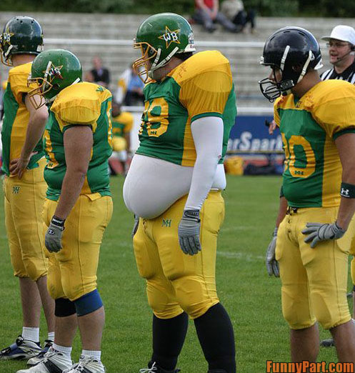
Thank You

