Slide 1

Principles
of Professionalism

Slide 2


Slide 3
The Principle of Professionalism
Integrity
Respect
Ethics
Responsibility
Commitment

Slide 4
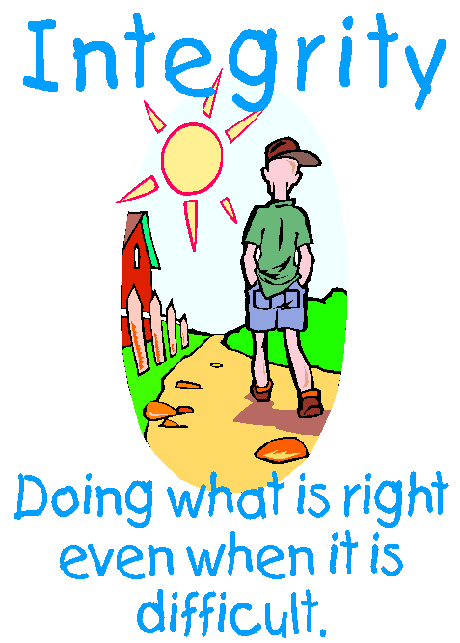
Integrity
Professional integrity includes demonstrating fairness in decision-making processes, acting in the best interest of the company and its clients, and treating colleagues with respect.
Being a person of high integrity means Consistently behaving in an ethical manner in every professional action or exchange.

Slide 5
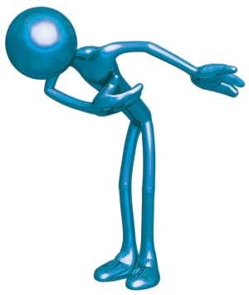
Respect
Principled professionals show respect for others and avoid harsh criticism of their colleagues' work.
This professional allows others the chance to speak and participate in workplace debates and carefully considers opposing points of view before making decisions.
Courtesy guides an individual in personal interactions, even contentious ones.
Respectful individuals do not disclose personal or professional confidences or talk about others in derogatory terms.

Slide 6

Ethics
An ethical professional does not take advantage of others, claim credit for others’ work, or misrepresent his own performance or the performance of his company.
An ethical person does not participate in inappropriate or unlawful behaviors and strives to maintain an unblemished reputation for honesty and fair business dealings.

Slide 7
Responsibility
A principled professional takes responsibility for his work product, his own performance and the performance of the teams he leads.
This type of professional also acknowledges mistakes or shortcomings and works to correct problems and situations to the best of his ability.
A responsible professional doesn't place undue blame on others, make false claims or statements or pawn off personal responsibilities on others.

Slide 8
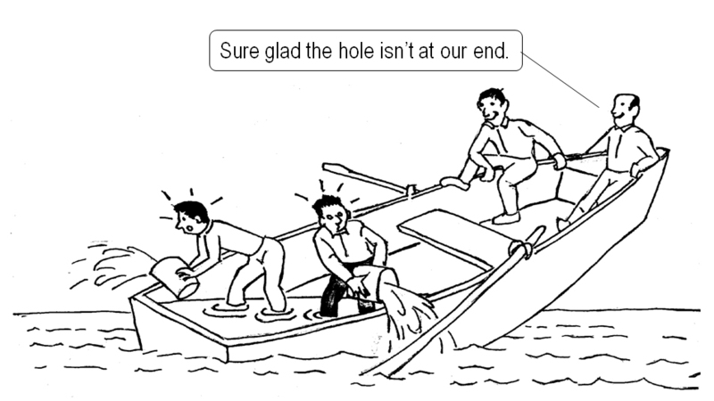
An Example of
Irresponsibility:

Slide 9

Commitment
A committed professional dedicates himself to his responsibilities in all ways possible.
This includes every effort to do his best work, whether independently or with a team, and to positively represent a company in public settings.
Commitment to a profession means avoiding real or perceived conflicts of interest and honoring all contractual obligations.

Slide 10
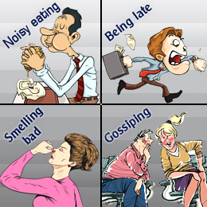
Avoid Being Unprofessional
Your employer may not tell you exactly their own view of what being professional means.
But we all know from experience how to get labelled as “unprofessional.”
By finishing tasks or projects late, for instance.
Being unprepared when attending meetings.
Spending time gossiping at work.

Slide 11
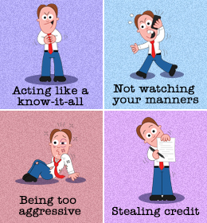
Other ways to be seen as unprofessional?
Treat people with disrespect.
Keep them waiting unnecessarily.
Steal their thunder by using their ideas without giving them credit.
Say one thing then do the complete opposite.
Break promises regularly.

Slide 12

Ways To Be Professional
Acting like a professional really means doing what it takes to make others think of you as reliable, respectful, and competent.
Depending on where you work and the type of job you have, this can take on many different forms.
There are, however, quite a few common traits when it comes to being professional.
This includes the following:
1. Competence. You’re good at what you do – and you have the skills and knowledge that enable you to do your job well.
2. Reliability. People can depend on you to show up on time, submit your work when it’s supposed to be ready, etc.

Slide 13

4. Integrity.
You are known for your consistent principles.
5. Respect For Others.
Treating all people as if they mattered is part of your approach
6. Self-Upgrading.
Rather than letting your skills or knowledge become outdated, you seek out ways of staying current. 7. Being Positive.
No one likes a constant pessimist. Having an upbeat attitude and trying to be a problem-solver makes a big difference.

Slide 14



8. Supporting Others.
You share the spotlight with colleagues, take time to show others how to do things properly, and lend an ear when necessary. 9. Staying Work-Focused.
Not letting your private life needlessly have an impact on your job, and not spending time at work attending to personal matters. 10. Listening Carefully.
People want to be heard, so you give people a chance to explain their ideas properly.

Slide 15
The Professional Advantage
The more you put into practice the 10 points listed above, the better your chances will be to create a positive reputation for yourself. This can ultimately translate into raises and promotions, chances to work on more assignments that you enjoy, less likelihood of being downsized when layoffs are being considered, and the respect of peers and senior management. You also benefit from feelings of increased self-worth and dignity.
Plus you keep yourself marketable for the future. All in all, some very good reasons to as professional as possible.

Slide 16
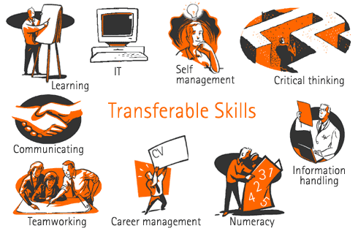

Slide 17
What are Transferable Skills?
Transferable skills are skills and abilities that are relevant and helpful across different areas of life: socially or professionally. They are ‘portable skills’.
People usually think about their transferable skills when applying for a job or when thinking about a career change.
Employers often look for people who can demonstrate a good set of transferable skills.
All skills and abilities can be transferable – depending on where they are being transferred to and from.

Slide 18

Team Work
Work effectively in a group or team to achieve goals. In many jobs you will be expected to work as part of a team.
Demonstrating your ability to work with others will help to reassure employees that you will ‘fit in’ and offer a valuable contribution.
Think about how you overcame issues and mention your successes. Use examples from previous work experience, from education or from being a member of a social or sports group.

Slide 19

Leadership(Show initiative and leadership abilities)
You may not be applying for a role that specifically requires leadership ability but you may well need to be able to demonstrate your capability to lead in certain situations.
There are many skills you need to be an effective leader so think about examples when you have helped to motivate, take responsibility for and lead others effectively to accomplish objectives and goals.
You should also consider whether you can delegate effectively and whether you are happy to ask for help when needed.

Slide 20
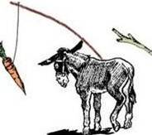
Personal Motivation, Organisation and Time management, Manage and prioritise your workload and time effectively.
As well as being able to work effectively in a group situation, you are likely to be required to work alone and take responsibility for your time and work.
It is important to demonstrate to potential employers that you have effective time management and personal organisational skills.
Mention examples in your covering letter, CV, résumé or during an interview that demonstrate how you have structured and arranged resources to achieve objectives.

Slide 21

Listening(Are you a good listener?)
Employers commonly complain about
their staff’s inability to listen effectively and Richard Branson rates effective listening as one of the most important skills we can develop.
In many job roles you will be required to understand and process important or complex information as not listening effectively can lead to potentially costly mistakes, misunderstandings and lost opportunities.

Slide 22
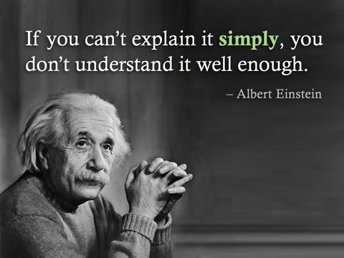

Slide 23

Written Communication
(Write accurately, clearly and concisely in variety of styles.)
Many job roles will require an element of writing skill.
You may be required to adapt your writing style frequently,
producing reports,
press releases,
marketing materials,
letters or emails, and you may have to write for the web,
for customers,
shareholders and colleagues.

Slide 24

Verbal Communication
(Speak clearly and dynamically in a variety of situations)
Employers often require staff with strong verbal communication skills.
Can you communicate information and ideas clearly and effectively in a variety of situations?
Think about your verbal communication skills and how you address others, both face-to-face and in group situations.

Slide 25

Research and Analytical Skills
(Gather, interpret and analyse information)
It may be appropriate to demonstrate your ability to research, analyse and critically evaluate information.
There could be a variety of complex information that you are required to work with and make sense of, for example sales figures, new product and supplier specifications, technical reports and financial information.

Slide 26

Numeracy Skills
(Accurately and effectively work with numbers)
You may not be applying for a job or pursuing a career in mathematics or statistics but it is likely that some basic understanding of numeracy will be useful.
Most jobs will require some numeracy skills.
Numeracy is an area that is frequently quoted
by employers as lacking – especially amongst graduates.
You should be able to demonstrate that you can work with figures, make calculations, understand graphs, charts and simple statistics and recognise important numerical information and trends.

Slide 27

Personal Development
Know yourself and find ways to develop. Personal development is an attractive quality to employers.
Personal development is about evaluating your own performance and recognising your personal strengths and weaknesses.

Slide 28


Slide 29
Definition:
Decision : is a solution chosen from among alternatives .
Decision-making process : is the process of selecting an alternative course of action that will solve a problem.
Problem solving: is the process of taking corrective action in order to meet objectives.

Slide 30
Decision making and Problem-Solving Steps:
Define the problem
Gather information
Develop alternatives
Weigh alternatives
Select the best alternative
Implement the solution
Monitor progress and follow up

Slide 31
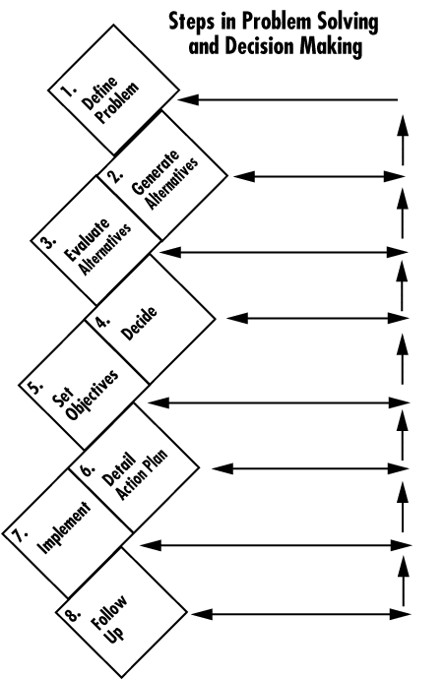

Slide 32


Slide 33

Professionalism in the Workplace:
Professionalism in the workplace is based on many factors, including how you dress, carry yourself, your attitude and how you interact with others. The definition of professionalism indicates that each person perform their tasks with genuine earnest and honesty. It refers to a person doing his / her job with sincerity, and maintaining professional etiquette and ethics in the workplace.

Slide 34
How to Show Professionalism in the Workplace?

Slide 35

Adhere to your commitments
Live up to your commitments every time.

Slide 36

Realize the sensitivity of the work that you represent
Make sure not to jeopardize the confidentiality of your organization or misuse it any way. This will help make you trustworthy.

Slide 37
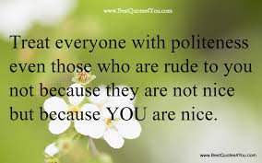
Treat everyone with respect.
That means everyone - from upper management, peers, and administrative staff to vendors, clients and competitors, to the person on the phone and the stranger in the elevator.

Slide 38
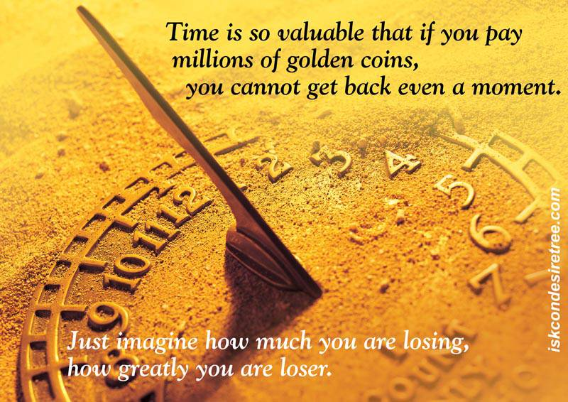
Value the time and effort spent by others
Do not take other members of the organization for granted.

Slide 39
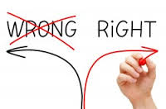
Always maintain ethical conduct
Be honest and refrain from deceitful practices.

Slide 40
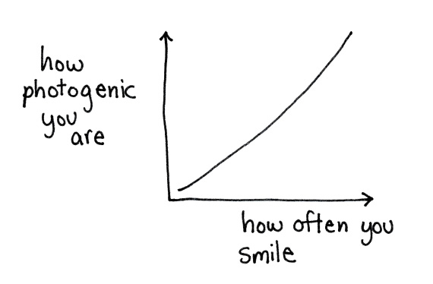
Smile and put your best face forward
Friendliness and understanding go a long way to creating an atmosphere of teamwork.
Maintain a positive can-do attitude even during stressful situations.

Slide 41
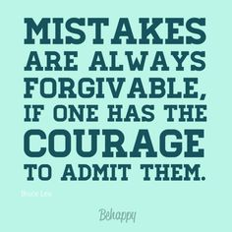
Admit your mistakes
We all make mistakes. Admitting your mistake shows that you are not only human, but also a professional. Don’t be surprised at how understanding people will be when you admit that you have made an error.

Slide 42
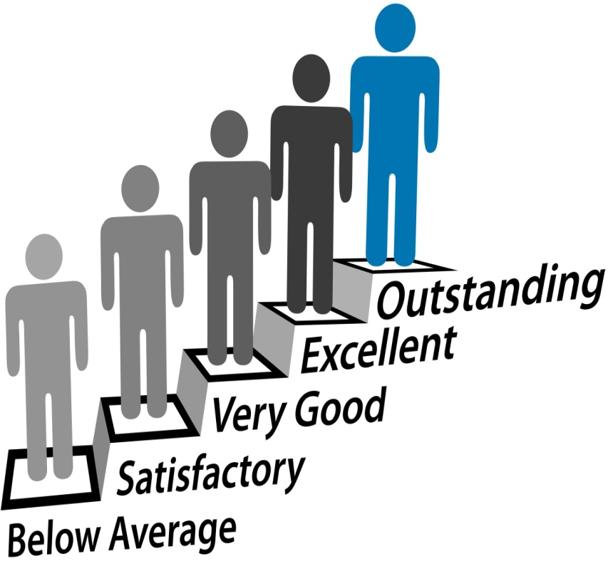
Display competence
Competence is the culmination of what you say that you can do and what you actually can do. Competent employees know their job and which skills they are capable of. It is not arrogance. It is an honest display of competencies.

Slide 43

Take a leadership role whenever possible
Show that you are willing to accept responsibility and produce results.

Slide 44

Keep personal issues at home
Refrain from using the company’s time for personal issues.
While personal issues will be considered by management when required, employees need to refrain from discussing it during office hours.
This keeps the office environment free from empathy-related biases about productivity.

Slide 45

Demonstrate the core values of professionalism
Appropriate attire, etiquette, punctuality, organization and dedication to your job, just to name a few.

Slide 46

Project a positive business appearance
It has long been recognized that those who dress professionally will behave in the same manner.

Slide 47

Be polite in speech and body language
“Please” and “Thank-you” go a long way in establishing a good working relationship.

Slide 48

Turn off or silence mobile devices
This will minimize distractions for you and others. It shows that you value the time spent by others

Slide 49
Thank You

