Slide 1



Slide 2
UNIT I
Ethics: Ethics, Normative ethics, Meta Ethics, Applied Ethics, Descriptive Ethics.
Values in human society and types of values: Understanding of values; definition; culture and values; the wider applications of values; societal values; aesthetic values; organizational values; spiritual values;

Slide 3

Objective & Outcomes of UNIT:1

Slide 4

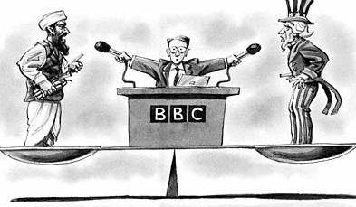

Understanding of how u can use what you have learned
Public accountability
Impartiality
Fairness
Objectives
Accuracy
Truthfulness
Critical Thinking Skills

Slide 5

Ethics:
The branch of knowledge that deals with moral principles.
the principles of right and wrong behavior.

Slide 6

Why do Engineers Need to Know about Ethics?
With Knowledge and skills, engineers have the Power to do great things.
With this Power,
Engineers have a tremendous responsibility to individuals, organizations, and society.

Slide 7
Ethics help guide our decisions to ensure we act responsibly.
All Engineers are expected to behave in a professional manner.

Slide 8
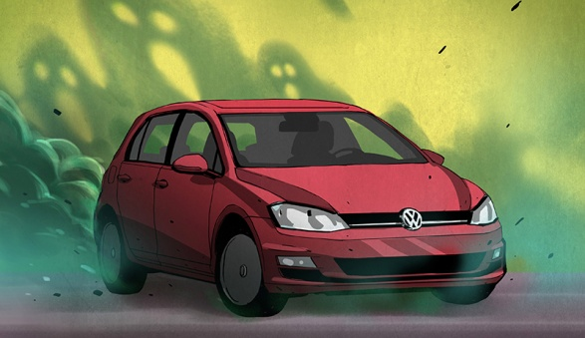
Every so often – and usually not under the best of circumstance – the field of engineering as a whole is presented with a teaching moment.
Volkswagen is currently embroiled in a huge scandal involving emissions testing of 11 Million diesel cars sold in recent years.
It’s a problem that could cost VW dearly, to the tune of eighteen Billion dollars in the US alone, and will, without a doubt, end the careers of more than a few Volkswagen employees.
In terms of automotive scandals, this is bigger than Unsafe at Any Speed. This is engineering history in the making, and an enormously teachable moment for ethics in engineering.

Slide 9
Ethics & Professionalism
Generally,
Ethics tell us what we should not do.
and
Professionalism deals with what we should do.

Slide 10

Types of Ethics

Slide 11
Meta-ethics
Meta-ethics is the systematic study of what we are doing when we engage in moral practice.
Definition of Meta-ethics:
The study of the meaning and nature of ethical terms, judgments, and arguments.
Or
We may define meta-ethics as the study of the origin and meaning of ethical concepts

Slide 12
The Two Main areas of Meta-Ethics:
(1) Metaphysical
Issues concerning whether morality exists independently of humans.
(2) Psychological
Issues concerning the underlying mental basis of our moral judgments and conduct.

Slide 13
Metaphysical issue:
Metaphysics is the study of the kinds of things that exist in the universe.
Some things in the universe are made of physical stuff, such as rocks; and perhaps other things are nonphysical in nature, such as thoughts, spirits, and gods.
The metaphysical component of meta-ethics involves discovering specifically whether moral values are eternal truths that exist in a spirit-like realm, or simply human conventions.

Slide 14
Psychological Issue:
A second area of meta-ethics involves the psychological basis of our moral judgments and conduct,
particularly
understanding what motivates us to be moral.

Slide 15
We might explore this subject by asking the simple question,
“ Why be moral ? "
Even if I am aware of basic moral standards, such as don't kill and don't steal, this does not necessarily mean that I will be psychologically compelled to act on them.
Some answers to the question "Why be moral?" are to avoid punishment, to gain praise, to attain happiness, to be dignified, or to fit in with society.

Slide 16
Three Types of Psychological Issues:
I. Egoism and Altruism
II. Emotion and Reason
III. Male and Female Morality

Slide 17

I. Egoism and Altruism
One important area of moral psychology concerns the inbuilt selfishness of humans.
That many, if not all, of our actions are prompted by selfish desires.
Even if an action seems selfless, such as donating to charity, there are still selfish causes for this, such as experiencing power over other people. This view is called psychological egoism and maintains that self-oriented interests ultimately motivate all human actions.

Slide 18
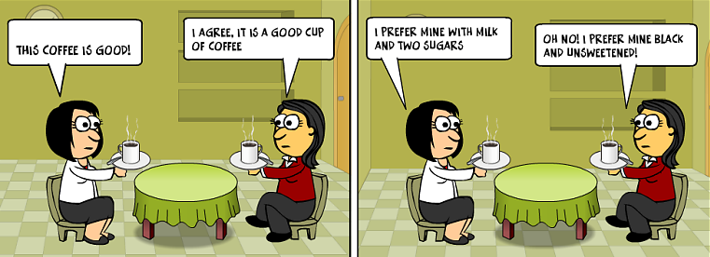
Altruism
Egoism

Slide 19
Closely related to psychological egoism is a view called psychological hedonism which is the view that pleasure is the specific driving force behind all of our actions.
we also have an inbuilt psychological capacity to show benevolence to others.
This view is called psychological altruism and maintains that at least some of our actions are motivated by instinctive benevolence.

Slide 20

II. Emotion and Reason
A second area of moral psychology involves a dispute concerning the role of reason in motivating moral actions.
Moral assessments involve our emotions.
Instead, true moral action is motivated only by reason.

Slide 21
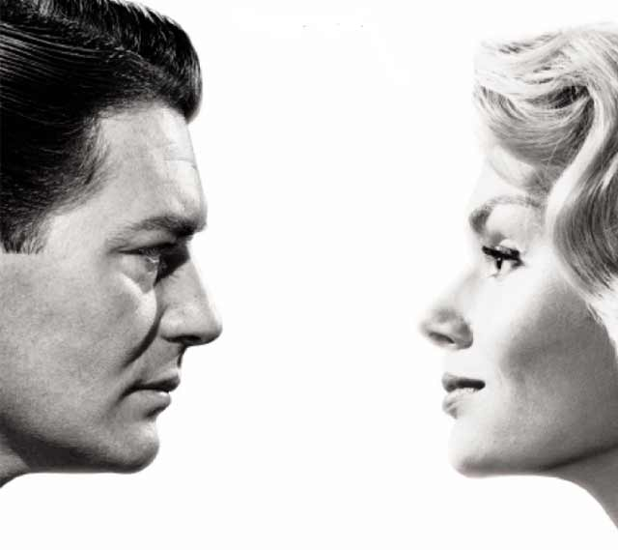
III. Male and Female Morality:
A third area of moral psychology focuses on whether there is a distinctly female approach to ethics that is grounded in the psychological differences between men and women.
Discussions of this issue focus on two claims:
(1) traditional morality is male-centered, and
(2) there is a unique female perspective of the world which can be shaped into a value theory.

Slide 22
Normative Ethics

Slide 23
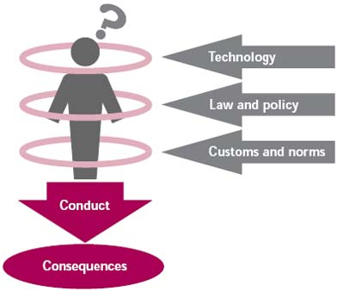
Normative Ethics
‘Normative’ means something that ‘guides’ or ‘controls’.
Normative ethics is the study of ethical action.
It is the branch of ethics that investigates the set of questions that arise when considering how one have to act, morally speaking.

Slide 24
Normative ethics is distinct from Meta-ethics because
It examines standards for the rightness and wrongness of actions,
while meta-ethics studies the meaning of moral language.

Slide 25

The Golden Rule is a classic example of a normative principle:

Slide 26
The Golden Rule is an example of a normative theory that establishes a single principle against which we judge all actions.
Other normative theories focus on a set of foundational principles, or a set of good character traits.

Slide 27


Religion and philosophy
Christianity
"Do to others what you want them to do to you. This is the meaning of the law of Moses and the teaching of the prophets" (Matthew 7:12 NCV, see also Luke 6:31).
Islam
"Wish for your brother, what you wish for yourself" or "Love your brother as you love yourself". The Golden Rule is implicitly expressed in some verses of the Qur'an, but is explicitly declared in the sayings of Muhammad

Slide 28
The key assumption in normative ethics is that there is only one ultimate criterion of moral conduct, whether it is a single rule or a set of principles.
Three strategies will be noted here:
(1) Virtue theories,
(2) Duty theories, and
(3) Consequentialist theories.

Slide 29
(1) virtue theories:
Places less emphasis on learning rules, and instead stresses the importance of developing good habits of character, such as benevolence.
Once I've acquired benevolence, for example, I will then habitually act in a benevolent manner.
Aristotle argued that virtues are good habits that we acquire, which regulate our emotions

Slide 30
Historically, virtue theory is one of the oldest normative traditions in Western philosophy, having its roots in ancient Greek civilization.
Plato emphasized four virtues in particular, which were later called cardinal virtues:
wisdom,
courage,
temperance and justice.
Other important virtues are fortitude, generosity, self-respect, good temper, and sincerity.

Slide 31
In addition to advocating good habits of character, virtue theorists hold that we should avoid acquiring bad character traits, or vices, such as cowardice, insensibility, injustice, and vanity.
Virtue theory emphasizes moral education since virtuous character traits are developed in one's youth. Adults, therefore, are responsible for instilling virtues in the young.

Slide 32
(2) Duty theories:
Many of us feel that there are clear commitments we have as human beings, such as to care for our children, and to not commit murder.
Duty theories base morality on specific, foundational principles of obligation.
There are Three central duty theories.
  Duties to God,
  Duties to oneself, and
  Duties to others.

Slide 33
1. Concerning our duties towards God, he argued that there are two kinds:
A) a theoretical duty to know the existence and nature of God, and
B) a practical duty to both inwardly and outwardly worship God.

Slide 34
2. Concerning our duties towards oneself, these are also of two sorts:
A) duties of the soul, which involve developing one's skills and talents.
B) duties of the body, which involve not harming our bodies, as we might through gluttony or drunkenness, and not killing oneself.

Slide 35
3. Concerning our duties towards others, these are also of three sorts:
A) Avoid wronging others,
B) Treat people as equals, and
C) Promote the good of others.

Slide 36
(3) Consequentialist theories:
Consequentialism: An action is morally right if the consequences of that action are more favorable than unfavorable.

Slide 37
Consequentialist normative principles require that we first tally both the good and bad consequences of an action.
Second, we then determine whether the total good consequences outweigh the total bad consequences.
If the good consequences are greater, then the action is morally proper.
If the bad consequences are greater, then the action is morally improper.

Slide 38

Thank You

