Slide 1
CHAPTER III
LINEAR ALGEBRAIC EQUATIONS
ELIAS Y.

Slide 2
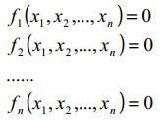
3.1 INTRODUCTION
3.1.1 Objective
How to solve systems that have the form of:
Where f1,f2,f3,….,fn are linear functions dependent on x1,x2…

Slide 3
3.1.2 Contents
Graphical Method
Cramer’s rule
Elimination
Naïve Gauss Elimination
Gauss-Jordan Elimination
LU-Decomposition
Gauss-Seidel Method

Slide 4
3.2 Graphical Method
For a system of linear equations, representing every equation graphically i.e.
Lines for 2 variables
Planes for 3 variables
For n variables, holding m variables constants and studying behavior graphically by varying the rest of the variables(n-m <3)

Slide 5
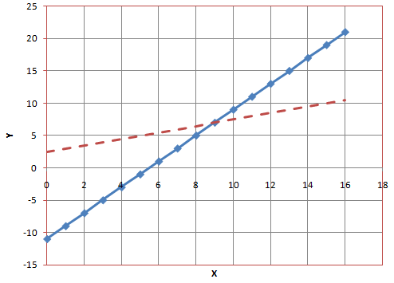
3.2 Graphical Method
Example
{-2x+4y=10; 2x-y=11} solution={x=9.0, y=7.0}

Slide 6
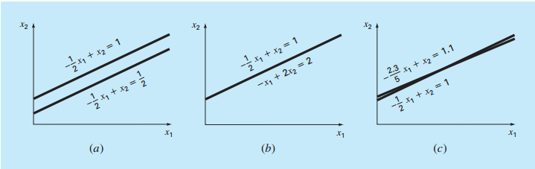
3.2 Graphical Method
Advantages
Help in visualizing the nature of such systems.
Singular
Infinite solutions
Ill-Conditioned

Slide 7
3.2 Graphical Method
Disadvantages
Useless for systems with rank>=3.
4D and 5D systems aren’t what you’d think.

Slide 8
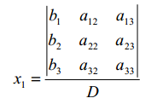
3.3 Cramer’s Rule
Applicable for smaller problems
[EXAMPLE]
[SCILAB DEMONSTRATION]

Slide 9
3.3 Cramer’s Rule
[EXAMPLE]
3x+5y=10
x+2y=5
D=1; D1=-5 ; D2=5
[solution : x=D1/D=-5; y=D2/D=5]
[SCILAB]

Slide 10
3.3 Cramer’s Rule
LIMITATIONS
If system is larger than rank 3, then evaluation of determinants becomes impractical.

Slide 11
3.4 Elimination methods
Naïve Gauss Elimination
Gauss-Jordan Elimination
Pitfalls of Gauss Elimination
Division by Zero
Round-off Errors
Ill-Conditioned systems
Singular systems

Slide 12
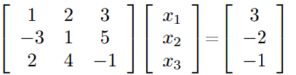
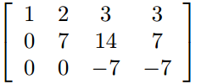
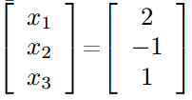
3.4.1 Naïve Gaussian Elimination
Elimination until Upper triangular matrix forms
[EXAMPLE][MAXIMA demo]

Slide 13
3.4.1 Naïve Gaussian Elimination
[SCILAB] (matrices and the “inv” function)
>>>a=[1 2 3;-3 1 5;2 4 -1];
>>>b=[3;-2;-1];
>>>x=inv(a)*b
>>>2.
-1.
1.

Slide 14

3.4.2 Gauss-Jordan Elimination
Perform until the IDENTITY matrix forms on the left side.

Slide 15
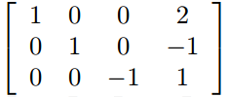
3.4.2 Gauss-Jordan Elimination

Slide 16
3.5 LU Decomposition
STEPS:
1.Initial : [A]{X}={B}
2.Decompose [A] into [U] and [L]
3. Construct new sets of systems:
[L]{D}={B}…….(1)
[U]{x}={D}…….(2)
4. Solve (1) and get {D}
5. Use {D} from step 4 to solve (2) and get {x}

Slide 17
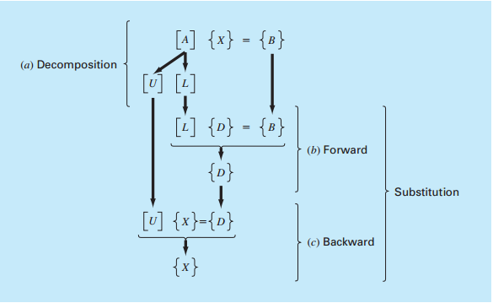
3.5 LU Decomposition

Slide 18
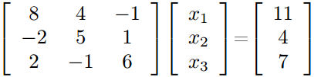
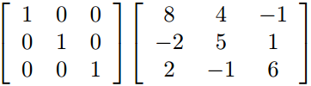
3.5 LU Decomposition
[EXAMPLE]
Step 1: Decomposition

Slide 19
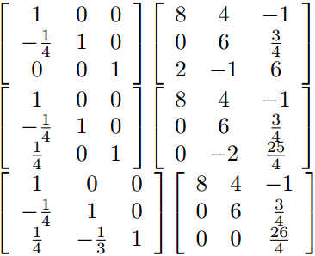
3.5 LU Decomposition

Slide 20

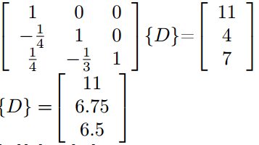
3.5 LU Decomposition
Step 2: Solve

Slide 21

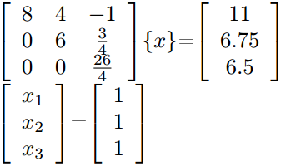
3.5 LU Decomposition
Step 3: Solve

Slide 22

3.5 LU Decomposition
Example 2: Alternate Decomposition Method

Slide 23
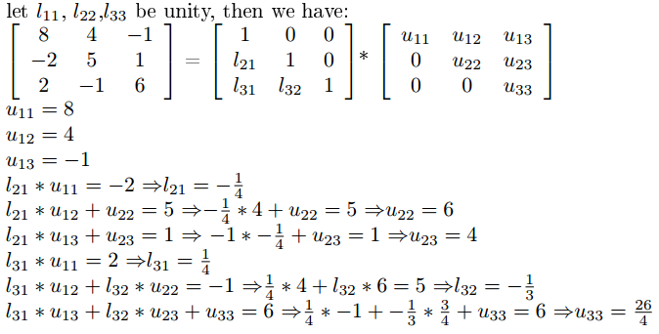
3.5 LU Decomposition

Slide 24

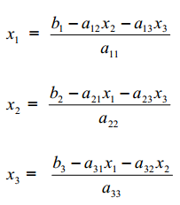
3.6 The Gauss-Seidel Iterative Method
Consider the following system:
This system can be transformed into:

Slide 25
3.6 The Gauss-Seidel Iterative Method
Steps:
1. Assume initial guesses of x2,x3….xn=selected values(usually zero)
2. Compute x1
3. Using the result from (2) and initial guesses from step (1),Compute x2,x3,x4….,xn
4. Using newly computed values of x2,x3,x4…xn compute x1.
5. DO until convergence

Slide 26
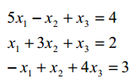



3.6 The Gauss-Seidel Iterative Method
[Example][FORTRAN Demo]

Slide 27
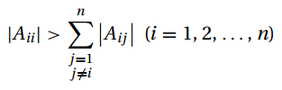
3.6 The Gauss-Seidel Iterative Method
DIAGONAL DOMINANCE
An NxN matrix is called diagonally dominant, if the diagonal element in every row is greater in magnitude(Absolute Values) than the sum of the elements in that row excluding the diagonal element.
i.e.

Slide 28
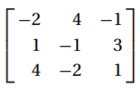
3.6 The Gauss-Seidel Iterative Method
[Example]
The matrix
is not diagonally dominant.
CHECK: row 1: |-2|<|4|+|-1|
row 2: |-1|<|1|+|3|
row 3: |1| < |4|+|-2|

Slide 29

3.6 The Gauss-Seidel Iterative Method
The matrix can be made diagonally dominant by exchanging rows
Can be used to facilitate convergence for iterative methods…

Slide 30
3.7 The Conjugate Gradient Method
[READING ASSIGNMENT]

Slide 31
ANY QUESTIONS ?

