Slide 1
CHAPTER - 4
SOLUTIONS TO SYSTEMS OF NON-LINEAR EQUATIONS

Slide 2
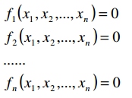
1.Introduction
Consider the following system of nonlinear equations
  Methods:
  -Generalized Fixed Point Iteration
  -Generalized Newton-Raphson Method

Slide 3

2.The Fixed Point Iterative Method
A function can be defined as a mapping of Rn to Rn.
Represented as a vector , the system in the prev. slide can be represented as:

Slide 4
2.The Fixed Point Iterative Method
Solution Procedure
  Assume an initial guess vector X0={X1,X2,X3….}
  Use initial guess {X2,X3…}to solve for X1
  Using the new value of X1 ,solve for {X2,X3…}
  Using the new values of {X2,X3…} solve for the next value of X1.
  Do until convergence is achieved
Convergence Acceleration using updated values.

Slide 5
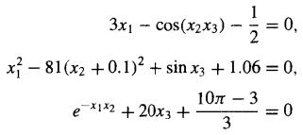
2.The Fixed Point Iterative Method
EXAMPLE

Slide 6
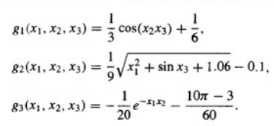
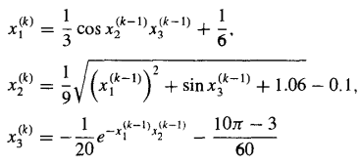
2.The Fixed Point Iterative Method

Slide 7
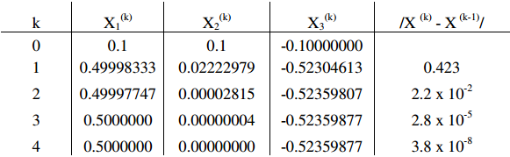
2.The Fixed Point Iterative Method

Slide 8
3. Generalized Newton-Raphson Method
For a single equation, the fixed point method and Newton’s method are derived from the generalized form for quadratic convergence. i.e.
Newton’s Method:φ(x)=1/f’(x) assuming
f’(x) !=0
Fixed Point Method: φ(x)=0.

Slide 9
3. Generalized Newton-Raphson Method
Using the same logic for N-dimensions, the previous form would be a matrix equation,
  {G(x)} = {X} – inv[A(x)] * {F(x)}
  [SIMILAR TO NEWTON’S METHOD FOR SOLVING SINGLE EQUATIONS]
Where each aij(x) in [A(x)] represents a function that maps Rn to R
It should follow that A(x) = J(x)

Slide 10
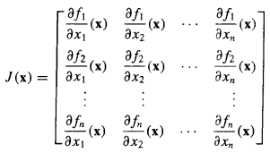

3. Generalized Newton-Raphson Method
Where J(x) is the Jacobian of F:
Which satisfies

Slide 11


3. Generalized Newton-Raphson Method
Consecutive values for {X} can be found using:
Where

Slide 12
3. Generalized Newton-Raphson Method
Limitations of Newton’s Method
  Evaluation of the Jacobian
  Finding an appropriate initial guess
  Each iteration involves solving a system of linear equations.
  Numerical errors may reduce the convergence to first order.

Slide 13
3. Generalized Newton-Raphson Method
Procedure:
  Form F with {f1,f2,f3…fn}’
  Analytically evaluate the Jacobian J(x1,x2,x3…xn)
  Form the system -[J(x1,x2,x3…xn)]{Y}=F
  Set an initial approximation/guess for {x1,x2,…xn}0
  Evaluate step 3 at {x1,x2,…xn}0
  Solve step 3 for {Y}
  Find X1 as {X}1={X}0 + {Y}
  Unless system converges, Go to Step 5.

Slide 14


3. Generalized Newton-Raphson Method
EXAMPLE 1

Slide 15

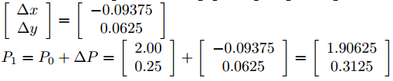
3. Generalized Newton-Raphson Method

Slide 16
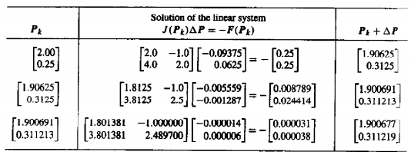
3. Generalized Newton-Raphson Method

Slide 17
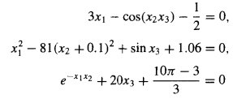
3. Generalized Newton-Raphson Method
EXAMPLE 2

Slide 18
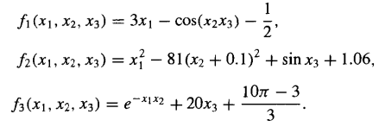
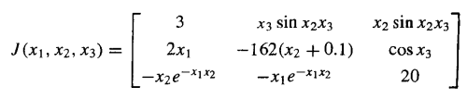
3. Generalized Newton-Raphson Method

Slide 19
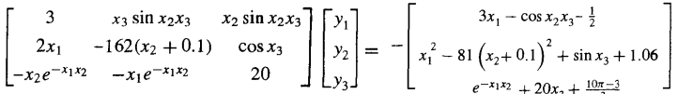
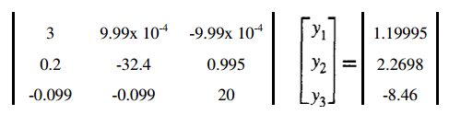
3. Generalized Newton-Raphson Method

Slide 20
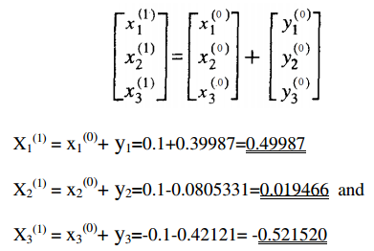
3. Generalized Newton-Raphson Method

Slide 21
Any Questions ?

