Slide 1
Chapter 6
Numerical Differentiation and Integration

Slide 2


1.Introduction
Differentiation:
Integration:

Slide 3
1. Introduction
Functions to be differentiated or integrated:
    Simple continuous functions [ polynomials, exponential and trigonometric functions]
    Complicated continuous functions which can not be integrated using direct integration methods
    Tabulated representations of functions

Slide 4
1. Introduction
Methods
  Analytical
  Single Point/Equal Area/Segment graphical differentiation and integration

Slide 5


2. Numerical Differentiation
Taylor’s Series
Forward Expansion
Backward Expansion

Slide 6



2. Numerical Differentiation
Lower Order Derivatives
  First forward difference
  First backward difference
  Centered first order difference

Slide 7
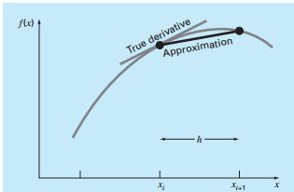
2. Numerical Differentiation
[FORWARD DIFFERENCE]

Slide 8
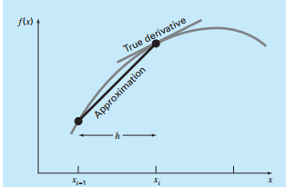
2. Numerical Differentiation
[BACKWARD DIFFERENCE]

Slide 9
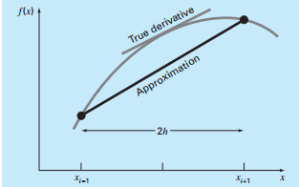
2. Numerical Differentiation
[CENTERED DIFFERENCE]

Slide 10
2. Numerical Differentiation
[EXAMPLE]: Evaluate the first derivative of the following function at x=0.5 with intervals of h=0.5 and h=0.25 using the forward, backward and centered difference expansions of Taylors series.
[EXACT VALUE]
    @ x=0.5, f’(x)=-0.9125

Slide 11




2. Numerical Differentiation
For h=0.5
Forward Diff.
Backward Diff.
Centered Diff.

Slide 12




2. Numerical Differentiation
For h=0.25
Forward Diff.
Backward Diff.
Centered Diff.

Slide 13
2. Numerical Differentiation
Higher Order Derivatives
  In a similar fashion as to that of first derivative approximations, approximations for higher order derivatives can be obtained by including additional terms in the Taylor expansion.
  [ASSIGNMENT: DERIVATION OF EXPRESSIONS FOR HIGHER ORDER FINITE DIFFERENCE EXPRESSIONS]

Slide 14
2. Numerical Differentiation
High Accuracy Formulae
  Expressions for higher order terms can be developed and integrated back into Taylor’s expansion to achieve high accuracy formulae for the estimation of first and higher order polynomials.
  [ASSIGNMENT: DERIVATION OF EXPRESSIONS FOR HIGH ACCURACY FINITE DIFFERENCE FORMULAE]

Slide 15
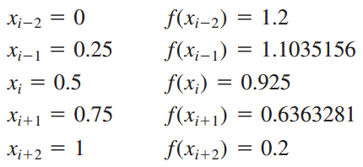
2. Numerical Differentiation
[EXAMPLE]: Estimate the first derivative for the following function at x=0.5 with h=0.25 using high accuracy differentiation formulas.
Data

Slide 16





2. Numerical Differentiation
Forward Difference
Backward Difference
Centered Difference

Slide 17
3. Numerical Integration
Newton –Cote Methods
  Rectangular Approximations[From the Leibniz integration formulation]
  Trapezoidal Rule
  Simpson’s Rule [INTRODUCTION]
  Simpson’s Rule [1/3]
  Simpson’s Rule [3/8]

Slide 18
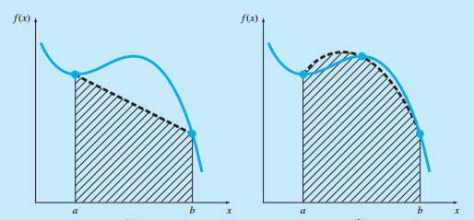
3. Numerical Integration

Slide 19
3. Numerical Integration
Rectangular Approximations
  Suitable for computing limits as intervals approach 0.
  Impractical for numerical computations since extremely small intervals would be needed to get accurate results.

Slide 20



3. Numerical Integration
Trapezoidal Rule
  A specific case of Simpson’s polynomial method where the approximation polynomial used is first order/linear

Slide 21
3. Numerical Integration
[EXAMPLE] Single Application of the Trapezoidal Rule: Integrate the following function from x=0 upto x=0.8 using
i. Direct Integration [ANS: 1.640533]
ii. Numerical Integration

Slide 22
3. Numerical Integration
Solution:-,
  a=0 => f(a)=f(0)=0.2
  b=0.8 => f(b)=f(0.8)=0.232
Area= width * Average Height
Area= (b-a) * (f(a)+f(b))/2
Area= (0.8-0)* (0.2+0.232)/2
Area=0.1738[error=89.5%]

Slide 23
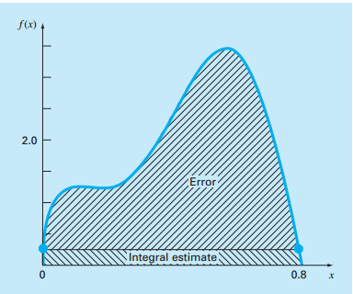
3. Numerical Integration

Slide 24


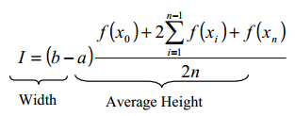
3. Numerical Integration
Multiple Application of the Trapezoidal Rule

Slide 25
3. Numerical Integration
[EXAMPLE] Multi-Segment Trapezoidal Integration
Using (i) 2, (ii) 4, (iii) 6 segments, integrate
from x=0 to x=0.8
[SOLN] n=2 : two adjecent trapezoids
(i.e. 2 equal intervals, 3 points)
n=4 : four adjecent trapezoids
(i.e. 4 equal intervals, 5 points)
n=6 : six adjecent trapezoids
(i.e. 6 equal intervals, 7 points)

Slide 26
3. Numerical Integration
N=2 interval= (b-a)/n=(0.8-0)/2=0.4
intermediate points:[0, 0.4, 0.8]
I=0.8/2*(0+f(0.4)*2+0.8)=1.0688
N=4 interval= (b-a)/n=(0.8-0)/4=0.2
intermediate points:[0, 0.2, 0.4, 0.6, 0.8]
I=0.8/2*(0+f(0.2)*2+f(0.4)*2+f(0.6)*2+0.8)=1.4848
N=8 interval= (b-a)/n=(0.8-0)/8=0.1
intermediate points:[0, 0.1, 0.2, 0.3, …, 0.8]
I=(0.8/2)*(f(0)+f(0.1)*2+f(0.2)*2+f(0.3)*2+f(0.4)*2+f(0.5)*2+f(0.6)*2+f(0.7)*2+f(0.8))=1.6008

Slide 27



3. Numerical Integration
Simpson’s 1/3 rule[ ] ] ]
  [Second order Lagrangian polynomial]

Slide 28
3. Numerical Integration
[EXAMPLE] Single Application of Simpson’s Rule
Approximate the integral in the previous examples using Simpson’s rule
h=(0.8-0)/2=0.4
f(0)=0.2
f(0.4)=2.456
f(0.8)=0.232
I=0.4*(0.2+4*2.456+0.232)/6=1.3674(e=16.6%)

Slide 29
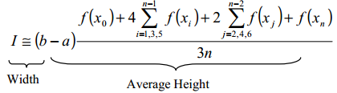
3. Numerical Integration
Multiple application of the 1/3 rule
[Example]

Slide 30
3. Numerical Integration
[EXAMPLE] Multiple Application of Simpson’s 1/3rd rule
Using n=4 for Simpson’s rule, Approximate
from x=0 up to x=0.8
h=(0.8-0)/4=0.2
x0=0, x1=0.2, x2=0.4, x3=0.6, x4=0.8
[first: x0=0], [last: x4=0.8], [even: x2=0.4],
[odd: x1=0.2, x3=0.6]

Slide 31
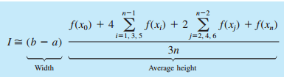
3. Numerical Integration
I=(0.8-0)*(0.2+4*(1.288+3.464)+2*(2.456)+0.232)/(3*4)
I=1.62347(e=1.04%)

Slide 32


3. Numerical Integration
Simpson’s 3/8 rule
  [third order Lagrangian polynomial]

Slide 33
3. Numerical Integration
[EXAMPLE]: Use Simpson’s 3/8th Rule to Evaluate
from x=0 up to x=0.8.
[Solution]: 4 equally spaced points are needed.
(since the Lagrange polynomial is of the third order (cubic), for a single application, 4 points are required)

Slide 34

3. Numerical Integration
(b-a)/n= (0.8-0.0)/3=0.2667
x0=0 f(x0) = 0.2
x1=0.2667 f(x1) = 1.432724
x2=0.5333 f(x2) = 3.487177
x3=0.8 f(x3) = 0.232
I=0.8*(0.2+3*1.432724+3*3.487177+0.232)/8
=1.519170(e=7.4%)

Slide 35
3. Numerical Integration
[EXAMPLE]
Using the 1/3rd and 3/8th rules in tandem for odd number of intervals/segments
Needs 5 segments or 6 points (3 points for 1/3 application, 4 points for 3/8 application =7 points-1 common point=6 points)
h=(b-a)/n=(0.8-0)/5=0.16

Slide 36
3. Numerical Integration
x0=0 f(0)= 0.2
X1=0.16 f(0.16)= 1.296919
X2=0.32 f(0.32)= 1.743393
X3=0.48 f(0.48)= 3.186015
x4=0.64 f(0.64)= 3.181929
X5=0.8 f(0.8) = 0.232

Slide 37
3. Numerical Integration
1/3rd application
I=0.32*(0.2+4*1.296919)+1.743393)/6
=0.380323
3/8th application
I=0.48(1.743393+3*(3.186015+3.181929)+0.232)/8
=1.264754
Total
0.3803237+1.264754=1.645077(e=-0.28%)

Slide 38
QUESTIONS???

