Slide 1
Numerical ODE solving methods
CHAPTER-7

Slide 2
Contents
EULER’S METHOD
RUNGE-KUTTA METHODS

Slide 3

1. Introduction
Objective: to solve ordinary differential equations of the form
Step Methods: Based on predicting successive values of a function based on an initial point and a slope estimate of the function.
These methods only differ in the procedure of as to how Phi is determined.

Slide 4
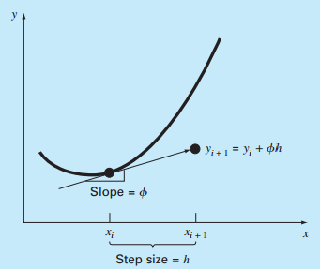
BASIS OF SOLUTIONS

Slide 5

EULER’S METHOD
Directly uses the first derivative [i.e. slope] for sequential estimations of the solution

Slide 6
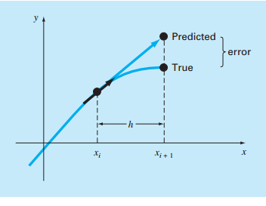
EULER’S METHOD

Slide 7

EULER’S METHOD
[EXAMPLE] EULER’S METHOD
Use EULER’s method to numerically integrate
from x=0 up to x=4 using a step size of 0.5
Initial Conditions: at x=0, y=1.
TRUE SOLUTION=3.21875

Slide 8

EULER’S METHOD
At x=0, y=1
At x=0.5, y=5.25

Slide 9
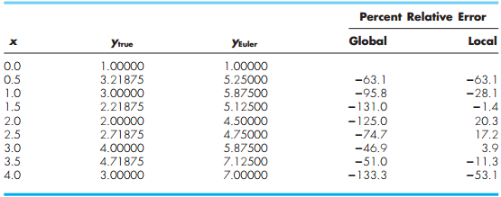
EULER’S METHOD

Slide 10
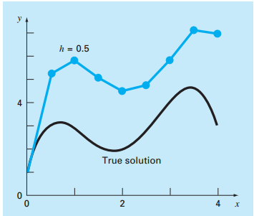
EULER’S METHOD

Slide 11
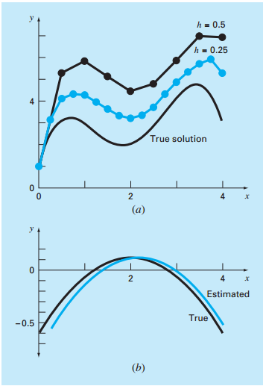
EULER’S METHOD

Slide 12

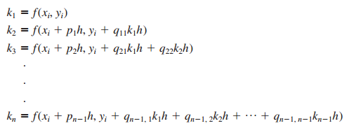
RUNGE-KUTTA METHODS
General Form
Where
And

Slide 13

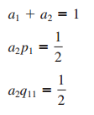
RUNGE-KUTTA METHODS
Second Order Runge-Kutta Method

Slide 14
RUNGE-KUTTA METHODS
We have a1, a2, p1 and q11 as unknowns, hence one of these values must be assumed in order to proceed with the solution.
Heun’s Method with a Single Corrector: a2=1/2
a1=1/2 , p1=q11=1
The Midpoint Method: a2=1
a1=0, p1=q11=1/2
Ralston’s Method: a2=2/3
a1=1/3, p1=q11=3/4

Slide 15
RUNGE-KUTTA METHODS
[EXAMPLE] Use the midpoint method, the Heun method and Ralston’s method on the previous example.
i. Midpoint Method

Slide 16

RUNGE-KUTTA METHODS
Ralston’s Method
k1=8.5
Heun’s Method
k1=8.5
k2= f(0+0.5, 1+8.5*0.5)=1.25
y(i+1)=1+((1/2)*8.5+(1/2)*1.25)*0.5=3.43750(6.8%)

Slide 17
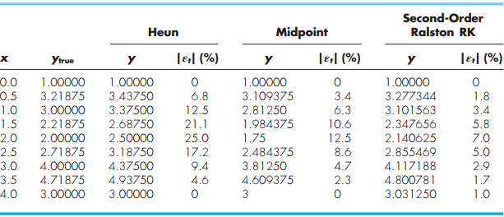
RUNGE-KUTTA METHODS

Slide 18



RUNGE-KUTTA METHODS
[Fourth order RUNGE-KUTTA method]

Slide 19
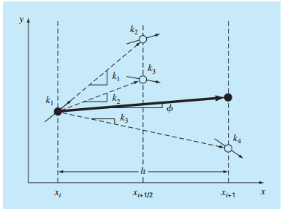
RUNGE-KUTTA METHODS

Slide 20

RUNGE-KUTTA METHODS
[EXAMPLE]
K1=8.5, K2=4.21875, K3=4.21875, k4=1.25
RUNGE-KUTTA SOLUTION=3.21875
TRUE SOLUTION = 3.21875

Slide 21
ANY QUESTIONS ?????

