Slide 1
Chapter four thermodynamics of solution
The Chemical Potential and Phase Equilibria
Partial Molar Properties
IDEAL-GAS MIXTURES
Fugacity of a Pure Substance
Fugacity of a Component in a Mixture

Slide 2

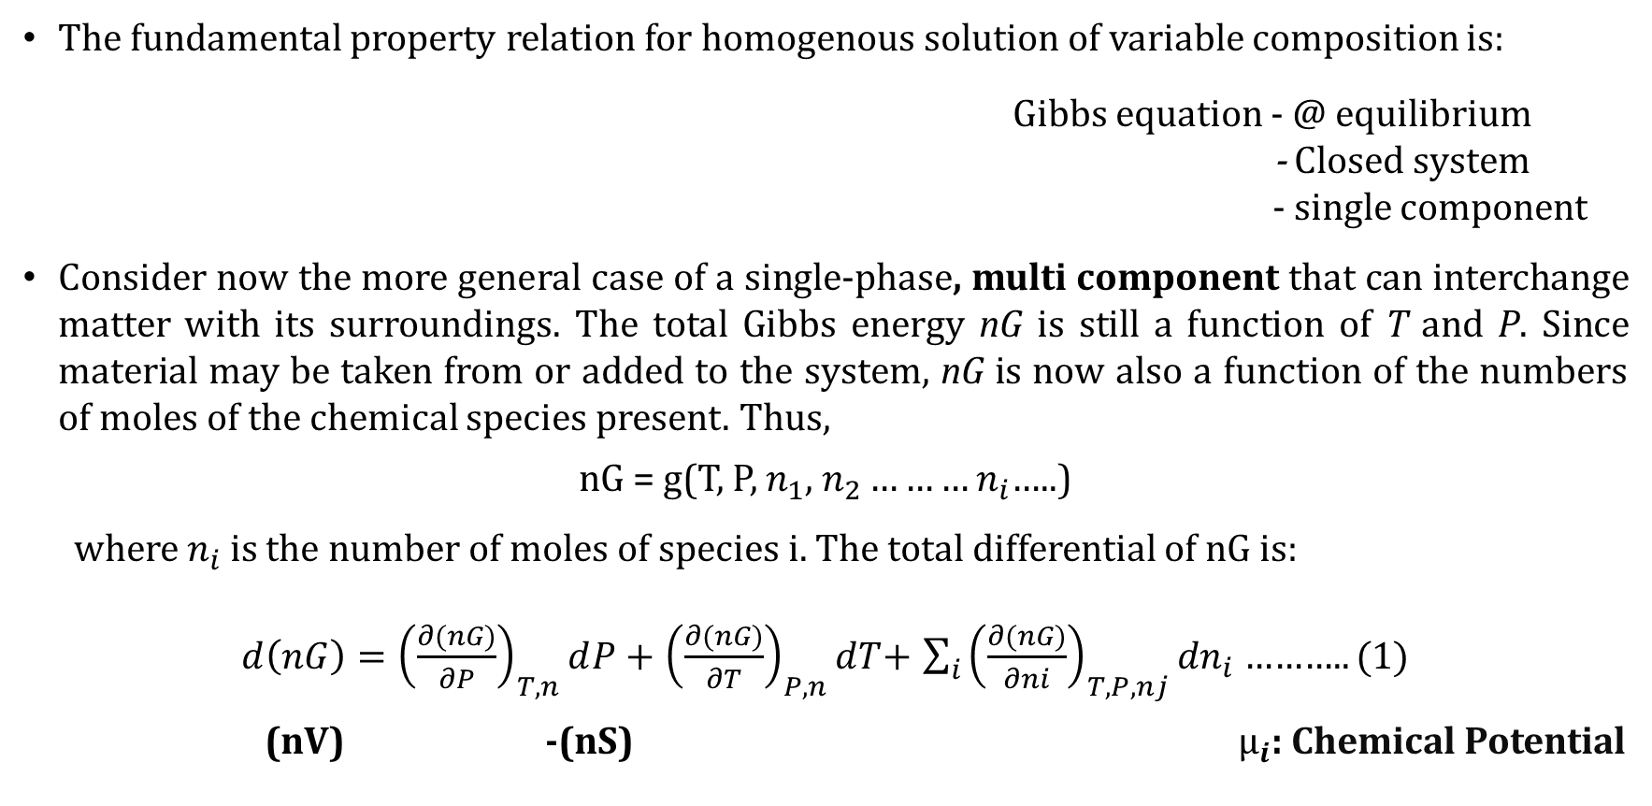
Fundamental property relation
The fundamental property relation for homogenous solution of variable composition is:
Gibbs equation - @ equilibrium
- Closed system
- single component
Consider now the more general case of a single-phase, multi component that can interchange matter with its surroundings. The total Gibbs energy nG is still a function of T and P. Since material may be taken from or added to the system, nG is now also a function of the numbers of moles of the chemical species present. Thus,
nG = g(T, P, $n_{1}$, $n_{2}………n_{i}$…..)
where $n_{i}$ is the number of moles of species i. The total differential of nG is:
$d\left(nG\right)={\left(\frac{∂(nG)}{∂P}\right)}_{T,n}ⅆP+$ ${\left(\frac{∂(nG)}{∂T}\right)}_{P,n}ⅆT$+ $\sum_{i}{{\left(\frac{∂(nG)}{∂ni}\right)}_{T,P,nj}}{dn}_{i}$ ……….. (1)
(nV) -(nS) $µ_{i}$: Chemical Potential
$$d(nG)=−(nS)dT+(nV)dP$$

Slide 3
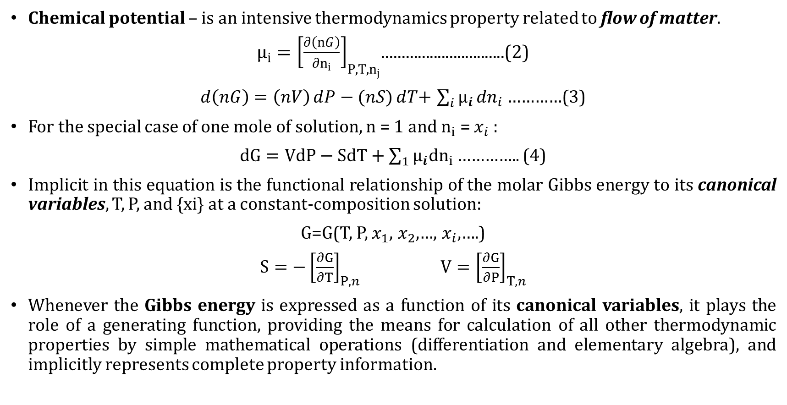
Fundamental property relation cond...
Chemical potential – is an intensive thermodynamics property related to flow of matter.
${μ_{i}=\left[\frac{∂\left(nG\right)}{∂n_{i}}\right]}_{P,T,n_{j}}$...............................(2)
$d\left(nG\right)=\left(nV\right)ⅆP−(nS)ⅆT$+ $\sum_{i}{µ_{i}}{dn}_{i}$ …………(3)
For the special case of one mole of solution, n = 1 and $n_{i}$ = $x_{i}$:
$dG=VdP−SdT+\sum_{1}{{µ_{i}dn}_{i}}$………….. (4)
Implicit in this equation is the functional relationship of the molar Gibbs energy to its canonical variables, T, P, and {xi} at a constant-composition solution:
G=G(T, P, $x_{1}$, $x_{2}$,…, $x_{i}$,….)
$S=−{\left[\frac{∂G}{∂T}\right]}_{P,n}$ $V={\left[\frac{∂G}{∂P}\right]}_{T,n}$
Whenever the Gibbs energy is expressed as a function of its canonical variables, it plays the role of a generating function, providing the means for calculation of all other thermodynamic properties by simple mathematical operations (differentiation and elementary algebra), and implicitly represents complete property information.

Slide 4
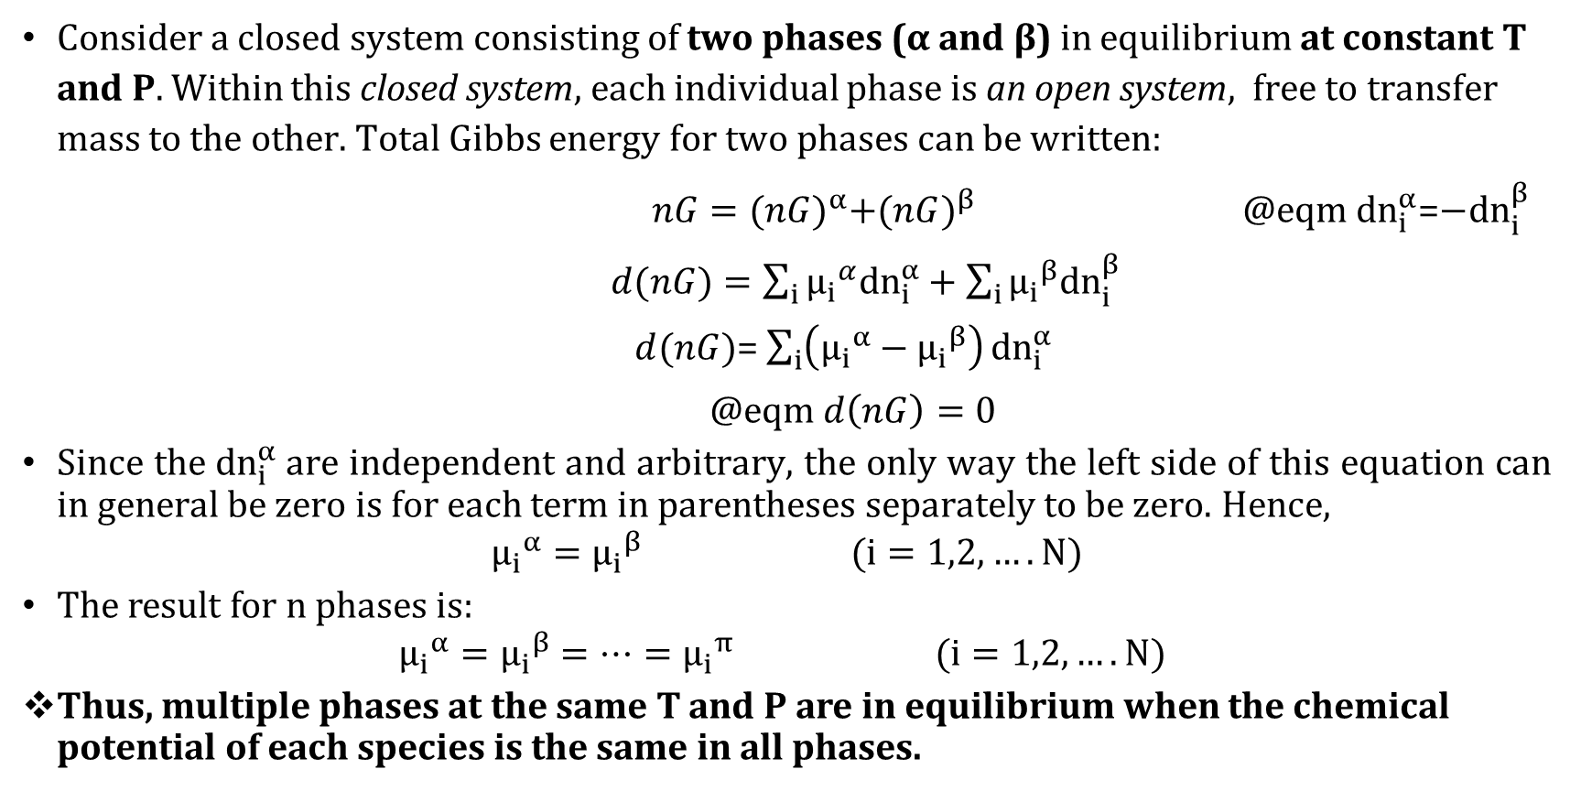
The Chemical Potential and Phase Equilibria
Consider a closed system consisting of two phases (α and β) in equilibrium at constant T and P. Within this closed system, each individual phase is an open system, free to transfer mass to the other. Total Gibbs energy for two phases can be written:
$nG={(nG)}^{α}+(n{G)}^{β}$ @eqm${ dn}_{i}^{α}$=$−dn_{i}^{β}$
$d(nG)=\sum_{i}{{µ_{i}}^{α}{dn}_{i}^{α}}+\sum_{i}{{μ_{i}}^{β}dn_{i}^{β}}$
$d(nG)$= $\sum_{i}{\left({μ_{i}}^{α}−{μ_{i}}^{β}\right)}dn_{i}^{α}$
@eqm $d\left(nG\right)=0$
Since the $dn_{i}^{α}$are independent and arbitrary, the only way the left side of this equation can in general be zero is for each term in parentheses separately to be zero. Hence,
$${μ_{i}}^{α}={μ_{i}}^{β} (i=1,2,….N)$$
The result for n phases is:
$${μ_{i}}^{α}={μ_{i}}^{β}=…={μ_{i}}^{π} (i=1,2,….N)$$
Thus, multiple phases at the same T and P are in equilibrium when the chemical potential of each species is the same in all phases.
α
β

Slide 5
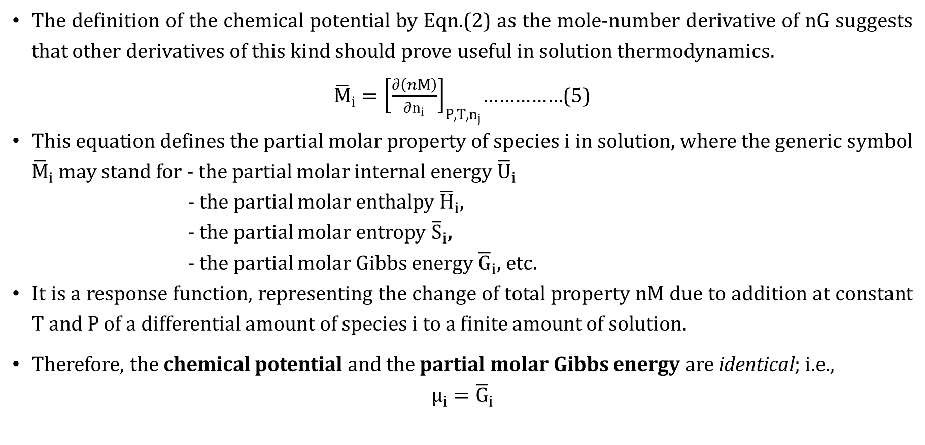
Partial property
The definition of the chemical potential by Eqn.(2) as the mole-number derivative of nG suggests that other derivatives of this kind should prove useful in solution thermodynamics.
${\overline{M}}_{i}={\left[\frac{∂\left(nM\right)}{∂n_{i}}\right]}_{P,T,n_{j}}$……………(5)
This equation defines the partial molar property of species i in solution, where the generic symbol ${\overline{M}}_{i}$ may stand for - the partial molar internal energy ${\overline{U}}_{i}$
- the partial molar enthalpy ${\overline{H}}_{i}$,
- the partial molar entropy ${\overline{S}}_{i}$,
- the partial molar Gibbs energy ${\overline{G}}_{i}$, etc.
It is a response function, representing the change of total property nM due to addition at constant T and P of a differential amount of species i to a finite amount of solution.
Therefore, the chemical potential and the partial molar Gibbs energy are identical; i.e.,
$$μ_{i}={\overline{G}}_{i}$$

Slide 6
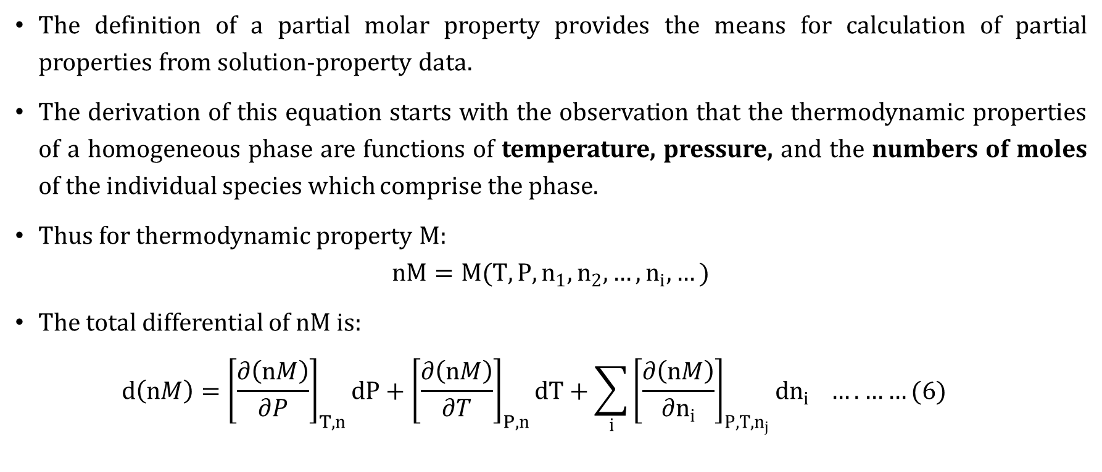
Equations Relating Molar and Partial Molar Properties
The definition of a partial molar property provides the means for calculation of partial properties from solution-property data.
The derivation of this equation starts with the observation that the thermodynamic properties of a homogeneous phase are functions of temperature, pressure, and the numbers of moles of the individual species which comprise the phase.
Thus for thermodynamic property M:
$$nM=M(T,P,n_{1},n_{2},…,n_{i},…)$$
The total differential of nM is:
$$d\left(nM\right)={\left[\frac{∂\left(nM\right)}{∂P}\right]}_{T,n}dP+{\left[\frac{∂\left(nM\right)}{∂T}\right]}_{P,n}dT+\sum_{i}{{\left[\frac{∂\left(nM\right)}{∂n_{i}}\right]}_{P,T,n_{j}}}dn_{i} …. ……(6)$$

Slide 7
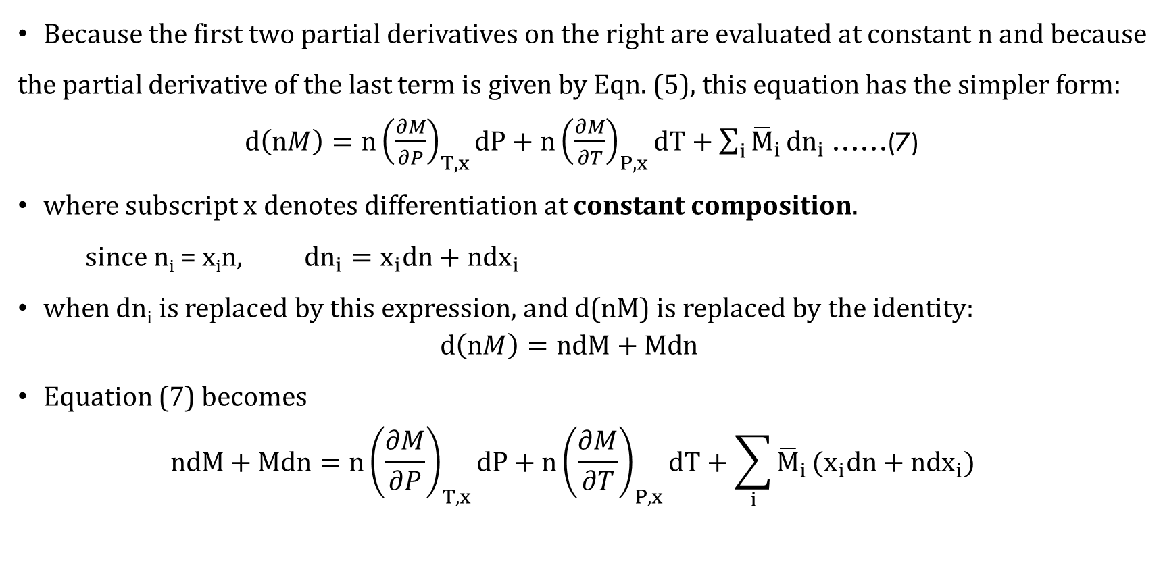
Equations Relating Molar and Partial Molar Properties cond…
Because the first two partial derivatives on the right are evaluated at constant n and because the partial derivative of the last term is given by Eqn. (5), this equation has the simpler form:
$d\left(nM\right)=n{\left(\frac{∂M}{∂P}\right)}_{T,x}dP+n{\left(\frac{∂M}{∂T}\right)}_{P,x}dT+\sum_{i}{{\overline{M}}_{i}}dn_{i}$……(7)
where subscript x denotes differentiation at constant composition.
since n_{i} = x_{i}n, ${dn}_{i}=x_{i}dn+{ndx}_{i}$
when dn_{i} is replaced by this expression, and d(nM) is replaced by the identity:
$$d\left(nM\right)=ndM+Mdn$$
Equation (7) becomes
$$ndM+Mdn=n{\left(\frac{∂M}{∂P}\right)}_{T,x}dP+n{\left(\frac{∂M}{∂T}\right)}_{P,x}dT+\sum_{i}{{\overline{M}}_{i}}(x_{i}dn+{ndx}_{i})$$

Slide 8
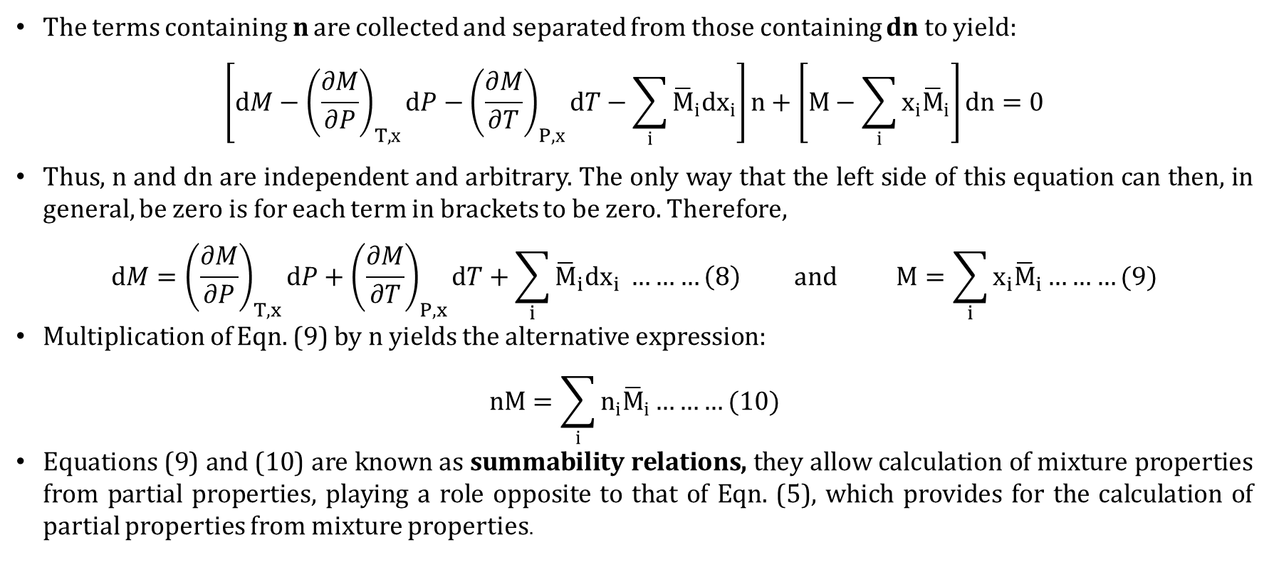
Equations Relating Molar and Partial Molar Properties cond…
The terms containing n are collected and separated from those containing dn to yield:
$$\left[dM−{\left(\frac{∂M}{∂P}\right)}_{T,x}dP−{\left(\frac{∂M}{∂T}\right)}_{P,x}dT−\sum_{i}{{\overline{M}}_{i}{dx}_{i}}\right]n+\left[M−\sum_{i}{x_{i}{\overline{M}}_{i}}\right]dn=0$$
Thus, n and dn are independent and arbitrary. The only way that the left side of this equation can then, in general, be zero is for each term in brackets to be zero. Therefore,
$$dM={\left(\frac{∂M}{∂P}\right)}_{T,x}dP+{\left(\frac{∂M}{∂T}\right)}_{P,x}dT+\sum_{i}{{\overline{M}}_{i}{dx}_{i}} ………\left(8\right) and M=\sum_{i}{x_{i}{\overline{M}}_{i}}………(9)$$
Multiplication of Eqn. (9) by n yields the alternative expression:
$$nM=\sum_{i}{n_{i}{\overline{M}}_{i}}………(10)$$
Equations (9) and (10) are known as summability relations, they allow calculation of mixture properties from partial properties, playing a role opposite to that of Eqn. (5), which provides for the calculation of partial properties from mixture properties.

Slide 9
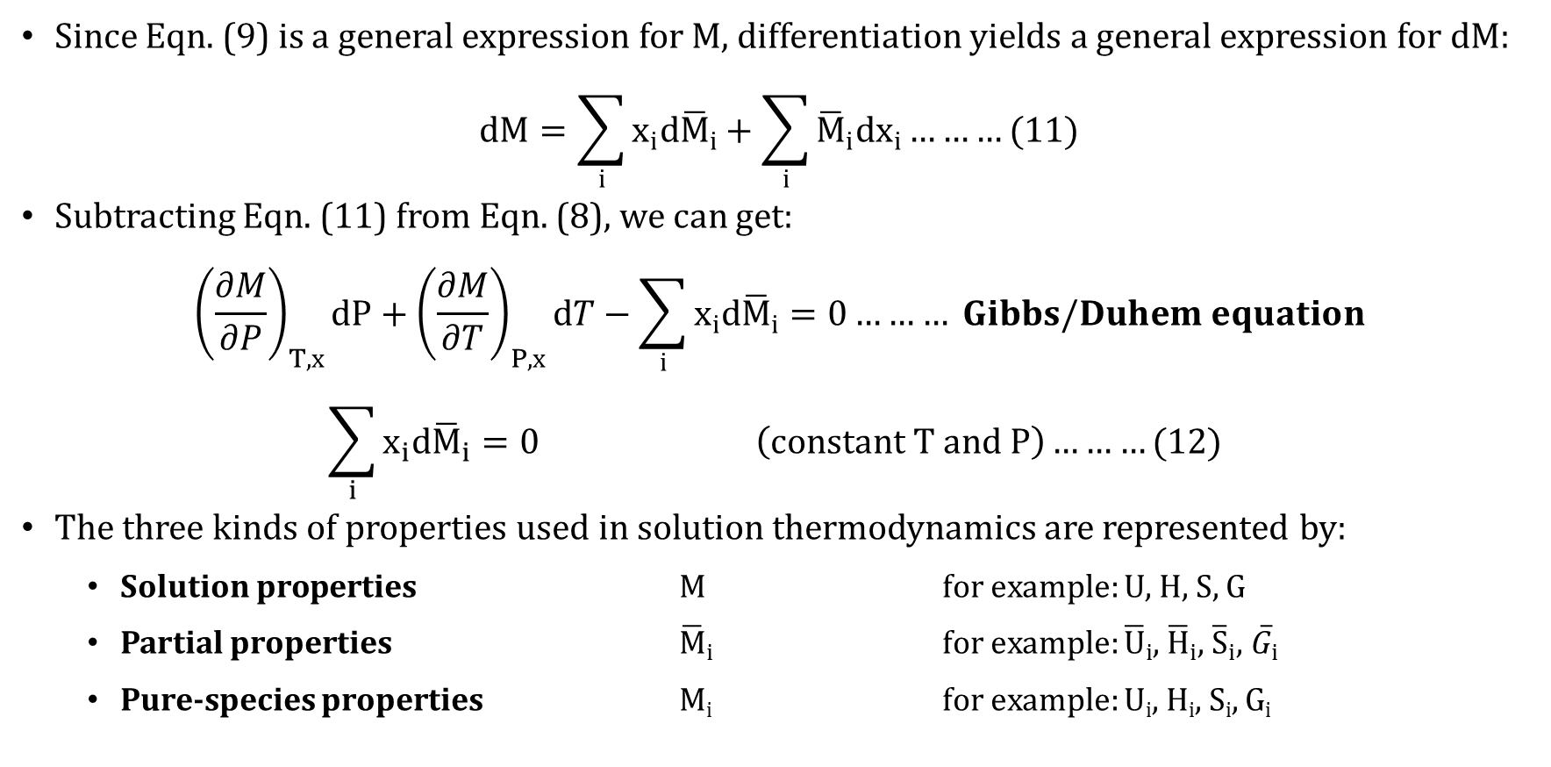
Gibbs/Duhem equation
Since Eqn. (9) is a general expression for M, differentiation yields a general expression for dM:
$$dM=\sum_{i}{{x_{i}d\overline{M}}_{i}}+\sum_{i}{{\overline{M}}_{i}{dx}_{i}}………(11)$$
Subtracting Eqn. (11) from Eqn. (8), we can get:
$${\left(\frac{∂M}{∂P}\right)}_{T,x}dP+{\left(\frac{∂M}{∂T}\right)}_{P,x}dT−\sum_{i}{{x_{i}d\overline{M}}_{i}}=0……… Gibbs/Duhem equation$$
$$\sum_{i}{{x_{i}d\overline{M}}_{i}}=0 \left(constant T and P\right)………(12)$$
The three kinds of properties used in solution thermodynamics are represented by:
Solution properties M for example: U, H, S, G
Partial properties ${\overline{M}}_{i}$ for example: ${\overline{U}}_{i}$, ${\overline{H}}_{i}$, ${\overline{S}}_{i}$, ${\overline{G}}_{i}$
Pure-species properties M_{i} for example: U_{i}, H_{i}, S_{i}, G_{i}

Slide 10
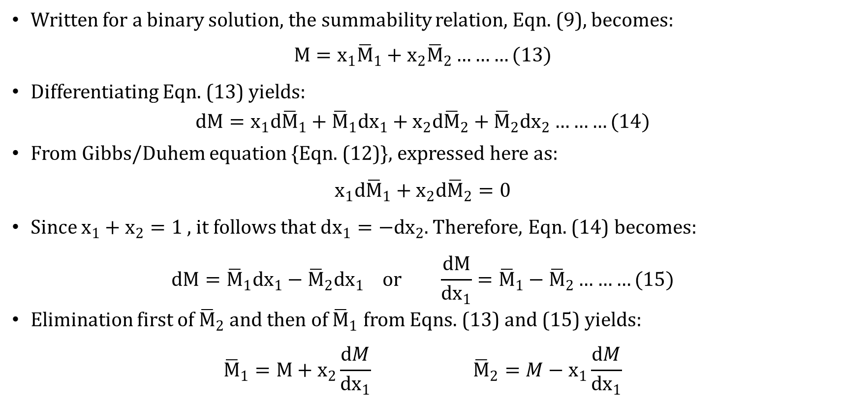
Partial Properties in Binary Solutions
Written for a binary solution, the summability relation, Eqn. (9), becomes:
$$M=x_{1}{\overline{M}}_{1}+x_{2}{\overline{M}}_{2}………(13)$$
Differentiating Eqn. (13) yields:
$$dM=x_{1}d{\overline{M}}_{1}+{\overline{M}}_{1}dx_{1}+x_{2}d{\overline{M}}_{2}+{\overline{M}}_{2}dx_{2}………(14)$$
From Gibbs/Duhem equation {Eqn. (12)}, expressed here as:
$$x_{1}d{\overline{M}}_{1}+x_{2}d{\overline{M}}_{2}=0$$
Since $x_{1}+x_{2}=1$ , it follows that $dx_{1}=−dx_{2}$. Therefore, Eqn. (14) becomes:
$$dM={\overline{M}}_{1}dx_{1}−{\overline{M}}_{2}dx_{1} or \frac{dM}{dx_{1}}={\overline{M}}_{1}−{\overline{M}}_{2}………(15)$$
Elimination first of ${\overline{M}}_{2}$ and then of ${\overline{M}}_{1}$ from Eqns. (13) and (15) yields:
$${\overline{M}}_{1}=M+x_{2}\frac{dM}{dx_{1}} {\overline{M}}_{2}=M−x_{1}\frac{dM}{dx_{1}}$$

Slide 11

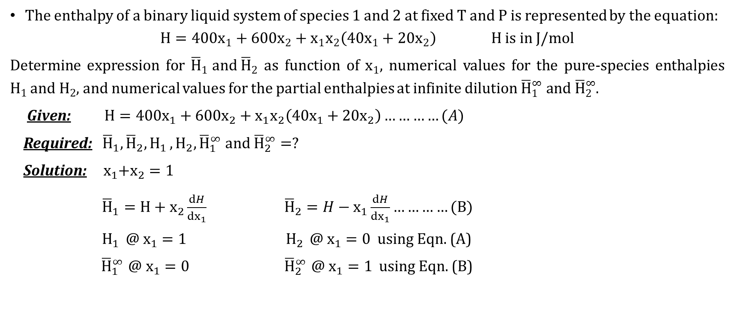
Example 4.1.
The enthalpy of a binary liquid system of species 1 and 2 at fixed T and P is represented by the equation:
$H={400x}_{1}+600x_{2}+x_{1}x_{2}\left(40x_{1}+20x_{2}\right) H is in J/mol$
Determine expression for ${\overline{H}}_{1} and {\overline{H}}_{2}$ as function of $x_{1}$, numerical values for the pure-species enthalpies $H_{1 }and H_{2}$, and numerical values for the partial enthalpies at infinite dilution ${\overline{H}}_{1}^{∞} and {\overline{H}}_{2}^{∞}$.
Given: $H={400x}_{1}+600x_{2}+x_{1}x_{2}\left(40x_{1}+20x_{2}\right)…………(A)$
Required: ${ \overline{H}}_{1},{\overline{H}}_{2}, H_{1 }, H_{2}, {\overline{H}}_{1}^{∞} and {\overline{H}}_{2}^{∞}=?$
Solution: ${ x}_{1}+x_{2}=1$
${\overline{H}}_{1}=H+x_{2}\frac{dH}{dx_{1}} {\overline{H}}_{2}=H−x_{1}\frac{dH}{dx_{1}}…………(B)$
$H_{1 } @ x_{1}=1 H_{2 } @ x_{1}=0$ using Eqn. (A)
${\overline{H}}_{1}^{∞}$ $@ x_{1}=0$ ${\overline{H}}_{2}^{∞}$ $@ x_{1}=1$ using Eqn. (B)
Answers:
${\overline{H}}_{1}=420−60{x_{1}}^{2}+40$ ${x_{1}}^{3}$
${\overline{H}}_{2}=600+40$ ${x_{1}}^{3}$
$H_{1 }=400$ $J/mol$
$H_{2 }=600$ $J/mol$
${\overline{H}}_{1}^{∞}=420$ $J/mol$
${\overline{H}}_{2}^{∞}=640$ $J/mol$

Slide 12

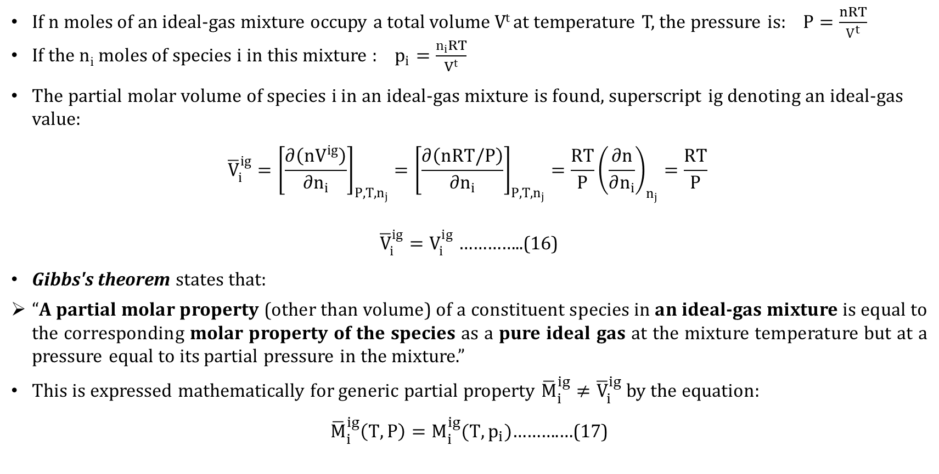
IDEAL-GAS MIXTURES
If n moles of an ideal-gas mixture occupy a total volume V^{t} at temperature T, the pressure is: $P=\frac{nRT}{V^{t}}$
If the n_{i} moles of species i in this mixture : $p_{i}=\frac{n_{i}RT}{V^{t}}$
The partial molar volume of species i in an ideal-gas mixture is found, superscript ig denoting an ideal-gas value:
$${\overline{V}}_{i}^{ig}={\left[\frac{∂\left(nV^{ig}\right)}{∂n_{i}}\right]}_{P,T,n_{j}}={\left[\frac{∂\left(nRT/P\right)}{∂n_{i}}\right]}_{P,T,n_{j}}=\frac{RT}{P}{\left(\frac{∂n}{∂n_{i}}\right)}_{n_{j}}=\frac{RT}{P}$$
${\overline{V}}_{i}^{ig}=V_{i}^{ig}$…………..(16)
Gibbs's theorem states that:
“A partial molar property (other than volume) of a constituent species in an ideal-gas mixture is equal to the corresponding molar property of the species as a pure ideal gas at the mixture temperature but at a pressure equal to its partial pressure in the mixture.”
This is expressed mathematically for generic partial property ${\overline{M}}_{i}^{ig}≠{\overline{V}}_{i}^{ig}$ by the equation:
${\overline{M}}_{i}^{ig}\left(T,P\right)=M_{i}^{ig}(T,p_{i})$……….…(17)
$$n=n_{i}+\sum{n_{j}}$$

Slide 13
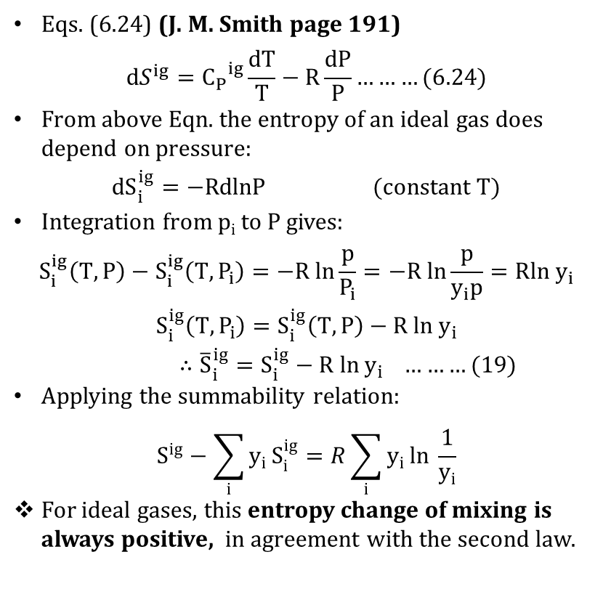
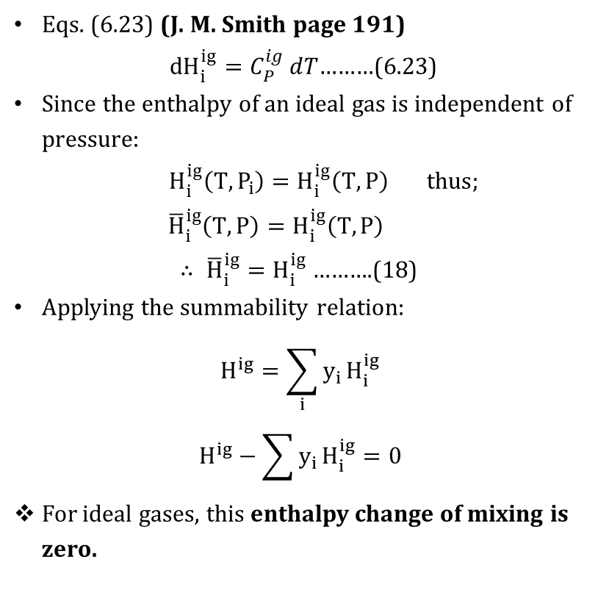
IDEAL-GAS MIXTURES cond…
Eqs. (6.23) (J. M. Smith page 191)
${dH}_{i}^{ig}=C_{P}^{ig}ⅆT$………(6.23)
Since the enthalpy of an ideal gas is independent of pressure:
$H_{i}^{ig}\left(T,P_{i}\right)=H_{i}^{ig}\left(T,P\right) thus;$
$${\overline{H}}_{i}^{ig}\left(T,P\right)=H_{i}^{ig}\left(T,P\right)$$
$∴ {\overline{H}}_{i}^{ig}=H_{i}^{ig}$……….(18)
Applying the summability relation$:$
$$H^{ig}=\sum_{i}{y_{i}}H_{i}^{ig}$$
$$H^{ig}−\sum{y_{i}}H_{i}^{ig}=0$$
For ideal gases, this enthalpy change of mixing is zero.
Eqs. (6.24) (J. M. Smith page 191)
$${dS}^{ig}={C_{P}}^{ig}\frac{dT}{T}−R\frac{dP}{P}………(6.24)$$
From above Eqn. the entropy of an ideal gas does depend on pressure:
$${dS}_{i}^{ig}=−RdlnP (constant T)$$
Integration from p_{i} to P gives:
$$S_{i}^{ig}\left(T,P\right)−S_{i}^{ig}\left(T,P_{i}\right)=−R ln\frac{p}{P_{i}}=−R ln\frac{p}{y_{i}p}=Rln{ y}_{i}$$
$$S_{i}^{ig}\left(T,P_{i}\right)=S_{i}^{ig}\left(T,P\right)−R ln{ y}_{i}$$
$∴{\overline{S}}_{i}^{ig}=S_{i}^{ig}−R ln{ y}_{i} ………(19)$
Applying the summability relation$:$
$$S^{ig}−\sum_{i}{y_{i}}S_{i}^{ig}=R\sum_{i}{y_{i}}ln \frac{1}{y_{i}}$$
For ideal gases, this entropy change of mixing is always positive, in agreement with the second law.

Slide 14
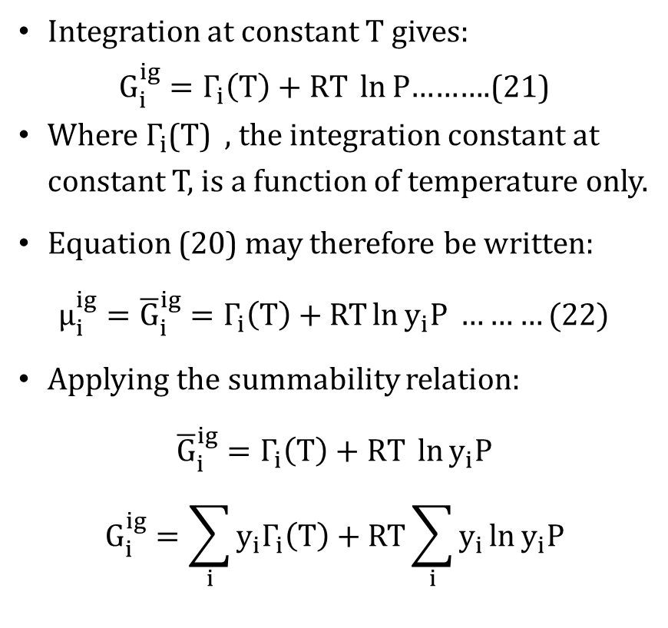
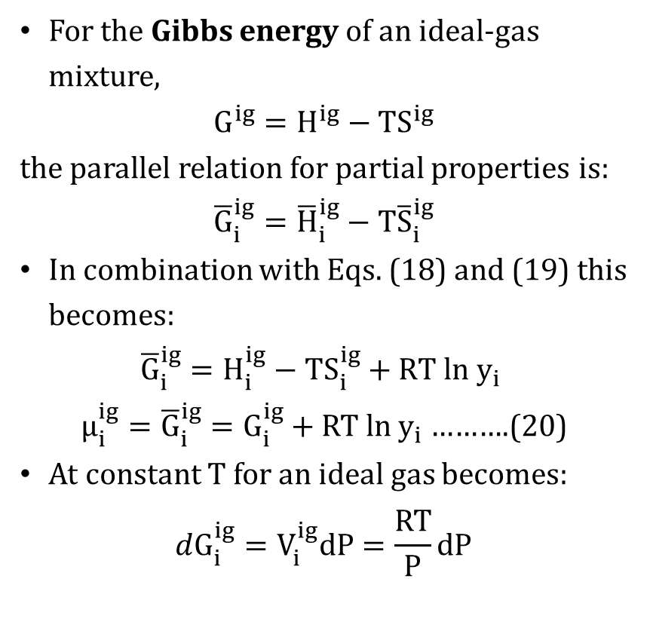
IDEAL-GAS MIXTURES cond…
For the Gibbs energy of an ideal-gas mixture,
$$G^{ig}=H^{ig}−{TS}^{ig}$$
the parallel relation for partial properties is:
$${\overline{G}}_{i}^{ig}={\overline{H}}_{i}^{ig}−T{\overline{S}}_{i}^{ig}$$
In combination with Eqs. (18) and (19) this becomes:
$${\overline{G}}_{i}^{ig}=H_{i}^{ig}−TS_{i}^{ig}+RT ln y_{i}$$
$μ_{i}^{ig}={\overline{G}}_{i}^{ig}=G_{i}^{ig}+RT ln y_{i}$……….(20)
At constant T for an ideal gas becomes:
$$dG_{i}^{ig}=V_{i}^{ig}dP=\frac{RT}{P}dP$$
Integration at constant T gives:
$G_{i}^{ig}=Γ_{i}\left(T\right)+RT \ln{P}$……….(21)
Where $Γ_{i}$(T) , the integration constant at constant T, is a function of temperature only.
Equation (20) may therefore be written:
$μ_{i}^{ig}={\overline{G}}_{i}^{ig}=Γ_{i}\left(T\right)+RT\ln{y_{i}P} ………(22)$
Applying the summability relation:
${\overline{G}}_{i}^{ig}=$ $Γ_{i}\left(T\right)+RT \ln{y_{i}P}$
$$G_{i}^{ig}=\sum_{i}{y_{i}Γ_{i}\left(T\right)}+RT\sum_{i}{y_{i}}\ln{y_{i}P}$$

Slide 15
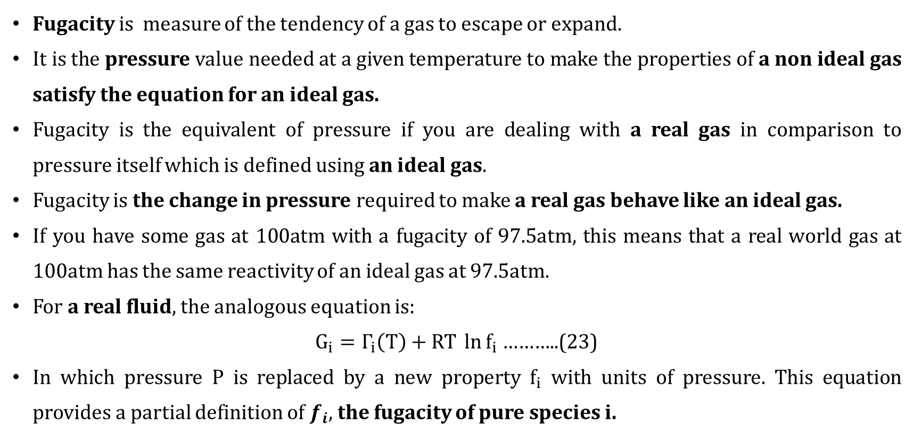
Fugacity of a Pure Substance
Fugacity is measure of the tendency of a gas to escape or expand.
It is the pressure value needed at a given temperature to make the properties of a non ideal gas satisfy the equation for an ideal gas.
Fugacity is the equivalent of pressure if you are dealing with a real gas in comparison to pressure itself which is defined using an ideal gas.
Fugacity is the change in pressure required to make a real gas behave like an ideal gas.
If you have some gas at 100atm with a fugacity of 97.5atm, this means that a real world gas at 100atm has the same reactivity of an ideal gas at 97.5atm.
For a real fluid, the analogous equation is:
$G_{i}=Γ_{i}\left(T\right)+RT \ln{f_{i}}$………..(23)
In which pressure P is replaced by a new property $f_{i}$ with units of pressure. This equation provides a partial definition of $f_{i}$, the fugacity of pure species i.

Slide 16
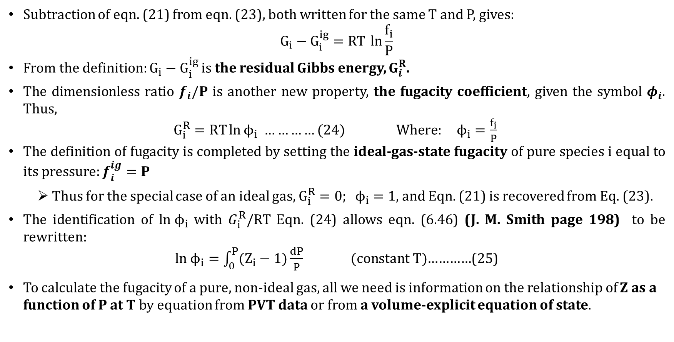
Fugacity of a Pure Substance cond…
Subtraction of eqn. (21) from eqn. (23), both written for the same T and P, gives:
$$G_{i}−G_{i}^{ig}=RT \ln{\frac{f_{i}}{P}}$$
From the definition: $G_{i}−G_{i}^{ig}$ is the residual Gibbs energy, $G_{i}^{R}$.
The dimensionless ratio $f_{i}/P$ is another new property, the fugacity coefficient, given the symbol $φ_{i}$. Thus,
$G_{i}^{R}=RT\ln{ϕ_{i}}$ $…………(24) Where: ϕ_{i}=\frac{f_{i}}{P}$
The definition of fugacity is completed by setting the ideal-gas-state fugacity of pure species i equal to its pressure: $f_{i}^{ig}=P$
Thus for the special case of an ideal gas, $G_{i}^{R}=0; ϕ_{i}=1$, and Eqn. (21) is recovered from Eq. (23).
The identification of $ln ϕ_{i}$ with $G_{i}^{R}/RT$ Eqn. (24) allows eqn. (6.46) (J. M. Smith page 198) to be rewritten:
$ln ϕ_{i}=\int_{0}^{P}{(Z_{i}−1)\frac{dP}{P}} (constant T)$…………(25)
To calculate the fugacity of a pure, non-ideal gas, all we need is information on the relationship of Z as a function of P at T by equation from PVT data or from a volume-explicit equation of state.

Slide 17
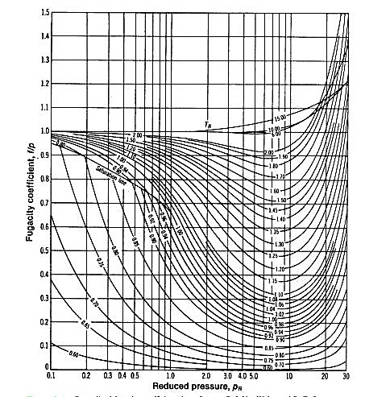
generalized fugacity charts (Michael J. Moran-fig A-6)

Slide 18

methods to get φ for a pure gas
Methods | Equation | Reference | Page
Lee-Kesler Correlation | φ = (φº)(φ¹)^{ω} | φº and φ¹ @ Appendix E (Table E.13 - E.16) P_{r} and T_{r} and ω @ Appendix B (Table B.1) | 658 632
Virial Equation |  | P_{r} and T_{r} and ω @ Appendix B (Table B.1) | 632
Vander Waals equation
Redlich-Kwong equation

Slide 19
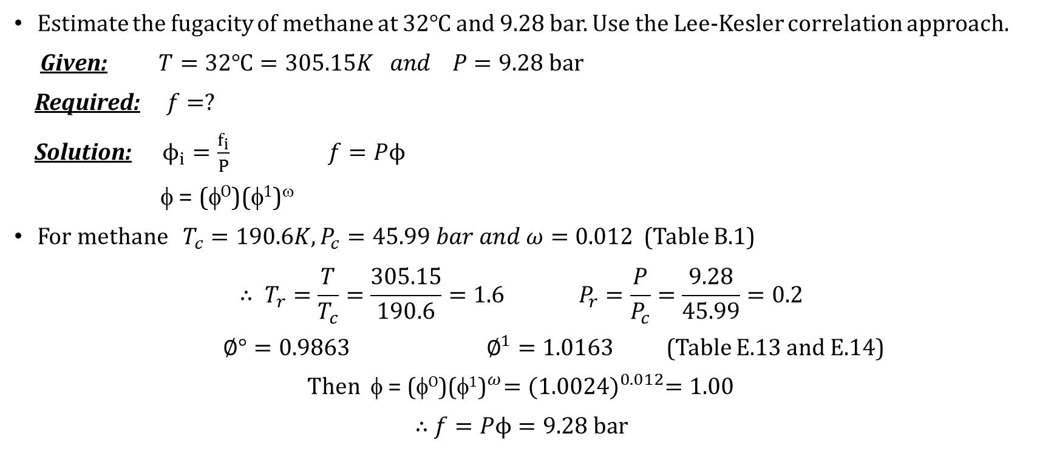
Example 4.2
Estimate the fugacity of methane at 32$℃$ and 9.28 bar. Use the Lee-Kesler correlation approach.
Given: $T=\text{32}℃=305.15K and P=\text{9.28 }\text{bar}$
Required: $f=?$
Solution: $ϕ_{i}=\frac{f_{i}}{P}$ $f=Pϕ$
φ = (φº)(φ¹)^{ω}
For methane $T_{c}=190.6K, P_{c}=45.99 bar and ω=0.012$ (Table B.1)
$$∴ T_{r}=\frac{T}{T_{c}}=\frac{305.15}{190.6}=1.6{ P}_{r}=\frac{P}{P_{c}}=\frac{9.28}{45.99}=0.2$$
$∅°=0.9863 ∅^{1}=1.0163$ (Table E.13 and E.14)
Then φ = ${\text{(}\text{o}\text{)(φ}\text{1}\text{)}}^{ω}={(1.0024)}^{0.012}=1.00$
$∴$ $f=Pϕ=9.28 bar$

Slide 20
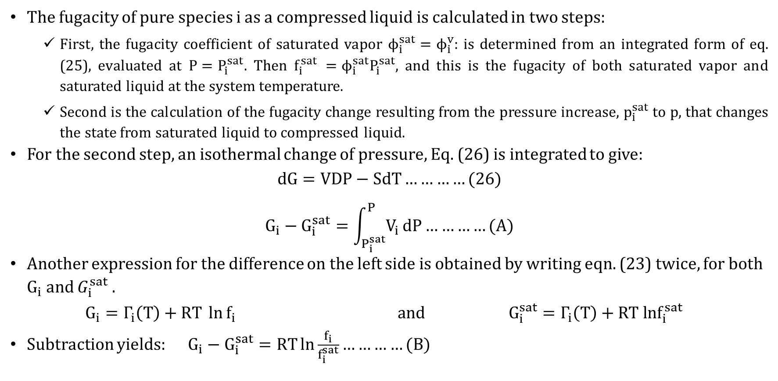
Fugacity of pure liquid
The fugacity of pure species i as a compressed liquid is calculated in two steps:
First, the fugacity coefficient of saturated vapor $ϕ_{i}^{sat}=ϕ_{i}^{v}$: is determined from an integrated form of eq. (25), evaluated at ${P=P}_{i}^{sat}$. Then $f_{i}^{sat} =ϕ_{i}^{sat}P_{i}^{sat}$, and this is the fugacity of both saturated vapor and saturated liquid at the system temperature.
Second is the calculation of the fugacity change resulting from the pressure increase, $p_{i}^{sat}$to p, that changes the state from saturated liquid to compressed liquid.
For the second step, an isothermal change of pressure, Eq. (26) is integrated to give:
$$dG=VdP−SdT…………(26)$$
$$G_{i}−G_{i}^{sat}=\int_{P_{i}^{sat}}^{P}{V_{i}}dP…………(A)$$
Another expression for the difference on the left side is obtained by writing eqn. (23) twice, for both $G_{i}$ and $G_{i}^{sat}$ .
$$G_{i}=Γ_{i}\left(T\right)+RT \ln{f_{i}} and G_{i}^{sat}=Γ_{i}\left(T\right)+RT lnf_{i}^{sat}$$
Subtraction yields: $G_{i}−G_{i}^{sat}=RT\ln{\frac{f_{i}}{f_{i}^{sat}}}…………(B)$

Slide 21
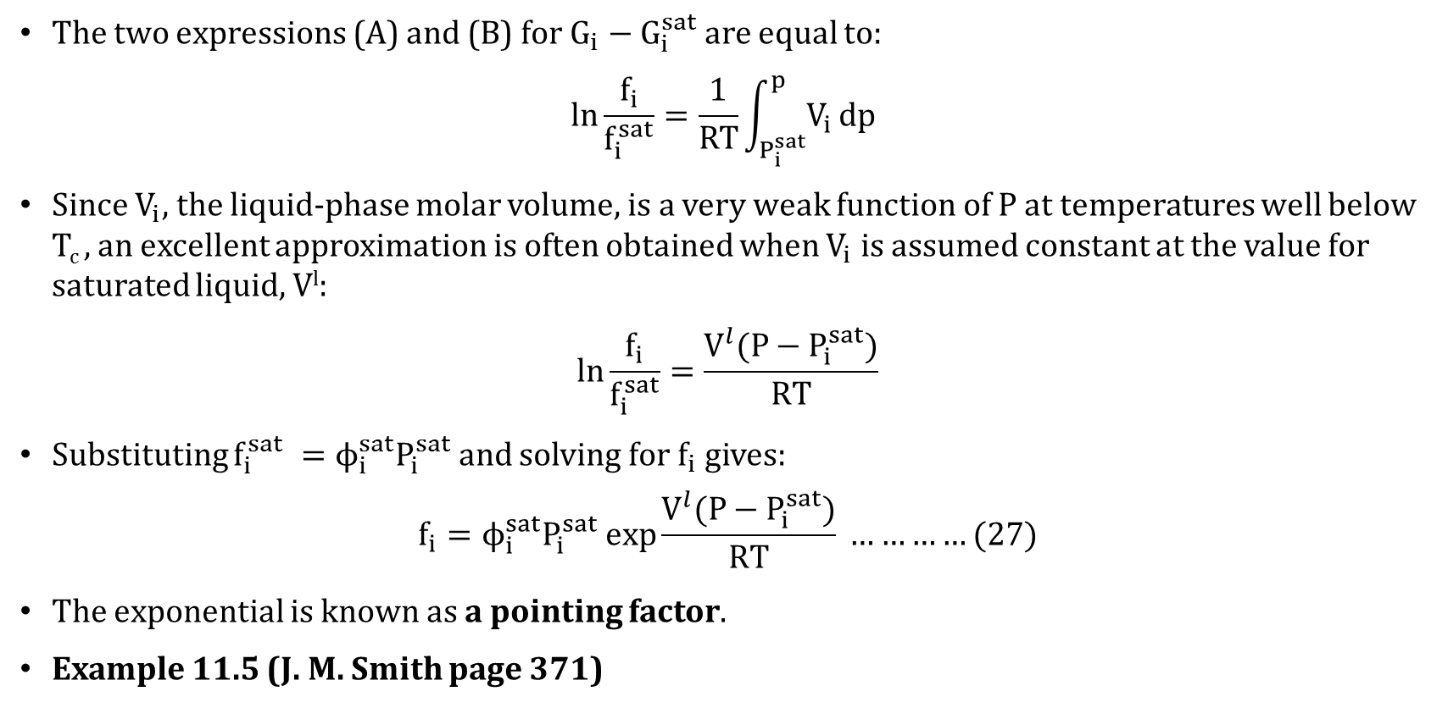
Fugacity of pure liquid cond…
The two expressions (A) and (B) for $G_{i}−G_{i}^{sat}$ are equal to:
$$\ln{\frac{f_{i}}{f_{i}^{sat}}}=\frac{1}{RT}\int_{P_{i}^{sat}}^{p}{V_{i}}dp$$
Since $V_{i}$, the liquid-phase molar volume, is a very weak function of P at temperatures well below T_{c} , an excellent approximation is often obtained when $V_{i}$ is assumed constant at the value for saturated liquid, V^{l}:
$$\ln{\frac{f_{i}}{f_{i}^{sat}}}=\frac{V^{l}(P−P_{i}^{sat})}{RT}$$
Substituting $f_{i}^{sat} =ϕ_{i}^{sat}P_{i}^{sat}$ and solving for $f_{i}$ gives:
$$f_{i}=ϕ_{i}^{sat}P_{i}^{sat} exp\frac{V^{l}(P−P_{i}^{sat})}{RT} …………(27)$$
The exponential is known as a pointing factor.
Example 11.5 (J. M. Smith page 371)

Slide 22
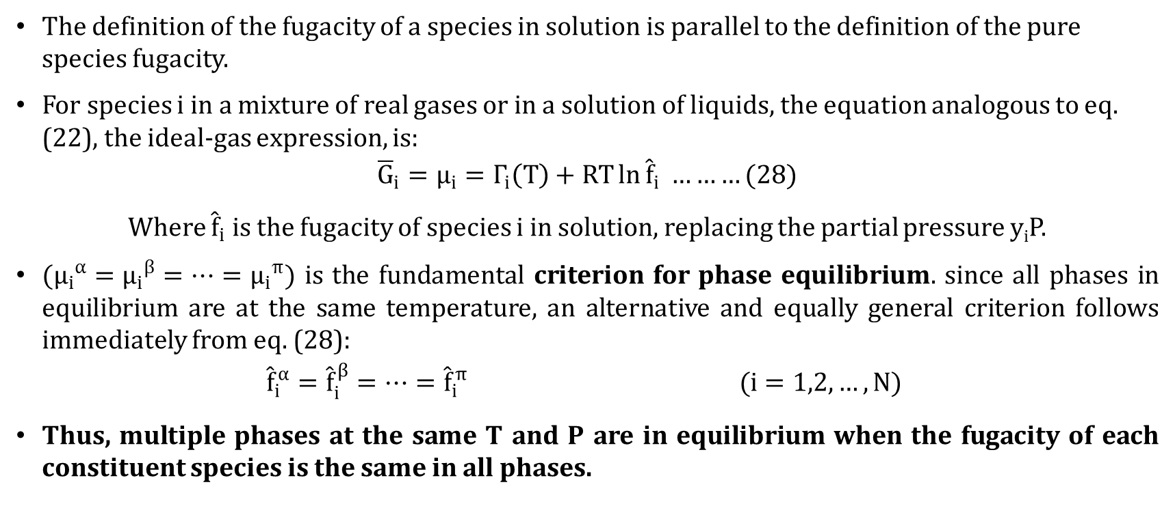
FUGACITY AND FUGACITY COEFFICIENT: SPECIES IN SOLUTION
The definition of the fugacity of a species in solution is parallel to the definition of the pure species fugacity.
For species i in a mixture of real gases or in a solution of liquids, the equation analogous to eq. (22), the ideal-gas expression, is:
$${\overline{G}}_{i}=μ_{i}=Γ_{i}\left(T\right)+RT\ln{{\hat{f}}_{i}} ………(28)$$
Where ${\hat{f}}_{i}$ is the fugacity of species i in solution, replacing the partial pressure y_{i}P.
$({μ_{i}}^{α}={μ_{i}}^{β}=…={μ_{i}}^{π})$ is the fundamental criterion for phase equilibrium. since all phases in equilibrium are at the same temperature, an alternative and equally general criterion follows immediately from eq. (28):
$${\hat{f}}_{i}^{α}={\hat{f}}_{i}^{β}=…={\hat{f}}_{i}^{π} (i=1,2,…,N)$$
Thus, multiple phases at the same T and P are in equilibrium when the fugacity of each constituent species is the same in all phases.

Slide 23
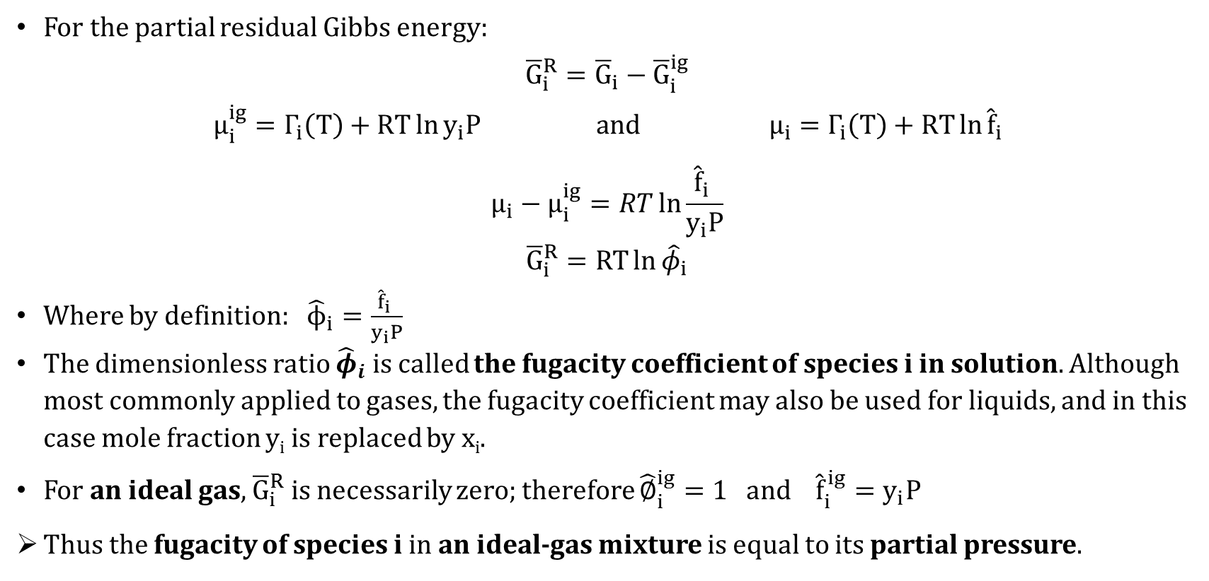
FUGACITY COEFFICIENT: SPECIES in solution
For the partial residual Gibbs energy:
$${\overline{G}}_{i}^{R}={\overline{G}}_{i}−{\overline{G}}_{i}^{ig}$$
$$μ_{i}^{ig}=Γ_{i}\left(T\right)+RT\ln{y_{i}P} and μ_{i}=Γ_{i}\left(T\right)+RT\ln{{\hat{f}}_{i}}$$
$$μ_{i}−μ_{i}^{ig}=RT\ln{\frac{{\hat{f}}_{i} }{y_{i}P}}$$
$${\overline{G}}_{i}^{R}=RT\ln{{\hat{φ}}_{i}}$$
Where by definition: ${\hat{ϕ}}_{i}=\frac{{\hat{f}}_{i} }{y_{i}P}$
The dimensionless ratio ${\hat{φ}}_{i}$ is called the fugacity coefficient of species i in solution. Although most commonly applied to gases, the fugacity coefficient may also be used for liquids, and in this case mole fraction y_{i} is replaced by x_{i}.
For an ideal gas, ${\overline{G}}_{i}^{R}$ is necessarily zero; therefore ${\hat{∅}}_{i}^{ig}=1$and ${\hat{f}}_{i}^{ig}=y_{i}P$
Thus the fugacity of species i in an ideal-gas mixture is equal to its partial pressure.

Slide 24
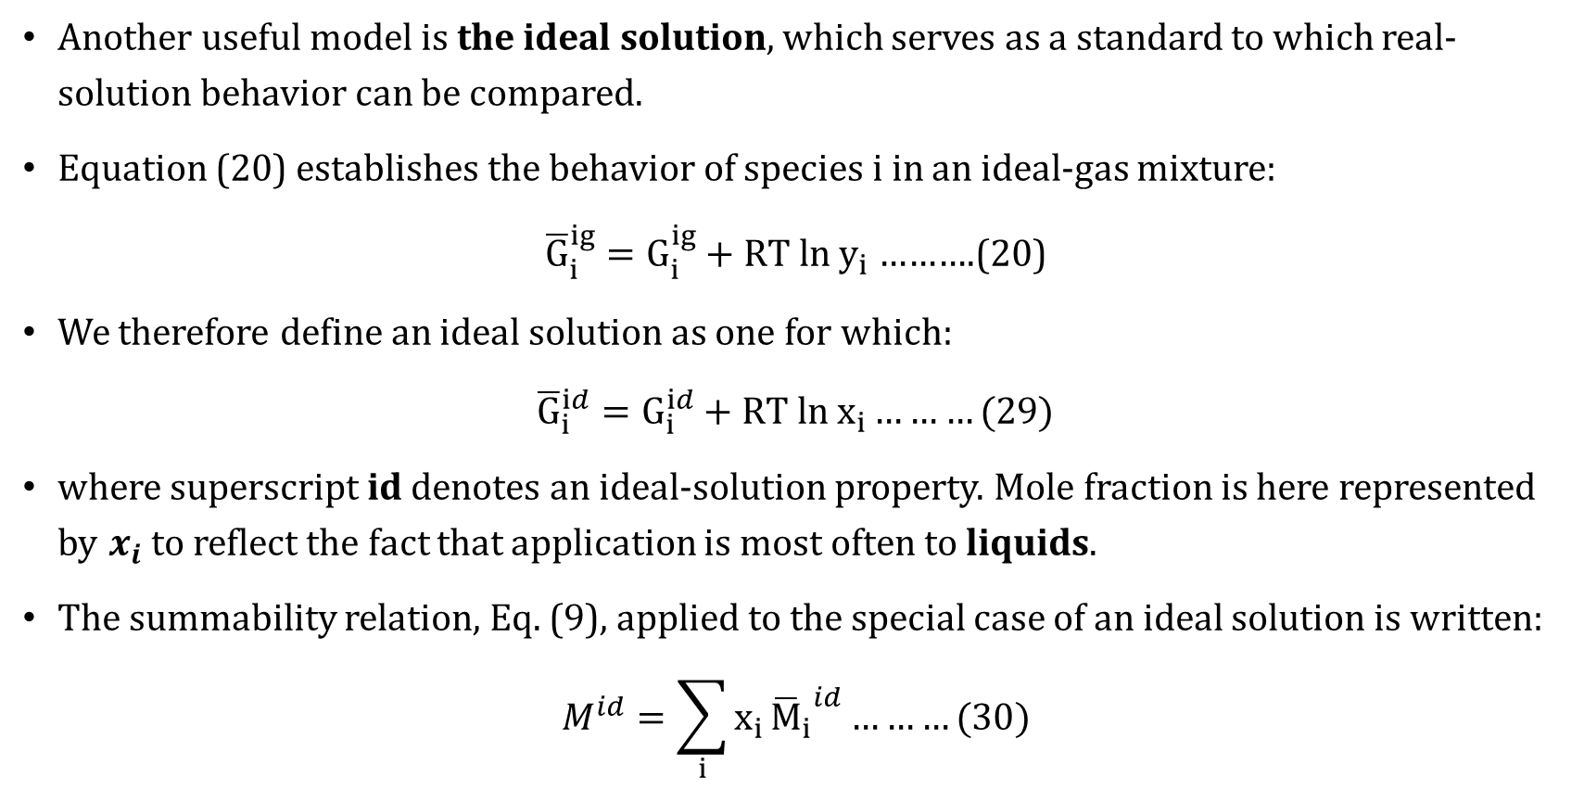
Ideal solution
Another useful model is the ideal solution, which serves as a standard to which real-solution behavior can be compared.
Equation (20) establishes the behavior of species i in an ideal-gas mixture:
${\overline{G}}_{i}^{ig}=G_{i}^{ig}+RT ln y_{i}$……….(20)
We therefore define an ideal solution as one for which:
${\overline{G}}_{i}^{id}=G_{i}^{id}+RT ln x_{i}………(29)$
where superscript id denotes an ideal-solution property. Mole fraction is here represented by $x_{i}$ to reflect the fact that application is most often to liquids.
The summability relation, Eq. (9), applied to the special case of an ideal solution is written:
$$M^{id}=\sum_{i}{x_{i}}{{\overline{M}}_{i}}^{id}………(30)$$

Slide 25
Assignment on chapter 5
Group No. | Title | Page
1 | 13.1 The Reaction Coordinate 13.2 Application of Equilibrium Criteria to Chemical Reactions | 451 455
2 | 13.3 The Standard Gibbs-Energy Change and the Equilibrium Constant | 456
3 | 13.4 Effect of Temperature on the Equilibrium Constant (until eqn. 13.18) | 458
13.6 Relation of Equilibrium Constants to Composition
4 | Gas-Phase Reactions | 464
5 | Liquid-Phase Reactions | 466
6 | 13.7 Equilibrium Conversions for Single Reactions Single-Phase Reactions Reactions in Heterogeneous Systems | 468
7 | 13.9 Multi-reaction Equilibria | 484

