Slide 1
CHAPTER THREE
Vapor/liquid equilibrium
Nature of equilibrium
Gibbs Phase rule
Criteria of equilibrium
Clapeyron and Clausious claperon equation
Simple models for vapor/liquid equilibrium
VLE by modified raoult’s law
Flash calculation

Slide 2


nature of equilibrium
Equilibrium is a static condition in which no changes occur in the macroscopic properties of a system with time.
Temperature
An isolated system Pressure remains fixed
Phase composition
Types of equilibrium
  Mechanical equilibrium – when $P_{sys}$ = $P_{ext}$
  Thermal equilibrium – when $T_{sys}$ = $T_{ext}$ i.e. no heat flow.
  Material equilibrium – when $µ_{1}$ = $µ_{2}$ i.e. no flow of matter.
    Diffusion
    Phase change
    Chemical reaction
Equilibrium is a static condition in which no changes occur in the macroscopic properties of a system with time.
Temperature
An isolated system Pressure remains fixed
Phase composition
Types of equilibrium
  Mechanical equilibrium – when $P_{sys}$ = $P_{ext}$
  Thermal equilibrium – when $T_{sys}$ = $T_{ext}$ i.e. no heat flow.
  Material equilibrium – when $µ_{1}$ = $µ_{2}$ i.e. no flow of matter.
    Diffusion
    Phase change
    Chemical reaction
liquid
Vapor

Slide 3


Gibbs Phase rule
Gibbs phase rule: specifies the minimum number of independent variables needed to completely describe the system of interest and expressed in the form:
T,P, concentration
The number of independent intensive properties needed to fix the state of a system is called degrees of freedom (F).
Phase (P)
  a distinct, homogeneous state of matter
  Can be a mixture of components that cannot be distinguished from one another.
Component – an independently variable constituents of mixture.
where f is number of formulas,
e is number of chemical equilibrium equation,
i is number of initial condition.
$P+F=C+2$
$$C=f−e−i$$

Slide 4
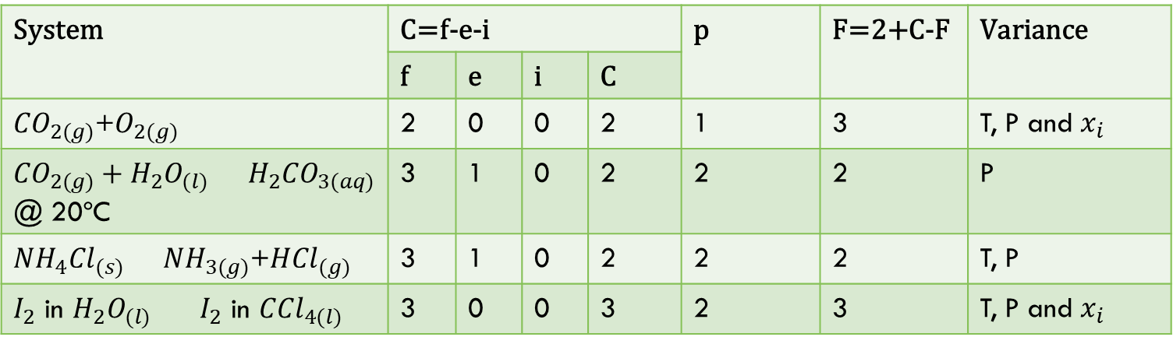

Gibbs Phase rule cond...
Example 3.1: Calculate degree of freedom or variance of each system.
  ${CO}_{2(g)}$+$O_{2(g)}$
  ${CO}_{2(g)}+H_{2}O_{(l)}$ $H_{2}{CO}_{3(aq)}$ @ 20ºC
  ${NH}_{4}{Cl}_{(s)}$ ${NH}_{3(g)}$+${HCl}_{(g)}$
  $I_{2}$ in $H_{2}O_{(l)}$ $I_{2}$ in ${CCl}_{4(l)}$
System | C=f-e-i |  |  |  | p | F=2+C-F | Variance
 | f | e | i | C
${CO}_{2(g)}$+$O_{2(g)}$ | 2 | 0 | 0 | 2 | 1 | 3 | T, P and $x_{i}$
${CO}_{2(g)}+H_{2}O_{(l)}$ ${ H}_{2}{CO}_{3(aq)}$ @ 20ºC | 3 | 1 | 0 | 2 | 2 | 2 | P
${NH}_{4}{Cl}_{(s)}$ ${ NH}_{3(g)}$+${HCl}_{(g)}$ | 3 | 1 | 0 | 2 | 2 | 2 | T, P
$I_{2}$ in $H_{2}O_{(l)}$ $I_{2}$ in ${CCl}_{4(l)}$ | 3 | 0 | 0 | 3 | 2 | 3 | T, P and $x_{i}$

Slide 5
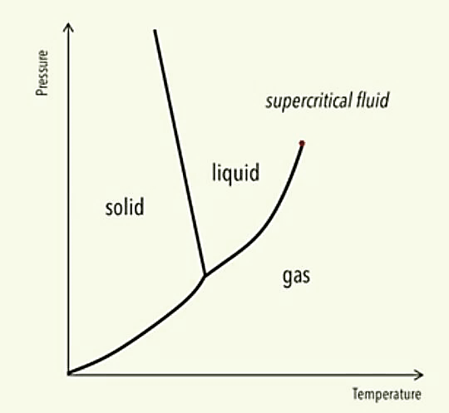
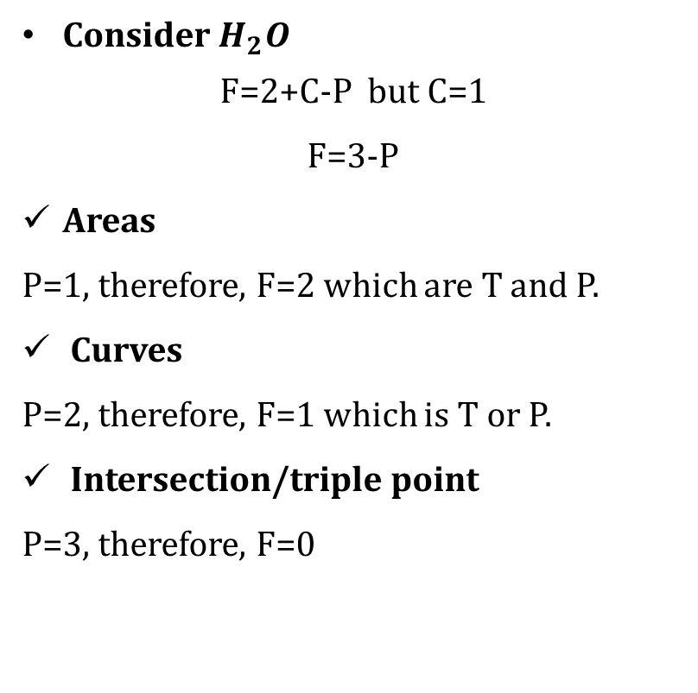
Gibbs Phase rule for one-component systems
Consider $H_{2}O$
F=2+C-P but C=1
F=3-P
Areas
P=1, therefore, F=2 which are T and P.
Curves
P=2, therefore, F=1 which is T or P.
Intersection/triple point
P=3, therefore, F=0

Slide 6
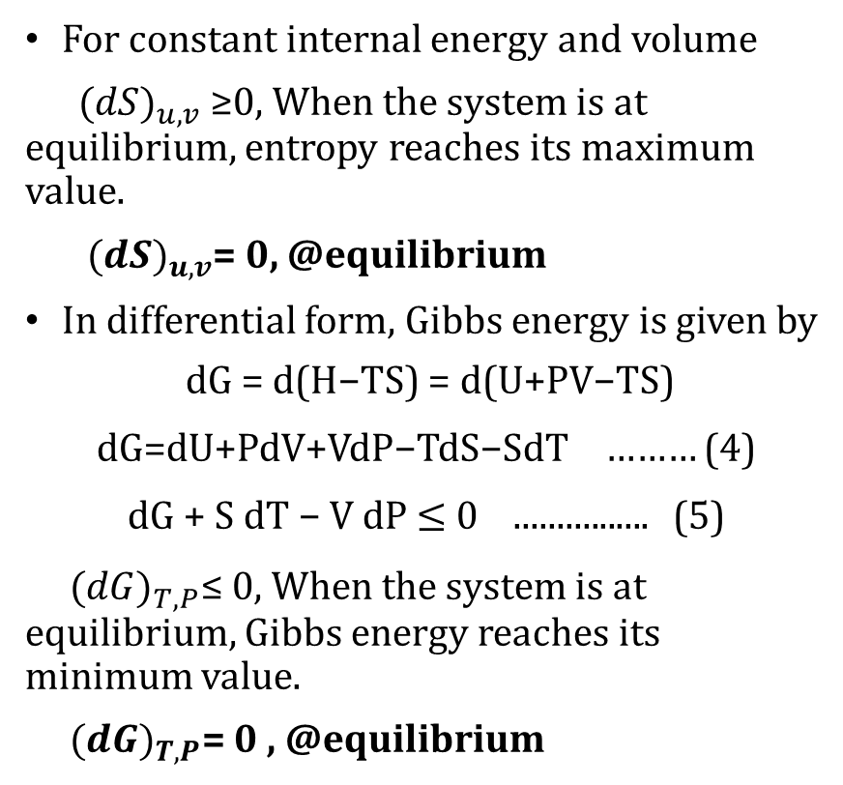
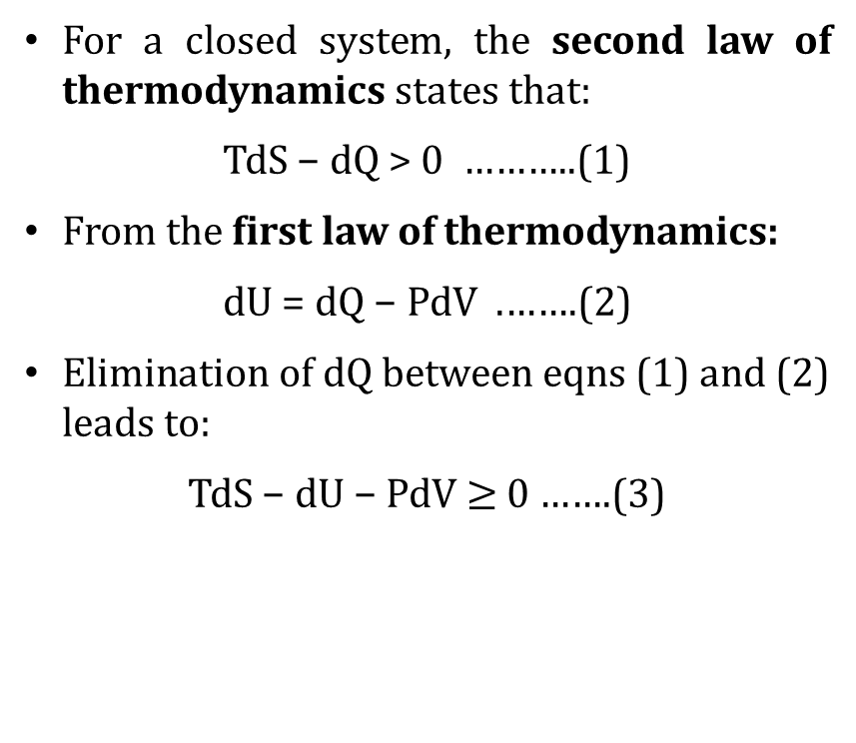
Criteria of equilibrium for a closed system
For a closed system, the second law of thermodynamics states that:
TdS − dQ > 0 ………..(1)
From the first law of thermodynamics:
dU = dQ − PdV .…….(2)
Elimination of dQ between eqns (1) and (2) leads to:
TdS − dU − PdV $≥$ 0 …….(3)
For constant internal energy and volume
${(dS)}_{u,v}$≥0, When the system is at equilibrium, entropy reaches its maximum value.
${ (dS)}_{u,v}$= 0, @equilibrium
In differential form, Gibbs energy is given by
dG = d(H−TS) = d(U+PV−TS) dG=dU+PdV+VdP−TdS−SdT ……… (4)
dG + S dT − V dP $≤$ 0 ................ (5)
${(dG)}_{T,P}$≤ 0, When the system is at equilibrium, Gibbs energy reaches its minimum value.
${(dG)}_{T,P}$= 0 , @equilibrium

Slide 7

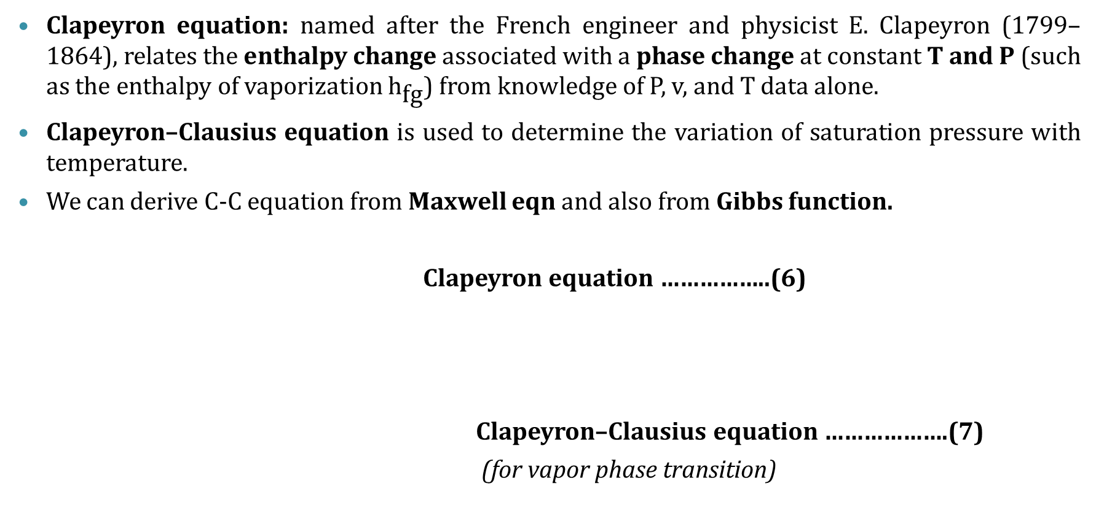

Clapeyron and Clapeyron-clausions Equation
Clapeyron equation: named after the French engineer and physicist E. Clapeyron (1799–1864), relates the enthalpy change associated with a phase change at constant T and P (such as the enthalpy of vaporization ${\text{h}}_{\text{fg}}$) from knowledge of P, v, and T data alone.
Clapeyron–Clausius equation is used to determine the variation of saturation pressure with temperature.
We can derive C-C equation from Maxwell eqn and also from Gibbs function.
Clapeyron equation ……………..(6)
Clapeyron–Clausius equation ……………….(7)
(for vapor phase transition)
$${\left(\frac{dP}{dT}\right)}_{sat}=\frac{h_{αβ}}{Tv_{αβ}}$$
$$ln{\left(\frac{P_{2}}{P_{1}}\right)}_{sat}=\frac{h_{fg}}{R}{\left(\frac{1}{T_{1}}−\frac{1}{T_{2}}\right)}_{sat}$$

Slide 8

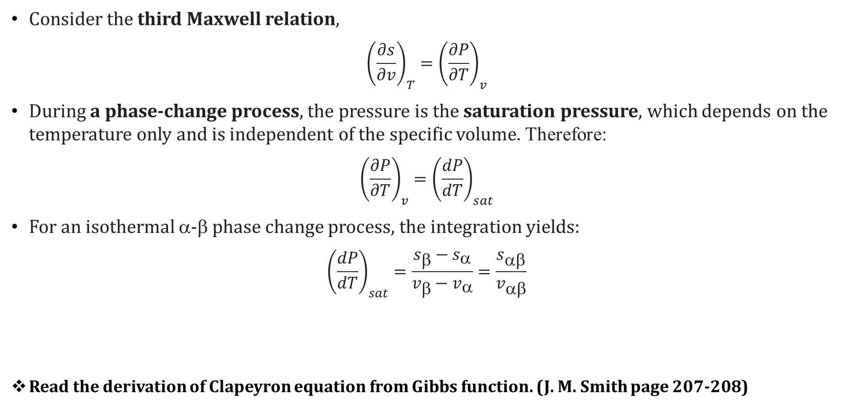

Clapeyron Equation derivation
Consider the third Maxwell relation,
$${\left(\frac{∂s}{∂v}\right)}_{T}={\left(\frac{∂P}{∂T}\right)}_{v}$$
During a phase-change process, the pressure is the saturation pressure, which depends on the temperature only and is independent of the specific volume. Therefore:
$${\left(\frac{∂P}{∂T}\right)}_{v}={\left(\frac{dP}{dT}\right)}_{sat}$$
For an isothermal α-β phase change process, the integration yields:
$${\left(\frac{dP}{dT}\right)}_{sat}=\frac{s_{β}−s_{α}}{v_{β}−v_{α}}=\frac{s_{αβ}}{v_{αβ}}$$
Read the derivation of Clapeyron equation from Gibbs function. (J. M. Smith page 207-208)
$$dh=TdS+v{dP}^{ 0}$$
$$\int_{α}^{β}{dh=\int_{α}^{β}{Tds}=T\int_{α}^{β}{ds}}$$
$$h_{β}−h_{α}=T(s_{β}−s_{α})$$
$$h_{αβ}={Ts}_{αβ}$$
$${\left(\frac{dP}{dT}\right)}_{sat}=\frac{h_{αβ}}{Tv_{αβ}}$$

Slide 9

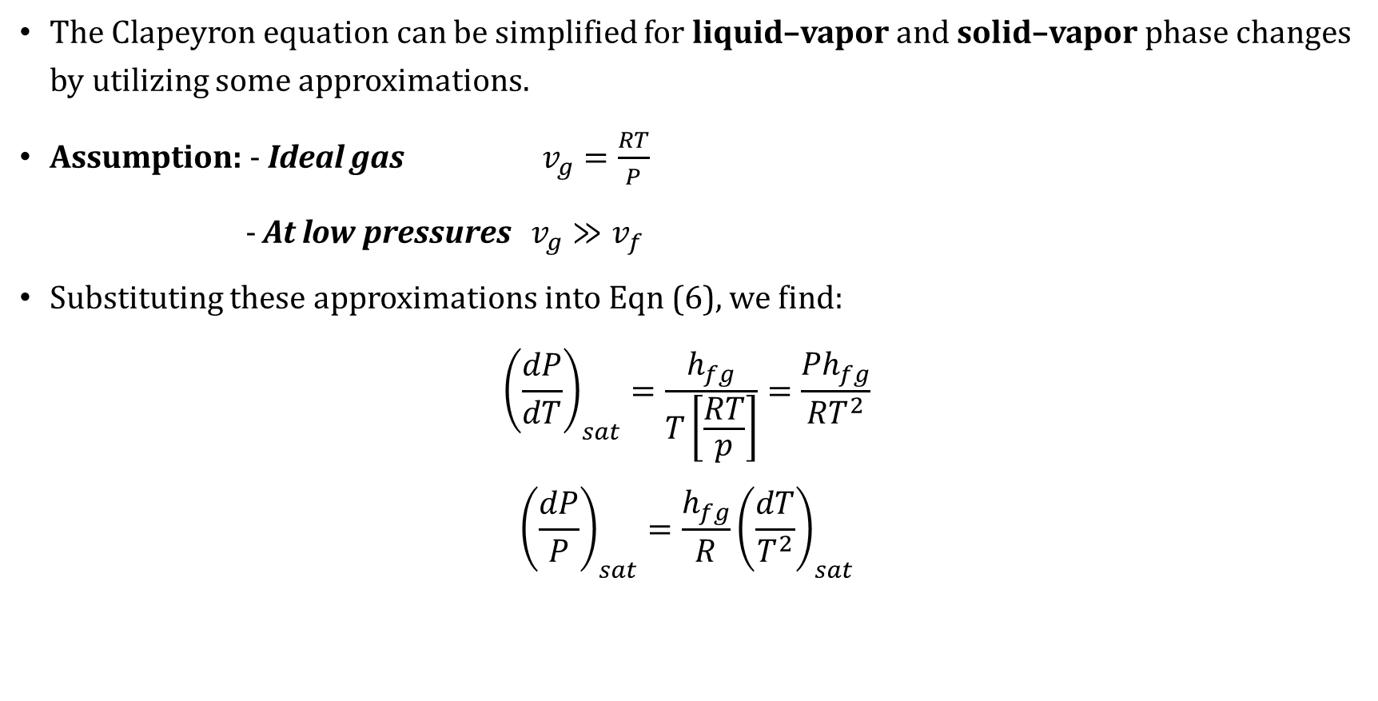

Clapeyron-clausions Equation derivation
The Clapeyron equation can be simplified for liquid–vapor and solid–vapor phase changes by utilizing some approximations.
Assumption: - Ideal gas $v_{g}=\frac{RT}{P}$
- At low pressures $v_{g}≫v_{f}$
Substituting these approximations into Eqn (6), we find:
$${\left(\frac{dP}{dT}\right)}_{sat}=\frac{h_{fg}}{T\left[\frac{RT}{p}\right]}=\frac{{Ph}_{fg}}{{RT}^{2}}$$
$${\left(\frac{dP}{P}\right)}_{sat}=\frac{h_{fg}}{R}{\left(\frac{dT}{T^{2}}\right)}_{sat}$$
$$v_{fg}≅v_{g}=\frac{RT}{P}$$
$$ln{\left(\frac{P_{2}}{P_{1}}\right)}_{sat}=\frac{h_{fg}}{R}{\left(\frac{1}{T_{1}}−\frac{1}{T_{2}}\right)}_{sat}$$

Slide 10
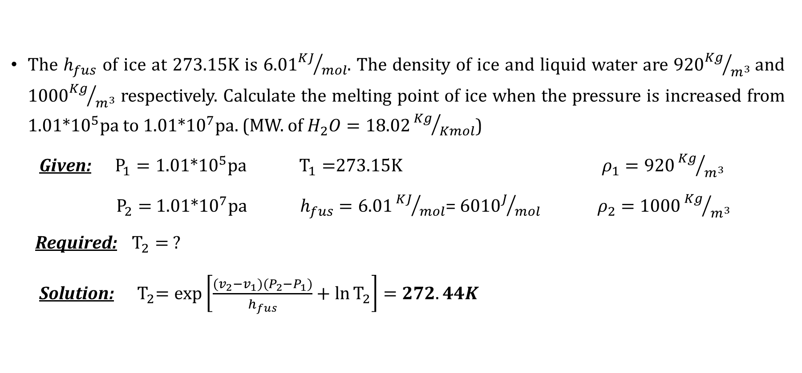
Example 3.2:
The $h_{fus}$ of ice at 273.15K is 6.01${KJ}/{mol}$. The density of ice and liquid water are 920${Kg}/{m^{3}}$and 1000${Kg}/{m^{3}}$ respectively. Calculate the melting point of ice when the pressure is increased from 1.01*${10}^{5}$pa to 1.01*${10}^{7}$pa. (MW. of $H_{2}O=18.02{Kg}/{Kmol}$)
Given: $P_{1}=\text{1.01∗}{10}^{5}\text{pa}$ $T_{1}=$273.15K $ρ_{1}=\text{920}{Kg}/{m^{3}}$
$P_{2}=$ 1.01*${10}^{7}$pa $h_{fus}=\text{6.01}{KJ}/{mol}$= 6010$J/{mol}$ $ρ_{2}=\text{1000}{Kg}/{m^{3}}$
Required: $T_{2}=$ ?
Solution: ${ T}_{2}=\exp\left[\frac{(v_{2}−v_{1})(P_{2}−P_{1})}{h_{fus}}+\ln{T_{2}}\right]=272.44K$

Slide 11
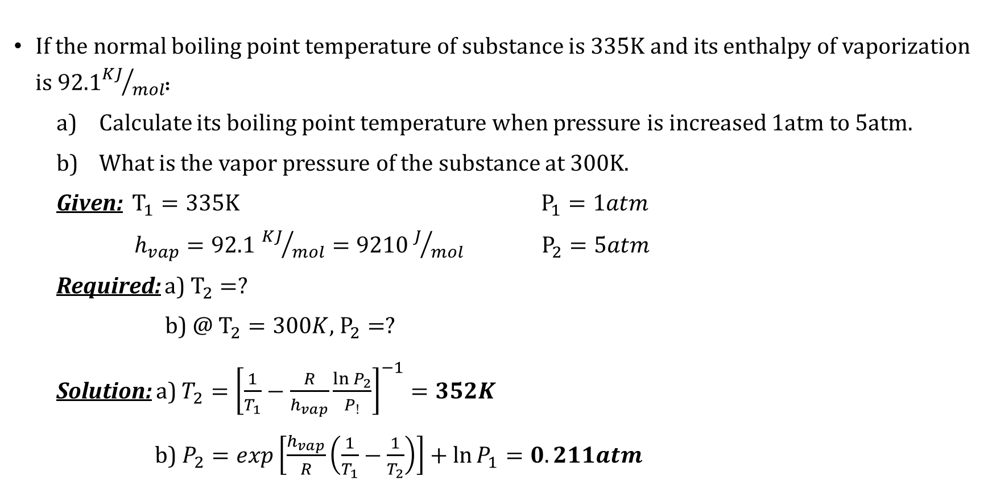
Example 3.3:
If the normal boiling point temperature of substance is 335K and its enthalpy of vaporization is 92.1${KJ}/{mol}$:
  Calculate its boiling point temperature when pressure is increased 1atm to 5atm.
  What is the vapor pressure of the substance at 300K.
  Given: $T_{1}=335K$ $P_{1}=1atm$
  $h_{vap}=92.1$ ${KJ}/{mol}=9210J/{mol}$ $P_{2}=5atm$
  Required: a) $T_{2}=?$
  b) @ $T_{2}=300K$, $P_{2}=?$
  Solution: a) $T_{2}={\left[\frac{1}{T_{1}}−\frac{R}{h_{vap}}\frac{\ln{P_{2}}}{P_{!}}\right]}^{−1}=352K$
  b) $P_{2}=exp\left[\frac{h_{vap}}{R}\left(\frac{1}{T_{1}}−\frac{1}{T_{2}}\right)\right]+\ln{P_{1}}=0.211atm$

Slide 12
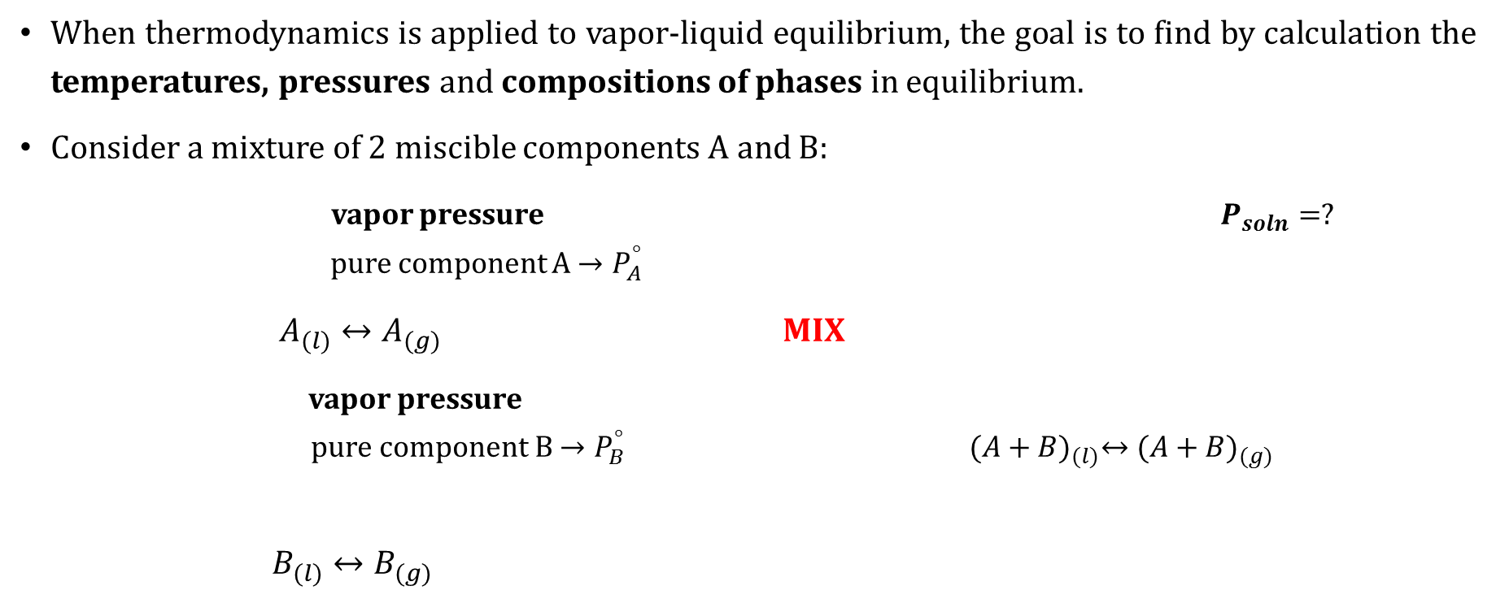
Simple models for vapor/liquid equilibrium
When thermodynamics is applied to vapor-liquid equilibrium, the goal is to find by calculation the temperatures, pressures and compositions of phases in equilibrium.
Consider a mixture of 2 miscible components A and B:
vapor pressure $P_{soln}=?$
pure component A ${→P}_{A}^{°}$
$A_{(l)}↔A_{(g)}$ MIX
vapor pressure
pure component B${→P}_{B}^{°}$ ${(A+B)}_{(l)}↔({A+B)}_{(g)}$
$B_{(l)}↔B_{(g)}$

Slide 13

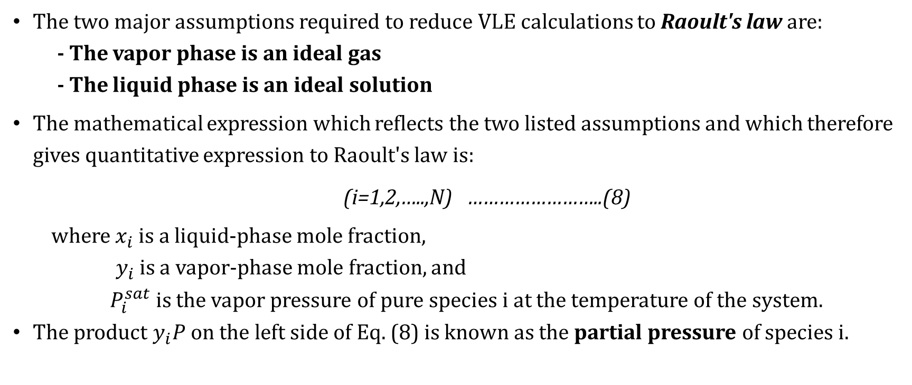
Raoult’s law
The two major assumptions required to reduce VLE calculations to Raoult's law are:
- The vapor phase is an ideal gas
- The liquid phase is an ideal solution
The mathematical expression which reflects the two listed assumptions and which therefore gives quantitative expression to Raoult's law is:
(i=1,2,…..,N) ……………………..(8)
where $x_{i}$is a liquid-phase mole fraction,
$y_{i}$ is a vapor-phase mole fraction, and
$P_{i}^{sat}$is the vapor pressure of pure species i at the temperature of the system.
The product $y_{i}P$on the left side of Eq. (8) is known as the partial pressure of species i.
$$y_{i}P=x_{i}P_{i}^{sat}$$

Slide 14




Dewpoint and Bubble point
Vapor pressure - Composition diagram (where B is the more volatile component)
Bubble point
is the first trace of vapor.
Dewpoint
is the last trace of liquid.
P(atm)
T=constant
Liquid
Vapor
$$P_{B}^{°}$$
Liquid + Vapor
BUBL P
$${ P}_{A}^{°}$$
Dew P
$$x_{i}$$
$$y_{i}$$
A
Moles %A Moles %B
B

Slide 15

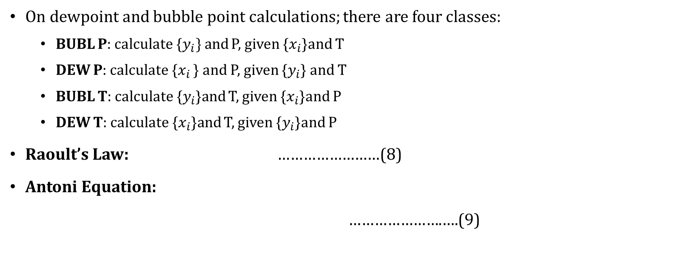

Dewpoint and Bubble point Calculations with Raoult's Law
On dewpoint and bubble point calculations; there are four classes:
  BUBL P: calculate {$y_{i}\}$and P, given {$x_{i}$}and T
  DEW P: calculate {$x_{i}$ } and P, given {$y_{i}$} and T
  BUBL T: calculate {$y_{i}$}and T, given {$x_{i}$}and P
  DEW T: calculate {$x_{i}$}and T, given {$y_{i}$}and P
Raoult’s Law: ……………………(8)
Antoni Equation:
………………….….(9)
$$y_{i}P=x_{i}P_{i}^{sat}$$
$$\ln{P_{i}^{sat}=A_{i}−\frac{B_{i}}{T+C_{i}}}$$

Slide 16
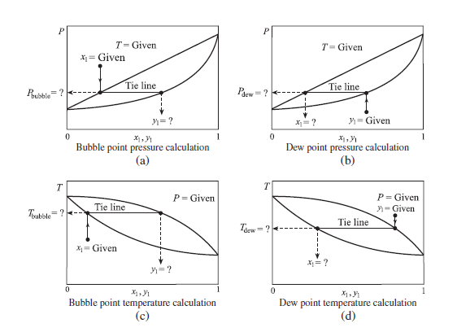
BUBL and dew point calculation

Slide 17
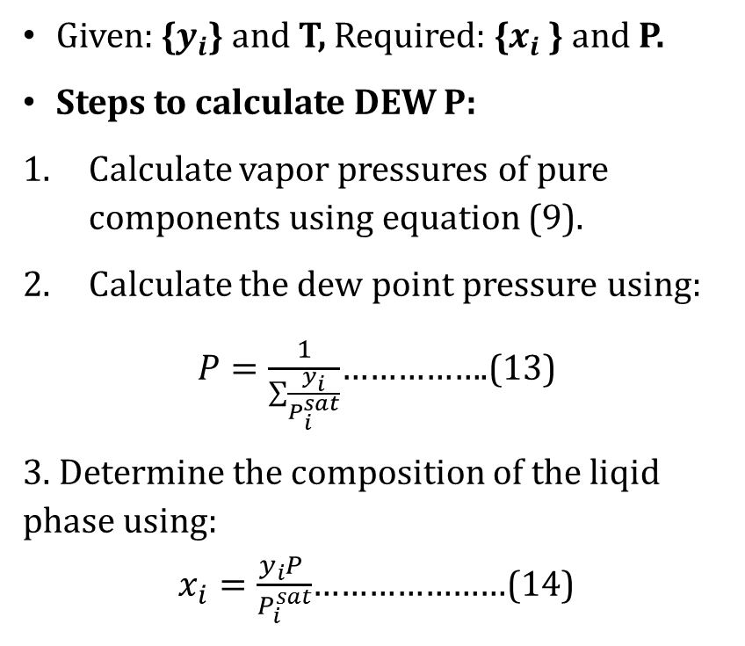
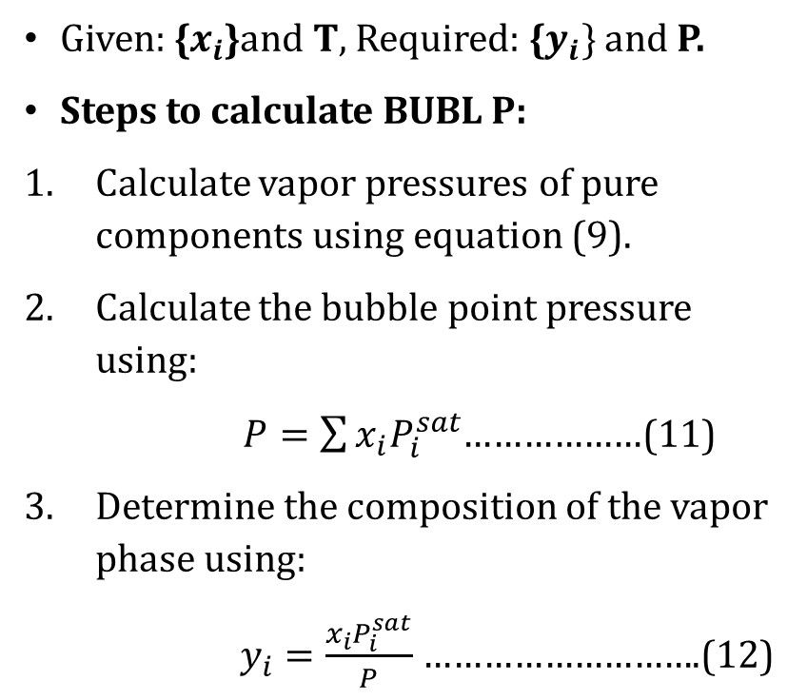
BUBL and DEW p
Bubl P calculation:
2. DEW P calculation:
Given: {$x_{i}$}and T, Required: {$y_{i}\}$and P.
Steps to calculate BUBL P:
Calculate vapor pressures of pure components using equation (9).
Calculate the bubble point pressure using:
$P=\sum{x_{i}P_{i}^{sat}}$………………(11)
Determine the composition of the vapor phase using:
$y_{i}=\frac{x_{i}P_{i}^{sat}}{P}$ ……………………….(12)
Given: {$y_{i}$} and T, Required: {$x_{i}$ } and P.
Steps to calculate DEW P:
Calculate vapor pressures of pure components using equation (9).
Calculate the dew point pressure using:
$P=\frac{1}{\sum{\frac{y_{i}}{P_{i}^{sat}}}}$…………….(13)
3. Determine the composition of the liqid phase using:
$x_{i}=\frac{y_{i}P }{P_{i}^{sat}}$…………………(14)

Slide 18
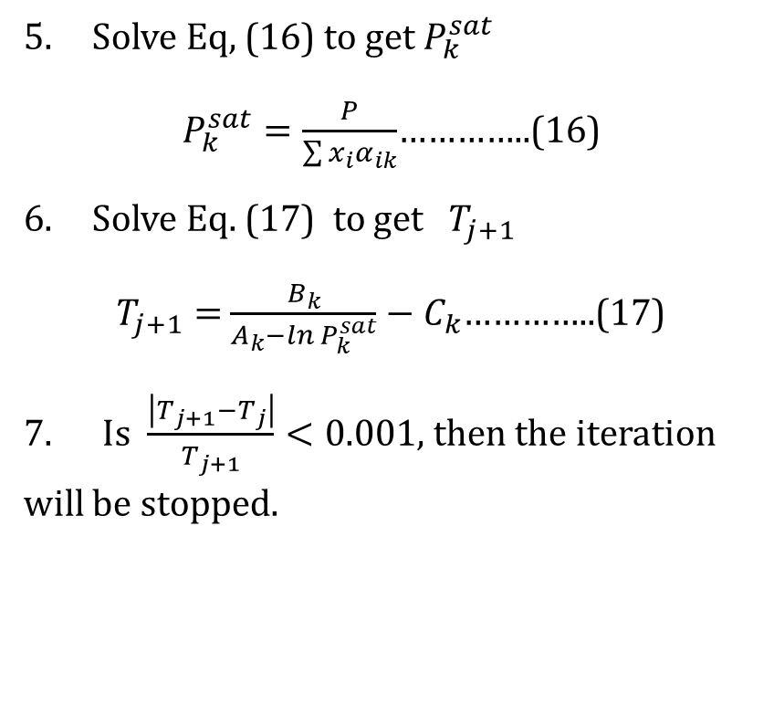
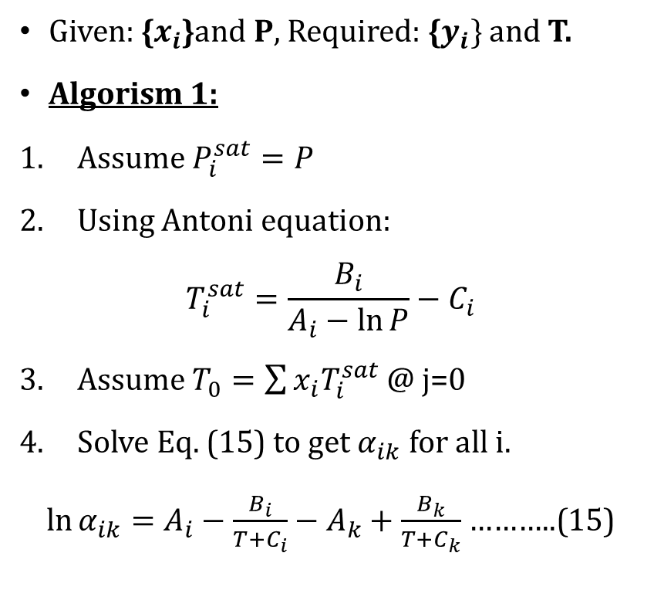
BUBL t calculation:
Given: {$x_{i}$}and P, Required: {$y_{i}\}$and T.
Algorism 1:
Assume $P_{i}^{sat}=P$
Using Antoni equation:
$$T_{i}^{sat}=\frac{B_{i}}{A_{i}−\ln{P}}−C_{i}$$
Assume $T_{0}=\sum{x_{i}T_{i}^{sat}}$ @ j=0
Solve Eq. (15) to get $α_{ik}$ for all i.
$\ln{α_{ik}}=$ $A_{i}−\frac{B_{i}}{T+C_{i}}−A_{k}+\frac{B_{k}}{T+C_{k}}$ ………..(15)
Solve Eq, (16) to get $P_{k}^{sat}$
$P_{k}^{sat}=\frac{P}{\sum{x_{i}α_{ik}}}$…………..(16)
Solve Eq. (17) to get $T_{j+1}$
$T_{j+1}=$ $\frac{B_{k}}{A_{k}−\ln{P_{k}^{sat}}}−C_{k}$…………..(17)
7. Is $\frac{\left|T_{j+1}−T_{j}\right|}{T_{j+1}}<0.001$, then the iteration will be stopped.

Slide 19
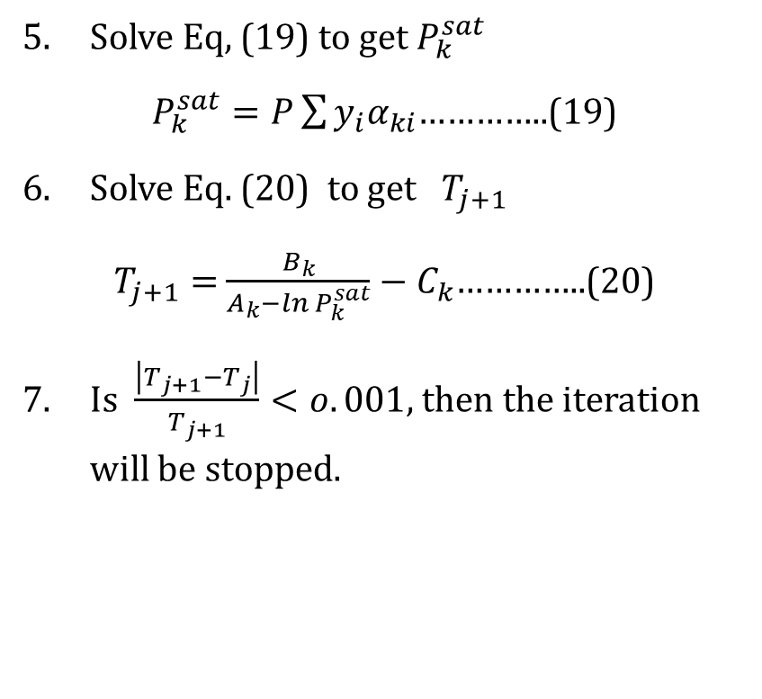
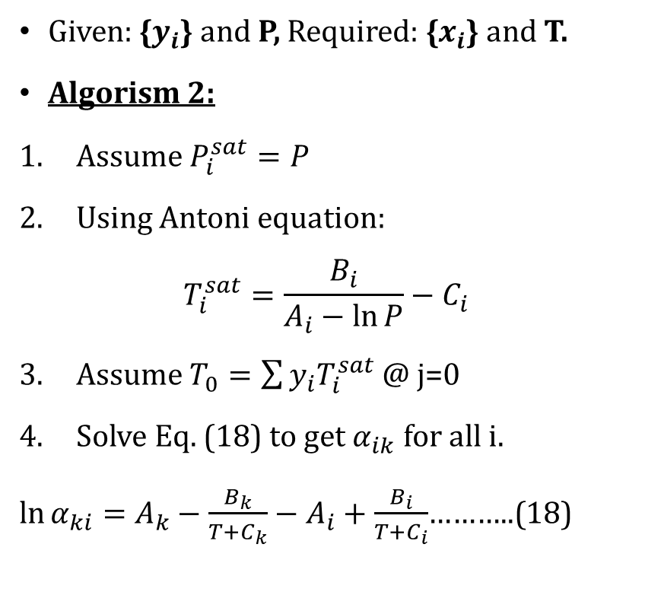
Dew t calculation:
Given: {$y_{i}$} and P, Required: {$x_{i}$} and T.
Algorism 2:
Assume $P_{i}^{sat}=P$
Using Antoni equation:
$$T_{i}^{sat}=\frac{B_{i}}{A_{i}−\ln{P}}−C_{i}$$
Assume $T_{0}=\sum{y_{i}T_{i}^{sat}}$ @ j=0
Solve Eq. (18) to get $α_{ik}$ for all i.
$\ln{α_{ki}}=$ $A_{k}−\frac{B_{k}}{T+C_{k}}−$ $A_{i}+\frac{B_{i}}{T+C_{i}}$………..(18)
Solve Eq, (19) to get $P_{k}^{sat}$
$P_{k}^{sat}=P\sum{y_{i}α_{ki}}$…………..(19)
Solve Eq. (20) to get $T_{j+1}$
$T_{j+1}=$ $\frac{B_{k}}{A_{k}−\ln{P_{k}^{sat}}}−C_{k}$…………..(20)
Is $\frac{\left|T_{j+1}−T_{j}\right|}{T_{j+1}}<o.001$, then the iteration will be stopped.

Slide 20
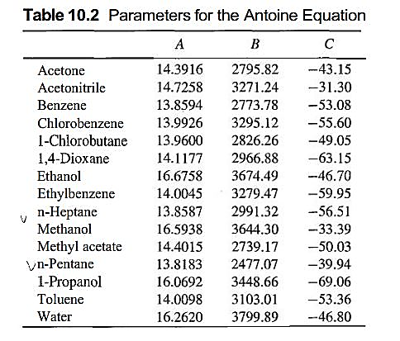
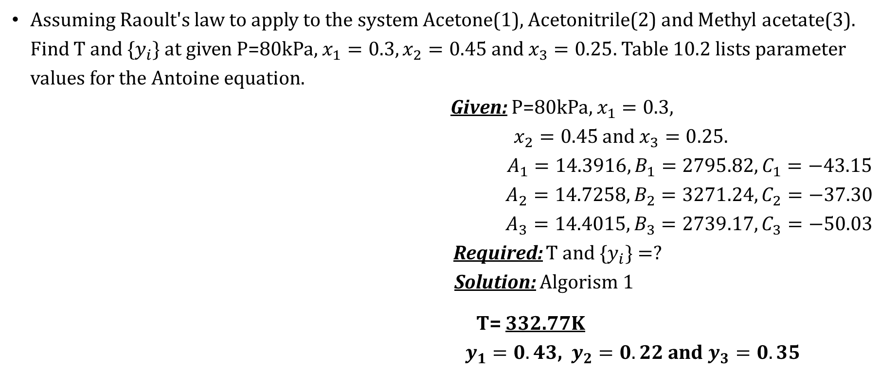
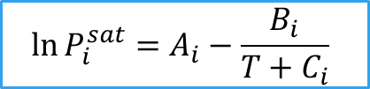
Example 3.4
Assuming Raoult's law to apply to the system Acetone(1), Acetonitrile(2) and Methyl acetate(3). Find T and {$y_{i}\}$at given P=80kPa, $x_{1}=0.3,x_{2}=0.45$ and $x_{3}=0.25$. Table 10.2 lists parameter values for the Antoine equation.
Given: P=80kPa, $x_{1}=0.3,$
$x_{2}=0.45$ and $x_{3}=0.25$.
$A_{1}=14.3916, B_{1}=2795.82, C_{1}=−43.15$
$$A_{2}=14.7258,B_{2}=3271.24, C_{2}=−37.30$$
$$A_{3}=14.4015, B_{3}=2739.17, C_{3}=−50.03$$
Required: T and {$y_{i}\}=?$
Solution: Algorism 1
T= 332.77K
$y_{1}=0.43$, $y_{2}=0.22$ and $y_{3}=0.35$
$$\ln{P_{i}^{sat}=A_{i}−\frac{B_{i}}{T+C_{i}}}$$

Slide 21

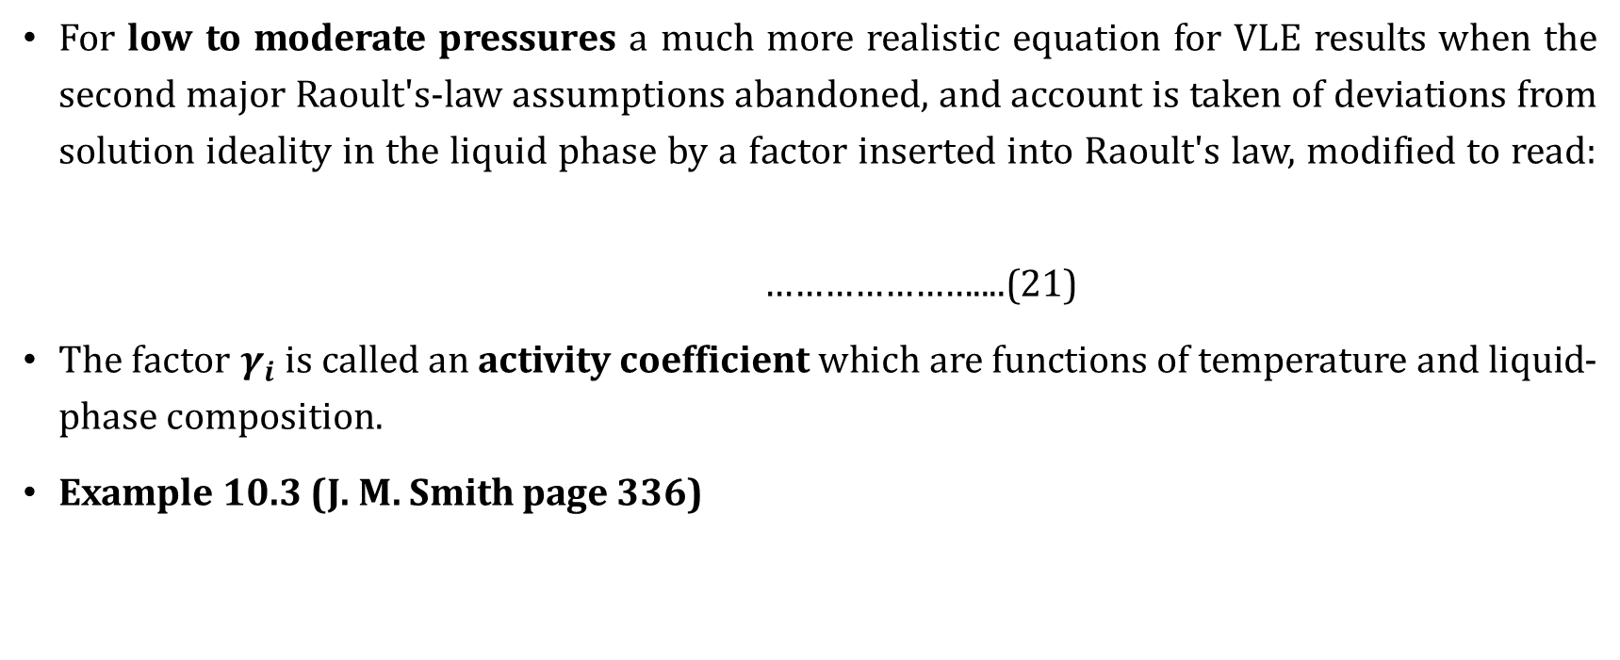
VLE by modified raoult’s law
For low to moderate pressures a much more realistic equation for VLE results when the second major Raoult's-law assumptions abandoned, and account is taken of deviations from solution ideality in the liquid phase by a factor inserted into Raoult's law, modified to read:
…………………....(21)
The factor $γ_{i}$is called an activity coefficient which are functions of temperature and liquid-phase composition.
Example 10.3 (J. M. Smith page 336)
$$y_{i}P=x_{i}γ_{i}P_{i}^{sat}$$

Slide 22
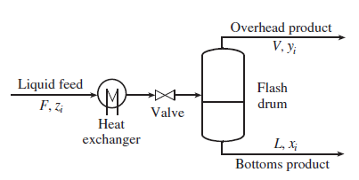




Flash calculation
An important application of VLE is flash calculation. The name originates from the fact
that a liquid at a pressure equal to or greater than its bubble point pressure "flashes“ or partially evaporates when the pressure is reduced, producing a two-phase system of vapor and liquid in equilibrium.
The overall and component material balances around
the flash drum are given as:

