Slide 1
Chapter 5
Cell Kinetics and Fermenter Design

Slide 2
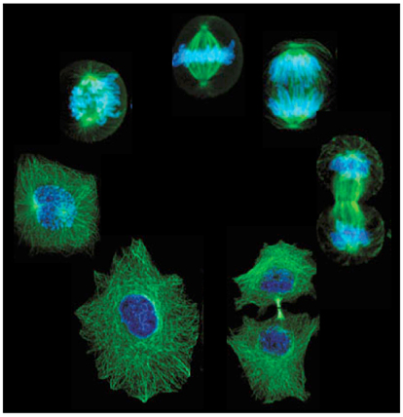
Introduction
Growth is a result of 2 things:
  Replication (Mitosis)
  Change in cell size
Growth occurs in response to the physiochemical environment
Nutrients are taken up and used for:
  Energy Production
  Biosynthesis & Product Formation → Increase Mass

Slide 3
Microbial Growth
Cell Cycle: Various events that occur during the growth of a single cell from its inception till its time of division into daughter cells are referred to as the cell cycle.
M-Phase: Nucleus division (mitosis) occurs
Inter-Phase: Daughter cells formed from cell division (mitosis) enter G-phase.
G₁ – Phase: High rate of biosynthesis.
S-Phase: DNA synthesis occurs till the DNA content of the cell has doubled.
G2 – Phase: Initiation of mitosis.
(next: repeat the sequence from step 1)

Slide 4
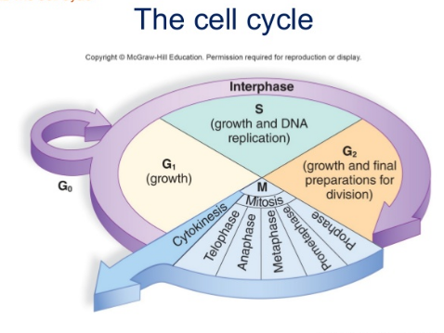

Slide 5
Introduction
Cell kinetics deals with the rate of cell growth and how it is affected by various chemical and physical conditions.
Unlike enzyme kinetics, cell kinetics is the result of numerous complicated networks:
    biochemical and chemical reactions
    transport phenomena
  involves multiple phases and multicomponent systems.
During the course of growth, the heterogeneous mixture of young and old cells is continuously changing and adapting itself in the media environment which is also continuously changing in physical and chemical conditions.
  As a result, accurate mathematical modeling of growth kinetics is impossible to achieve.

Slide 6
Various models can be developed based on the assumptions concerning cell components and population:
The simplest model is the unstructured, non segregated model.
Cells can be represented by a single component, such as cell mass, cell number, or the concentration of protein, DNA, or RNA.
The population of cellular mass is distributed uniformly throughout the culture.

Slide 7
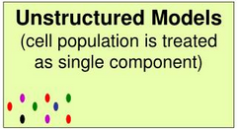
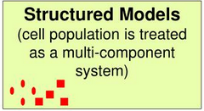
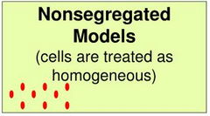
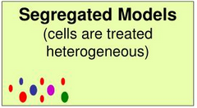
Approach to modelling growth

Slide 8
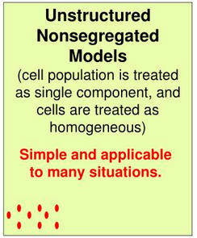
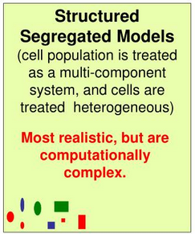
Approach to modelling growth

Slide 9
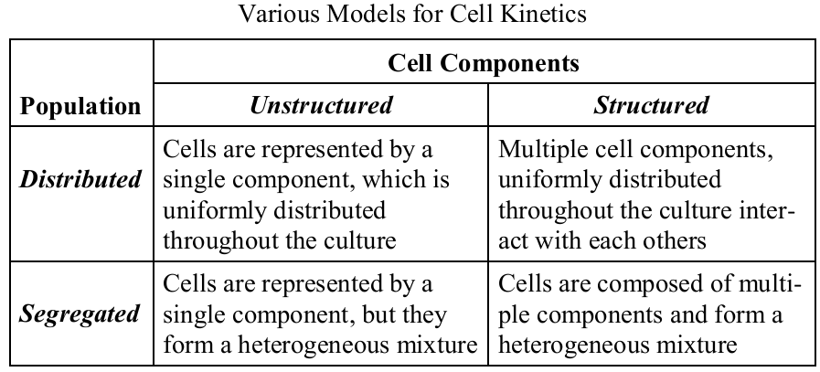

Slide 10
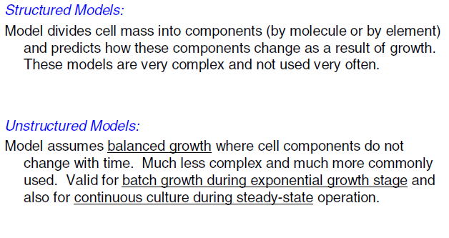
Modelling cell growth

Slide 11
Besides the assumptions for the cells, the medium is formulated so that only one component may be limiting the reaction rate.
All other components are present at sufficiently high concentrations, so that minor changes do not significantly affect the reaction rate.
Fermenters are also controlled so that environmental parameters such as pH, temperature, and dissolved oxygen concentration are maintained at a constant level.
In this chapter, cell kinetic equations are derived from the unstructured, distributed model, and those equations are applied for the analysis and design of ideal fermenters.

Slide 12
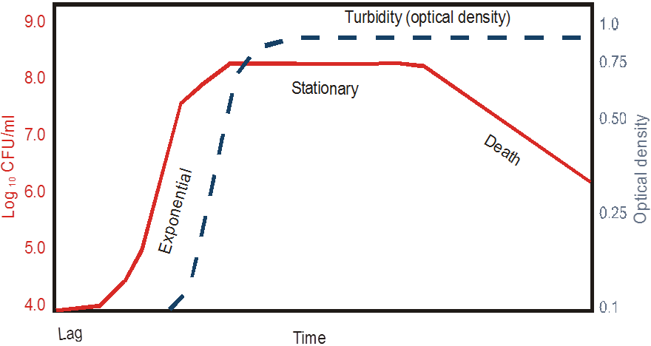
Growth cycle for batch cultivation

Slide 13
Phase of growth
Lag phase
Exponential phase/ Log phase
Stationary phase
Death phase

Slide 14
Lag phase
Is thought to be due to the physiological adaption of the cell to the culture condition
Period of adaptation of cells to a new environment
No change in number, but an increase in mass
Multiple lag phases may sometimes be observed - more than one carbon source
(Diauxic growth)….why?

Slide 15
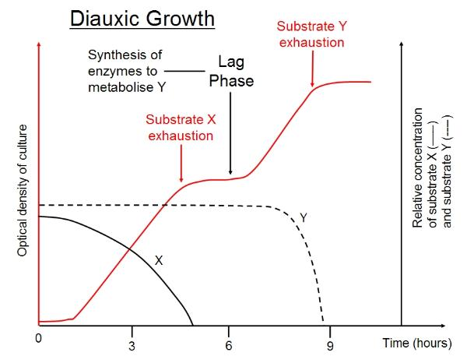

Slide 16
Lag phase
Length of lag phase variables – depends on history of the culture and growth conditions
Exponentially growing culture inoculated into same media, same growth conditions – no lag phase
Size of the inoculum
- small amount of cells into large volume will have a long lag phase

Slide 17
Exponential phase
Cells have adjusted to their new environment and multiply rapidly
Increase in cell mass and cell number with time exponentially
This phase results in straight line… why?
Period of balanced growth, in which all the components of a cell grow at the same rate
Growth rate is independent of nutrient concentration, as nutrient are in excess

Slide 18
Exponential phase
Nutrients and conditions are not limiting
growth = 2^{n} or X = 2^{n}X₀
Where X₀ = initial number of cells
X = final number of cells
n = number of generations
2⁰
2¹
2²
2³
2⁴
2⁰
2¹
2²
2³
2⁴
2⁰
2¹
2²
2³
2⁴
2⁰
2¹
2²
2³
2⁴
2⁰
2¹
2²
2³
2⁴
2⁰
2¹
2²
2³
2⁴
2^{n}
2^{n}
2^{n}
2^{n}
2^{n}
2^{n}
Notes:
- Each cell divide to form 2 cells;2 cells divide to 2 cells;2 cells divide to form 4 cells……….

Slide 19
Example: An experiment was performed in a lab flask growing cells on 0.1% salicylate and starting with 2.2 x 10⁴ cells. As the experiment below shows, at the end there were 3.8 x 10⁹ cells.
This is an increase is 5 orders of magnitude!!
How many doublings or generations occurred?
X = 2^{n}X₀
3.8 x 10⁹ = 2^{n}(2.2 x 10⁴)
1.73 x 10⁵ = 2^{n}
log(1.73 x 10⁵) = nlog2
17.4 = n
Cells grown on salicylate, 0.1%

Slide 20
Calculating growth rate during exponential growth
dX/dt = uX where u = specific growth rate (h⁻¹)
Rearrange: dX/X = udt
Integrate: lnX = ut + C, where C = lnX₀
lnX = ut + ln X₀ or X = X₀e^{ut}
dX/dt = uX
where u = specific growth rate (h⁻¹)
y = mx + b (equation for a straight line)
Note that u, the growth rate, is the slope of this straight line
Notes:
cells grow (divide) at a constant, maximum rate

Slide 21
Calculating growth rate during exponential growth
dX/dt = uX where u = specific growth rate (h⁻¹)
Rearrange: dX/X = udt
Integrate: lnX = ut + C, where C = lnX₀
lnX = ut + ln X₀ or X = X₀e^{ut}
y = mx + b (equation for a straight line)
Note that u, the growth rate, is the slope of this straight line

Slide 22
Find the slope of this growth curve
lnX = ut + ln X₀ or u = lnX – lnX₀
t – t₀
u = ln 5.5 x 10⁸ – ln 1.7 x 10⁵
8.2 - 4.2
= 2 hr⁻¹

Slide 23
Now calculate the doubling time
If you know the growth rate, u, you can calculate the doubling time for the culture.
lnX = ut + ln X₀
For X to be doubled: X/X₀ = 2
or: 2 = e^{ut}
From the previous problem, u = 2 hr⁻¹,
2 = e^{2(t)}
t = 0.34 hr = 20.4 min

Slide 24
Growth Curve
Stationary

Slide 25
Stationary phase
In batch culture exponential growth cannot occur indefinitely
- essential nutrient in medium is used up and/or some waste product of the organism builds up to an inhibitor advice
- Exponential growth ceases = stationary phase
In stationary phase- no net increase or decrease in cell number
Growth rate = Death rate
Even though the net growth rate is zero during the stationary phase, cells are metabolically active and produce secondary metabolites( non growth linked)

Slide 26
Death phase
If incubation continues after stationary phase, cells may remain alive and continue to metabolize or they may die= death phase
In some cases cell death is accompanied by lysis
Rate of cell death generally slower than that of exponential growth
death > growth (dX/dt = -kdX)

Slide 27
Approach to modelling growth

Slide 28
Factors affecting the specific growth rate
Substrate concentration
Product concentration
pH
Temperature
Oxygen supply

Slide 29
Monod Equation
The exponential growth equation describes only a part of the growth curve as shown in the graph below.
The Monod equation describes the dependence of the growth rate on the substrate concentration:
.
u = u_{m} S
K_{s} + S
u = specific growth rate (h⁻¹)
u_{m} = maximal growth rate (h⁻¹)
S = substrate concentration (mg L⁻¹)
K_{s} = half saturation constant (mg L⁻¹)

Slide 30
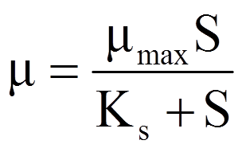
Monod Equation
Widely employed expressions for the effect of substrate concentration on specific growth rate (µ)
Analogous to Michaelis-Menten enzyme kinetics

Slide 31
Combining the Monod equation and the exponential growth equation allows expression of an equation that describes the increase in cell mass through the lag, exponential, and stationary phases of growth:
dX/dt = uX
u = dX/Xdt
.
u = u_{m} S
K_{s} + S
Monod equation
Exponential growth equation
dX/dt = u_{m} S X
K_{s} + S
.
.
Does not describe death phase!

Slide 32
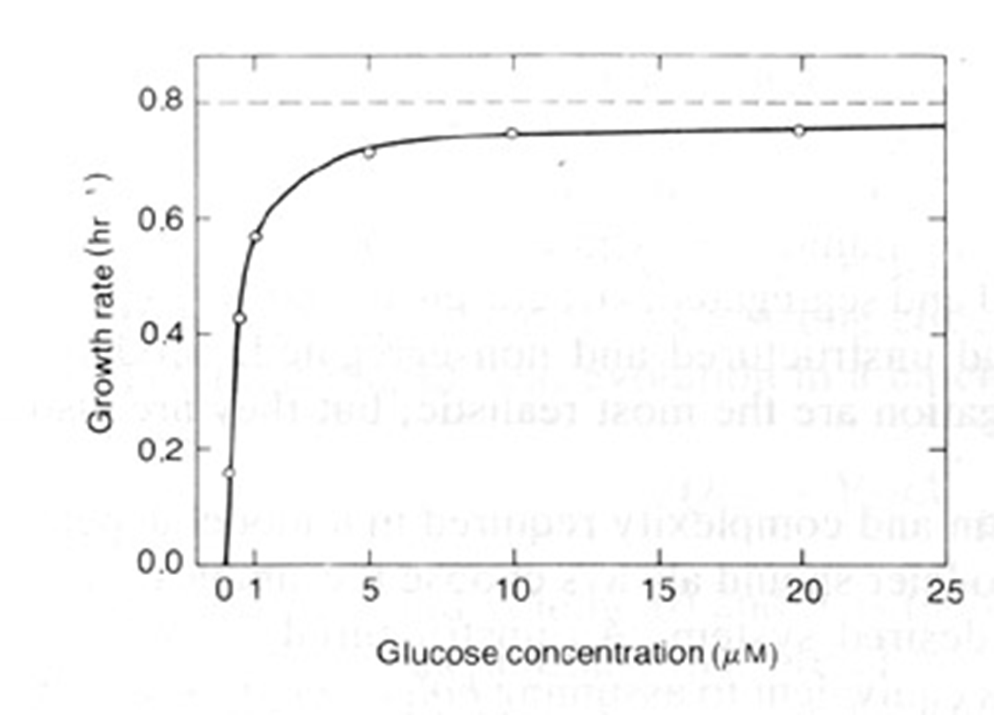


Monod equation

Slide 33
Monod Equation
There are two constants in this equation, µ_{m} maximum specific growth rate and K_{s}, the half saturation constant
Both reflect intrinsic physiological properties of particular type of microorganisms
They also depend on substrate being utilized and temperature of growth

Slide 34
There are two special cases for the Monod growth equation
At high substrate concentration when S>>K_{s}, the Monod equation
simplifies to:
dX/dt = u_{m}X
growth will occur at the maximal growth rate.
K_{s}
2. At low substrate concentration
when S<< K_{s}, the Monod equation
simplifies to:
dX/dt = u_{m} S X
K_{s}
.
.
growth will have a first order dependence on substrate concentration (growth rate is very sensitive to S).

Slide 35




Others Unstructured, nonsegregated models

Slide 36
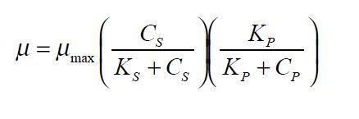
Product concentration
As cells grow they produce metabolic by-products which can accumulate in the medium.
The growth of microorganisms is usually inhibited by these products, whose effect can be added to the Monod equation as follows:

Slide 37
Other condition
The specific growth rate of microorganisms is also affected by medium pH, temperature, and oxygen supply.
The optimum pH and temperature differ from one microorganism to another.

Slide 38
Continuous culture
Exponential growth in batch culture may be prolonged by addition of fresh medium
Culture is not toxin limited!
In batch culture: exponential growth will proceed until substrate is exhausted…. But on additional of fresh medium, exponential growth is maintained
If added medium displaces an equal volume of culture: then a continuous culture can be achieved
If medium is fed continuously at a suitable rate, a steady- state is achieved

Slide 39
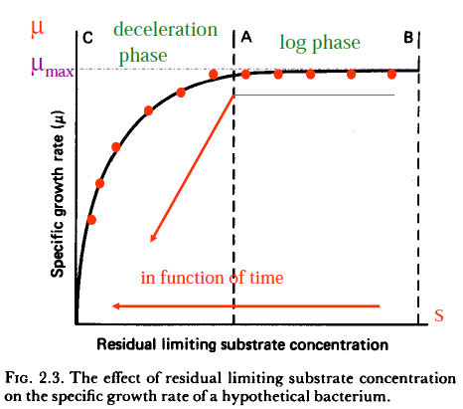
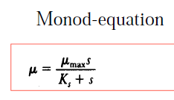
Start: Batch culture

Slide 40
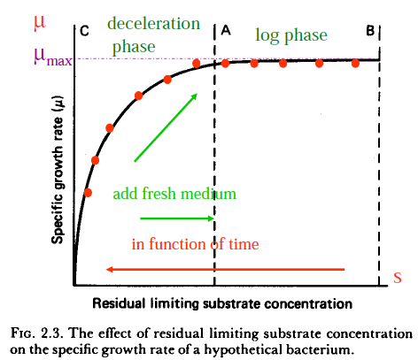
Add fresh medium

Slide 41

Dilution rate
The rate of nutrient exchange is expressed as dilution rate (D)
The net change in biomass concentration over a time period is
dX/dt = growth – output

Slide 42
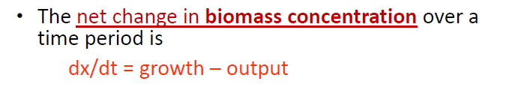

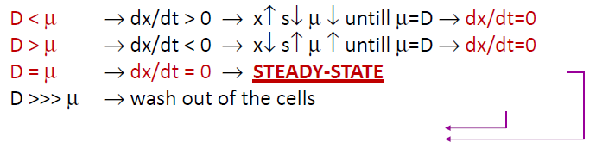
Continuous culture
For

Slide 43
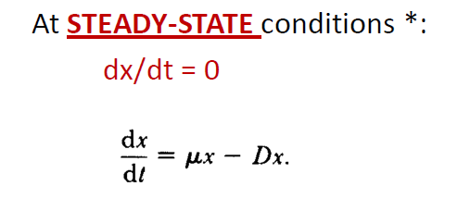
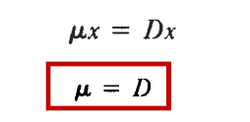
Continuous culture

Slide 44
Continuous culture
Two types of continuous culture
Chemostat: culture is controlled by its chemical environment=by the availability of the growth limiting substrate
Turbidostat: biomass concentration in culture is kept constant by controlling turbidity(photoelectric cell)

Slide 45
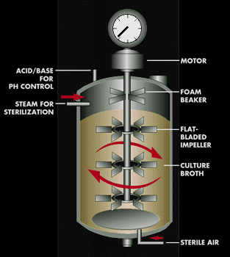
What is a bioreactor?
Bioreactor: device, usually a vessel, used to direct the activity of a biological catalyst to achieve a desired chemical transformation.
Fermenter: type of bioreactor in which the biocatalyst is a living cell.

Slide 46
  Challenges in Bioreactor Design
Aerobic bioreactor: Need adequate mixing and aeration
Anaerobic bioreactor: no need for sparging or agitation

Slide 47
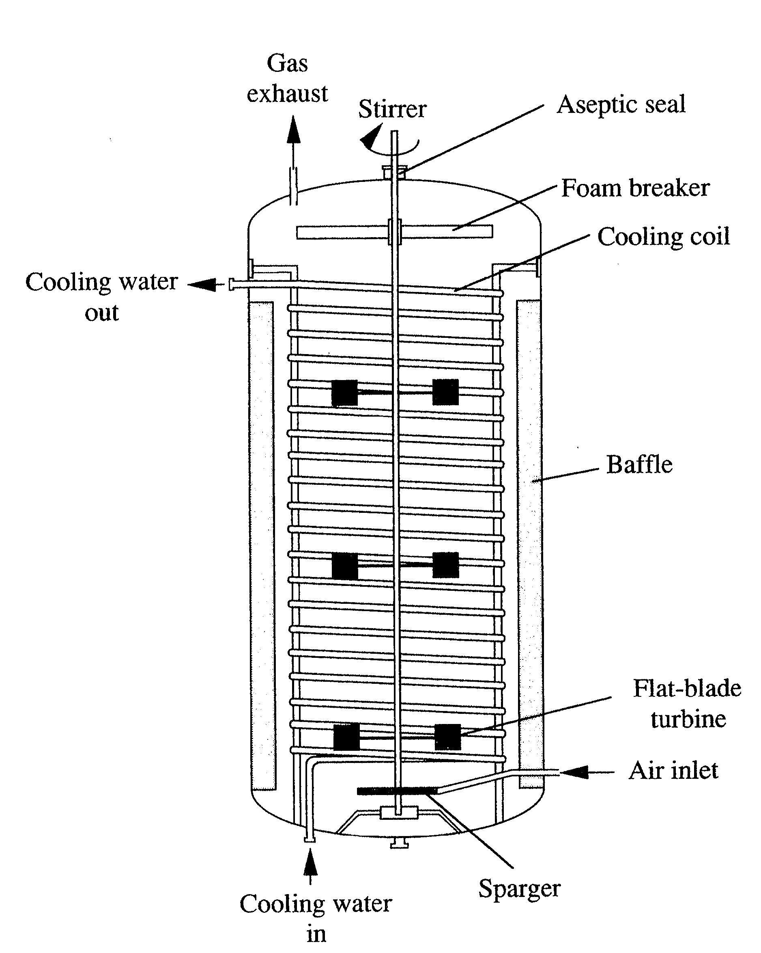
  Stirred tank
Mixing method: Mechanical agitation
Baffles are usually used to reduce vortexing
Applications: free and immobilized enzyme reactions
High shear forces may damage cells
Require high energy input
Notes:
Bioreactor Configurations

Slide 48
Batch or plug flow reactor
An ideal stirred fermenter is assumed to be well mixed so that the contents are uniform in composition at all times
Plug-flow is an ideal fermenter where the analysis is analogous to the ideal batch fermenter.
Tubular-flow fermenter, nutrients and microorganisms enter one end of a cylindrical tube and the cells grow while they pass through.

Slide 49
Batch or plug flow reactor
Since the long tube and lack of stirring device prevents complete mixing of the fluid, the properties of the flowing stream will vary in both longitudinal and radial direction
However, the variation in the radial direction is small compared to that in the longitudinal direction. The ideal tubular-flow fermenter without radial variations is called a plug-flow fermenter(PFF).

Slide 50
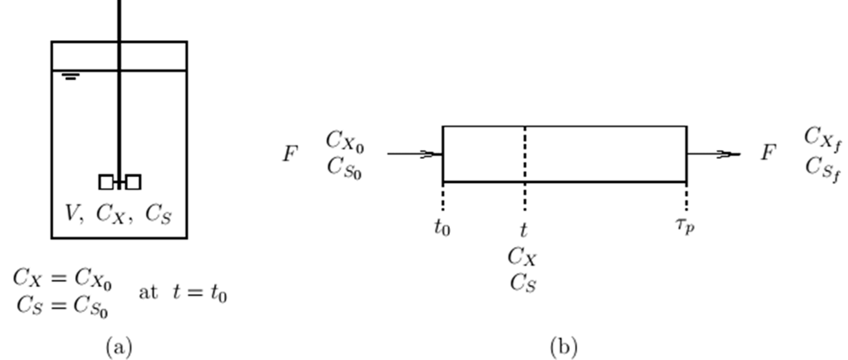
Even though the steady-state PFF is operated in a continuous mode, the cell concentration of an ideal batch fermenter after time t will be the same as that of a steady-state PFF at the longitudinal location where the residence time τ is equal to t.

Slide 51


Batch or plug flow reactor
If liquid medium is inoculated with a seed culture, the cell will start to grow exponentially after the lag phase.
The change of the cell concentration in a batch fermenter is equal to the growth rate of cells in it:
To evaluate the performance, it is required to integrate the equ
Notes:
- analysis applies for both the ideal batch fermenter and steady-state PFF.

Slide 52
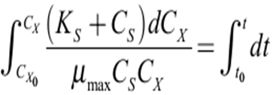
Batch or plug flow reactor
It should be noted that the above equation only applies when rx is larger than zero.
Therefore, to in the above Eq. is not the time that the culture was inoculated, but the time that the cells start to grow, which is the beginning of the accelerated growth phase.
If Monod kinetics adequately represents the growth rate during the exponential period,

Slide 53
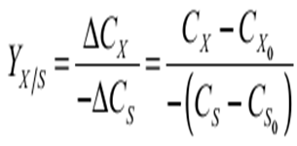
Batch or plug flow reactor
The above Eq. can be integrated if we know the relationship between CS and CX.
It has been observed frequently that the amount of cell mass produced is proportional to the amount of a limiting substrate consumed. The growth yield (Y_{x/s}) is defined as

Slide 54
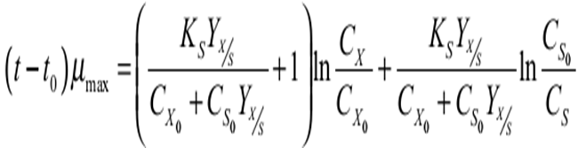
Batch or plug flow reactor
Combining the above two consecutive equations and solving the integration gives a relationship which shows how the cell concentration changes with respect to time:

Slide 55
Batch or plug flow reactor
The Monod kinetic parameters, µmax and KS, cannot be estimated with a series of batch runs as easily as the Michaelis-Menten parameters for an enzyme reaction.
In the case of an enzyme reaction, the initial rate of reaction can be measured as a function of substrate concentration in batch runs.
However, in the case of cell cultivation, the initial rate of reaction in a batch run is always zero due to the presence of a lag phase, during which Monod kinetics does not apply.

Slide 56


Batch or plug flow reactor
M-M equation
Monod equation

Slide 57
Continuous stirred tank Fermenter
Microbial populations can be maintained in a state of exponential growth over a long period of time by using a system of continuous culture.
In a Chemostat the flow rate is set at a particular value and the rate of growth of the culture adjusts to this flow rate
In a Turbidostat the turbidity is set at a constant level by adjusting the flow rate.
Notes:
Continous culture systems can be operated as chemostat or turbidosta

Slide 58
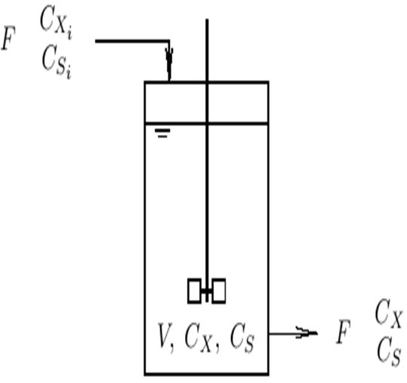
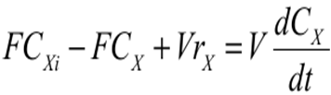
Continuous stirred tank Fermenter
The material balance for the microorganisms in a CSTF can be written as

Slide 59
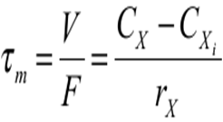
Continuous stirred tank Fermenter
For the steady-state operation of a CSTF, the change of cell concentration with time is equal to zero (dCX/dt = 0).
The microorganisms in the vessel grow just fast enough to replace those lost through the outlet stream, and the above Eq. becomes

Slide 60
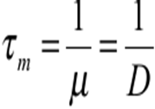
Continuous stirred tank Fermenter
If the input stream is sterile (CXi= 0), and the cells in a CSTF are growing exponentially (rX= µ CX),
Where D is known as dilution rate and is equal to the reciprocal of the residence time (τm).
Therefore, for the steady-state CSTF with sterile feed, the specific growth rate is equal to the dilution rate.
In other words, the specific growth rate of a microorganism can be controlled by changing the medium flow rate.

Slide 61
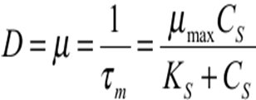
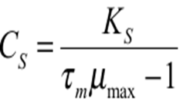
Continuous stirred tank Fermenter
If the growth rate can be expressed by Monod equation, then
From the above Eq. CS can be calculated with a known residence time and the Monod kinetic parameters as:
Notes:
It should be noted, however, that the preceding expression is only valid when τmµmax > 1. If τmµmax < 1, the growth rate of the cells is less than the rate of cells leaving with the outlet stream. Consequently, all of the cells in the fermenter will be washed out and the above Eq. is invalid.

Slide 62


Cont.
If the growth yield (Y_{X/S}) is constant, then
Substituting in the above equation
Similarly
The above equations are valid only if
Notes:
-Material balance for the substrate and product concentration can also be obtained in the same way

Slide 63
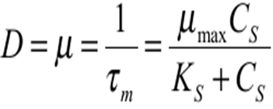
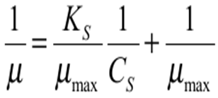
Evaluation of monod Kinetic parameters
By measuring the steady-state substrate concentration at various flow rates, various kinetic models can be tested and the value of the kinetic parameters can be estimated.
By rearranging the above Eq., a linear relationship can be obtained as follows
Notes:
The equality of the specific growth rate and the dilution rate of the steady-state CSTF is helpful in studying the effect of various component of the medium on the specific growth rate

Slide 64
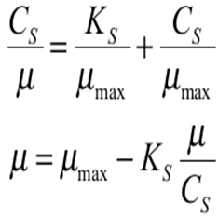
Evaluation of monod Kinetic parameters
If a certain microorganism follows Monod kinetics, the plot of 1/µ versus 1/CS yields the values of µmax and KS by reading the intercept and the slope of the straight line.
The equality of the specific growth rate and the dilution rate of the steady-state CSTF can be rearranged to give also the following linear relationships, which can be employed instead,

Slide 65
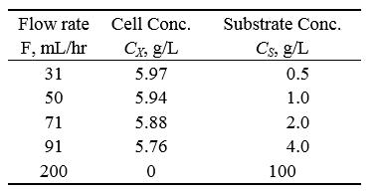
Example 1
A chemostat study was performed with yeast. The medium flow rate was varied and the steady-state concentration of cells and glucose in the fermenter were measured and recorded. The inlet concentration of glucose was set at 100 g/L. The volume of the fermenter contents was 500 mL. The inlet stream was sterile.
a. Find the rate equation for cell growth.
b. What should be the range of the flow rate to prevent washout of the cells?

Slide 66
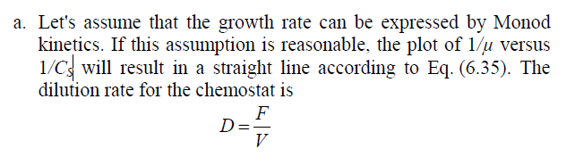
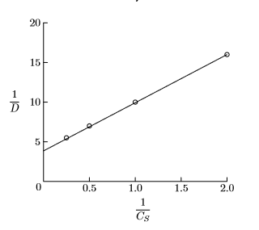





Slide 67
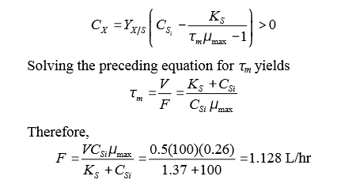
b. To prevent washout of the cells, the cell concentration should be maintained so that it will be greater than zero. Which means M > D=F/V . The range of the flow rate to prevent washout of the cells must be controlled to do that
Notes:
0.128

Slide 68
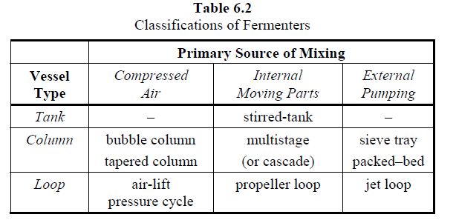
Alternative fermenters

Slide 69
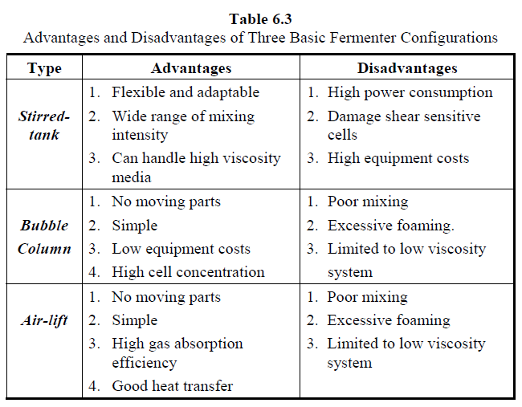
Alternative fermenters

