Slide 1
Chapter 6
Sterilization

Slide 2
Outline
Introduction
Medium sterilization
The Design of Batch Sterilization process
The Design of Continuous Sterilization process
Filter sterilization (Air and Media)

Slide 3
Introduction: Definition
Is the action of eliminating microorganisms from a medium (Ghasem 2007)
Reduction of any naturally occurring organisms in the substrate and air supply to a level where they are unable to compete effectively for the nutrients in the substrate with the organism being deliberately cultivated (Jackson 1990)
Killing any microbes that is present in the media or passed through any filtering system (Layman)
Notes:
What is STERILIZATION?

Slide 4
Introduction: Definition
•
Sterilization: inactivation of all living
organisms (both vegetative
cells and spores)
•
Pasteurization: inactivation
cells
of all vegetative
•
Spores are more resistent to extreme
conditions like high temperature, high pressure, low pH,…

Slide 5
If the fermentation is contaminated
The medium would have to support the growth of both producer and contaminant organism resulting in loss of productivity.
In case of continuous cultivation the contaminant may outgrow the producer organism.
In case of biomass as product, the contaminant will result in total loss of product.
The contaminant may produce compounds, which make downstream processing difficult.
The contaminant may degrade the product; this is common in antibiotics fermentation eg. β Lactamase producing organism degrade β-Lactum antibiotics.
Contaminant with phage could result in the lysis of culture

Slide 6
Introduction
•
Consequences after invasion by a contaminating
organism
micro-
–
medium is used by the production micro-organism and by
contaminant: loss of productivity
the
–
–
–
–
contaminant may ‘overgrow’ the production micro-organism
contaminant may ‘contaminate’ the final product (e.g. SCP)
contaminant may interfere with ‘down stream processing’
contaminant may degrade the desired product (e.g. degradation of
-lactam antibiotics by
-lactamase-producing bacteria)
–
contamination of bacterial fermentation with phage can result in
lysis of the culture

Slide 7
Introduction
•
Avoidance of contamination may be achieved
by
–
–
–
–
–
using a pure inoculum to start the fermentation
sterilizing
sterilizing sterilizing
the medium
the fermentor all feeds
maintaining aseptic
conditions
during the fermentation

Slide 8
Introduction: Where is it being used?
Food & dairy industries
Pharmaceutical industries
Research laboratories and etc.
Autoclave → huge stainless steel vessel → steam → 105 kPa (15 psig) for 20-30 mins
High temp & long duration → will kill microorganism / spores of fungus / bacteria
Overheating → negative impact / media components destroyed / media pH ↓ / affected culture growth → acid pH sensitive to heating → carbohydrates will caramelize → difficult to solidify

Slide 9
Introduction
•
Probability of contamination ?
–
Some fermentations are ‘protected’ against
contamination
• Medium utilized by a limited range of micro- organisms
• Growth may result in
growth conditions
Example: ‘BREWING
the development
of
selective
OF BEER’
–
–
–
Water
Wort
Hop
Notes:
Such as reduction in pH

Slide 10
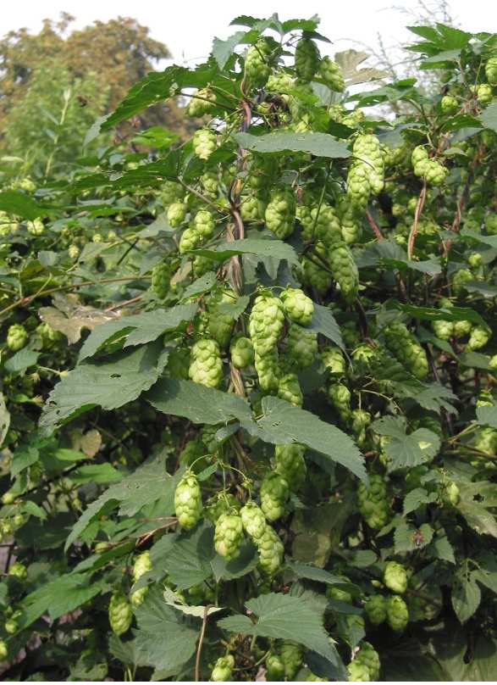
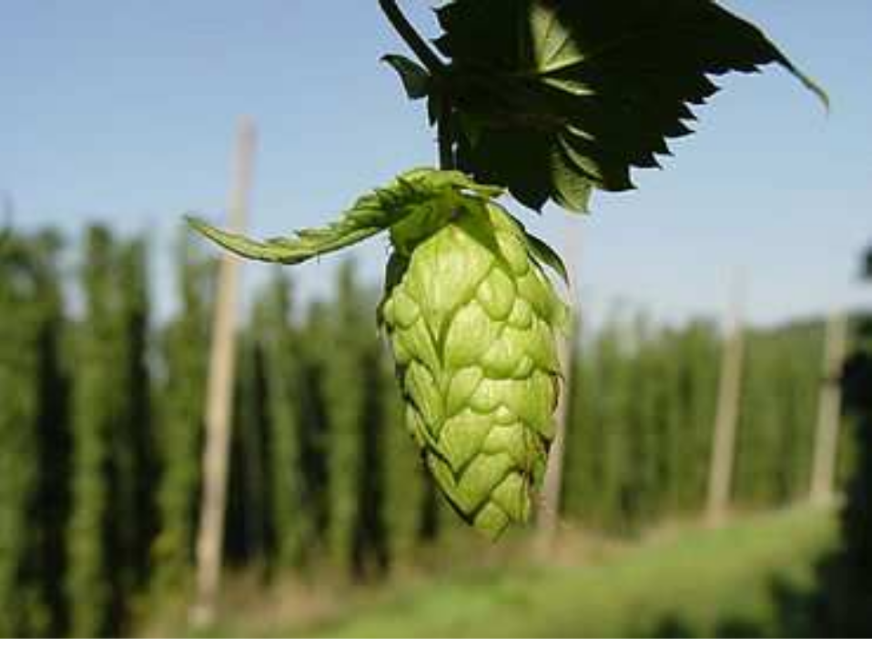
Example: Brewing of beer
•
Hop resins tend to inhibit the growth of
micro-organisms
→ added to give bitter taste
many

Slide 11
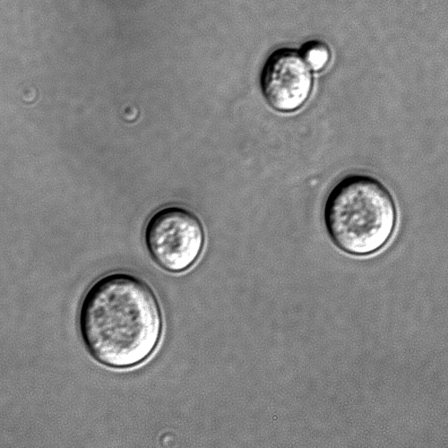
Example: Brewing of beer
•
Growth
of
brewing
yeasts tends to
decrease
pH
Glucose
→
ethanol
+
organic
acid

Slide 12
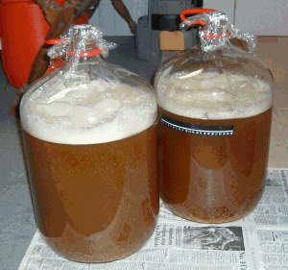
Example: Brewing of beer
Result:
•
Wort
is
boiled,
not
sterilized
•
Fermentor is cleaned but not
sterile
– Majority of fermentations is ‘not protected’
!!!

Slide 13
Medium Sterilization
Filtration
Radiation
Ultrasonic treatment
Chemical treatment
Heat
Notes:
Filtration techniques will be considered later in this chapter. Before the techniques which are used for the steam sterilization of culture media are
discussed it is necessary to discuss the kinetics of sterilization

Slide 14
Radiations
Many cellular materials absorb ultraviolet light, leading to DNA damage and consequently to cell death. Wavelengths around 265 nm have the highest bacterial efficiency.
However they have very little ability to penetrate. Use is limited to clean chambers, operation theatre etc.,
X-rays are lethal and have penetration ability. However due to expensive and safety concerns it is not used

Slide 15
Chemical sterilization
Chemical agents are frequently used for disinfection.
Major antimicrobial chemical agents are :
- phenol and compounds
- alcohol
- Detergents, acids, and alkali

Slide 16

Kinetics of sterilization
Destruction of microorganisms by steam is represented by first order reaction
-dN/dt = kN (1)
N
t
k
the total number of viable organisms present
where
Time of sterilization treatment
Reaction constant of the reaction( specific death rate)
Dependent on the species
Dependent on the physiological form( vegetative cell, spore
Dependent on temperature(
Notes:
It is important to note that we are considering the number of organisms and not the concentration of the microorganism

Slide 17

Kinetics of sterilization
Destruction of microorganisms by steam is represented by first order reaction
-dN/dt = kN (1)
Compare to growth kinetics: dx/dt = µx
Expressed as cell concentration! (Chapter 5)

Slide 18
Kinetics of Sterilization
Rearranging the eqn [1]
-dN/N = kdt
Upon Integration
ln (N_{t}/N_{o}) = - kt (2)
N_{t}/N_{o} = e^{-kt} (3)
N_{t} = No of organisms present after sterlization
N_{o} = No of organisms present before sterlization

Slide 19
ln
Time
Time
N_{t}/N_{o} = e^{-kt}
ln (N_{t}/N_{o}) = - kt
An infinite time is required to achieve sterile condition i.e. N_{t}=0
After certain period there will be less than one viable cell present i.e N_{t}<1
Notes:
Plots of the proportion of survivors and z natural logarithm of the proportion of survivors in a population of microorganism subjected to a lethal temperature over a time period
The graphical representation of equation 1 and 3 are illustrated in the above figure

Slide 20
N_{t}<1 is the probability of an organism surviving the treatment
i.e. N_{t}=0.1 is the probability that one organism surviving ten treatments.
In other words one in ten batches may get contaminated due to improper sterlization
The value of k is dependent on temperature, species and its physiological form.
But your sterlization media contains mixture of microorganism.
Notes:
- a value of Nt of less than one is considered in terms of the probability of an organism surviving the treatment.

Slide 21
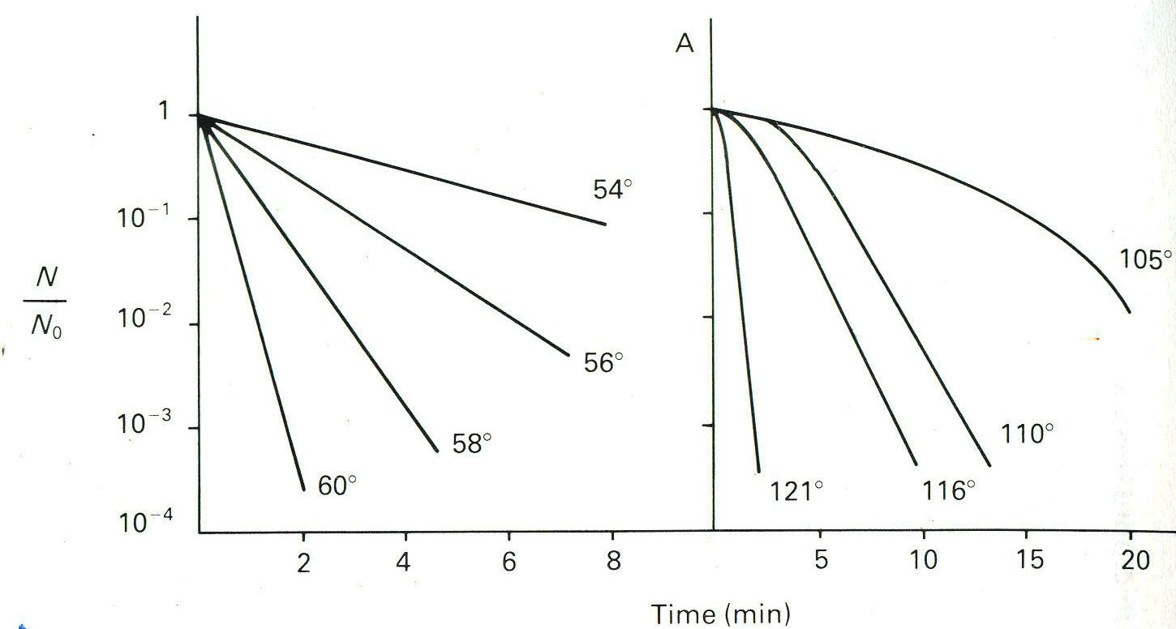
E. coli
B. stereothermophillus
Notes:
The value of k is not only species dependent, but dependent on the physiological form of the cell; for example, the endospores of the genus Bacillus are far more heat resistant than the vegetative cells.

Slide 22
As in any first order, The reaction rate increases with increase in temperature i.e. k increases with increase in temperature. This relation ship is given by Arrhenius eqn.
E activation energy
R gas constant
T absolute temperature
A Arrhenius constant
(4)

Slide 23

Taking logarithm of eqn 4
(5)
Plot of ln k Vs 1/T will give a straight line( Arrhenius plot)
Intercept = ln A
Slope = -E/R
Such a plot is termed an Arrhenius plot and enables the calculation of the activation energy and the prediction of the reaction rate for any temperature
Ln k
1/T
Notes:
Such a plot is termed an Arrhenius plot and enables the calculation of the activation energy and the prediction of the reaction rate for any temperature

Slide 24
Design criterion
The design criterion ( ∇ ) for sterilization which is a measure of the destruction ratio can be defined as:
It is a parameter which encompasses the contamination level of the medium to be sterilized, No, and the desired sterility level, Nt.

Slide 25

Design criterion
Also known as the Del factor, a measure of the size of the job to be accomplished. For example, the Del factor to reduce the number of cells in a fermenter from 10¹⁰ viable organisms to one is :
The Del factor to reduce the number of cells to zero is infinity, which means that it is theoretically impossible to ensure the total destruction of the viable cells.
Industrially accepted level of contamination is 0.001. i.e. 1 in 1000 batches can get contaminated

Slide 26
Combining eqn 2 and 4
(6)
Del factor is the sterilization criterion
(7)
(8)

Slide 27
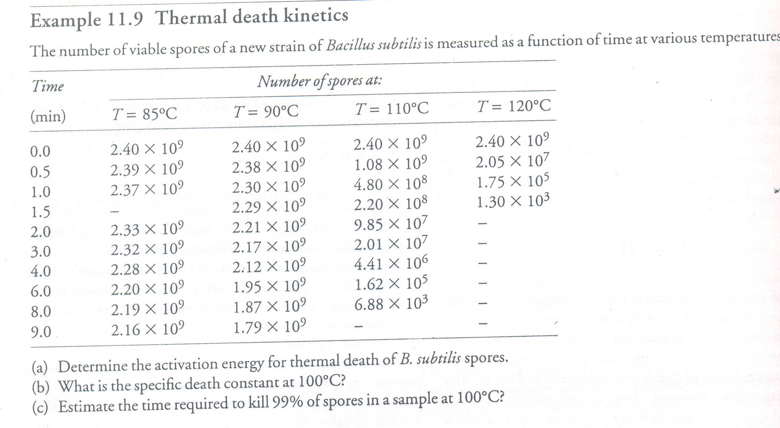
Example 1

Slide 28
Step 1
Plot ln N_{o}/N_{t} Vs Time for each temperature and find out the slope. Slope will give k value.
Step 2
Plot ln k Vs 1/T from the above values. Slope will give E/R values and Intercept will give you the A value
Step 3
From the above graph calculate the k value for 100 ºC
Step 4
From the k value calculate time required to kill 99% spores

Slide 29
Y=0.0326 X
Y=0.0122 X

Slide 30
Y=9.5859 X
Y=1.5943 X

Slide 31
Ln k
1/T

Slide 32
E/R = 26869 ºK
R = 8.3144 J/K/gmol
E = 26869 X 8.3144 = 2.24 X 10⁵J/gmol=224 KJ/gmol
A =4.7 X 10³⁰ min⁻¹
k= 4.7 X 10³⁰ e^{-26869/T}
T=100 +273 =373 ºK
k=0.244 min⁻¹
Ln(100/1)=0.244 t
t=18.9 min

Slide 33
Batch sterilization
The medium is prepared and pumped to an agitated vessel fitted with either a heating jacket or heating coils.
The contents of the vessel are then heated to a particular sterilization temperature (usually 121ºC, held for a certain length of time at that temperature, and then cooled down to the fermentation temperature.
This time of process is carried out in the fermentor itself – in-situ sterilization

Slide 34
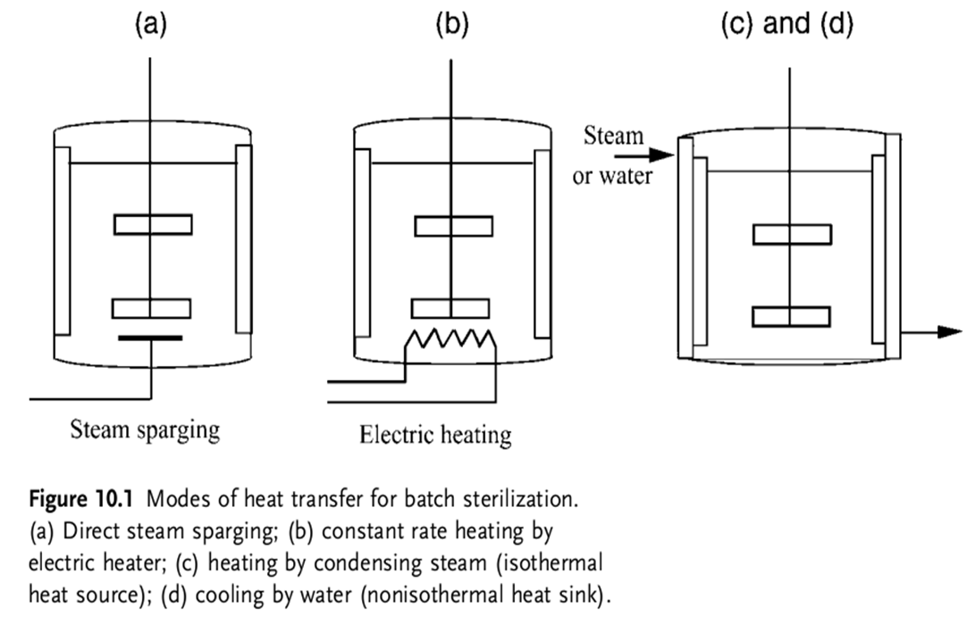
Batch Sterilization
Sterilization of the medium in a fermenter can be carried out in batch mode by direct steam sparging, by electrical heaters, or by circulating constant pressure condensing steam through heating coil.

Slide 35
sterilization
Temperature (ºC)
cooling
heating
Time (min)

Slide 36
Heating
Holdup
Cooling
Temperature
Time
Notes:
The sterilization cycles are composed of heating, holding, and cooling. Therefore, the total Del factor is the sum of:

Slide 37
Notes:
The values of ∇heat and ∇cool are determined by the methods used for the heating and cooling. The value of ∇hold is determined by the length of the controlled holding period.

Slide 38
Heating Curve
T₃
T₂
Temperature
T₁
t₁
t₂
t₃
Time
Notes:
The relationship between Del factor, the temperature and time is given by equation 7 However, during the heating and cooling periods the temperature is not constant and, therefore, the calculation of Ñ would require the integration of equation 7 for the time-temperature regime observed.

Slide 39
Example 2
The initial concentration of contaminants is 10⁶ per ml and the fermenter volume is 10000 liters. The del factor contribution from heating is 9.8 and that of cooling is 10.1. Calculate the holdup time assuming all the contaminants are B.st having k value at 121ºC of 2.54 min⁻¹

Slide 40
N_{o} = 10⁶X1000X10000 =10¹³ N_{t}=0.001

Slide 41
Design of batch sterilization process
•
Scale up of batch sterilization processes
–
Example: calculate Del factor for
•
1000 l medium containing 10⁶ micro-organims/ml
and Nt = 1/1000
V = In {(10⁶ X 10³ X l0³)/10⁻³}
= In (10¹²/10⁻³)
= In 10¹⁵ = 34.5.
•
10 000 l medium
containing 10⁶
micro-organims/ml
and Nt
= 1/1000
V = In {(10⁶ X 10³ X 10⁴)/l0⁻³}
= In (10¹³/10⁻³)
~ In 10¹⁶ = 36.8.
Del factor increases with an increase in the medium volume

Slide 42
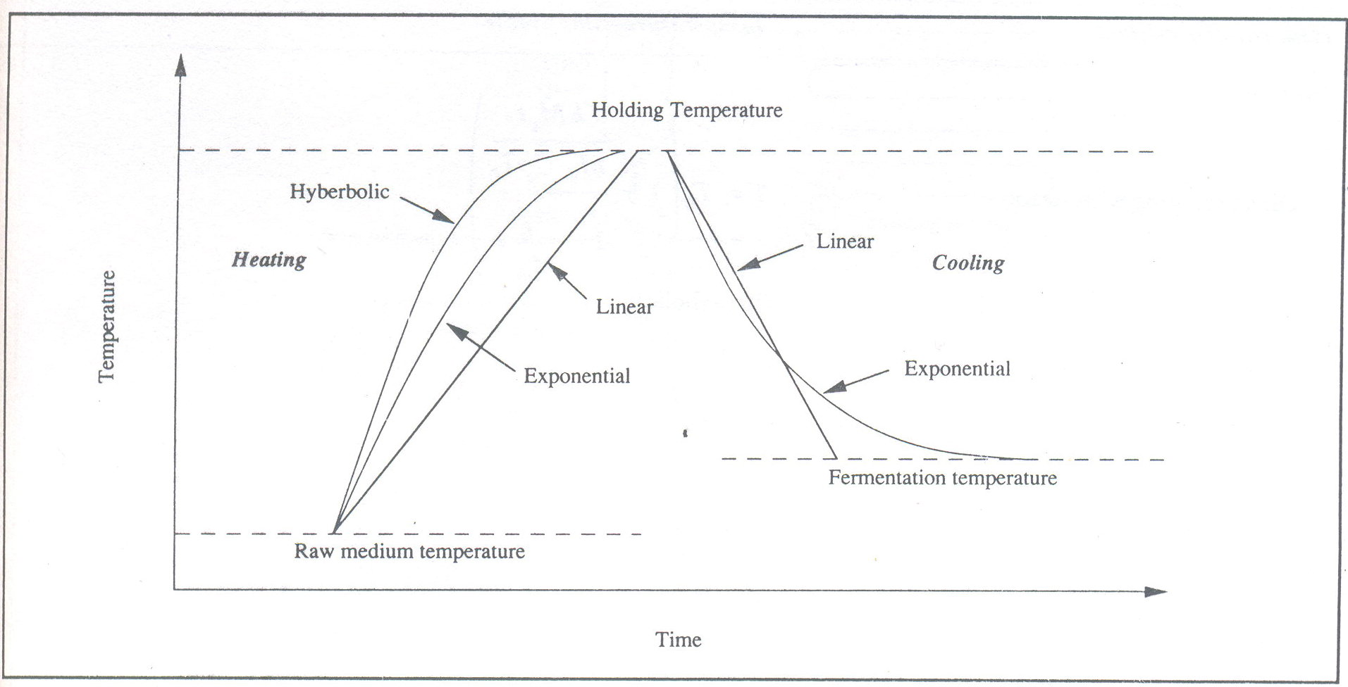
Notes:
Explanation of this graph is important?

Slide 43

Theoretical equations for heating and cooling can be employed, which are of linear, exponential, or hyperbolic form depending on the mode of heating and cooling. The suggested equations for different heating and cooling processes are as follows:
  For batch heating by direct steam sparging into the medium, the hyperbolic form is used:

Slide 44



  For batch heating with a constant rate of heat flow such as electrical heating, the linear form is used:
  For batch heating with a isothermal heat source such as steam circulation through heating coil, the exponential form is used:
  For batch cooling using a continuous non isothermal heat sink such as passing cooling water through cooling coil, the exponential form is used:

Slide 45
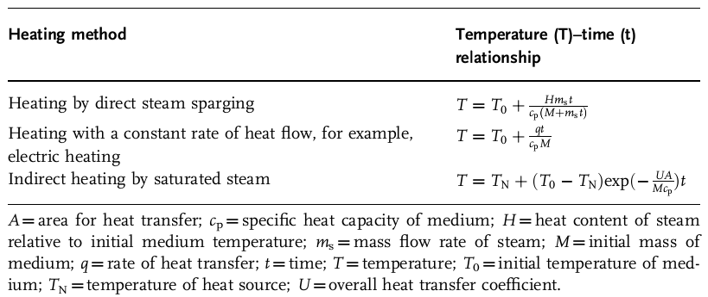

Slide 46
Example 3
A steam sterilizer is used to sterilize liquid medium for fermentation. The initial concentration of contaminants is 10⁸ per ml . How long 1 liter medium be treated if the temperature is 80ºC, 121ºC, 140ºC
Assume all the contaminants are B.st.
E=283 KJ/gmol
A=10^{36.2}sec⁻¹
R = 8.3144 J/K/gmol

Slide 47
E=2.83 X 10⁵ J/gmol
A=10^{36.2}sec⁻¹
R = 8.3144 J/K/gmol
N_{o}=10¹¹
N_{t}=0.001
Ln(N_{o}/N_{t})=34.54
-E/R=-3.4X10^{4 o}K
T | -E/RT | exp(-E/RT) | A*exp(-E/RT) | time (min)
353 | -9.64E+01 | 1.33047E-42 | 2.10866E-06 | 272991.8
394 | -8.64E+01 | 3.03152E-38 | 0.048046344 | 11.98106
413 | -8.24E+01 | 1.61319E-36 | 2.556734665 | 0.225149

Slide 48
The fermentation media is not an inert mixture.
Due to sterilization deleterious reactions may occur resulting in loss of nutrient quality
The initial rise in yield is due to some components of the medium being made more available to the process micro-organism by the 'cooking effect' of a brief sterilization period.
Product yield
Duration of sterilization
Notes:
The initial rise in yield is due to some components of the medium being made more available to the process micro-organism by the 'cooking effect' of a
brief sterilization period.

Slide 49
Loss of nutrient quality is due to two reasons
Interactions between nutrient components of the medium
  Maillard type browning reaction – reactions of the carbonyl group usually from reducing sugar with the amino group of aminoacids, proteins.
  Effect of sterilization time on availability of glucose in CSL medium was investigated
  Time Glucose remaining
  60 min 35%
  40 min 46%
  30 min 64%
  Problems of this type are normally resolved by sterilizing sugar separately and adding to the medium
Notes:
Corn steeper liquid

Slide 50
Degradation of heat labile components
  Certain vitamins, amino acids and proteins may be degraded during sterilization regime
  In certain cases such as animal cell culture media filtration is used
  In other cases judicious choice of sterilization regime is selected.
  Nutrient destruction follows first order reaction
Xt is the concentration of nutrient after a heat treatment period, t,
X0 is the original concentration of nutrient at the onset of sterilization,
k is the reaction rate constant.

Slide 51

The effect of temperature on the reaction rate constant may be expressed by the Arrhenius equation:
Therefore, a plot of the natural logarithm of the reaction rate against 1/T will give a straight line, slope - (E / R).
As the value of R, the gas constant, is fixed the slope of the graph is determined by the value of the activation energy (E)

Slide 52
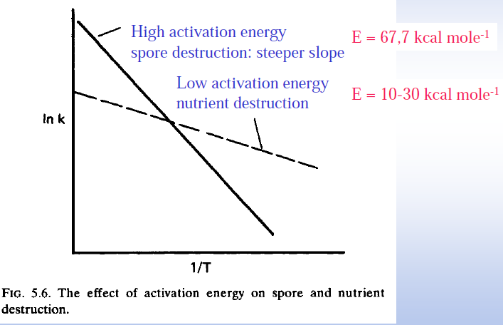
Figure 5.6 is an Arrhenius plot for two reactions - one with a lower activation energy than the other.
From this plot it may be seen that as temperature is increased, the reaction rate rises more rapidly for the reaction with the higher activation energy.

Slide 53
From the graph it is evident that sterilizing the medium at higher temperature for lesser time will result in spores destruction with lesser loss in nutrient quality.
Heating the huge reactors for higher temperature and cooling down in short duration is impossible
Alternately continuous sterilizer can be used
Spores destruction
Ln k
Nutrient destruction
1/T

Slide 54
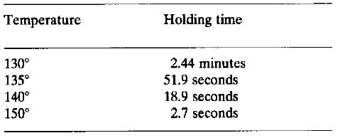
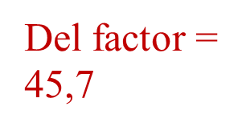
The Design of continuous sterilization
Advantage
- a much higher temperature may be utilized, reducing holding time and nutrient degradation
Typical time- temperature combination for continuous sterilization
Notes:
The continuous system includes a time period during which the medium is heated to the sterilization temperature, a holding time at the desired temperature and a cooling period to restore the medium to the fermentation temperature

Slide 55
The Design of continuous sterilization
Advantage
- a much higher temperature may be utilized, reducing holding time and nutrient degradation
- ‘heating up’ and ‘cooling down’ periods are very small – nearly negligible

Slide 56
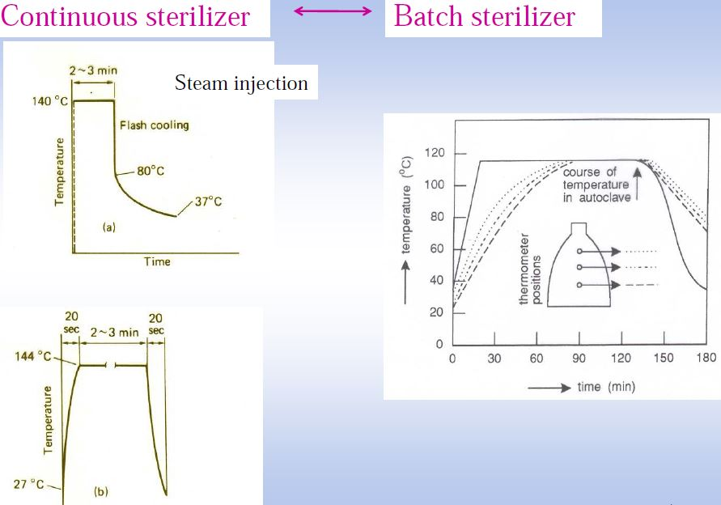

Slide 57
Design of continuous
sterilization process
Advantage
- a much higher temperature may be utilized, holding time and nutrient degradation
reducing
- ‘heating up’ and ‘cooling down’ periods are very
small – nearly negligible
Heating: two sequential continuous heat exchangers
•
•
Holding: holding coil with holding time proportional
to
coil length
Cooling: two sequential continuous heat exchanger
•
Notes:
The length of the holding period is dictated by the length of the coil and the flow rate of the medium.

Slide 58
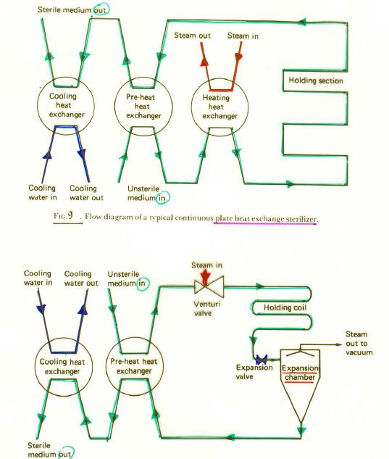
Notes:
The hot medium is then cooled to the fermentation temperature using two sequential heat exchangers - the first utilizing the incoming
medium as the cooling source (thus conserving heat by heating-up the incoming medium) and the second using cooling water

Slide 59
Types of continuous
sterilizers
•
Indirect heat exchanger
– plate heat exchanger
Direct heat exchanger
•
–
steam
injector

Slide 60
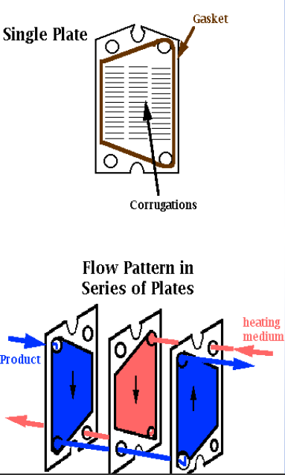
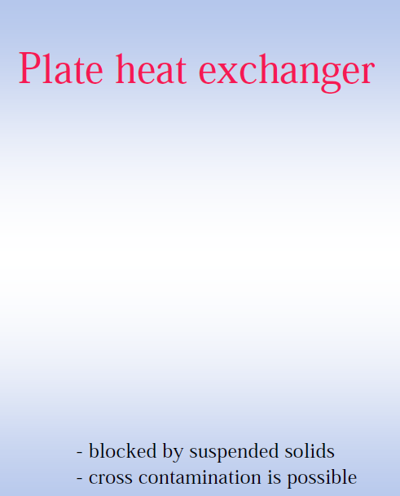
consist of alternating plates through which the countercurrent streams are circulated
The plates are separated by gaskets and failure of these gaskets can cause cross-contamination between the two streams

Slide 61

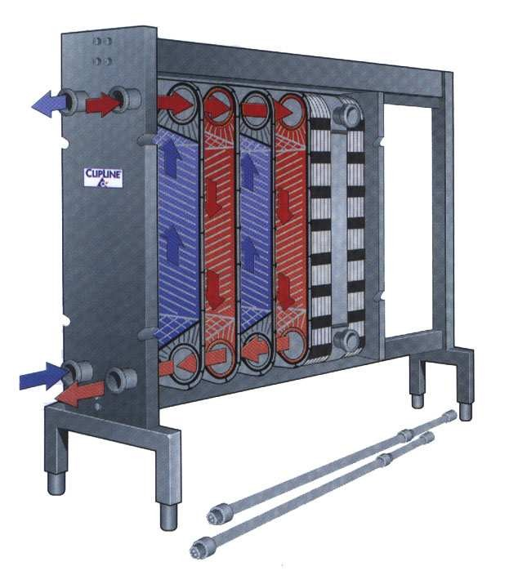
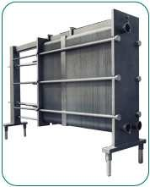
Plate
heat
exchanger

Slide 62
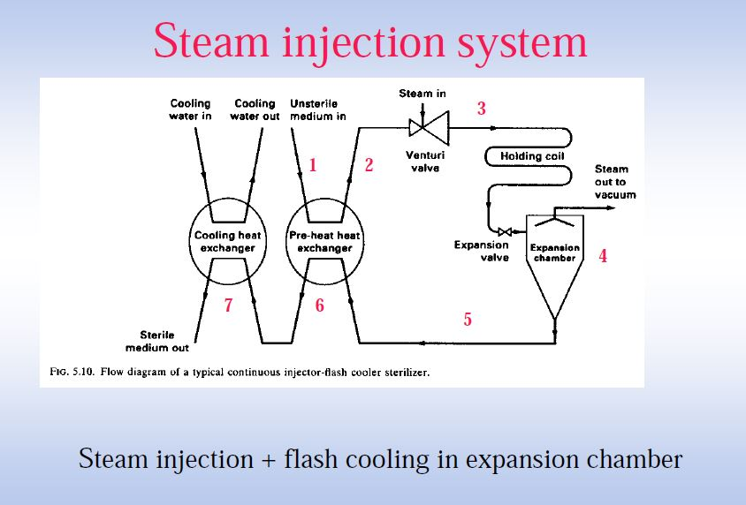
The continuous steam injector injects steam directly into the unsterile broth

Slide 63
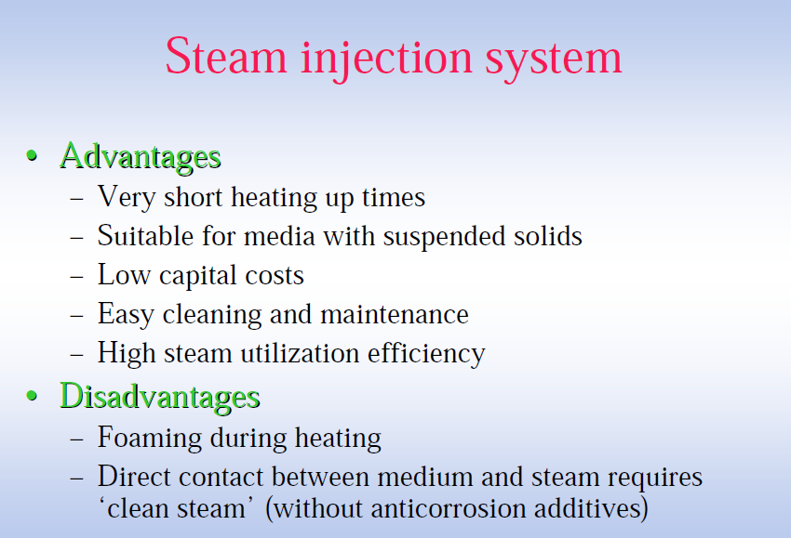

Slide 64
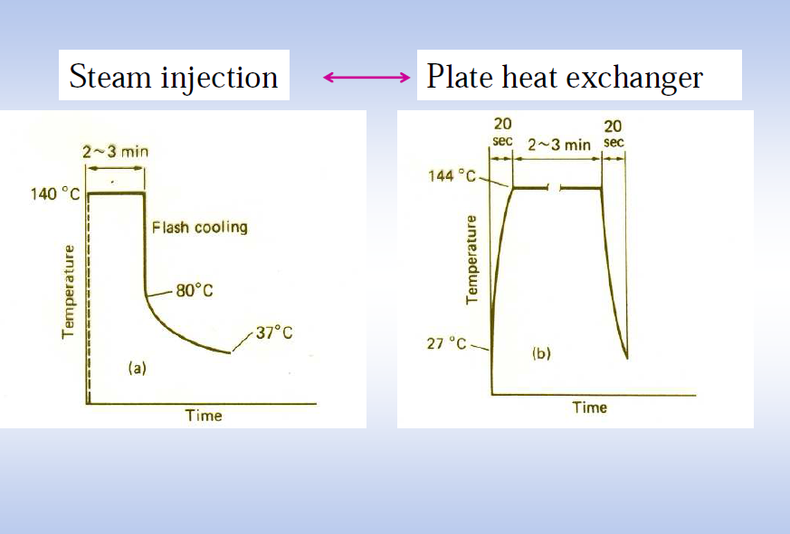

Slide 65
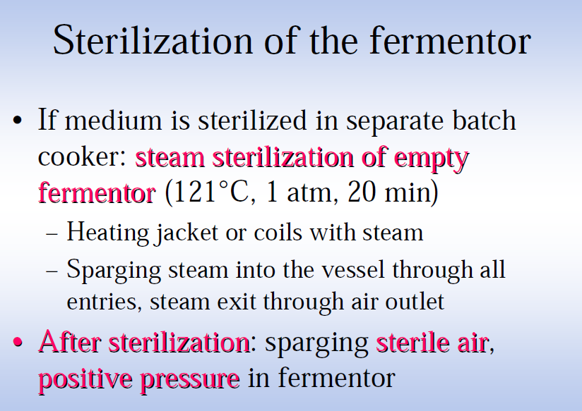

Slide 66
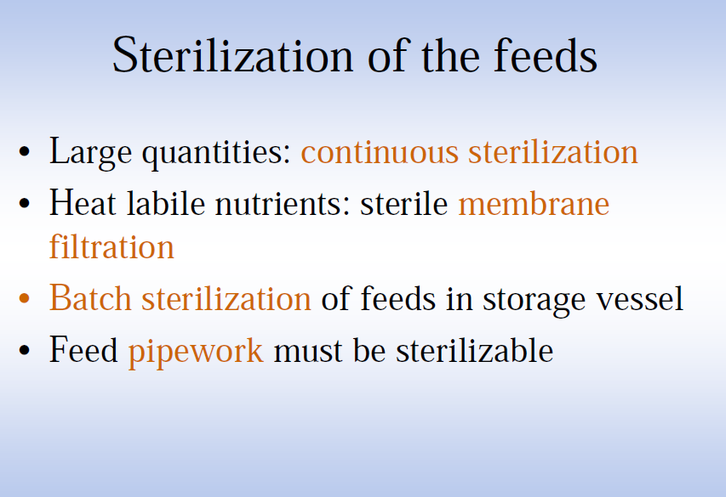

Slide 67
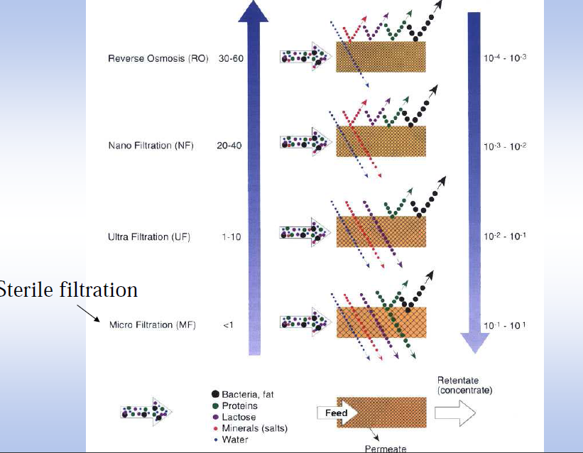

Slide 68
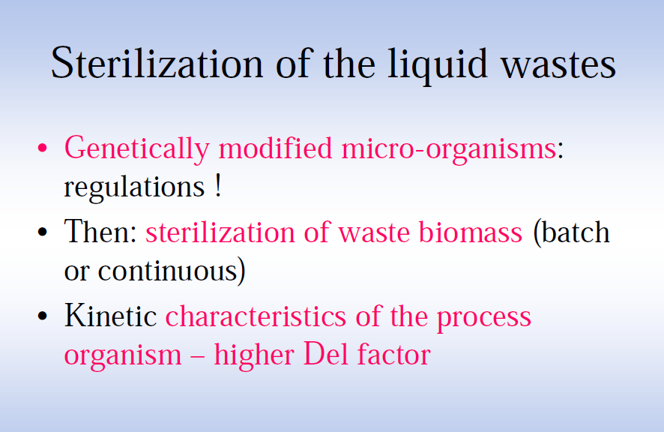

Slide 69
Filter sterilization
Suspended solids may be separated from a fluid during sterilization by the following mechanisms
- Inertial impaction
  - Diffusion
  - Electrostatic attraction
  - Interception
Notes:
Fluid - gas or liquid

Slide 70

Inertial impaction
The inertial impaction model assumes particles has mass, and hence inertia, but no size.
.
Due to this they tend to move straight and therefore impact on the filtration fibers where they may be retained.
This mechanism is more prominent in filtration of gases than liquids.
Notes:
The particles because of their mass will have sufficient momentum to continue to move toward the cylinder and break through the streamlines

Slide 71

  Diffusion
Extremely small particles suspended in the fluid are subjected to Brownian movement which is random movement due to collision of particles.
Thus due to this the fluid particles deviate from the path of movement and impact on the filter fibers.
Diffusion is more significant in the filtration of gases than liquids

Slide 72
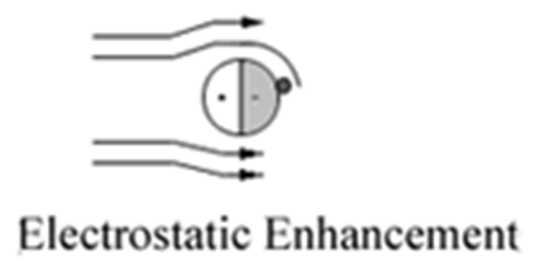
Electrostatic attraction
Charged particles are attracted by opposite charges on the surface of the filtration medium

Slide 73
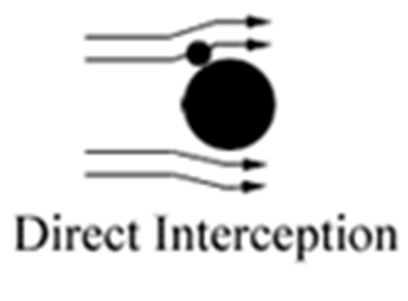
  Interception
The inertial impaction model assumed particles had mass, and hence inertia, but no size.
An interception mechanism is considered where the particle has size, but no mass, and so they can follow the streamlines of the air around the collector
If a streamline which they are following passes close enough to the surface of the fiber, the particles will contact the fiber and be removed shown in the figure

Slide 74
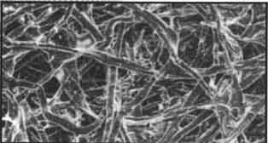
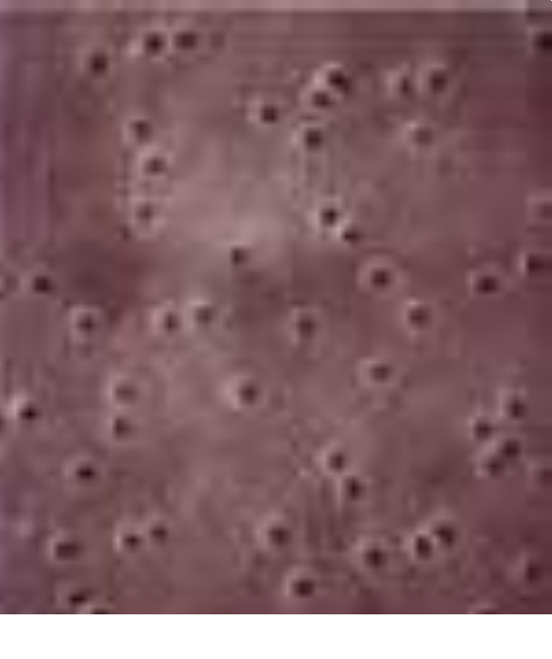
Types
of
filters
•
‘Fixed pore’ filter
•
‘Non-fixed
pore’
filter
membrane
filter
depth
filter
77
Notes:
Filters have been classified into two types: those in which the pores in the filter are smaller than the particles which are to be removed and those in which the pores are larger than the particles which are to be removed.

Slide 75
Filter sterilization
•
for fermentation media with heat-labile
components (membrane filtration)
for incoming air and exhaust air (heat
•
sterilization is not practical)
(membrane
filtration
or
depth
filters)
79

