Slide 1
MUO (Introduction)
Based on mechanical force:
    To mix different components
    To separate a specified component from a mixture
    Size reduction and enlargement
    Enhance mass and heat transfer (drying, absorption, etc.)
Most frequent mechanical unit operations (MUO):
    Size reduction, screening, sedimentation, fluidization, filtration, centrifugation, cyclones, magnetic separation, electro-static precipitators, floatation, solid transportation , mixing

Slide 2
MUO (Intro…particle size)
If not all, most unit operations depend on particle size range of the material involved.
Particles resulting from size reduction (naturally):
  Are not perfectly spherical
  Contain (more or less) broad range of particle sizes
Two basic challenges
  How to characterize a particle of arbitrary shape by one single particle size?
  How to describe a particle size distribution?

Slide 3
MUO (Particle size measurement)
Particle size measuring methods
  Microscopic techniques are based on direct observation (used as a reference method)
      Light microscopy (>0.5μm)
      (Scanning) electron microscopy (>5nm)
  Sieving
      Dry sieving (50 μm – 10cm)
      Wet sieving (>20 μm)
    Performed in a range of standard sieves
Image analysis technique

Slide 4
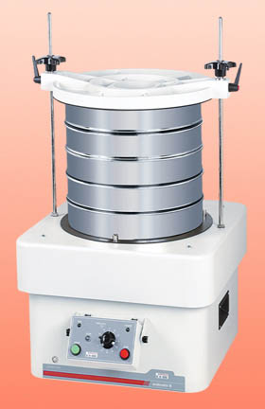
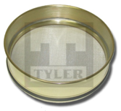
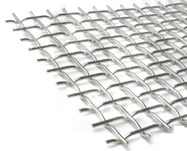
MUO (Particle size measurement)
Aperture size is the dimension of the opening
Mesh number is the number of openings per inch
  e.g. 200mesh = 200 openings/inch
= 74 μm/opening
The particle size of the material remaining between the two sieves is mostly accepted to be halve of the sum of the two sieve openings
The results of the sieve analysis can be represented by
    histogram
    differential distribution
    cumulative distribution

Slide 5
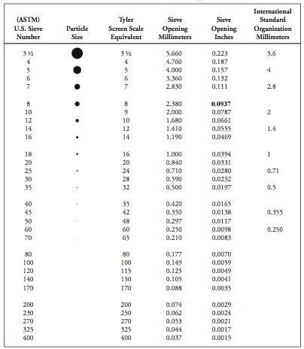
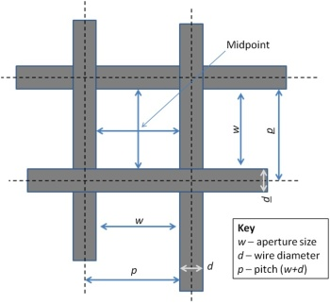
Sieve standards: Mesh size vs. aperture size

Slide 6
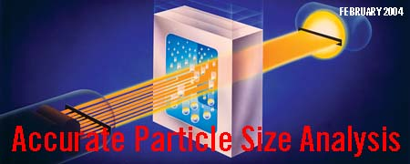
MUO (Particle size measurement)
Sedimentation
  Sedimentation in a gravitational field (50 μm – 0.5 μm )
  Detection techniques
    Photo
    X-ray
    Gravimetric
    Densitometric
    Pipette-sedimentometry
  Sedimentation in a centrifugal field is applicable (1 μm – 1nm)

Slide 7
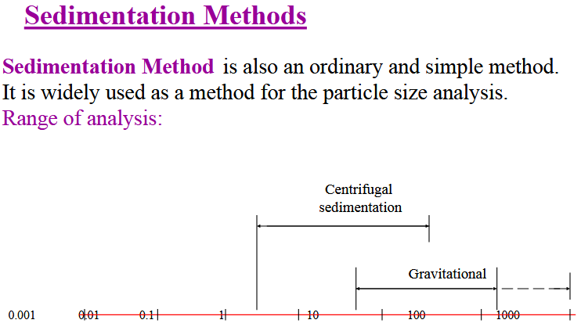

Slide 8
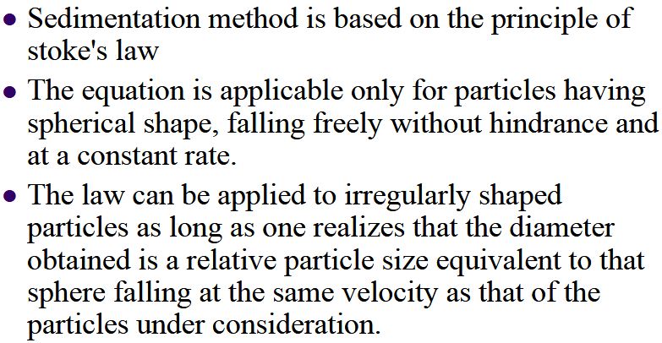

Slide 9
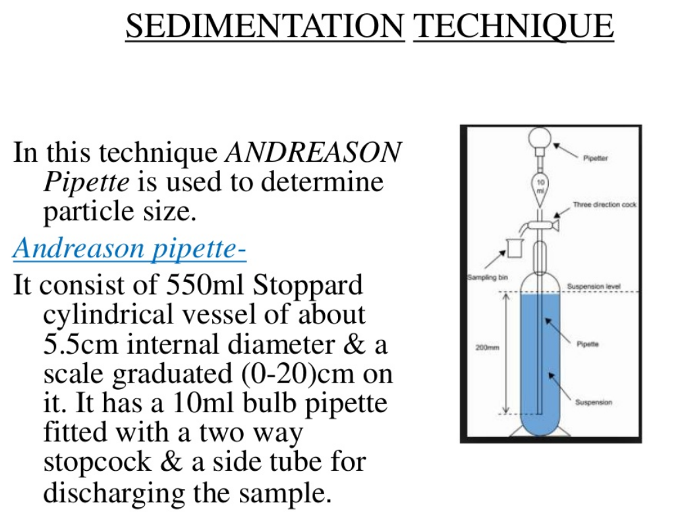
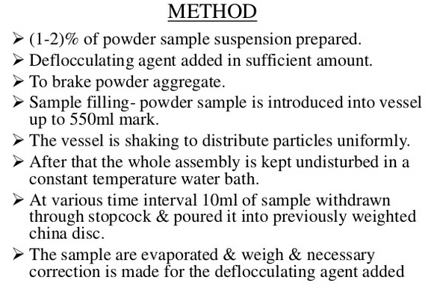
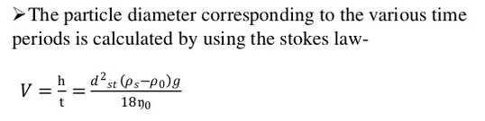

Slide 10
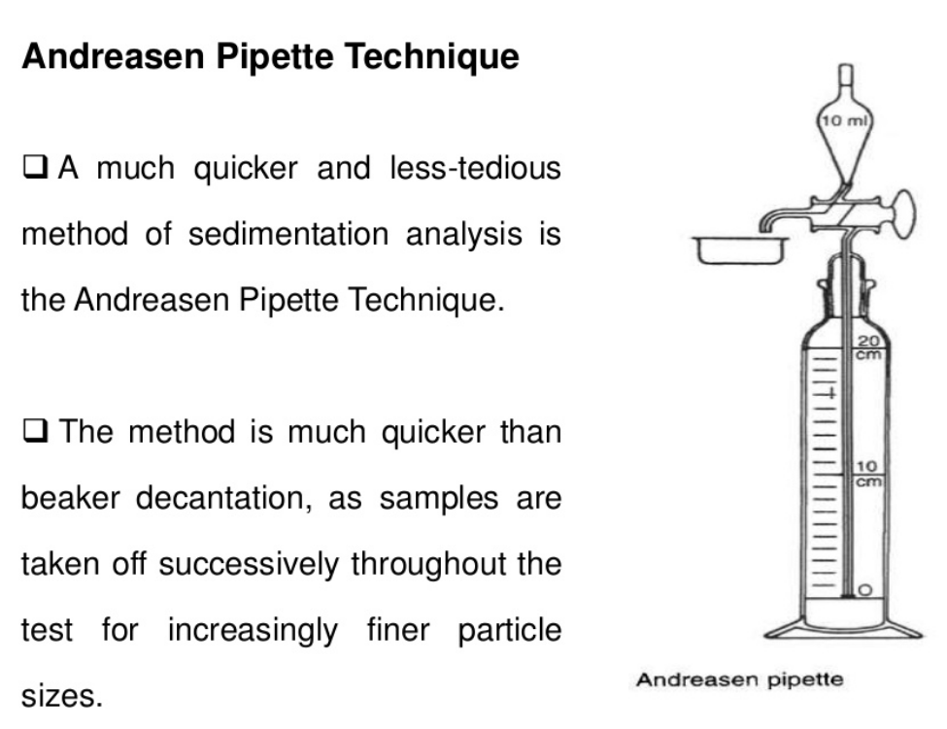

Slide 11
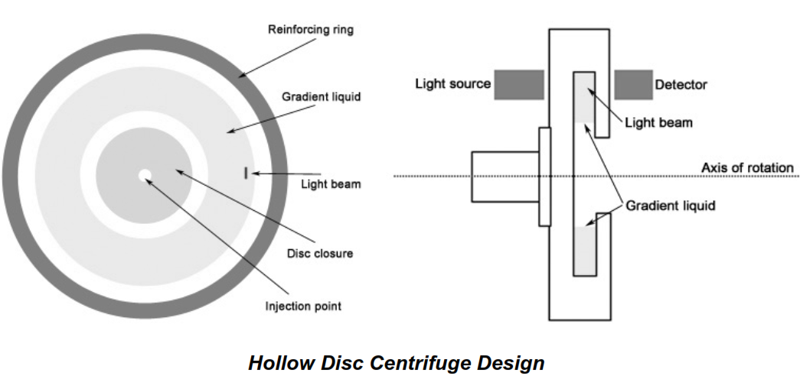


Slide 12
MUO (Particle size measurement)
Electrical sensing zone (coulter counter)
  Suspension passed through capillary conductivity cell
  Size range (1000 μm – 0.1 μm)
Light scattering techniques
  Classical light scattering according to Rayleigh or Mie-theory
  Laser-Fraunhofer-diffraction (1 μm -1800 μm)
  Laser-photon correlation spectroscopy(3 nm-3 μm)

Slide 13
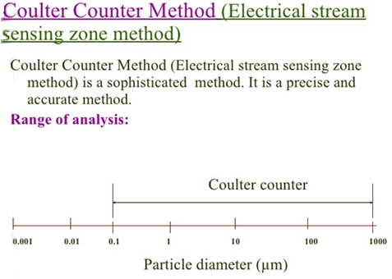

Slide 14
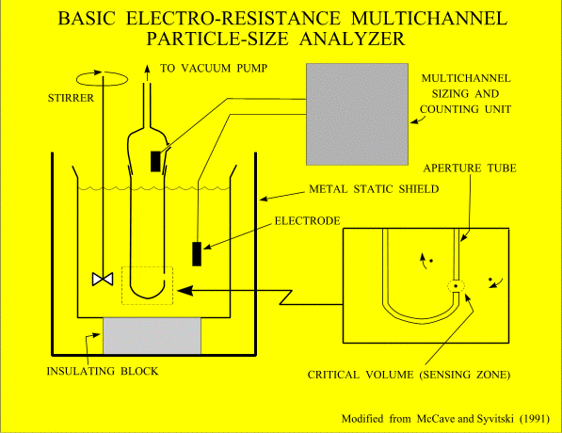
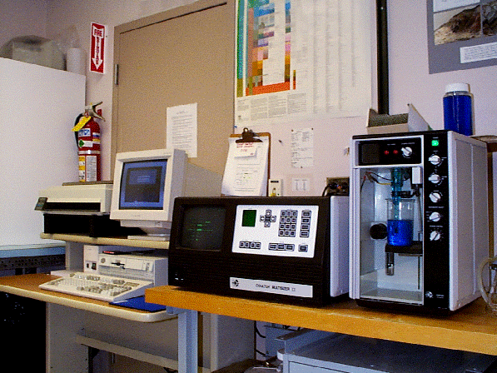

Slide 15
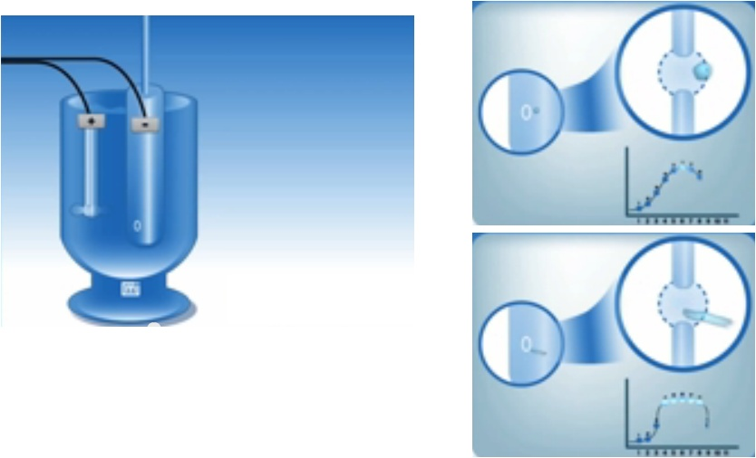
MUO(Particle size measurement)
Electrical sensing zone (coulter counter)
Helps to count the particles
Based on the resistance
b/n the electrodes

Slide 16
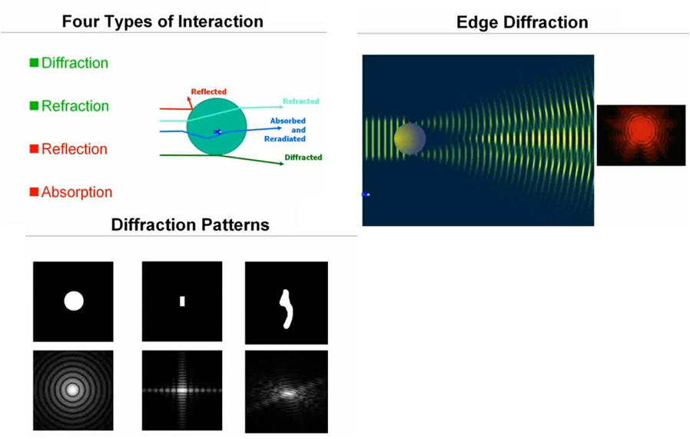
MUO(Particle size measurement)
Light scattering techniques

Slide 17
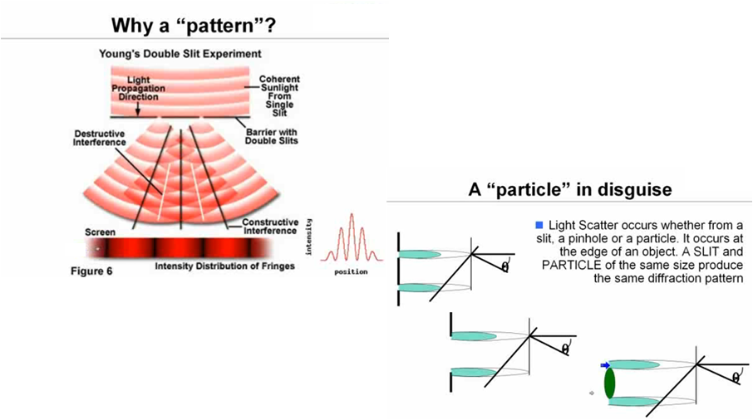
MUO(Particle size measurement)
Light scattering techniques

Slide 18
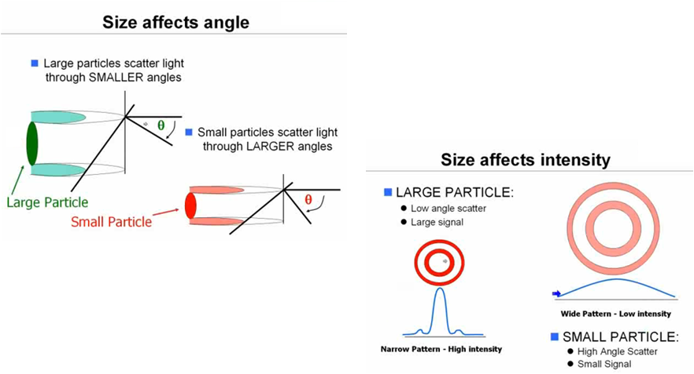
MUO(Particle size measurement)
Light scattering techniques

Slide 19
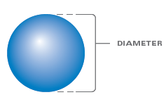
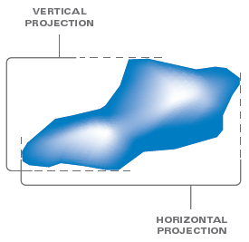
MUO (Particle size characterization)
Particle size characterization:
  Spherical particles have one single dimension (i.e. the diameter φ)
  Particles of arbitrary shape are assigned a diameter of an equivalent sphere. The equivalency can be based on:
    Surface area of the particle (a₁)
Area equivalent
sphere diameter

Slide 20
MUO (Particle size characterization)
    Volume of the particle (V₁):
    Specific surface per unit volume of the particle (S’):
volume equivalent
sphere diameter

Slide 21
MUO (Particle size characterization)
    Sedimentation velocity of the particle (u):
    Sieve opening = mesh equivalent sphere diameter
  The diameter of the various equivalent spheres is different. Hence, irregularly shaped particle doesn’t have an unequivocal size.
stokes equivalent
sphere diameter

Slide 22
MUO (Particle size characterization)
Equivalent sphere diameters of a cube of edge L
Equivalency | Cube | Sphere | esd
Surface
Volume
Vol.-spec. area

Slide 23
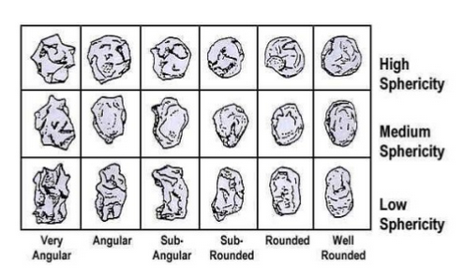
MUO (Shape factors)
Shape factors
  Shape of the particles can be as important as their size
  Shape factor is derived from the ratio of two different equivalent sphere diameters:
    Sphericity (ψ)

Slide 24
MUO (Shape factors)
    e.g. sphericity of a cube of edge L:
    Circularity (Φ):
    Based on a projected area of the particle (found from image analysis) a_{1P} and the perimeter of the projected area P.

Slide 25
MUO (Shape factors)
    e.g. the circularity of a cube of edge L:

Slide 26
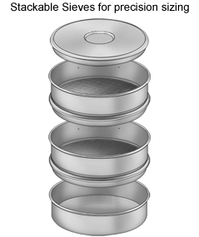
MUO (size distribution analysis)

Slide 27
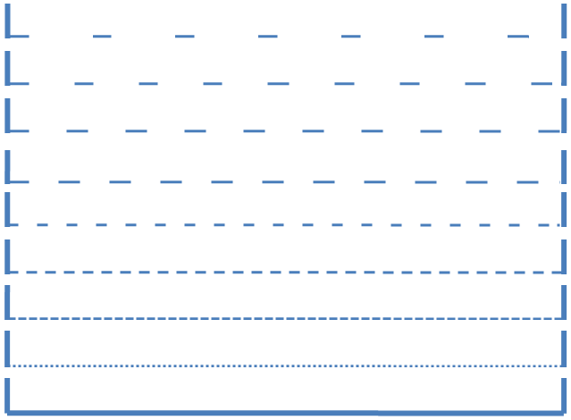
Total mass of the sample = 500gm
At t = t_{f}
0.94mm
0 gm
0.84mm
50 gm
0.76mm
50 gm
0.68mm
100 gm
0.62mm
100 gm
0.56mm
100 gm
0.5mm
60 gm
0.4mm
40 gm
Pan
0 gm

Slide 28
Sieve opening | φ_{i} (mm) | Δm_{i} (gm) | Δm_{i} (%) | Δφ_{i} (mm) | Δm_{i}/Δφ_{i} (mm)⁻¹ | ΣΔm_{i} (%)
< 0.4 | 0.2 | 0 | 0 | 0.4 | 0 | 0
0.4 < φ_{i} < 0.5 | 0.5(0.4+0.5) =0.45 | 40 | (40/500)100 =8 | (0.5-0.4) =0.1 | (8/0.1) =80 | 8+0 = 8
0.5 < φ_{i} < 0.56 | 0.53 | 60 | 12 | 0.06 | 200 | 12+8 = 20
0.56 < φ_{i} < 0.62 | 0.59 | 100 | 20 | 0.06 | 333 | 20+20 = 40
0.62 < φ_{i} < 0.68 | 0.65 | 100 | 20 | 0.06 | 333 | 20+40 = 60
0.68 < φ_{i} < 0.76 | 0.72 | 100 | 20 | 0.08 | 250 | 20+60 = 80
0.76 < φ_{i} < 0.84 | 0.80 | 50 | 10 | 0.08 | 125 | 10+80 = 90
0.84 < φ_{i} < 0.94 | 0.89 | 50 | 10 | 0.10 | 100 | 10+90 = 100
> 0.94 |  | 0 | 0 |  | 0
 |  | Total = 500

Slide 29
Sieve opening | φ_{i} (m) | Δm_{i} (gm) | Δm_{i} (%) | Δφ_{i} (m) | Δm_{i}/Δφ_{i} (m)⁻¹ | ΣΔm_{i} (%)
< 0.4 | 0.2e-3 | 0 | 0 | 0.4e-3 | 0 | 0
0.4 < φ_{i} < 0.5 | 0.5(0.4+0.5)e-3 =4.5e-4 | 40 | (40/500)100 =8 | (0.5-0.4)e-3 =1e-4 | (0.08/1e-4) =8e2 | 8+0 = 8
0.5 < φ_{i} < 0.56 | 5.3e-4 | 60 | 12 | 6e-5 | 2e3 | 12+8 = 20
0.56 < φ_{i} < 0.62 | 5.9e-4 | 100 | 20 | 6e-5 | 3.33e3 | 20+20 = 40
0.62 < φ_{i} < 0.68 | 6.5e-4 | 100 | 20 | 6e-5 | 3.33e3 | 20+40 = 60
0.68 < φ_{i} < 0.76 | 7.2e-4 | 100 | 20 | 8e-5 | 2.5e3 | 20+60 = 80
0.76 < φ_{i} < 0.84 | 8e-4 | 50 | 10 | 8e-5 | 1.25e3 | 10+80 = 90
0.84 < φ_{i} < 0.94 | 8.9e-4 | 50 | 10 | 1e-4 | 1e3 | 10+90 = 100
> 0.94 |  | 0 | 0 |  | 0
 |  | Total = 500

Slide 32
sieve openings (mm) | mass of particles | mass of particles < sieve opening(%) | mass of particles > sieve opening(%)
0.4 | 0 | 0 | 100
0.5 | 8 | 8 | 92
0.56 | 12 | 20 | 80
0.62 | 20 | 40 | 60
0.68 | 20 | 60 | 40
0.76 | 20 | 80 | 20
0.84 | 10 | 90 | 10
0.94 | 10 | 100 | 0

Slide 34
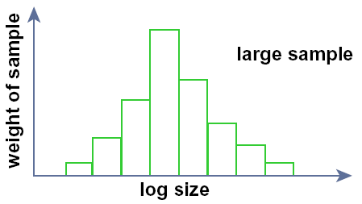
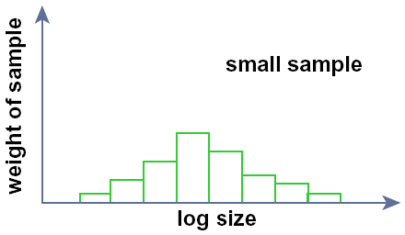
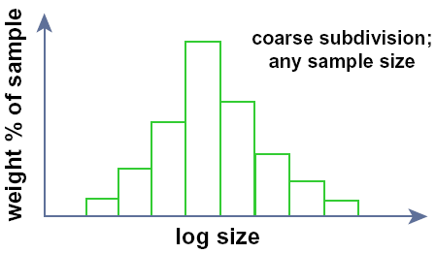
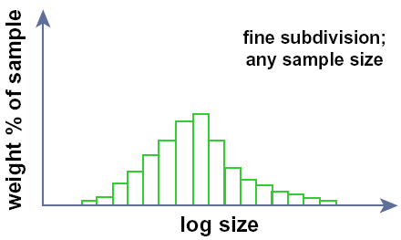
Histogram of weight of sample against particle size
The heights of the bars depends on the size of the sample you use
Histogram of weight percent of sample against particle size
The histogram is normalized by plotting percent of total weight vs. size class interval. Then, no matter how large or small the class interval, the total area under the histogram bars is unity. But still the height of the bars varies with the fineness of division of the size scale.

Slide 35
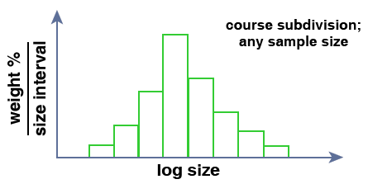
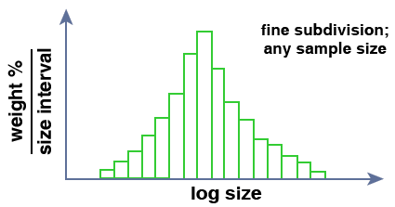
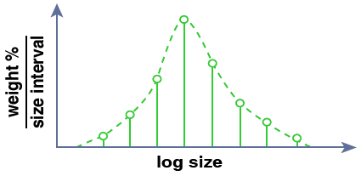
Normalized histogram of weight percent of sample per unit size interval against particle size
When the vertical axis is weight percent divided by size interval, then the overall course of the tops of the bars is the same regardless of the fineness of subdivision.
As you progressively decrease the size class interval, the bars get thinner, but the overall shape and size of the histogram stays the same. This is best visualized in a vertical line graph, with data plotted as vertical lines from the midpoints of the class intervals.

Slide 36
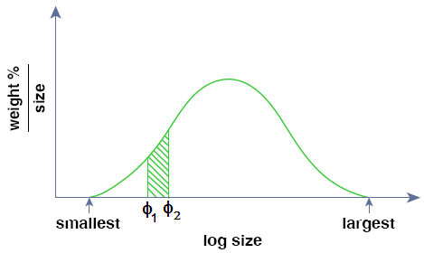
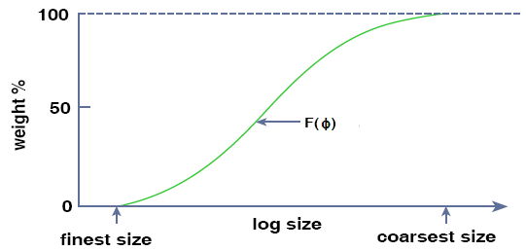
If you performed the limiting process for a smoothly continuous variable, you would get a limiting continuous curve toward which the successively finer histograms would tend. This is called the frequency distribution curve or frequency distribution function
Cumulative distribution function showing weight percent of sample against particle size

Slide 37
MUO (size distribution analysis)
Particle size distributions
  Number of particles of a given size -- number weighted PSD
  The length of particles of a given size --length weighted PSD
  The area of particles of a given size -- area weighted PSD
  The volume of particles of a given size -- volume weighted PSD
  The mass of particles of a given size -- mass weighted PSD
number distribution is dominated by smaller particles, mass distribution is dominated by larger particles

Slide 38
MUO (size distribution analysis)
For discrete particle size distribution, the number weighted distribution is written as Δn_{i}/Δφ_{i}.

Slide 39
MUO (size distribution analysis)
For continuous particle size distributions:

Slide 40
MUO (size distribution analysis)
In general,
represents particle size distribution
Arbitrary PSD can be transformed into a
number distribution by:

Slide 41
MUO (size distribution analysis)
The factor F_{q} and the exponent q correspond to:
Q | F_{q} | q
n | 1 | 0
l | 1 | 1
a | π | 2
v | π/6 | 3
m | ρ(π/6) | 3

Slide 42
MUO (size distribution analysis)
The integral value of from 0 to ∞ provide the total value of

Slide 43
MUO (size distribution analysis)
k-th moment of a function around the reference value is given by:

Slide 44
MUO (size distribution analysis)
k-th moment of a function
around the origin is given by:
The 0-th moment around the origin is the total value

Slide 45
MUO (size distribution analysis)
The integral or total value of may be written as a function of the number weighted distribution
Weighted average diameters of any
function is defined as

Slide 46
MUO (size distribution analysis)
Combining the previous formulations, the weighted average diameter of the PSD can be written as:
Accordingly, if then (known as mass weighted average diameter)

Slide 47
MUO (size distribution analysis)
-Equivalent average diameter is given by:

Slide 48
MUO (size distribution analysis)
Variance and standard deviation is defined as the ratio of the 2-nd moment relative to the mean value to the 0-th moment around the origin:

Slide 49
sieve opening (m) | Δm_{i} | φ_{i} (m) | Δφ_{i} (m) | Δm_{i}/Δφ_{i} | Δn_{i} | Δn_{i}/Δφ_{i}
<4.00E-04 | 0 | 2.00E-04 |  | 0 | 0 | 0
4.00E-04---5.00E-04 | 0.08 | 4.50E-04 | 1.00E-04 | 8.00E+02 | 6.33E+05 | 6.33E+09
5.00E-04---5.60E-04 | 0.12 | 5.30E-04 | 6.00E-05 | 2.00E+03 | 5.81E+05 | 9.68E+09
5.60E-04---6.20E-04 | 0.2 | 5.90E-04 | 6.00E-05 | 3.33E+03 | 7.02E+05 | 1.17E+10
6.20E-04---6.80E-04 | 0.2 | 6.50E-04 | 6.00E-05 | 3.33E+03 | 5.25E+05 | 8.75E+09
6.80E-04---7.60E-04 | 0.2 | 7.20E-04 | 8.00E-05 | 2.50E+03 | 3.86E+05 | 4.83E+09
7.60E-04---8.40E-04 | 0.1 | 8.00E-04 | 8.00E-05 | 1.25E+03 | 1.41E+05 | 1.76E+09
8.40E-04---9.40E-04 | 0.1 | 8.90E-04 | 1.00E-04 | 1.00E+03 | 1.02E+05 | 1.02E+09
>9.40E-04 |  | 9.40E-04 |  | 0 | 0 | 0

Slide 50
sieve opening (m) | Δm_{i} | φ_{i} (m) | Δn_{i} | Δa_{i} | Δv_{i} | Δl_{i} | Δn_{i} *φ_{i} | Δl_{i} *φ_{i} | Δa_{i} *φ_{i} | Δv_{i} *φ_{i} | Δm_{i} *φ_{i}
<4.00E-04 | 0 | 2.00E-04 | 0
4.00E-04---5.00E-04 | 0.08 | 4.50E-04 | 6.33E+05 | 4.03E-01 | 3.02E-05 | 2.85E+02 | 2.85E+02 | 1.28E-01 | 1.81E-04 | 1.36E-08 | 3.60E-05
5.00E-04---5.60E-04 | 0.12 | 5.30E-04 | 5.81E+05 | 5.13E-01 | 4.53E-05 | 3.08E+02 | 3.08E+02 | 1.63E-01 | 2.72E-04 | 2.40E-08 | 6.36E-05
5.60E-04---6.20E-04 | 0.2 | 5.90E-04 | 7.02E+05 | 7.68E-01 | 7.55E-05 | 4.14E+02 | 4.14E+02 | 2.44E-01 | 4.53E-04 | 4.45E-08 | 1.18E-04
6.20E-04---6.80E-04 | 0.2 | 6.50E-04 | 5.25E+05 | 6.97E-01 | 7.55E-05 | 3.41E+02 | 3.41E+02 | 2.22E-01 | 4.53E-04 | 4.91E-08 | 1.30E-04
6.80E-04---7.60E-04 | 0.2 | 7.20E-04 | 3.86E+05 | 6.29E-01 | 7.55E-05 | 2.78E+02 | 2.78E+02 | 2.00E-01 | 4.53E-04 | 5.43E-08 | 1.44E-04
7.60E-04---8.40E-04 | 0.1 | 8.00E-04 | 1.41E+05 | 2.83E-01 | 3.77E-05 | 1.13E+02 | 1.13E+02 | 9.01E-02 | 2.26E-04 | 3.02E-08 | 8.00E-05
8.40E-04---9.40E-04 | 0.1 | 8.90E-04 | 1.02E+05 | 2.54E-01 | 3.77E-05 | 9.10E+01 | 9.10E+01 | 8.10E-02 | 2.26E-04 | 3.36E-08 | 8.90E-05
>9.40E-04 | 0
Total values | 1 |  | 3069486 | 3.55E+00 | 3.77E-04 | 1.83E+03 | 1.83E+03 | 1.13E+00 | 2.26E-03 | 2.49E-07 | 6.61E-04
 | m_{tot} |  | n_{tot} | a_{tot} | v_{tot} | l_{tot} | ΣΔn_{i} *φ_{i} | ΣΔl_{i} *φ_{i} | ΣΔa_{i} *φ_{i} | ΣΔv_{i} *φ_{i} | ΣΔm_{i} *φ_{i}
Total values/n_{tot} | 3.25787E-07 |  |  | 1.16E-06 | 1.23E-10 | 5.96E-04
 | m₁ |  |  | a₁ | v₁ | l₁
Average values |  |  |  |  |  |  | 5.96E-04 | 6.17E-04 | 6.39E-04 | 6.61E-04 | 6.61E-04
 |  |  |  |  |  |  | φ_{1,0} | φ_{2,1} | φ_{3,2} | φ_{4,3} | φ_{4,3}
Equivalent values |  |  |  | 6.06E-04 | 6.17E-04 | 5.96E-04
 |  |  |  | φ_{2,0} | φ_{3,0} | φ_{1,0}

Slide 51
MUO (size distribution analysis)
Analytical distribution functions (frequently used in particle technology)
  Gauss or normal distribution function

Slide 52
MUO (size distribution analysis)
  Log-normal distribution function (for asymmetric distributions)
Log normal distribution – appears as a normal distribution when x-axis is plotted on log scale

Slide 53
MUO (size distribution analysis)
  The geometric mean and the geometric standard deviation are related to the arithmetic mean and standard deviation by:

Slide 54
MUO (size distribution analysis)
  Similarly the geometric mean and standard deviation can be calculated from the corresponding arithmetic values by:

Slide 55
MUO (size distribution analysis)
  The geometric standard deviation can be derived from the log-normal distribution function as the ratio of the median particle diameter to the particle diameter (the value of the particle diameter from which 15.9% of particles are smaller and hence 84.1% are larger)
  Transformation of log-normal number weighted distribution to other distributions yields new log-normal distribution with the same geometric standard deviation but with different geometric mean:

Slide 56
MUO (size distribution analysis)
  The Rosin Rammler Sperling Bennet (RRSB)-function in double ln-ln coordinates

Slide 57
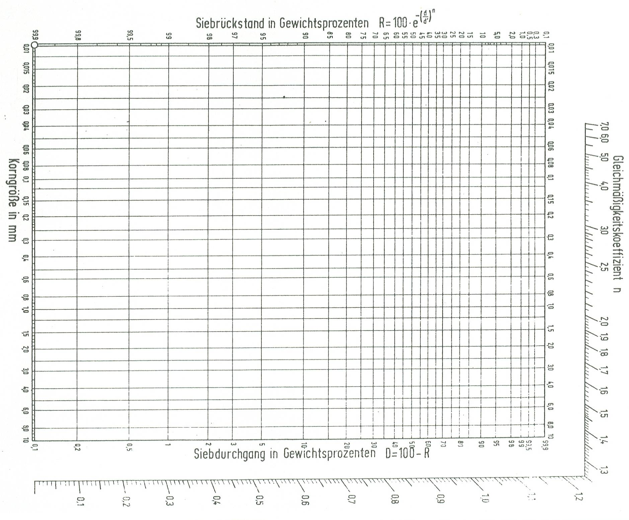
0.53
n=2.05
63%

Slide 58
Assignment
  The particle size distribution of a powder (density = 2650 kg/m³) has been determined using a serious of sieves. Calculate the average diameter . Calculate the area and volume distribution. Compare which analytical function describes it well.
under size Mass fraction | Sieve Opening (mm)
0 | 0.4
7 | 0.56
20 | 0.66
30 | 0.68
47 | 0.72
58 | 0.74
74 | 0.78
85 | 0.80
100 | 0.90

Slide 59
